Slide 1

Chum salmon bycatch patterns

Slide 2
Information requests of staff for March Salmon Bycatch Committee meeting (items in strike out were covered at the January 25 th SBC meeting)
Temperature changes (warm and cold patterns) compared to bycatch.
How do temperature changes interact with prey conditions?
Salmon encounter rates compared to pollock total allowable catch (TAC).
How or what conditions have changed since 2012? E.g., increased CDQ dependance on pollock; in river subsistence restrictions, some synthesis of local and traditional knowledge by in river salmon users across western Alaskan regions.
Review State of Alaska Bycatch Task Force recommendations and information available on the Task Force website.
Pollock fishery avoidance measures in 2022 for chum salmon.
Process for initiating analysis of alternative management measures for chum salmon bycatch.
Expansion of the discussion of Council rationale for current management priorities for salmon bycatch (i.e., Chinook).
Information to help inform consideration of indexing to some estimate of chum salmon abundance (eg run reconstructions that exist, additional escapement and weir information across other river systems)
Vessel information on closures for chum as compared to chum bycatch concentrations/hot spots in data

Slide 3
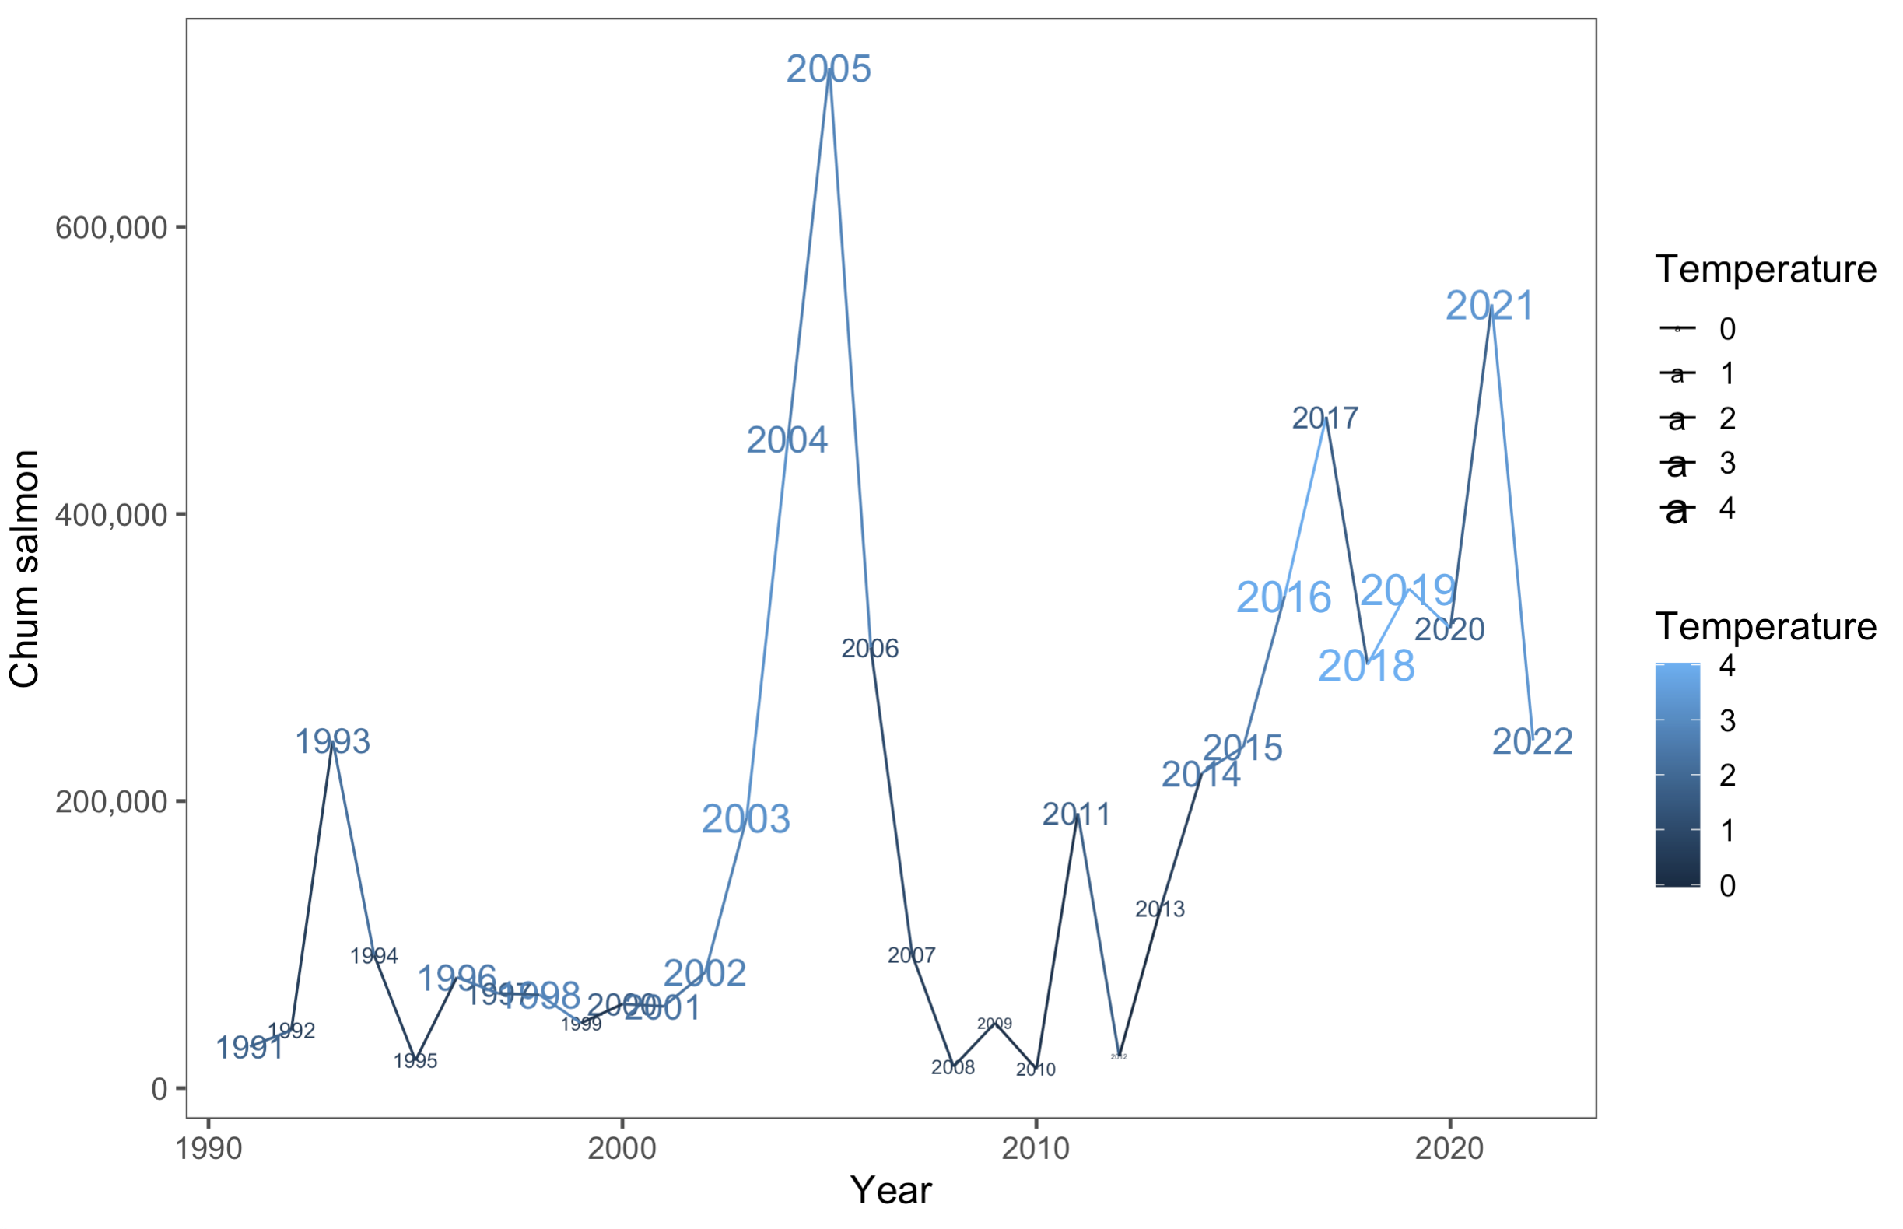

Slide 4
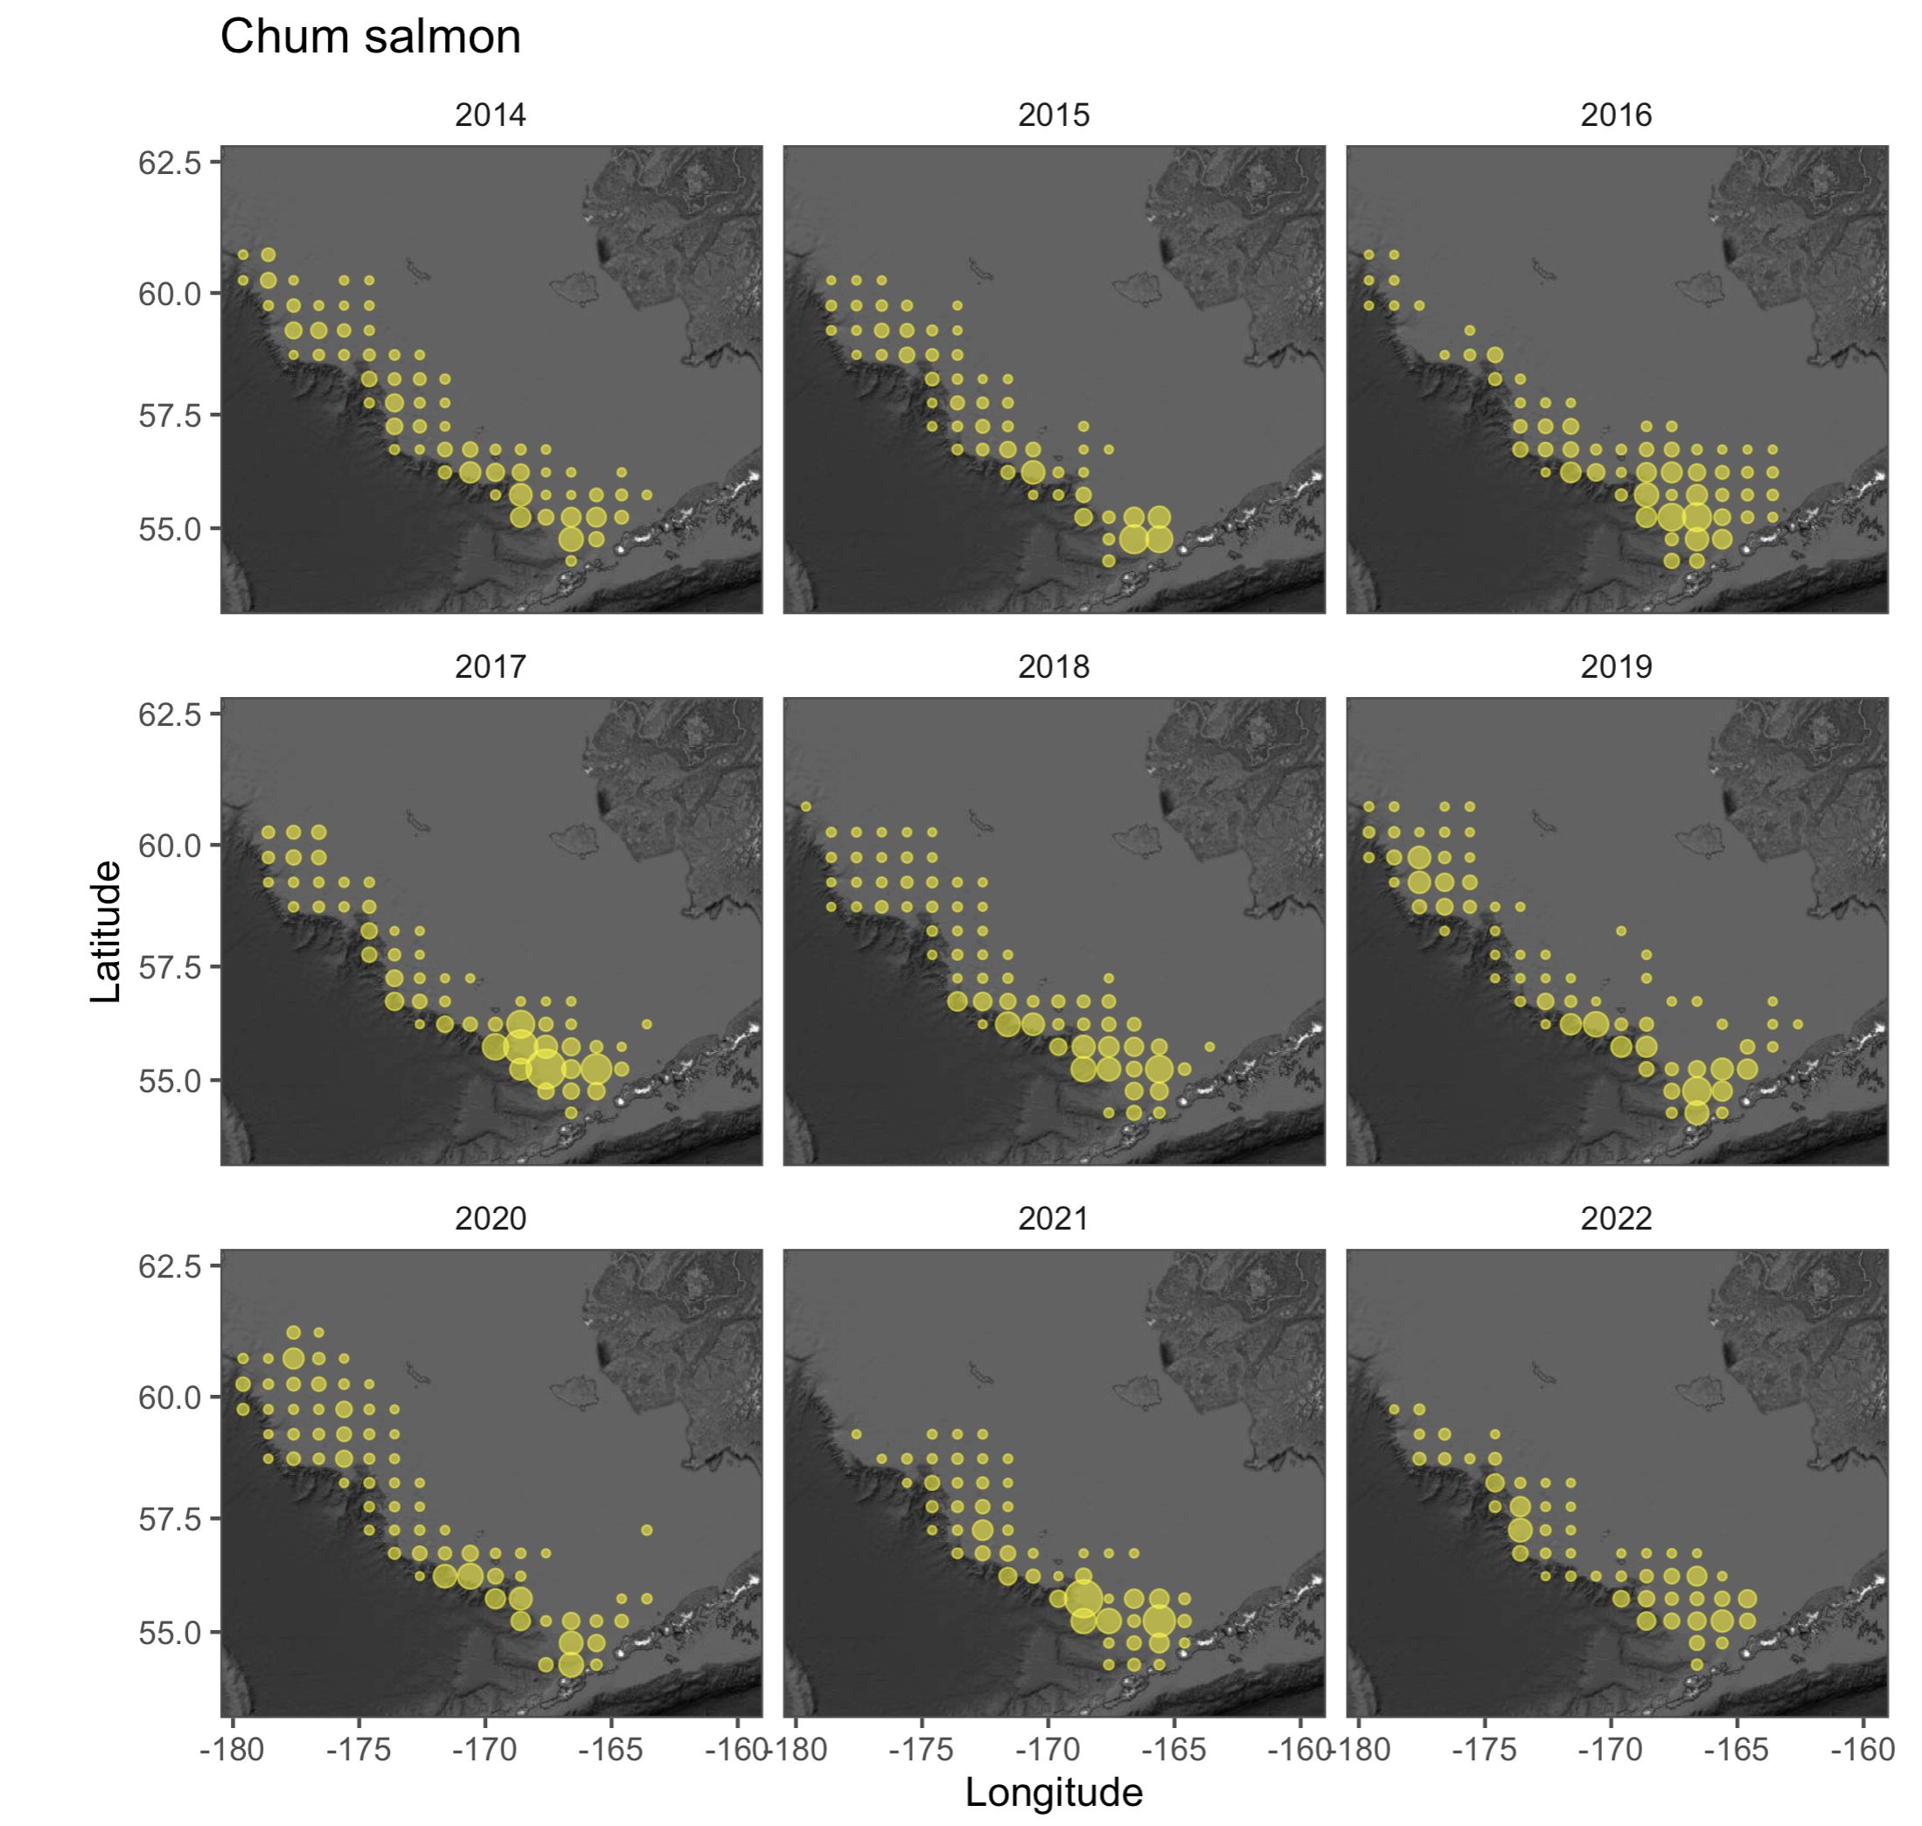

Slide 5
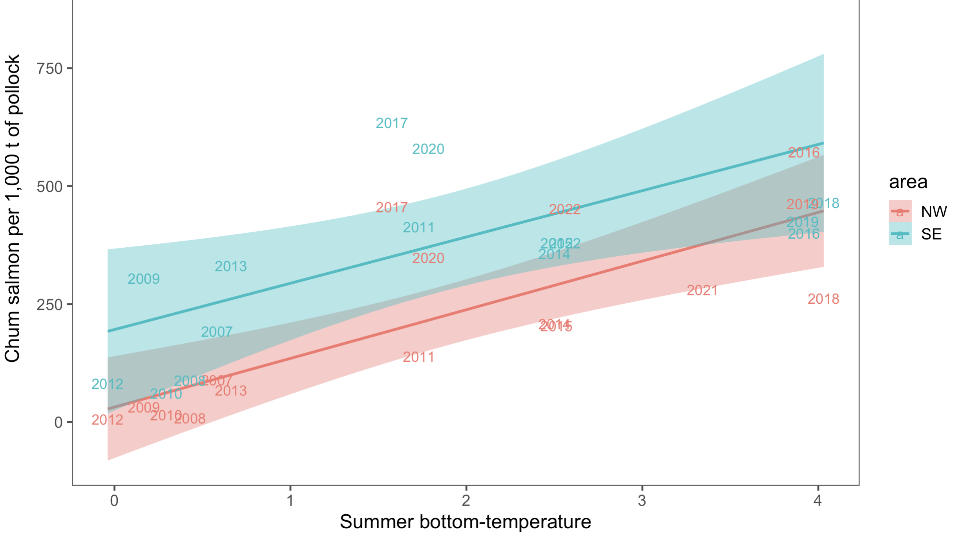

Slide 6
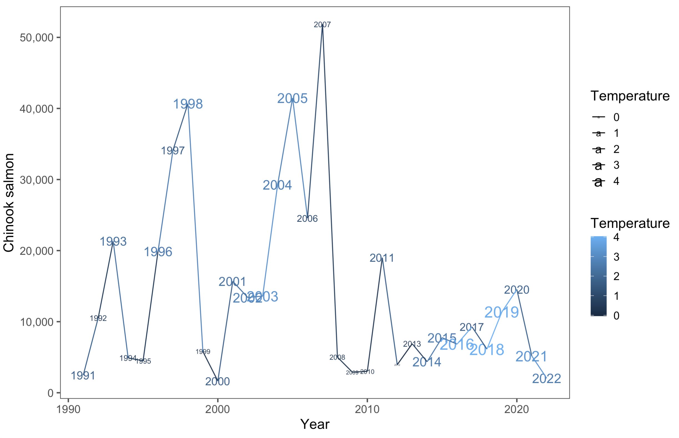
Chinook salmon
(B-season only)

Slide 7
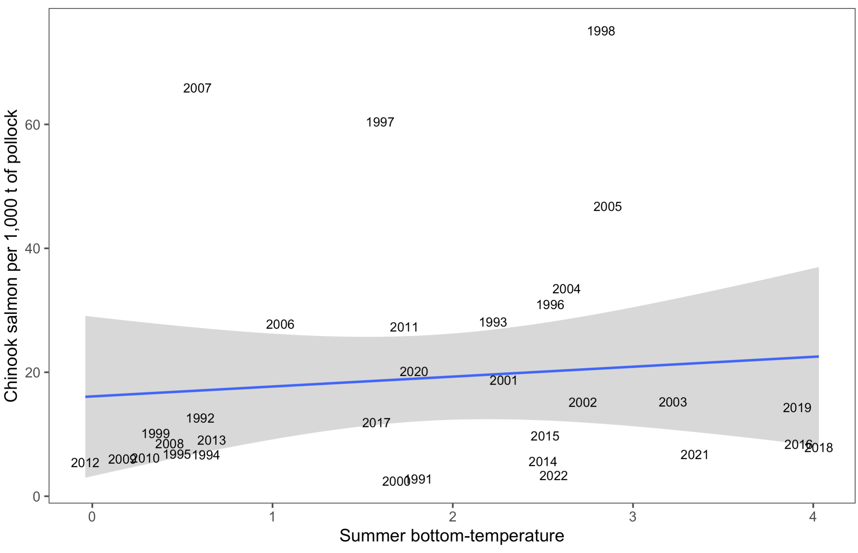
Chinook salmon vs Temperature
(B-season only)

Slide 8
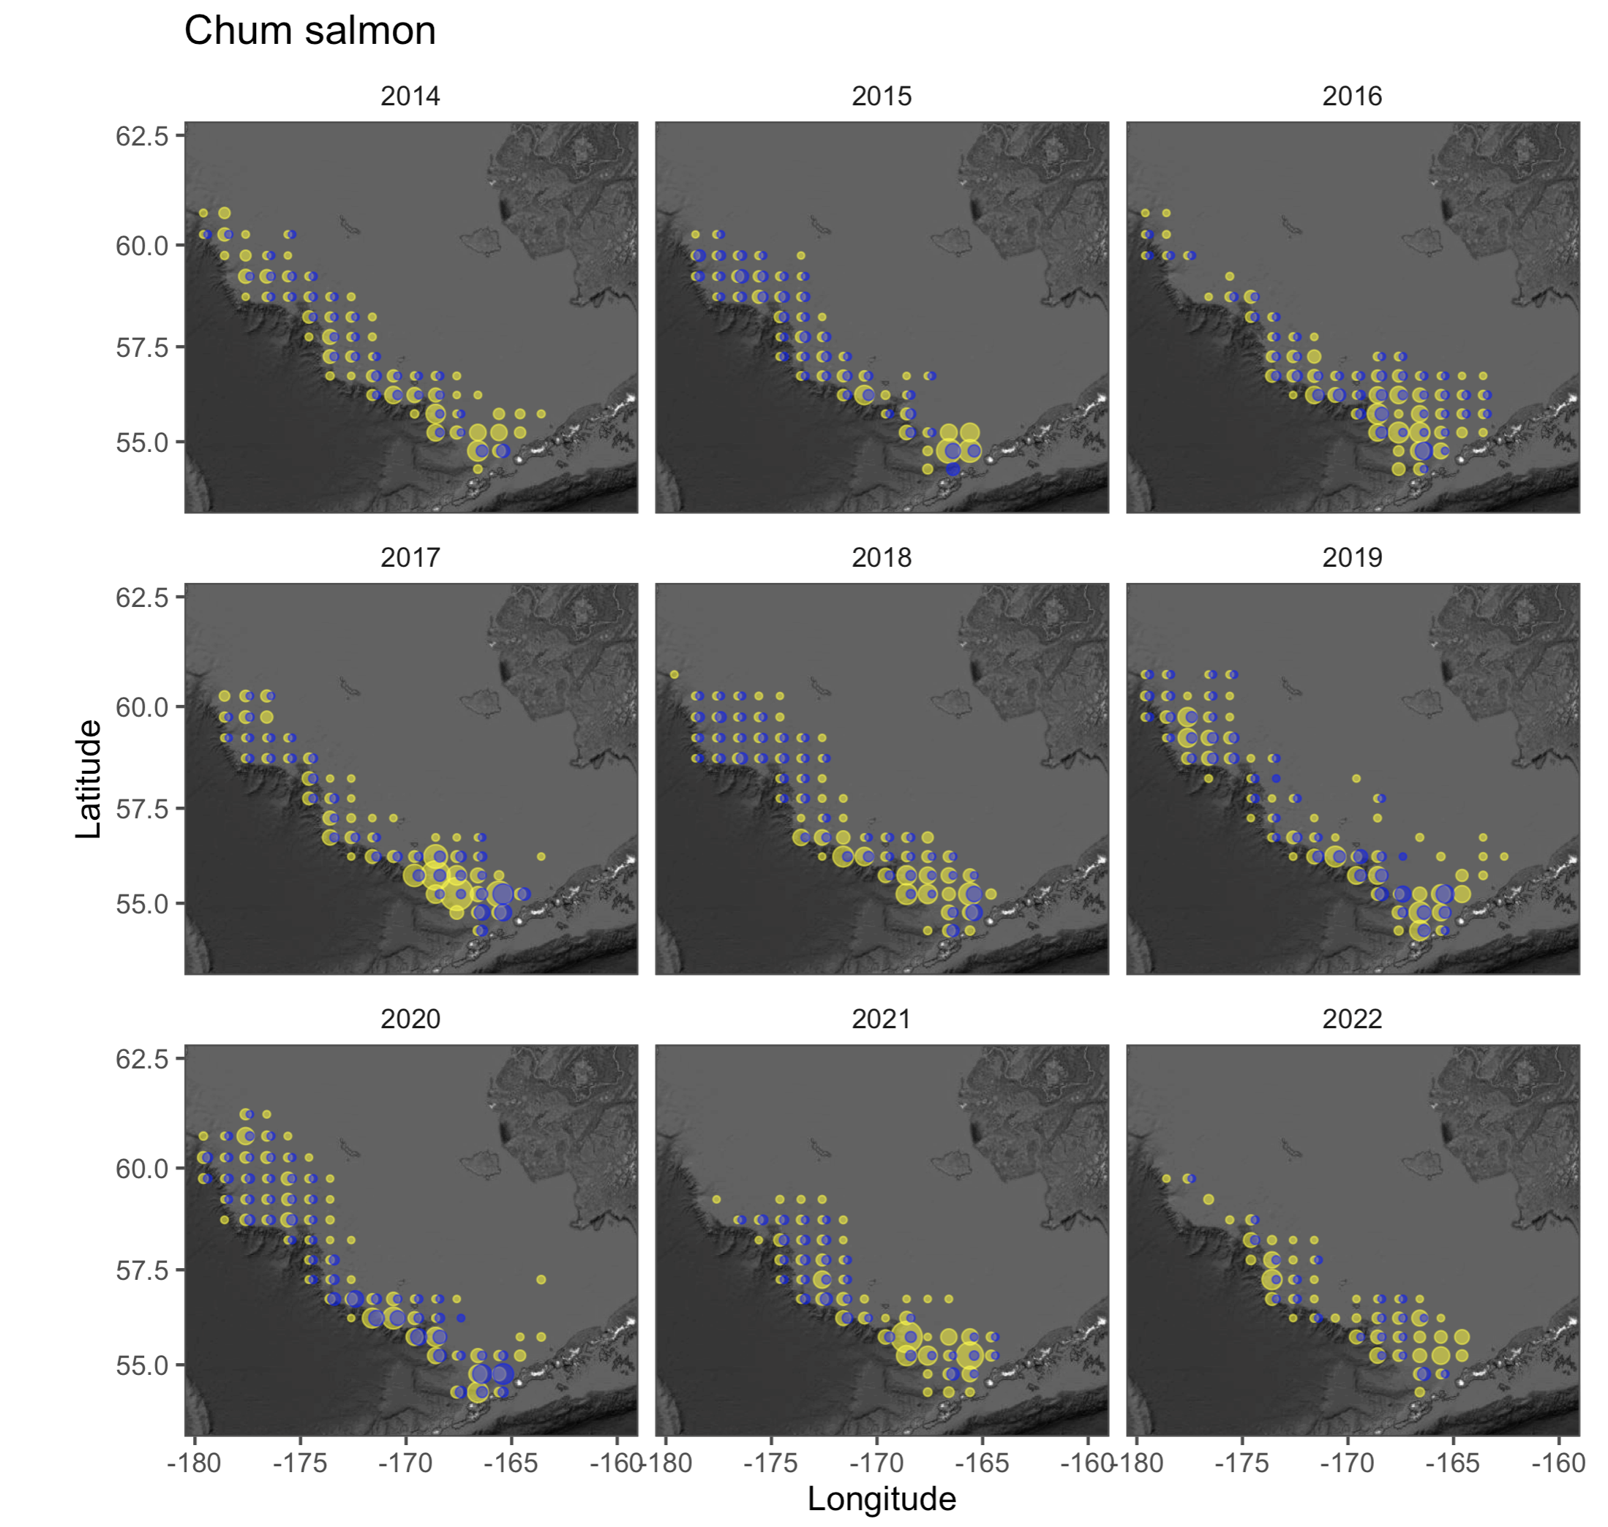
Chum
and
Chinook salmon
Chum salmon scale one order of magnitude larger than Chinook
Notes:
Scales one order of magnitude

Slide 9
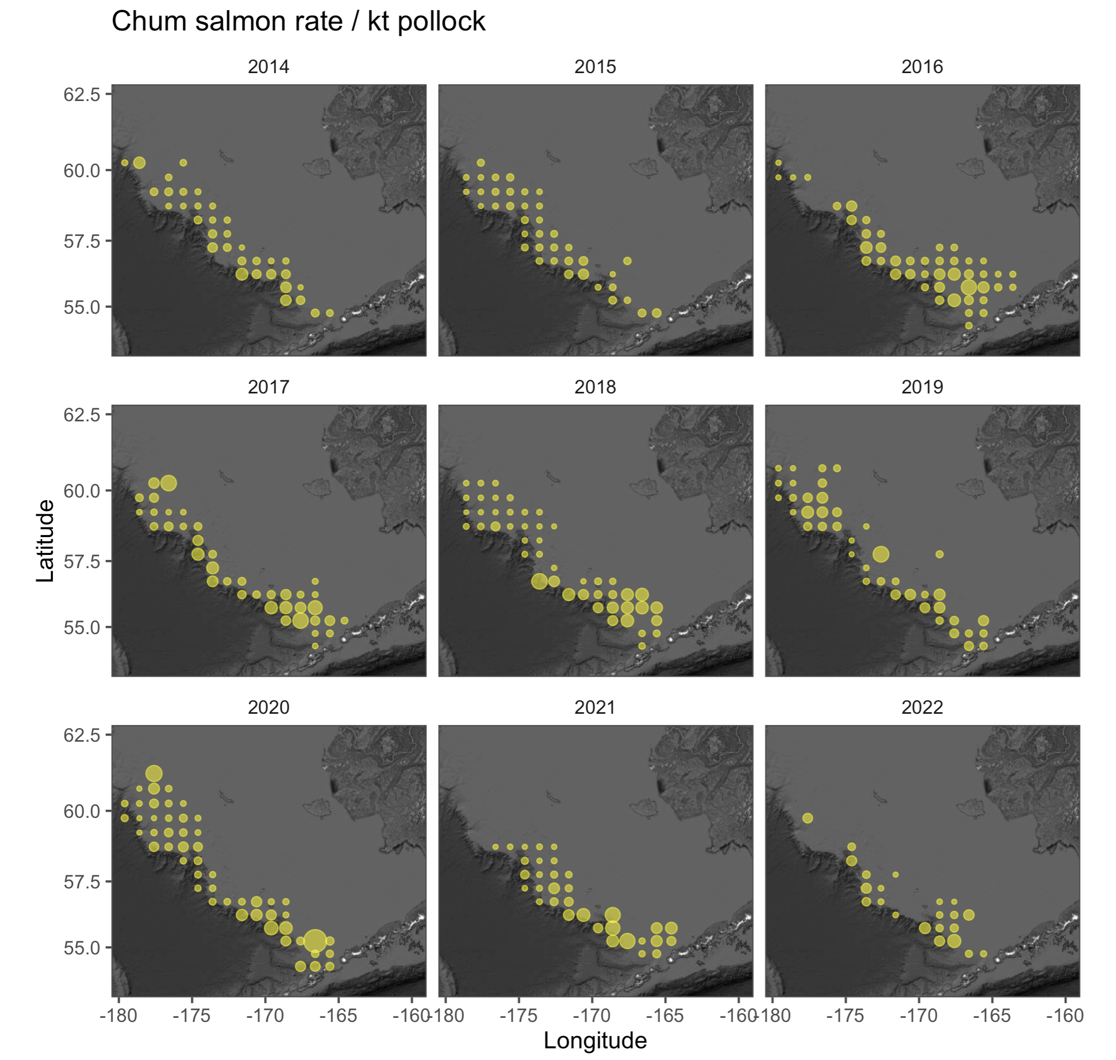
Chum
rate
Notes:
Scales one order of magnitude

Slide 10
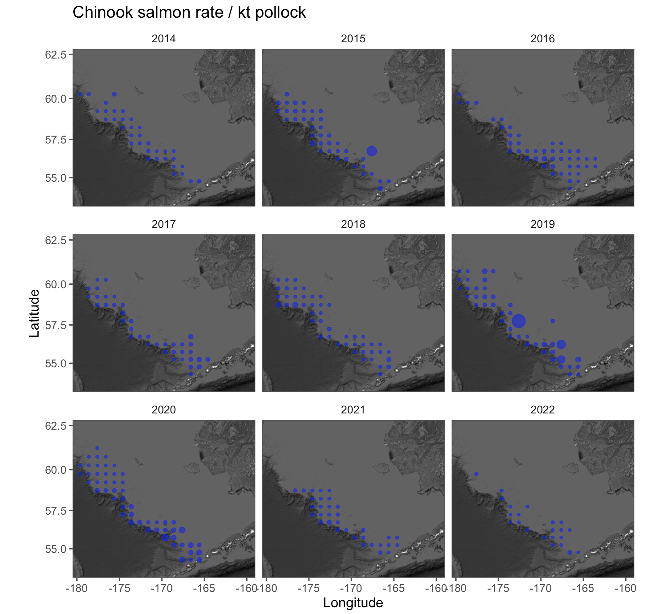
Chinook salmon
Rate B season
Notes:
Scales one order of magnitude

