Slide 1
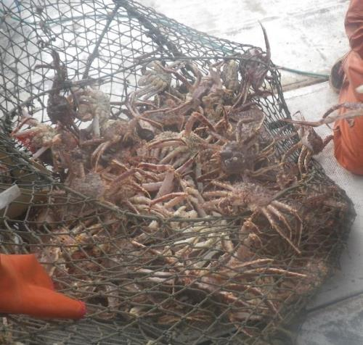
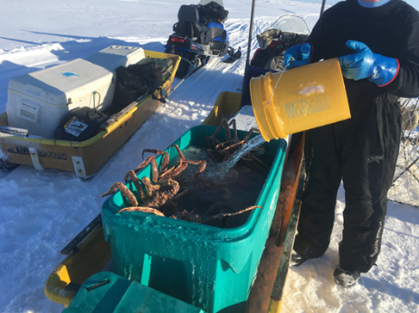
Norton Sound red king crab: can we look at other RKC populations for information?
Jenefer Bell
Research Fishery Biologist
Alaska Department of Fish and Game

Slide 2
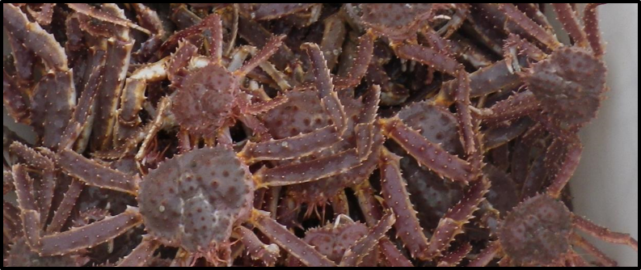
Introduction
Topics for discussion-
Trawl survey stratification and/or estimating abundance in untrawled stations
Male size at maturity
Disappearing large males
Handling/ bycatch/observer data

Slide 3
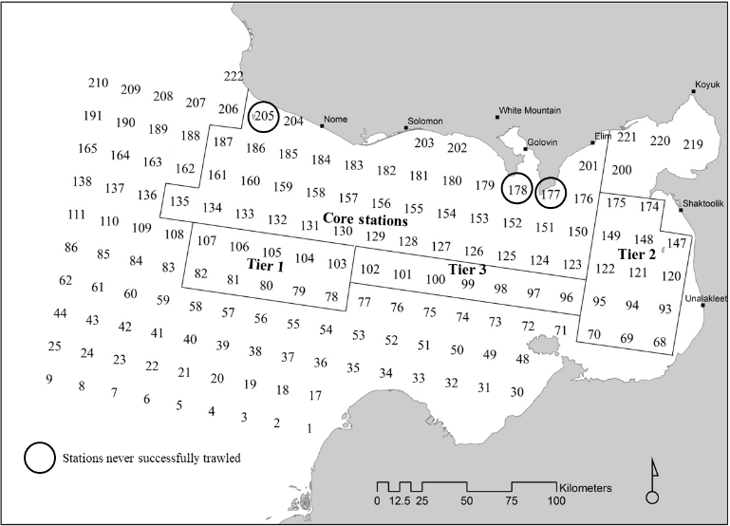
Trawl survey
Triennial bottom trawl
1976-2017
10 X 10 nm grid
Core and Tier 1 stations became standardized in 1998 (Fair 1998)
Tiers 2 and 3 were reported in 2002 trawl report (Brennan 2002)
Abundance:
area swept method
Notes:
Fair, L.F. 1998. Standardization of Norton Sound trawl survey red king crab abundance estimates. Alaska Department of Fish and Game, Commercial Fisheries Division, AYK Region, Regional Infornlation Report 3A98-36, Anchorage.
Brennan, E. L. 2003 Analysis of Red king crab date from the 2002 ADF&G trawl survey of Norton Sound. Alaska Department of Fish and Game, Commercial Fisheries Division, AYK Region, Regional Information Report No. 3A02-52, Anchorage.

Slide 4
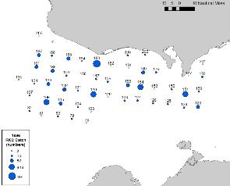
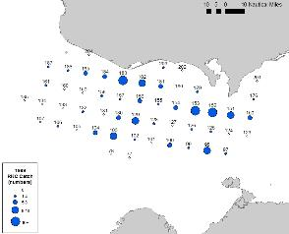
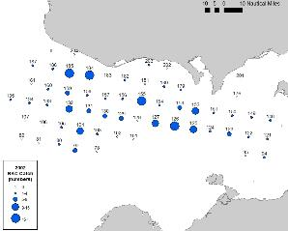
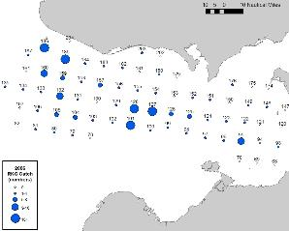
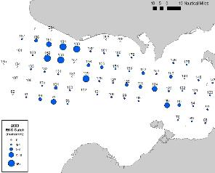
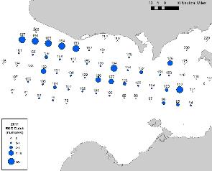
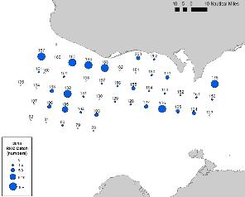
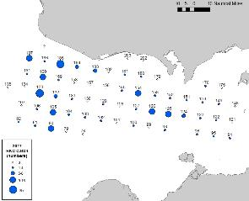
Trawl survey
1996
1999
2002
2006
2008
2011
2014
2017
47 (2014) to 86 (2008) stations in a survey → it was assumed zero crab at untrawled stations

Slide 5
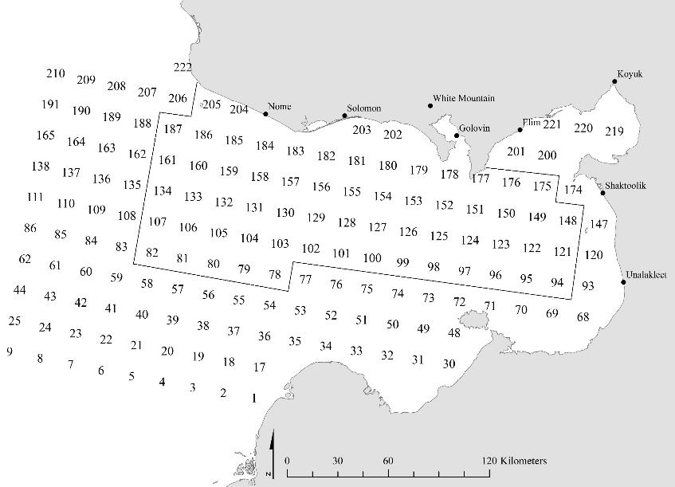
Trawl survey
Annual bottom trawl survey
2018 - ?
Redefined trawl area to include 60 stations
X
X
Based on the tiers
Crab presence
Efficient trawl path
Reasonable number of stations for weather windows
X
X
Setting the stage for stratification methods…

Slide 6
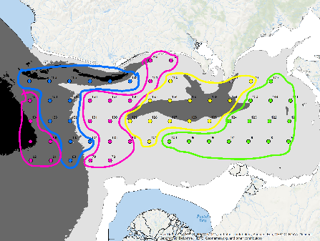
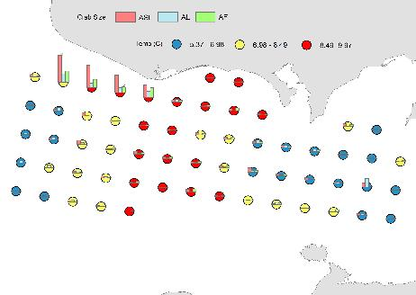
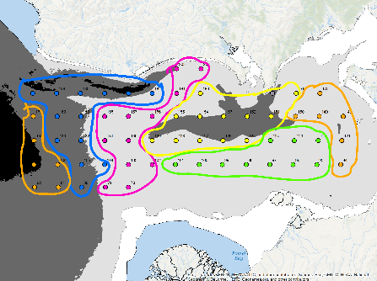
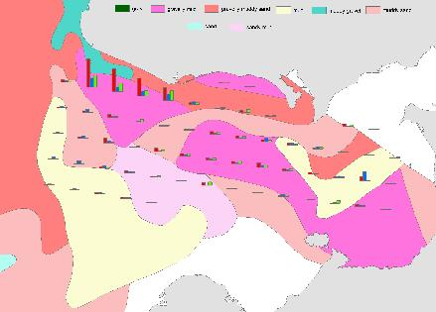
Trawl survey
Example stratifications
temperature
sediment type
bathymetry
Other suggestions or strategies???

Slide 7
Male size at ____maturity
Physiological maturity at 50 mm CL (Paul et al. 1991)
Kodiak functional maturity (Powell et al. 2002)
Norton Sound functional maturity?
Observer data 2012-2017; n = 1867
130 mm CL-m
91 mm CL-m
=
102 mm CL-f
71 mm CL-f
Kodiak size at 50% ovigerity (Pengilly et al. 2002)
Norton Sound size at 50% ovigerity (Paul et al. 1991)
Trawl survey 1996-2017, n = 520
No Clutch
Clutch
Notes:
Powell et al. 2002- 3651 grasping pairs- 120 mm CL smallest male, <3% were under 130 mm CL. 130 is 5th percentile of all CL in grasping pairs (KCOTW book, table 10.1)

Slide 8
Male size at ______maturity
Morphometric maturity
n=202 (fall pot survey)
Other ideas about how to address male ______ maturity?

Slide 9
Disappearing large males
Two options:
Near shore in the summer
Migrate beyond the commercial fishery
Is this pattern apparent in other RKC fisheries?
Where are large males commonly found?

Slide 10
Handling / Bycatch - Summer Commercial
Concerns:
Observed boats and sublegal densities
  High abundance of sublegal crab in NS in 2012-2015 skew results
Limited participation due to boat size and fishing locations
  Representativeness of data
Handling in summer commercial fishery
(based on observer program)

Slide 11
Handling /
Bycatch

Slide 12
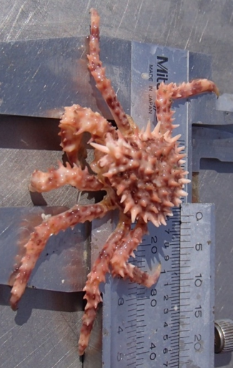
Handling / Bycatch
Is observer data useful to model?
Yes – use crab lengths to calculate retention curves to estimate discarded crab
Discards are important because they inform the abundance estimate for the next model year
Suggestions for increasing observer participation?
Maintain ‘large boat’ observers and have logbook-type collection from ‘small boats’

Slide 13
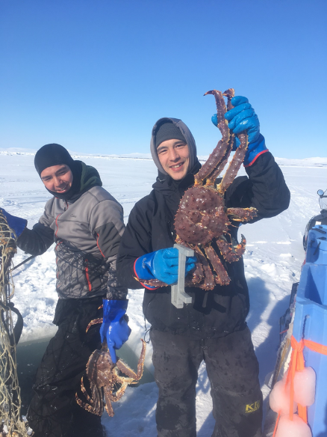

Any other thoughts on Norton Sound red king crab?
ADF&G thanks subsistence and commercial crab fishermen for helping us collect information to help manage red king crab fisheries.
ADF&G thanks Norton Sound Economic Development Corporation for their participation in and support of data collection projects to enhance management of red king crab fisheries.

