Slide 1
2020/21 BSAI crab catch and fishery performance
Benjamin Daly (ADF&G) and Krista Milani (NOAA)
Crab Plan Team Meeting
September 13-16, 2021
Virtual

Slide 2
Directed fishery observer coverage
Mandatory catcher-vessel coverage requirements, per 5 AAC 39.645.
All vessels processing crab must carry observers.
Fishery | Coverage
Bering Sea snow crab | 30-100% (a)
Bristol Bay red king crab | 20% (a)
Bering Sea Tanner crab | 30-100% (a)
Pribilof District red king crab | 100%
Pribilof District blue king crab | 100%
Saint Matthew Island blue king crab | 100%
Norton Sound red king crab | Discretionary
Aleutian Islands golden king crab | 50% (b)
Pribilof District golden king crab | 100%
Adak red king crab | 100%
2020/21: Generally status quo
Despite COVID challenges, no reduction from data point of view
ª Vessels required to carry observers are randomly selected.
^{b} All catcher vessels must carry an observer during harvest of 50% of total landed catch weight in each three-month trimester of nine-month season Aug 1 – Oct 31; Nov 1 – Jan 31; Feb 1 – April 30.
Notes:
Catcher-vessel observer coverage levels:
Funding for observer deployments on C/Vs in BBR, EBT, WBT and BSS, and corresponding CDQ fisheries has been provided through cost-recovery test fishing and funds granted to ADF&G from proceeds generated by a federal 3 percent CR tax.
Annually, ADF&G randomly selects a percentage of registered vessels in each fishery (BBR, EBT, WBT, and BSS) to carry state-funded observers during 100 percent of their fishing for the season. SMB and PIK observer deployments are pay-as-you-go and observer coverage is set at 100 percent.
ADF&G and COOTF determined that for fisheries where observer coverage is less than 100 percent and funding for observer costs is provided, randomly selecting vessels is the most cost effective and efficient manner in which to meet data collection needs in crab fisheries. In a pay as you go system, selection of only a portion of the registered vessels to carry observers would unfairly require some harvesters to pay for observer coverage. In fisheries where observer funding is pay-as-you-go, each harvester is required to carry an observer during a designated minimum percentage of their harvest as outlined in regulation, 5 AAC 39.645 (d)(4).

Slide 3
Directed fishery observer coverage
*AIGKC calculated by trip because of trimester regulation
Notes:
AIGKC coverage rates determined by the number of landings observed.

Slide 4
Directed fishery observer coverage

Slide 5
GF Vessels in Full Coverage vs Partial Coverage
Full coverage vessels (1 or 2 observers 100% of the time)
  Catcher Processors (limited exceptions for non-trawl CPs)
  Motherships
  AFA Pollock catcher vessels delivering shoreside
  Non-Pollock BSAI trawl catcher vessels can opt for 100% coverage during all fishing
Partial Coverage
  Catcher Vessels fishing groundfish
  Catcher Vessels fishing IFQ/CDQ halibut/sablefish
  Small non-trawl Catcher Processors – They have to apply in advance
No selection for observer coverage
  Vessels using Electronic Monitoring (30% selection rate)
  40 feet and under
  Jig Catcher Vessels
  No FFP (can only fish inside three miles)
  State Guideline Harvest Level fisheries

Slide 6
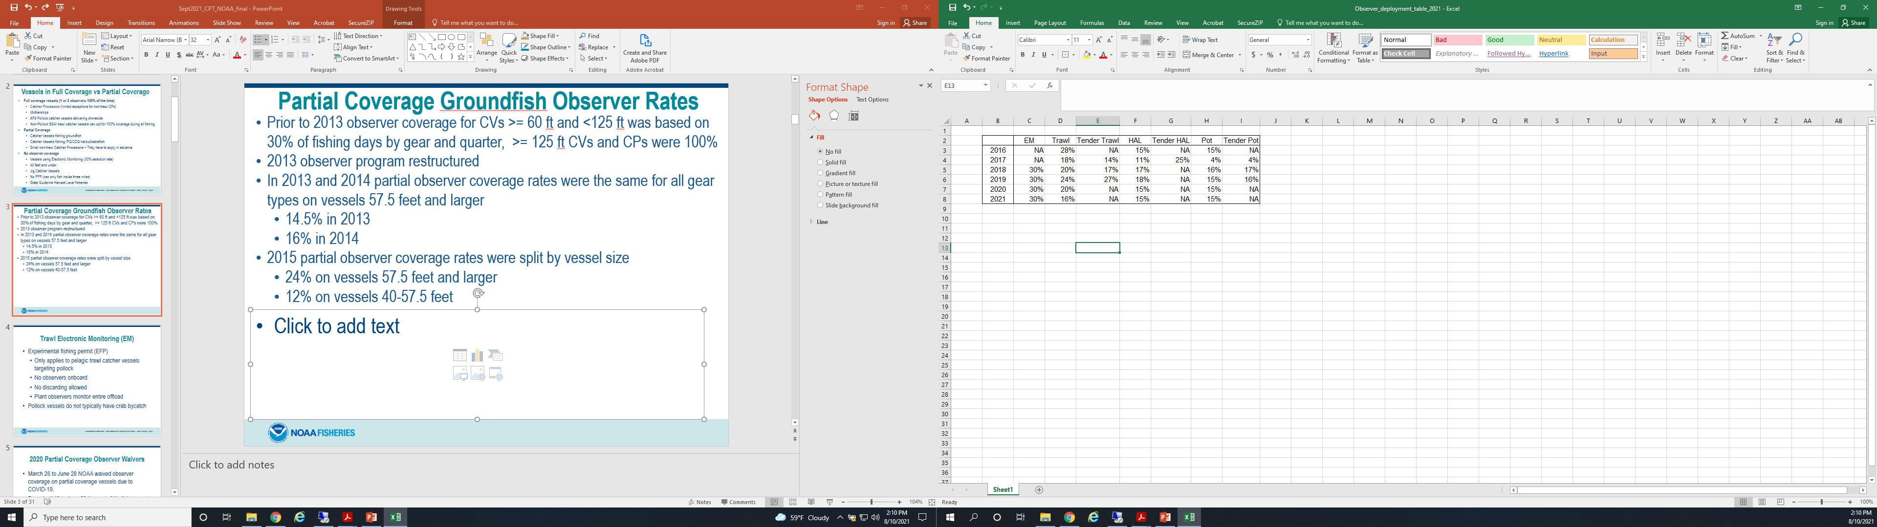
Partial Coverage Groundfish Observer Rates
Prior to 2013 observer coverage for CVs >= 60 ft and <125 ft was based on 30% of fishing days by gear and quarter, >= 125 ft CVs and CPs were 100%
2013 observer program restructured
In 2013 and 2014 partial observer coverage rates were the same for all gear types on vessels 57.5 feet and larger
  14.5% in 2013
  16% in 2014
2015 partial observer coverage rates were split by vessel size
  24% on vessels 57.5 feet and larger
  12% on vessels 40-57.5 feet

Slide 7
Groundfish Fisheries: Trawl Electronic Monitoring (EM)
Experimental fishing permit (EFP)
  EFP for 2020 and 2021
  Only applies to pelagic trawl catcher vessels targeting pollock
  No observers onboard
  No discarding allowed
  EM must be on 100% of the time
  Plant observers monitor entire offload
Pelagic pollock vessels do not typically have crab bycatch

Slide 8
Groundfish Fisheries: 2020/21 Partial Coverage Observer Rates and COVID-19
July 2020 through December 2020, observer deployments only occurred in 13 ports within Alaska due to COVID-19
  During this timeframe observer coverage was lower than expected for Hook-and-Line (expected 15.4%, realized 10.2%) and Pot gear (expected 15.2%, realized 8.5%)
January 2021 through June 2021, observer deployments continue to be restricted to specific ports due to COVID-19
Vessels in the full coverage category have continued to carry observers throughout the COVID-19 pandemic
Vessels in the EM program have continued to deploy EM throughout the COVID-19 pandemic

Slide 9
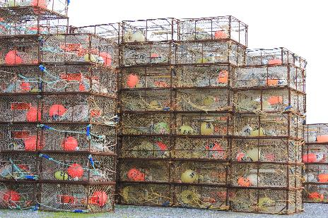
Incidental Crab Catch in Groundfish Fisheries
All weights are in kilograms
Mortality has been applied
(50% for fixed gear and 80%
for trawl gear)
All weights are extrapolated from
observer data
All weights came from AKFIN database
Incidental catch data in this presentation are for the crab year (July 1 to June 30) except for Pribilof Island Golden king crab and Norton Sound red king crab which are a calendar year
Fixed gear includes pot, hook-and-line, and jig
Trawl gear includes non-pelagic and pelagic trawl

Slide 10
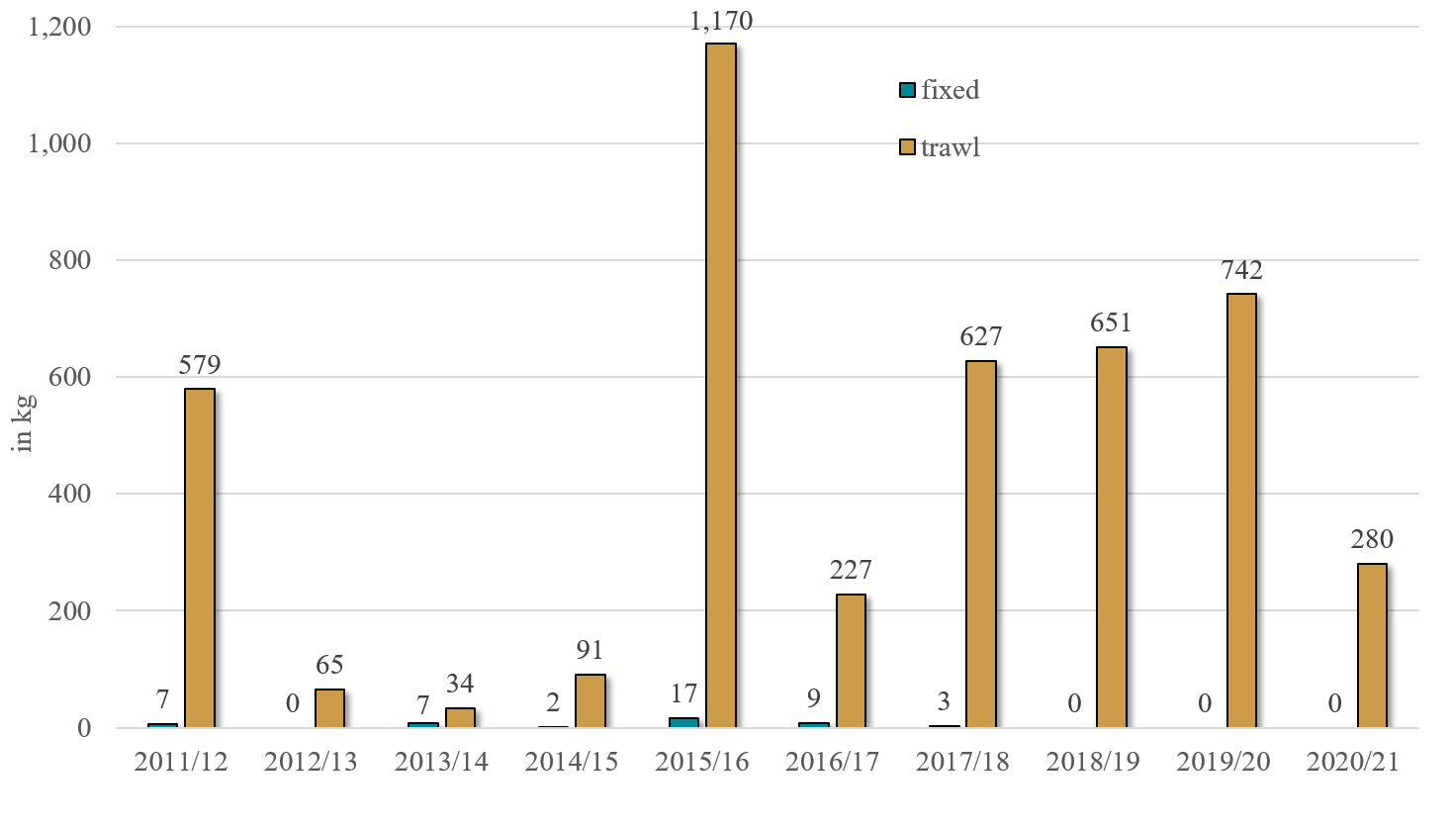
Aleutian Islands Red King Crab Incidental Catch in Groundfish Fisheries
Not much federal fixed gear fishing in this area.
Not very much fixed gear observer coverage.
There is a State Pcod fishery in the area but there is no observer/EM coverage in State fisheries.

Slide 11
Groundfish Fisheries: Definitions of Fishing Trip
CVs – time they start fishing until offload
CPs and Motherships:
(A) The effective date of a notification prohibiting directed fishing in the same area under §679.20 or §679.21;
(B) The offload or transfer of all fish or fish product from that vessel;
(C) The vessel enters or leaves an area where a different directed fishing prohibition applies;
(D) The vessel begins fishing with a different type of authorized fishing gear; or
(E) The end of a weekly reporting period,
whichever comes first.

Slide 12
Groundfish Fisheries: Trip Target Codes
The trip target code is assigned by the majority species for the fishing trip.
CVs and fixed gear CPs usually only target one species per fishing trip.
Trawl CPs and Motherships often target more than one species per fishing trip.
  For example if a CP or Mothership has 51% Atka mackerel and 49% rockfish for a fishing trip then all catch for that trip will be assigned the Atka mackerel target.

Slide 13
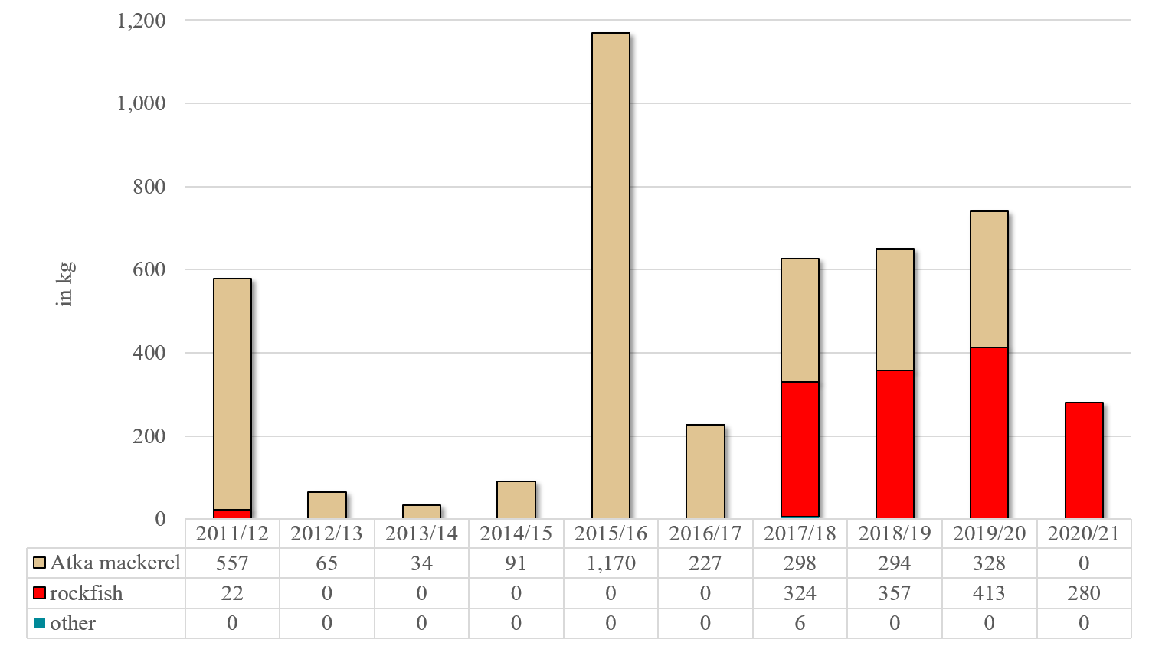
Aleutian Islands Red King Crab Trawl Incidental Catch by Trip Target
In recent years A80 has been targeting both Atka mackerel and rockfish within the same trip.
Most RKC is found while fishing in the summer months (June – August).
“Other” species includes: Kamchatka flounder, Pacific cod, and pollock.

Slide 14
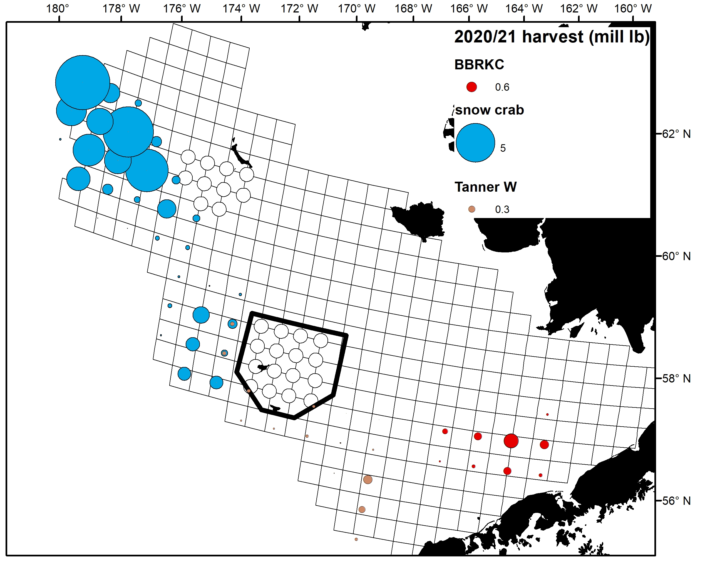
2020/21 BBRKC, Tanner W, + snow crab directed fisheries
* Excludes stat areas with <3 vessels

Slide 15
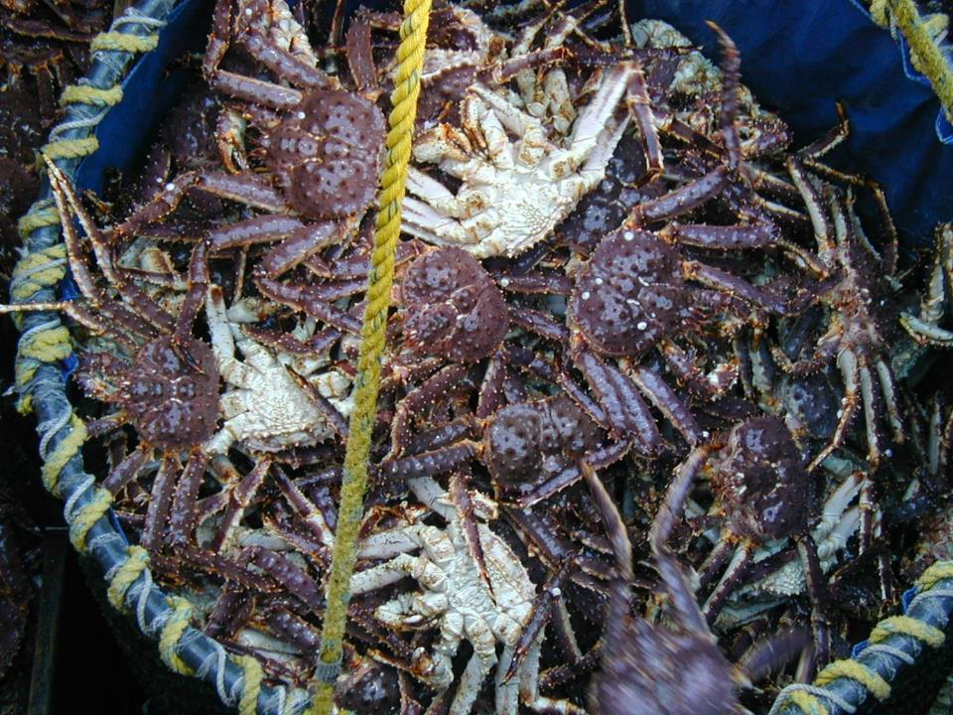
BBRKC

Slide 16
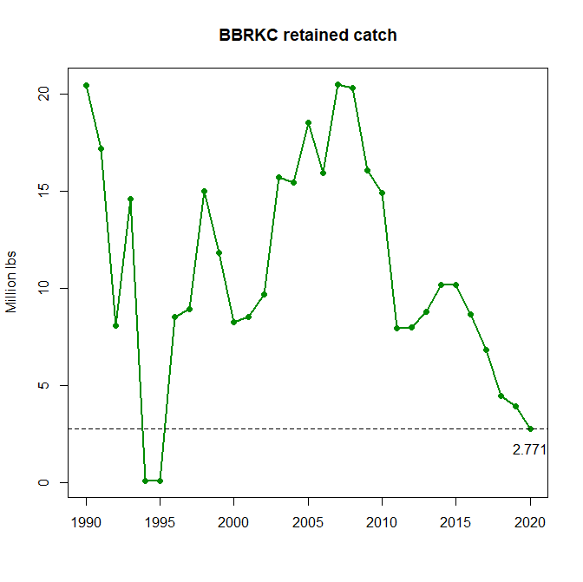

Slide 17
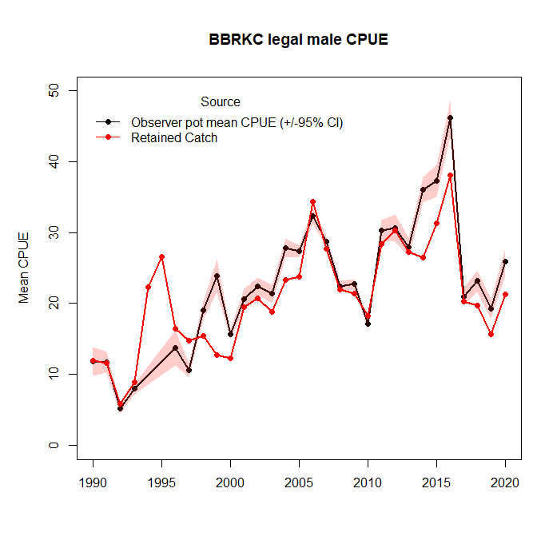

Slide 18
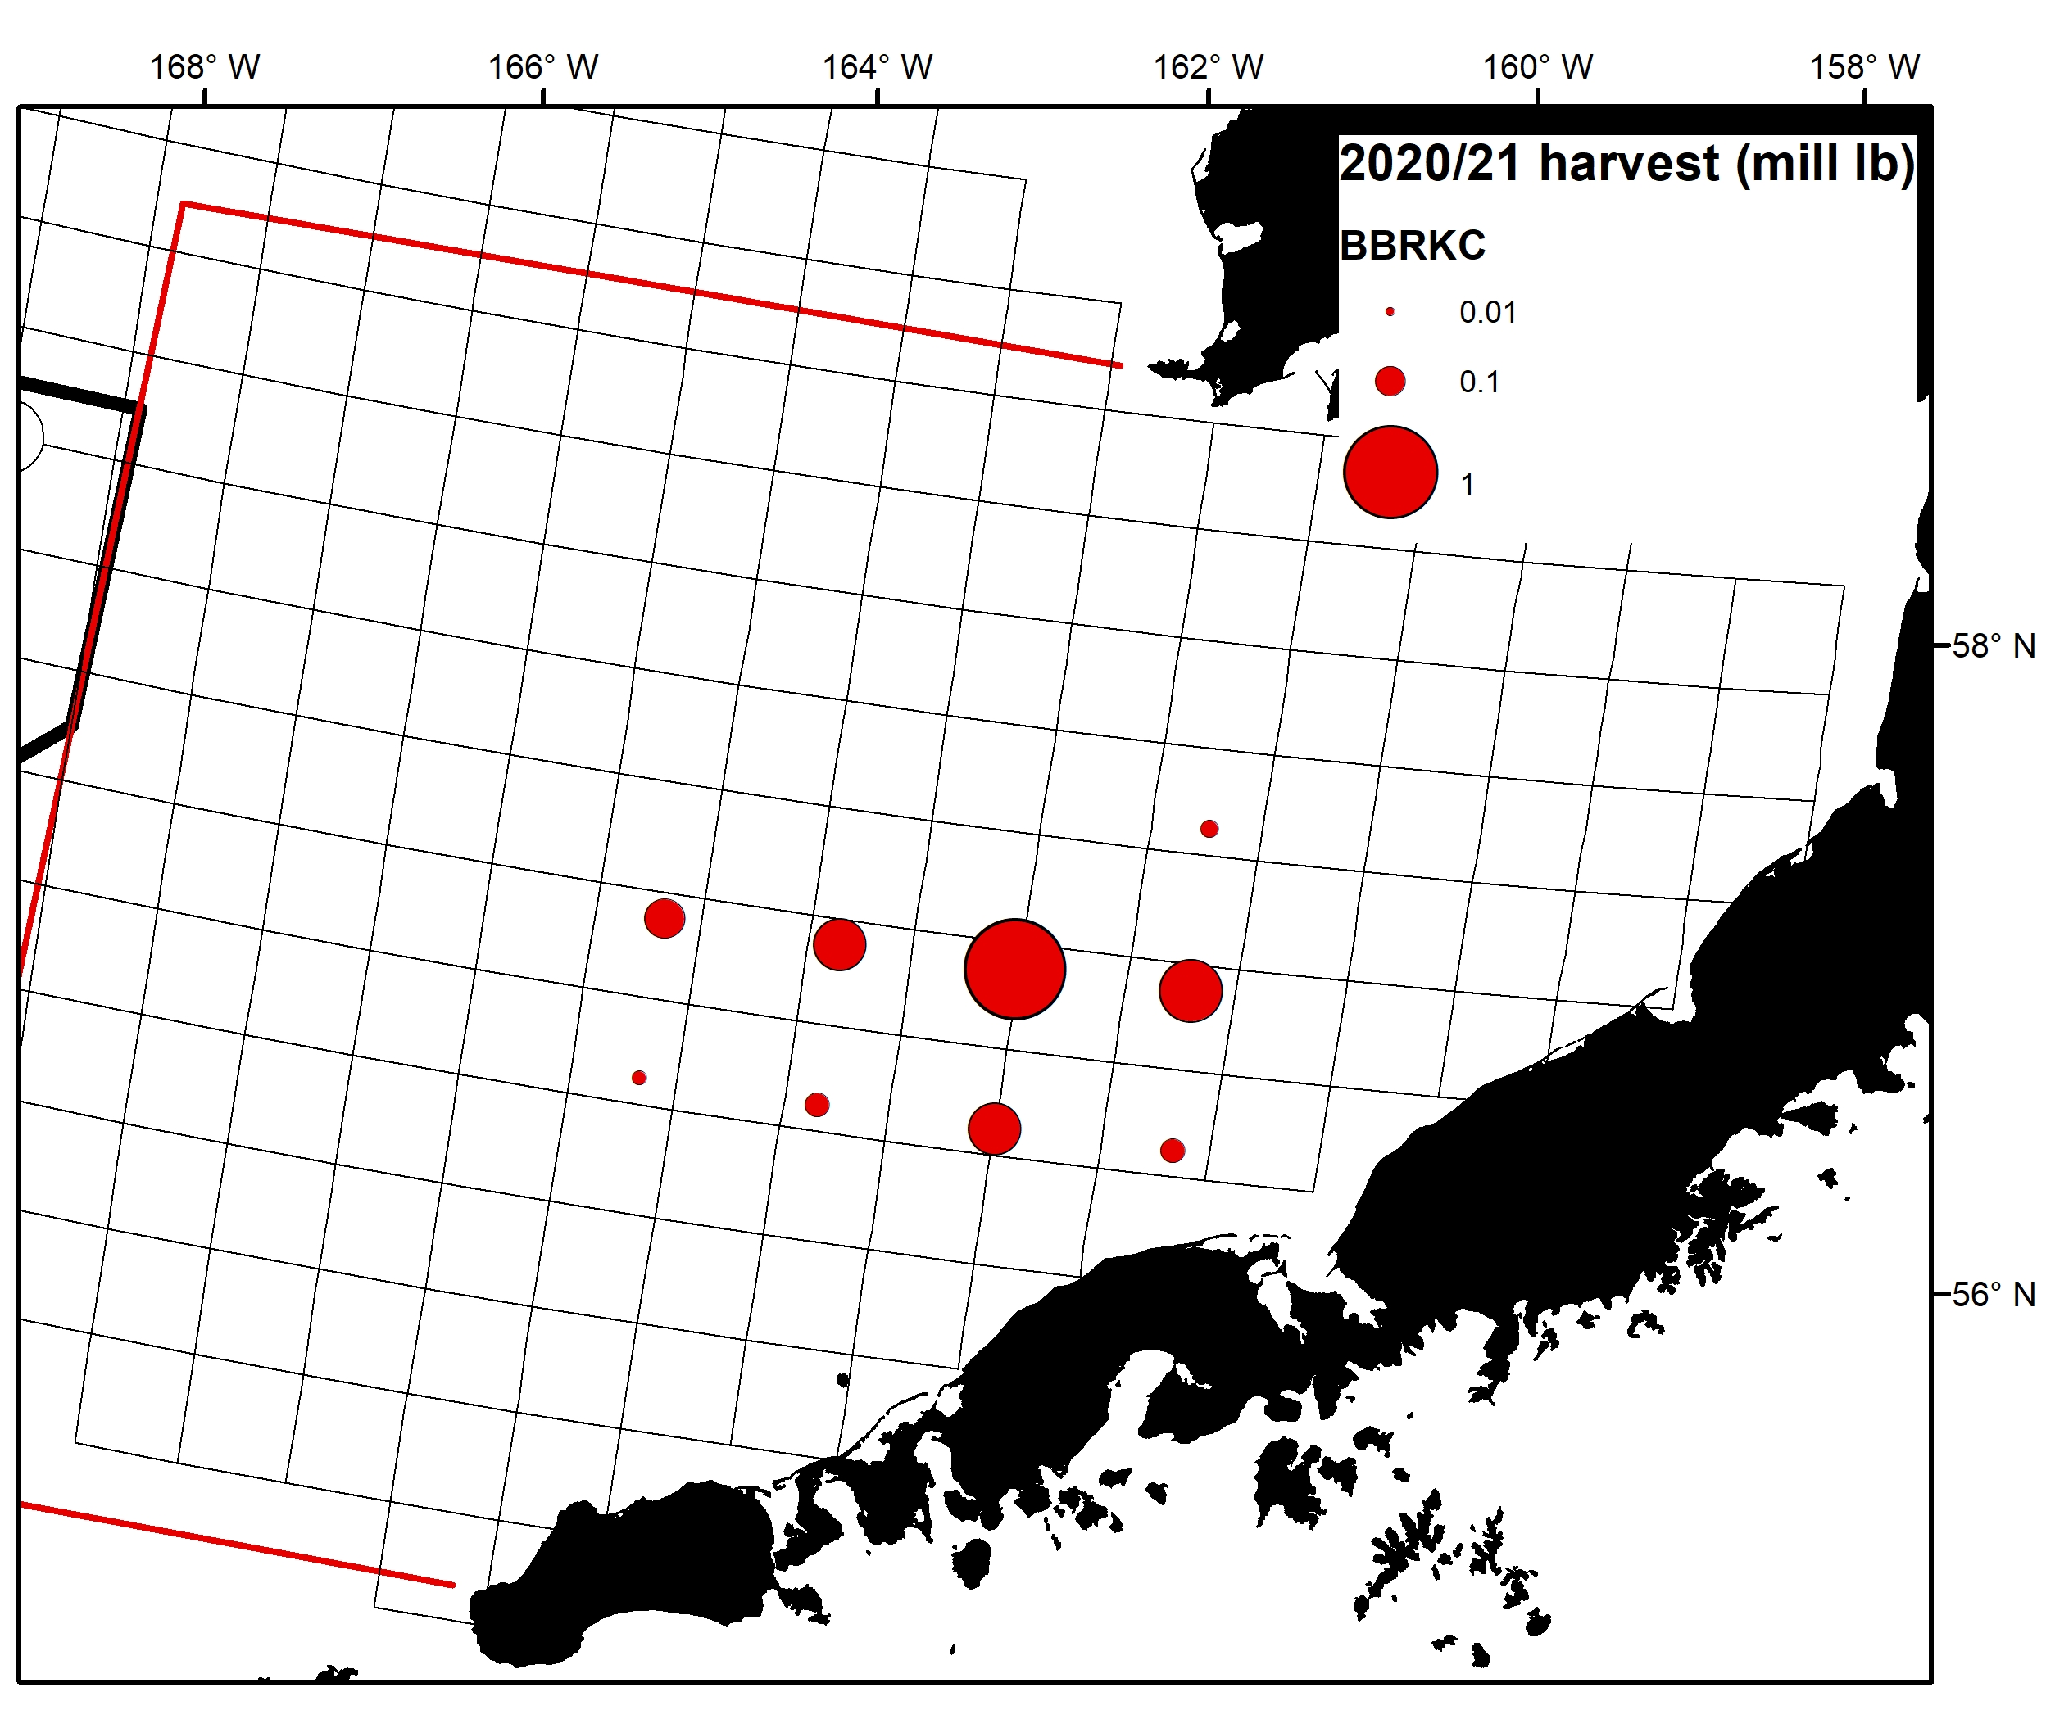
2020/21 BBRKC
* Excludes stat areas with <3 vessels

Slide 19
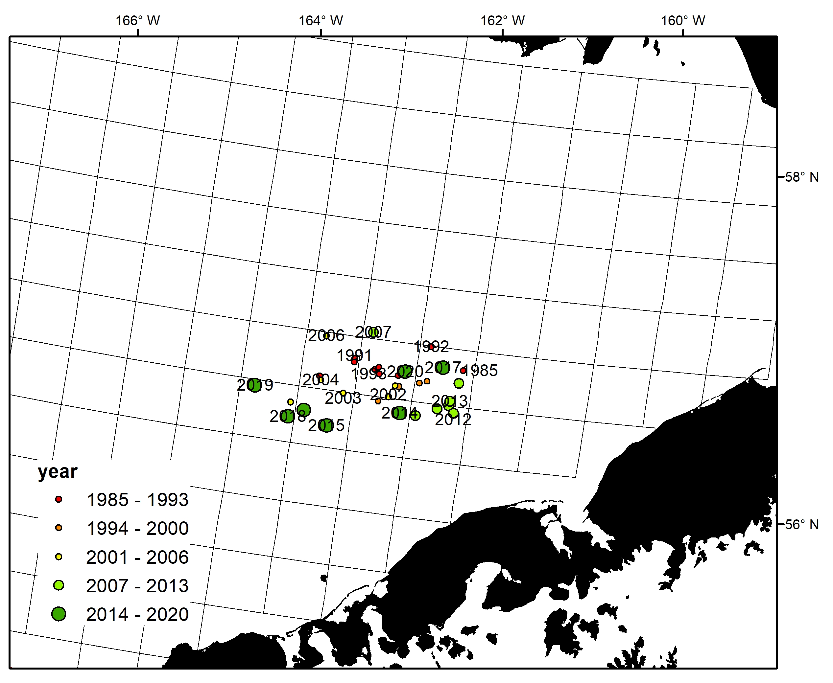
BBRKC weighted centers of catch

Slide 20
2020/21 BBRKC

Slide 21
2020/21 BBRKC: observations from the fleet
Effort was well distributed across the fishing grounds, with vessels fishing more of the “traditional” areas to the east.
Captains reported high CPUE fishing with nearly all new shell crab.
Majority of captains reported that they saw more recruits in the pots than in the two previous seasons.
Most captains reported seeing “some” females.

Slide 22
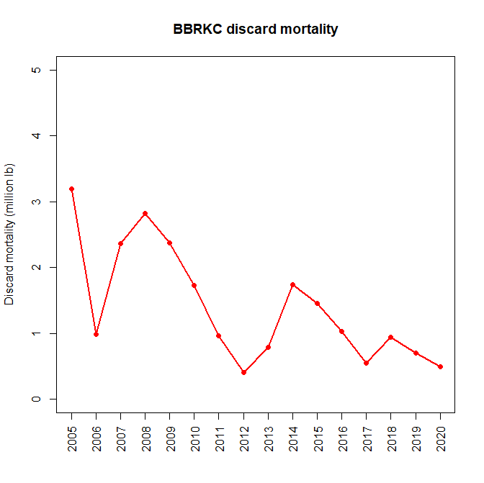

Slide 23
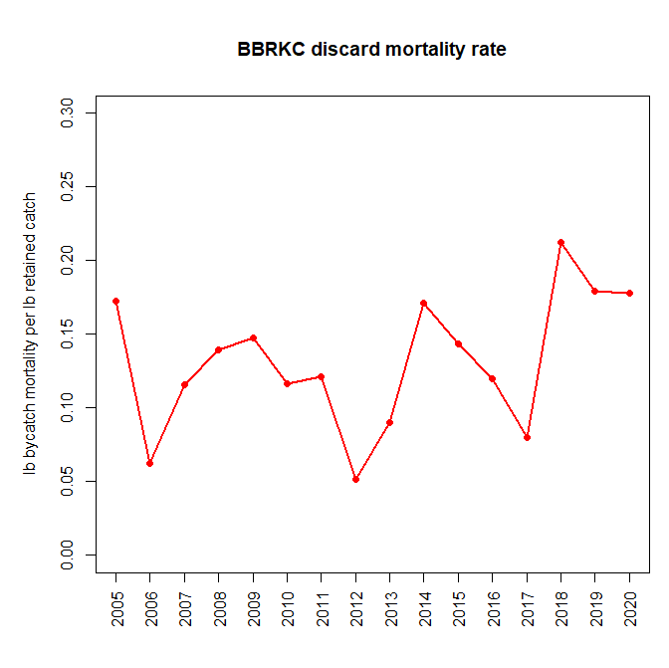

Slide 24
Ratio of sublegal crabs up in recent years, but comparable to the long-term trends
Vessels were seeing more sublegal male crabs than they have since 2011-ish

Slide 25
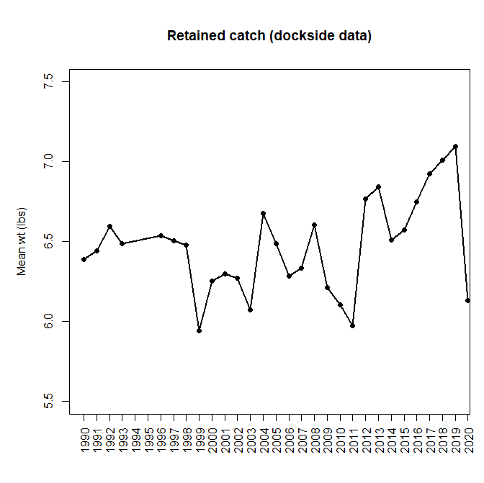

Slide 26
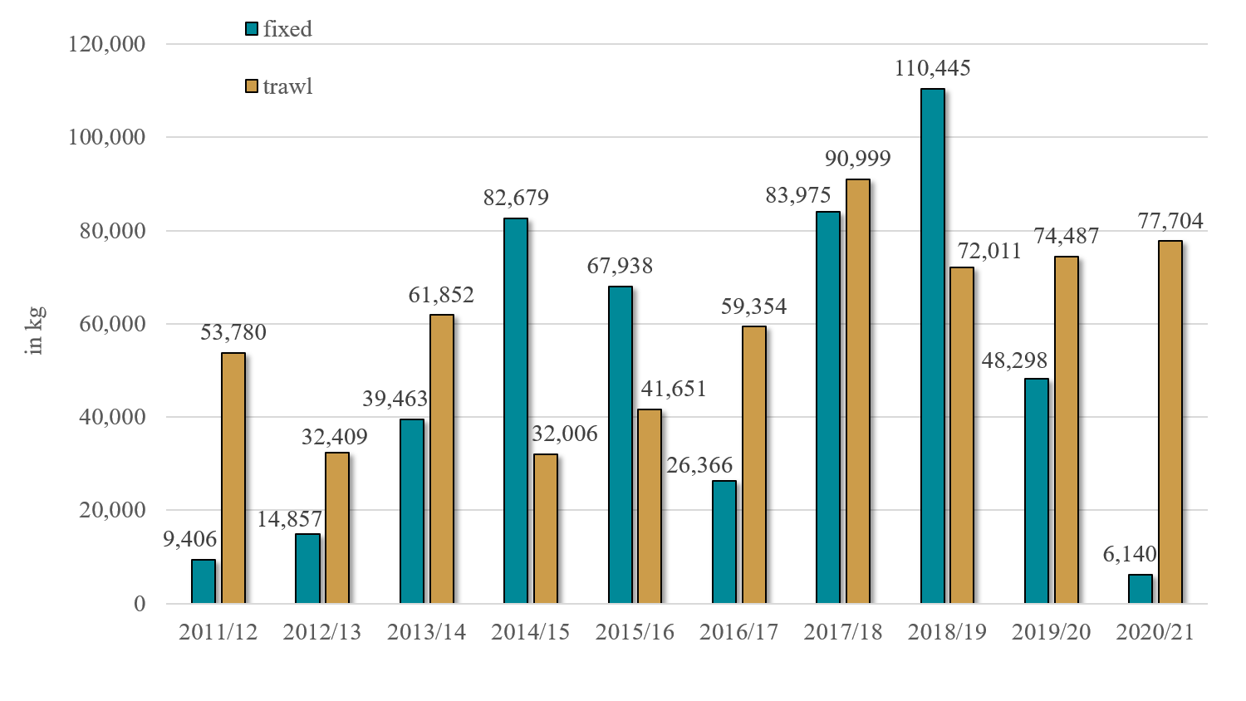
Bristol Bay Red King Crab Incidental Catch in Groundfish Fisheries
Most fixed gear bycatch is in the Pacific cod fishery using pot gear.
In most years there is more RKC bycatch in the Pacific cod pot fisheries in the fall.
During the 2020/21 crab year most RKC bycatch in Pacific cod pot fisheries was in the winter.
Lower RKC rates during the 2020/21 crab year in the fixed gear sectors could be due to:
  Lower observer coverage in the pot Pacific cod fishery in the fall of 2020 due to COVID (although there was EM data in this sector)
  Lower Pacific cod TACs
  Pacific cod pot fleet using more gear with crab excluders

Slide 27
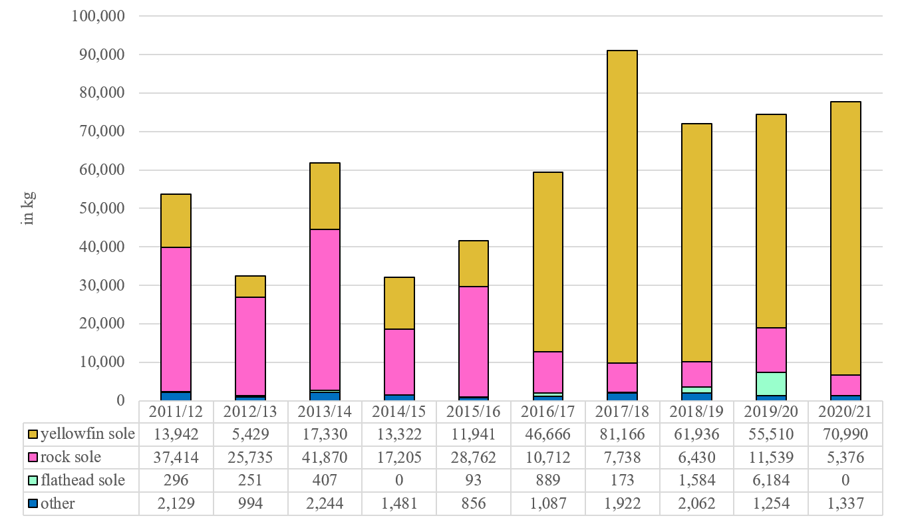
Bristol Bay Red King Crab Trawl Incidental Catch by Trip Target
Rock sole and yellowfin sole are often targeted during the same fishing trip.
“Other” species includes: Alaska plaice, arrowtooth flounder, Atka mackerel, Greenland turbot, Kamchatka flounder, other flatfish, Pacific cod, rockfish, and pollock.

Slide 28
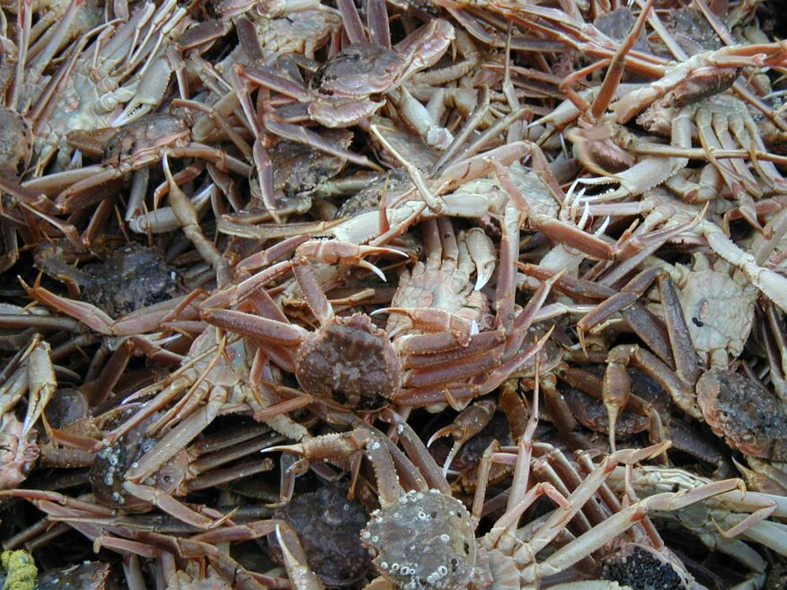
Snow crab

Slide 29
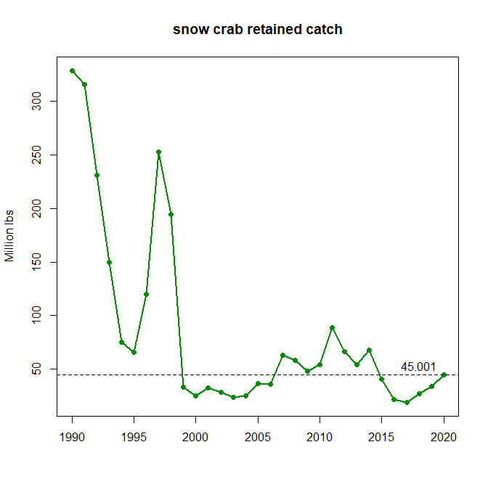

Slide 31
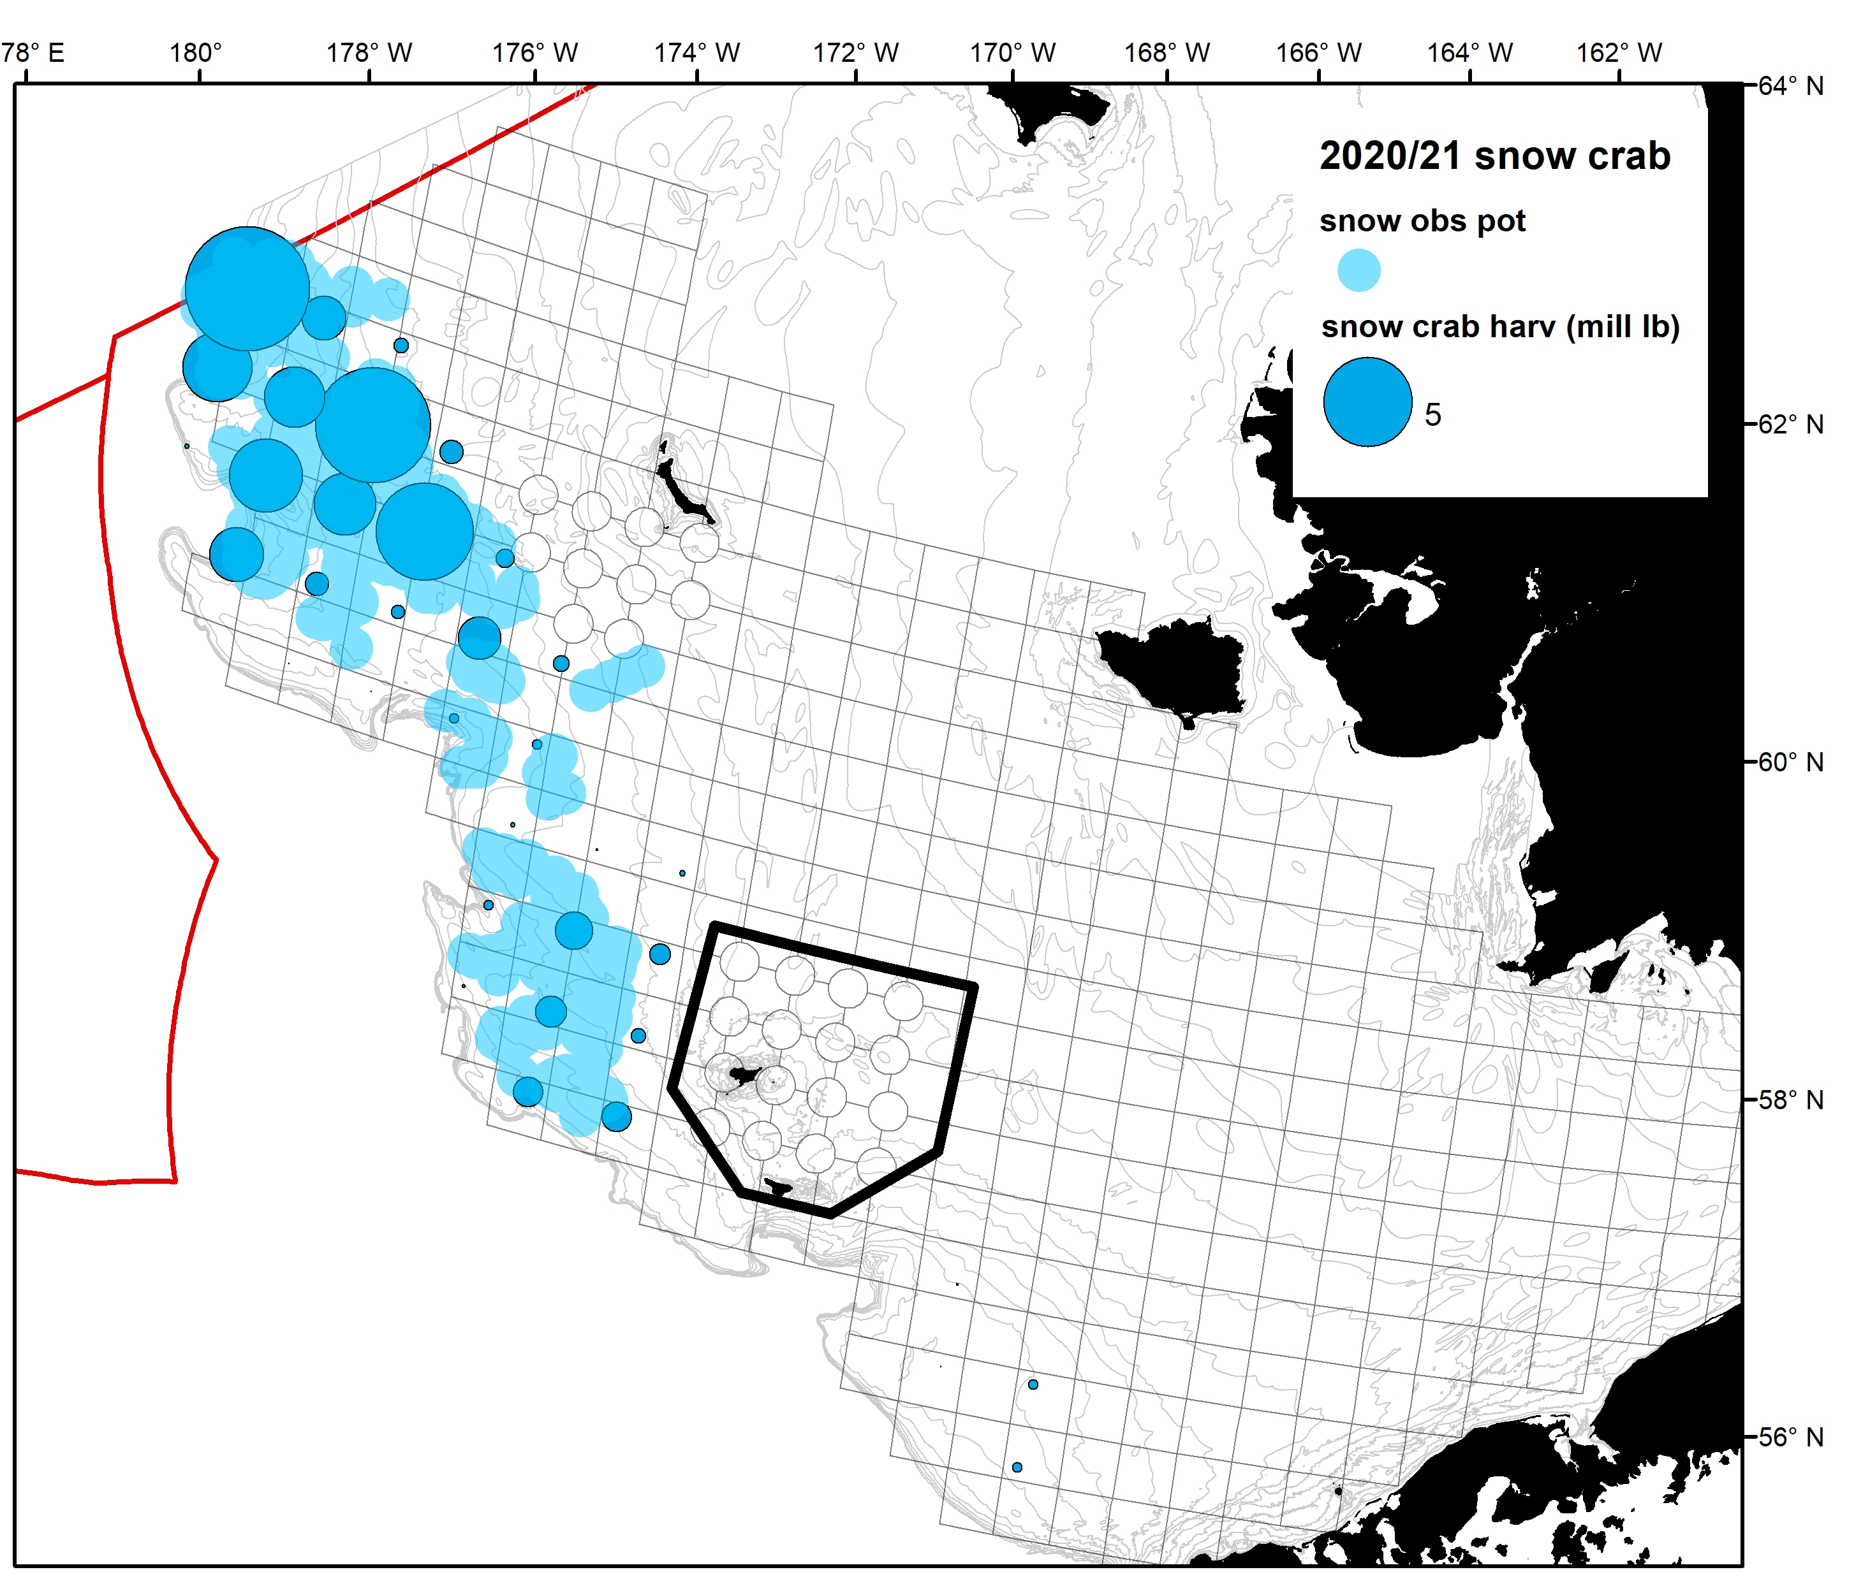
2020/21 snow crab retained catch
* Excludes stat areas with <3 vessels

Slide 32
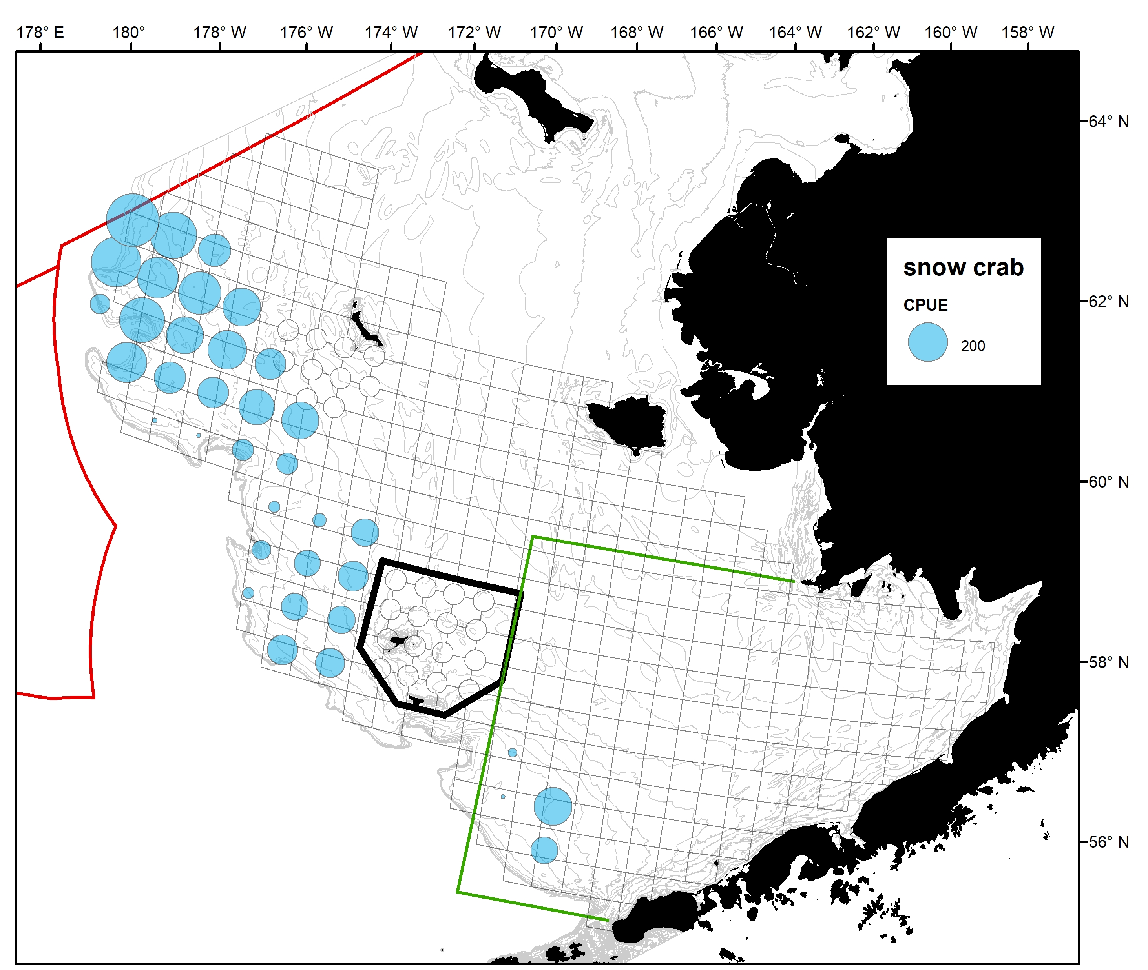

2020/21 snow crab
Fishery CPUE
Fishery Effort
* Excludes stat areas with <3 vessels

Slide 33
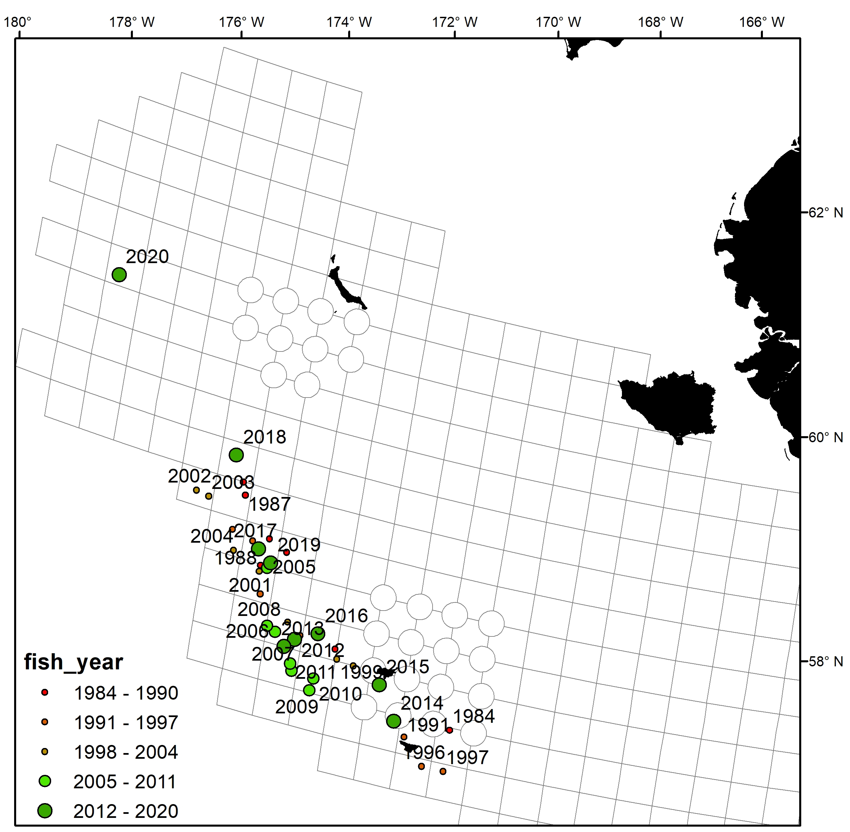
Snow crab weighted mean centers of catch

Slide 34
2020/21 snow crab

Slide 35
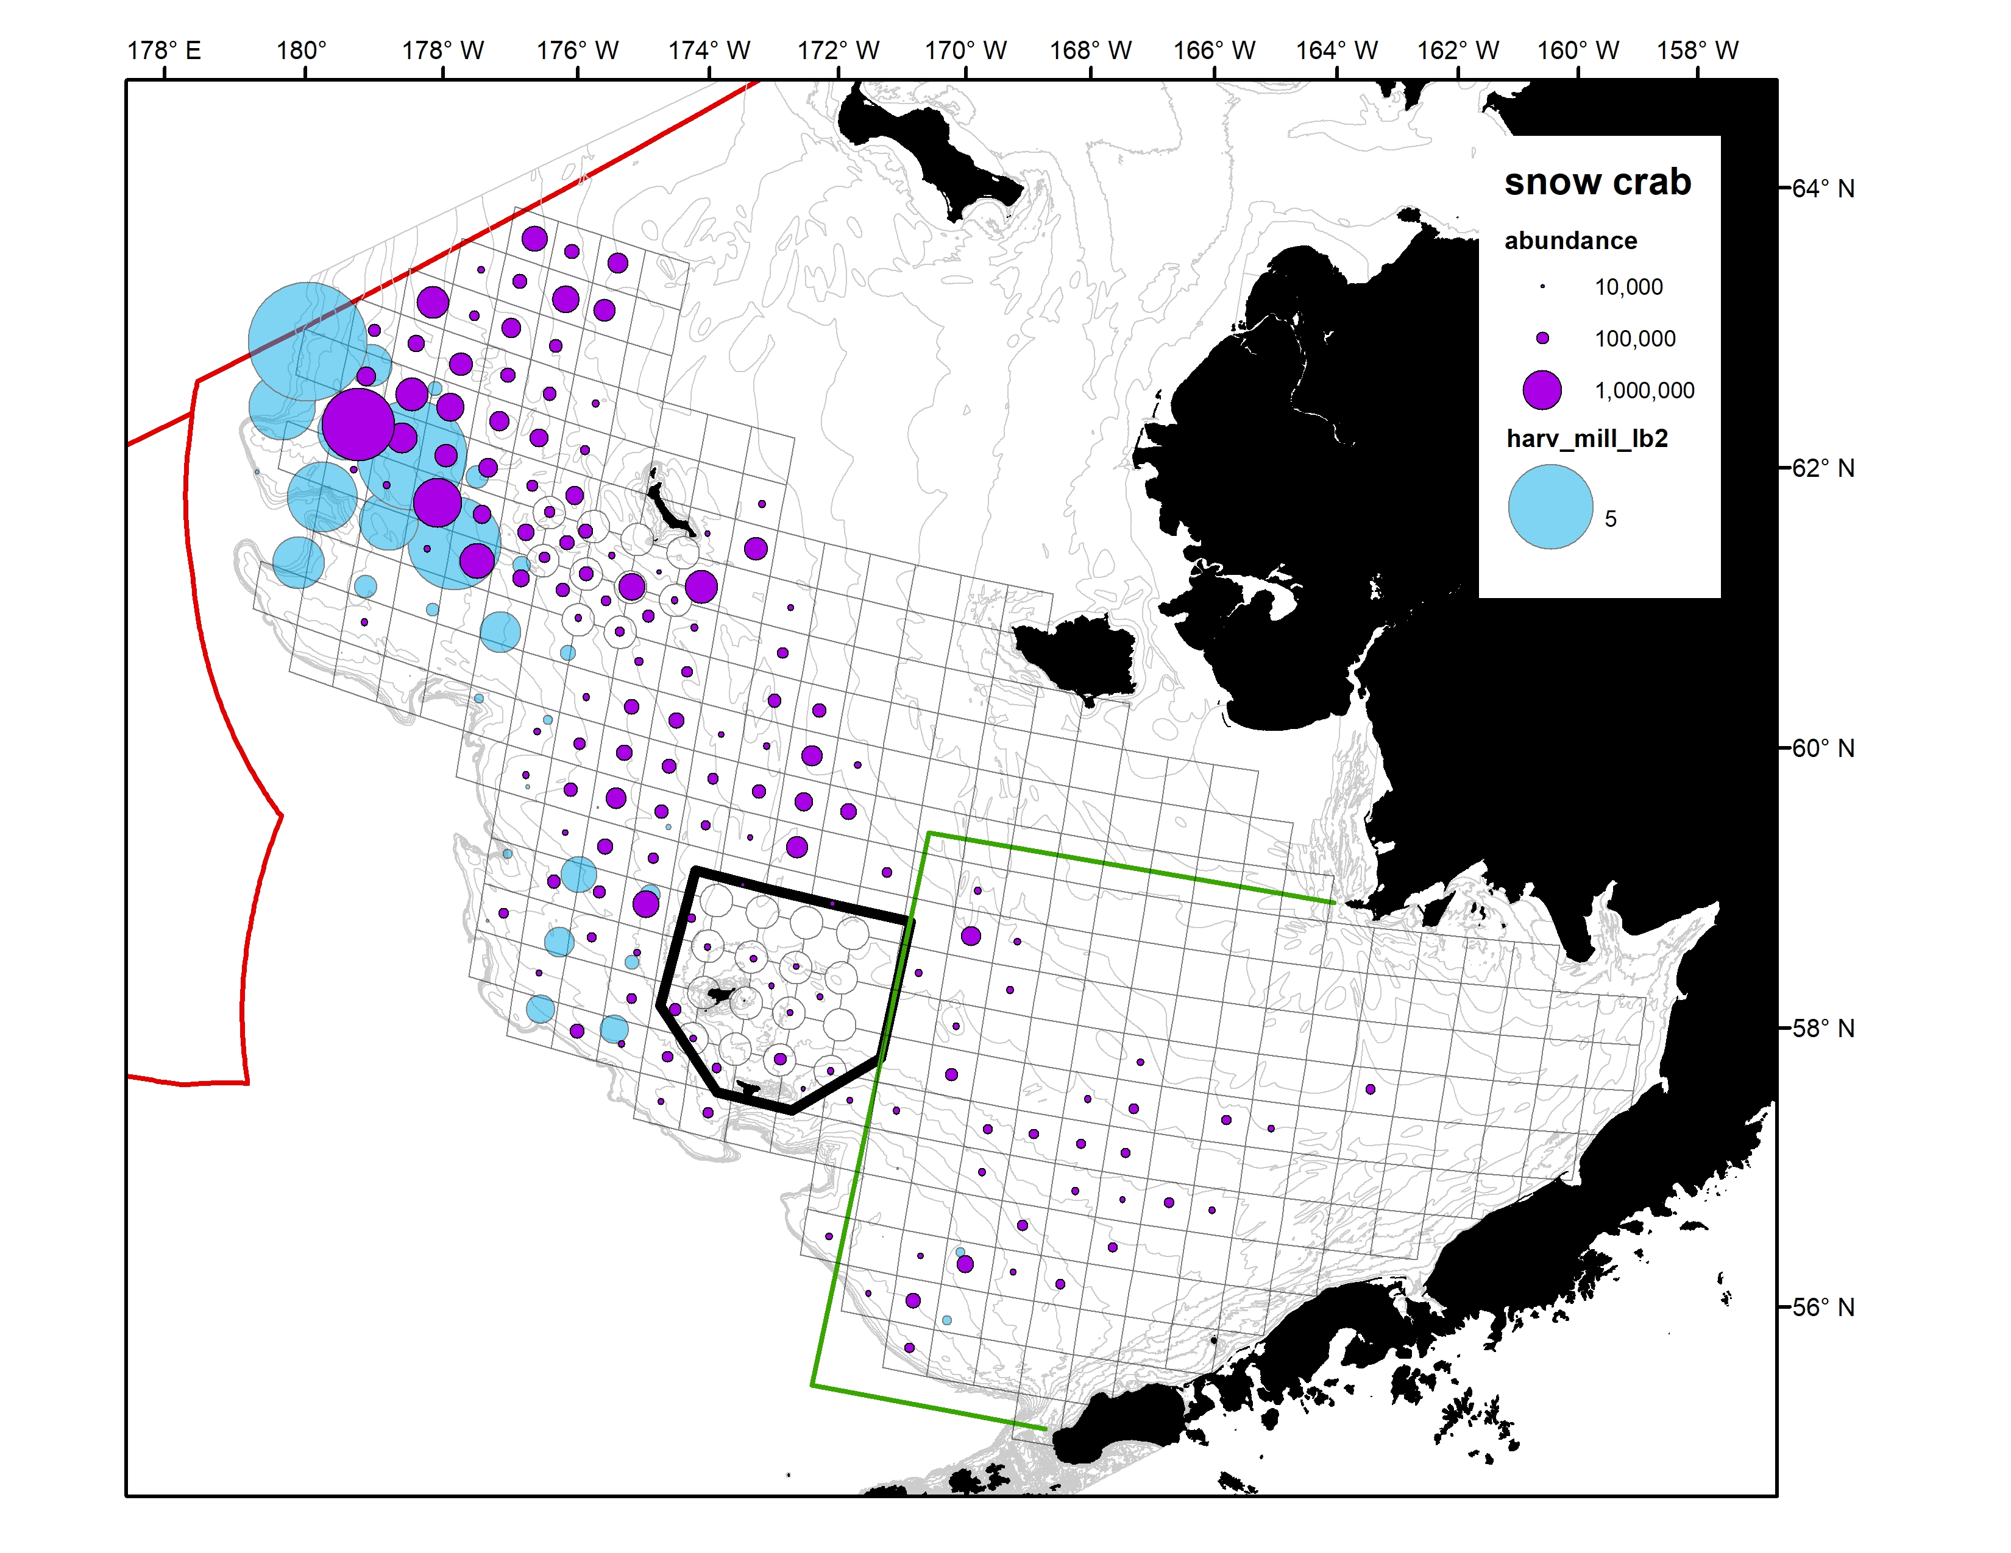
~50% of harvest occurred in March + April
Survey occurs in June+ July
Purple= 2021 survey abundance 4 inch males
Blue = 2020/21 fishery harvest

Slide 36
2020/21 Snow crab: observations from the fleet
Poor fishing reported in nearly all areas except the northern grounds west of St. Matthew Island where CPUE was high.
Areas of clean fishing on new shell legal males down deep (90+ fathoms)
Many vessels were fishing right up against the Russian border.
Sea ice limited the amount of area vessels could fish in for part of the season.

Slide 37
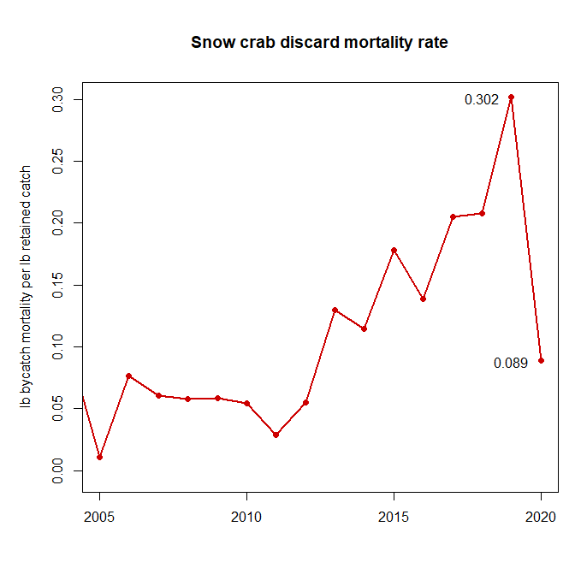

Slide 38
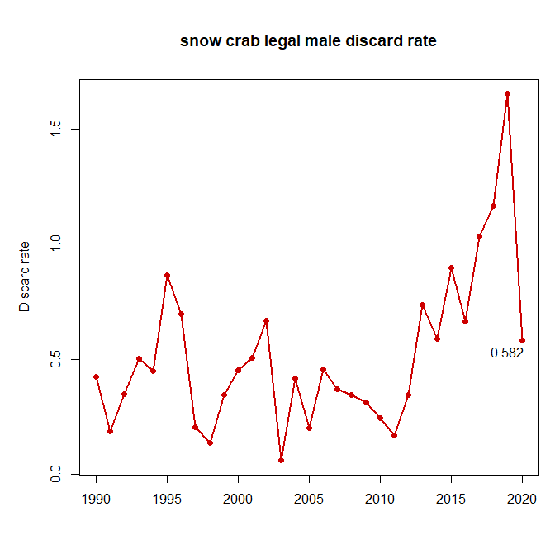

Slide 39
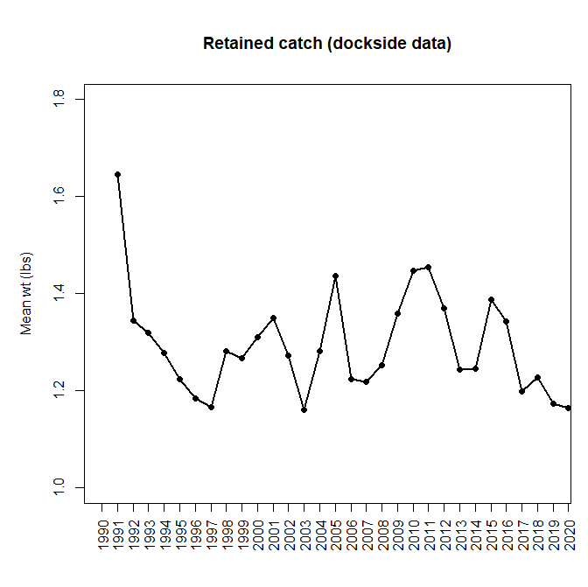

Slide 40
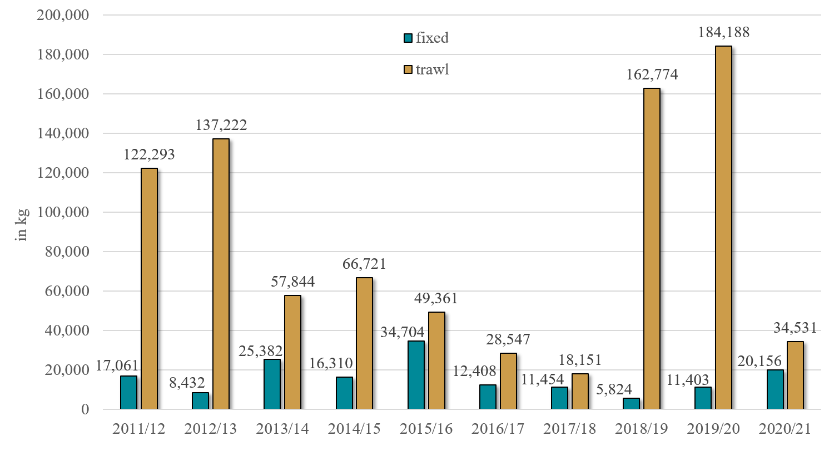
BS Snow Crab Incidental Catch in Groundfish Fisheries
Pot and hook-and-line Pacific cod fishing accounts for most BSS bycatch in the fixed gear category with about 75% coming from pot gear.
Hook-and-line Pacific cod fishing is spread out throughout the stock area.
Pot Pacific cod fishing is concentrated on the north side of Unimak Island to Port Moller.

Slide 41
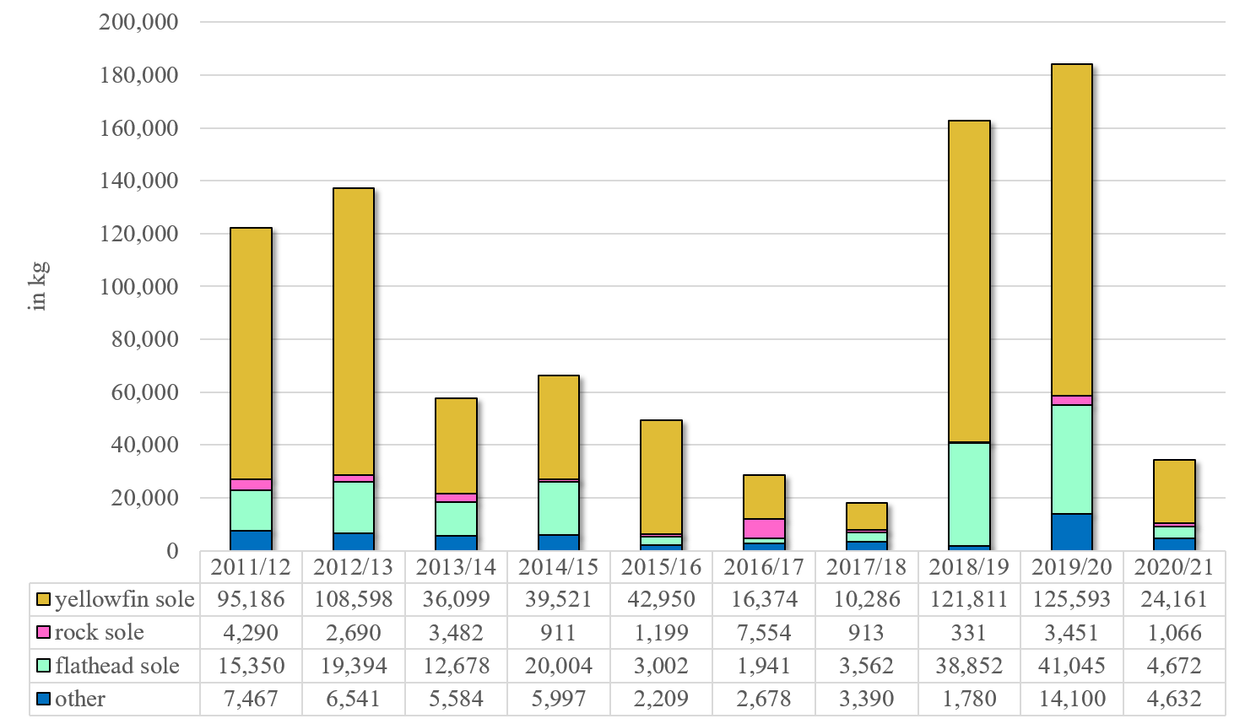
BS Snow Crab Trawl Incidental Catch by Trip Target
2018/19 and 2019/20 increased BSS bycatch in the yellowfin fishery was due mainly to increased yellowfin sole fishing in the area above the Pribilof Islands.
“Other” species includes: Alaska plaice, arrowtooth flounder, Atka mackerel, Greenland turbot, Kamchatka flounder, other flatfish, Pacific cod, rockfish, and pollock.

Slide 42
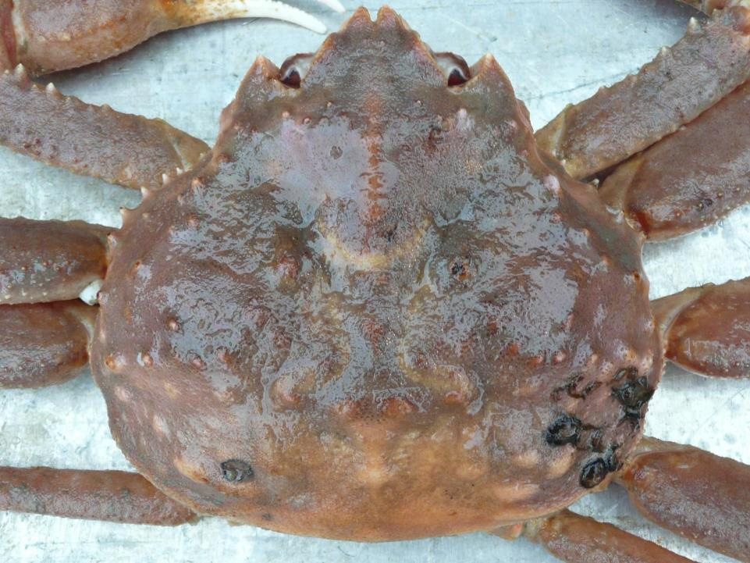
Tanner crab

Slide 43
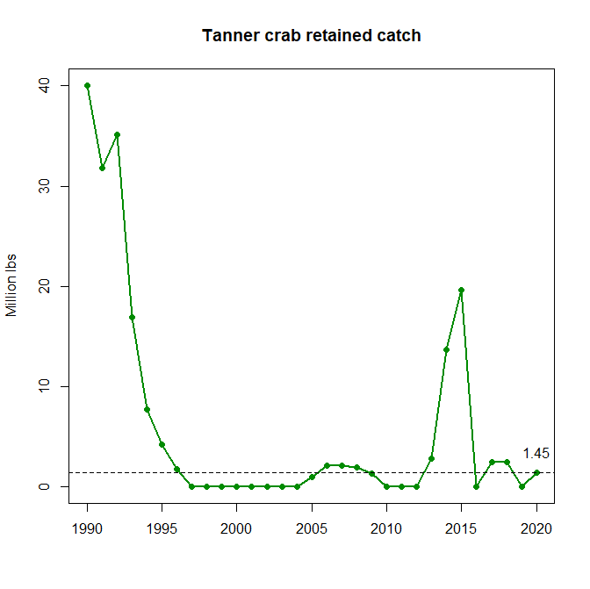
East and west combined
2020/21 TAC East=0, West=2.348 mill lb

Slide 44
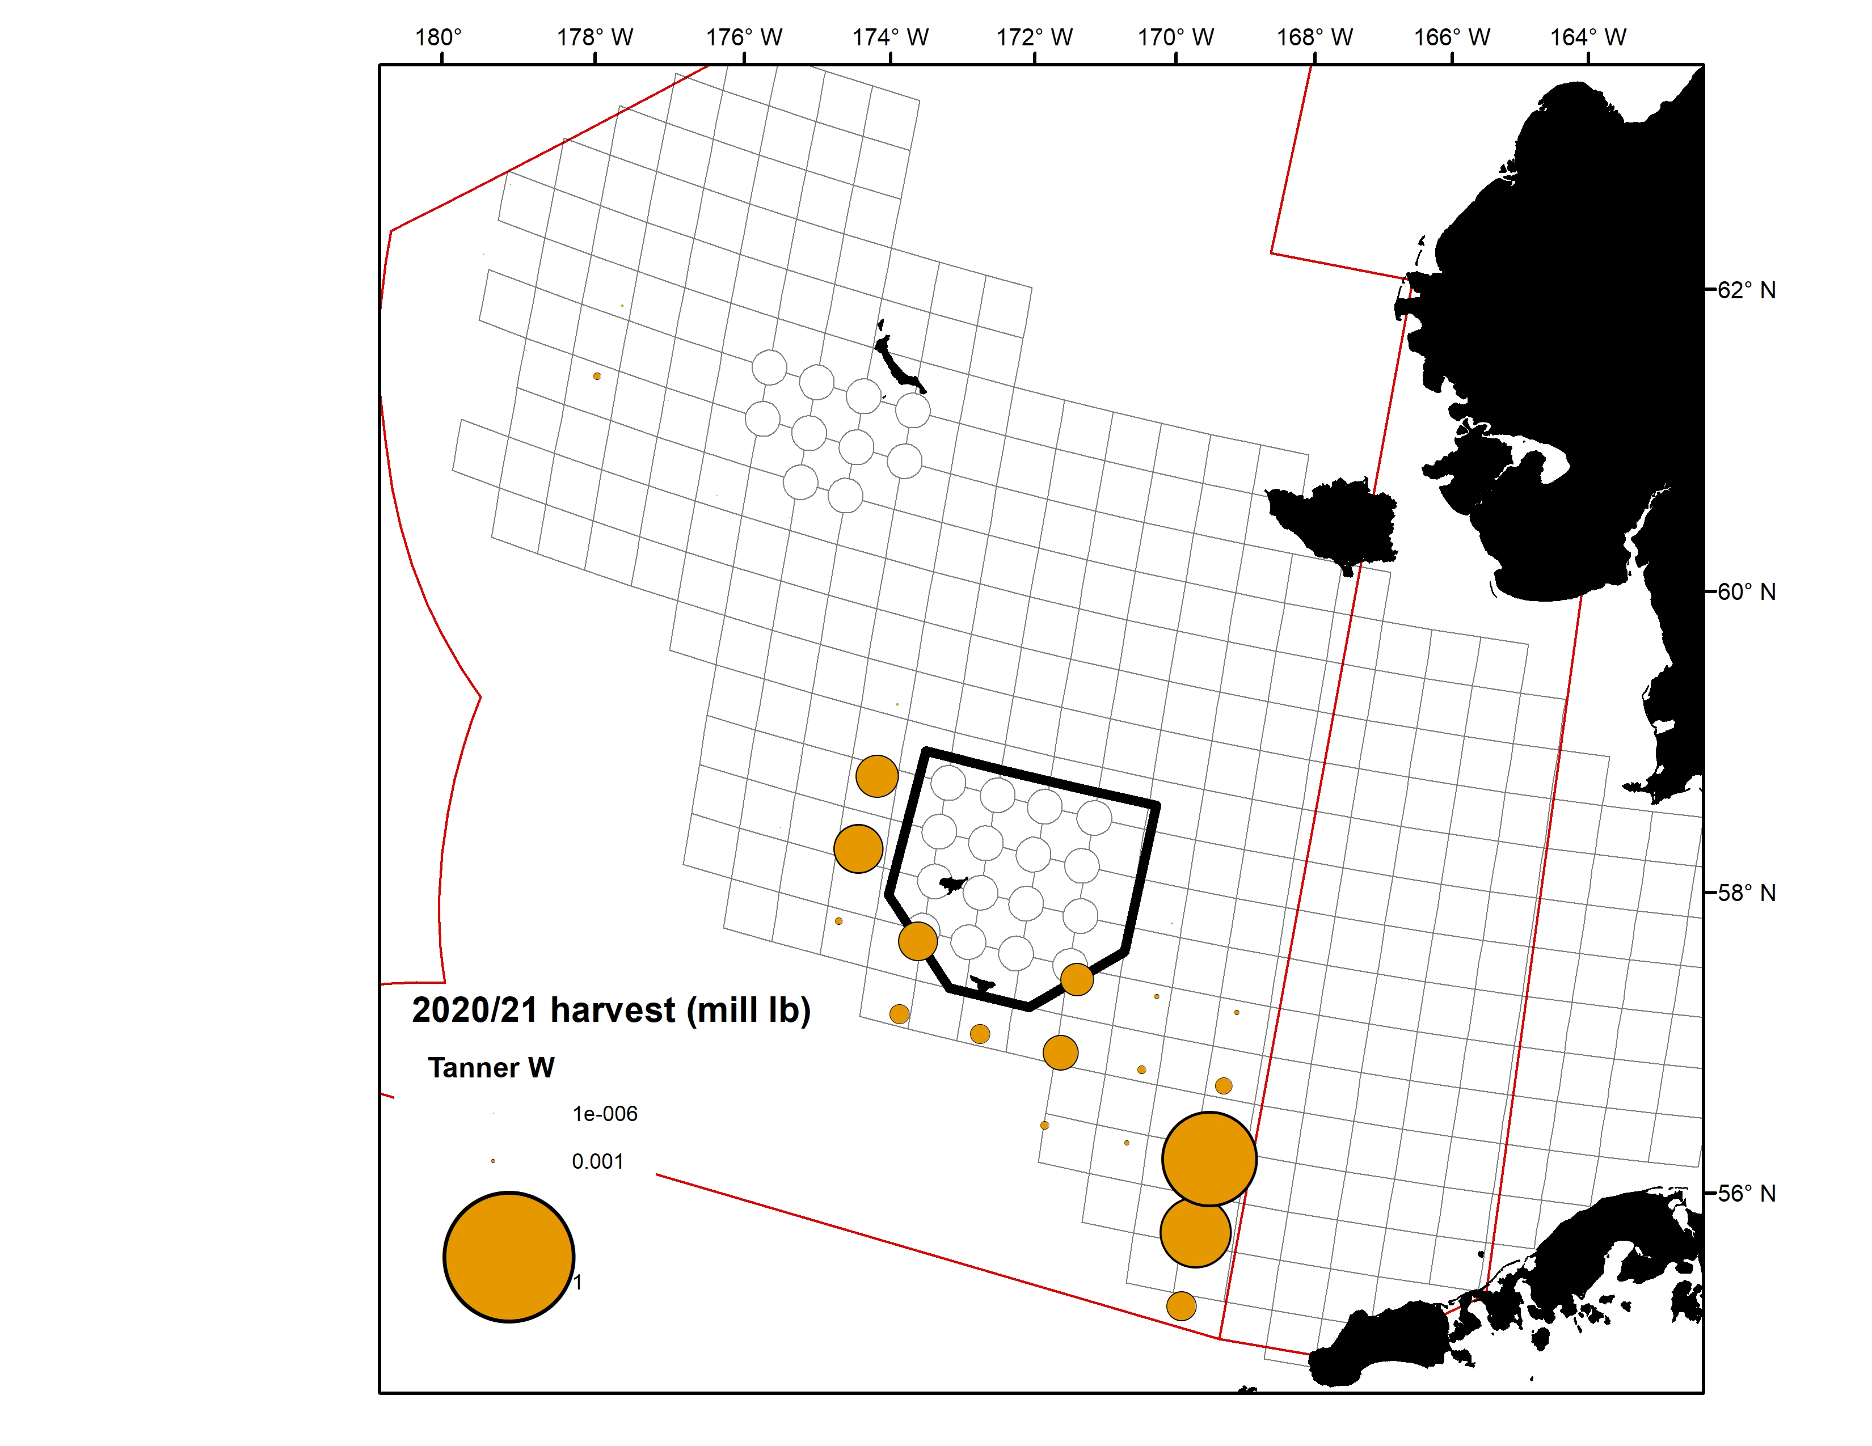
2020/21 Tanner crab retained catch
* Excludes stat areas with <3 vessels

Slide 45
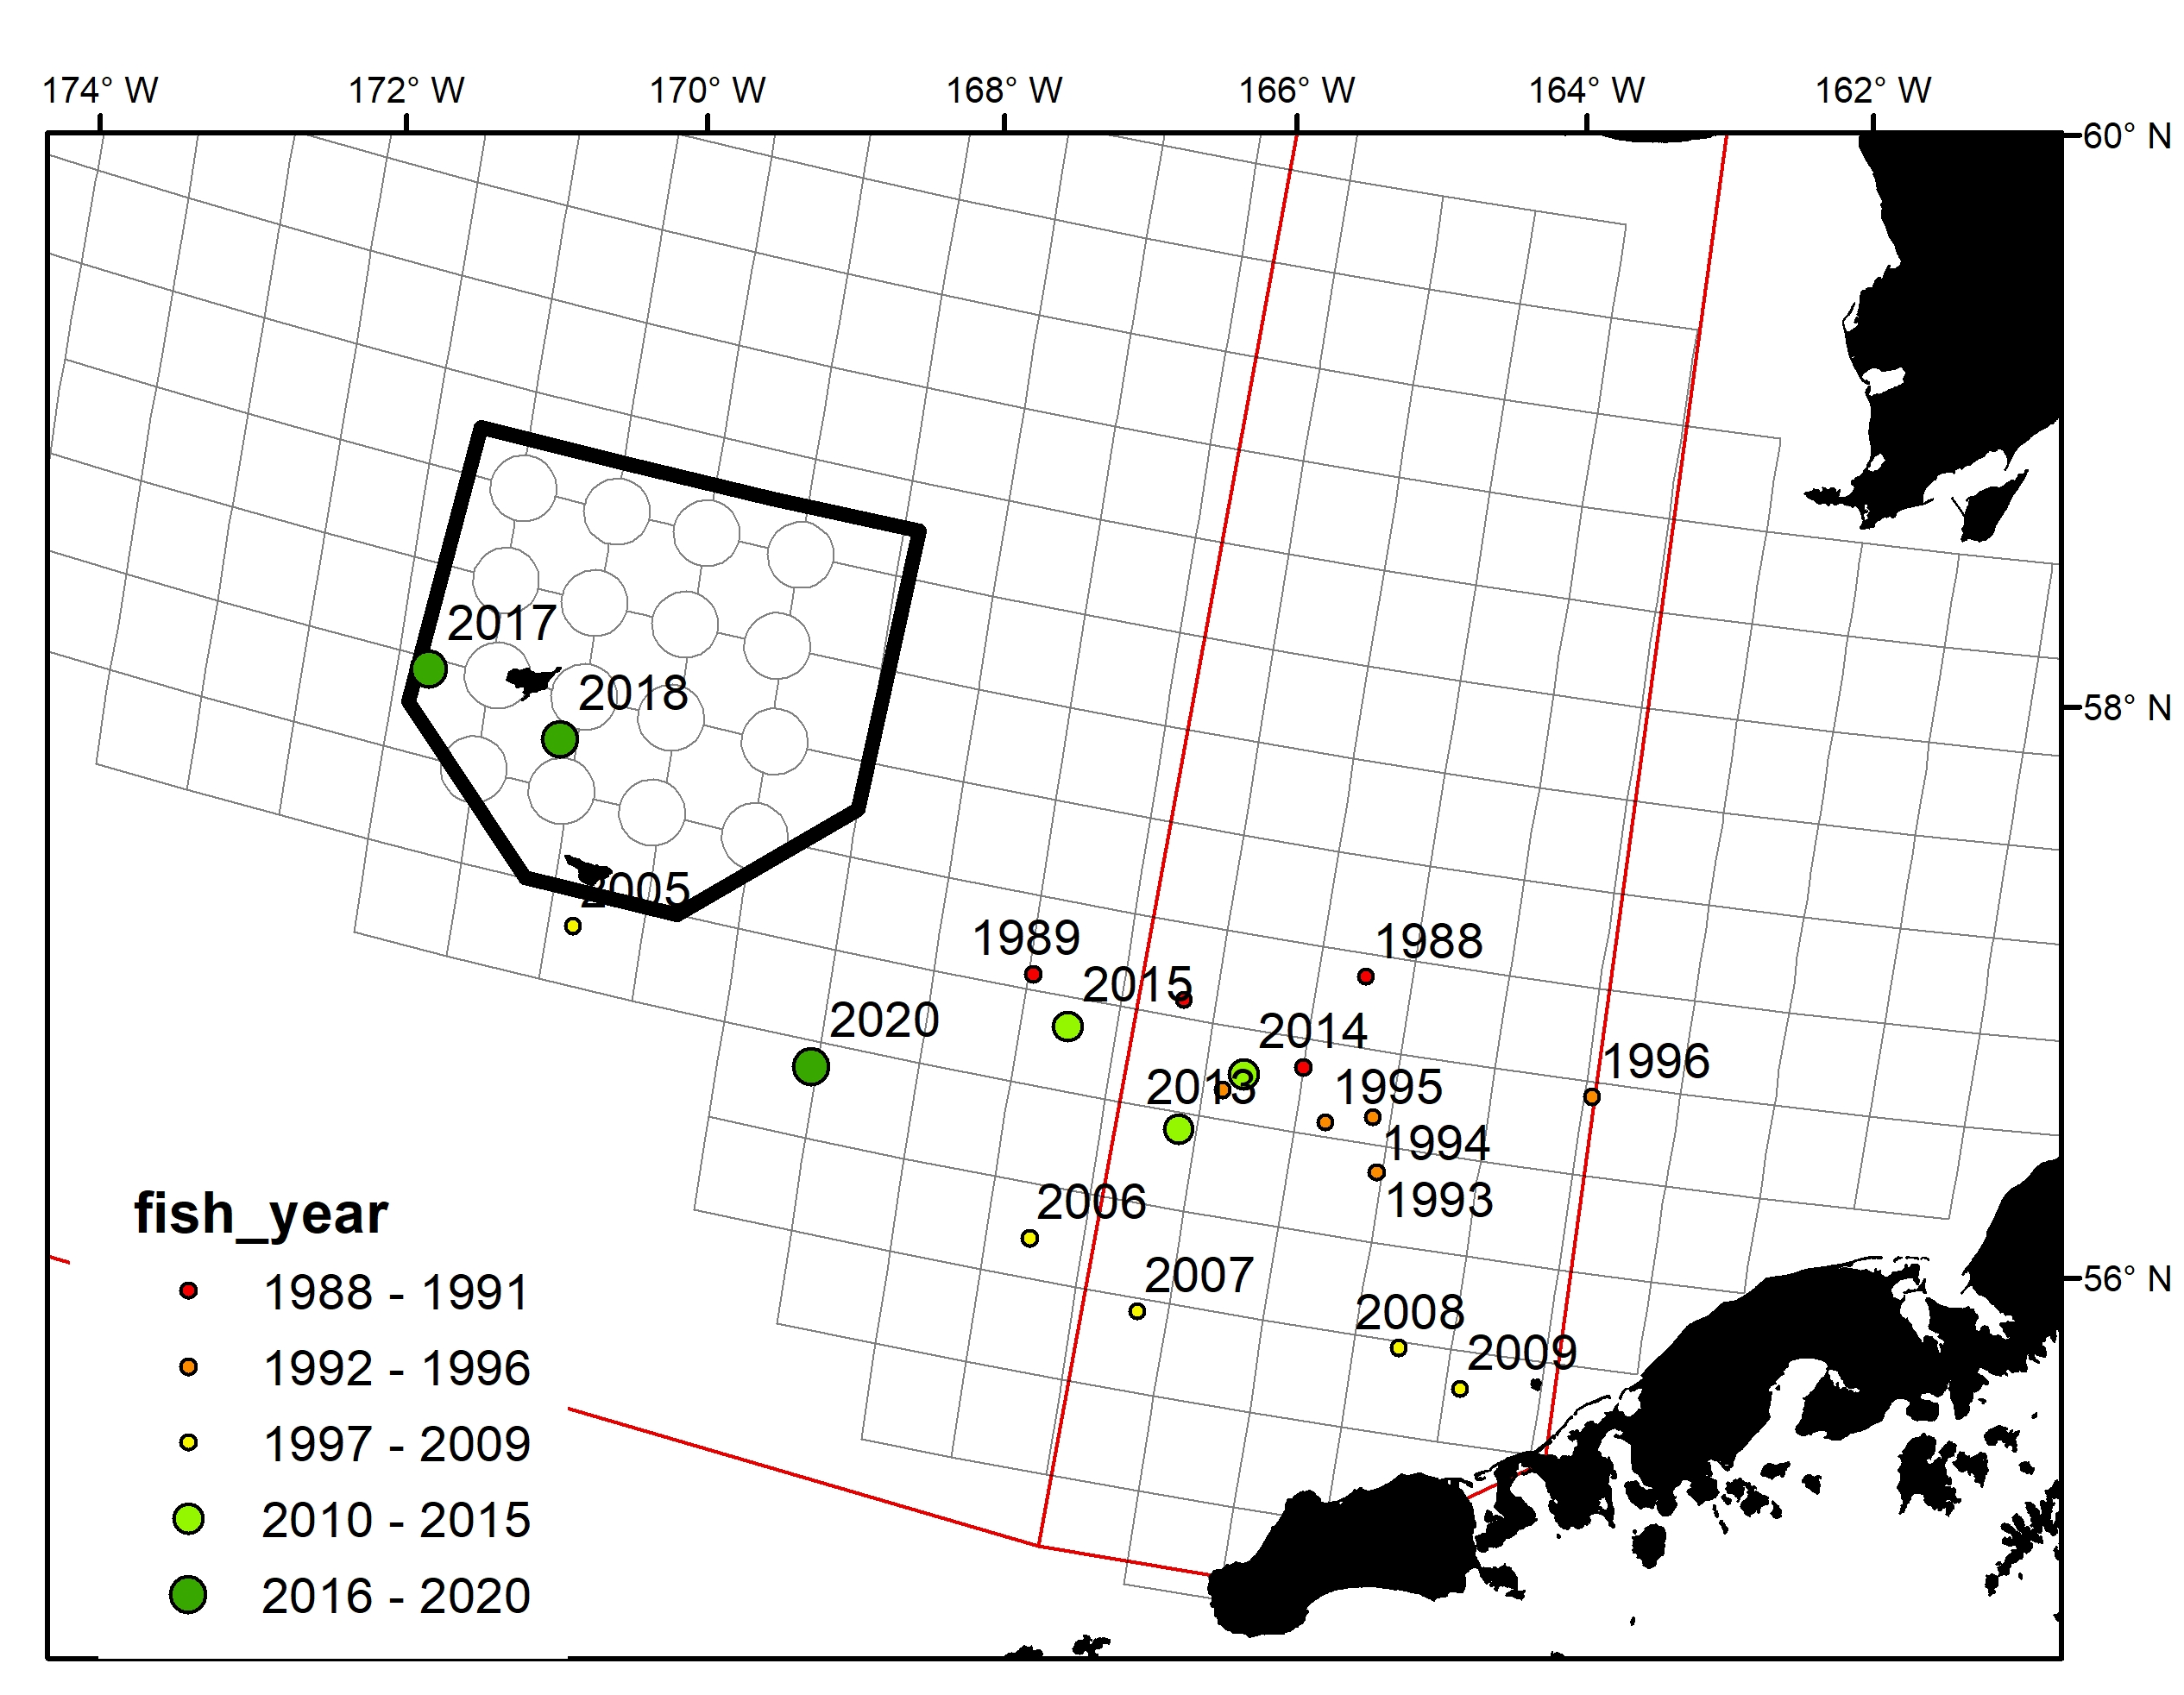
Tanner crab weighted mean centers of catch

Slide 46
2020/21 Tanner crab

Slide 47
2020/21 WBT: observations from the fleet
Captains reported low cpue fishing across most of the WBT grounds, particularly in the fall after BBRKC. Many vessels made one trip and called it quits due to poor fishing.
Good pots of legal crab here and there, but very inconsistent and hard to find steady enough numbers to set back on.

Slide 48
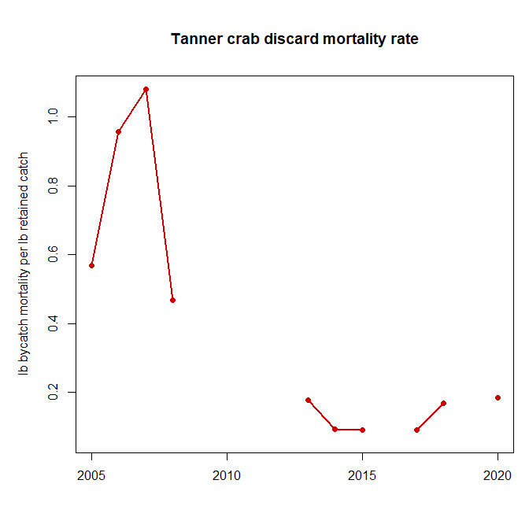

Slide 50
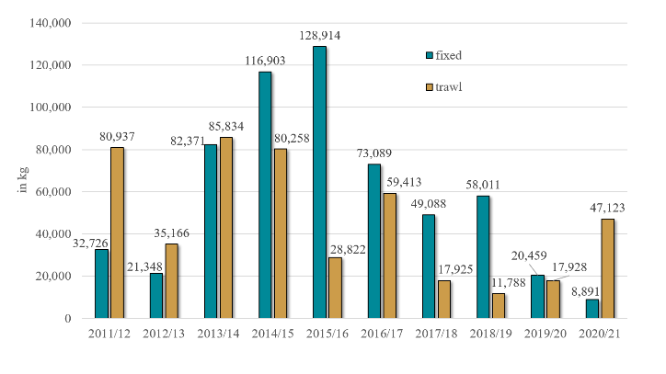
Eastern Bering Sea Tanner Crab Incidental Catch in Groundfish Fisheries (East of 166° W)
Pacific cod fishing with pot gear accounts for most EBST bycatch in the fixed gear category.
Pot Pacific cod fishing is concentrated on the north side of Unimak Island to Port Moller.
Lower EBST rates during the 2020/21 crab year in the fixed gear sectors could be due to:
  Lower observer coverage in the pot Pacific cod fishery in the fall of 2020 due to COVID (although there was EM data in this sector)
  Lower Pacific cod TACs
  Pacific cod pot fleet using more gear with crab excluders

Slide 51
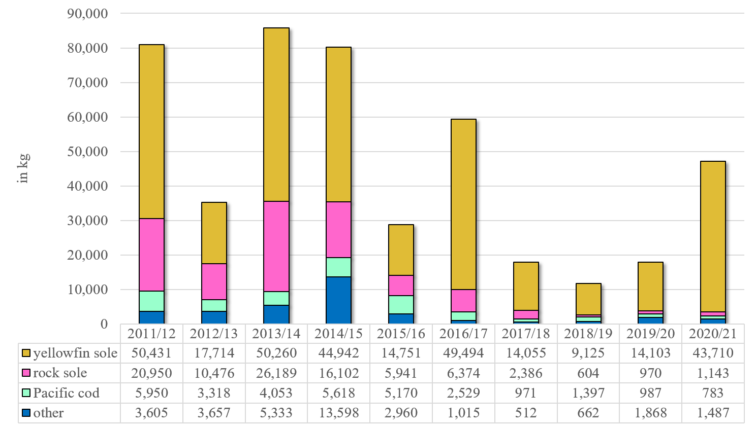
Eastern Bering Sea Tanner Crab Trawl Incidental Catch by Trip Target (East of 166° W)
“Other” species includes: Alaska plaice, arrowtooth flounder, Atka mackerel, flathead sole, Greenland turbot, Kamchatka flounder, other flatfish, Pacific cod, rockfish, sablefish, and pollock.

Slide 52
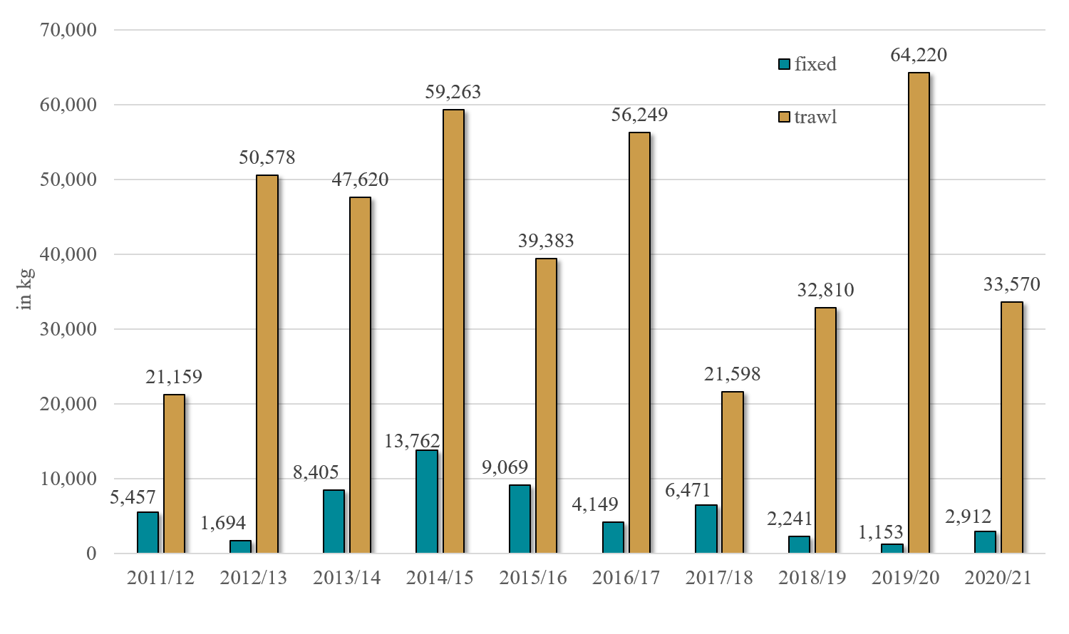
Western Bering Sea Tanner Crab Incidental Catch in Groundfish Fisheries (West of 166° W)
WBST bycatch in fixed gear is mostly from hook-and-line and pot Pacific cod fisheries.
Pot catcher vessels do not fish for groundfish in the WBST stock area as much as in the EBST stock area which results in less fixed gear bycatch in the Western area than the Eastern area.

Slide 53
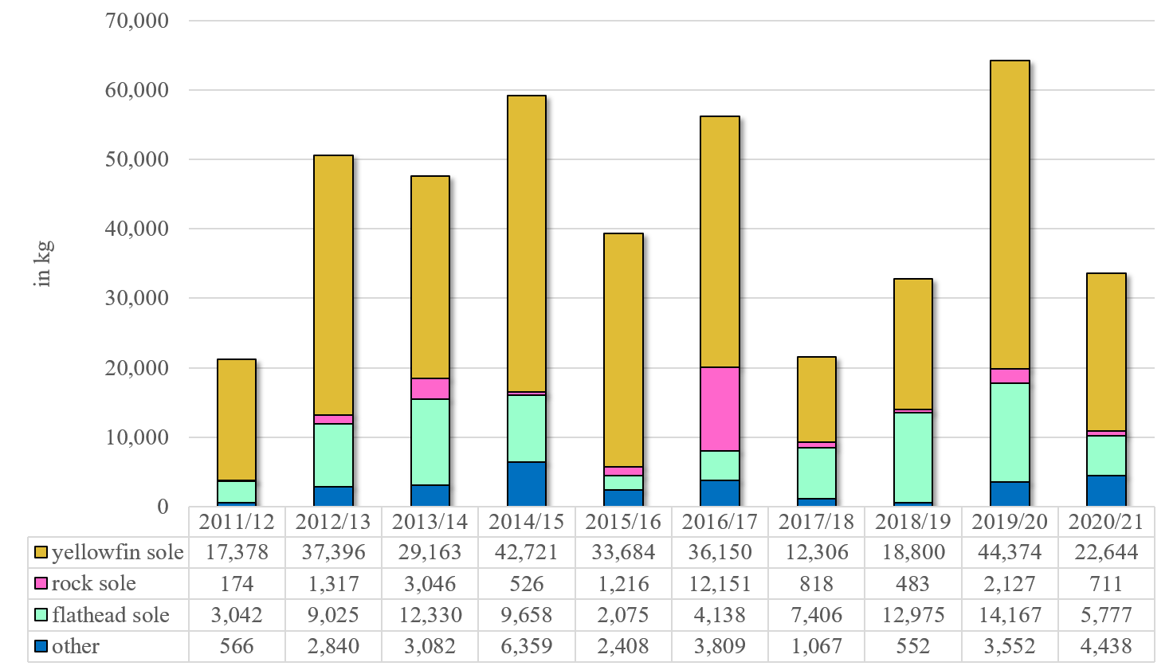
Western Bering Sea Tanner Crab Trawl Incidental Catch by Trip Target (West of 166° W)
“Other” species includes: Alaska plaice, arrowtooth flounder, Atka mackerel, Greenland turbot, Kamchatka flounder, other flatfish, Pacific cod, rockfish, sablefish, and Pollock.

Slide 54
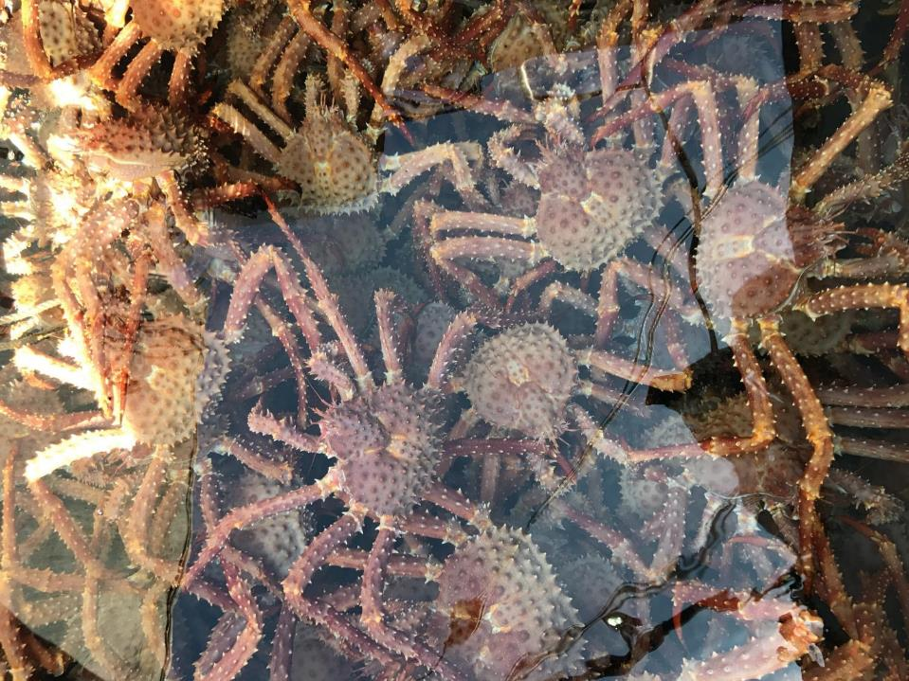
AIGKC

Slide 56
  EAG down from prior season but approximates rationalized time series average
  WAG down from last year and among lowest in rationalized timeseries

Slide 57
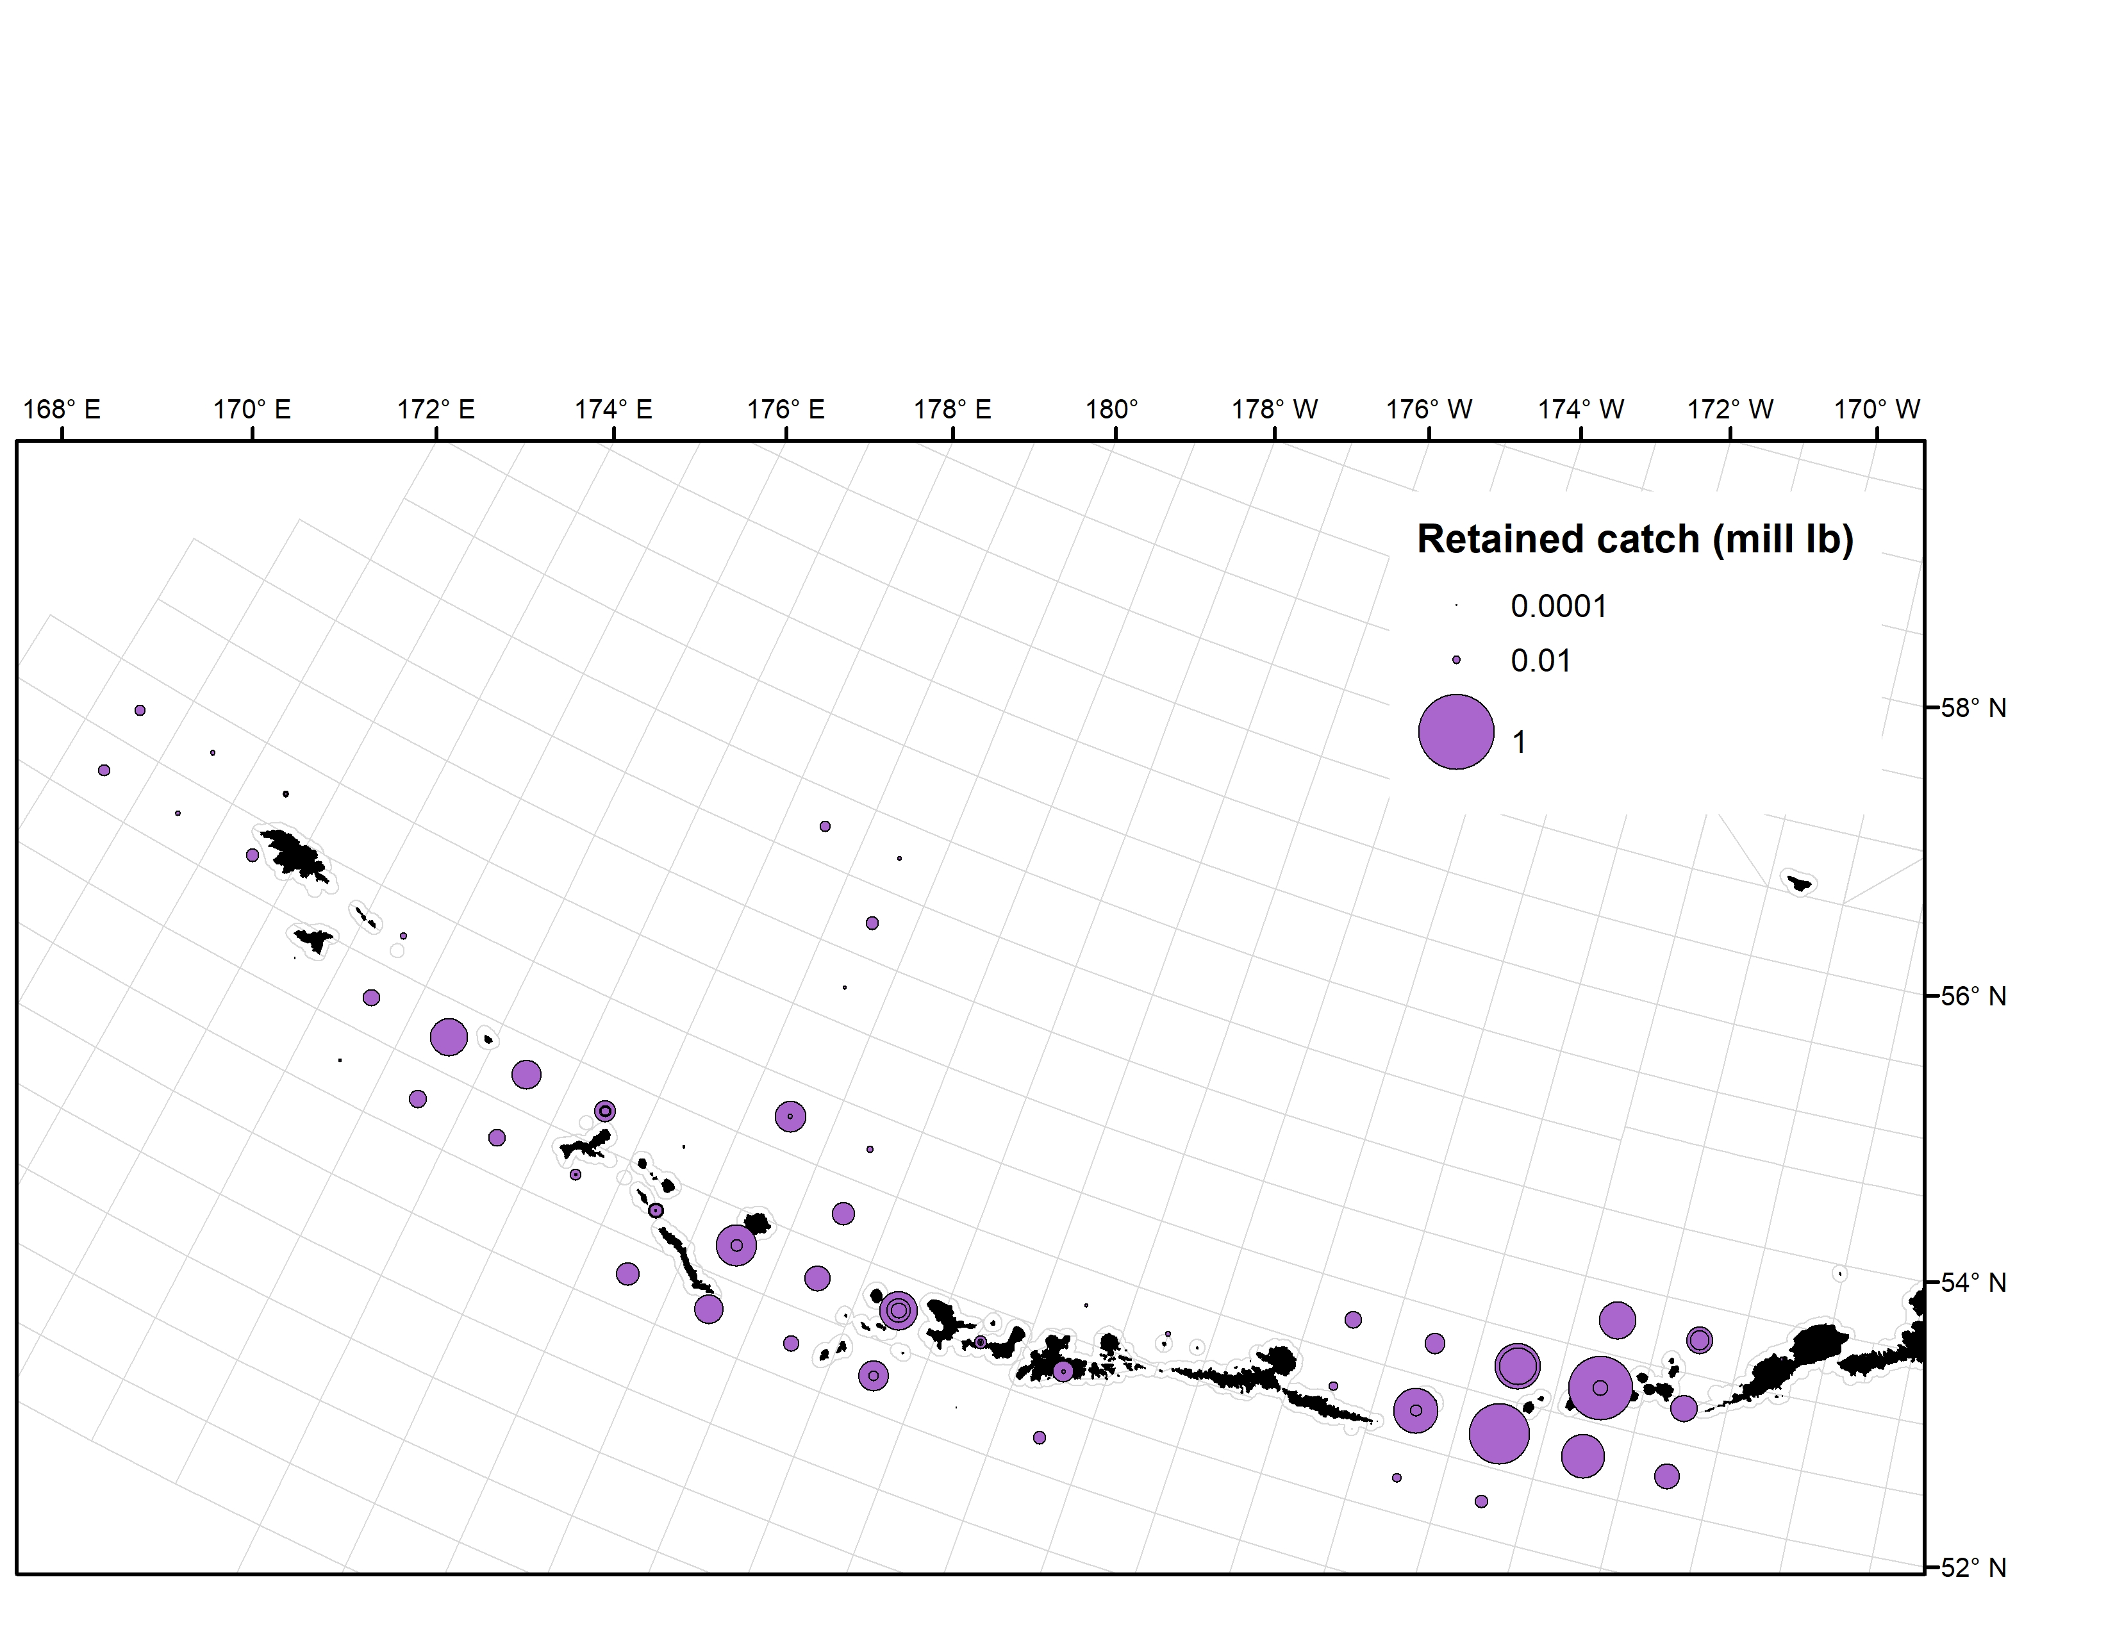
2020/21 Harvest Spatial Distribution

Slide 58
2020/21 AIGKC

Slide 59
AIGKC Average Weights

Slide 60
Bycatch mortality: area specific

Slide 61
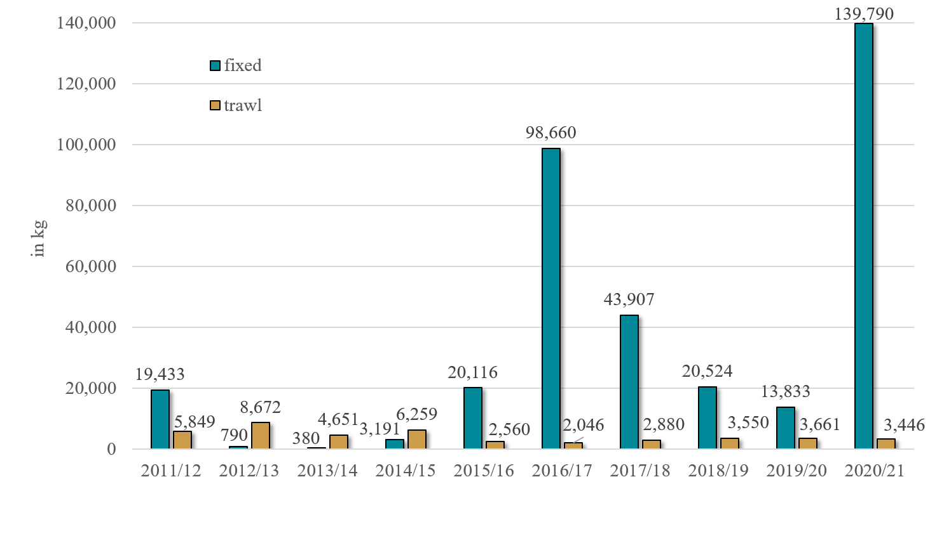
Eastern Aleutian Islands Golden King Crab Incidental Catch in Groundfish Fisheries (East of 174° W)
The EAG stock area includes federal groundfish areas from the WGOA, BS, and AI.
No federal pot Pcod observer coverage so far in 2021.
There is a Pcod State fishery for pot gear which can occur in the Eastern AI stock area and opens early in the year.
When there is no federal pot Pcod observer/EM coverage in the stock area the State pot vessels get an extrapolation rate based on all observed/EM groundfish targeted with pot gear in the stock area, including sablefish.
Rates for the 2020/21 crab year could come down if vessels go to the Western AI to fish Pcod with pot gear later this year.

Slide 62
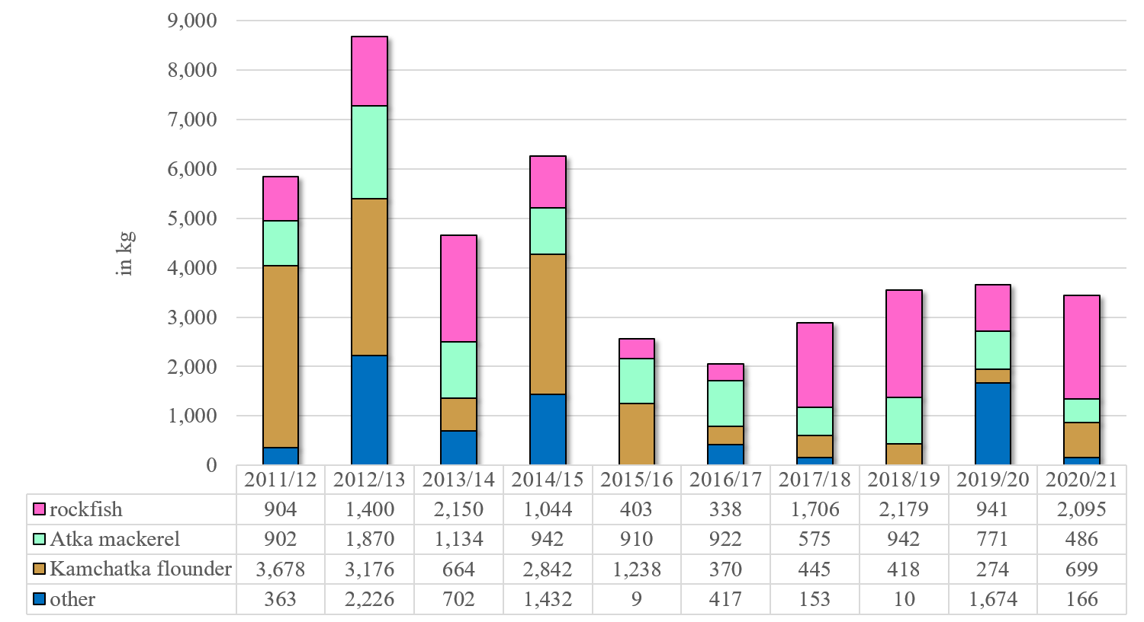
Eastern Aleutian Islands Golden King Crab Trawl Incidental Catch by Trip Target (East of 174° W)
The EAG stock area includes federal groundfish areas from the WGOA, BS, and AI.
Amendment 80 is targeting a variety of species during the same trip in this stock area.
“Other” species includes: Alaska plaice, arrowtooth flounder, Greenland turbot, other flatfish, Pacific cod, flathead sole, rock sole, yellowfin sole, sablefish, and pollock.

Slide 63
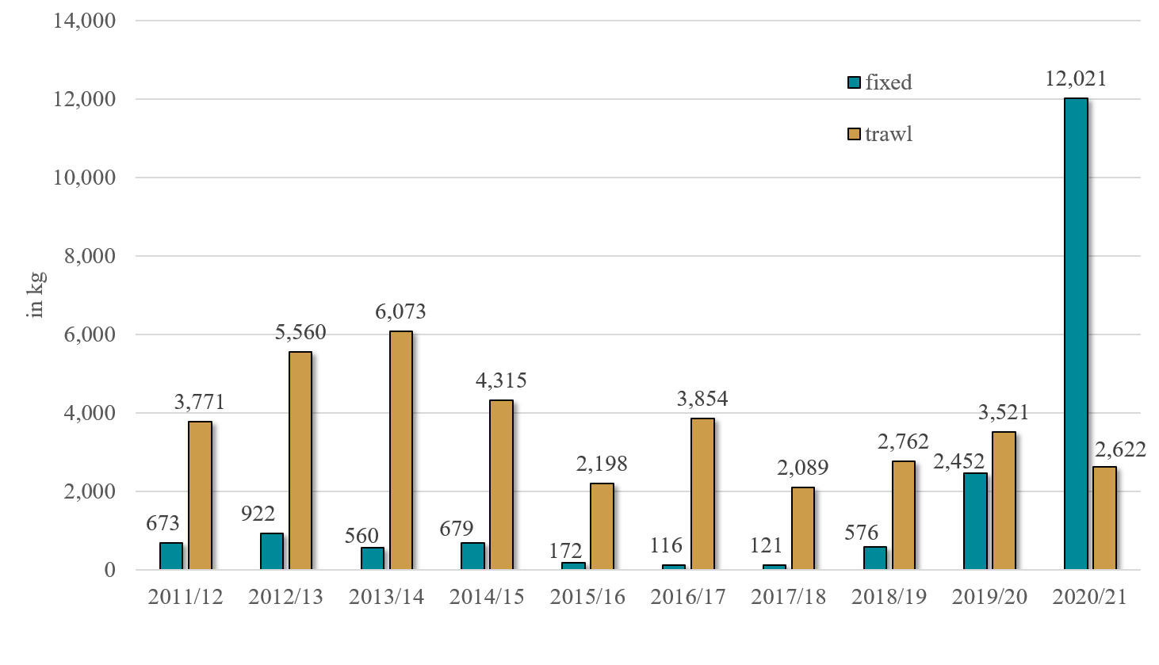
Western Aleutian Islands Golden King Crab Incidental Catch in Groundfish Fisheries (West of 174° W)
Not much federal Pcod fixed gear participation in Western AI stock area in most years.
No federal pot Pcod observer coverage so far in 2021.
There is a Pcod State fishery in the AI for pot, HAL, jig, and trawl gear which opens in January.
When there is no federal pot Pcod observer/EM coverage in the stock area the State pot vessels get an extrapolation rate based on all observed/EM groundfish targeted with pot gear in the stock area, including sablefish.
Rates for the 2020/21 crab year could come down if vessels go to the Western AI to fish Pcod with pot gear later this year.

Slide 64
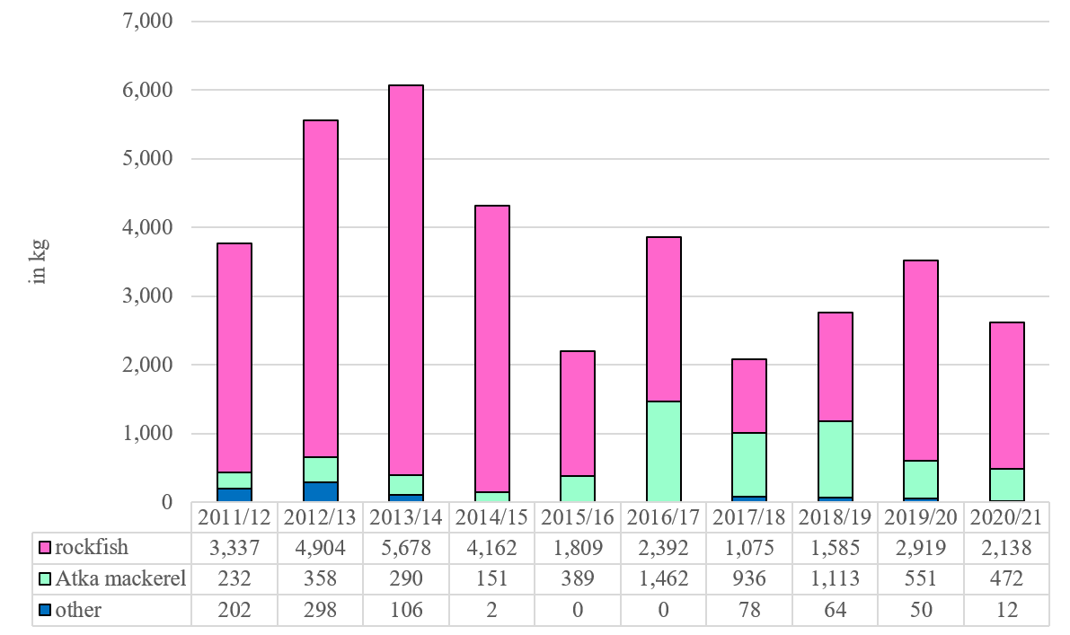
Western Aleutian Islands Golden King Crab Trawl Incidental Catch by Trip Target (West of 174° W)
Most trawl bycatch accrues in the summer months.
“Other” species includes: Kamchatka flounder, Pacific cod, and pollock.

Slide 65
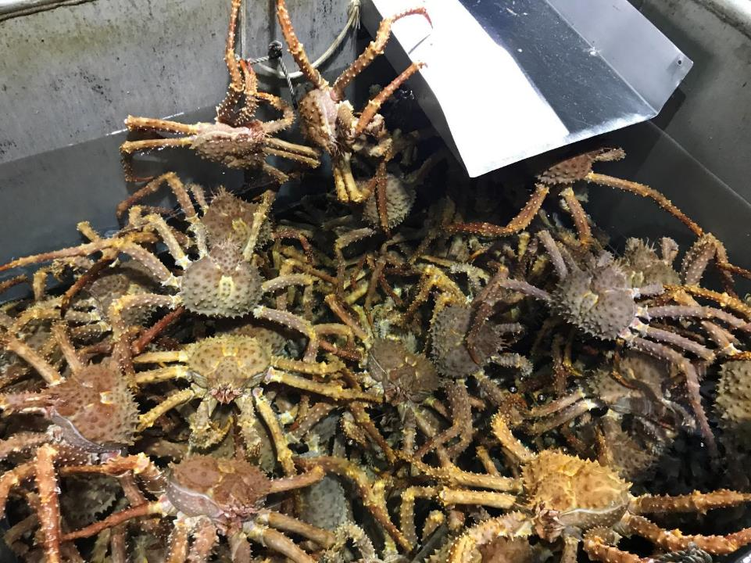
PIGKC

Slide 66
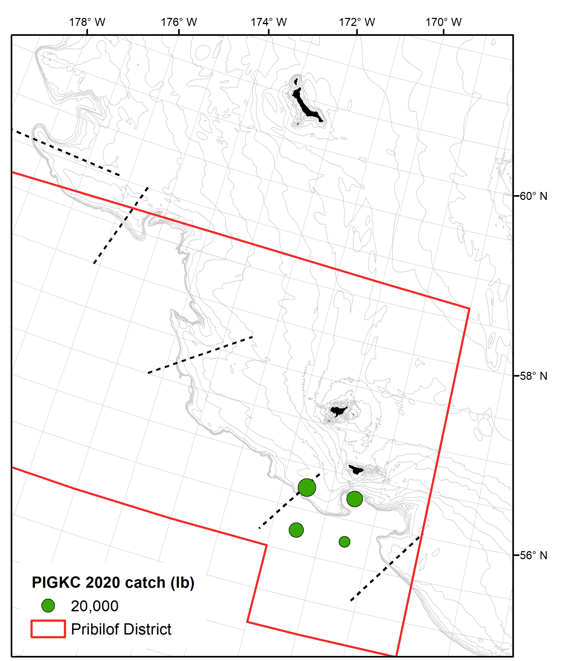
2020 Pribilof GKC
Fishery conducted by calendar year
4 vessels participated in the 2020 fishery
  GHL = 130,000 lb (59 t)
  Harvest = 107,679 lb

Slide 67
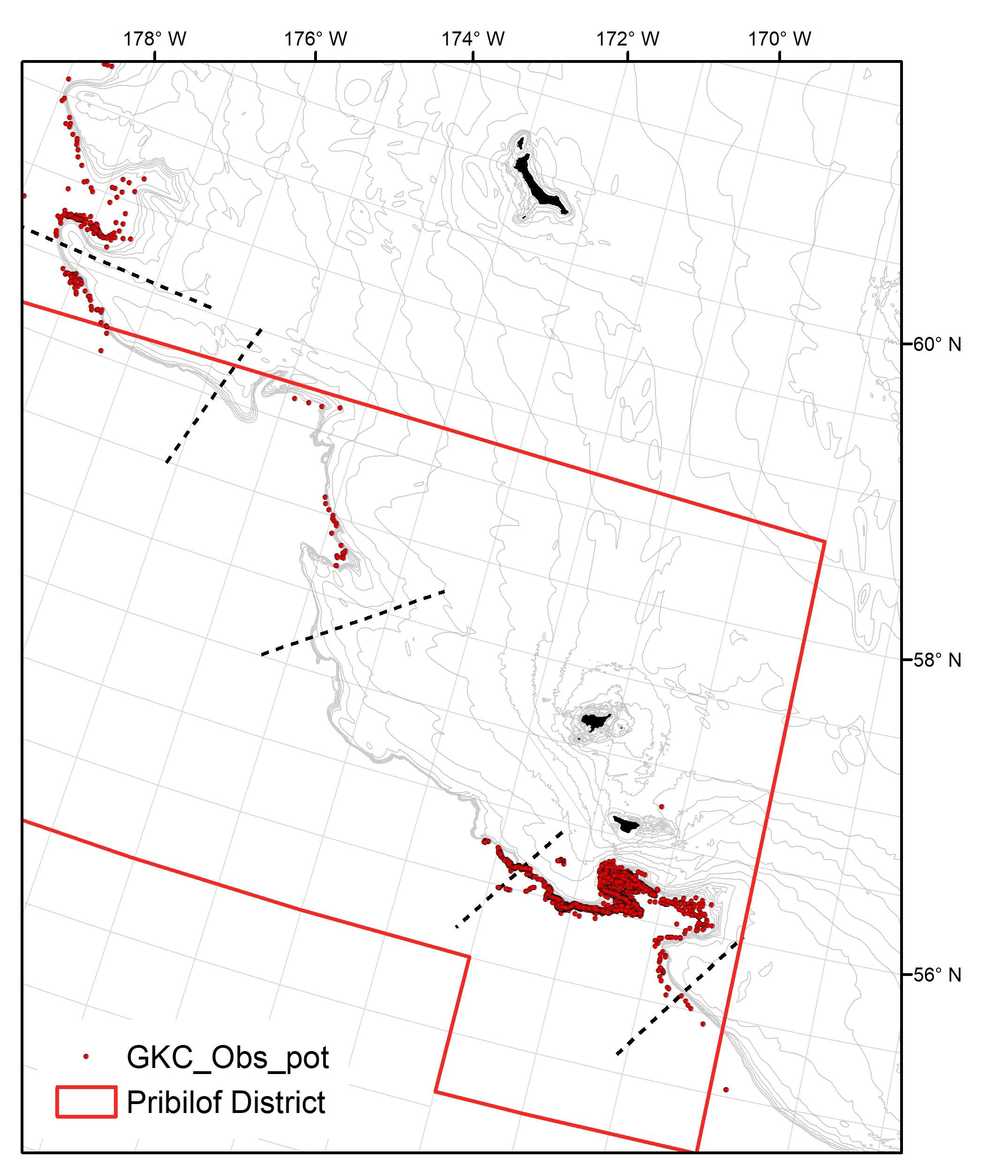
Observer pot location during Bering Sea golden king crab fisheries from 1992-2020 (n=7,747).
Pots north of the Pribilof District northern boundary were fished during the Northern District – Saint Matthew island Section fishery.
~95% of all observer pots

Slide 68
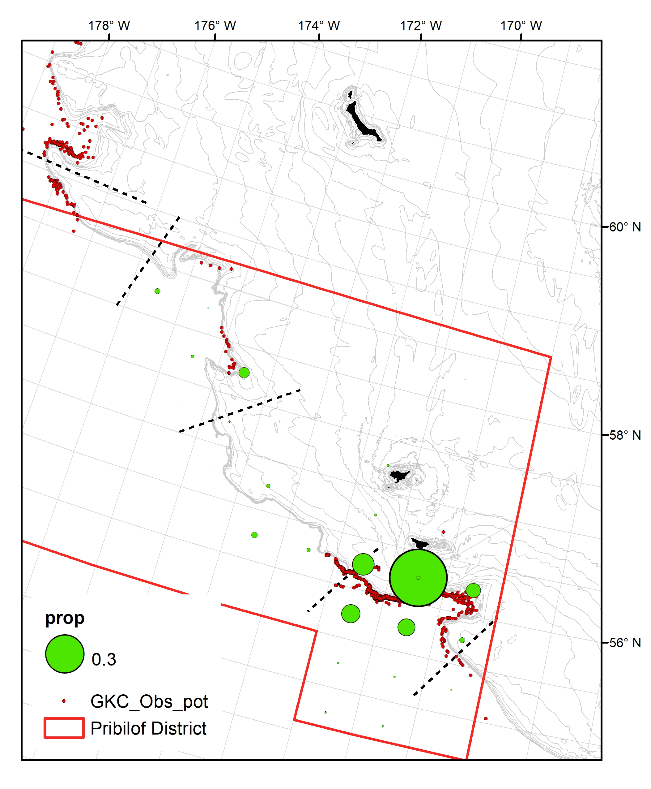
Proportion of historical catch by stat_area
67% of all historical catch

Slide 69
2020 PIGKC

Slide 70
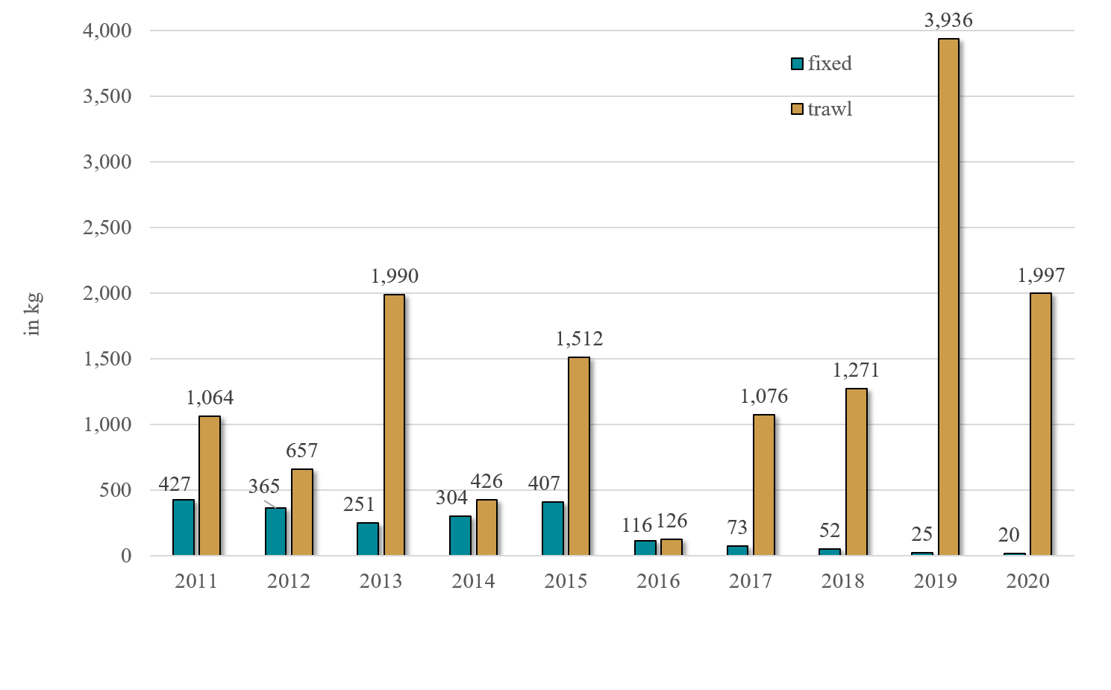
Pribilof Island Golden King Crab Incidental Catch in Groundfish Fisheries
Most fixed gear GKC bycatch is from hook-and-line Pacific cod fishing.

Slide 71
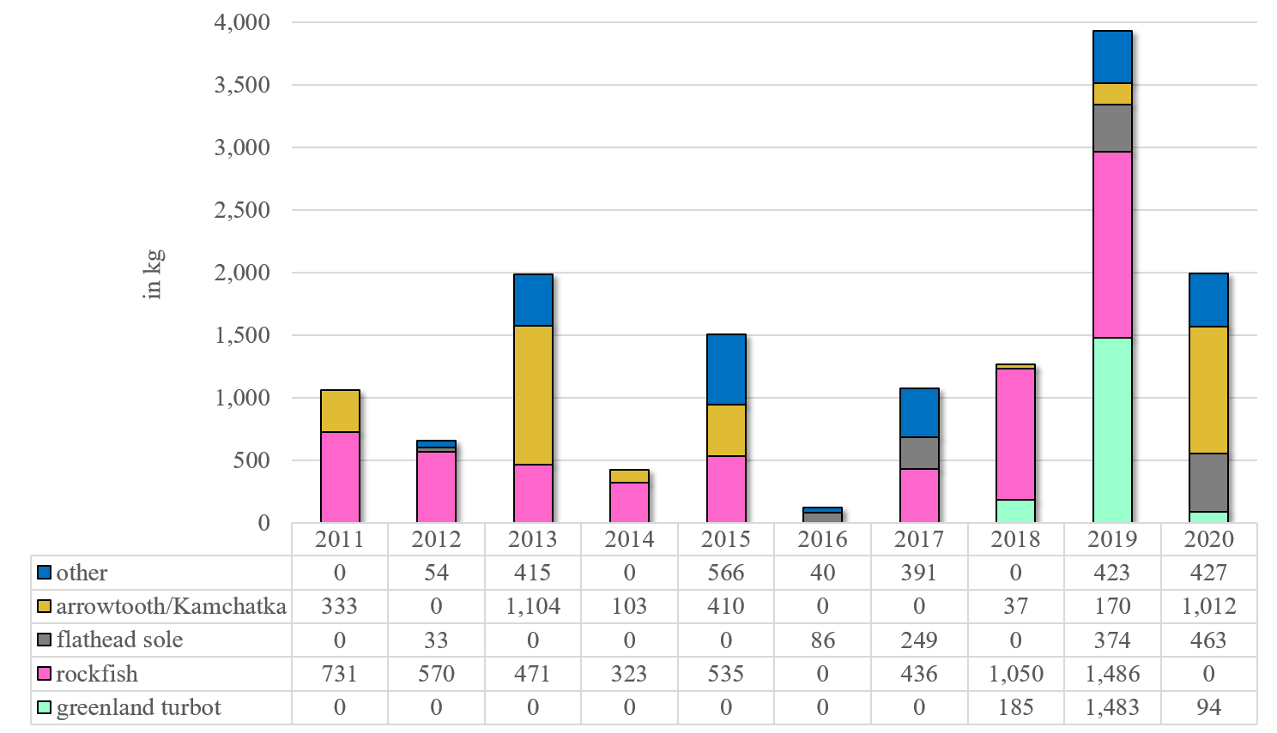
Pribilof Island Golden King Crab Trawl Incidental Catch by Trip Target
“Other” species includes: Alaska plaice, Atka mackerel, other flatfish, Pacific cod, rockfish, rock sole, yellowfin sole, sablefish, and pollock.

Slide 72
Other BSAI crab stocks

Slide 73
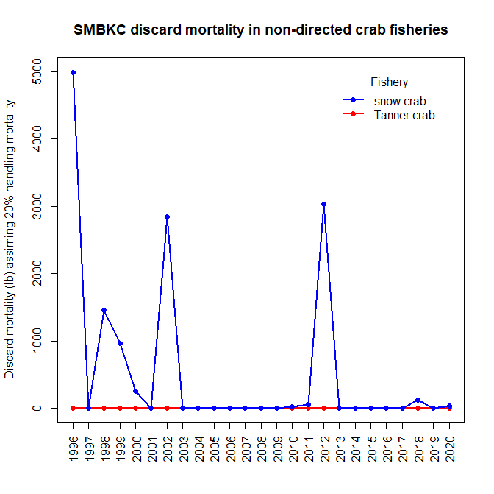
SMBKC: non-directed crab fishery bycatch

Slide 74
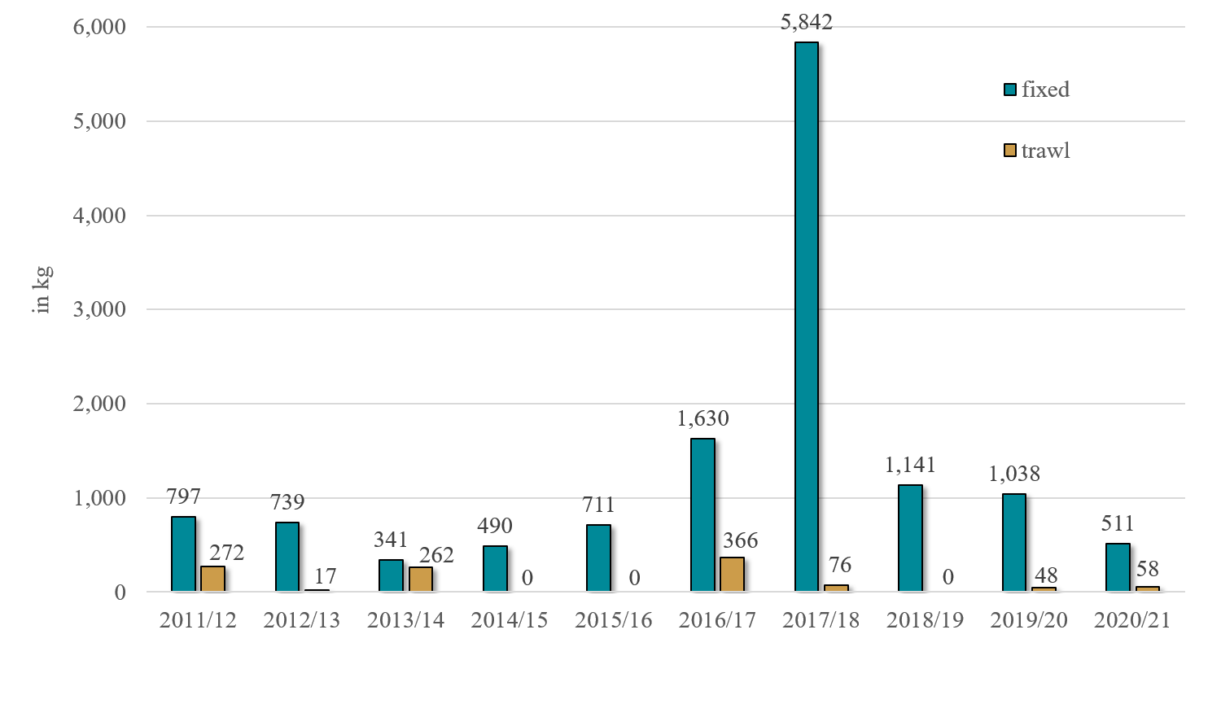
Saint Matthew Islands Blue King Crab Incidental Catch in Groundfish Fisheries
Overfished stock.
Very little trawling in this stock area due to trawl closure areas.
Fixed gear trip targets in this area include halibut, Greenland turbot, sablefish, and Pacific cod.
BKC is usually seen in the Pacific cod trip target for fixed gear (pot and hook-and-line).

Slide 75
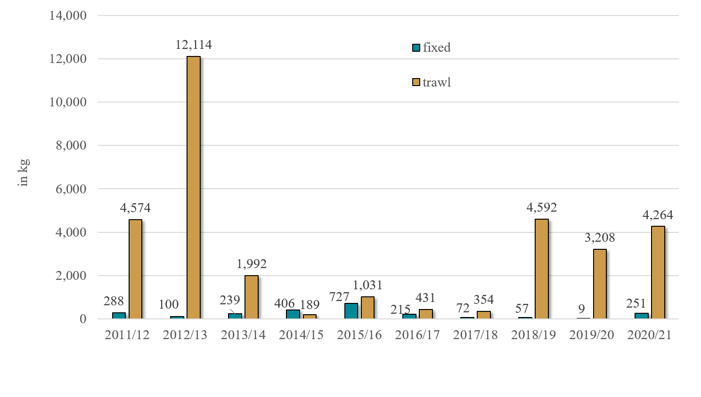

Pribilof Islands Red King Crab Incidental Catch in Groundfish Fisheries
Pot and trawl gear are prohibited in the Pribilof Islands Habitat Conservation Zone which is in place to protect blue king crab.
Most fixed gear fishing in this area is with hook-and-line gear targeting Pacific cod.

Slide 76

Pribilof Islands Red King Crab Trawl Incidental Catch by Trip Target
In the 2020/21 crab year most of the RKC found in the “other” category were during trips with the Alaska Plaice target in March 2021.
“Other” species includes: Alaska plaice, arrowtooth flounder, Atka mackerel, Greenland turbot, Kamchatka flounder, other flatfish, Pacific cod, rockfish, and pollock.

Slide 77

Pribilof Islands Blue King Crab Incidental Catch in Groundfish Fisheries
Pot and trawl gear are prohibited in the Pribilof Islands Habitat Conservation Zone which is in place to protect blue king crab.
Overfished stock.
Overfishing occurred in the 2015/16 crab year.
Most fixed gear fishing in this area is with hook-and-line gear targeting Pacific cod.

Slide 78

Pribilof Islands Blue King Crab Trawl Incidental Catch by Trip Target
During the 2020/21 crab year, trawling occurred in same areas as previous years but no BKC was reported by observers.
“Other” species includes: Alaska plaice, arrowtooth flounder, Atka mackerel, Greenland turbot, Kamchatka flounder, other flatfish, Pacific cod, rockfish, and pollock.

Slide 79

Norton Sound Red King Crab Incidental Catch in Groundfish Fisheries
2009 – 2017: no RKC bycatch in NSRKC stock area
In 2018: 8 kg of RKC bycatch (mortality applied)
In 2019: 13 kg of RKC bycatch (mortality applied)
In 2020: less than 1 kg of
RKC bycatch

Slide 80
Guideline Harvest Level (GHL) Fisheries
GHL fisheries are state waters fisheries managed by ADF&G that occur within 3nm of shore.
GHL fisheries do not have observer or EM coverage requirements.
There are three major GHL fisheries in the BSAI:
  AI sablefish
    Pot, hook-and-line, and jig gear allowed
    Started in 1995
  AI Pacific cod
    Non-pelagic trawl, hook-and-line, jig, and pot gear allowed
    Started in 2006
  Dutch Harbor (DH) subdistrict Pacific cod
    Pot gear allowed
    Started in 2014

Slide 81


Pacific Cod GHL Management Areas and Quotas
AI GHL Pacific cod Management Area
DH Pacific cod Management Area
In 2021 the GHL was 6,804 mt.
Fishery is usually prosecuted in the first part of the calendar year.
Area overlaps with the following crab stock areas:
  Western AI red king crab
  Western AI golden king crab
  Eastern AI golden king crab
In 2021 the GHL was 12,379 mt.
Fishery is usually prosecuted in the first part of the calendar year.
Area overlaps with the following crab stock areas:
  Eastern AI golden king crab
  Eastern Bering Sea Tanner crab
  Bristol Bay red king crab
  Bering Sea snow crab
In 2021 the three federal pot Pacific cod TACs in the BSAI were a total of 14,945 mt

Slide 82
Impact of GHL Fisheries on Crab Estimates
Eastern AI Golden King Crab (EAIGKC) Bycatch
GHL fisheries contribute to the majority of fixed gear crab bycatch in the EAIGKC and WAIGKC areas.
GHL pot cod fisheries also contribute to crab bycatch in the Bristol Bay red king crab, Bering Sea snow crab, Aleutian Islands red king crab, and Eastern Bering Sea Tanner crab areas.
In the Aleutian Islands there is very little federal fixed gear fishing for groundfish.
GHL vessels in the AI using fixed gear receive a rate extrapolated from federal observer/EM coverage which is limited.
For example, in 2021 there have not been any observer/EM trips for pot Pacific cod. As a result AI GHL vessels received a rate based on bycatch in the pot sablefish fishery.

Slide 83
2020/21 Estimated Fixed Gear Crab Bycatch From GHL Fisheries
Crab Year | Stock Area | Estimated Fixed Gear Crab Bycatch in GHL Fisheries | Estimated Fixed Gear Crab Bycatch in Federal Fisheries | Estimated Total Fixed Gear Crab Bycatch | % From GHL Fisheries
2020/21 | AIR | 0 | 0 | 0 | NA
2020/21 | BSS | 1,836 | 18,322 | 20,157 | 9%
2020/21 | EBT | 2,346 | 6,545 | 8,891 | 26%
2020/21 | BBR | 986 | 5,154 | 6,140 | 16%
2020/21 | WAG | 11,371 | 648 | 12,019 | 95%
2020/21 | EAG | 114,112 | 25,543 | 139,654 | 82%
GHL fisheries receive extrapolated rates from vessels mostly fishing in federal waters.
Some crab species may be more prevalent in federal waters than in state waters.
AIGKC bycatch in the GHL fisheries is likely inaccurate due to a lack of federal observer/EM data in the stock areas.
The Alaska Region is recommending we discontinue extrapolating crab bycatch to GHL fisheries.

Slide 84

Thank you
Photo courtesy of Sam Zmolek

