Slide 1
2021 assessment for eastern Bering Sea snow crab
September 13, 2021

Slide 2
Updated SAFE
Typos—mostly years
Clarification on status and MMB in Table 10
Revision of last row of table 11

Slide 3
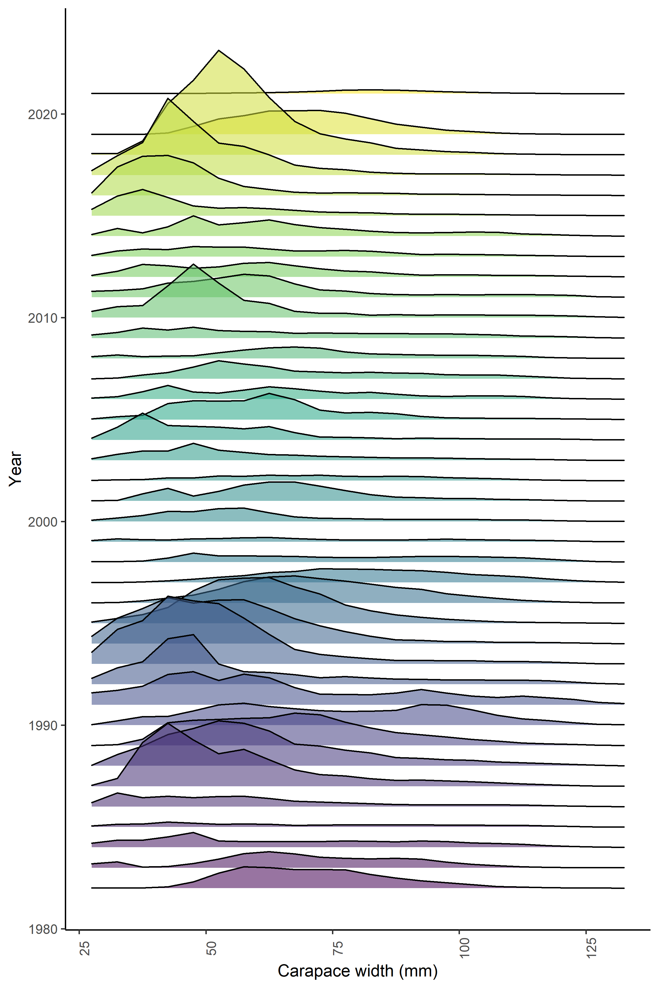
Record lows Maturity What happened?
The drop in observed numbers of male crab at size from 2018 to 2019 was even more severe in 2021.

Slide 4
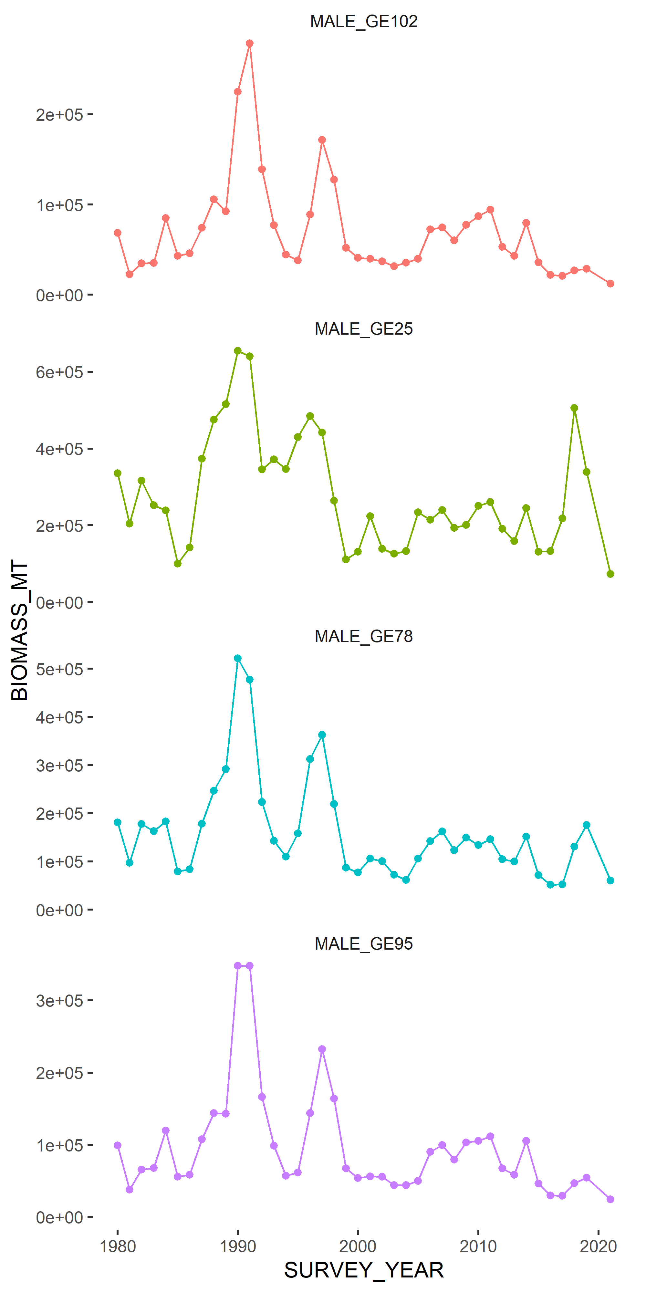
Record lows Maturity What happened?
Nearly every size grouping is at all time lows.
Size group | Current biomass (kt) | Previous low (kt) | Overfished declaration (1999)
>101 mm | 12.4 | 20.7 (2016) | 52.0
>24 mm | 73.5 | 99.8 (1985) | 111.5
>77 mm | 60.1 | 51.7 (2016) | 87.1
>94 mm | 24.4 | 29.4 (2016) | 67.4

Slide 5
Record lows Maturity What happened?
Allowing for a more flexible survey selectivity produces probabilities of maturing more similar to observed…but reference points are impacted.

Slide 6
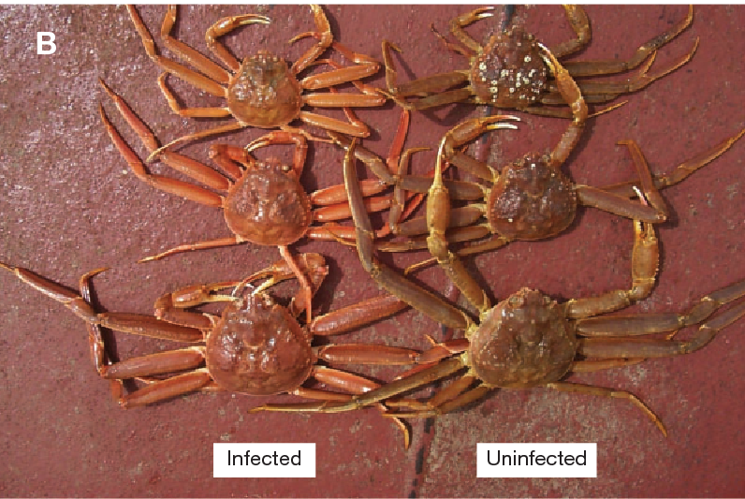
Record lows Maturity What happened?
Likely a combination of factors.
Bitter crab syndrome?
Cod predation?
No cold pool?

Slide 7
Record lows Maturity What happened?
Females are in the same boat.
Cod predation?

Slide 8
CIE REVIEW
March 22, 2021
Dr. Yong Chen
  University of Maine
  American lobster, shrimp
Dr. Nick Caputi
  Australia
  Rock lobster, prawn
Dr. Billy Ernst
  University of Concepcion
  Bering Sea snow crab

Slide 9
Key recommendations
GMACS is great; incorporate more functionality
  Matthieu Veron, new GMACS postdoc
    Documentation
    Help with NSRKC
Retrospective patterns
  Time-variation in M and q in May CPT (and again here, but with a different implementation)
Data re-weighting + selectivity patterns
  Tried two methods here
Spatio-temporal modeling
  Maxime Olmos
    spatial snow crab assessment (present in January)
    Management strategy evaluation with spatial operating models (starting soon)

Slide 10
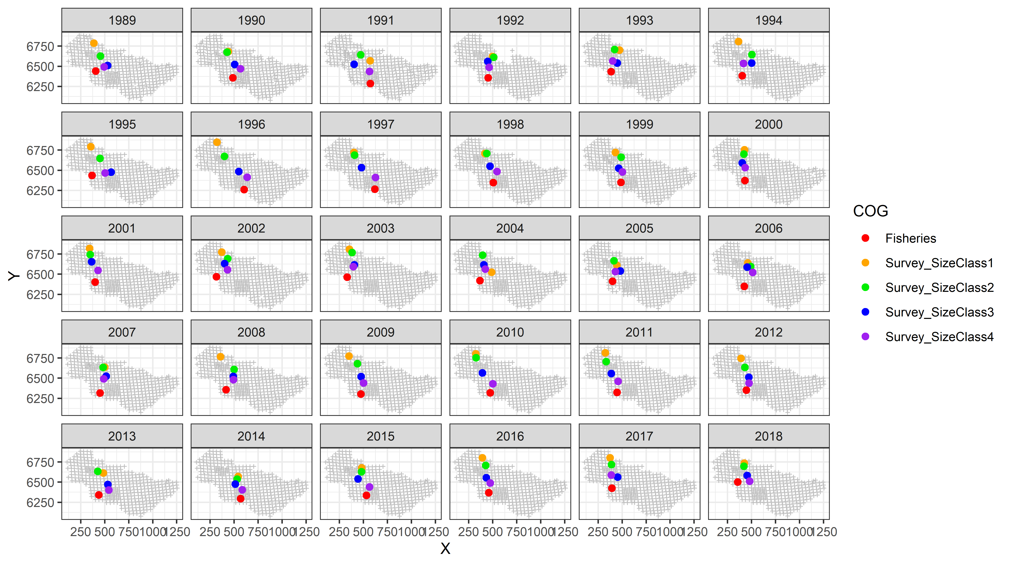

Slide 11
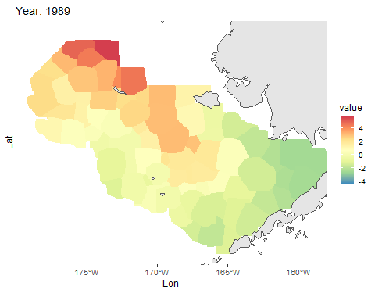

Slide 12
Models considered

Slide 13
Status quo model with updated data did not converge
Availability and natural mortality parameters had large gradients
Size composition re-weighting was recommended by CPT, SSC, CIE
  Tried both McAllister-Ianelli (1998) and Francis (2011) reweighting for size composition, but neither produced viable models (for slightly different reasons)
No GMACS model—time-varying M doesn’t work with terminal molt yet

Slide 14
Status quo model with updated data did not converge
Availability and natural mortality parameters had large gradients
Size composition re-weighting was recommended by CPT, SSC, CIE
  Tried both McAllister-Ianelli (1998) and Francis (2011) reweighting for size composition, but neither produced viable models (for slightly different reasons)
No GMACS model—time-varying M doesn’t work with terminal molt yet

Slide 15
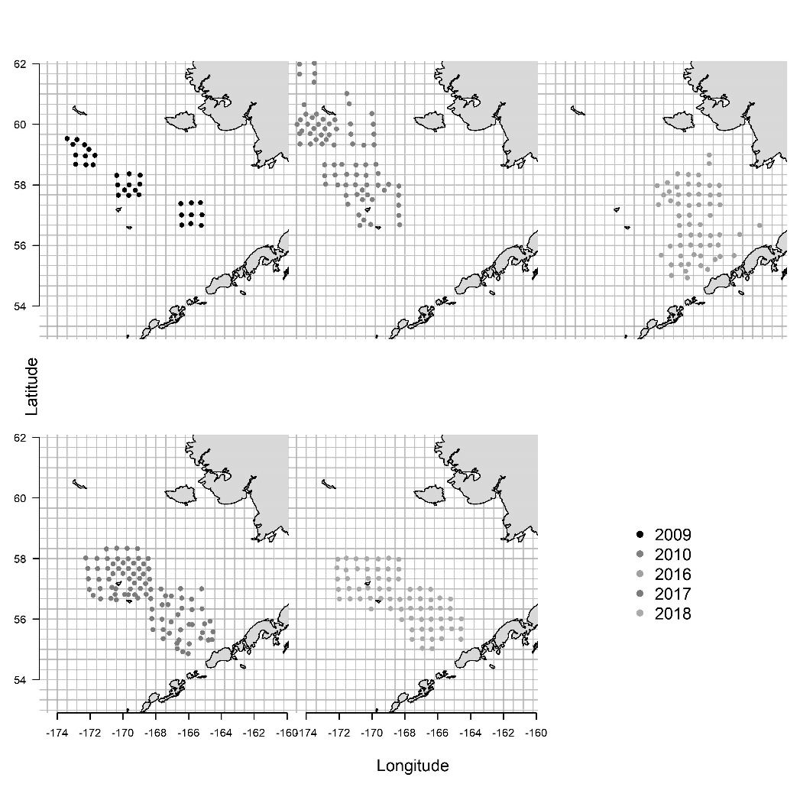
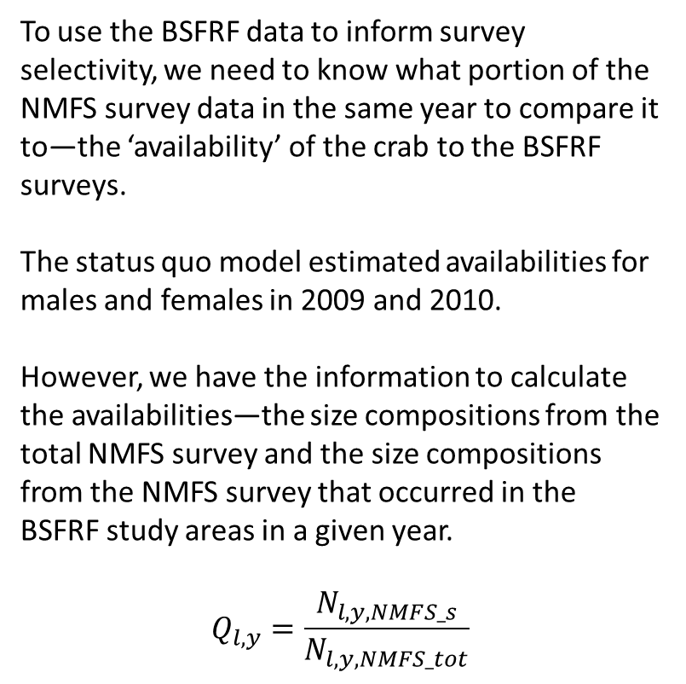
Empirical availability
To use the BSFRF data to inform survey selectivity, we need to know what portion of the NMFS survey data in the same year to compare it to—the ‘availability’ of the crab to the BSFRF surveys.
The status quo model estimated availabilities for males and females in 2009 and 2010.
However, we have the information to calculate the availabilities—the size compositions from the total NMFS survey and the size compositions from the NMFS survey that occurred in the BSFRF study areas in a given year.
$$Q_{l,y}=\frac{N_{l,y,NMFS_s}}{N_{l,y,NMFS_tot}}$$

Slide 16
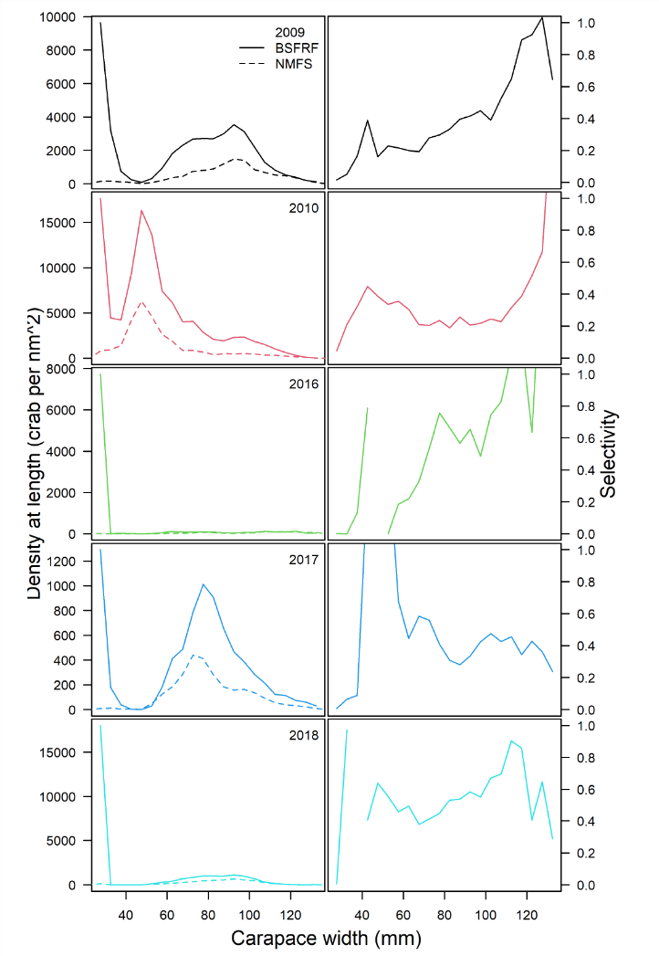
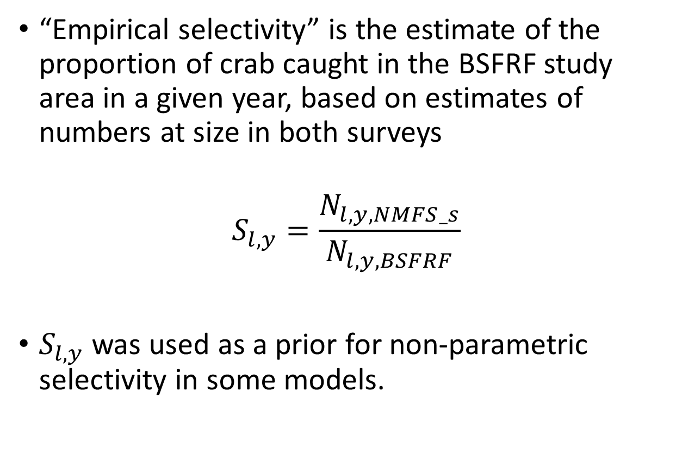
Empirical selectivity
“Empirical selectivity” is the estimate of the proportion of crab caught in the BSFRF study area in a given year, based on estimates of numbers at size in both surveys
$$S_{l,y}=\frac{N_{l,y,NMFS_s}}{N_{l,y,BSFRF}}$$
$S_{l,y}$ was used as a prior for non-parametric selectivity in some models.

Slide 17
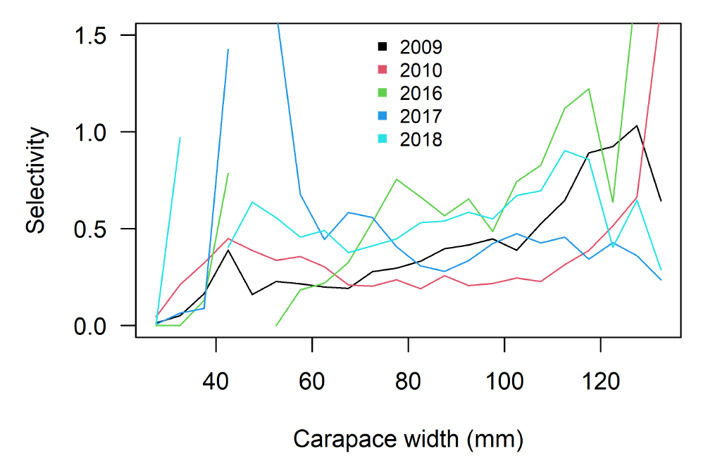
Empirical selectivity

Slide 18
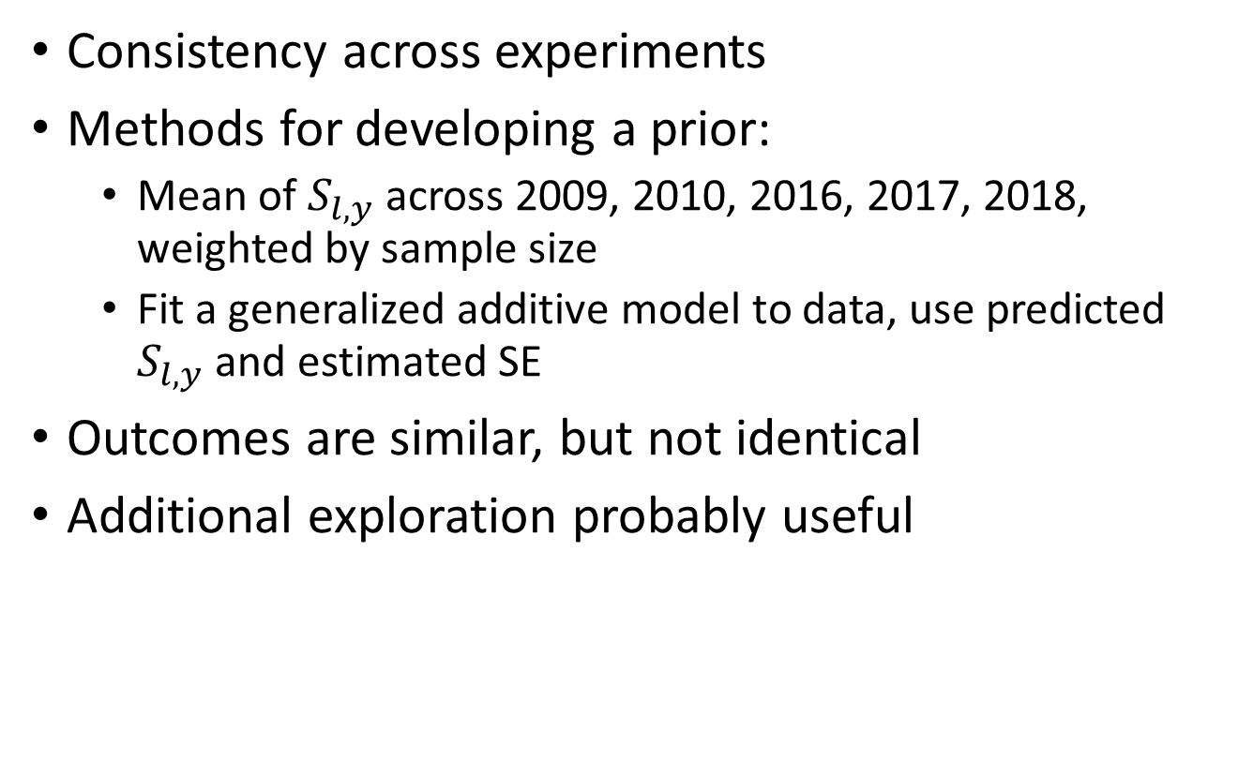
Empirical selectivity
Consistency across experiments
Methods for developing a prior:
  Mean of $S_{l,y}$ across 2009, 2010, 2016, 2017, 2018, weighted by sample size
  Fit a generalized additive model to data, use predicted $S_{l,y}$ and estimated SE
Outcomes are similar, but not identical
Additional exploration probably useful

Slide 19
Size composition reweighting
Size composition reweighting ‘balances’ the contribution of size composition data in the model.
Francis and McAllister-Ianelli methods attempted
M-I converged to stable weightings, but the models ran with those weights did not converge (max gradient >>0.01)
Francis did not converge to stable weightings, the size composition data were essentially removed from the objective function.

Slide 20
Mortality events
############################
## time-varying natural mortality specs
#############################
# use_extra_m_imm : extra immature mortality added?
1
# extra_m_phase_imm : phase
5
# extra_m_len_imm_n : number of years of extra imm
2
# extra_m_yr_imm : what years have extra mortality?
2018 2019
# use_extra_m_mat : extra mature mortality added?
1
# extra_m_phase_mat : phase
5
# extra_m_len_mat_n : number of years of extra mature m
2
# extra_m_yr_mat : what years have extra mortality?
2018 2019
Transformed M to an array with dimensions for sex, maturity, and year
Specify years for mortality (2018, 2019)
All classes of M allow additional mortality in those year
  Immature
  Mature female
  Mature male
Estimated as bounded numbers between 0 and 4

Slide 21
Model overview
July 1
Survey
Logistic selectivity in 2 ‘eras’
Linked to BSFRF data
Size composition and biomass index
7.5/12 M
Directed fishery
Non-directed fishery
Mating
4.5/12 M
Molting
Growth
Recruitment

Slide 22
Model overview
Survey
Mature males, immature for both sexes, mature females
Estimated with a prior
7.5/12 M
Directed fishery
Non-directed fishery
Mating
4.5/12 M
Molting
Growth
Recruitment

Slide 23
Model overview
Survey
7.5/12 M
Directed fishery
Logistic selectivity
Retention selectivity
Discard mortality equal to 30%
Fit to:
Retained length comps
Total length comps
Retained biomass
Male and female discard biomass
Non-directed fishery
Mating
4.5/12 M
Molting
Growth
Recruitment

Slide 24
Model overview
Survey
7.5/12 M
Directed fishery
Non-directed fishery
Logistic selectivity
Discard mortality equal to 80%
Mating
4.5/12 M
Molting
Growth
Recruitment

Slide 25
Model overview
Survey
7.5/12 M
Directed fishery
Non-directed fishery
Mating
Freely estimated maturity curves
February 15
4.5/12 M
Molting
Growth
Recruitment

Slide 26
Model overview
Survey
7.5/12 M
Directed fishery
Non-directed fishery
Mating
4.5/12 M
Molting
All immature crab assumed to molt
Terminal molt to maturity
Growth
Recruitment

Slide 27
Model overview
Survey
7.5/12 M
Directed fishery
Non-directed fishery
Mating
4.5/12 M
Molting
Growth
Linear growth estimated outside of the model for both sexes
Recruitment

Slide 28
Fits to data
Data source | 21.1a | 21.2 | 21.3
Survey biomass |  | X | X
Growth
Catch
Retained size comp
Total size comp
Bycatch size comp
BSFRF size comp
Survey size comp (imm M)
Survey size comp (imm F)
Survey size comp (mat M)
Survey size comp (mat F)

Slide 29
Fits to data
Data source | 21.1a | 21.2 | 21.3
Survey biomass |  | X | X
Growth
Catch
Retained size comp
Total size comp
Bycatch size comp
BSFRF size comp
Survey size comp (imm M)
Survey size comp (imm F)
Survey size comp (mat M)
Survey size comp (mat F)
Model estimates of MMB are lower than the observed…why is that?

Slide 30
2021

Slide 31
Fits to data
Data source | 21.1a | 21.2 | 21.3
Survey biomass |  | X | X
Growth | ~ | ~ | ~
Catch
Retained size comp
Total size comp
Bycatch size comp
BSFRF size comp
Survey size comp (imm M)
Survey size comp (imm F)
Survey size comp (mat M)
Survey size comp (mat F)

Slide 32
Fits to data
Data source | 21.1a | 21.2 | 21.3
Survey biomass |  | X | X
Growth | ~ | ~ | ~
Catch | ~ | ~ | ~
Retained size comp
Total size comp
Bycatch size comp
BSFRF size comp
Survey size comp (imm M)
Survey size comp (imm F)
Survey size comp (mat M)
Survey size comp (mat F)

Slide 33
Fits to data
Data source | 21.1a | 21.2 | 21.3
Survey biomass |  | X | X
Growth | ~ | ~ | ~
Catch | ~ | ~ | ~
Retained size comp | ~ | ~ | ~
Total size comp
Bycatch size comp
BSFRF size comp
Survey size comp (imm M)
Survey size comp (imm F)
Survey size comp (mat M)
Survey size comp (mat F)

Slide 34
Fits to data
Data source | 21.1a | 21.2 | 21.3
Survey biomass |  | X | X
Growth | ~ | ~ | ~
Catch | ~ | ~ | ~
Retained size comp | ~ | ~ | ~
Total size comp | ~ | ~ | ~
Bycatch size comp
BSFRF size comp
Survey size comp (imm M)
Survey size comp (imm F)
Survey size comp (mat M)
Survey size comp (mat F)

Slide 35
Fits to data
Data source | 21.1a | 21.2 | 21.3
Survey biomass |  | X | X
Growth | ~ | ~ | ~
Catch | ~ | ~ | ~
Retained size comp | ~ | ~ | ~
Total size comp | ~ | ~ | ~
Bycatch size comp | ~ | ~ | ~
BSFRF size comp
Survey size comp (imm M)
Survey size comp (imm F)
Survey size comp (mat M)
Survey size comp (mat F)

Slide 36
Fits to data
Data source | 21.1a | 21.2 | 21.3
Survey biomass |  | X | X
Growth | ~ | ~ | ~
Catch | ~ | ~ | ~
Retained size comp | ~ | ~ | ~
Total size comp | ~ | ~ | ~
Bycatch size comp | ~ | ~ | ~
BSFRF size comp | ~
Survey size comp (imm M)
Survey size comp (imm F)
Survey size comp (mat M)
Survey size comp (mat F)

Slide 37
Fits to data
Data source | 21.1a | 21.2 | 21.3
Survey biomass |  | X | X
Growth | ~ | ~ | ~
Catch | ~ | ~ | ~
Retained size comp | ~ | ~ | ~
Total size comp | ~ | ~ | ~
Bycatch size comp | ~ | ~ | ~
BSFRF size comp | ~
Survey size comp (imm M)
Survey size comp (imm F)
Survey size comp (mat M)
Survey size comp (mat F)

Slide 38
Fits to data
Data source | 21.1a | 21.2 | 21.3
Survey biomass |  | X | X
Growth | ~ | ~ | ~
Catch | ~ | ~ | ~
Retained size comp | ~ | ~ | ~
Total size comp | ~ | ~ | ~
Bycatch size comp | ~ | ~ | ~
BSFRF size comp | ~
Survey size comp (imm M)
Survey size comp (imm F)
Survey size comp (mat M)
Survey size comp (mat F)

Slide 39
Fits to data
Data source | 21.1a | 21.2 | 21.3
Survey biomass |  | X | X
Growth | ~ | ~ | ~
Catch | ~ | ~ | ~
Retained size comp | ~ | ~ | ~
Total size comp | ~ | ~ | ~
Bycatch size comp | ~ | ~ | ~
BSFRF size comp | ~
Survey size comp (imm M)
Survey size comp (imm F) |  |  | ~
Survey size comp (mat M)
Survey size comp (mat F)

Slide 40
Fits to data
Data source | 21.1a | 21.2 | 21.3
Survey biomass |  | X | X
Growth | ~ | ~ | ~
Catch | ~ | ~ | ~
Retained size comp | ~ | ~ | ~
Total size comp | ~ | ~ | ~
Bycatch size comp | ~ | ~ | ~
BSFRF size comp | ~
Survey size comp (imm M)
Survey size comp (imm F) |  |  | ~
Survey size comp (mat M)
Survey size comp (mat F) |  |  | ~

Slide 42
Estimated population processes
Population process | 21.1a | 21.2 | 21.3
Mature male biomass
Survey selectivity
Probability of maturing
Fishing mortality
Recruitment
Natural mortality
Status

Slide 43
Estimated population processes
Population process | 21.1a | 21.2 | 21.3
Mature male biomass
Survey selectivity |  |  | ~
Probability of maturing
Fishing mortality
Recruitment
Natural mortality
Status
Next cycle, exclude the first era (this was done in the GMACS models prepared for this cycle…which then couldn’t be used because of the lack of time-variation in M)

Slide 44
Estimated population processes
Population process | 21.1a | 21.2 | 21.3
Mature male biomass
Survey selectivity |  |  | ~
Probability of maturing
Fishing mortality
Recruitment
Natural mortality
Status
Size-comp reweighting gives fits similar to the logistic curve estimated in Somerton and Otto (1998)
Free selectivity ‘wants’ higher selection around 50 mm carapace width than in the BSFRF data
Remarkably consistent pattern in experimental data

Slide 45
Estimated population processes
Population process | 21.1a | 21.2 | 21.3
Mature male biomass
Survey selectivity |  |  | ~
Probability of maturing |  |  | ~
Fishing mortality
Recruitment
Natural mortality
Status
Reweighting the size composition data produced much higher probabilities of terminal molt than all other models.

Slide 46
Estimated population processes
Population process | 21.1a | 21.2 | 21.3
Mature male biomass
Survey selectivity |  |  | ~
Probability of maturing |  |  | ~
Fishing mortality
Recruitment
Natural mortality
Status
Bold blue is size composition reweighting
Purple is 21.3; green is 21.2, red is 21.1

Slide 47
Estimated population processes
Population process | 21.1a | 21.2 | 21.3
Mature male biomass
Survey selectivity |  |  | ~
Probability of maturing |  |  | ~
Fishing mortality
Recruitment
Natural mortality
Status
Considerable jumps in estimated F in recent years with the updated data

Slide 48
Estimated population processes
Population process | 21.1a | 21.2 | 21.3
Mature male biomass
Survey selectivity |  |  | ~
Probability of maturing |  |  | ~
Fishing mortality
Recruitment |  | ~ | ~
Natural mortality
Status
Model 21.2 and 21.3 were able to estimate the large recruitment pulse in 2015, 21.1a was not

Slide 49
Estimated population processes
Population process | 21.1a | 21.2 | 21.3
Mature male biomass
Survey selectivity |  |  | ~
Probability of maturing |  |  | ~
Fishing mortality
Recruitment |  | ~ | ~
Natural mortality |  | ~ | ~
Status
Model | Immature males |  | Immature females |  | Mature males |  | Mature females
 | ‘18 | ‘19 | ‘18 | ‘19 | ‘18 | ‘19 | ‘18 | ‘19
21.2 | 0.45 | 1.69 | 4 | 4 | 1.14 | 1.87 | 0.31 | 0.65
21.3 | 0.35 | 1.85 | 4 | 4 | 1.22 | 1.96 | 0.25 | 0.63
M | 0.5 | 1.0 | 1.5 | 2.0 | 4
Survival | 60% | 36% | 22% | 13% | 2%

Slide 50
What model to choose?

Slide 51
Data source | 21.1a | 21.2 | 21.3
Survey biomass |  | X | X
Growth | ~ | ~ | ~
Catch | ~ | ~ | ~
Retained size comp | ~ | ~ | ~
Total size comp | ~ | ~ | ~
Bycatch size comp | ~ | ~ | ~
BSFRF size comp | ~
Survey size comp (imm M)
Survey size comp (imm F) |  |  | ~
Survey size comp (mat M)
Survey size comp (mat F) |  |  | ~
Population process | 21.1a | 21.2 | 21.3
Mature male biomass
Survey selectivity |  |  | ~
Probability of maturing |  |  | ~
Fishing mortality
Recruitment |  | ~ | ~
Natural mortality |  | ~ | ~
Status
In terms of fits to data and population processes, model 21.3 is a clear winner in my opinion.

Slide 52
Estimated population processes are a clear improvement in 21.3

Slide 53
Target fishing mortality (F35) of 4.76 translates to an exploitation rate of 99.2%
(F35 = 1.43 is 76%)
This means that almost all males >101mm could be harvested in a given year.

Slide 54
Morphometric maturity as currency of management

Slide 55
Maybe a high F35% is appropriate?
Dungeness crab seem to do ok with high Fs, given size limits and seasons are appropriate (Richardson, 2020)
Laboratory studies show small males can fertilize females (e.g. Watson, 1972 in which a 61 mm male successfully mated with a female that molted from 64 mm to 74 mm).
Richerson, K. et al. 2020. Nearly half a century of high but sustainable exploitation in the Dungeness crab fishery.

Slide 56
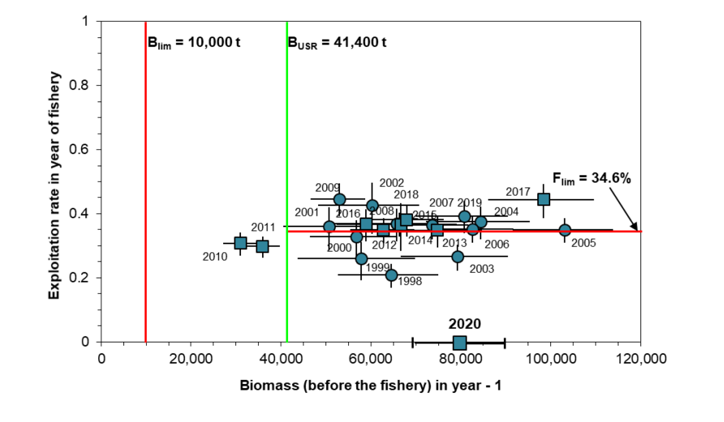
Maybe F35% isn’t appropriate?
Other productive snow crab fisheries have somewhat lower Fs (see Gulf of St Lawrence →)
Functional maturity in situ appears to be >95mm carapace width (Conan and Comeau, 1986; Ennis et al., 1988)

Slide 57
Model 21.3a
Model 21.3a uses the same model as 21.3, but substitutes M for the FMSY proxy, similar to tier 4 stocks.
Tier 4 is for stocks where essential life-history, recruitment information, and understanding are insufficient to achieve Tier 3.
In Tier 4, a default value of natural mortality rate (M) or an M proxy, and a scalar, γ, are used in the calculation of the FOFL.
Somewhat unsatisfying because we have all the information listed above.

Slide 58
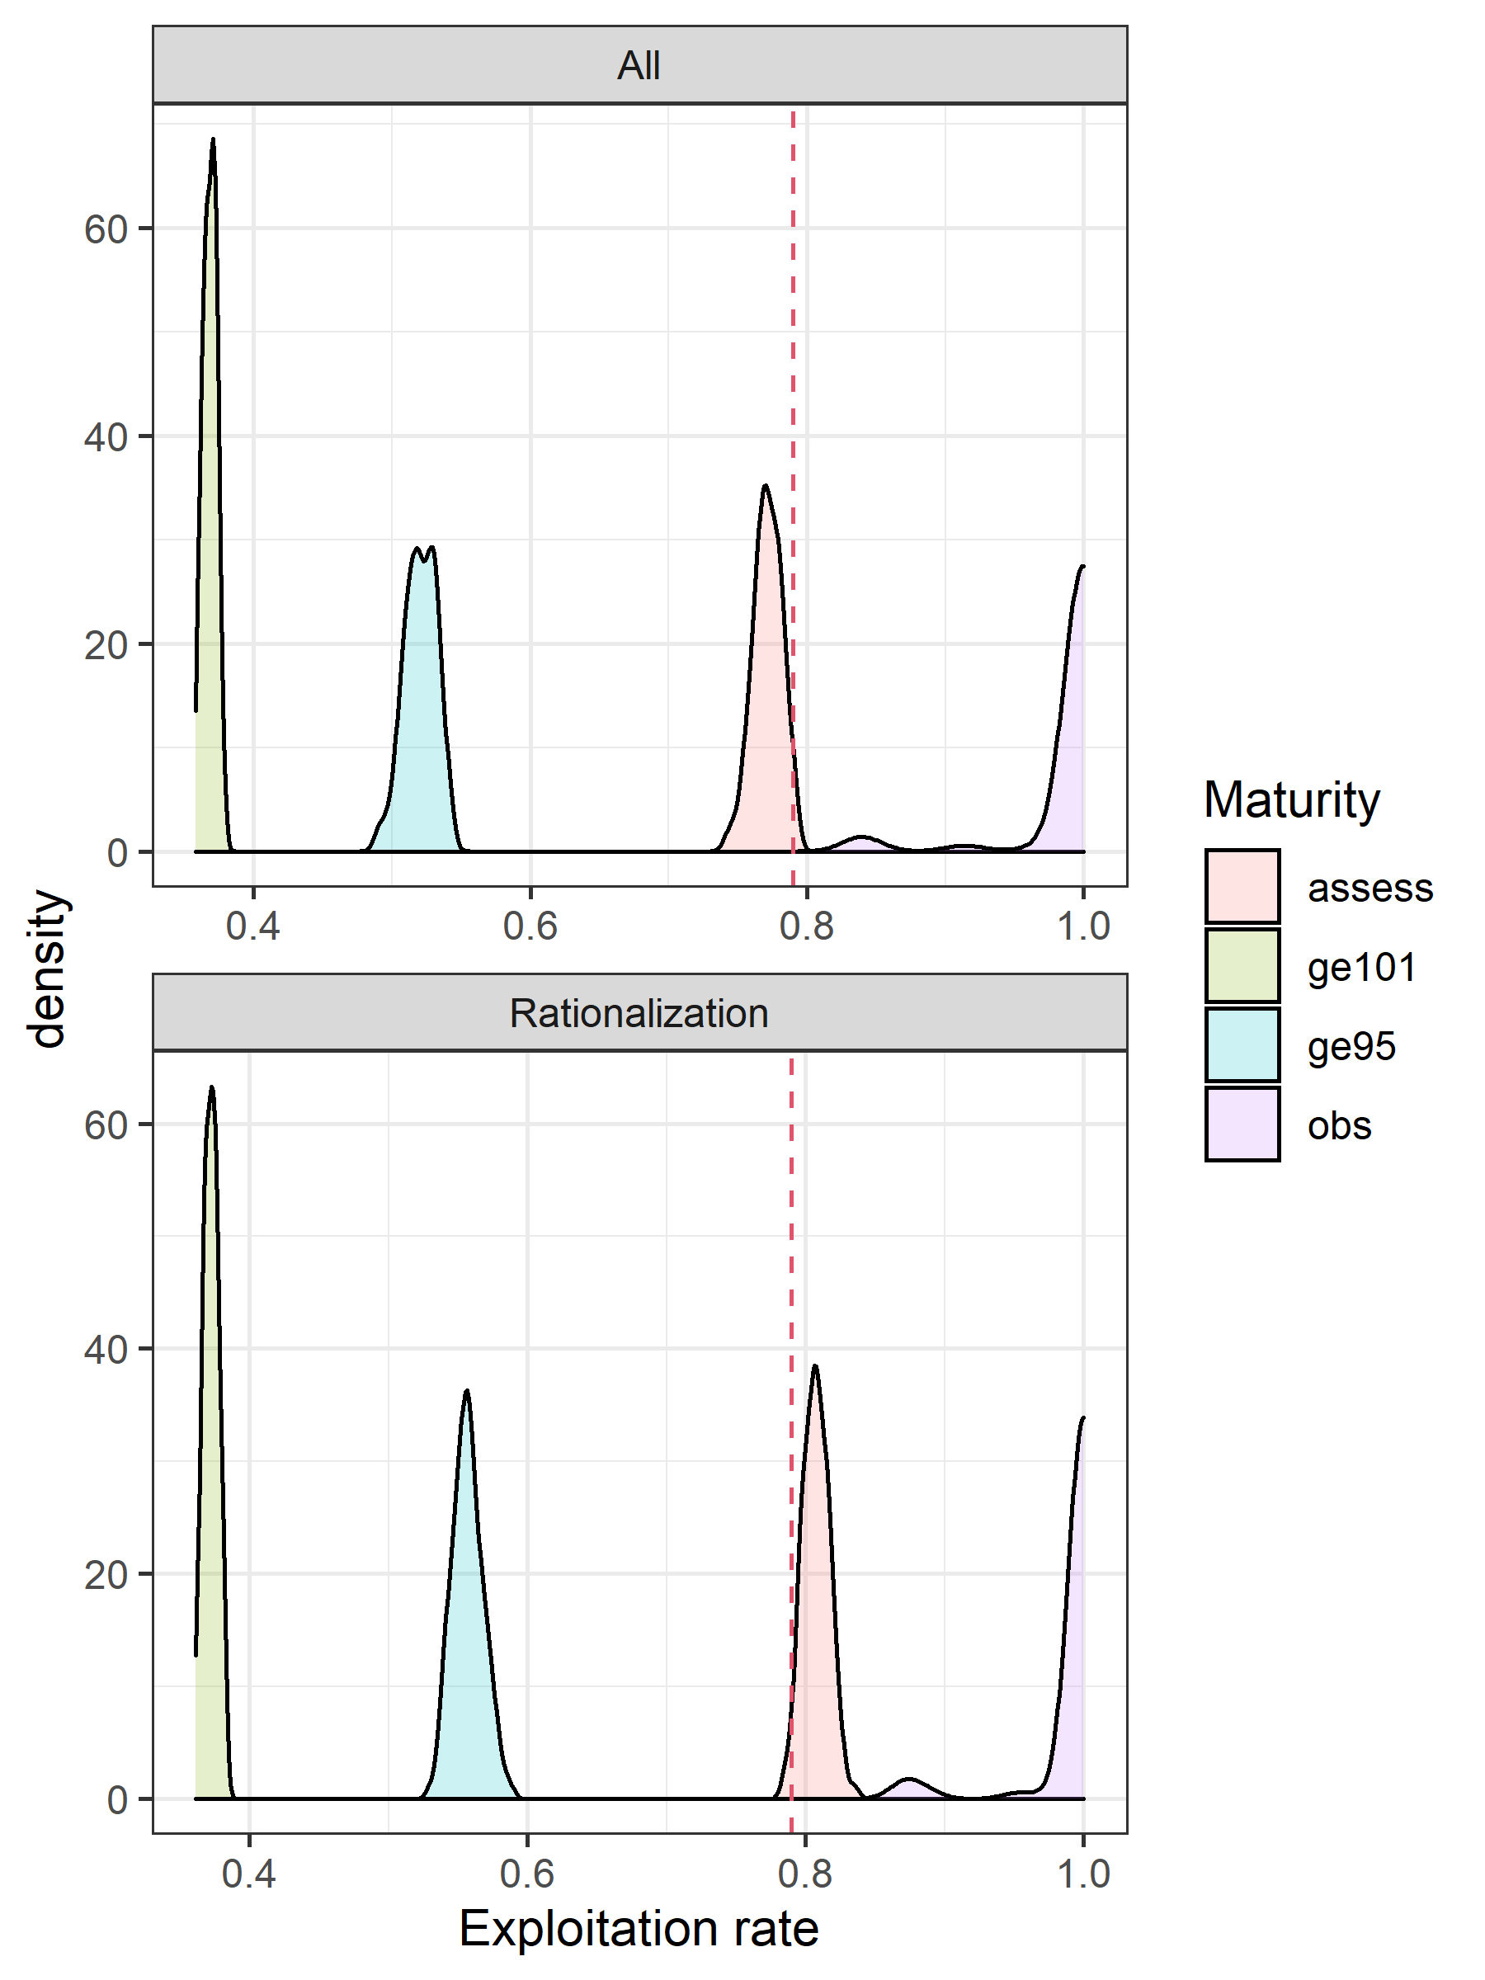
Other management possibilities
Change the currency of management from ‘morphometric maturity’ to ‘functional maturity’
A potential definition for ‘functional maturity’ could be >95mm carapace width given work in Canada
This mirrors what BBRKC does
F35% | 0.63
FOFL | 0.146
OFL | 3.14

Slide 59
21.3b | 32.42 | 105.01 | 0.63 | 0.146 | 3.14 | 0.30 | 146.83 | 0.30

