Slide 1
Biology, Behaviour, and Bycatch Reduction Devices:
Conservation Engineering Approaches to Salmon
Bycatch Mitigation
Noëlle Yochum
NOAA-NMFS-Alaska Fisheries Science Center
noelle.yochum@noaa.gov
NPFMC Salmon Bycatch Workshop 15 April 2019 Seattle, WA

Slide 2
Conservation engineering
NOAA: National Oceanic and Atmospheric Administration
NMFS: National Marine Fisheries Service
AFSC: Alaska Fisheries Science Center (Science Center)
RACE: Resource Assessment and Conservation Engineering (Division)
MACE: Midwater Assessment and Conservation Engineering (Program)
CE: Conservation Engineering (Group)

Slide 3
Conservation engineering
Collaboration with industry and other partners to evaluate ways to support fisheries sustainability through research on:
Bycatch
Bycatch mortality
Habitat-gear interactions
By evaluating:
Fish biology/ physiology and behavior
Fishing gear design and use (fluid dynamics, gear mensuration, etc.)

Slide 4
Conservation engineering
Collaboration with industry and other partners to evaluate ways to support fisheries sustainability through research on:
Bycatch
Bycatch mortality
Habitat-gear interactions
By evaluating:
Fish biology/ physiology and behavior
Fishing gear design and use (fluid dynamics, gear mensuration, etc.)

Slide 5
Conservation engineering
Salmon Bycatch in the North Pacific Pollock Fisheries

Slide 6
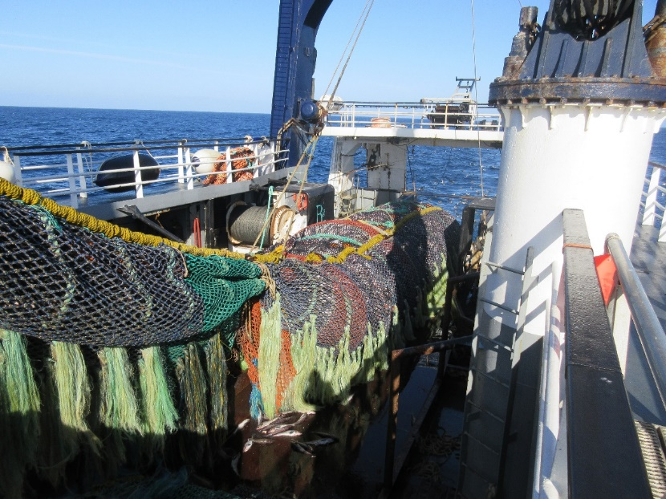
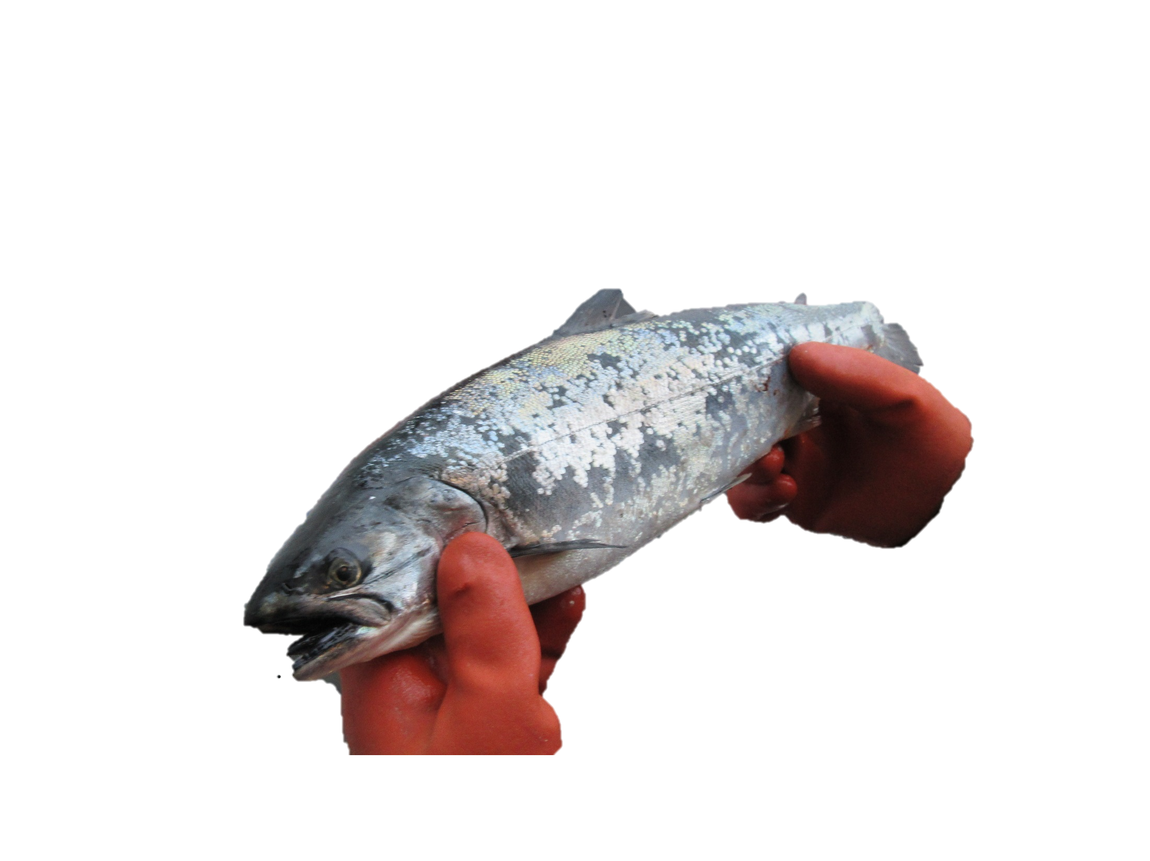
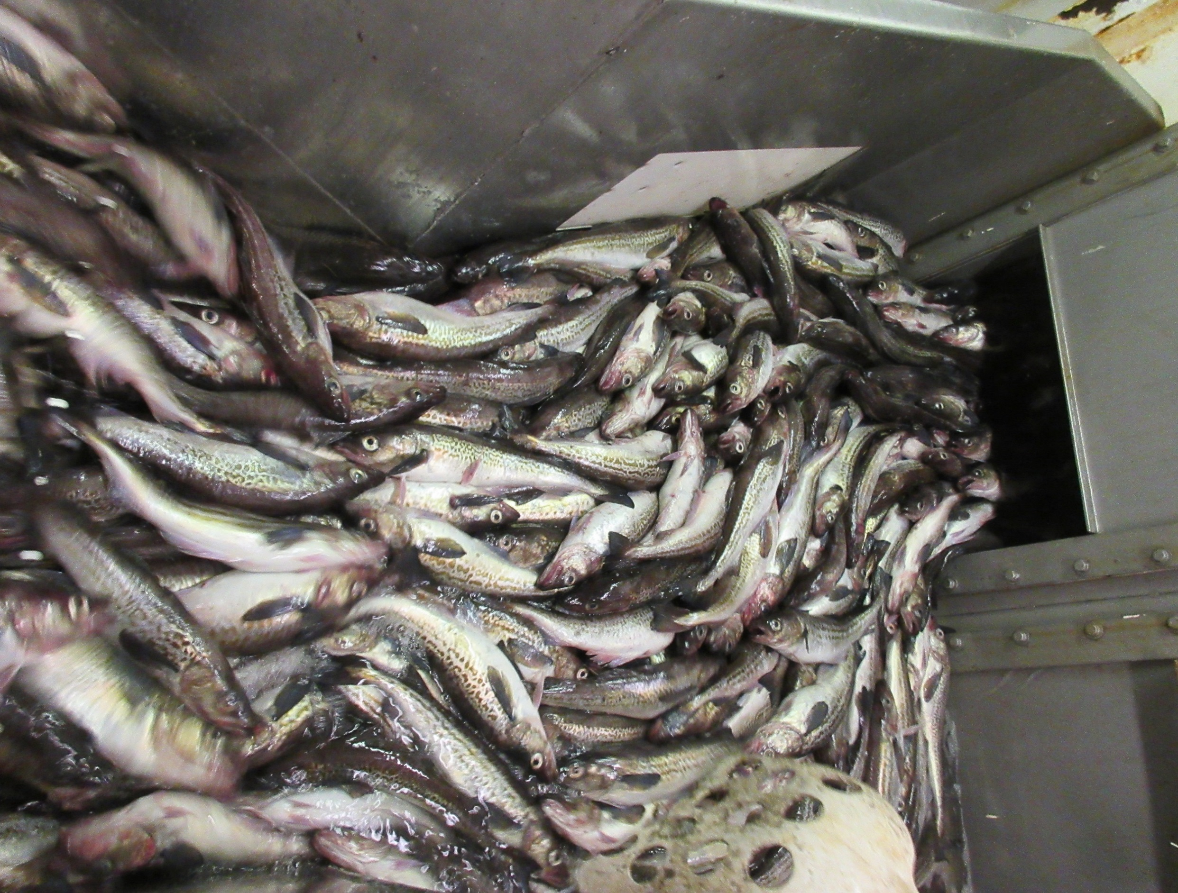
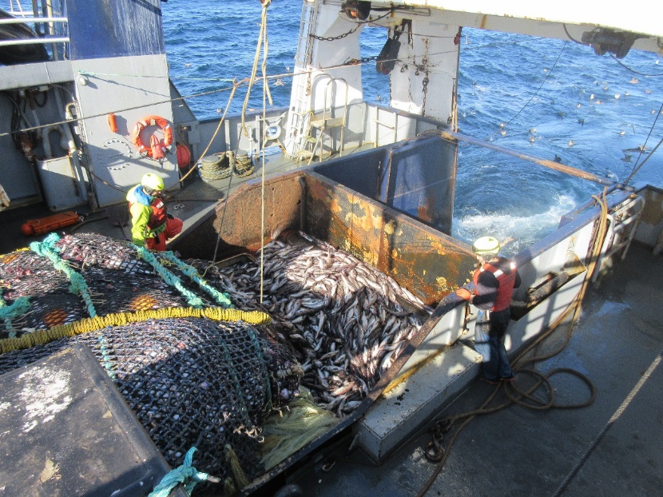
Salmon bycatch
Pollock fishery

Slide 7
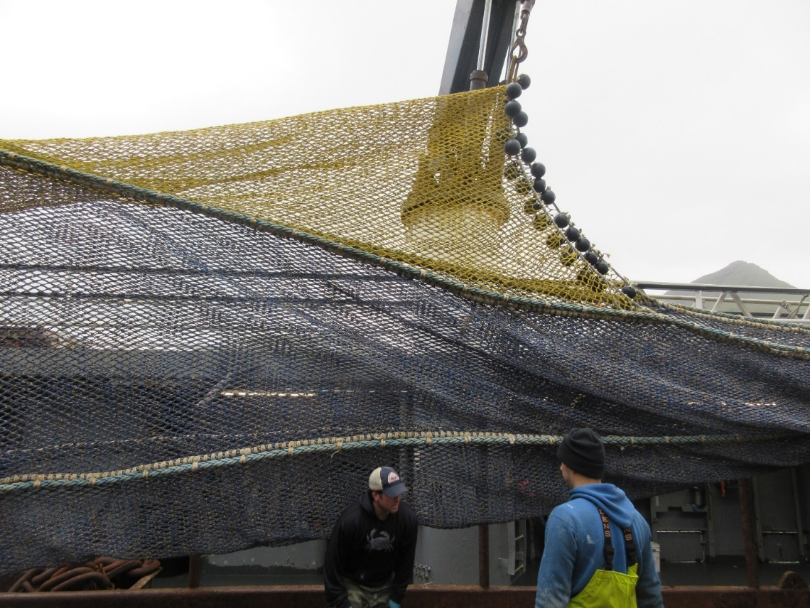
Salmon Excluder
Pollock fishery

Slide 8

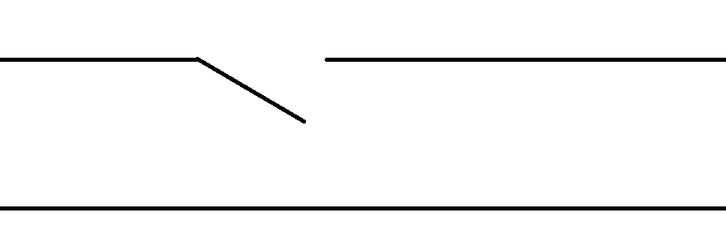
Salmon Excluder
Codend
Salmon
Pollock

Slide 9
Salmon Excluder
‘Flapper’
‘Winston Hole’
‘Over- Under’
Codend

Slide 10
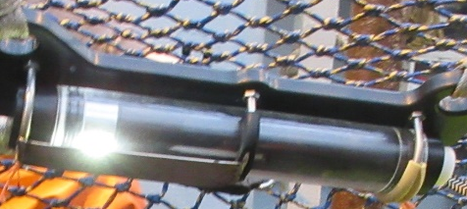
Salmon Excluder
Codend
Salmon

Slide 11
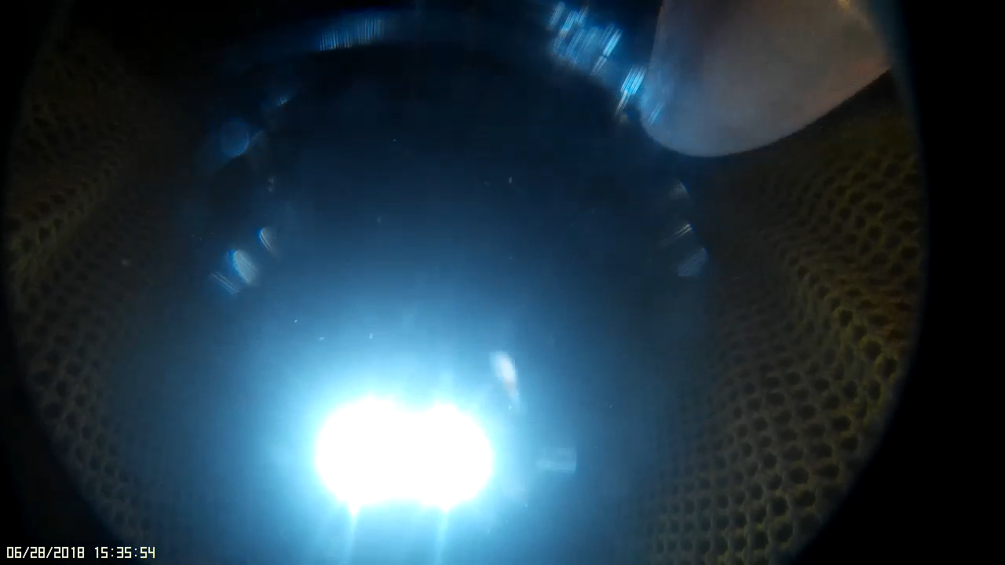
Are salmon attracted to the lights?
Gauvin EFP footage

Slide 12
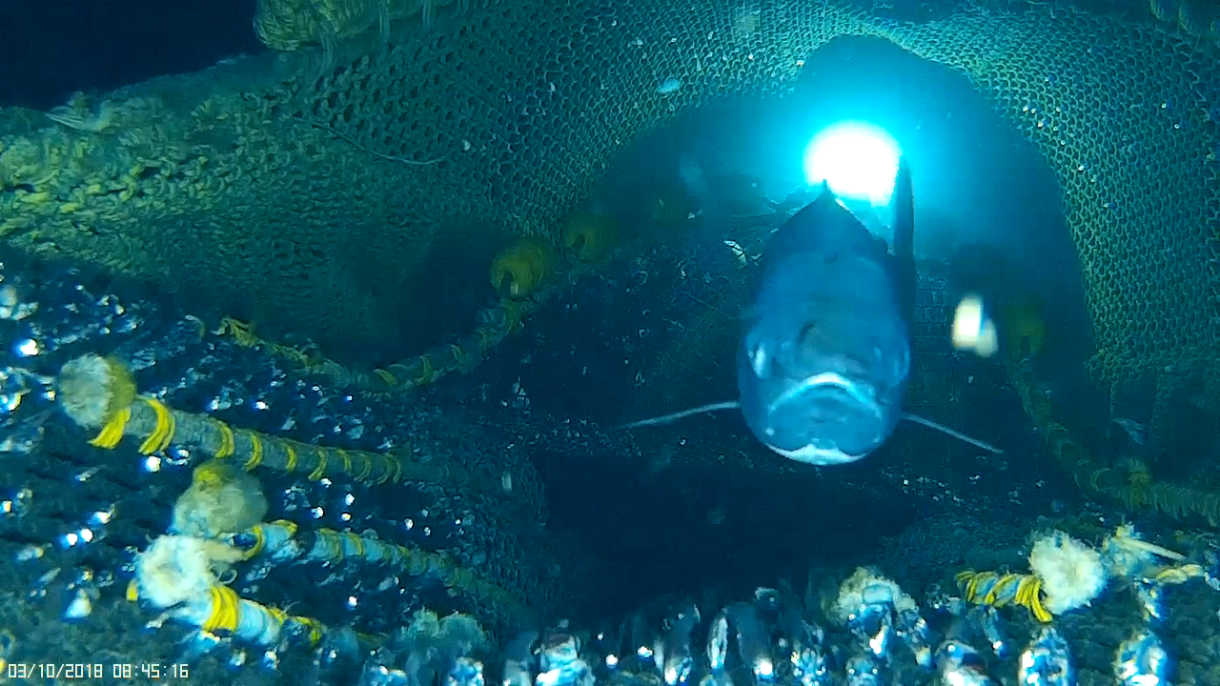
Are salmon attracted to the lights?
Gauvin EFP footage

Slide 13
Multi-pronged Approach
2017 Research cruise:
  How do salmon respond to artificial lights in the trawl in absence of other variables?
  Can you image salmon behavior using near infra-red light and low light cameras?
2018-2020 EFP (John Gauvin, John Gruver):
  Testing salmon excluders by vessel type and horsepower
2018 Laboratory studies:
  How do salmon respond to artificial lights in the lab
    Color, intensity, strobe
  What do salmon see?
2019 Research cruise:
  New salmon excluder idea
  Testing with and without lights
  Imaging salmon without visible light

Slide 14
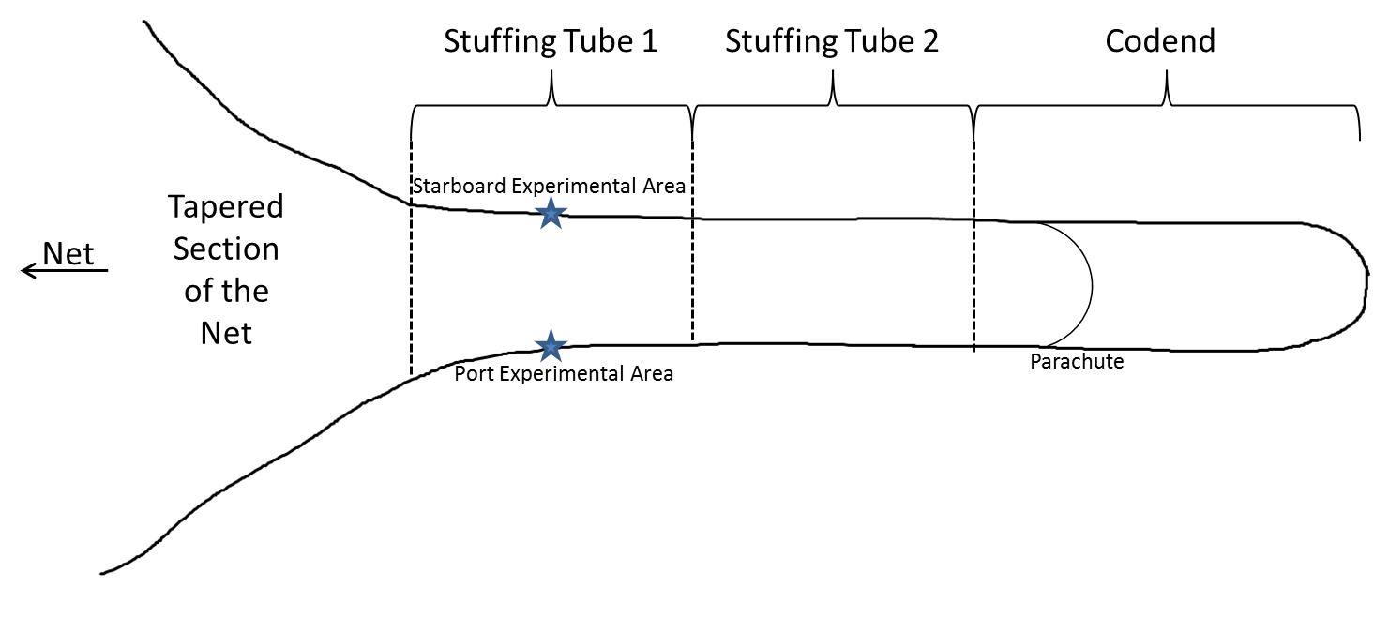
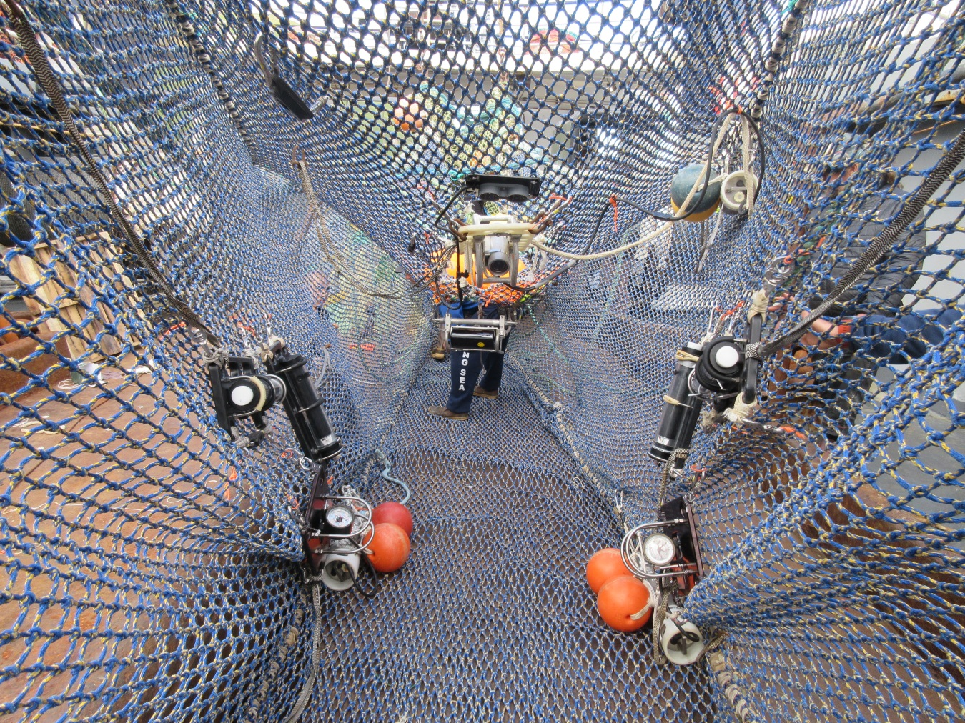
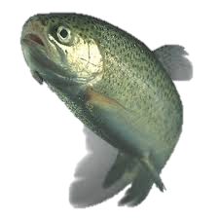
2017 Research Cruise
Scott McEntire and Brad Harris
  Lights

Slide 15
2017 Research Cruise
  Cameras
  IR Illumination
Intensified charge-coupled device (ICCD) camera with intensifier
Low-light charge coupled device (CCD) cameras, IR cut out filter removed
Security IR LED arrays
NIR centered at 840 nm

Slide 16
2017 Research cruise- Results
Can you image salmon behavior using near infra-red light and low light cameras?
Not very well

Slide 17
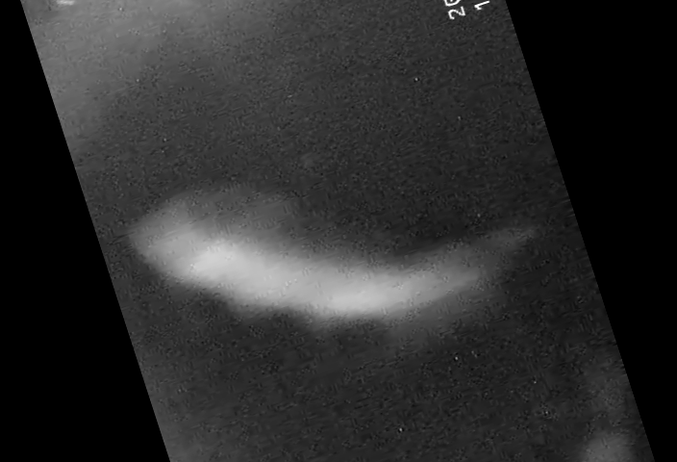
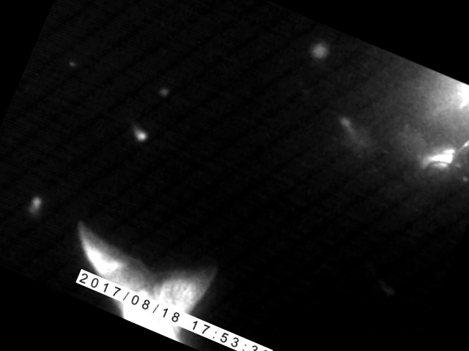

Slide 18
2017 Research cruise
Preliminary Results
Can you image salmon behavior using near infra-red light and low light cameras?
How do salmon respond to artificial lights in the trawl absence of other variables?
Not very well
Preliminary results: >80% passively swim/flow toward codend (facing foreword)

Slide 19
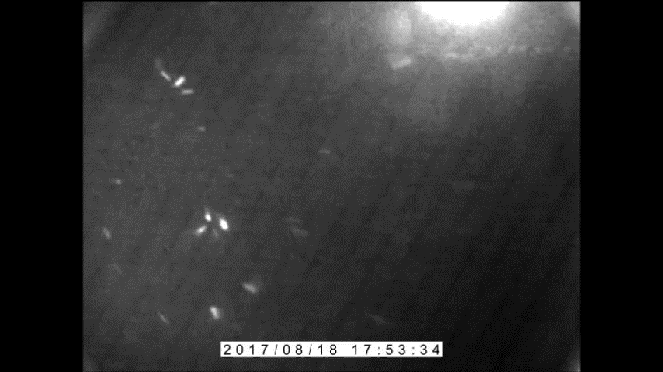

Slide 20
2018 laboratory studies
Lyle Britt, Barry Berejikian, Scott McEntire, Rebecca Haehn, Rick Towler, Jeff Atkins, Brad Gadberry, Paul Irvin
What do salmon see?
How do salmon respond to artificial lights in the lab
  Color, intensity, strobe, time of day

Slide 21
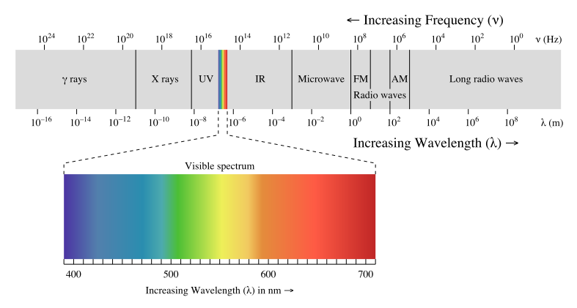
2018 laboratory studies
Salmon Vision

Slide 22
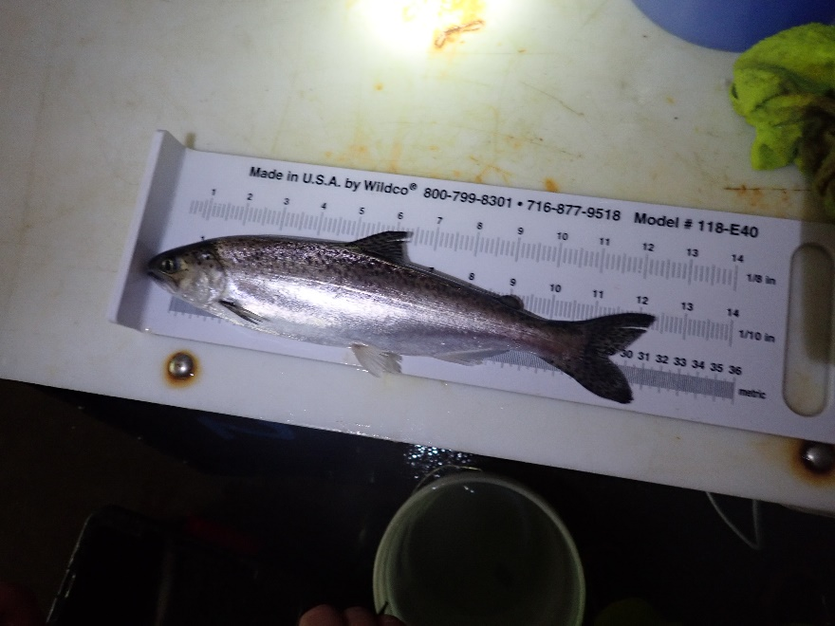
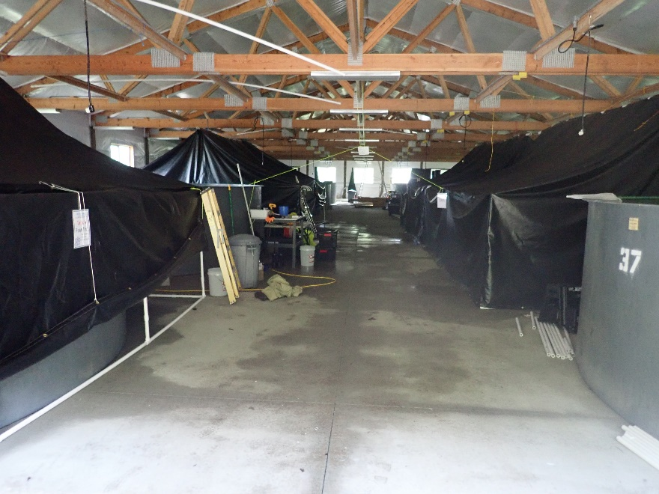
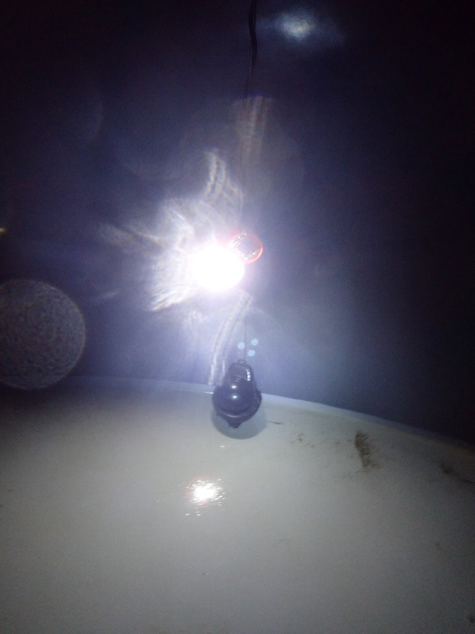
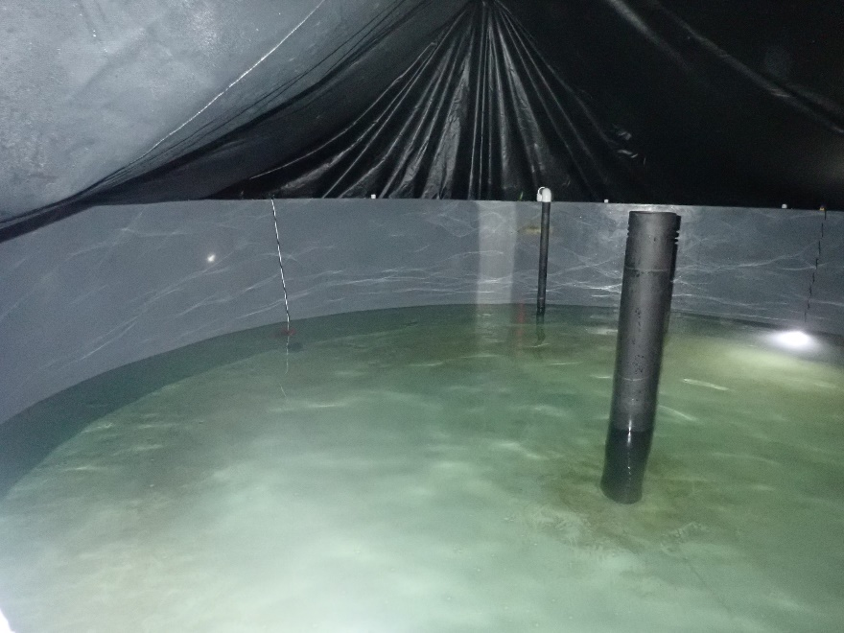
2018 laboratory studies

Slide 23
2018 laboratory studies
Preliminary Results
How do salmon respond to artificial lights in the lab
Deterrent rather than attractant?

Slide 24
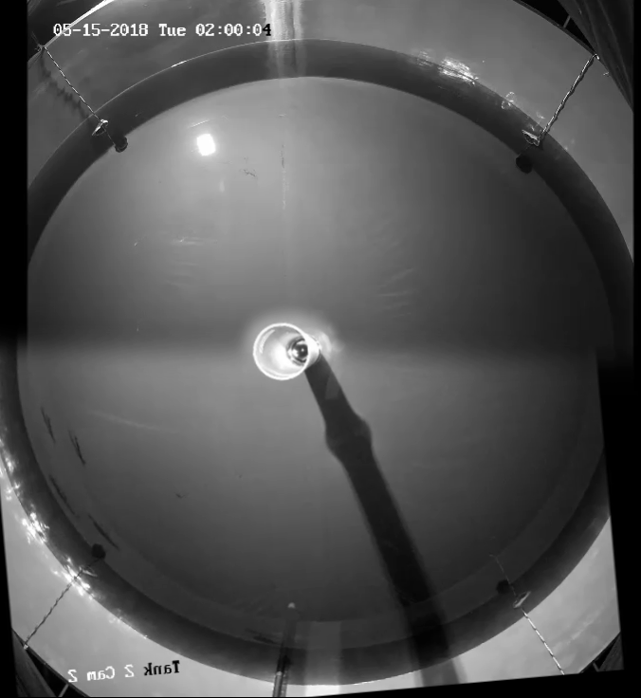
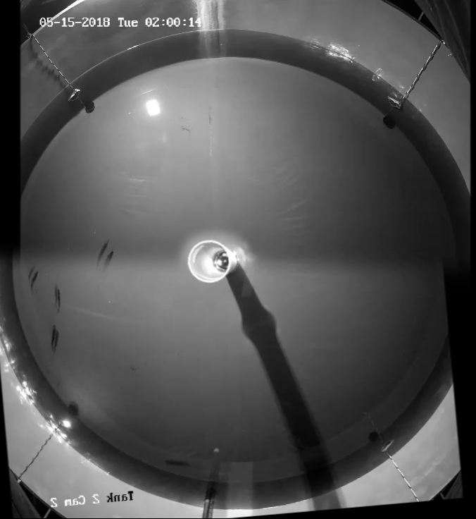
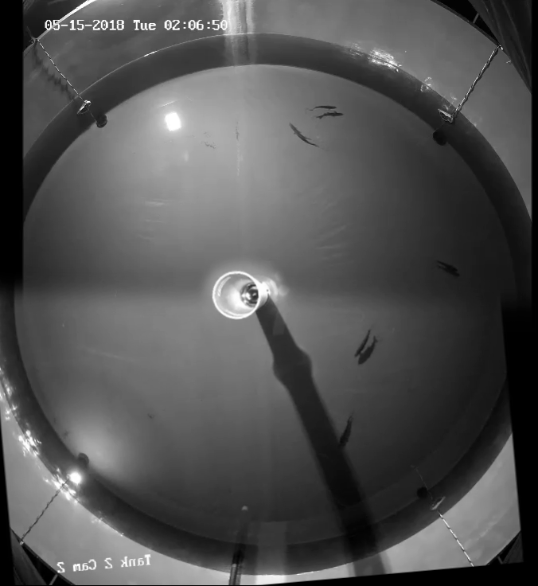

Slide 25
2018 laboratory studies Preliminary Results
How do salmon respond to artificial lights in the lab
What do salmon see?
Deterrent rather than attractant?
Dependent on color, intensity, strobe rate, time of day?
Do not see into the far red spectrum

Slide 26
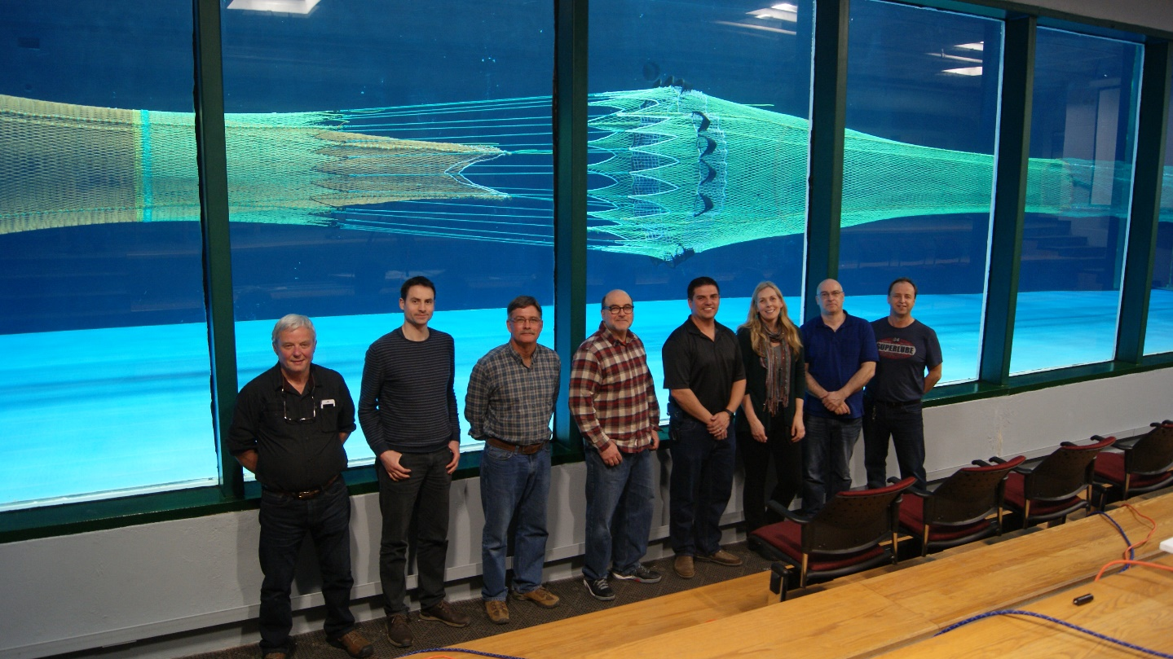
2019 research charter
Mike Stone, Karsten Breddermann, Barry Berejikian, David Irvine, John Gruver, John Gauvin
New salmon excluder idea: the ‘rope & funnel excluder’
  Fluid dynamics modeling
  Flume tank testing
  June 2019 testing at full scale at-sea

Slide 27
2019 research charter
Mike Stone, Karsten Breddermann, Barry Berejikian, David Irvine, John Gruver, John Gauvin
Rope & Funnel Excluder
  With and without lights
  Continue looking into camera lighting options that will go undetected by salmon

Slide 28
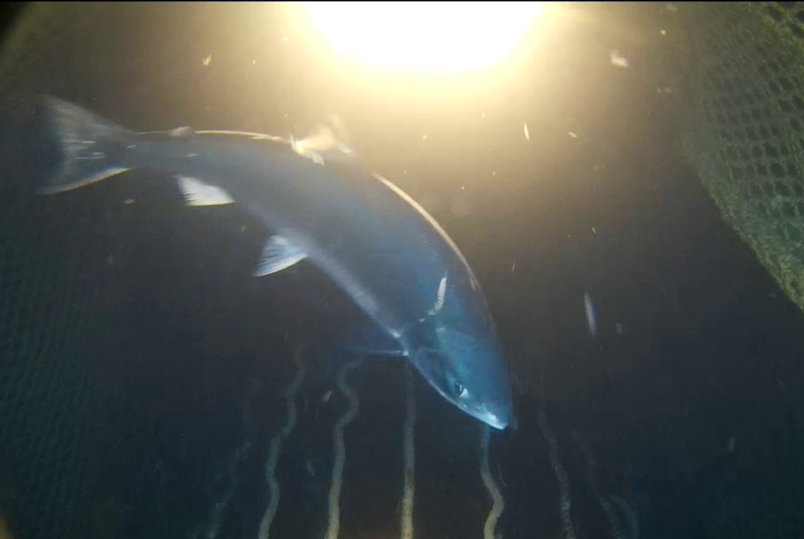
Thank you!
noelle.yochum@noaa.gov
(206) 526-4432
(916) 719-5920

