Slide 1
Aleutian Islands Golden King Crab Model-Based Stock Assessment
May 2019 CRAB SAFE DRAFT Report
M.S.M. Siddeek^{1,} J. Zheng¹, C. Siddon¹, B. Daly², M.J. Westphal³, and L. Hulbert¹
Alaska Department of Fish and Game, Juneau¹, Kodiak², and Dutch Harbor³, Alaska
May 30, 2019, Coast International Inn, Anchorage

Slide 2
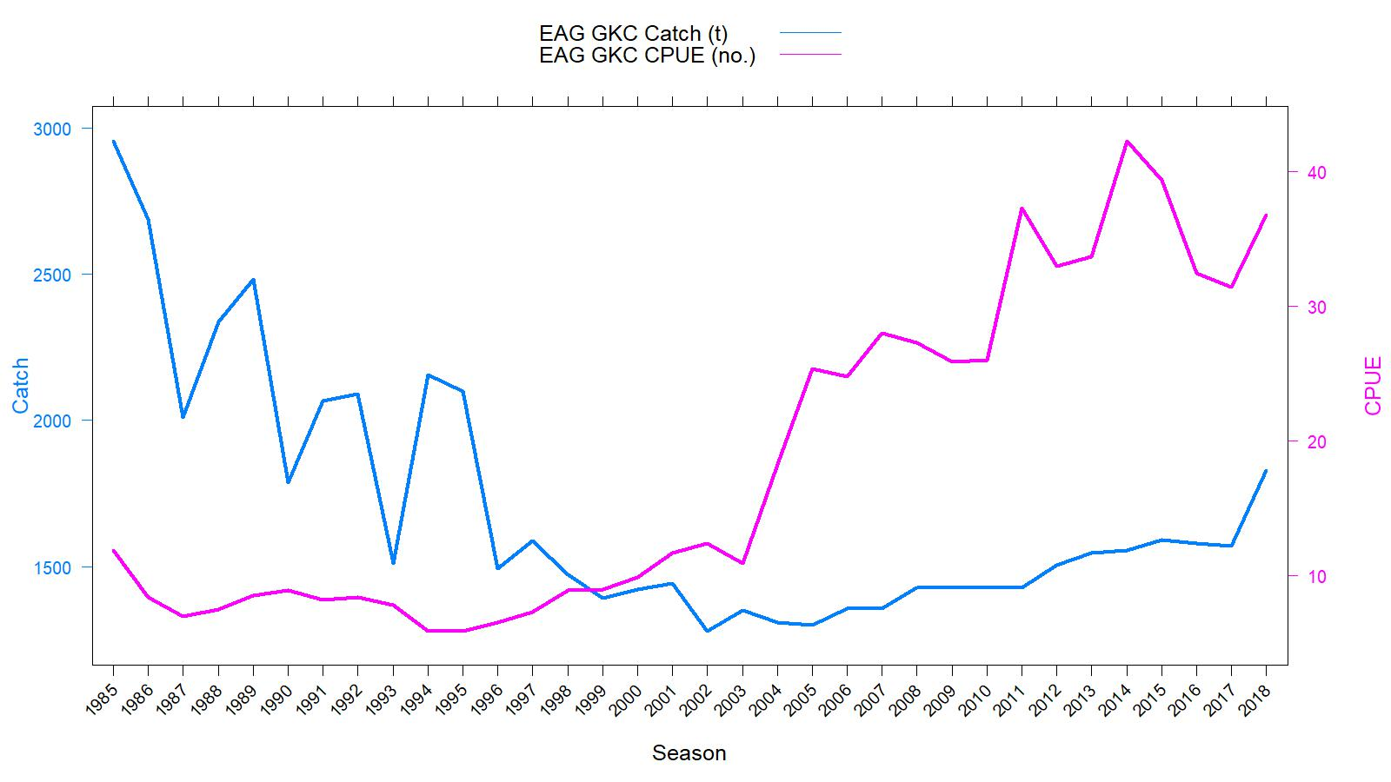
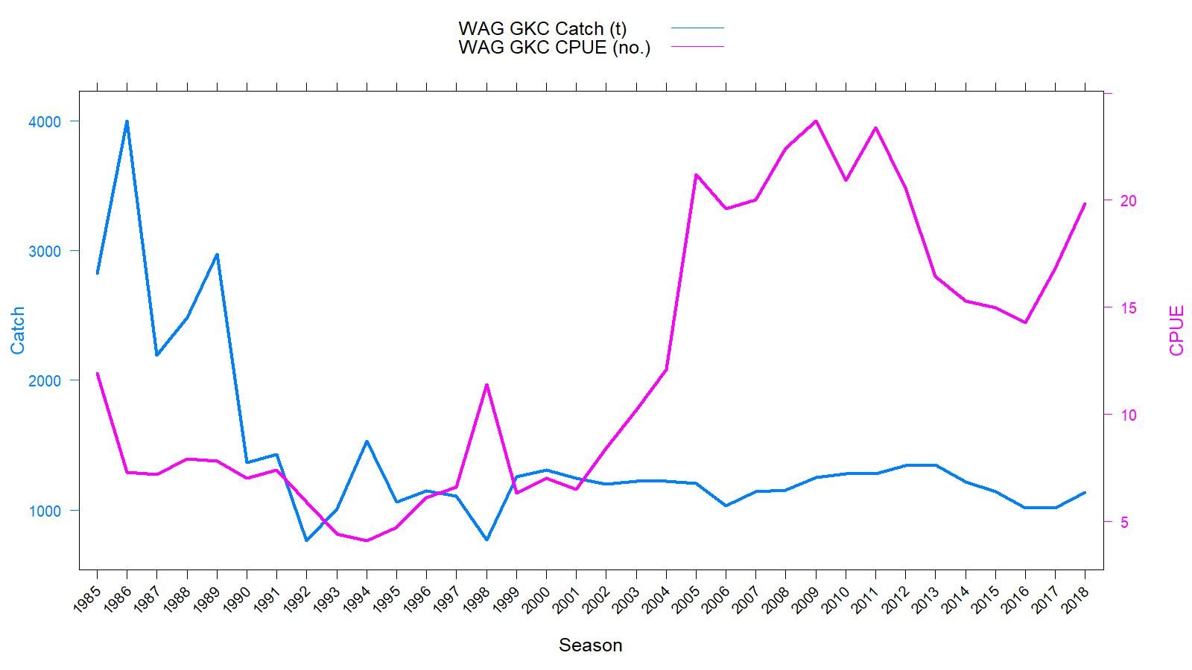
EAG
Catch (t) and CPUE
(number of crab per pot lift), 1985/86–2018/19
Rationalization
TAC
WAG
TACs :
2018/19:
(1) EAG: 3.856 million pounds
(2) WAG: 2.500 million pounds
gear/mesh modification

Slide 3
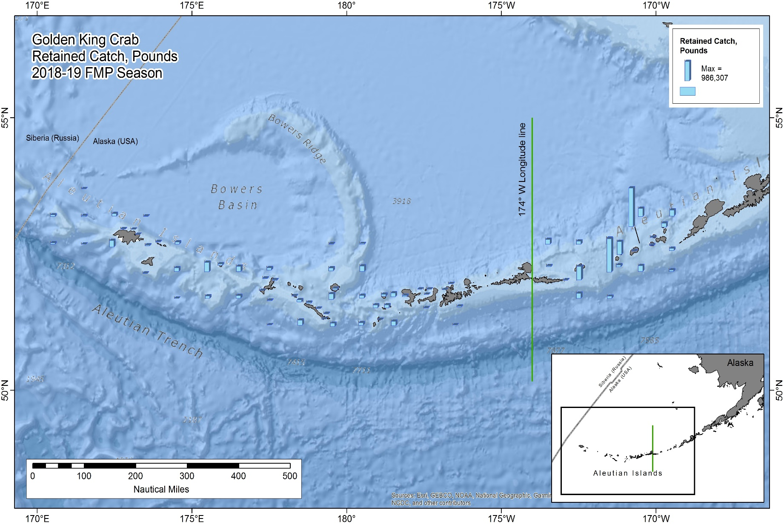
Figure 8. Catch distribution by statistical area in 2018/19.

Slide 4
Topics
Responses to May 2018 and Jan 2019 CPT, and June 2018 and Feb 2019 SSC comments
Results
Tier 3 OFL and ABC

Slide 5
Length based modeling approach
An integrated length based model. This is the only FMP crab stock modelled with fishery dependent catch and CPUE data without survey information.
Constant M of 0.21yr⁻¹.
Projected the abundance from unfished equilibrium in 1960 to initialize the 1985 abundance.
3 Scenarios for EAG and WAG.
Knife edge maturity of 111 mm CL for MMB calculation.
Francis re-weighting method for Stage-2 effective sample sizes calculation for all scenarios.

Slide 6
May 2018 CPT (selected) comments
Comment 2: Reanalyze chela measurement data for AIGKC using new analytical techniques developed for snow crab and Tanner crab.
Response:
Currently collecting more chela measurement data from the Observer, dockside retained catch, and independent survey (in EAG) sampling. Plan to complete analysis for the May 2020 CPT.
Comment 3: Work on appropriate statistical models for analysis of ADF&G cooperative pot survey that reflect the nested sampling design of vessels, strings within vessel, and pots within strings and consider the use of random effects as appropriate.
Response:
Completed 2015/16, 2016/17, 2017/18, and 2018/19 surveys in EAG. For the first time extended the survey to WAG in 2018/19. Time series is not long enough to provide meaningful results. Will follow the random effect approach and plan to present preliminary results at the 2020 CPT meeting.

Slide 7
May 2018 CPT comments continued
Comment 5: Continue exploration of year-area interactions using appropriate analytical methods and develop area weights using fishing footprint calculations.
Response:
Scenarios 19_2 (WAG) and 19_2a (EAG) used CPUE indices estimated with Year:Area interaction. Details in Appendix B.
.
Comment 6: Prepare standard set of plots to summarize B0 calculations. Plot 1: dynamic B0 and MMB time series. Plot 2: B0 depletion ratio time series. Plot 3: recruitment time series.
Response:
Analysis done for three scenarios: 19_0, 19_1, and 19_2 (or 19_2a). Please see Figures C.1 (EAG) and C.2 (WAG) in Appendix C.

Slide 8
June 2018 SSC (selected) comments
Comment 1: (a) The SSC reminds all assessment authors to implement the guidelines for model numbering.
Response:
Followed CPT suggested model numbering. E.g., When the base scenario 18_0, which is the 2018 model with up to 2017/18 data, is used with up to 2018/19 data, we labeled the new model as 19_0.
Comment 1: (b) Authors should use their best estimate of catch for current and future years to get the best estimate of projected ABC/OFLs. The groundfish stock assessment authors have adopted methods to do this, such as using the 3-year average ratio of catch/TAC.
Response:
This time this was not needed because we were using the currently completed (2018/19) fishery data.

Slide 9
June 2018 SSC comments continued
Comment 2: There is continued high uncertainty about maturity. Using knife-edge maturity, as currently implemented, was an interim fix due to problems with estimating maturity at size. We support and encourage efforts to obtain additional chela measurements to improve the parameterization of maturity in the model as a probabilistic function of size (e.g., logistic).
Response:
Will be developing a logistic maturity curve with the additional data analysis (Please see our response to CPT comment #2).

Slide 10
June 2018 SSC comments continued
Comment 3: We encourage the co-operative survey to be continued and endorse further work to include this independent survey into the model. The SSC specifically endorses the CPT recommendation to use nested random effects for strings within vessels and for pots within strings in a mixed-effects model.
The SSC also requests the authors to include a brief description of the cooperative survey in the document, including the area sampled, size composition, and a summary of trends in CPUE.
Response:
Will provide description of the survey method in consultation with the independent survey project leader in the near future.

Slide 11
June 2018 SSC comments continued
Comment 5: The CPT noted that the year effect is not appropriate as an abundance index in the presence of interactions and recommended use of the “fishing footprint” as a measure of area, then use of area weights to compute the annual abundance index. The SSC supports this recommendation but notes that, like the VAST analyses, the ‘fishing footprint’ needs to be clearly defined and a rationale for how it is quantified needs to be developed before further pursuing year-area interactions in the model.
Response:
We identified the fishing footprints based on the observer pot sampling locations in the 1995/96 to 2018/19 database. We used a geostatistical package in R to allocate the fishing footprints into 30X30 nmi cell grids for Year and Area interaction investigation (Appendix B). Please see our response to CPT comment #5.

Slide 12
January 2019 CPT comments
Comment 1: The projection for the 2018/19 fishing year should be based on setting the retained catch to the 2018/19 TAC and assuming that groundfish bycatch for 2018/19 equals the recent three-year mean groundfish bycatch. No catch composition data for the 2018/19 fishing year should be generated based on averaged past data.
Response:
This approach is no longer needed at this time because we used the currently completed fishery data.
Comment 2: Scenario 18_1a should be dropped because the suggested approach for adjusting pot bycatch is plausible at the individual pot level, but not at the total bycatch level.
Response:
Dropped.

Slide 13
January 2019 CPT comments continued
Comment 3: Add a new scenario based on a revised definition of “area” when conducting the CPUE standardization – consideration should be given to including an interaction between year and the
revised area definition in the standardization model. If an area*year interaction is supported, the final index should be an area-weighted index
Response:
Investigated Year:Area interaction effect on observer CPUE indices. Scenarios 19_2 (WAG) and 19_2a (EAG) included observer CPUE indices estimated with the interaction term. Details in Appendix B.
Comment 4: The next assessment should report results from the May 2017, September 2017, and May 2018 assessments as well as those from the new scenarios to enable an evaluation of the impact of changes to the model and the data.
Response:
Done. Please see examples Figures: 26, B2, and B3

Slide 14
January 2019 CPT comments continued
Comment 5: The increase in MMB in the last year of the assessment for the EAG is caused by a large recruitment three years ago, but this increase is not reflected in the standardized CPUE – the analysts should identify what in the data (e.g. the length-compositions) are the cause of the increased recruitment. Showing the fits to the length-composition data may help identify whether there is a basis in the data for higher estimated recruitment.
Response:
We provide the observer collected total catch size composition data to justify the possibility of high recruitment to wider size groups until 2015 in EAG and then the total catch size range narrowing down during 2016 to 2018.

Slide 15
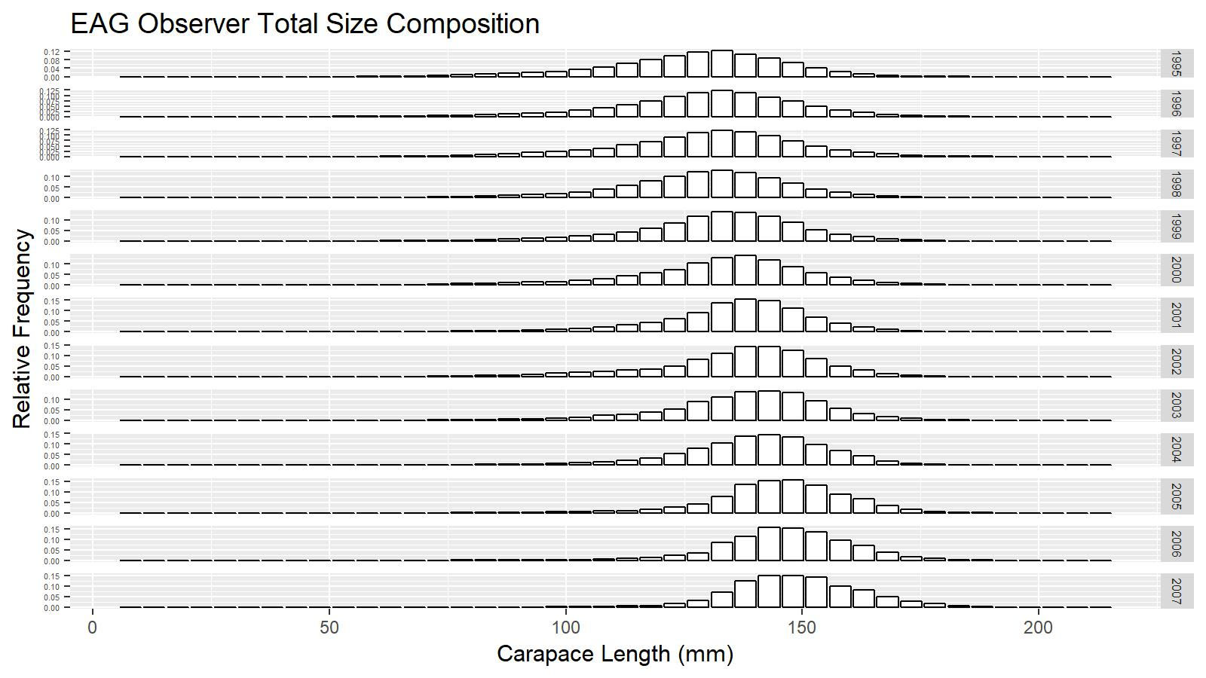
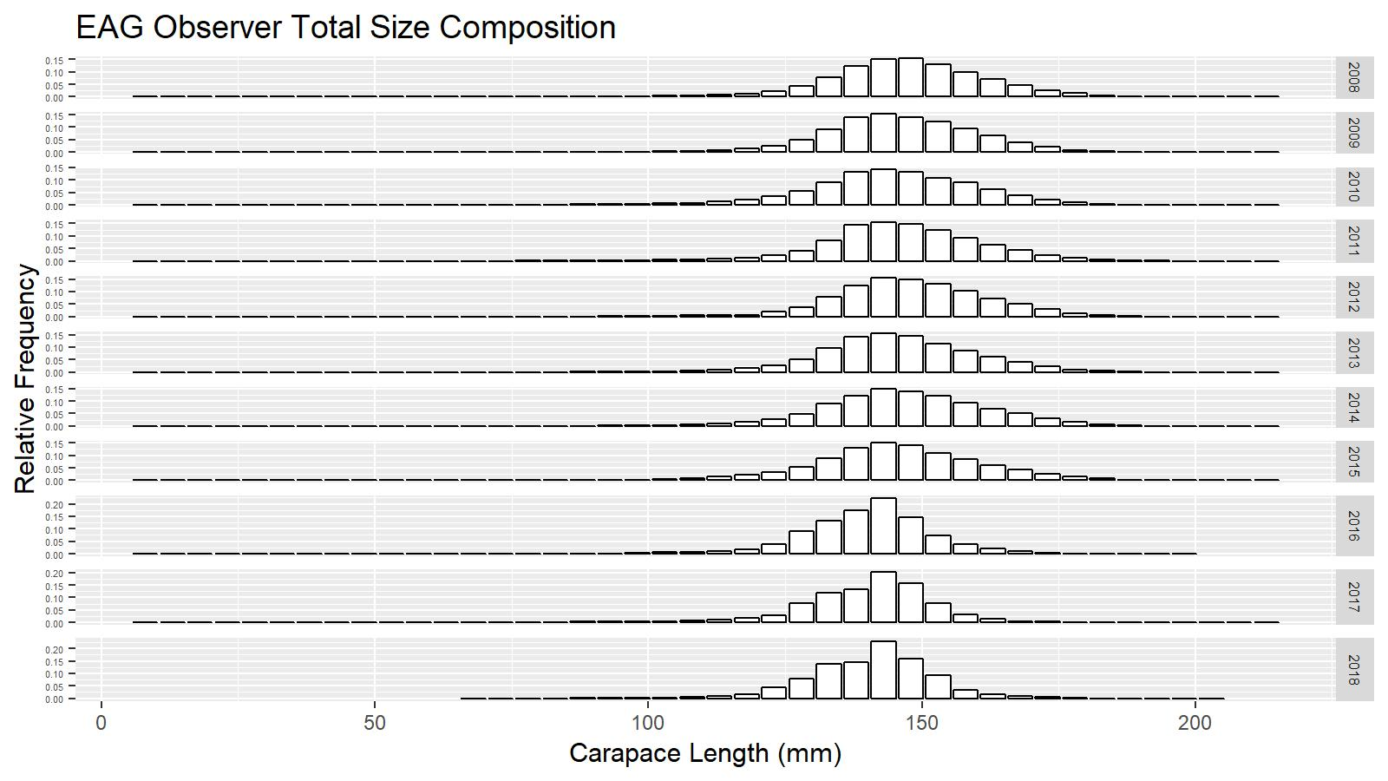

Slide 16
January 2019 CPT comments continued
Comment 6: The results of the three scenarios are hard to distinguish in the figures. Whether they are actually different needs to be checked.
Comment 7: The time-trajectories for dynamic B0 should be clearly labelled in figures such as 17 and 18.
Response:
Scenarios 19_0 and 19_1 results are indistinguishable because only the gear codes were reduced in the CPUE standardization. So, we plotted scenario 19_1 with orange points to differentiate it from others.
B0 plots are differentiable now. Please see Figures C.1 (EAG) and C.2 (WAG) in Appendix C.
Comment 8: The survey data will not be included in the assessment formally until the 2020 assessment. However, there would be value in plotting the length-composition data from the survey as it may provide evidence in support of the large estimated recent recruitment.
Response: Data not yet analyzed.

Slide 17
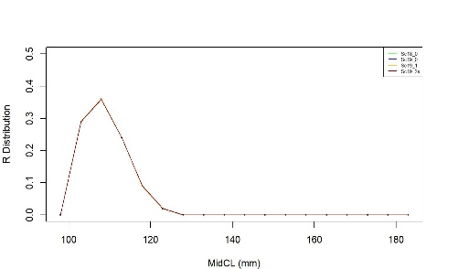
February 2019 SSC comments
Comment 1: Exploration of geostatistical models (e.g., VAST) for spatial analysis of the NMFS and ADF&G survey information.
Response:
We have postponed analysis of data using VAST pending the presentation by the developer on applicability of VAST to crab stocks. We have not yet analyzed the independent survey data.
Comment 2: Removing one dataset at a time from the model to identify the source of the large estimated recruitment three years ago; the CPUE time series does not show this increase and the source of information for this large recruitment estimate should be identified.
Response:
Please see retrospective analysis on MMB (Figure 23 for EAG and Figure 41 for WAG). Peeling off the data set year-by-year show some spread on MMB time series for EAG but not for WAG, which may suggest influx of large recruitment in recent years. When the new data set 2018/19 was added, the recruitment pulse did not disappear (high recruitment during 2015 to 2017, please see Figure14).
Since the recruitment distribution peaked ~ 108 mm CL mid-length (Figure 15), it directly contributed to high MMB.

Slide 18
February 2019 SSC comments continued
Comment 3: Exploring the use of the industry survey for purposes other than stock assessment modeling, such as length compositions.
Response:
We have not yet analyzed the independent survey data.
Comment 4: Pursuing other CPT recommendations, including a comparison with the May 2017, September 2017, and May 2018 assessments to assess the impact of incremental model and data changes. This type of retrospective comparison among assessment results has been reported in some groundfish assessments and, if routinely reported, would provide useful information on the development of the assessment model.
Response:
Done. Please see our response to January 2019 CPT comment #4.

Slide 19
EAG and WAG Data
Year | 81 | 82 | 83 | 84 | 85 | 86 | 87 | 88 | 89 | 90 | 91 | 92 | 93 | 94 | 95 | 96 | 97 | 98 | 99 | 00 | 01 | 02 | 03 | 04 | 05 | 06 | 07 | 08 | 09 | 10 | 11 | 12 | .. | .. | 17 | 18
Ret.C. & Size Comp.
Total C. & Size Comp.
Ground fish ByC. & Size Comp.
Observ. CPUE
Fishery CPUE
Tag release
Tag Recovery

Slide 20
Table T1. EAG and WAG model scenarios
Scenario | Size-composition weighting | CPUE data type | Natural mortality (M yr⁻¹)
18_0 | Stage-1: Number of days/trips Stage-2: Francis method | Observer data from 1995/96–2017/18; Fish Ticket data from 1985/86–1998/99; and number of gear codes were not reduced for CPUE standardization. | 0.21
18_1 | Stage-1: Number of days/trips Stage-2: Francis method | Observer data from 1995/96–2017/18; Fish Ticket data from 1985/86–1998/99; and number of gear codes were reduced for CPUE standardization | 0.21
19_0 | Stage-1: Number of days/trips Stage-2: Francis method | Observer data from 1995/96–2018/19; Fish Ticket data from 1985/86–1998/99; and number of gear codes were not reduced for CPUE standardization. | 0.21
19_1 | Stage-1: Number of days/trips Stage-2: Francis method | Observer data from 1995/96–2018/19; Fish Ticket data from 1985/86–1998/99; and number of gear codes were reduced for CPUE standardization. | 0.21
19_2a (EAG) or 19_2 (WAG) | Stage-1: Number of days/trips Stage-2: Francis method | Observer data from 1995/96–2018/19; Fish Ticket data from 1985/86–1998/99; Year and Area interaction factor was considered & number of gear codes were reduced for CPUE standardization. | 0.21

Slide 21
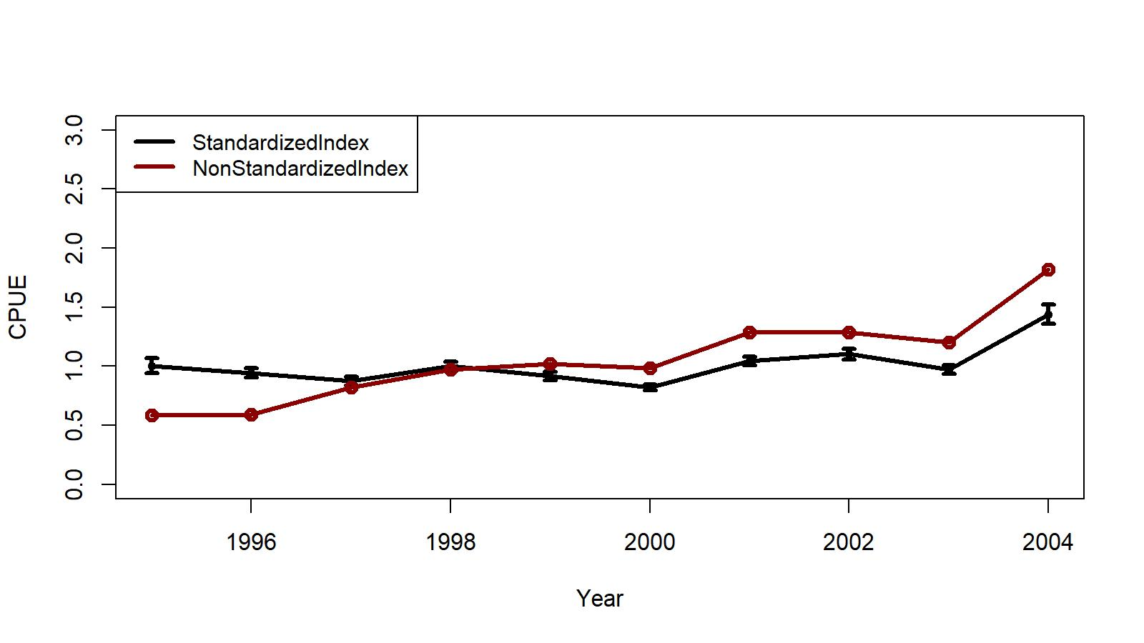
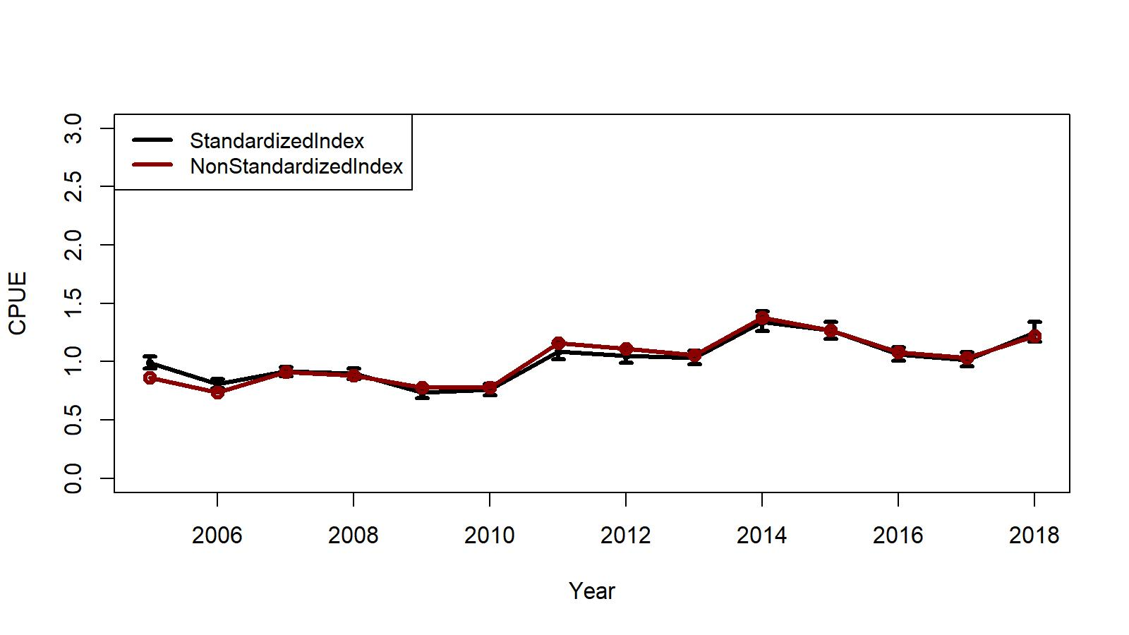
Fig. B.4. Trends in non-standardized and standardized CPUE indices with +/- 2 SE by GLM for EAG. Standardized indices: black line and non-standardized indices: red line. Variables selected by hybrid method. Sc19_1.
1995/96 – 2004/05
2005/06 – 2018/19
Ln(CPUE) = Year + Gear + Captain+ ns(Soak, df=4) + Month,
family = negative binomial (theta = 1.38)
Ln(CPUE) = Year + Captain + Gear + ns(Soak, df=9),
family = negative binomial (theta = 2.33)

Slide 22
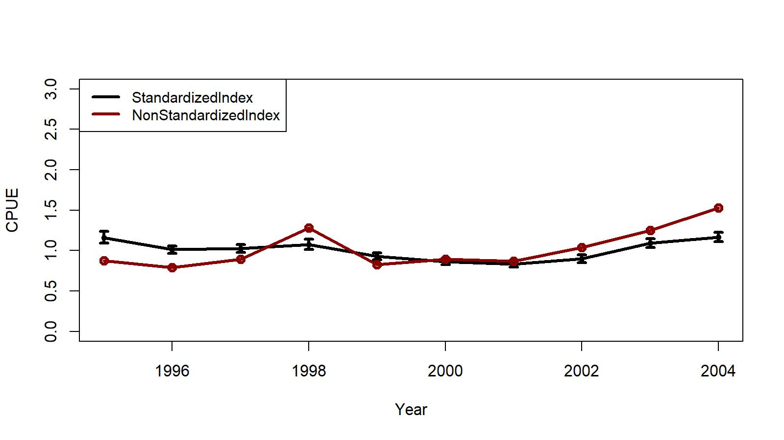
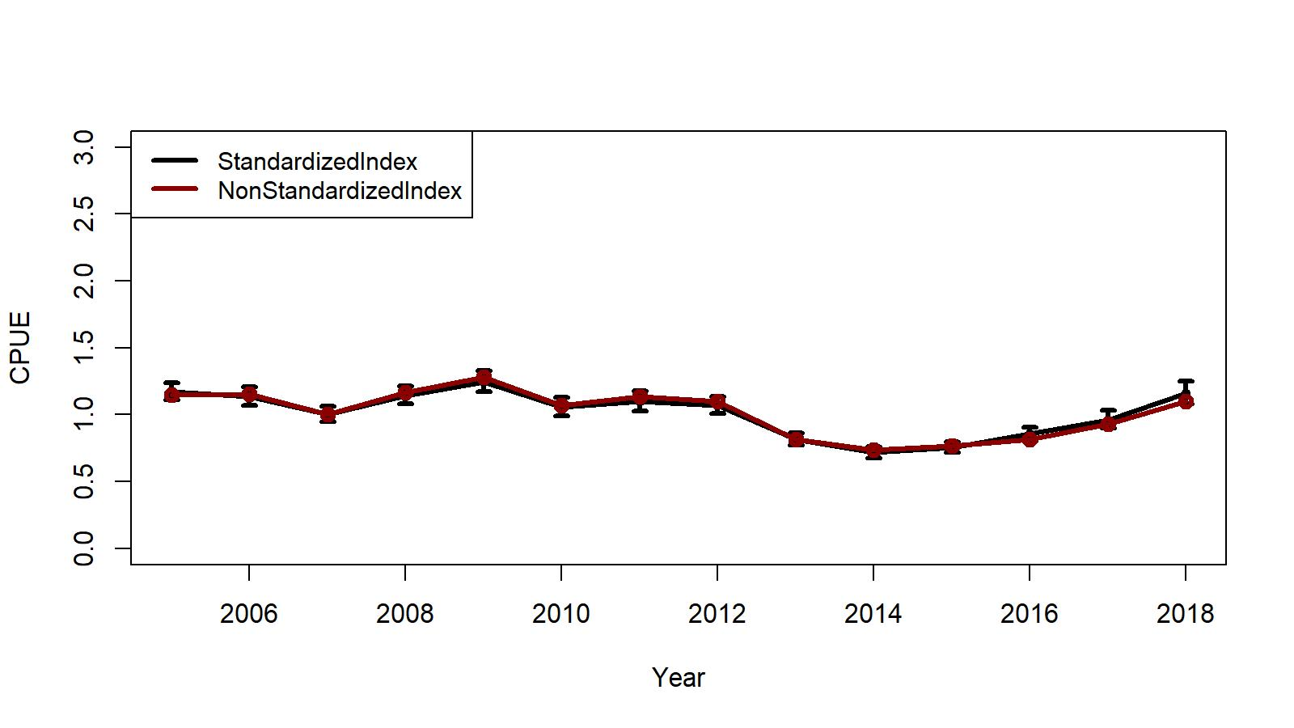
Fig. B.5. Trends in non-standardized and standardized CPUE indices with +/- 2 SE by GLM for WAG. Standardized indices: black line and non-standardized indices: red line. Variables selected by hybrid method. Sc19_1.
1995/96 – 2004/05
2005/06 – 2018/19
Ln(CPUE) = Year + Captain + ns(Soak, df=8) + Gear + Area,
family = negative binomial (theta = 1.0)
Ln(CPUE) = Year + Gear +ns(Soak, df=5) , Soak forced in
family = negative binomial (theta = 1.15)

Slide 23
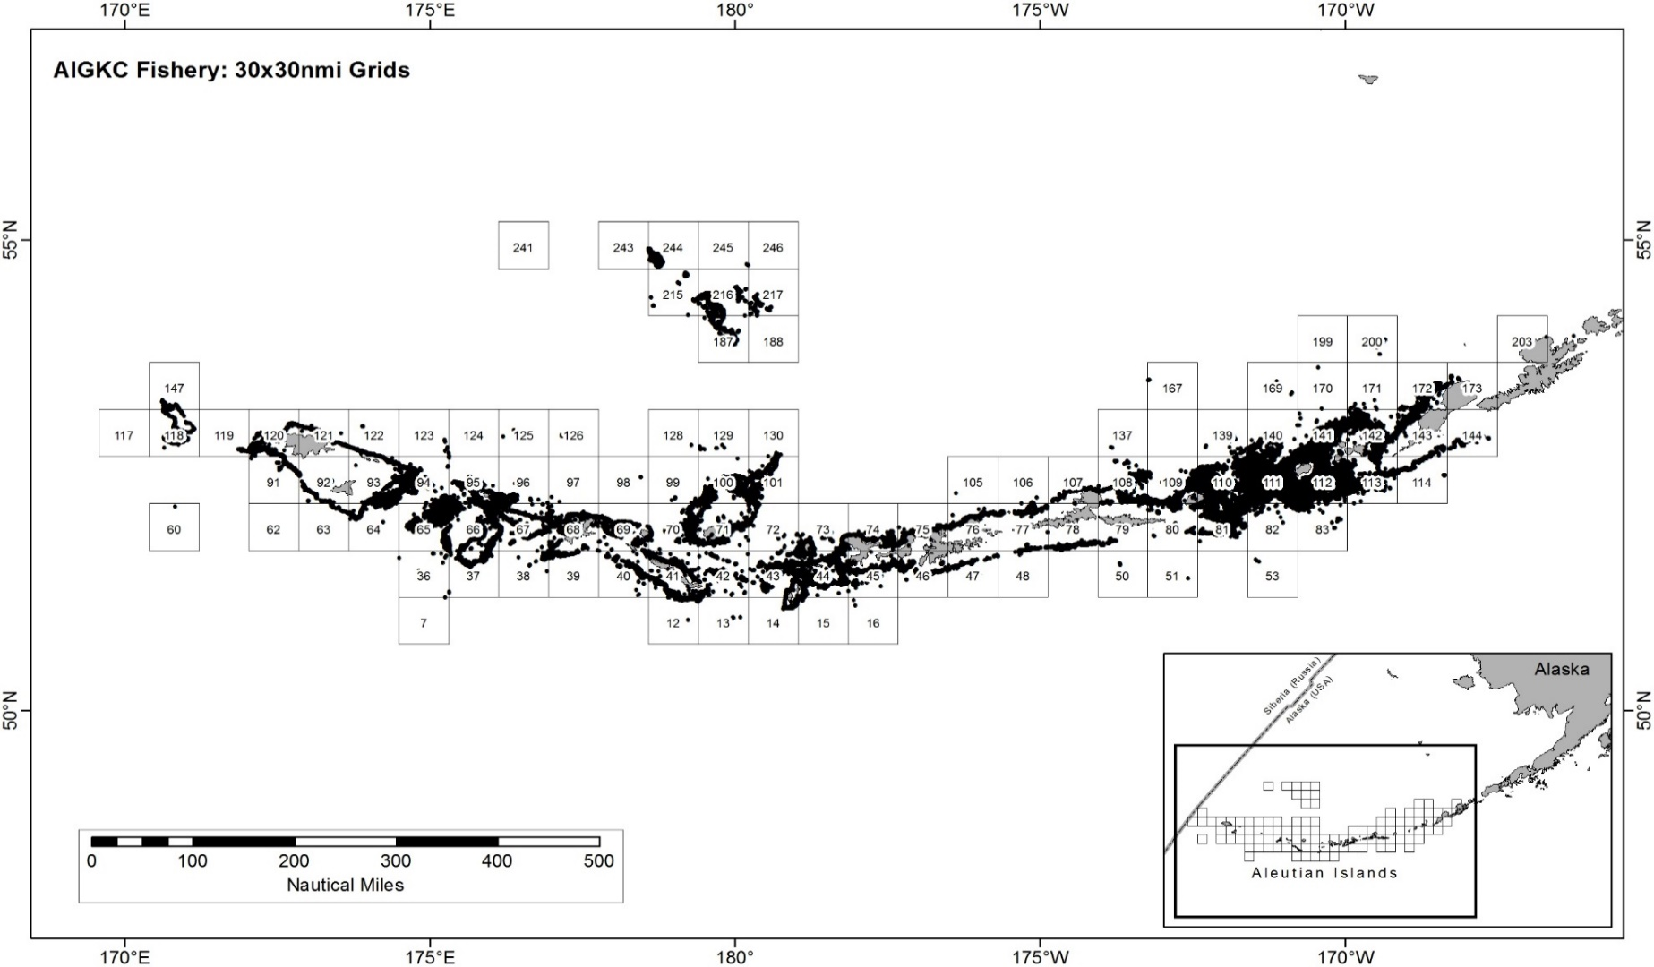
Figure B.1. The 1995/96 to 2018/19 observer pot samples enmeshed in 30X30nmi grids for the Aleutian Islands golden king crab.
Area Factor Levels (no.) | 1995-04 | 2005-18
EAG | 19 | 13
WAG | 34 | 40

Slide 24
An example bivariate correlation matrix subset of Year and Area (Grid Cell) factors for EAG, 1995/06-04/05. Note: we removed columns/rows with all NAs / Zeros before GLM fitting.
 | 1995 | 96 | 97 | 98 | 99 | 2000 | 01 | 02 | 03 | 2004 | Cell79 | Cell80 | Cell81 | Cell82 | Cell83 | Cell108 | Cell109 | Cell110 | Cell111 | Cell112 | Cell113 | Cell114 | Cell140 | Cell141 | Cell142 | Cell143 | Cell144 | Cell172
1995 | 1 | -0.14 | -0.12 | -0.11 | -0.1 | -0.1 | -0.12 | -0.1 | -0.1 | -0.08 | 0.04 | -0.02 | 0.01 | -0.02 | 0 | 0.13 | 0.05 | 0.06 | 0.02 | -0.1 | -0.06 | -0.02 | 0 | -0.08 | 0.02 | -0.01 | -0.02 | 0.02
96 | -0.14 | 1 | -0.14 | -0.13 | -0.1 | -0.2 | -0.14 | -0.1 | -0.1 | -0.09 | 0.01 | -0.01 | -0.01 | 0 | 0.04 | 0 | -0.02 | -0.03 | -0.01 | 0.12 | -0.02 | -0.02 | 0.01 | -0.06 | 0 | -0.02 | -0.03 | -0.03
97 | -0.12 | -0.14 | 1 | -0.11 | -0.1 | -0.1 | -0.11 | -0.1 | -0.1 | -0.08 | -0.01 | -0.02 | 0.03 | 0 | 0.01 | -0.03 | -0.04 | 0.06 | 0.09 | -0.06 | 0.06 | 0.02 | -0.01 | -0.07 | -0.05 | 0.02 | -0.02 | 0
98 | -0.11 | -0.13 | -0.11 | 1 | -0.1 | -0.1 | -0.11 | -0.1 | -0.1 | -0.07 | -0.01 | 0.03 | 0 | 0 | -0.01 | -0.06 | 0 | 0.01 | -0.02 | -0.01 | 0.14 | 0.02 | -0.02 | -0.02 | 0.01 | -0.01 | -0.02 | 0.01
99 | -0.11 | -0.14 | -0.11 | -0.1 | 1 | -0.1 | -0.11 | -0.1 | -0.1 | -0.07 | 0 | -0.01 | -0.05 | -0.01 | 0 | -0.06 | -0.01 | -0.06 | -0.06 | 0.1 | 0.07 | 0.08 | -0.01 | 0.01 | -0.03 | 0.01 | 0.2 | 0.05
00 | -0.13 | -0.16 | -0.13 | -0.12 | -0.1 | 1 | -0.13 | -0.1 | -0.1 | -0.09 | 0 | 0 | 0 | 0.02 | 0.01 | -0.04 | 0.01 | -0.04 | 0.04 | -0.03 | -0.03 | -0.02 | 0.02 | 0.07 | 0.01 | -0.02 | -0.03 | -0.02
01 | -0.12 | -0.14 | -0.11 | -0.11 | -0.1 | -0.1 | 1 | -0.1 | -0.1 | -0.08 | -0.01 | 0.07 | 0.04 | -0.02 | -0.01 | 0 | 0.02 | -0.02 | -0.04 | -0.01 | -0.05 | -0.02 | -0.02 | 0.05 | 0.04 | -0.03 | -0.02 | -0.02
02 | -0.11 | -0.13 | -0.1 | -0.1 | -0.1 | -0.1 | -0.1 | 1 | -0.1 | -0.07 | -0.01 | -0.02 | -0.01 | 0.01 | -0.02 | 0 | -0.04 | 0.02 | 0 | 0.01 | -0.03 | -0.01 | 0.02 | 0.01 | 0 | 0.11 | -0.01 | -0.02
03 | -0.11 | -0.13 | -0.11 | -0.1 | -0.1 | -0.1 | -0.11 | -0.1 | 1 | -0.07 | -0.01 | -0.02 | 0.01 | 0 | -0.02 | 0.04 | -0.02 | 0.01 | -0.02 | -0.02 | -0.04 | -0.02 | 0 | 0.07 | 0 | -0.02 | -0.02 | -0.02
2004 | -0.08 | -0.09 | -0.08 | -0.07 | -0.1 | -0.1 | -0.08 | -0.1 | -0.1 | 1 | -0.01 | 0 | -0.02 | 0.02 | -0.02 | 0 | 0.06 | 0.01 | -0.03 | -0.02 | -0.03 | -0.01 | 0 | 0.04 | -0.01 | -0.02 | -0.02 | 0.07
Cell79 | 0.04 | 0.01 | -0.01 | -0.01 | 0 | 0 | -0.01 | -0 | -0 | -0.01 | 1 | 0 | -0.01 | 0 | 0 | -0.01 | -0.01 | -0.01 | -0.02 | -0.02 | -0.01 | 0 | 0 | -0.01 | -0.01 | 0 | 0 | 0
Cell80 | -0.02 | -0.01 | -0.02 | 0.03 | -0 | 0 | 0.07 | -0 | -0 | 0 | 0 | 1 | -0.02 | -0.01 | -0.01 | -0.02 | -0.02 | -0.04 | -0.05 | -0.04 | -0.02 | 0 | -0.01 | -0.04 | -0.03 | -0.01 | -0.01 | -0.01
Cell81 | 0.01 | -0.01 | 0.03 | 0 | -0.1 | 0 | 0.04 | -0 | 0.01 | -0.02 | -0.01 | -0.02 | 1 | -0.02 | -0.02 | -0.05 | -0.05 | -0.08 | -0.1 | -0.1 | -0.05 | -0.01 | -0.02 | -0.08 | -0.06 | -0.02 | -0.01 | -0.01
Cell82 | -0.02 | 0 | 0 | 0 | -0 | 0.02 | -0.02 | 0.01 | 0 | 0.02 | 0 | -0.01 | -0.02 | 1 | -0.01 | -0.02 | -0.02 | -0.03 | -0.04 | -0.04 | -0.02 | 0 | -0.01 | -0.03 | -0.02 | -0.01 | -0.01 | -0.01
Cell83 | 0 | 0.04 | 0.01 | -0.01 | 0 | 0.01 | -0.01 | -0 | -0 | -0.02 | 0 | -0.01 | -0.02 | -0.01 | 1 | -0.02 | -0.02 | -0.03 | -0.04 | -0.04 | -0.02 | 0 | -0.01 | -0.03 | -0.02 | -0.01 | -0.01 | -0.01
Cell108 | 0.13 | 0 | -0.03 | -0.06 | -0.1 | -0 | 0 | 0 | 0.04 | 0 | -0.01 | -0.02 | -0.05 | -0.02 | -0.02 | 1 | -0.07 | -0.1 | -0.12 | -0.12 | -0.06 | -0.01 | -0.03 | -0.1 | -0.07 | -0.02 | -0.02 | -0.02
Cell109 | 0.05 | -0.02 | -0.04 | 0 | -0 | 0.01 | 0.02 | -0 | -0 | 0.06 | -0.01 | -0.02 | -0.05 | -0.02 | -0.02 | -0.07 | 1 | -0.11 | -0.13 | -0.13 | -0.06 | -0.01 | -0.03 | -0.1 | -0.08 | -0.02 | -0.02 | -0.02
Cell110 | 0.06 | -0.03 | 0.06 | 0.01 | -0.1 | -0 | -0.02 | 0.02 | 0.01 | 0.01 | -0.01 | -0.04 | -0.08 | -0.03 | -0.03 | -0.1 | -0.11 | 1 | -0.2 | -0.19 | -0.1 | -0.02 | -0.05 | -0.16 | -0.12 | -0.03 | -0.03 | -0.03
Cell111 | 0.02 | -0.01 | 0.09 | -0.02 | -0.1 | 0.04 | -0.04 | 0 | -0 | -0.03 | -0.02 | -0.05 | -0.1 | -0.04 | -0.04 | -0.12 | -0.13 | -0.2 | 1 | -0.23 | -0.12 | -0.02 | -0.05 | -0.19 | -0.14 | -0.04 | -0.03 | -0.03
Cell112 | -0.1 | 0.12 | -0.06 | -0.01 | 0.1 | -0 | -0.01 | 0.01 | -0 | -0.02 | -0.02 | -0.04 | -0.1 | -0.04 | -0.04 | -0.12 | -0.13 | -0.19 | -0.23 | 1 | -0.11 | -0.02 | -0.05 | -0.18 | -0.14 | -0.04 | -0.03 | -0.03
Cell113 | -0.06 | -0.02 | 0.06 | 0.14 | 0.07 | -0 | -0.05 | -0 | -0 | -0.03 | -0.01 | -0.02 | -0.05 | -0.02 | -0.02 | -0.06 | -0.06 | -0.1 | -0.12 | -0.11 | 1 | -0.01 | -0.03 | -0.09 | -0.07 | -0.02 | -0.02 | -0.02
Cell114 | -0.02 | -0.02 | 0.02 | 0.02 | 0.08 | -0 | -0.02 | -0 | -0 | -0.01 | 0 | 0 | -0.01 | 0 | 0 | -0.01 | -0.01 | -0.02 | -0.02 | -0.02 | -0.01 | 1 | -0.01 | -0.02 | -0.01 | 0 | 0 | 0
Cell140 | 0 | 0.01 | -0.01 | -0.02 | -0 | 0.02 | -0.02 | 0.02 | 0 | 0 | 0 | -0.01 | -0.02 | -0.01 | -0.01 | -0.03 | -0.03 | -0.05 | -0.05 | -0.05 | -0.03 | -0.01 | 1 | -0.04 | -0.03 | -0.01 | -0.01 | -0.01
Cell141 | -0.08 | -0.06 | -0.07 | -0.02 | 0.01 | 0.07 | 0.05 | 0.01 | 0.07 | 0.04 | -0.01 | -0.04 | -0.08 | -0.03 | -0.03 | -0.1 | -0.1 | -0.16 | -0.19 | -0.18 | -0.09 | -0.02 | -0.04 | 1 | -0.11 | -0.03 | -0.03 | -0.03
Cell142 | 0.02 | 0 | -0.05 | 0.01 | -0 | 0.01 | 0.04 | 0 | 0 | -0.01 | -0.01 | -0.03 | -0.06 | -0.02 | -0.02 | -0.07 | -0.08 | -0.12 | -0.14 | -0.14 | -0.07 | -0.01 | -0.03 | -0.11 | 1 | -0.02 | -0.02 | -0.02
Cell143 | -0.01 | -0.02 | 0.02 | -0.01 | 0.01 | -0 | -0.03 | 0.11 | -0 | -0.02 | 0 | -0.01 | -0.02 | -0.01 | -0.01 | -0.02 | -0.02 | -0.03 | -0.04 | -0.04 | -0.02 | 0 | -0.01 | -0.03 | -0.02 | 1 | -0.01 | -0.01
Cell144 | -0.02 | -0.03 | -0.02 | -0.02 | 0.2 | -0 | -0.02 | -0 | -0 | -0.02 | 0 | -0.01 | -0.01 | -0.01 | -0.01 | -0.02 | -0.02 | -0.03 | -0.03 | -0.03 | -0.02 | 0 | -0.01 | -0.03 | -0.02 | -0.01 | 1 | 0
Cell172 | 0.02 | -0.03 | 0 | 0.01 | 0.05 | -0 | -0.02 | -0 | -0 | 0.07 | 0 | -0.01 | -0.01 | -0.01 | -0.01 | -0.02 | -0.02 | -0.03 | -0.03 | -0.03 | -0.02 | 0 | -0.01 | -0.03 | -0.02 | -0.01 | 0 | 1

Slide 25

Year:Area interaction model
Null model:
$\ln\left({CPUE}_{i}\right)={Year}_{y_{i}}$:Area_{ai} (B.12)
The maximum set of model terms offered to the stepwise selection procedure was:
${ln⁡(CPUE}_{I}) ={Year}_{y_{i}}:{Area}_{ai}+ns\left({Soak}_{si},df\right)+{Month}_{m_{i}}+{Vessel}_{vi}+{Captain}_{ci}+{Area}_{ai}+{Gear}_{gi}+ns\left({Depth}_{di},df\right)$,
R Code
library(MASS)
library(splines)
Step 1:
glm.object<- glm(Legals~Year:Area, family = negative.binomial(1.0), data=datacore)
wpotsampleoutAIC<-stepAIC(glm.object, S
scope=list(upper= ~(Year:Area+ns(SoakDays,df=8)+Month+Vessel+Captain+Area+Gear+ns(Depth,df=10)),
lower=~Year:Area),
family= negative.binomial(1.0),direction="forward",trace=9,k=log(nrow(datacore))+1.0)
Step 2:
glm.object<- glm(Legals~Year:Area,family = negative.binomial(1.0),data=datacore)
wpotsampleout<-stepCPUE(glm.object,scope=list(upper=~(Captain+ns(SoakDays,df=8)+Gear+Area+Month+Year:Area),lower= ~Year:Area),
family= negative.binomial(1.0),direction="forward",trace=9,r2.change=0.01)

Slide 26

Table B.2. Comparison of CPUE indices and variances of log CPUE between EAG and WAG for scenario 19_2. Year:Area Interaction factor was considered for CPUE indices calculation.
Year | EAG CPUE Index 19_2 | EAG Variance (ln(CPUE)) | WAG CPUE Index 19_2 | WAG Variance (ln(CPUE))
1995 | 0.8796 | 0.9656 | 0.9291 | 0.0725
1996 | 0.6943 | 0.9651 | 1.0757 | 0.0645
1997 | 0.7232 | 0.9045 | 0.9771 | 0.0283
1998 | 0.9321 | 0.9045 | 0.9623 | 0.0918
1999 | 0.8269 | 0.9275 | 0.8855 | 0.0384
2000 | 0.8824 | 0.9170 | 0.8203 | 0.0358
2001 | 1.3353 | 0.9591 | 0.8227 | 0.0275
2002 | 1.2385 | 0.9623 | 1.1716 | 0.0523
2003 | 1.1646 | 0.9049 | 1.0789 | 0.0328
2004 | 1.7285 | 0.8996 | 1.4085 | 0.0574
2005 | 0.9103 | 0.0539 | 1.1771 | 0.0649
2006 | 0.7970 | 0.0457 | 1.1095 | 0.0782
2007 | 0.9785 | 0.0589 | 1.0932 | 0.0764
2008 | 0.7926 | 0.0540 | 1.1148 | 0.0899
2009 | 0.5490 | 0.0630 | 1.2306 | 0.0695
2010 | 0.9999 | 0.0571 | 0.9935 | 0.0686
2011 | 1.1685 | 0.0709 | 1.2384 | 0.1084
2012 | 0.9646 | 0.0520 | 0.9521 | 0.1160
2013 | 1.3463 | 0.0491 | 0.9121 | 0.0893
2014 | 1.3650 | 0.0572 | 0.7339 | 0.1101
2015 | 1.2458 | 0.0639 | 0.7906 | 0.0769
2016 | 1.2662 | 0.0434 | 0.7636 | 0.0788
2017 | 0.9440 | 0.0371 | 0.8403 | 0.0958
2018 | 1.0498 | 0.0420 | 1.2837 | 0.1020
${Index}_{yi}=\sum_{i}{e^{coefficient ({Year}_{i} : {Area}_{i})}} X {Area}_{i}$
scaled by geometric means of the indices

Slide 27
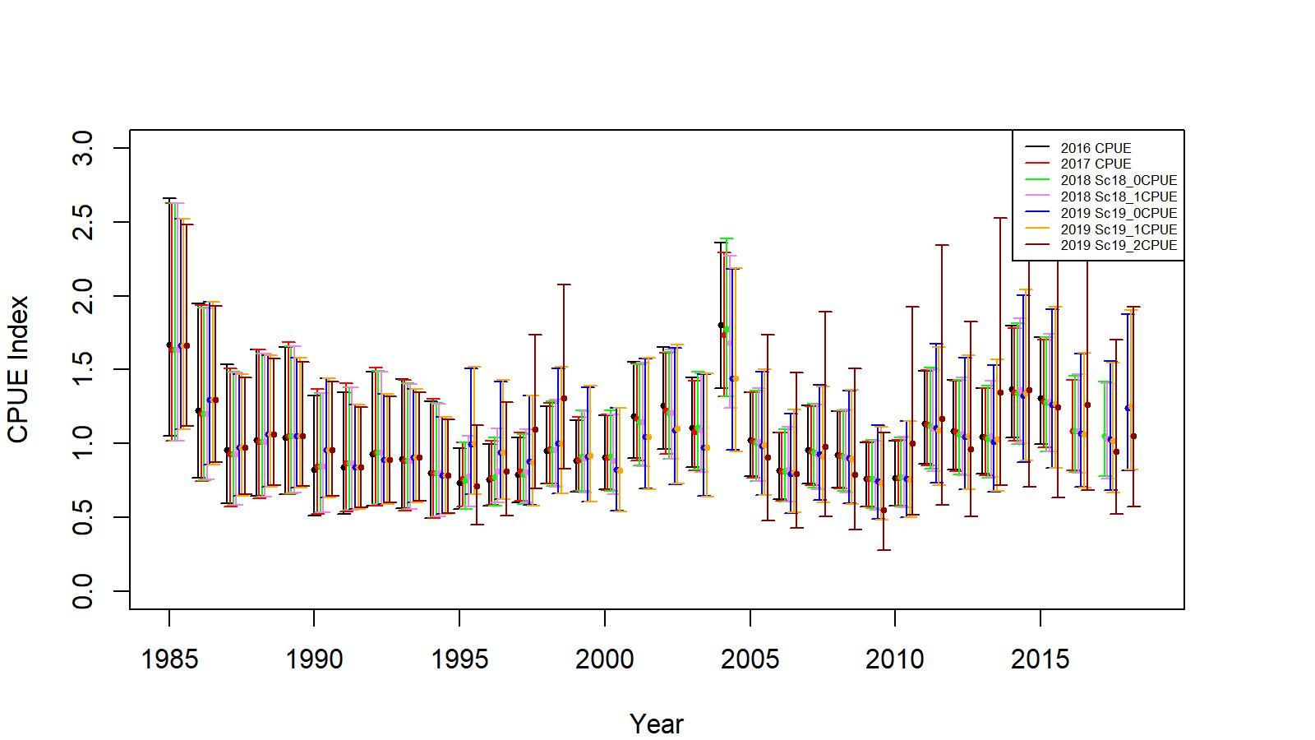
Figure B.2. Comparison of input CPUE indices for scenarios 2016 (ADF&G area codes grouped into 10 groups, up to 2015/16 data), 2017 (ADF&G area codes not grouped, up to 2016/17 data), 2018 Sc 18_0 (Lat and Long position of observed pot, up to 2017/18 data), 2018 Sc18_1 ( Lat and Long position of observed pot, reduced number of gear codes, , up to 2017/18 data), 2019 Sc 19_0 (Grid Cell position of observed pot, up to 2018/19 data), 2019 Sc 19_1 (Grid Cell position of observed pot, reduced number of gear codes, up to 2018/19 data), and 2019 Sc 19_2a (Grid Cell position of observed pot, reduced number of gear codes, fish ticket CPUE indices extended up to 1998/99, pre rationalization period observer CPUE indices ignored, up to 2018/19 data) for EAG golden king crab. Model estimated additional standard error was added to each input standard error for 2-standard error confidence interval determination.

Slide 28
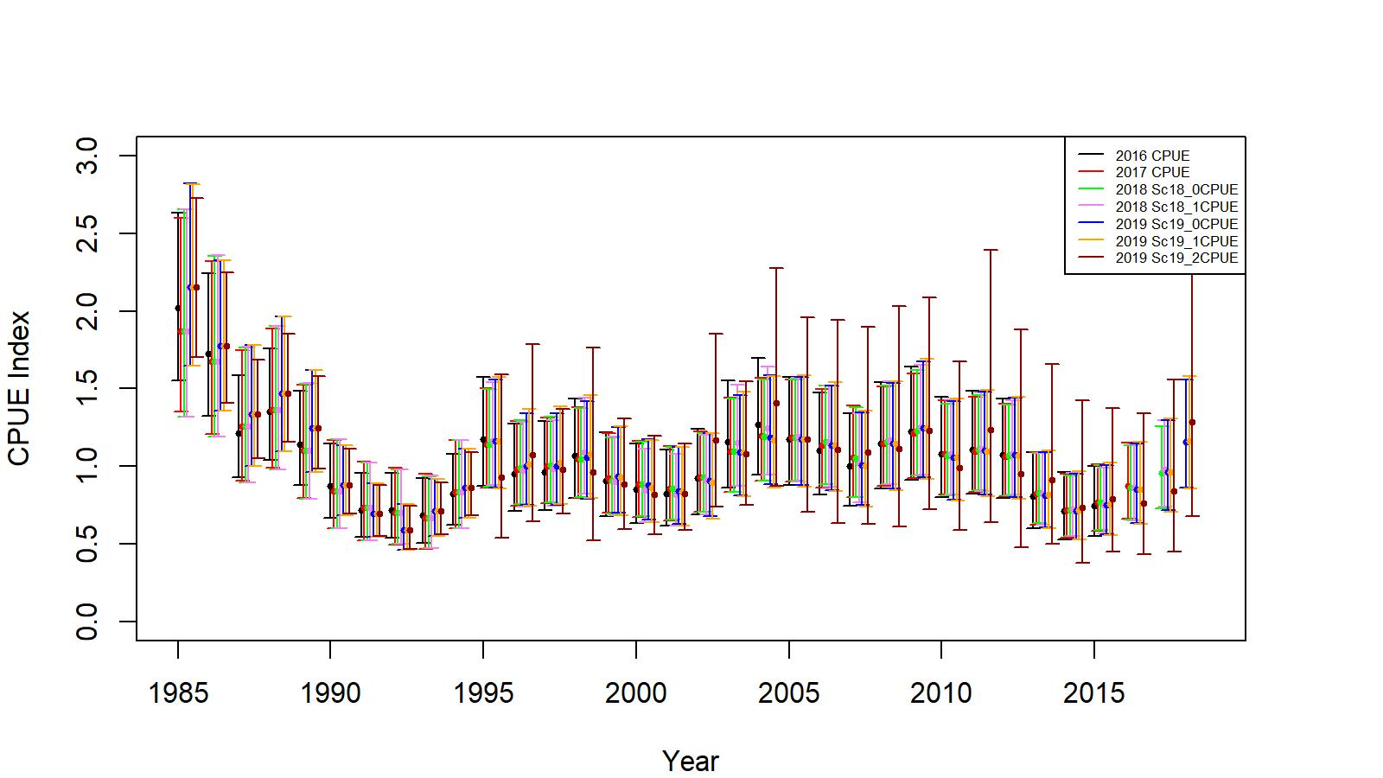
Figure B.3. Comparison of input CPUE indices for scenarios 2016 (ADF&G area codes grouped into 10 groups, up to 2015/16 data), 2017 (ADF&G area codes not grouped, up to 2016/17 data), 2018 Sc 18_0 (Lat and Long position of observed pot, up to 2017/18 data), 2018 Sc18_1 ( Lat and Long position of observed pot, reduced number of gear codes, , up to 2017/18 data), 2019 Sc 19_0 (Grid Cell position of observed pot, up to 2018/19 data), 2019 Sc 19_1 (Grid Cell position of observed pot, reduced number of gear codes, up to 2018/19 data), and 2019 Sc 19_2 (Grid Cell position of observed pot, reduced number of gear codes, up to 2018/19 data) for WAG golden king crab. Model estimated additional standard error was added to each input standard error for 2-standard error confidence interval determination.

Slide 29
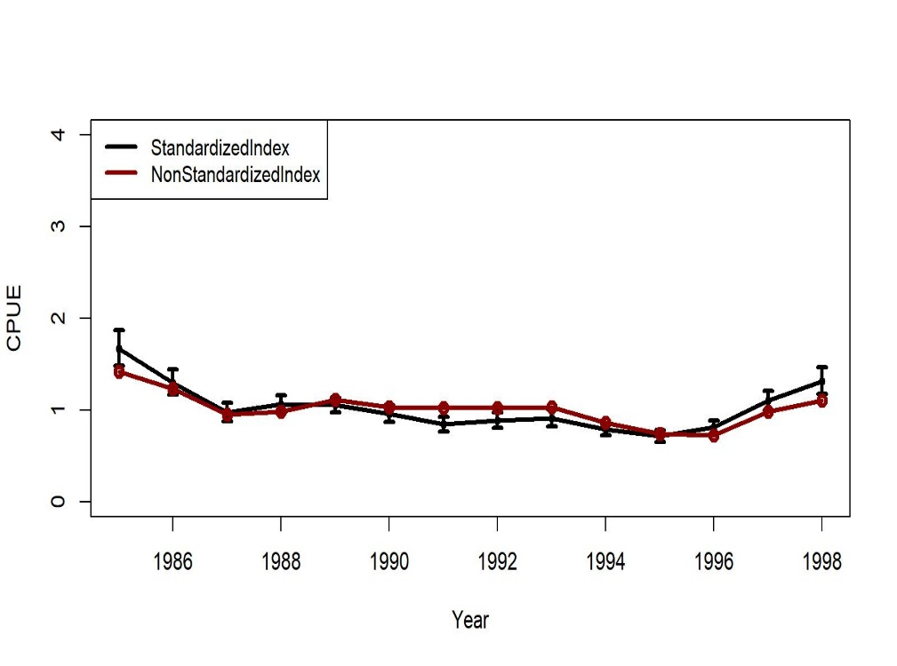
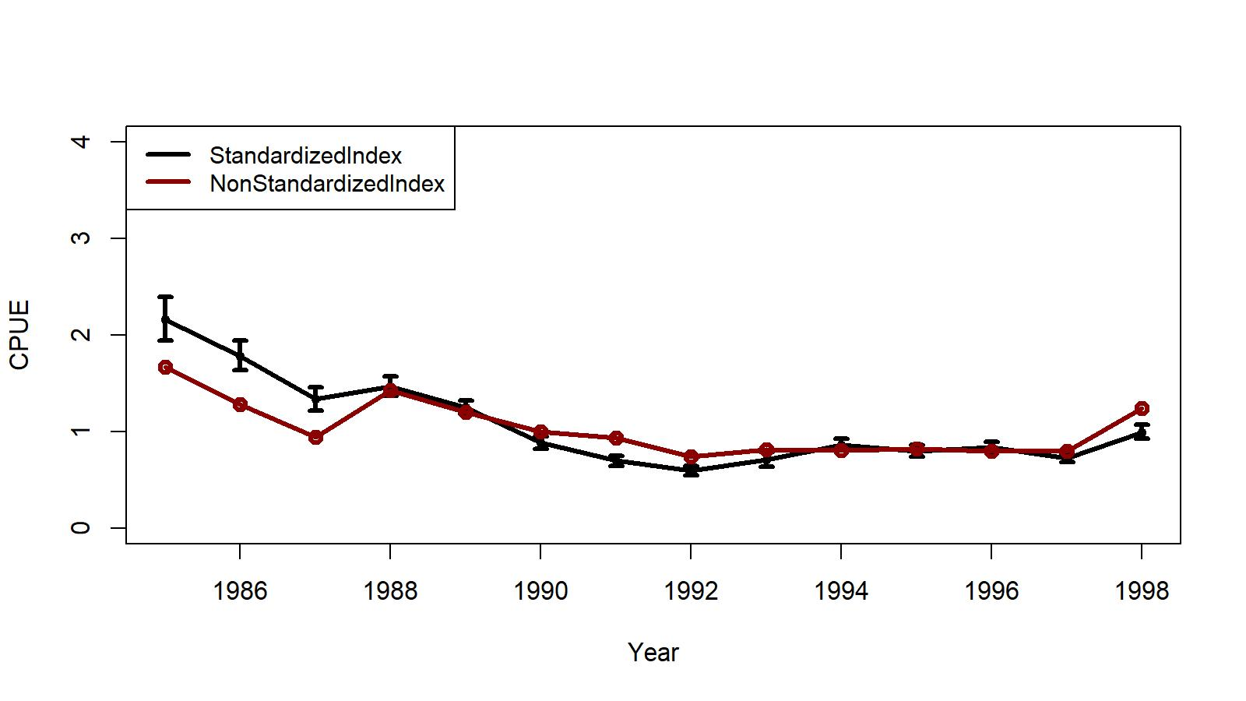

Fish Ticket CPUE by GLM
Figures B.6 and B.7. Trends in non-standardized and standardized (lognormal GLM) CPUE indices with +/- 2 SE for EAG (left panel) and WAG (right panel). The 1985/86–1998/99 fish ticket data set was used. Standardized indices: black line and non-standardized indices: red line. Variables selected by the hybrid method.
EAG
WAG
$$\ln\left(CPUE\right)= Year +Vessel+Month, R^{2}=0.3700$$
$$\ln\left(CPUE\right)= Year +Vessel, R^{2}=0.3679$$

Slide 30
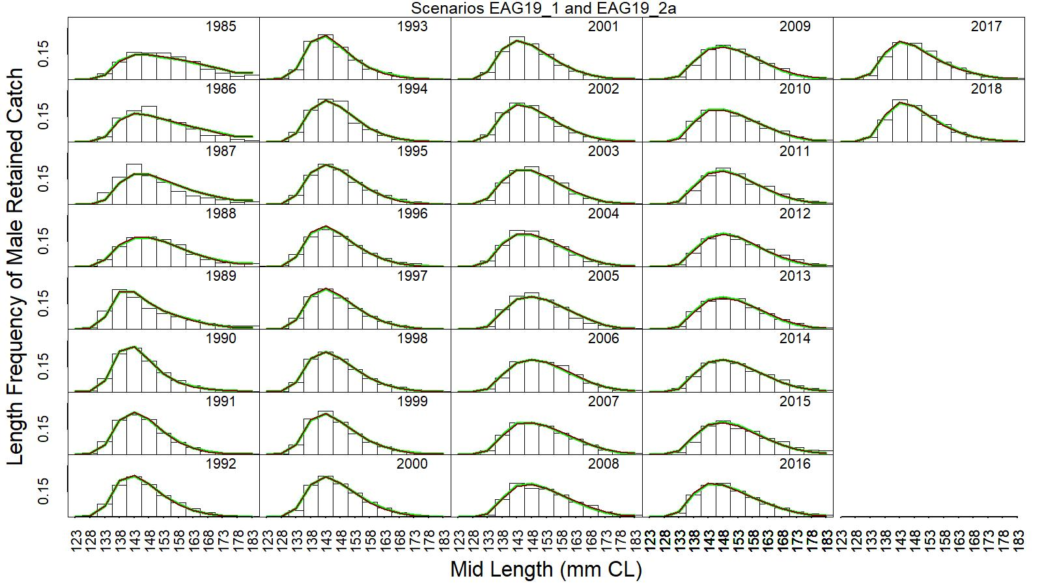
Figure 9. Predicted (line) vs. observed (bar) retained catch relative length frequency distributions under scenarios 19_1 (green line) and 19_2a (dark red line) for golden king crab in the EAG, 1985/86 to 2018/19. This color scheme is used in all other figures.

Slide 31
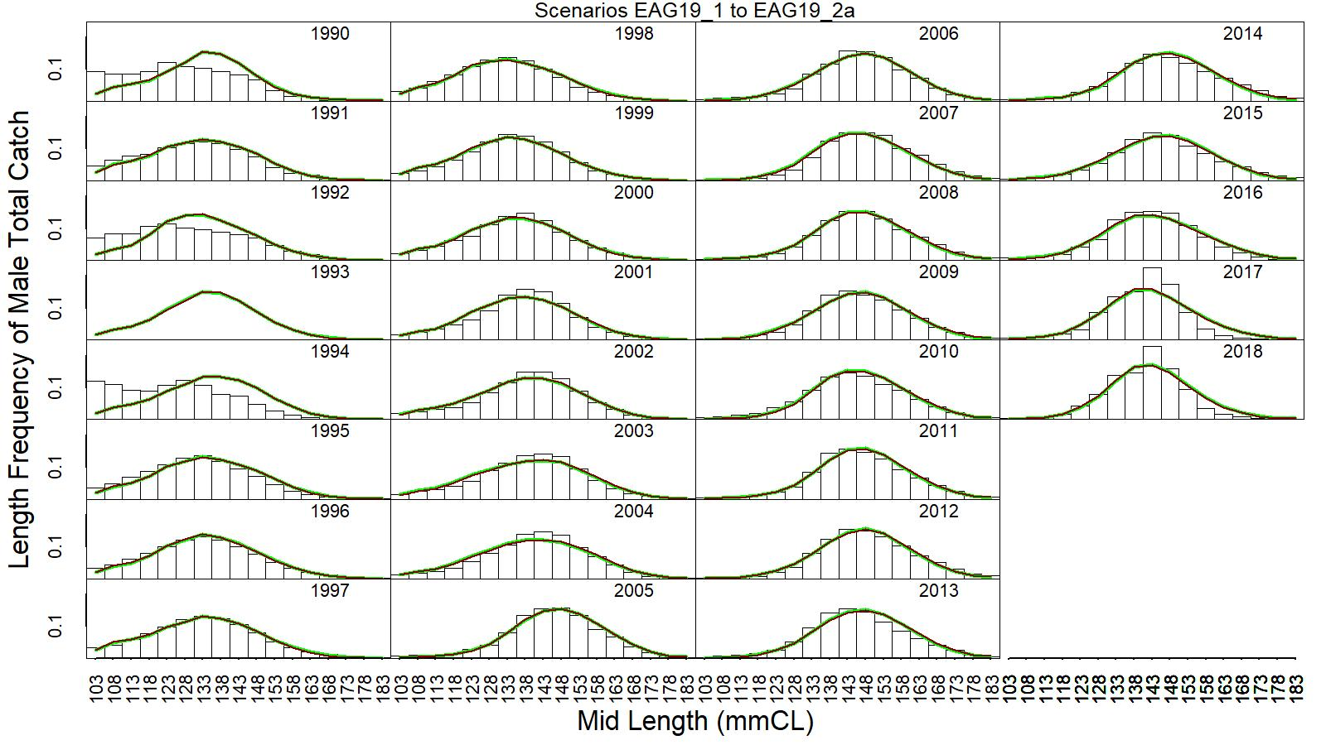
Figure 10. Predicted (line) vs. observed (bar) total catch relative length frequency distributions under scenarios 19_1 (green line) and 19_2a (dark red line) for golden king crab in the EAG, 1990/91 to 2018/19.

Slide 32
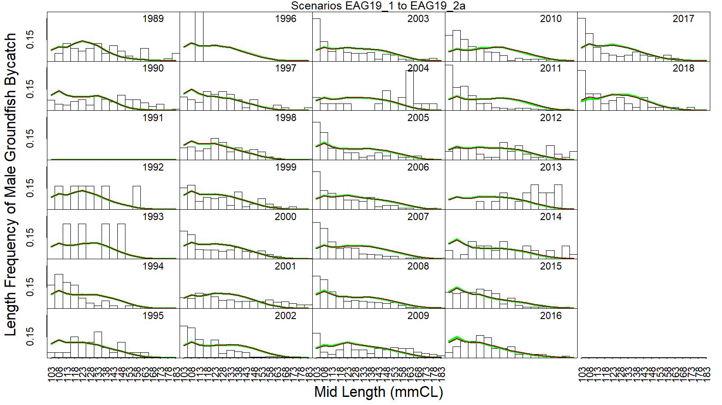
Figure 11. Predicted (line) vs. observed (bar) groundfish discarded bycatch relative length frequency distributions under scenarios 19_1 (green line) and 19_2a (dark red line) for golden king crab in the EAG, 1989/90 to 2018/19.

Slide 33
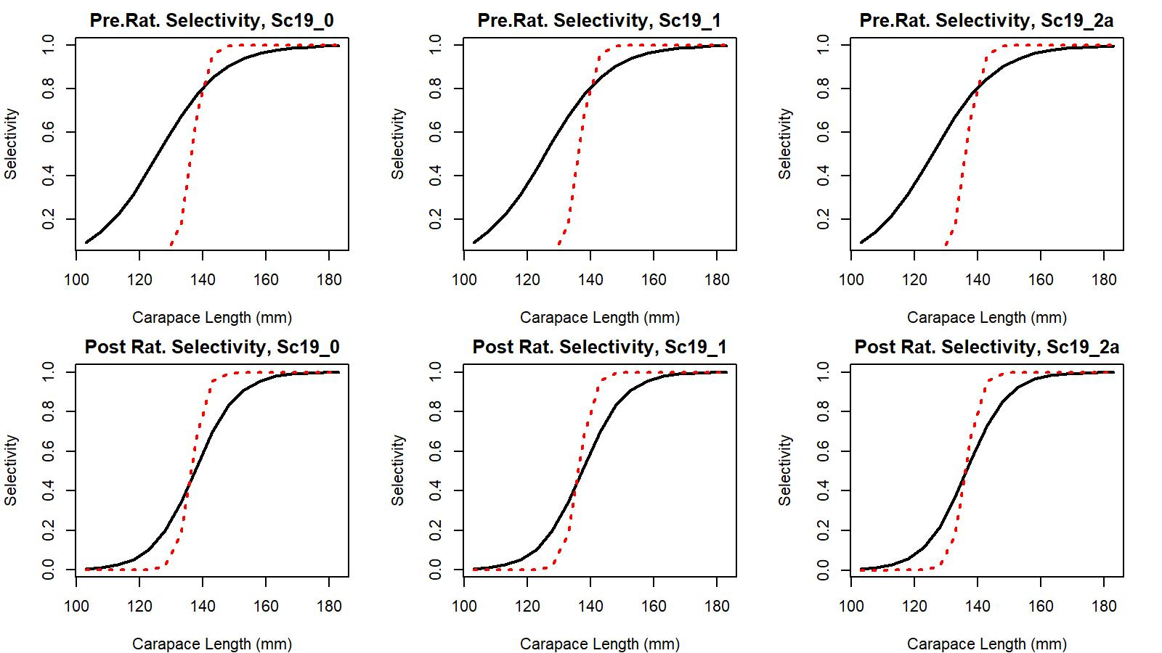
Figure 12. Estimated total (black solid line) and retained selectivity (red dotted line) for pre- and post- rationalization periods under scenarios 19_0, 19_1, and 19_2a model fits to golden king crab data in the EAG.

Slide 34
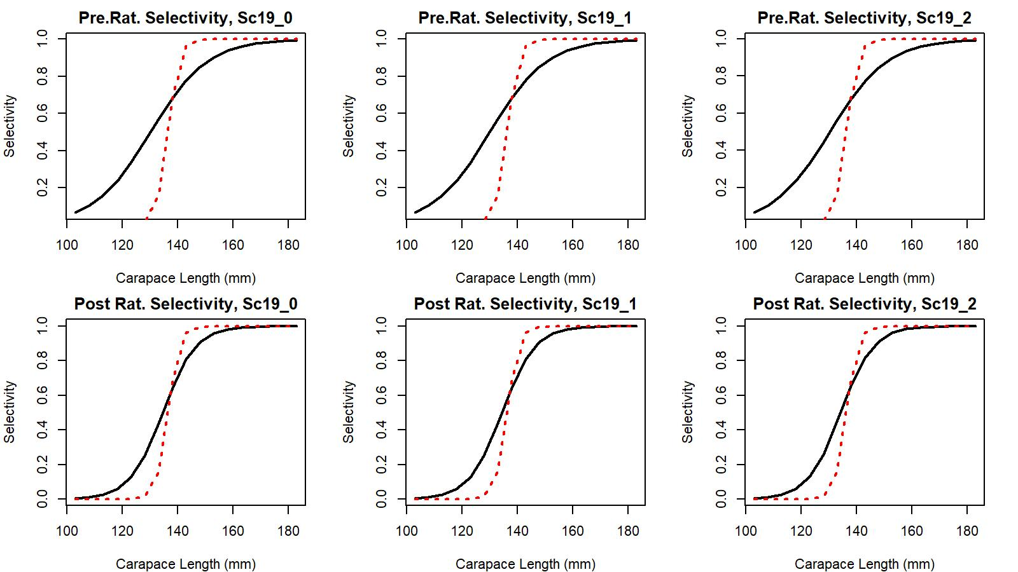
Figure 30. Estimated total (black solid line) and retained selectivity (red dotted line) for pre- and post- rationalization periods under scenarios 19_0, 19_1, and 19_2a model fits to golden king crab data in the WAG.

Slide 35
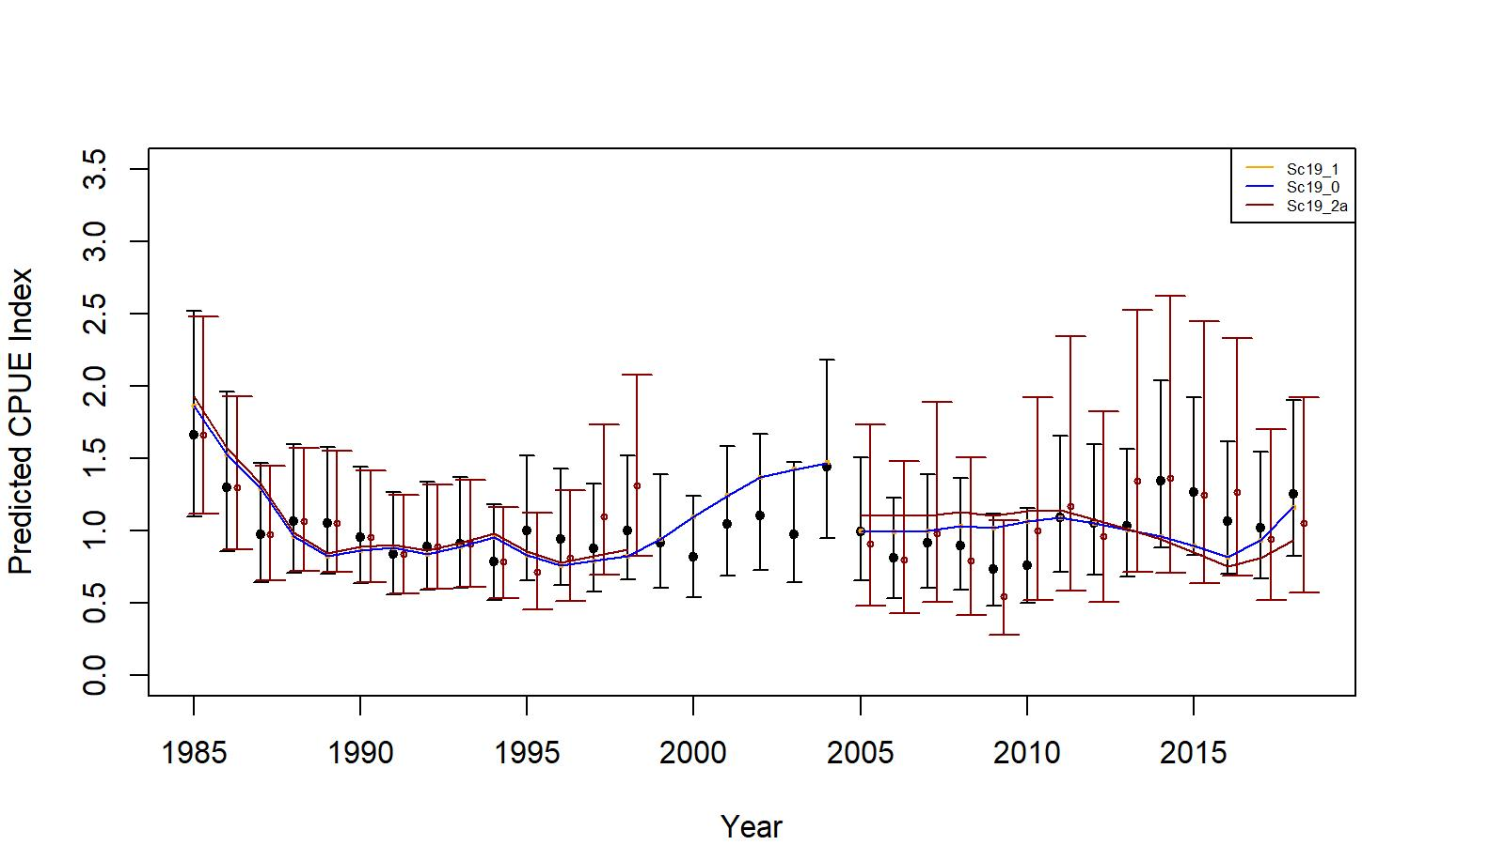
Figure 24. Comparison of input CPUE indices [closed circles with +/- 2 SE for Sc19_1(black) and Sc19_2a (dark red)] with predicted CPUE indices (colored solid lines) under scenarios 19_0, 19_1, and 19_2a for EAG golden king crab data, 1985/86–2018/19. Model estimated additional standard error was added to each input standard error.

Slide 36
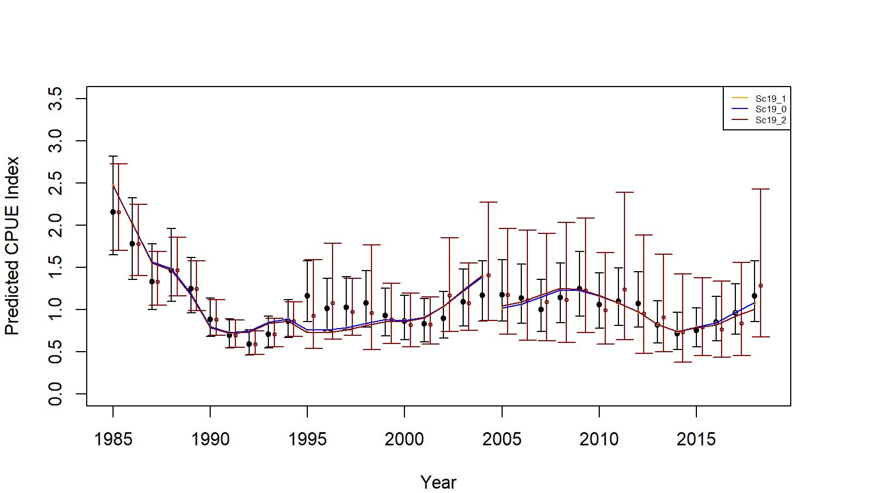
Figure 42. . Comparison of input CPUE indices [closed circles with +/- 2 SE for Sc19_1 (black) and Sc19_2 (dark red)] with predicted CPUE indices (colored solid lines) under scenarios 19_0, 19_1, and 19_2 for WAG golden king crab data, 1985/86–2018/19. Model estimated additional standard error was added to each input standard error.

Slide 37
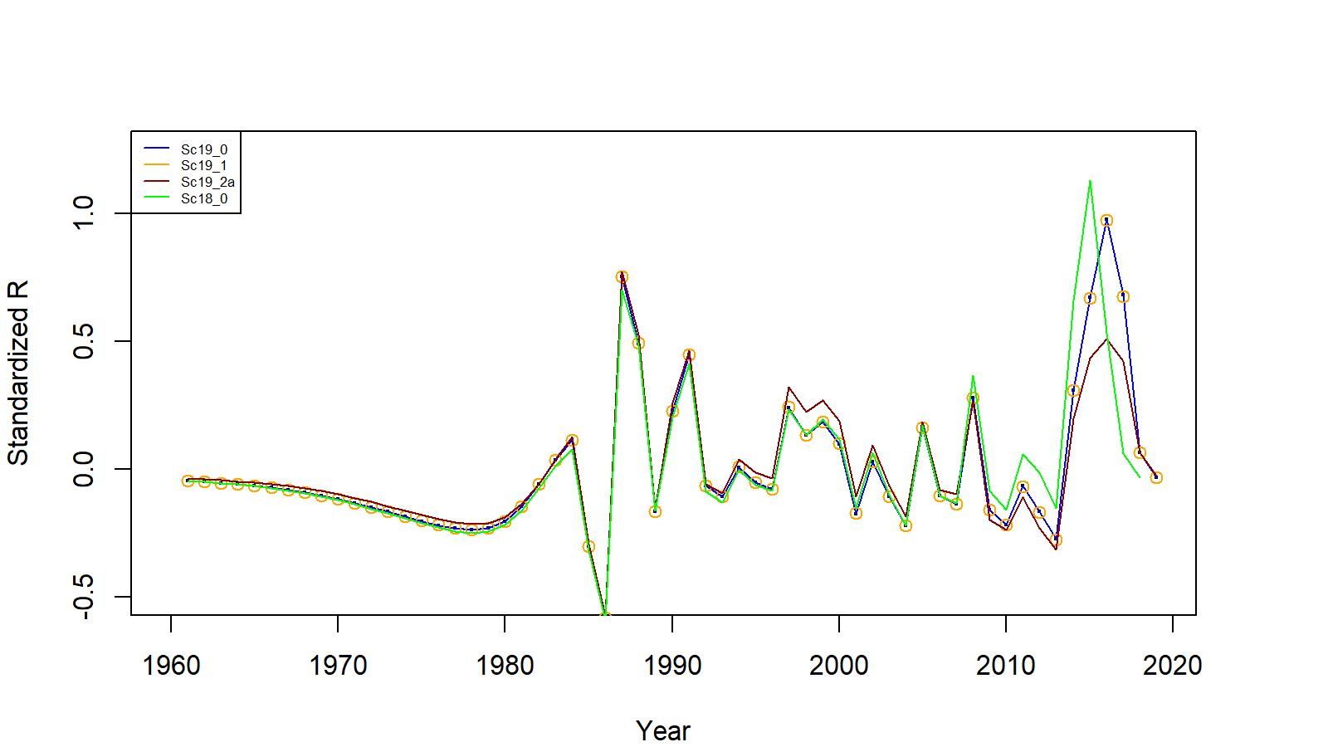
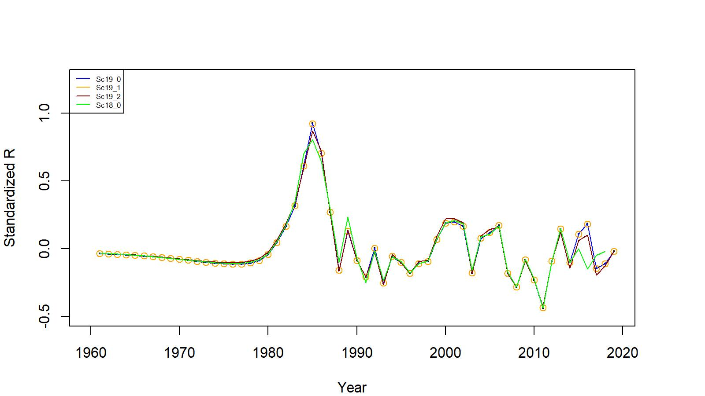
Figs. 14 and 32. Estimated number of male recruits to the assessment model under scenarios (Sc) 18_0 (up to 2017/18 data, green curve), 19_0 (up to 2018/19 data), 19_1, 19_2, and 19_2a for EAG (top) and WAG (bottom). The number of recruits are standardized using (R-mean R)/mean R.
EAG
WAG

Slide 38
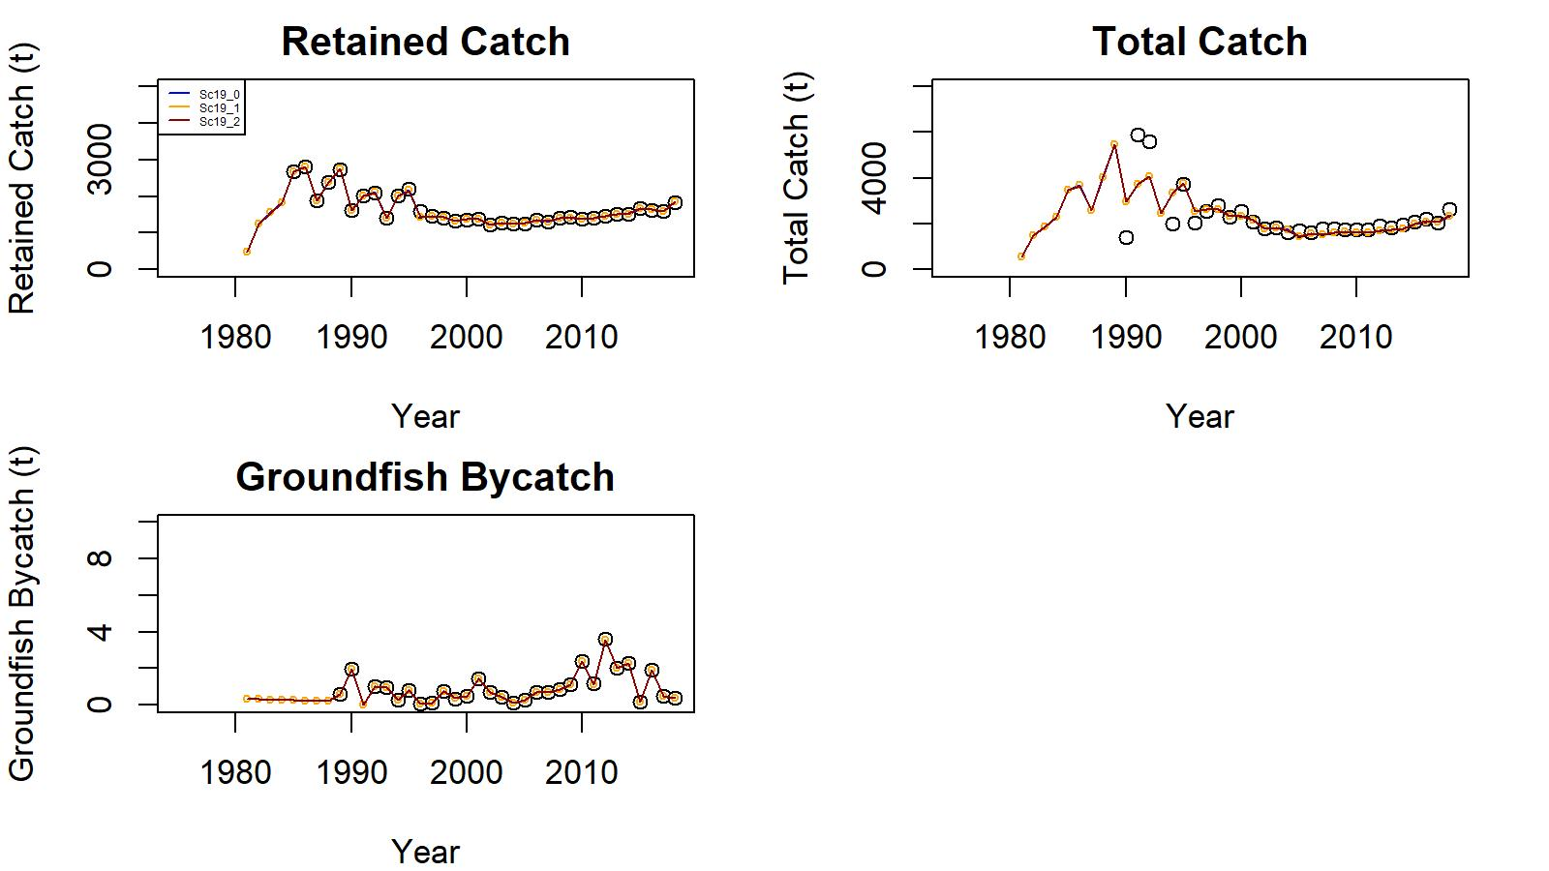
Figure 17. Observed (open circle) vs. predicted (solid line) retained catch (top left), total catch (top right), and groundfish bycatch (bottom left) of golden king crab for scenarios 19_0, 19_1, and 19_2a fits in EAG, 1981/82–2018/19.

Slide 39
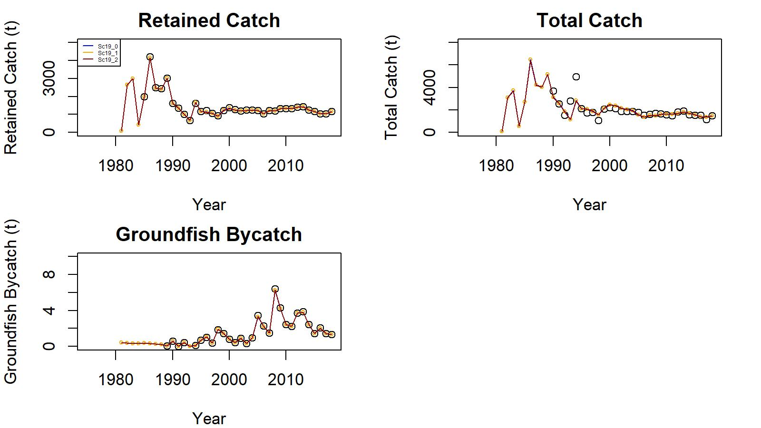
Figure 35. Observed (open circle) vs. predicted (solid line) retained catch (top left), total catch (top right), and groundfish bycatch (bottom left) of golden king crab for scenarios 19_0, 19_1, and 19_2 fits in WAG, 1981/82–2018/19.
.

Slide 40
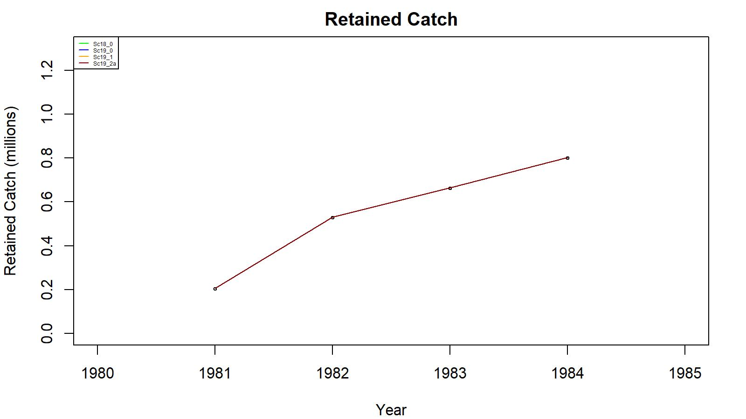
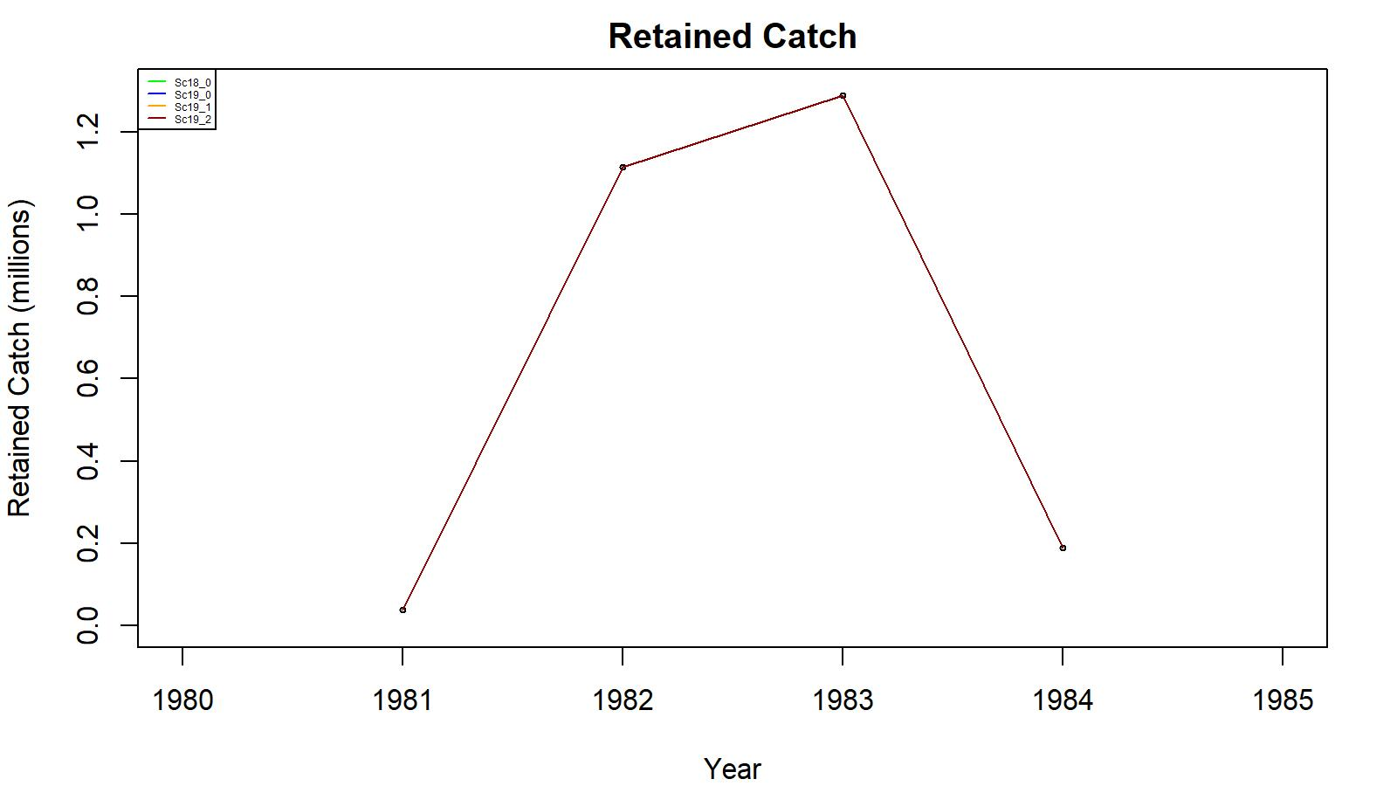
Figures 18 and 36. Observed (open circle) vs. predicted (solid line) retained catch of golden king crab for scenarios (Sc) 18_0 (up to 2017/18 data, green curve), 19_0 (up to 2018/19 data), 19_1, and 19_2a for EAG (top) and WAG (bottom), 1981/82–1984/85.
EAG
WAG

Slide 41
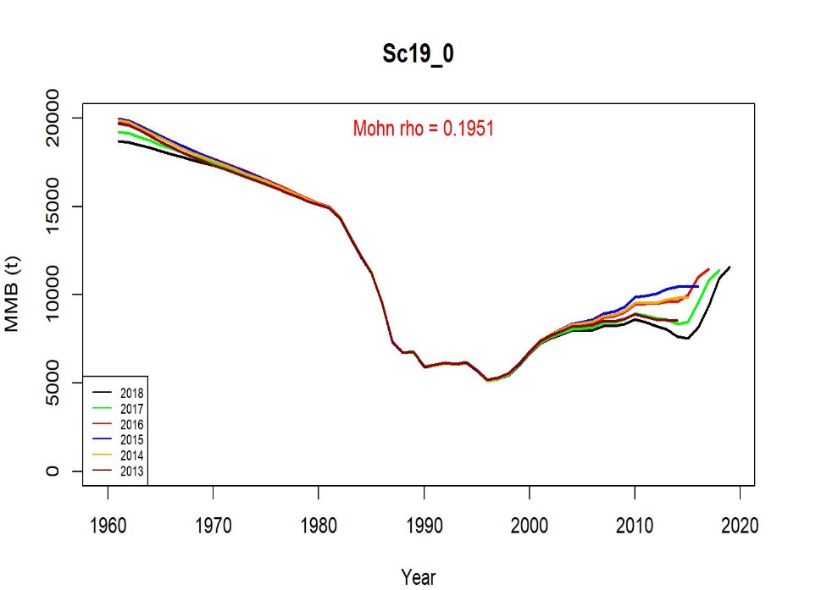
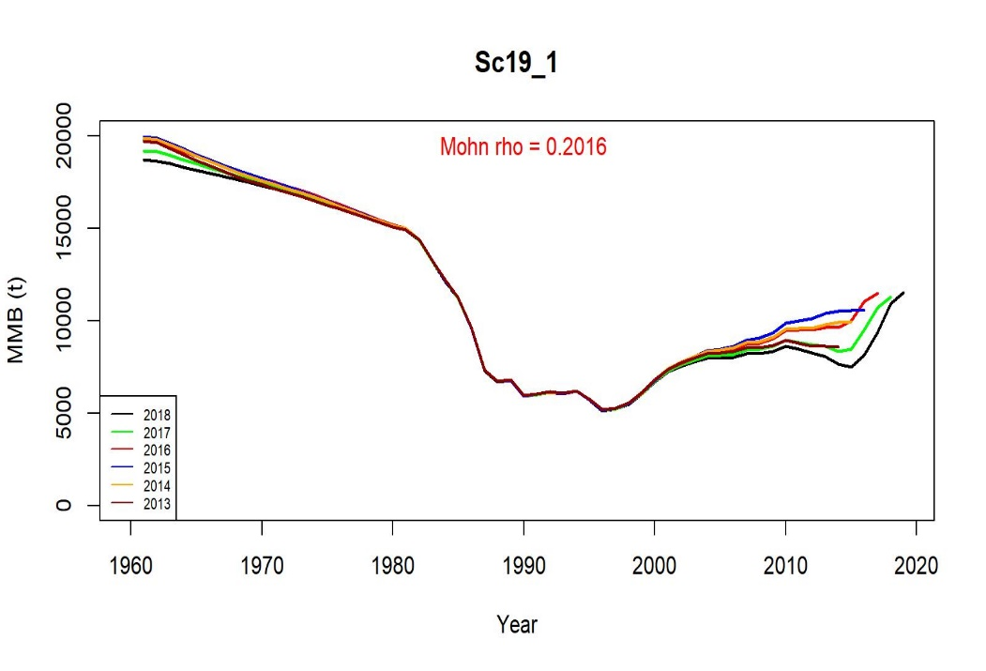
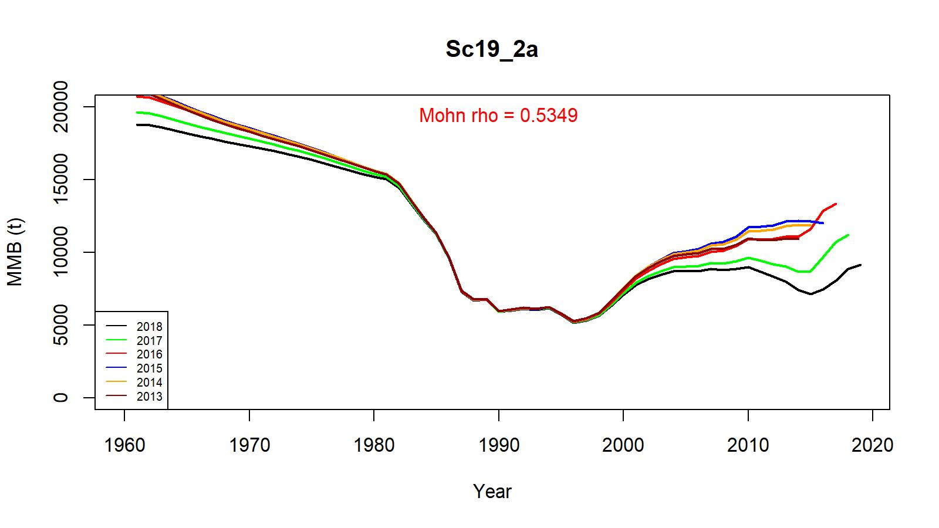
Figure 23. Retrospective fits of MMB by the model following removal of terminal year data under scenarios 19_0, 19_1 and 19_2a for golden king crab in the EAG, 1960/61–2018/19.

Slide 42
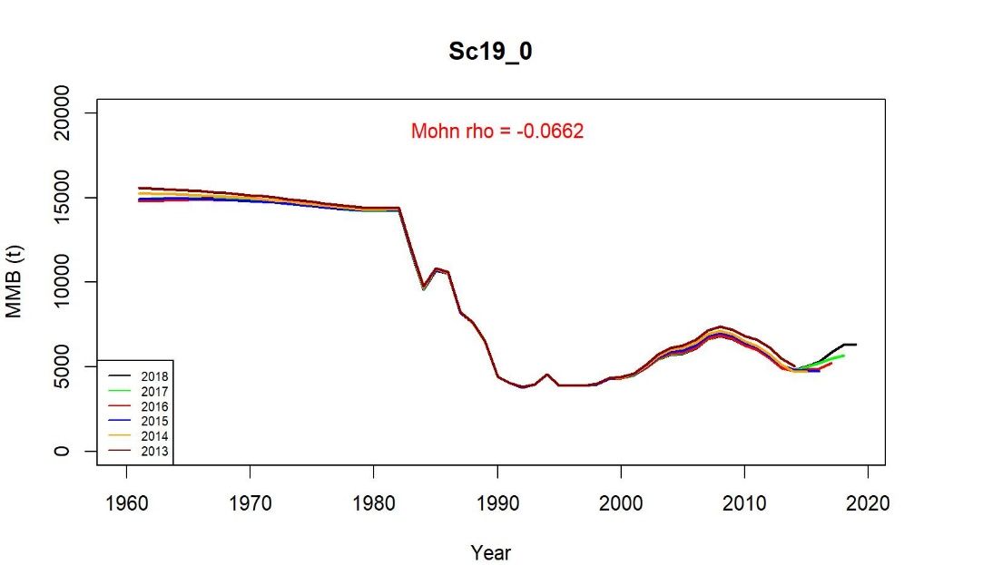
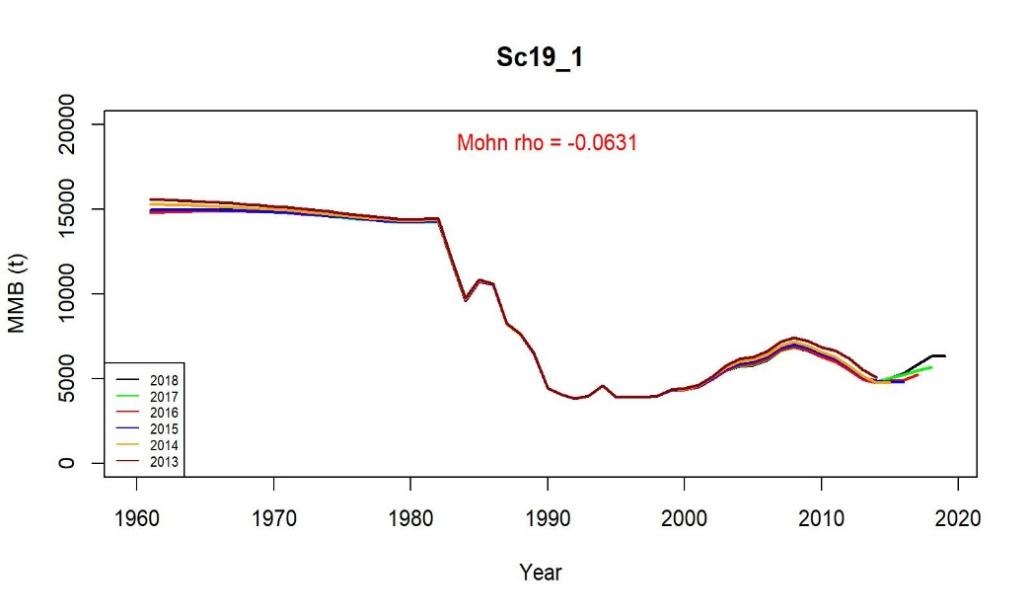
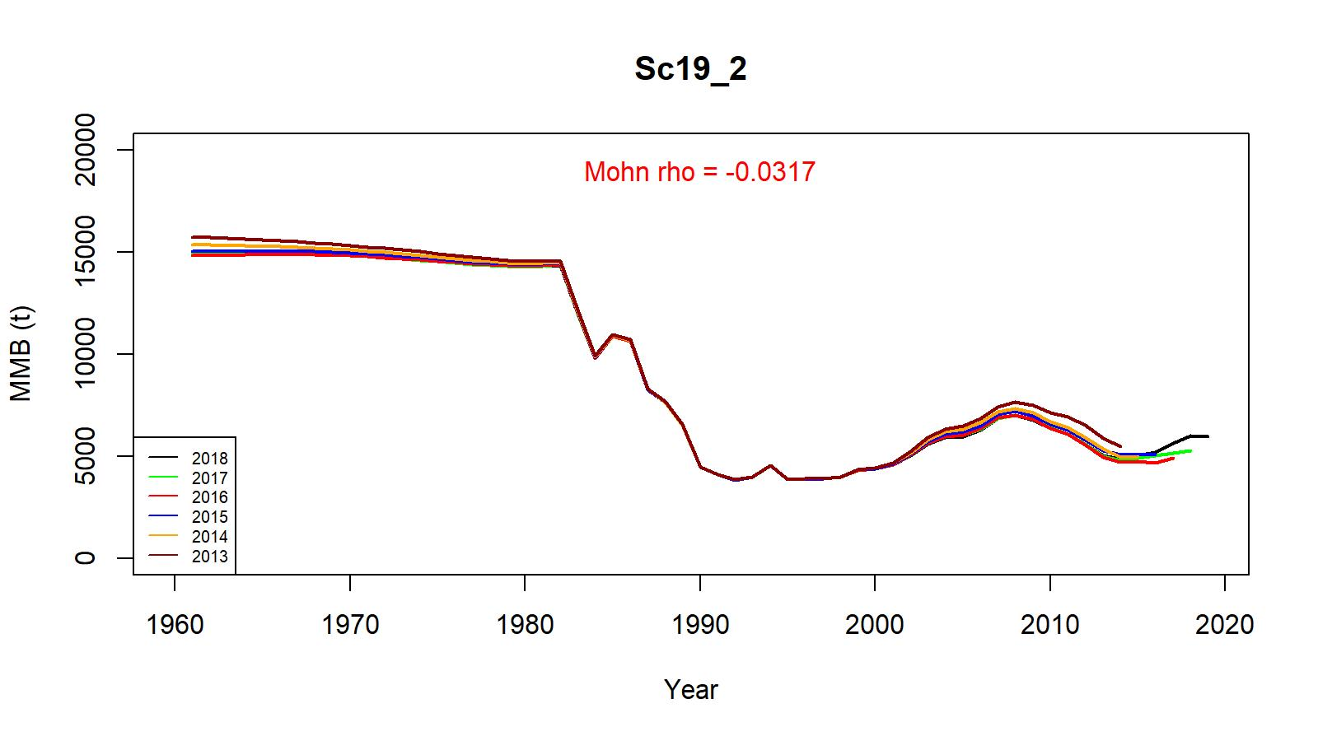
Figure 41. Retrospective fits of MMB by the model following removal of terminal year data under scenarios 19_0, 19_1 and 19_2 for golden king crab in the WAG, 1960/61–2018/19.

Slide 43
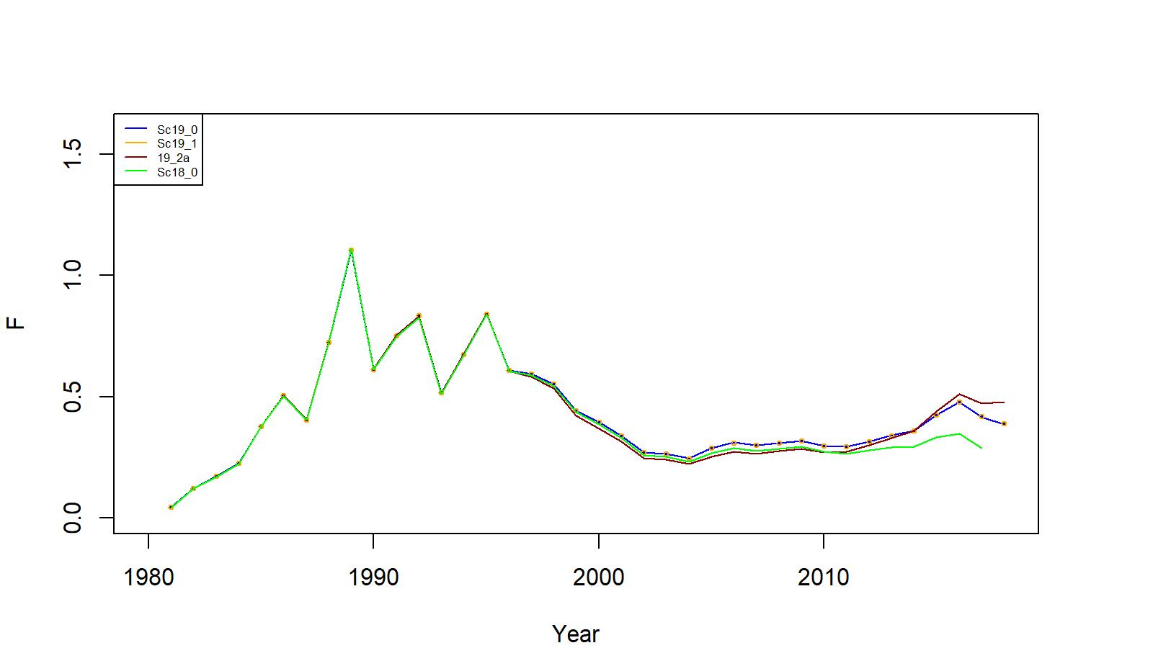
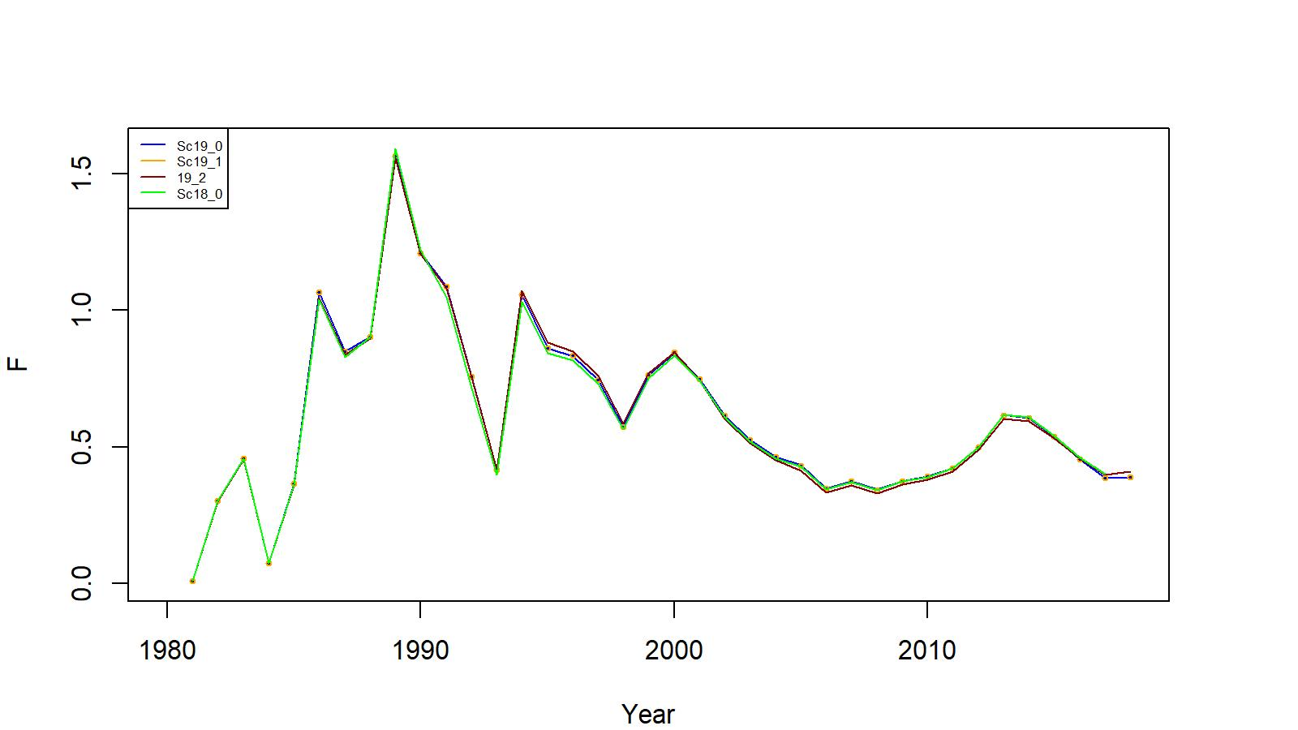
Figures 25 and 43. Trends in pot fishery full selection total fishing mortality of golden king crab for scenarios 18_0 (green line, up to 2017/18 data), 19_0 (up to 2018/19 data), 19_1, and 19_2a/19_2 model fits in the EAG (top) and WAG (bottom),1981/82–2018/19.
EAG
WAG

Slide 44
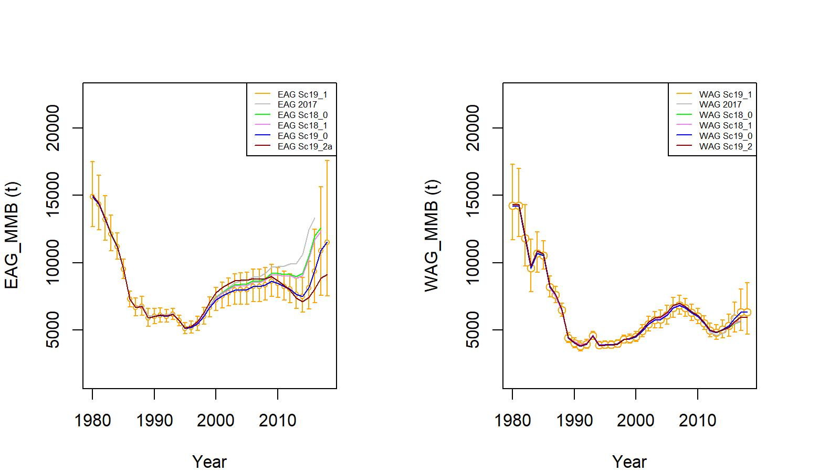
Figure 26. Trends in golden king crab mature male biomass for scenarios EAG 2017 (up to 2016/17 data), 18_0 and 18_1 (up to 2017/18 data), and 19_0, 19_1, 19_2a/19_2 (up to 2018/19 data) fits to EAG (left) and WAG (right), 1960/61–2018/19. Scenario 19_1 estimates have two standard error confidence limits.

Slide 45
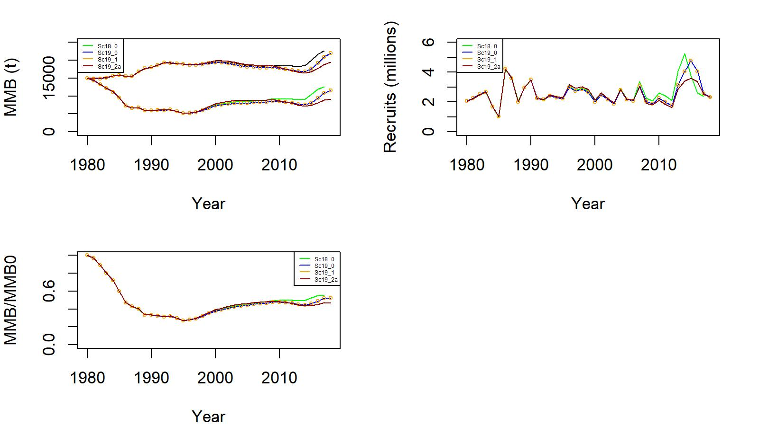
Figure C.1. Comparison of estimated B0 (t) with MMB (top left), estimated number of recruits (top right), and MMB/B0 ratio (bottom left) for scenarios (Sc.) 18_0 (green line, up to 2017/18 data), 19_0 (up to 2018/19 data), 19_1, and 19_2a model fits in the EAG.

Slide 46
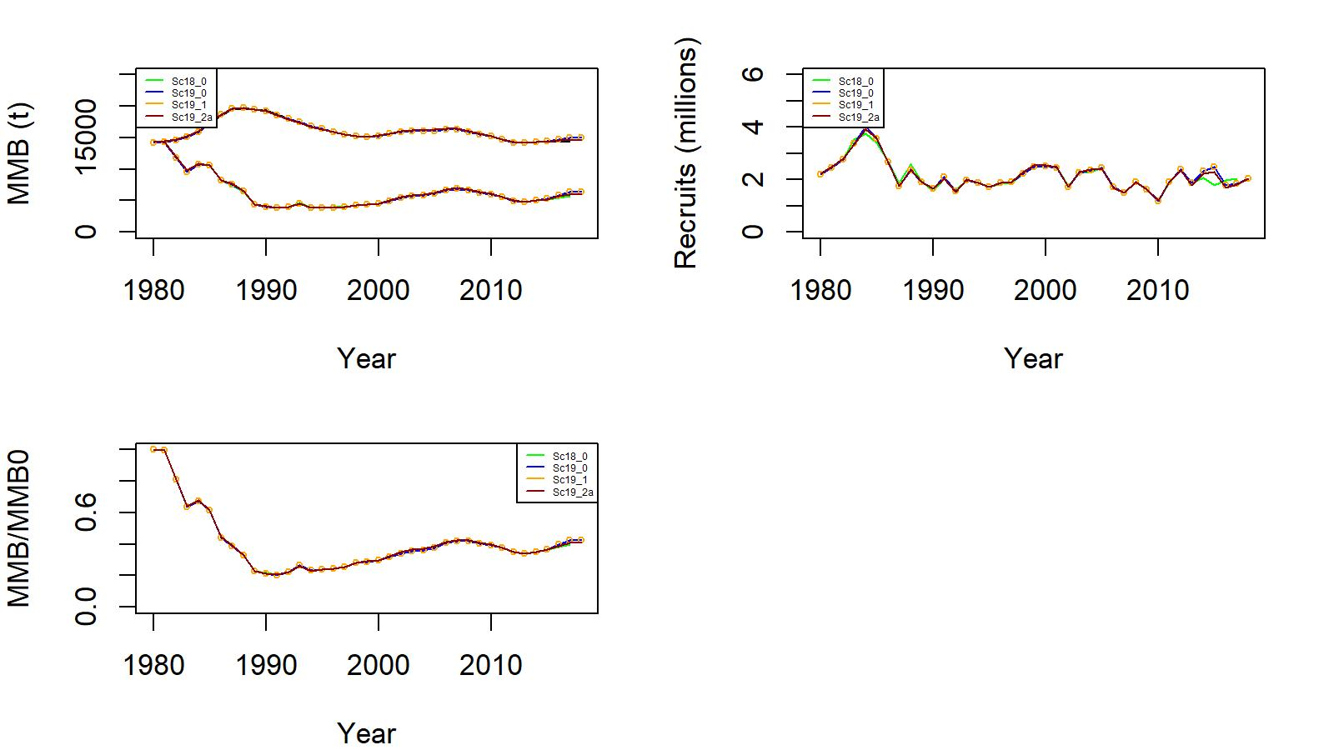
Figure C.2. Comparison of estimated B0 (t) with MMB (top left), estimated number of recruits (top right), and MMB/B0 ratio (bottom left) for scenarios (Sc.) 18_0 (green line, up to 2017/18 data), 19_0 (up to 2018/19 data), 19_1, and 19_2a model fits in the WAG.

Slide 47
Table 12. Negative log-likelihood values for scenarios (Sc) 19_0 (base), 19_1 (observer CPUE with reduced number of gear codes), and 19_2a (observer CPUE with Year:Area interaction) in the EAG.
Likelihood Component | Sc 19_0 | Sc 19_1 | Sc 19_2a
Number of free parameters | 146 | 146 | 146
Retlencomp | -1251.82 | -1251.74 | -1250.70
Totallencomp | -1363.48 | -1363.84 | -1380.79
Observer cpue | -3.88 | -3.55 | 4.03
RetdcatchB | 7.35 | 7.36 | 7.82
TotalcatchB | 22.53 | 22.53 | 22.80
GdiscdcatchB | 0.00 | 0.00 | 0.00
Rec_dev | 7.55 | 7.53 | 6.42
Pot F_dev | 0.01 | 0.01 | 0.01
Gbyc_F_dev | 0.03 | 0.03 | 0.03
Tag | 2692.49 | 2692.48 | 2692.15
Fishery cpue | -2.2896 | -2.2935 | -2.835
RetcatchN | 0.0065 | 0.0065 | 0.0048
Total | 108.50 | 108.52 | 98.94

Slide 48
Table 21. Negative log-likelihood values for scenarios (Sc) 19_0 (base), 19_1 (observer CPUE with reduced number of gear codes), and 19_2 (observer CPUE with Year:Area interaction) in the WAG.
Likelihood Component | Sc 19_0 | Sc 19_1 | Sc 19_2
Number of free parameters | 146 | 146 | 146
Retlencomp | -1204.90 | -1204.75 | -1205.02
Totallencomp | -1511.17 | -1511.61 | -1518.91
Observer cpue | -12.08 | -11.23 | -6.10
RetdcatchB | 4.90 | 4.93 | 5.51
TotalcatchB | 45.31 | 45.31 | 45.56
GdiscdcatchB | 0.00 | 0.00 | 0.00
Rec_dev | 4.65 | 4.65 | 4.62
Pot F_dev | 0.03 | 0.03 | 0.03
Gbyc_F_dev | 0.04 | 0.04 | 0.04
Tag | 2694.37 | 2694.36 | 2694.14
Fishery cpue | -9.6898 | -9.7218 | -9.2786
RetcatchN | 0.0022 | 0.0021 | 0.0017
Total | 11.45 | 12.00 | 10.60

Slide 49
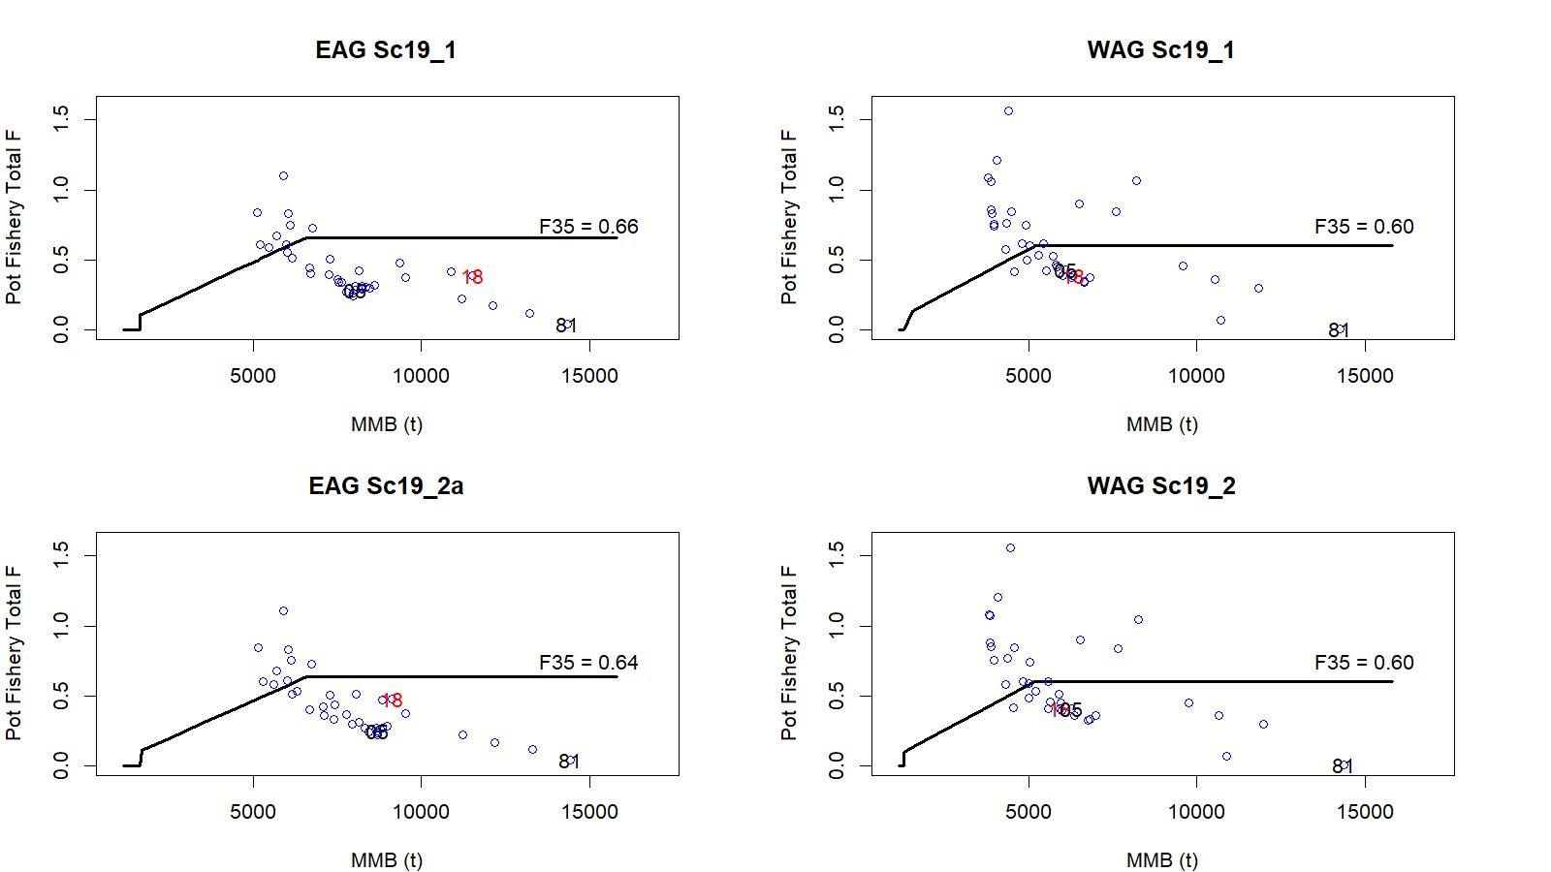
Figure 44. Relationships between full F for the directed pot fishery and MMB during 1981/82–2018/19 under scenarios 19_1, 19_2a (EAG), and 19_2 (WAG).

Slide 50
Biomass, total OFL, and ABC in millions of pounds. For 18_... scenarios, Current MMB = MMB on 15 Feb. 2019; and for 19_... scenarios, Current MMB = MMB on 15 Feb. 2020.
Scenario | Tier | MMB_{35%} | Current MMB | MMB/ MMB_{35%} | F_{OFL} | Recruitment Years to define MMB_{35%} | F_{35%} | OFL | ABC (0.75*OFL)
EAG18_0 | 3a | 14.982 | 23.682 | 1.58 | 0.644 | 1987–2012 | 0.644 | 8.141 | 6.106
EAG18_1 | 3a | 14.958 | 23.327 | 1.56 | 0.644 | 1987–2012 | 0.644 | 7.928 | 5.946
EAG19_0 | 3a | 14.517 | 22.561 | 1.55 | 0.660 | 1987–2012 | 0.660 | 7.564 | 5.673
EAG19_1 | 3a | 14.516 | 22.494 | 1.55 | 0.660 | 1987–2012 | 0.660 | 7.536 | 5.652
EAG19_2a | 3a | 14.629 | 18.587 | 1.27 | 0.640 | 1987–2012 | 0.640 | 5.856 | 4.392
EAG
Scenario | Tier | MMB_{35%} | Current MMB | MMB/ MMB_{35%} | F_{OFL} | Recruitment Years to Define MMB_{35%} | F_{35%} | OFL | ABC (0.75* OFL)
WAG18_0 | 3a | 11.365 | 11.801 | 1.04 | 0.596 | 1987–2012 | 0.596 | 3.465 | 2.598
WAG18_1 | 3a | 11.451 | 11.947 | 1.04 | 0.596 | 1987–2012 | 0.596 | 3.512 | 2.634
WAG19_0 | 3a | 11.412 | 12.664 | 1.11 | 0.600 | 1987–2012 | 0.600 | 4.039 | 3.029
WAG19_1 | 3a | 11.412 | 12.656 | 1.11 | 0.600 | 1987–2012 | 0.600 | 4.036 | 3.027
WAG19_2 | 3a | 11.406 | 11.971 | 1.05 | 0.600 | 1987–2012 | 0.600 | 3.800 | 2.850
WAG

Slide 51
OFL and ABC for the whole Aleutian Islands (million pounds)
Scenario | OFL | ABC | ABC
 |  | (P*=0.49) | (0.75*OFL)
18_0 | 11.606 | 11.373 | 8.704
18_1 | 11.440 | 11.212 | 8.580
19_0 | 11.603 | 11.546 | 8.702
19_1 | 11.572 | 11.515 | 8.679
19_2 | 9.656 | 9.590 | 7.242
AI

Slide 52
Status and catch specifications (million lb)
Year | MSST | Biomass (MMB) | TAC | Retained Catch | Total Catchª | OFL | ABC^{b}
2015/16 | N/A | N/A | 6.290 | 6.016 | 6.782 | 12.53 | 9.40
2016/17 | N/A | N/A | 5.545 | 5.716 | 6.497 | 12.53 | 9.40
2017/18 | 13.325^{A} | 31.315^{A} | 5.545 | 5.699 | 6.487 | 13.333 | 10.000
2018/19^{c} | 13.329^{B} | 39.577^{B} | 6.356 | 6.536 | 7.396 | 12.157 | 9.118
2019/20^{f} |  | 35.225^{C} |  |  |  | 11.603 | 8.702
2019/20^{g} |  | 35.150^{C} |  |  |  | 11.572 | 8.679
2019/20^{h} |  | 30.558^{C} |  |  |  | 9.656 | 7.242
c: 2018/19 accepted model, f: Sc19_0, g: Sc19_1, h: Sc19_2 &19_2a
A: calculated from the assessment reviewed by CPT in May 2017, up to 2015/16 data
B: calculated from the assessment reviewed by CPT in May 2018, up to 2016/17 data
C: calculated from the assessment reviewed by CPT in May 2019, up to 2018/19 data

Slide 53
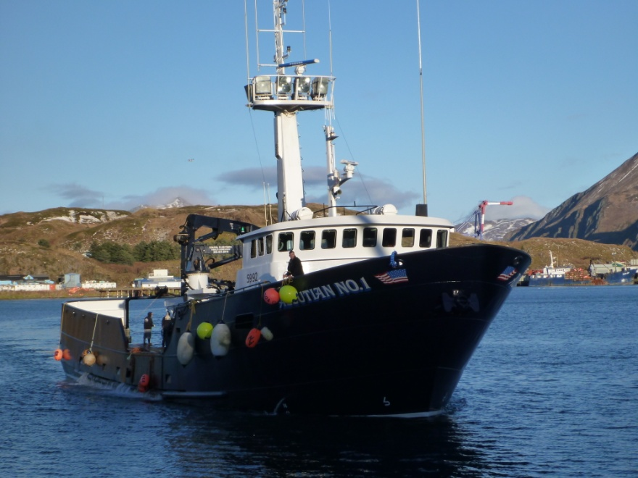
Thank you
Acknowledgement
We thank Ethan Nichols, Bo Whiteside, Vicki Vanek, and Andrew Nault for preparing/providing various fisheries and biological data and plots for this assessment; We appreciate the technical and editorial help at various time from Andre Punt, Martin Dorn, William Stockhausen, Steve Martel, Paul Starr, Sherri Dressel, Katie Palof, Hamazaki Hamachan, Karla Bush, William Bechtol, CPT and SSC members, and industry personnel.

