Slide 1
Aleutian Islands Golden King Crab Model-Based Stock Assessment
Responses to some CIE review comments
M.S.M. Siddeek, J. Zheng, C. Siddon, B. Daly, M.J. Westphal, and L. Hulbert

Slide 2
Comments by Yong Chen
Comment A.1: More in-depth and structured diagnosis of relative importance of different likelihood functions for different input data sets and how they should be weighted in model fitting. A careful examination of potential temporal trends in residual distribution may be also needed.
Response:
Because size frequency likelihoods consume large part of the total likelihood, for all scenarios we objectively weighted the length composition data by Francis’ re-weighting method. We also examined the temporal trends in size compositions fit by bubble plots (Figures 19, 20, 37, and 38). We validated the error model used in the CPUE standardization by the QQ plot.
Comment A.2: Multiple model configurations were used over the time, which reflect different assumptions on the fishery dynamics. I recommend analyzing among-model variations to better understand the structural uncertainty and possible management implications of making changes to the models over the time.
Response:
Because AIGKC model was recently approved for OFL and ABC calculations, the model has not been changed during the last three years of its implementation. Only new data points have been added. Therefore, the comment is not strictly applicable to the AIGKC model.

Slide 3
Comments by Yong Chen continued
Comment A.3: I suggest that the assessment model structure be kept relatively stable over time. If a new model or new model configurations/parametrizations need to be used, it should be run in parallel to the old model to identify changes in stock assessment outcomes resulting from changes in model configurations. i.e., New scenarios should be run in parallel to the old one.
Response:
We have kept the assessment model structure relatively stable since the acceptance of the model. We are showing the time trends in input CPUE indices (Figures B.2 and B.3), recruitment (Figures 14 and 32), fishing mortality (Figures 25 and 43), and mature male biomasses (Figure 26) in parallel as a result of changes in model configurations and expansion of input data sources over time. Please see some figures in the next slide.
Comment A.4: Retrospective analysis should be done for all scenarios.
Response:
We did for all scenarios: 19_0, 19_1, 19_2/19_2a.

Slide 4
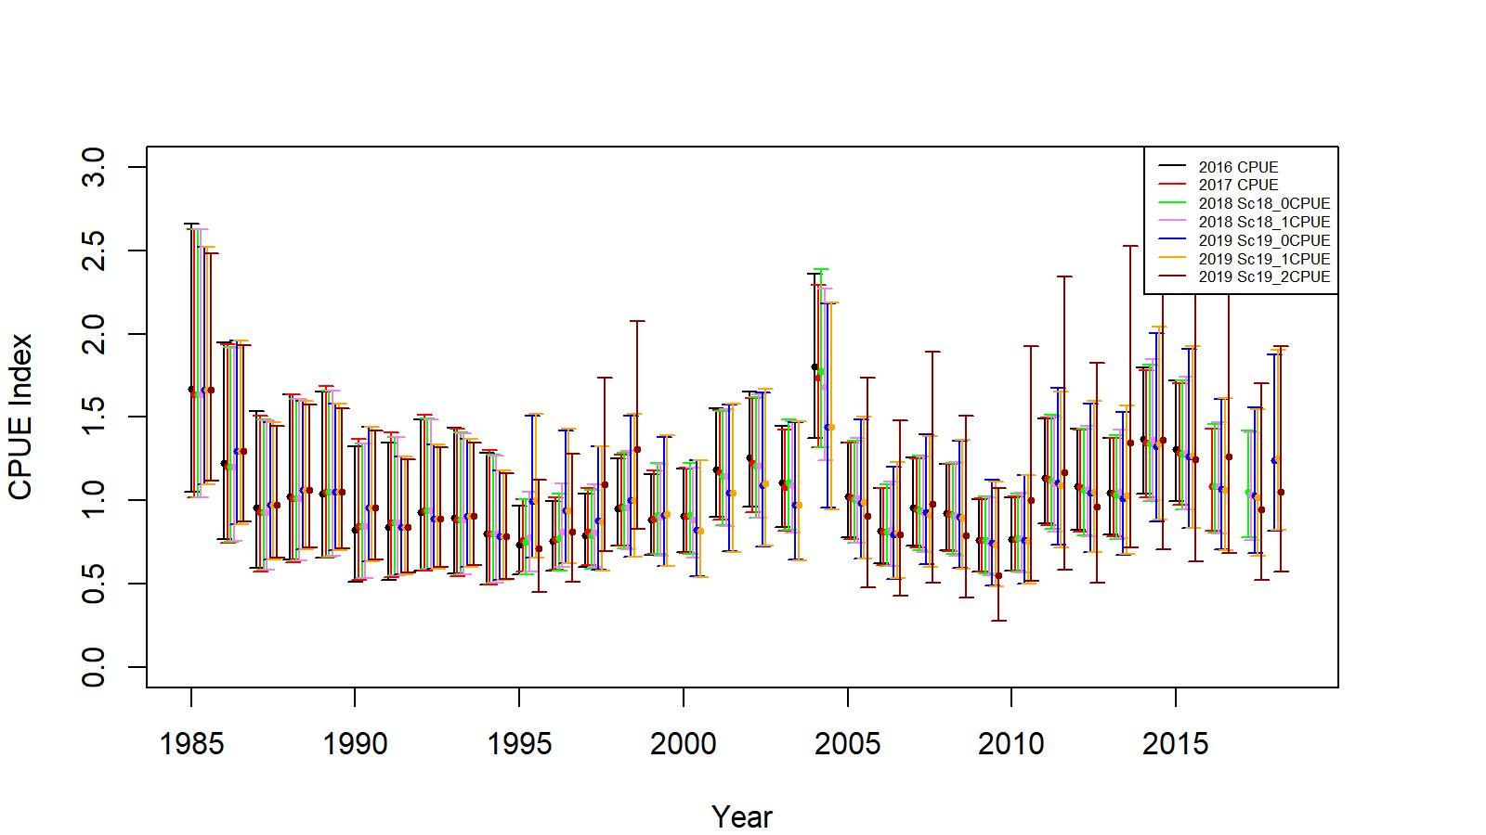
Figure B.2. EAG. Comparison of Input cpue indices from various time series

Slide 5
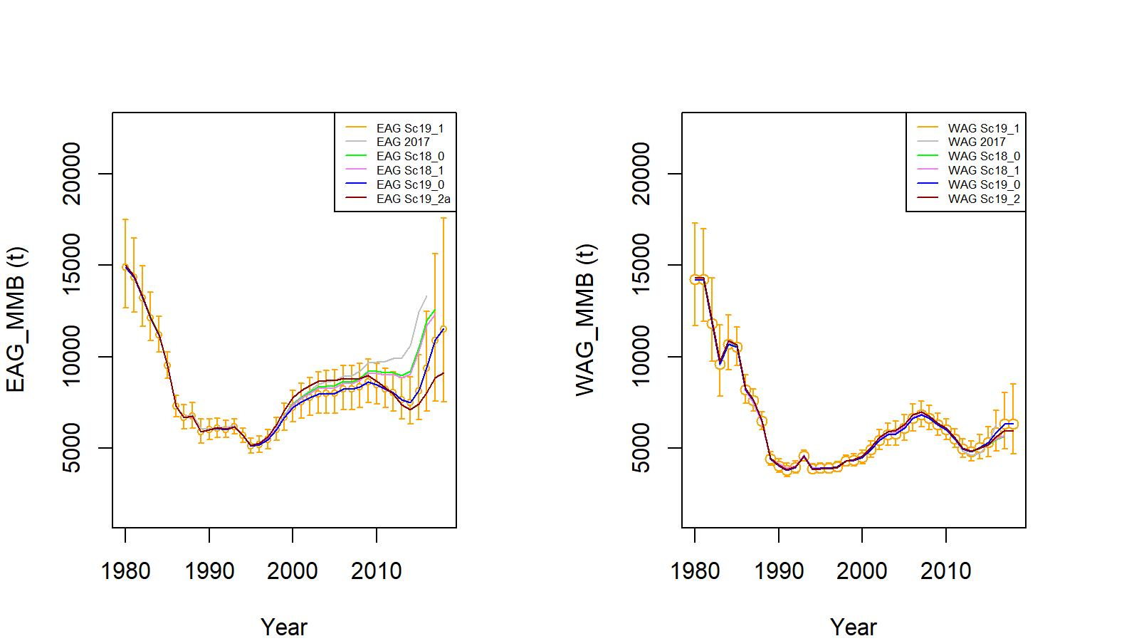
Figure 26. Trends in golden king crab mature male biomass for scenarios EAG 2017 (up to 2016/17 data), 18_0 and 18_1 (up to 2017/18 data), and 19_0, 19_1, 19_2a (EAG), or 19_2 (WAG) (up to 2018/19 data) fits to EAG (left) and WAG (right) data, 1960/61–2018/19. Scenario 19_1 estimates have two standard error confidence limits.

Slide 6
Yong Chen comments continued
Comment A.5: The current models estimate model parameters using maximum likelihood function and is not a full Bayesian model. Uncertainty estimates may not be reliable (tend to be under-estimated), which limits the full consideration of uncertainty in stock assessment and management. A full Bayesian model may be more desirable.
Response:
This is debatable for the length-based models. We have not undertaken this step yet.
Comment A.6: VAST type analysis should be carried out for index estimation to capture autocorrelation over space and time of independent survey data.
Response:
The VAST developer will present the applicability of VAST to crab stocks at the May 2019CPT meeting. We will discuss its applicability at the CPT meeting and follow the CPT guidance.
Comment A.7: Jittering should be done to evaluate the sensitivity of model convergence.
Response:
Done for scenarios 19_1 and 19_2 /19_2a.

Slide 7
Yong Chen comments continued
Long-term:
Comment A.8: Given strong seasonality of fishery and life history, a model with season as its time step may better capture the dynamics of fishery and life history. A comparative study may be needed for evaluating possible differences in stock assessments using “year” and “season” as time steps.
Response:
A good suggestion. We will investigate this in the near future.
Comment A.9: Given the importance of the survey data in the assessment, I suggest conducting an extensive computer simulation study based on past data to evaluate the effectiveness of the current survey designs capturing the spatio-temporal dynamics of the stocks.
Response:
We have not looked into this yet.

Slide 8
Yong Chen comments continued
Comment A.10: There is a need to evaluate temporal ad spatial variability in key life history parameters such as weight-at-length and maturity-at-length. Mixed-effect model can be used for analysis.
Response:
A good suggestion. We are currently collecting data on weight-at-length and maturity-at-length over time and space. We will consider using appropriate model to analyze these data.
Comment A.11: Constant discard mortality over time and space may not be biologically realistic.
Response:
We will investigate how best to capture this aspect. We presented our first thought at the January 2019 CPT meeting by weighting the mortality rate by overall landing and was not accepted by the CPT.
Comment A.12: Survey for AIGKC should be extended to WAG and more information on small crab need to be collected, in particular for the WAG area.
Response:
We extended the survey to WAG in 2018.

Slide 9
Yong Chen comments continued
Comment A.13: It is likely that outliers may exist I fisheries data, which may introduce biases in stock assessment results because of log-normal and multinomial likelihood functions tend to be sensitive to outliers in data. Using robust likelihood functions may be more appropriate. Some simulation studies can be done to evaluate possible impacts of using different likelihood functions in the absence and presence of outliers in various input data sets.
Response:
We used the robust likelihood function for the length composition data sets. We will investigate its applicability to other likelihood components.

Slide 10
Comments by john neilson
Comment B.1: Bycatch mortality may vary over season.
Response:
See our response to comment #A.11.
Comment B.2: Past models’ projections should have been compared with the current estimates and trends of MMB.
Response:
Yes, we did in this report. See our response to comment #A.3.
Comment B.3: However, there are so many degrees of freedom associated with Gear in the CPUE standardization. Consulting with fishing industry could help obtain realistic and sensible ways of combining gear types that have essentially similar selectivity.
Response:
We reduced the number of gear codes in scenarios 18_1, 19_1, and 19_2/19_2a. Please see the gear code reduction process in the next slide.

Slide 11


Table B.1. Updated Gear code for observer data analysis. Only gear code # 5, 6, 7, 8, and 13 were considered following crab industry suggestion. Note: Identical codes were given to those gear codes with similar catchability/selectivity. X stands for the gear codes that were ignored.
Original Gear code | Pot gear description | Mark X against the code that can be ignored | Number Encountered by Observers during 1990-2016 | Updated Gear Code
1 | Dungeness crab pot, small & round | X | 2 | X
2 | Pyramid pot, tunnel openings usually on sides, stackable | X | 2121 | X
3 | Conical pot, opening at top of cone, stackable | X | 2000 | X
4 | 4' X 4' rectangular pot |  | 60 | X
5 | 5' X 5' rectangular pot |  | 18032 | 5
6 | 6' X 6' rectangular pot |  | 17508 | 6
7 | 7' X 7' rectangular pot |  | 23806 | 7
8 | 8' X 8' rectangular pot |  | 1936 | 8
9 | 5 1/2' X 5 1/2' rectangular pot |  | 6934 | 5
10 | 6 1/2' X 6 1/2' rectangular pot |  | 22085 | 6
11 | 7 1/2' X 7 1/2' rectangular pot |  | 387 | 7
12 | Round king crab pot, enlarged version of Dungeness crab pot |  | 8259 | X
13 | 10' X 10' rectangular pot |  | 466 | 13
14 | 9' X 9' rectangular pot | X | 1 | X
15 | 8 1/2' X 8 1/2' rectangular pot | X | 1 | X
16 | 9 1/2' X 9 1/2' rectangular pot | X | Not used | X
17 | 8' X 9' rectangular pot | X | 1 | X
18 | 8' X 10' rectangular pot | X | 1 | X
19 | 9' X 10' rectangular pot |  | Not used | X
20 | 7' X 8' rectangular pot | X | 252 | X
21 | Hair crab pot, longlined and small, stackable |  | Not used | X
22 | snail pot | X | 1 | X
23 | Dome-shaped pot, tunnel opening on top, often longlined in deep-water fisheries | X | 6756 | X
24 | ADF&G shellfish research 7’ X 7’ X34” rectangular pot with 2.75” stretch mesh and no escapement rings or mesh |  | Research pot | X
80 | Historical: Cod pot, any shape pot targeting cod, usually with tunnel fingers | X | 711 | X
81 | Historical: Rectangular pot, unknown size, with escape rings | X | 1123 | X

Slide 12
Comments by john neilson continued
Comment B.4: The CPUE standardization attempts to deal with the issue of reduction in number of vessels by considering vessels stayed in the fishery for a long time period.
Response:
Agree.
Comment B.5: The fishery independent survey is not truly independent index because the survey does not standardize for soak time and depth. But useful for the model and sampling young crabs. The industry survey offers the best hope to avoid problems with the changes in the area fished or number of vessels over time. Can test the gear power as well. The coverage should also expand to WAG.
Response:
Agree. We extended the independent survey to WAG in 2018.
Comment B.6: Estimate maturity outside the model.
Response:
We did.

Slide 13
Comments by Rauf kalida
Comment C.1: Breakpoint analysis is a good approach. Spatial and temporal changes in maturity should also be investigated to improve maturity breakpoint.
Response:
With the additional data currently being collected we will follow the breakpoint analysis and investigate spatio-temporal changes in maturity.
Comment C.2: Several other recommendations, such as tagging experiments with DST and PIT tags, larval distribution study, crab ageing, have been made by Rauf in the CIE report, which will be addressed in the future as data are available.
Acknowledgments
We thank the three independent CIE reviewers for their thorough review and helpful suggestions to improve the models. We also thank the chairman for successfully presiding this review.

