Slide 1
Aleutian Islands Golden King Crab Model Scenarios for May 2022 Assessment
M.S.M. Siddeek^{1,} J. Zheng¹, C. Siddon¹, B. Daly², M.J. Westphal³, and L. Hulbert¹
Alaska Department of Fish and Game, Juneau¹, Kodiak², and Dutch Harbor³, Alaska
Virtual CPT meeting, January 11, 2022,

Slide 2
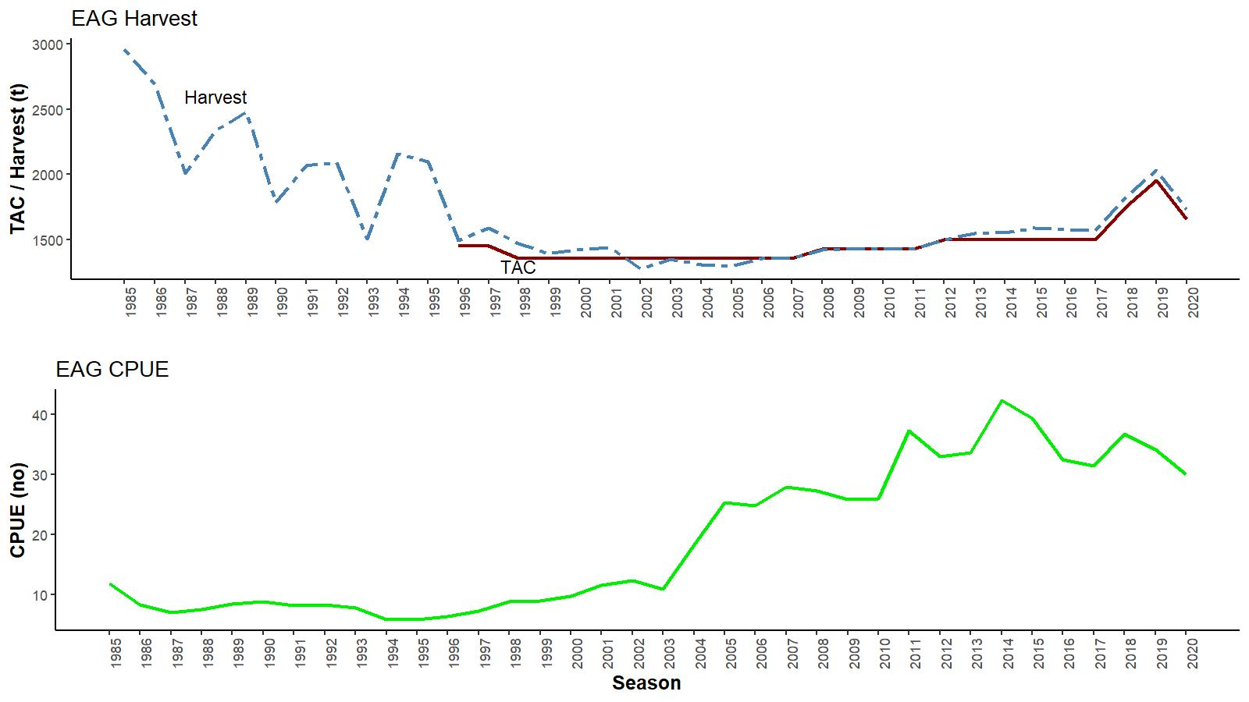
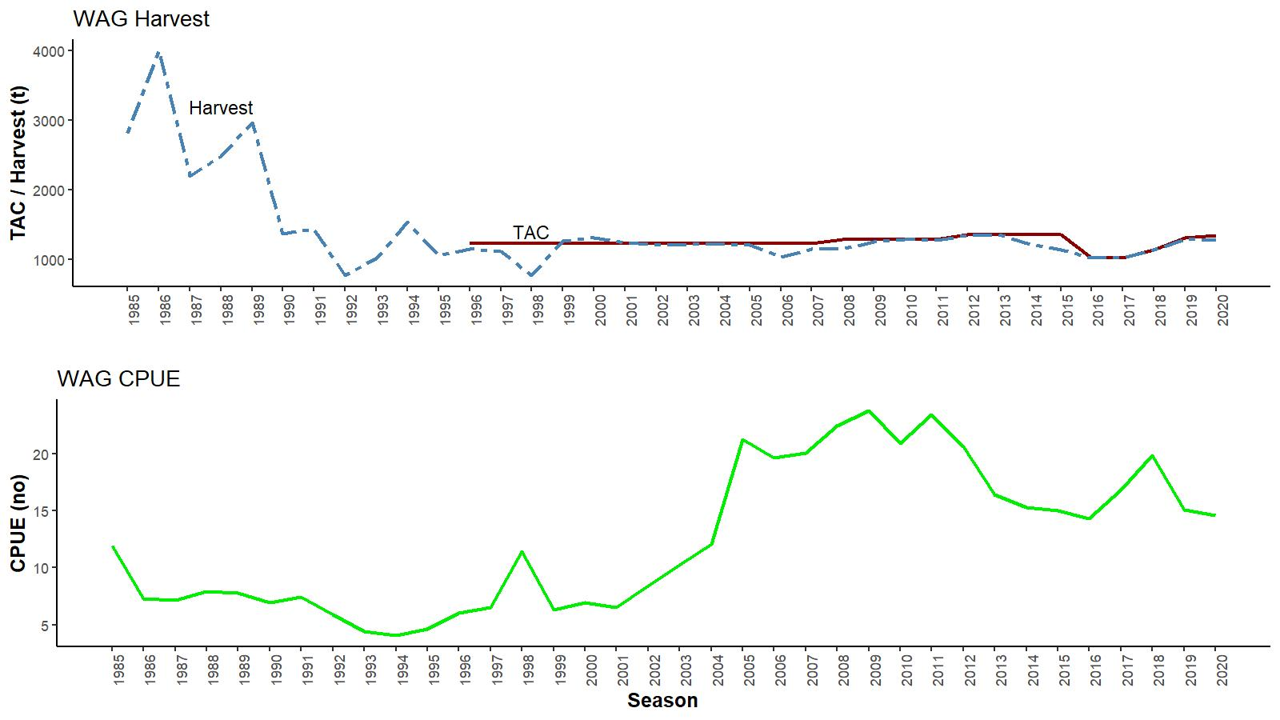
EAG
Catch (t) and CPUE
(number of crab per pot lift), 1985/86–2020/21
WAG
TACs :
2020/21:
(1) EAG: 3.650 million lbs
(2) WAG: 2.960 million lbs

Slide 3
Topics
Responses to May 2021 CPT and June 2021 SSC comments
Model scenarios for May 2022 assessment consideration
Results and suggested model scenarios

Slide 4
Length based modeling approach
Integrated male-only length-based models fitted to fishery dependent catch and CPUE data.
Constant M of 0.21yr⁻¹.
Projected the abundance from unfished equilibrium in 1960 to initialize the 1985 abundance.
5 models for EAG and 6 models for WAG.
Francis re-weighting method for Stage-2 effective sample sizes calculation for all models.

Slide 5
May 2021 CPT (selected) comments
Comment 1:
The analysis of the maturity data should be repeated using, for example, the methods of Olson et al. (2018) and Somerton and Macintosh (1983). The results of the analyses should be presented to the CPT.
Response:
The analysis was repeated following Olson et al.’ s approach of directly fitting chela height against carapace length by the bend point analysis R package. The focus was to determining the knife-edge maturity rather than establishing a maturity curve (Appendix B).

Slide 6
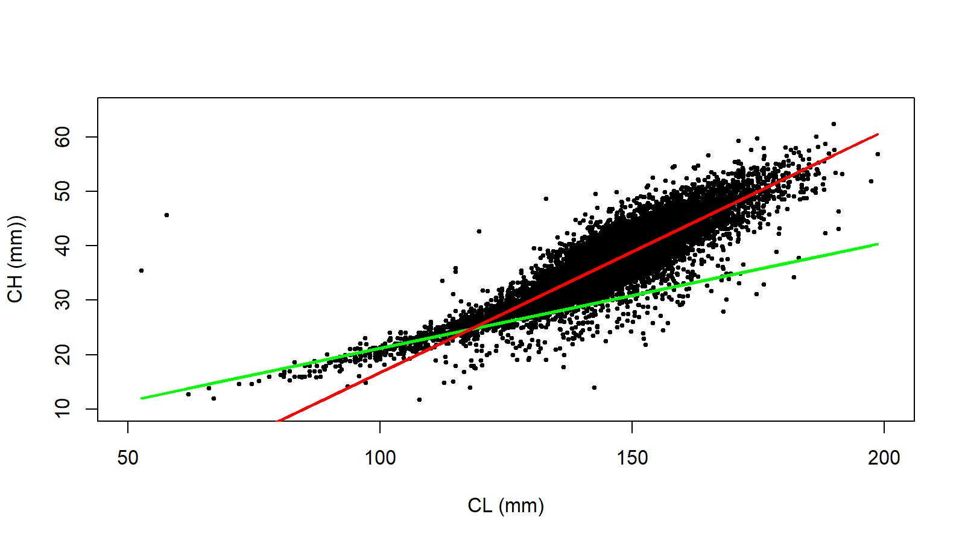
Figure B.3. Segmented linear regression fit to CH vs. CL data of male golden king crab for 2018–2020 in AI.

Slide 7
CPT comments continued
Comment 2:
Consider including the NMFS Aleutian Islands trawl survey as an additional index of abundance. The first step in this process should be to compare the depths at which the survey is conducted to those at which AI golden king crab are found/fished.
Response:
A preliminary comparison figures of NMFS Aleutian Islands trawl survey index of abundance vs observer CPUE index for comparable years and areas/depths was detailed in Appendix D. The purpose was to solicit the CPT and SSC advice on how to incorporate NMFS indices into GKC assessment model.

Slide 8
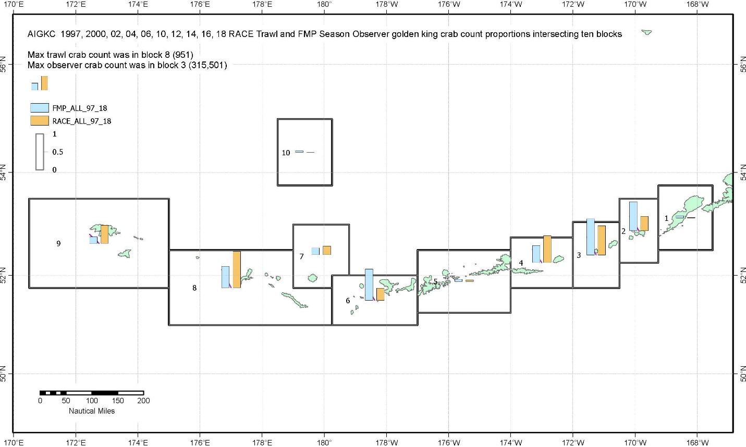
Figure D.1. Comparison of Aleutian Islands golden king crab index of abundance in Blocks#1 to 10 between RACE slope survey (light brown bars) and corresponding years’ observer samples (light blue bars).

Slide 9
CPT comments continued
Comment 3:
The CPUE standardization for the post rationalization years:
○ explore why the index for the WAG is lower in the last three years based on area*year interactions;
○ explore why the index for the WAG is more precise in the earlier years based on area*year interactions; and
○ better justify the degrees of freedom for smooths and plot the smooths.
Response:
1. The CPUE standardization procedure was improved with special attention given to selecting non-significant predictor variable coefficients in the final GLM.
The degrees of freedom of selected smoother variables had drastically reduced in this process (Appendix A).
2. The predicted area*year interaction curve was compared with the input area*year interaction curve in a separate plot in Figure 17 for WAG. It indicated that the index was no more precise in early years than later years.

Slide 10
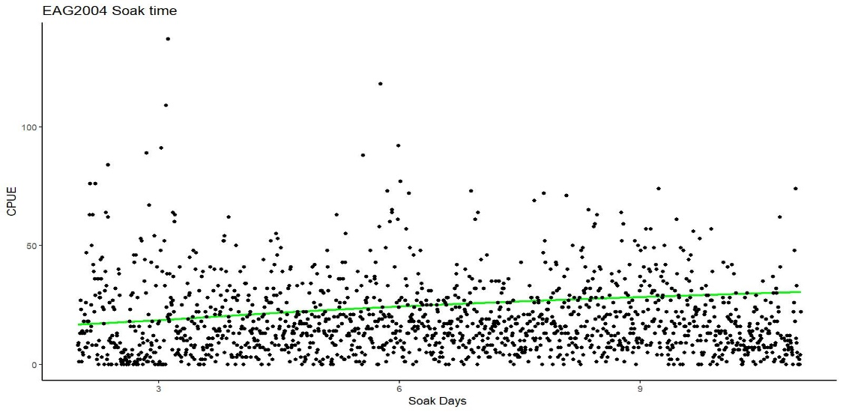
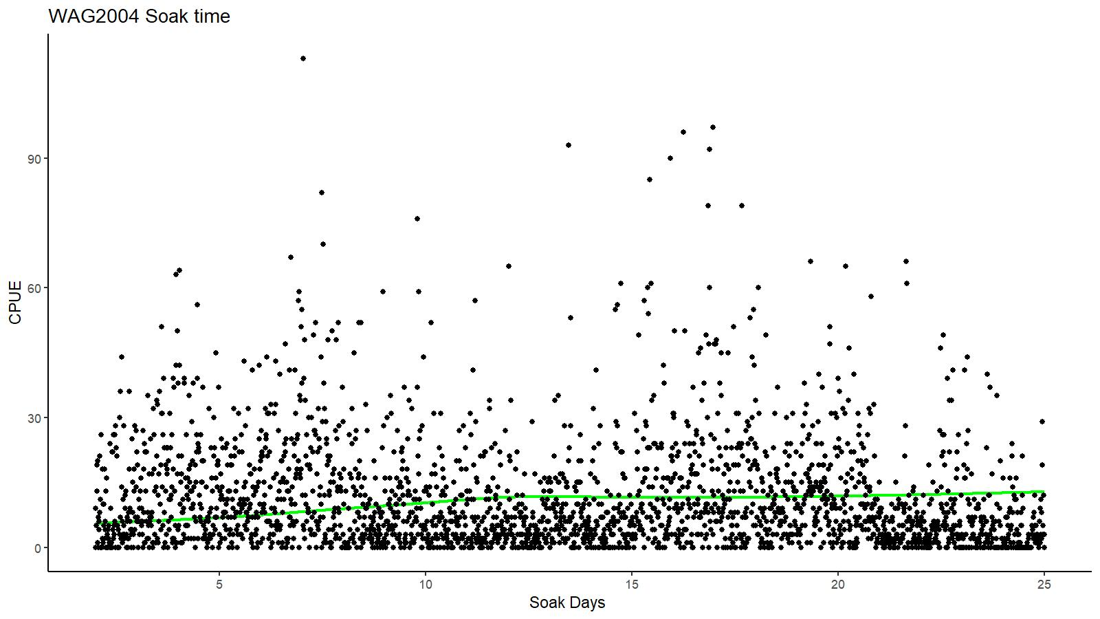
CPT comments continued
3. The smoothers in the final model appeared to adequately trace through raw CPUE data.
Fig. A.3. Smoother fit to 2004 observed CPUE for EAG.
Fig. A.5. Smoother fit to 2004 observed CPUE for WAG.

Slide 11
CPT comments continued
Comment 7:
Progress towards further GMACS implementation for this stock is expected for the next cycle in 2022.
Response:
That is the plan. Progress in EAG implementation is presented in Appendix E.

Slide 12
CPT comments continued
Comment 9:
Presentational
● The rationale for conducting separate assessments for the EAG and WAG should be integrated into the narrative of the assessment.
Done
● Avoid showing fits of models such as 21.1c to observed data used to fit different models.
Done
● Use consistent y-axis ranges in similar figures – see Figure 12a (top panels do not go to 0 vs. bottom panels that do include 0.
Done
● Increase line width in figures for easier viewing of model runs (e.g., Figures 14 and 32).
Done for some
--------------- many ---------
Response:
Out of several suggestions, the above were addressed in this draft report. The entire set of suggestions will be considered when presenting the final assessment report in May 2022.

Slide 13
June 2021 SSC (selected) comments
Comment 2: The CPT recommends 25% buffer but SSC recommends an increase to a 30% buffer from the maximum permissible ABC, based on: 1) the continued positive retrospective pattern in the EAG Model, 2) continued model convergence concerns indicating remaining parameter confounding (specifically, the jitter analysis for the 19.1 WAG model resulted in multiple solutions for MMB and B35% at identical total likelihood values), and 3) the CPUE series which included a year:area interaction indicated a steeper decline in recent years than the series used in model 21.1a (the model accepted for harvest specifications).
Response:
The issue of WAG model producing multiple solutions for MMB and B35% at identical likelihood values was resolved in the current jitter analysis of model 21.1a.
Although the contribution of groundfish bycatch to total removal is very small, the likelihood emphasis factor interfered with the optimization process. In this run, a higher likelihood weight of 0.5 (instead of 0.2) was used for groundfish bycatch and the model produced identical solutions for MMB, B35% and OFL at identical total likelihood values.

Slide 14
SSC comments continued
Comment 3:
The author’s rationale for continued use of two separate stock assessment models for the EAG and WAG is very helpful, and the SSC recognizes that this approach is reasonable. However, the SSC notes that sharing biological parameters and basic stock dynamics within a single assessment model that has two largely independent areas modelled simultaneously may help address recurrent convergence and estimation challenges. The SSC suggests that such an approach be considered further, as either a replacement for the current approach, or as part of a multi-model evaluation.
Response:
We intend to do this during the May/June 2022 assessment cycle.

Slide 15
SSC comments continued
Comment 4:
The SSC did not find the logistic fit to the maturity predictions based on the chela height to carapace length relationship to be compelling and supports the CPT’s recommendations for additional modelling. However, the SSC also notes that direct observational data on maturity may ultimately be needed to resolve this process and recommends holding studies or any other research be considered.
Response:
Logistic fit to maturity was not considered in this run but focused on improving the method of bend point analysis following other studies (e.g., Olson et al. 2018). We agree with SSC’s observation that direct observational data on mating activity are needed to identify the true minimum size at first maturity.

Slide 16
Table A. Models
Model | CPUE data type and modeling consideration | Knife-edge Maturity Size (Lower limit of the size bin) | Period for mean number of recruit calculation for (a) initial equilibrium abundance composition and (b) reference points estimations
21.1a (accepted model in May/June 2021, implemented with up to 2020/21 data) | Observer data 1995/96–2020/21; fish ticket data 1985/86–1998/99; two catchability and total selectivity for 1960–2004 and 2005–2020, one retention and groundfish bycatch selectivity; and standardization by negative binomial models. | 111 mm CL | 1987–2017
21.1a1 | 21.1a+ consider an M of 0.38yr⁻¹ for years >1998 (to address the retrospective issue on EAG assessment) | 111 mm CL | 1987–2017
21.1b | 21.1a+ consider observer CPUE standardized with Year:Area interaction. | 111 mm CL | 1987–2017
21.1c | 21.1a+ consider three catchability and additional CPUE CVs (Fish ticket: 1985-1994, Observer:1995–2004 and 2005–2020). | 111 mm CL | 1987–2017
21.1d | 21.1a+ CPUE indices estimated omitting one vessel for WAG. | 111 mm CL | 1987–2017
21.1a2 | 21.1a+ higher knife-edge maturity | 116 mm CL | 1987–2017
21.1b2 | 21.1b+ higher knife-edge maturity | 116 mm CL | 1987–2017

Slide 17


CPUE standardization: (a) final main effects models for observer samples (21.1a)
EAG:
$\ln\left(CPUE\right)= Year+Captain+ns\left(Soak, 4\right)$ (A.4)
for the 1995/96–2004/05 period [θ=1.38, $R^{2}=0.1813, AIC=133,925$]
$\ln\left(CPUE\right)= Year+ Captain+ Gear+ns\left(Soak, 3\right)$ (A.5)
for the 2005/06–2020/21 period [$=2.32, R^{2}=0.1027, AIC=75,185$].
WAG:
$\ln\left(CPUE\right)= Year+Captain+ns\left(Soak, 7\right)$ (A.6)
for the 1995/96–2004/05 period [θ=0.97, $R^{2}=0.1425, AIC=146,246$]
$\ln\left(CPUE\right)= Year+Gear+ ns\left(Soak, 2\right)$ (A.7)
for the 2005/06–2020/21 period [$=1.13, R^{2}=0.0482, AIC=117,673, Soak forced in$].

Slide 18

CPUE standardization: (b) final main effects models for observer samples omitting one vessel’s data (21.1d)
WAG:
$\ln\left(CPUE\right)= Year+ns\left(Soak, 5\right)+Area$ (A.20)
for the 1995/96–2004/05 period [θ=0.97, $R^{2}=0.1478, AIC=17,432$]
$\ln\left(CPUE\right)= Year+Captain+Gear+ ns\left(Soak, 2\right)$ (A.21)
for the 2005/06–2020/21 period [$=1.13, R^{2}=0.0538, AIC=117,597, Soak forced in$].

Slide 19
CPUE standardization: (c) final main effects models for fish ticket samples
EAG:
$\ln\left(CPUE\right)= Year+Vessel+Month$ (A.22)
for the 1985/86–1998/99 period [θ=10.40, $R^{2}=0.3327, AIC=16,535$]
WAG:
$\ln\left(CPUE\right)= Year+Vessel+Area$ (A.23)
for the 1985/86–1998/99 period [θ=6.67, $R^{2}=0.3569, AIC=31,215$]

Slide 20
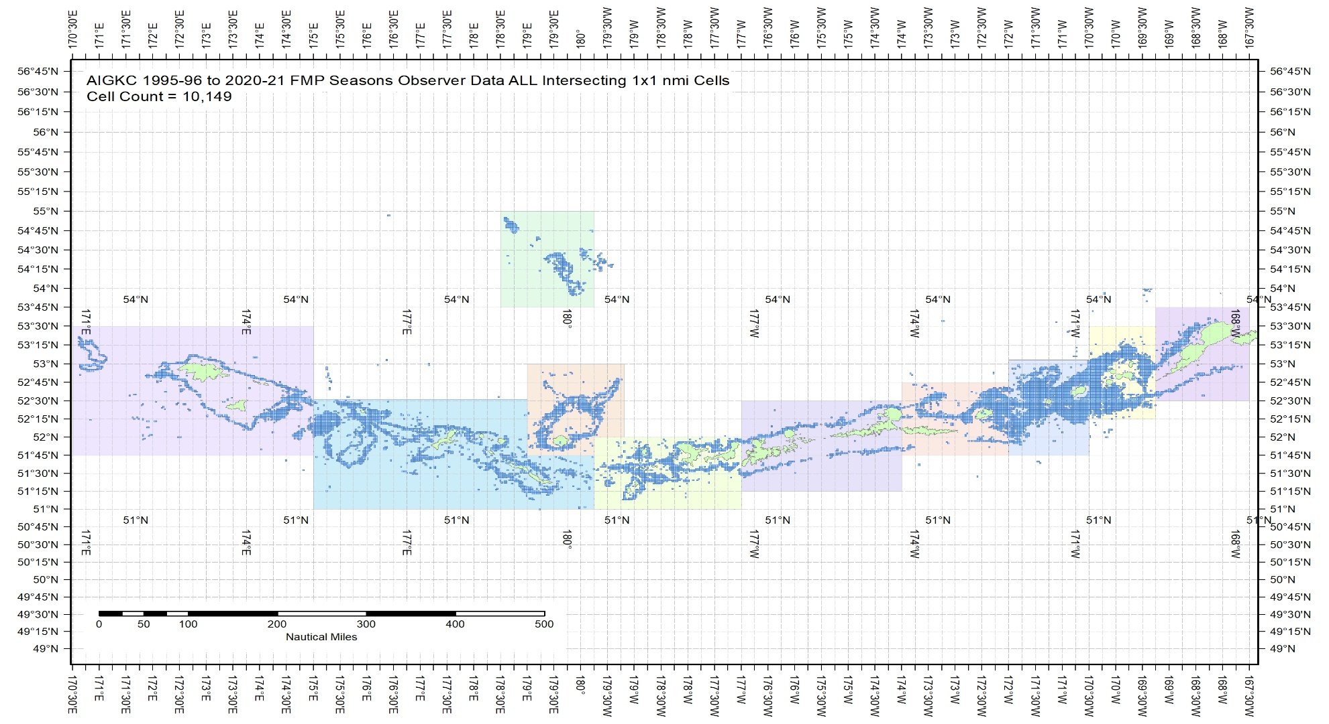
d. Estimation of observer CPUE index by the Year:Area interaction model (21.1b)
Figure A.11. The 1995/96 – 2020/21 observer pot samples enmeshed in 10 blocks.

Slide 21
Table A.6. Total number of 1 x 1 nmi cells ever fished, 1995/96 – 2020/21 AIGKC data. Blocks 1 – 4 belong to EAG and 5 – 10 to WAG.
Ever Fished:
AIGKC 1995/96–2020/21 | Block1 | Block2 | Block3 | Block4 | Block5 | Block6 | Block7 | Block8 | Block9 | Block10
Sum of 1x1 cells | 381 | 1402 | 1792 | 917 | 459 | 1028 | 796 | 2012 | 1021 | 334

Slide 22

Observer CPUE index by the Year:Area interaction model …..continued
Final model for EAG:
$\ln\left(CPUE\right)= Captain+ns\left(Soak, 4\right)+Year:Area$ (A.10)
for the 1995/96–2004/05 period [θ=1.38, $R^{2}=0.2060$, AIC=170,920],
$\ln\left(CPUE\right)= Vessel+Year:Area+ns\left(Soak, 3\right)$ (A.11)
for the 2005/06–2020/21 period [$=2.32, R^{2}=0.1047, AIC=46,455, Soak forced in$].

Slide 23

Observer CPUE index by the Year:Area interaction model ……continued
Final model for WAG:
$\ln\left(CPUE\right)= Vessel+ns\left(Soak, 7\right)+Year:Area$ (A.12)
for the 1995/96–2004/05 period [θ=0.97, $R^{2}=0.1657, AIC=147,887$]
$\ln\left(CPUE\right)=Gear+Year:Area+ns(Soak,2)$ (A.13)
for the 2005/06–2020/21 period [$=1.13, R^{2}=0.0862, AIC=76,797, Soak forced in$].

Slide 24
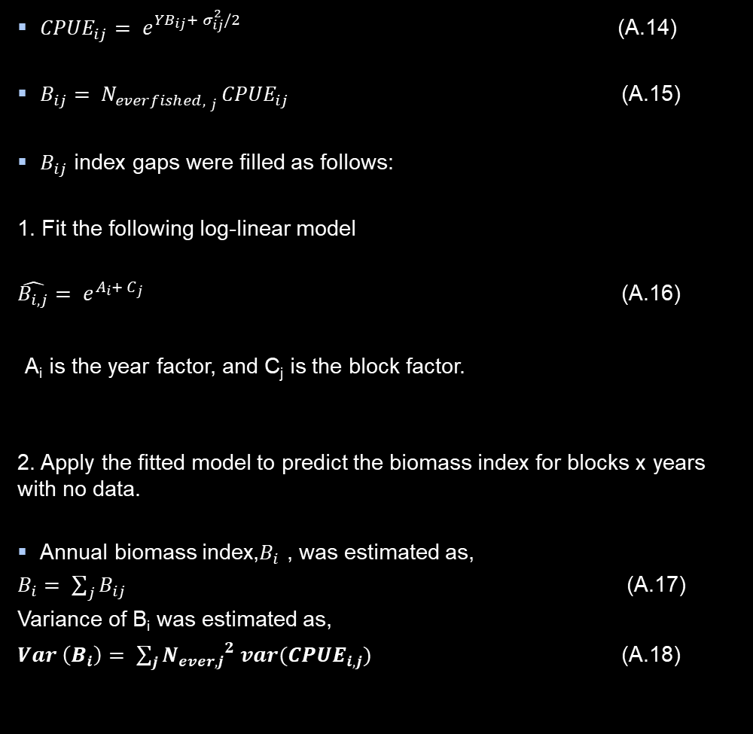
Observer CPUE index by the Year:Area interaction model ….. continued
Block-scale analysis:
${CPUE}_{ij}= e^{{YB}_{ij}+ σ_{ij}^{2}/2}$ (A.14)
$B_{ij}= N_{{everfished, }_{j} }{CPUE}_{ij}$ (A.15)
$B_{ij}$ index gaps were filled as follows:
1. Fit the following log-linear model
$\hat{B_{i, j}}= e^{A_{i}+ C_{j}}$ (A.16)
A_{i} is the year factor, and C_{j} is the block factor.
2. Apply the fitted model to predict the biomass index for blocks x years with no data.
Annual biomass index,$B_{i}$ , was estimated as,
$B_{i}= \sum_{j}{B_{ij}}$ (A.17)
Variance of B_{i} was estimated as,
$Var \left(B_{i}\right)= \sum_{j}{{N_{ever, j}}^{2} var({CPUE}_{i, j})}$ (A.18)
The variance for the final indices (A.17) comes from two contributions: (a) the variance of the standardized CPUE values for years*blocks with data, and (b) those based on the prediction formula (A.16) for year*blocks with no or few data.

Slide 25
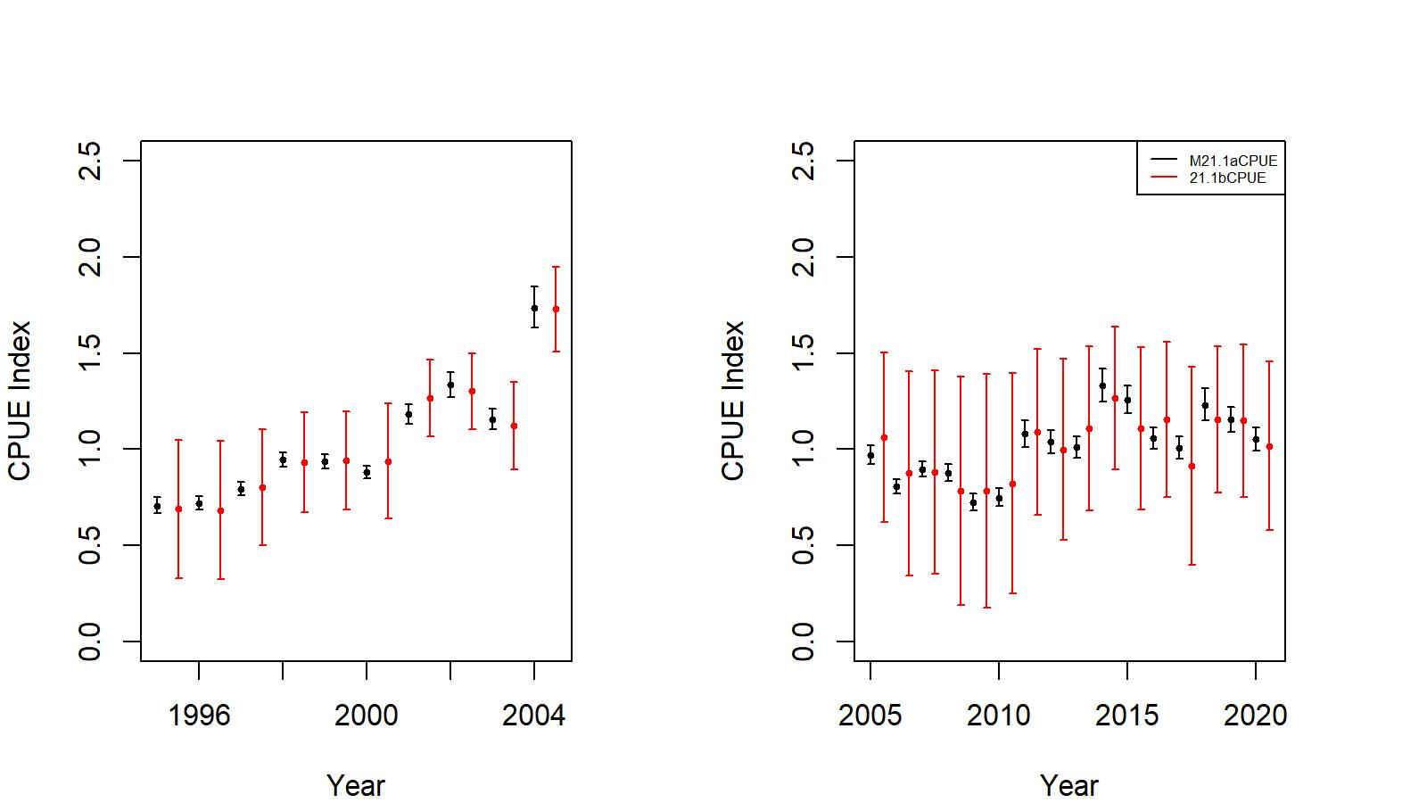
Observer CPUE index by the Year:Area interaction model….. continued
Figure A.12. Main effects (black) vs. interaction effects (red) CPUE indices during pre- (left panel) and post (right panel)-rationalization periods for EAG. The confidence intervals are +/- 2 SE.

Slide 26
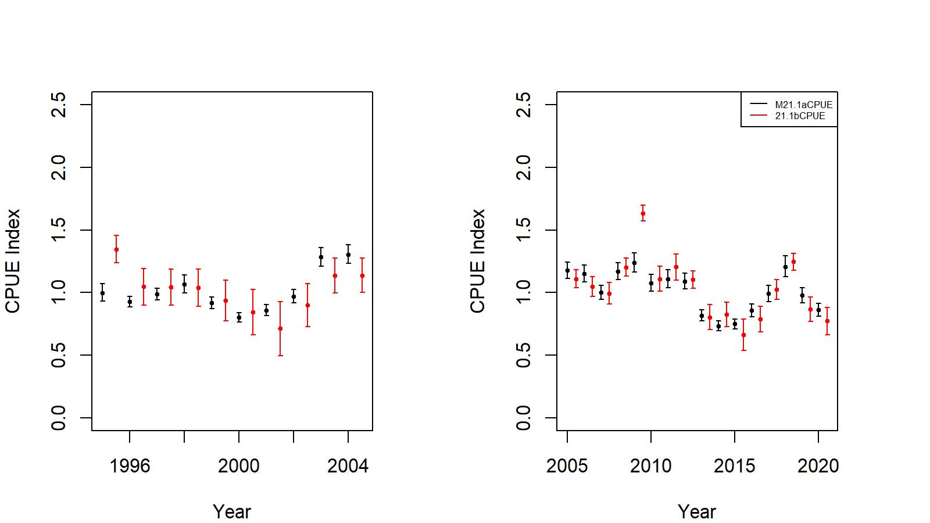
Observer CPUE index by the Year:Area interaction model….. continued
Figure A.13. Main effects (black) vs. interaction effects (red) CPUE indices during pre- (left panel) and post (right panel)-rationalization periods for WAG. The confidence intervals are +/- 2 SE.

Slide 27
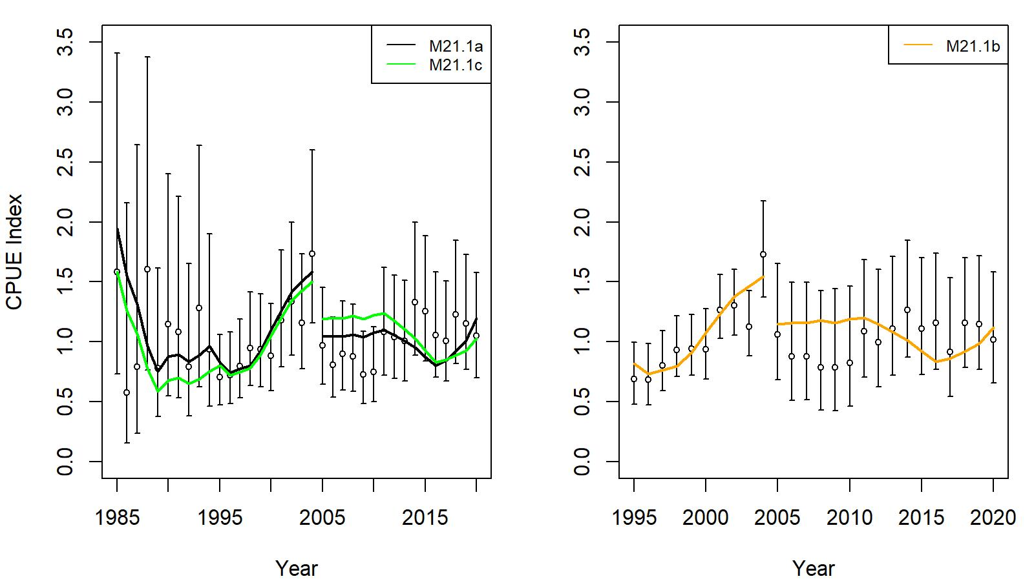
Model results
Figure 7. Comparison of input CPUE indices [black open circles with +/- 2 SE for model 21.1a (left) and model 21.1b (right)] with predicted CPUE indices (colored solid lines) by 21.1a, 21.1b, and 21.1c, model fits for EAG golden king crab data, 1985/86–2020/21. Model estimated additional standard error was added to each input standard error.

Slide 28
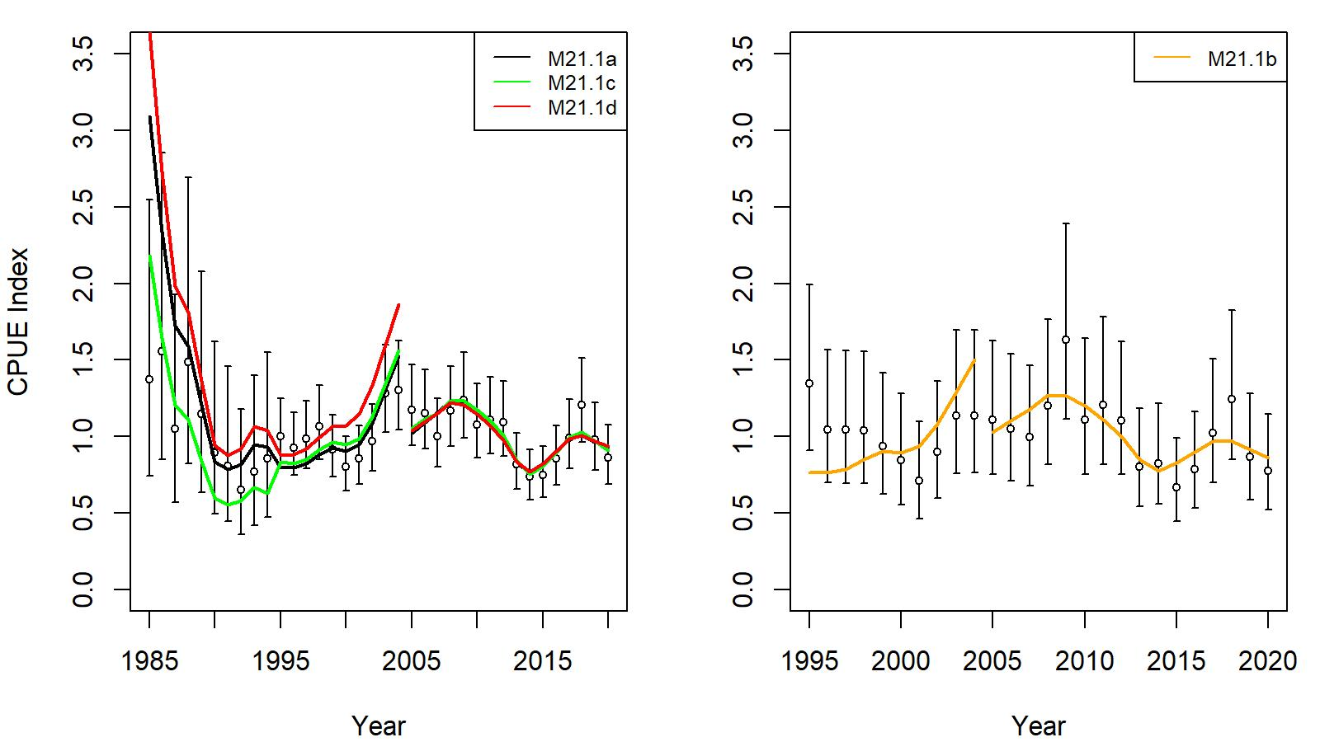
Model results
Figure 7. Comparison of input CPUE indices [black open circles with +/- 2 SE for model 21.1a (left) and model 21.1b (right)] with predicted CPUE indices (colored solid lines) by 21.1a, 21.1b, 21.1c and 21.1d, model fits for WAG golden king crab data, 1985/86–2020/21. Model estimated additional standard error was added to each input standard error.

Slide 29
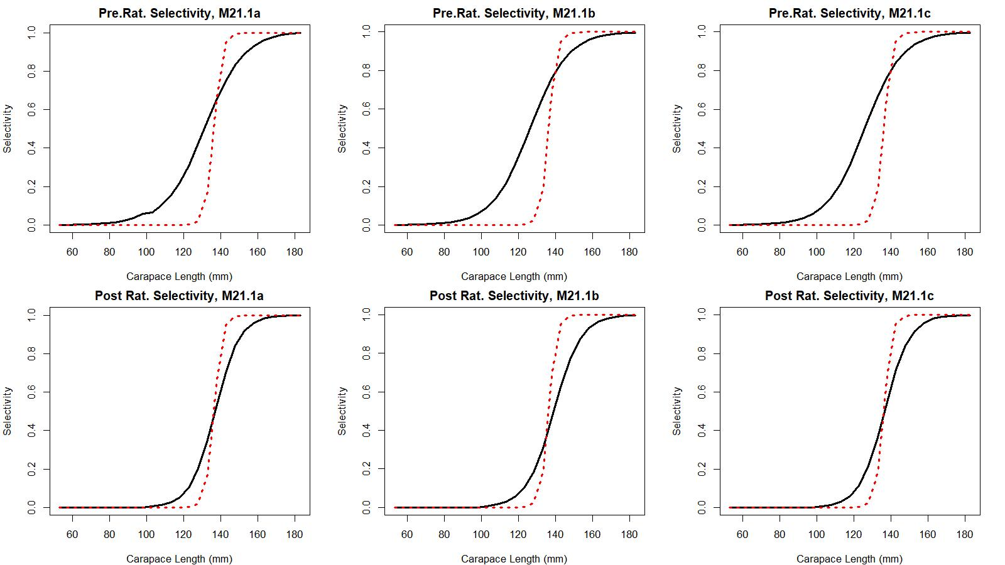
Model results
Figure 6. Estimated total (black solid line) and retained selectivity (red dotted line) for pre- and post- rationalization periods for models 21.1a, 21.1b, and 21.1c fits to golden king crab data in the EAG.

Slide 30
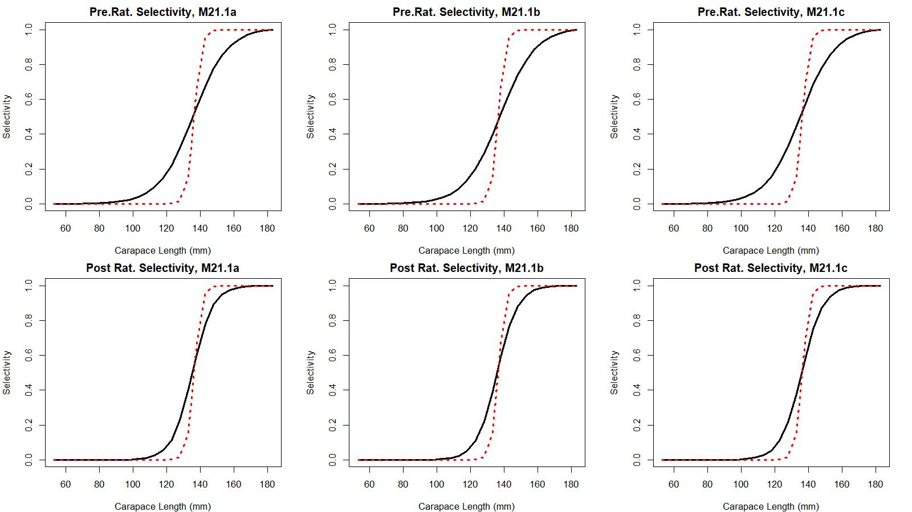
Model results
Figure 16. Estimated total (black solid line) and retained selectivity (red dotted line) for pre- and post- rationalization periods for models 21.1a, 21.1b, and 21.1c fits to golden king crab data in the WAG.

Slide 31
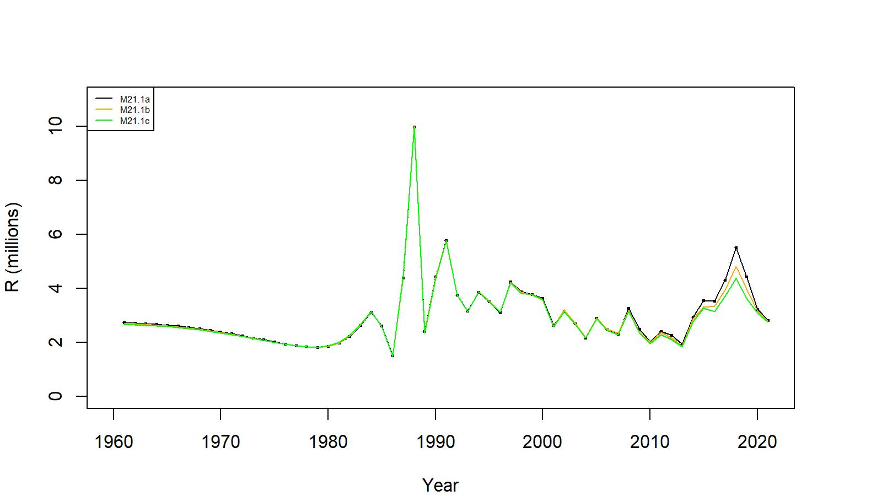
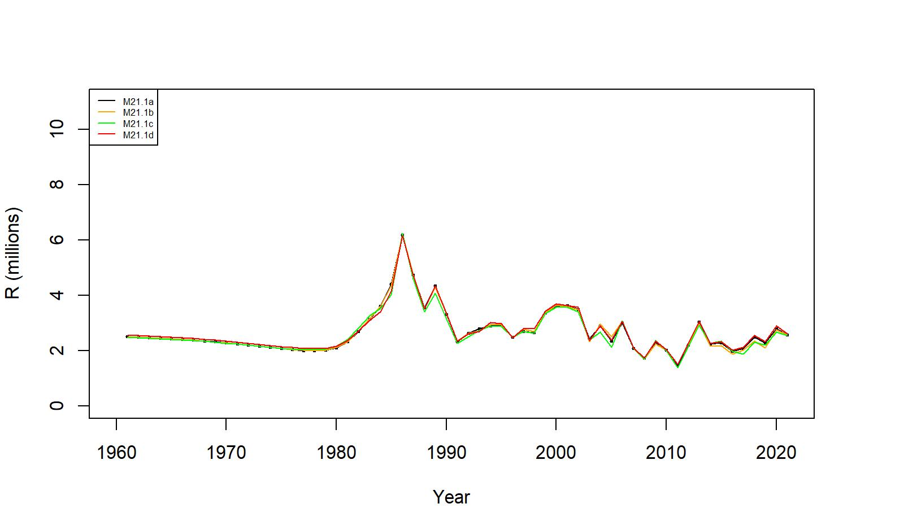
Figures 8 and 18 . Estimated number of male recruits (millions of crab ≥ 101 mm CL) for 21.1a, 21.1b, and 21.1c model fits to EAG (top) and 21.1a, 21.1b, 21.1c, and 20.1d model fits for WAG (bottom), 1961–2021.
EAG
WAG

Slide 32
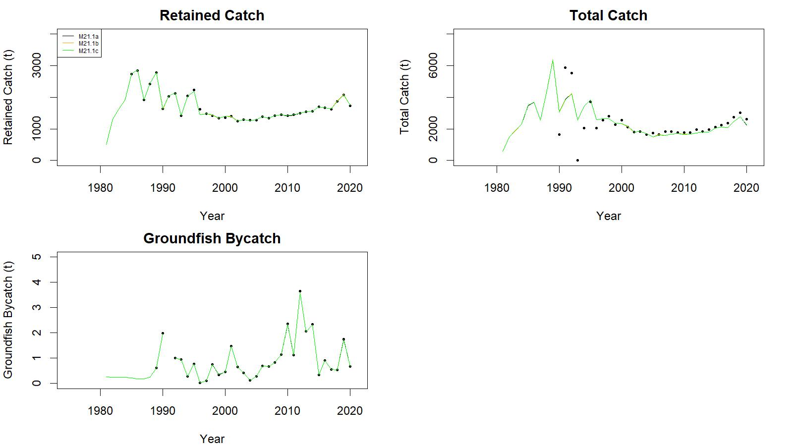
Figure 9. Observed (open circle) vs. predicted (solid line) retained catch (top left), total catch (top right), and groundfish bycatch (bottom left) of golden king crab for 21.1a, 21.1b, and 21.1c model fits to EAG data, 1981/82–2020/21.
.

Slide 33
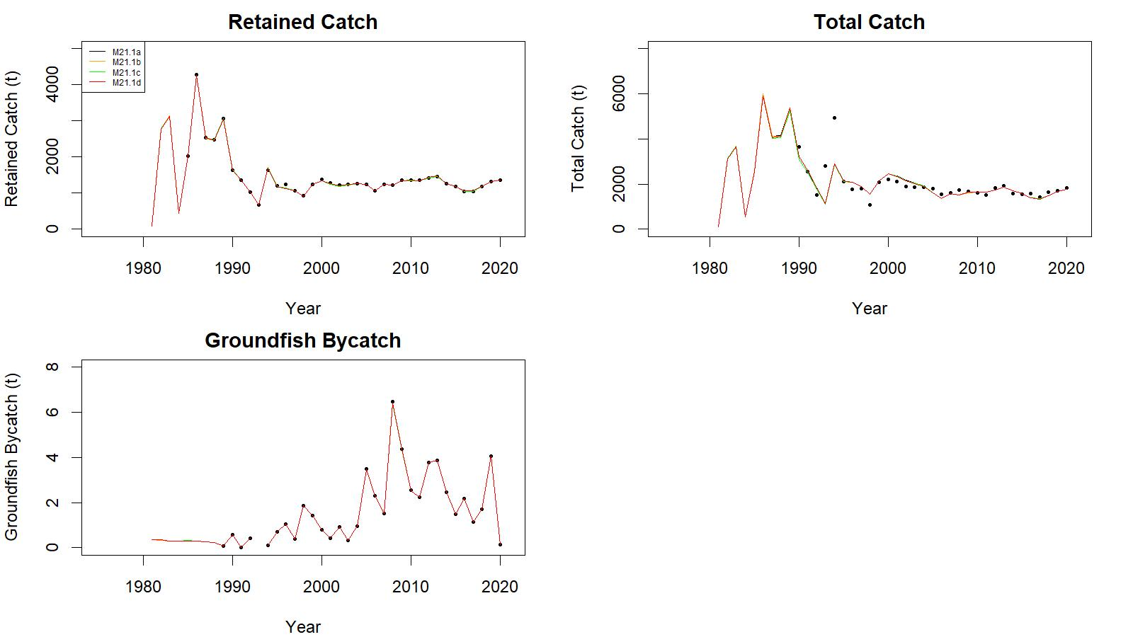
Figure 19. Observed (open circle) vs. predicted (solid line) retained catch (top left), total catch (top right), and groundfish bycatch (bottom left) of golden king crab for 21.1a, 21.1b, 21.1c, and 21.1d model fits to WAG data, 1981/82–2020/21.
.
.

Slide 34
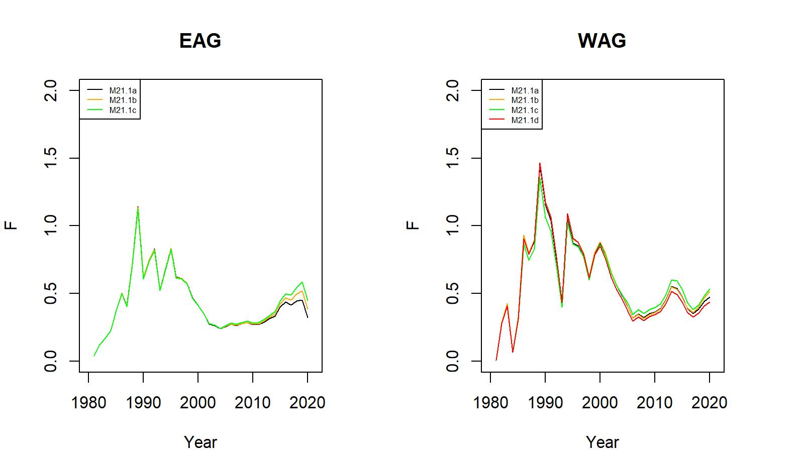
Figure 11. Trends in pot fishery full selection total fishing mortality of golden king crab for 21.1a, 21.1b, and 21.1c model fits to EAG (left) and for 21.1a, 21.1b, 21.1c, and 21.1d model fits to WAG (right) data, 1981/82–2020/21.

Slide 35
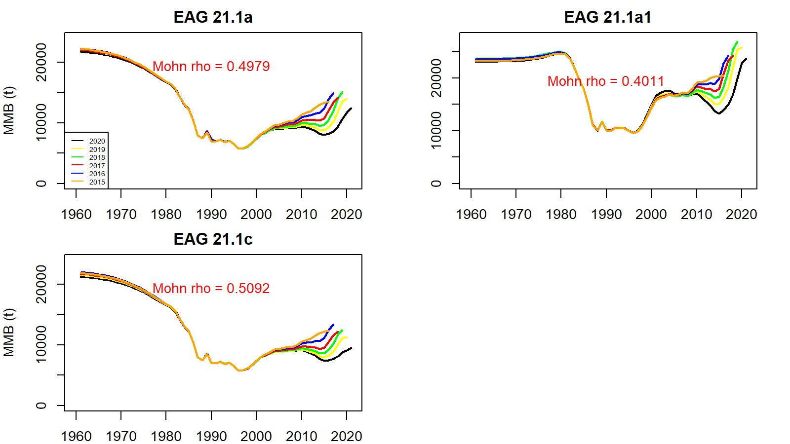
Figure 21. Comparison of 21.1a, 21.1a1 (a higher M of 0.38yr⁻¹ was used for years > 1998 in the assessment), and 21.1c models’ retrospective fits for EAG.

Slide 36
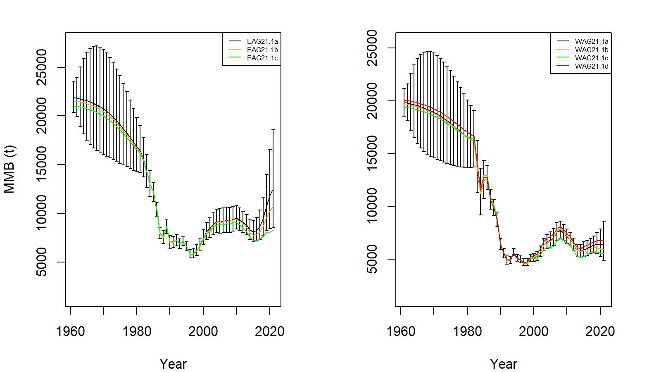
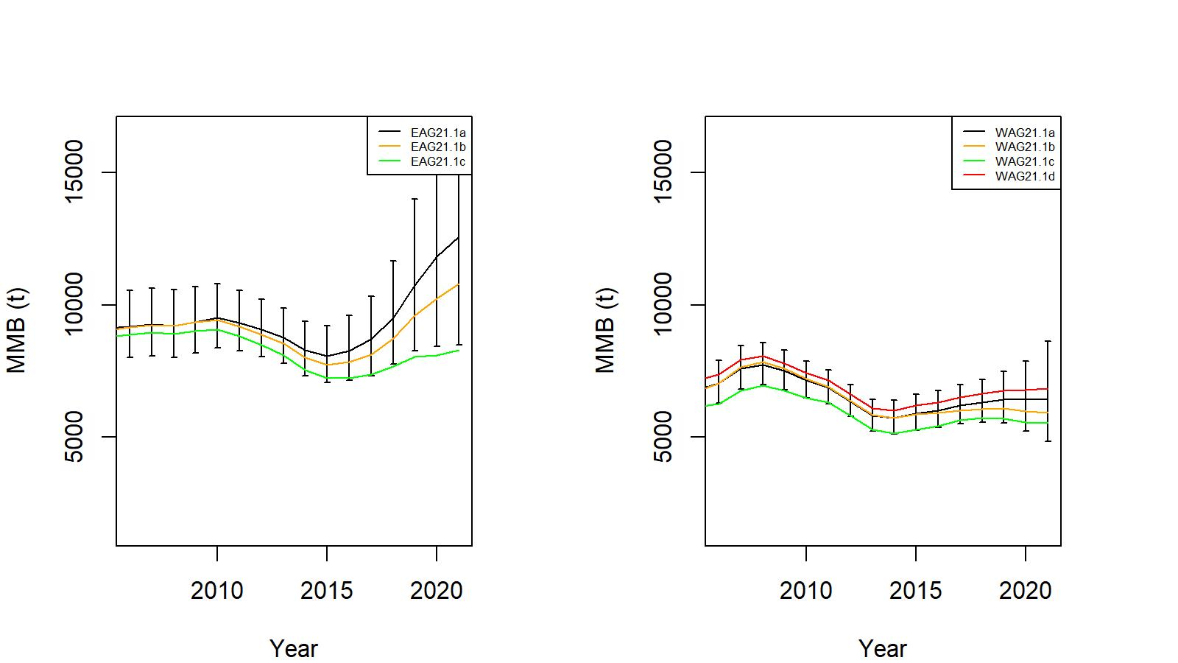
Figure 12. Trends in golden king crab mature male biomass for 21.1a, 21.1b, and 21.1c model fits to EAG (left) and for 21.1a, 21.1b, 21.1c, and 21.1d model fits to WAG (right) data. Top: 1960/61–2020/21, bottom: 2005/06–2020/21. Model21.1a estimate has two standard error confidence limits.

Slide 37
Table 16. Stock status, reference biomass and fishing mortality, OFL (total catch), and ABC for various models for EAG, WAG, and AI golden king crab stock.
Biomass, OFL, and ABC are in t. Current MMB = 2021 MMB.
EAG:
Model | Tier | MMB_{35%} | Current MMB | MMB/ MMB_{35%} | F_{OFL} | F_{35%} | M(yr⁻¹) | OFL | MaxABC (P*=0.49) | ABC (0.75*OFL) | ABC (0.70*OFL)
21.1a | 3a | 9,298 | 11,039 | 1.19 | 0.64 | 0.64 | 0.21 | 3,795 | 3,775 | 2,846 | 2,657
21.1b | 3a | 9,157 | 9,834 | 1.07 | 0.65 | 0.65 | 0.21 | 3,212 | 3,195 | 2,409 | 2,248
21.1c | 3b | 8,974 | 8,279 | 0.92 | 0.60 | 0.66 | 0.21 | 2,204 | 2,182 | 1,653 | 1,543
21.1a2 | 3a | 8,999 | 10,668 | 1.19 | 0.56 | 0.56 | 0.21 | 3,416 | 3,398 | 2,562 | 2,391
21.1b2 | 3a | 8,848 | 9,417 | 1.06 | 0.57 | 0.57 | 0.21 | 2,897 | 2,881 | 2,172 | 2,028

Slide 38
Table 16 continued.
Model | Tier | MMB_{35%} | Current MMB | MMB/ MMB_{35%} | F_{OFL} | F_{35%} | M(yr⁻¹) | OFL | MaxABC (P*=0.49) | ABC (0.75*OFL) | ABC (0.70*OFL)
21.1a | 3b | 7,370 | 6,702 | 0.91 | 0.57 | 0.63 | 0.21 | 1,669 | 1,659 | 1,252 | 1,169
21.1b | 3b | 7,354 | 6,378 | 0.87 | 0.54 | 0.63 | 0.21 | 1,446 | 1,435 | 1,085 | 1,012
21.1c | 3b | 7,089 | 6,069 | 0.86 | 0.55 | 0.66 | 0.21 | 1,314 | 1,307 | 986 | 920
21.1d | 3b | 7,441 | 6,960 | 0.94 | 0.58 | 0.62 | 0.21 | 1,836 | 1,825 | 1,377 | 1,285
21.1a2 | 3b | 7,157 | 6,260 | 0.87 | 0.46 | 0.54 | 0.21 | 1,422 | 1,414 | 1,067 | 996
21.1b2 | 3b | 7,078 | 5,897 | 0.83 | 0.45 | 0.55 | 0.21 | 1,247 | 1,237 | 935 | 873
WAG:
 | OFL | ABC (0.75*OFL) | ABC (0.7*OFL)
21.1a | 5,464 | 4,098 | 3,826
21.1b | 4,658 | 3,494 | 3,260
21.1c | 3,518 | 2,639 | 2,463
21.1a2 | 4,838 | 3,629 | 3,387
21.1b2 | 4,144 | 3,107 | 2,901
AI:

Slide 39
Suggested models for May 2022 assessment:
Models 21.1a, 21.1b, and 20.1c & extension with one-bin higher knife-edge maturity size for MMB estimation
Thank you

