Slide 1
Aleutian Islands Golden King Crab Model Discussions and Scenarios for May 2019 Assessment
M.S.M. Siddeek, J. Zheng, C. Siddon, B. Daly, and M. Westphal
Alaska Department of Fish and Game, Juneau, Kodiak, and Dutch Harbor
January 23, 2019, Nome

Slide 2
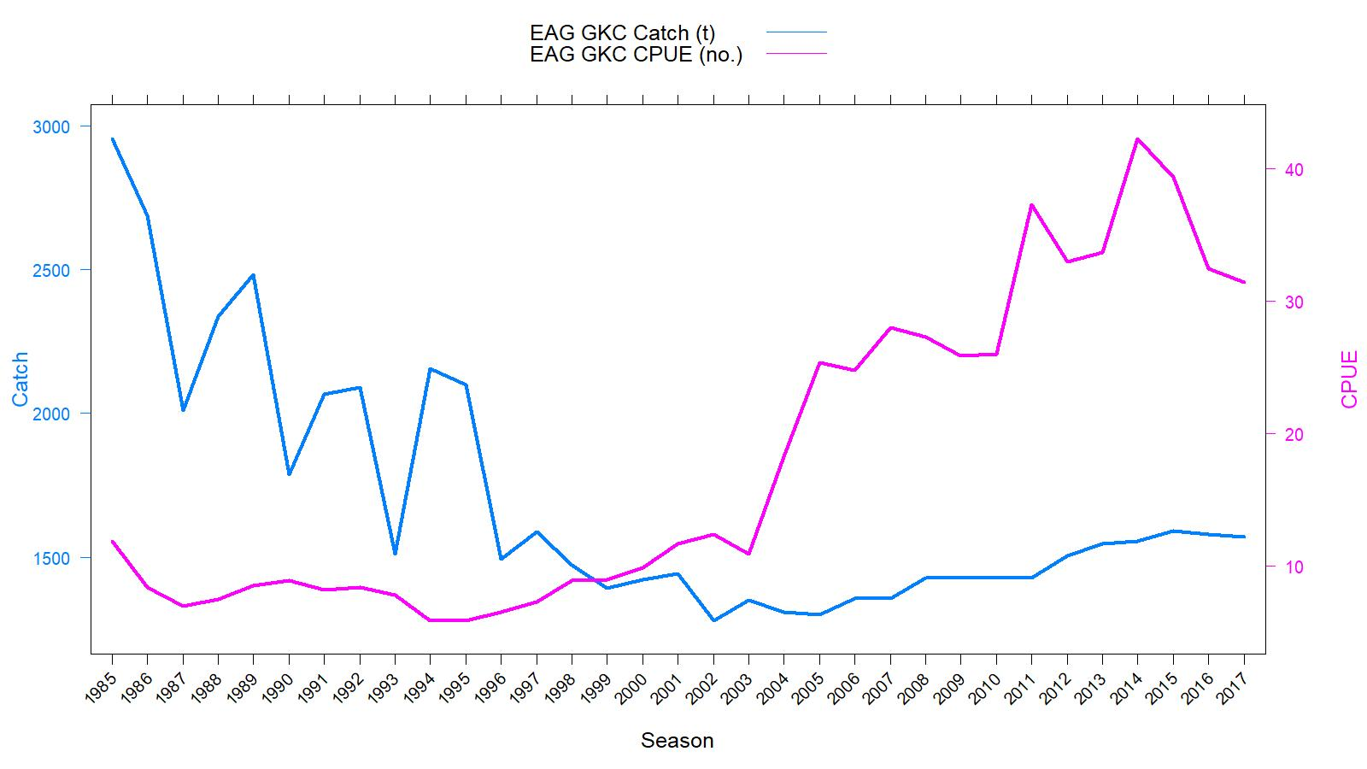
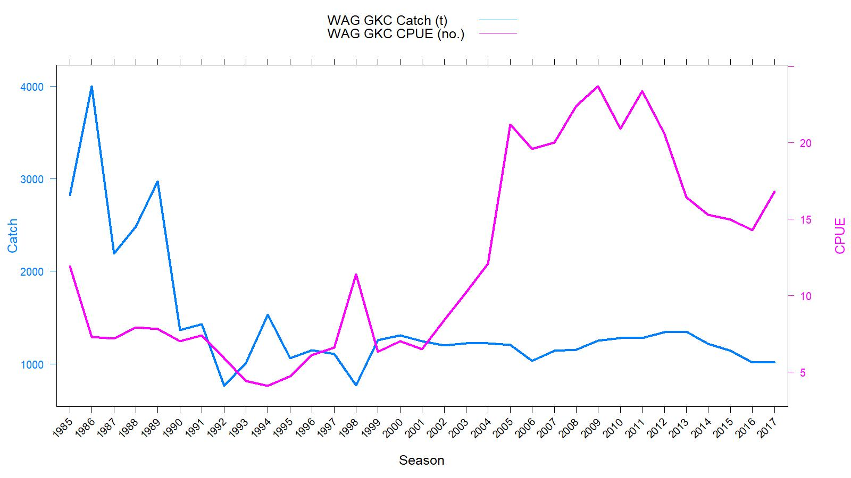
EAG
Catch (t) and CPUE
(number of crab per pot lift) in 1985/86–2017/18
Rationalization
TAC
WAG
TACs :
2017/18: (1) EAG: 3.31 million pounds; and
(2) WAG: 2.235 million pounds
2018/19: (1) EAG: 3.856 million pounds; and
(2) WAG: 2.50 million pounds; But
gear/mesh modification

Slide 3
Topics
Responses to May 2018 CPT, June 2018 SSC, and June 2018 CIE review comments
Proposed Scenarios
Some diagnostic fits
Preliminary Tier 3 OFL and ABC estimates

Slide 4
Length based modeling approach
An integrated male-only length based model. This is the only FMP crab stock modelled with fishery dependent catch and CPUE data.
M estimated in the model.
Projected the abundance from unfished equilibrium in 1960 to initialize the 1985 abundance.
3 Scenarios for EAG and WAG.
Knife edge maturity used for MMB calculation.
Francis re-weighting method for Stage-2 effective sample sizes calculation for all scenarios.

Slide 5
May 2018 CPT (major) comments
Comment 1: Base OFL and ABC recommendations on a model projection for the coming fishing year that includes total catch for the concluded fishing year.
Response:
Because the 2018/19 completed fishery data will not be ready by May 2019CPT, we projected the next year OFL and ABC considering a total catch composed of recent three-year mean retained catch, model predicted pot fishery bycatch, and recent three-year mean groundfish bycatch.
Comment 2: Reanalyze chela measurement data for AIGKC using new analytical techniques developed for snow crab and Tanner crab.
Response:
Currently collecting more chela measurement data from the Observer, dockside, and independent survey (in EAG) samplings. We will start with the independent survey maturity data analysis and complete the analysis for the May 2020 CPT.

Slide 6
May 2018 CPT (major) comments continued
Comment 3: Work on appropriate statistical models for analysis of ADF&G cooperative pot survey that reflect the nested sampling design of vessels, strings within vessel, and pots within strings and consider the use of random effects as appropriate.
Response:
We will follow the random effect approach and present the results at the 2020 CPT meeting. Still the data series will be short ( 2015/16, 2016/17, 2017/18, and 2018/19).
Comment 4: Work on the VAST spatial modeling approach. This work can be given lower priority until approaches using VAST for CPUE data are better established and suitable model diagnostics become available.
Response:
Agree. Analysis is temporarily stopped.

Slide 7
May 2018 CPT (major) comments continued
Comment 5: Continue exploration of year-area interactions using appropriate analytical methods, and develop area weights using fishing footprint calculations.
Response:
With the modification of observer database [following CIE review suggestion, fishery industry input, and SSC comment (below)] we re-analyzed the CPUE index (Appendix B). The Year:Area interaction was not selected by the hybrid stepwise selection procedure. We suspect with the detail area locations (Lat and Long), there is a possibility of severe collinearity between Area and Year. We are investigating this further. For the current assessment, we considered the main effect final model.
Comment 6: A standard set of plots should be prepared to summarize the B0 calculations. Plot 1 should compare dynamic B0 and the estimated time series of MMB. Plot 2 should plot the B0 depletion ratio, MMB/B0. Plot 3 should plot the estimated recruitment time series.
Response:
Done. See Figures 17 (EAG) and 18 (WAG).

Slide 8
June 2018 SSC (major) comments
Comment 1: Standardize model labeling.
Response:
done
Comment 2: There is continued high uncertainty about maturity. Using knife-edge maturity, as currently implemented, was an interim fix due to problems with estimating maturity at size. We support and encourage efforts to obtain additional chela measurements to improve the parameterization of maturity in the model as a probabilistic function of size (e.g., logistic).
Response:
Pl. Read our response to CPT comment#2. We will be developing a logistic curve with the additional data and analysis.
Comment 3: We encourage the co-operative survey to be continued and endorse further work to include this independent survey into the model. The SSC specifically endorses the CPT recommendation to use nested random effects for strings within vessels and for pots within strings in a mixed-effects model.
The SSC also requests the authors to include a brief description of the cooperative survey in the document, including the area sampled, size composition, and a summary of trends in CPUE.
Response:
Pl. read CPT comment#3. We will provide a description of the survey and the data summary in May 2019 CPT. .

Slide 9
June 2018 SSC comments continued
Comment 4: We agree with the CPT that the VAST model will require more analyses, which are ongoing, before it can be adopted for AIGKC. One specific suggestion to consider is using a smoother in the analysis that is designed to better deal with edge effects such as a “soap film” smoother. need to be chosen carefully.
Response:
Pl. read our response to CPT comment#4.
Comment 5: The CPT noted that the year effect is not appropriate as an abundance index in the presence of interactions and recommended use of the “fishing footprint” as a measure of area, then use of area weights to compute the annual abundance index. The SSC supports this recommendation but notes that, like the VAST analyses, the ‘fishing footprint’ needs to be clearly defined and a rationale for how it is quantified needs to be developed before further pursuing year-area interactions in the model.
Response:
Pl. read our response to CPT comment#5.

Slide 10
June 2018 SSC (major) comments
Comment 6: In terms of model selection, all models except one use a somewhat arbitrary R² criterion for model selection. The SSC is unclear on the rationale for this choice of model selection criterion and why it was considered better than the AIC. The SSC encourages the authors to consider AIC or other information-theoretic approaches (e.g., BIC) if any non-independence in the fishery CPUE data can be addressed appropriately through a geostatistical approach and/or the use of random effects.
Response:
We followed a hybrid approach: 1. Select a set of independent variables by the stepwise selection using the consistence AIC procedure and 2. Carryout further reduction (if feasible) for model parsimony using another step wise selection procedure with a R² criterion. This way we can address over parametrization of the final GLM model by the AIC method.

Slide 11
June 2018 CIE (major) comments
Comment by Yong Chen:
Short Term:
Comment A.1: New scenarios should be run in parallel to the old one.
Response:
Time trends in CPUE indices, fishing mortality, and mature male and legal male biomasses are shown in parallel to the May 2017 and in some cases September 2017 estimates.
Comment A.2: Retrospective analysis should be done for all scenarios.
Response:
Will do with the May 2019 final assessment.

Slide 12
June 2018 CIE (major) comments continued
Comment by Yong Chen:
Comment A.3: VAST type analysis should be carried out for index estimation to capture autocorrelation over space and time
Response:
Will be discussed by the CPT. We will follow their decision.
Comment A.4: Jittering should be done to evaluate the sensitivity of model convergence.
Response:
Previously done. Will do with the May 2019 final assessment.

Slide 13

June 2018 CIE (major) comments continued
Comment by Yong Chen:
Long-term:
Comment A.5: Constant discard mortality over time and space may not be biologically realistic.
Response:
We re-scaled the pot fishery bycatch mortality rate by the amount of annual bycatch in scenario 18_1a. We will re-scale the groundfish by catch mortality rate by the amount of annual bycatch in the next assessment.
$${Byc_M}_{t}= \frac{0.2×{Byc}_{t}}{maxByc}$$
Comment A.6: Survey for AIGKC should be extended to WAG and more information on small crabs
Response:
That is our future plan.

Slide 14
June 2018 CIE (major) comments continued
Comments by John Neilson:
Comment B.1: Bycatch mortality may vary over season.
Response:
Yes, we re-scaled the pot fishery bycatch mortality rate by the amount of bycatch (t) in one scenario 18_1a.
Comment B.2: Past models’ projections should have been compared with the current estimates and trends of MMB.
Response:
Yes, we did in this report
Comment B.3: There are so many degrees of freedom associated with Gear in the CPUE standardization. Consulting with fishing industry could help obtain realistic and sensible ways of combining gear types that have essentially similar selectivity.
Response:
We reduced the number of gear codes in scenarios 18_1 and 18_1a with the industry consultation. (Pl. see Appendix B)
.

Slide 15
June 2018 CIE (major) comments continued
Comments by John Neilson:
Comment B.1: Bycatch mortality may vary over season.
Response:
Yes, we re-scaled the pot fishery bycatch mortality rate by the amount of bycatch (t) in one scenario 18_1a.
Comment B.2: Past models’ projections should have been compared with the current estimates and trends of MMB.
Response:
Yes, we did in this report
Comment B.3: There are so many degrees of freedom associated with Gear in the CPUE standardization. Consulting with fishing industry could help obtain realistic and sensible ways of combining gear types that have essentially similar selectivity.
Response:
We reduced the number of gear codes in scenarios 18_1 and 18_1a with the industry consultation. (Pl. see Appendix B)
.

Slide 16
June 2018 CIE (major) comments continued
Comments by John Neilson:
Comment B.1: Bycatch mortality may vary over season.
Response:
Yes, we re-scaled the pot fishery bycatch mortality rate by the amount of bycatch (t) in one scenario 18_1a.
Comment B.2: Past models’ projections should have been compared with the current estimates and trends of MMB.
Response:
Yes, we did in this report
Comment B.3: There are so many degrees of freedom associated with Gear in the CPUE standardization. Consulting with fishing industry could help obtain realistic and sensible ways of combining gear types that have essentially similar selectivity.
Response:
We reduced the number of gear codes in scenarios 18_1 and 18_1a with the industry consultation. (Pl. see Appendix B)
.

Slide 17
June 2018 CIE (major) comments continued
Comments by John Neilson:
Comment B.4: The CPUE standardization attempts to deal with the issue of reduction in number of vessels by considering vessels stayed in the fishery for a long time period.
Response: Agree.
Comment B.5: The fishery independent survey is not truly independent index because the survey does not standardize for soak time and depth. But useful for the model and sampling young crabs. The industry survey offers the best hope to avoid problems with the changes in the area fished or number of vessels over time. Can test the gear power as well. The coverage should also expand to WAG.
Response:
Agree. We are planning to extend the fishery independent survey to WAG.
Comment B.6: Estimate maturity outside the model.
Response: We did. Will follow this advice when analyzing additional data.
.

Slide 18
June 2018 CIE (major) comments continued
Comments by Rauf Kalida:
Comment C.1: Breakpoint analysis is a good approach. Spatial and temporal changes in maturity should also be investigated to improve maturity breakpoint.
Response:
With the additional data currently being collected we will investigate spatial and temporal changes in maturity.
Several other recommendations, such as tagging experiments with DST and PIT tags, larval distribution study, crab ageing, have been made in the CIE report, which will be addressed in the future.

Slide 19
Table A. EAG and WAG model scenarios
Sc. | Size-comp. weighting | Catchability and logistic total selectivity sets | Maturity | CPUE data type | Initial Abundance, Treatment of M | M yr⁻¹
18_0 | Stage-1: Number of days/trips Stage-2: Francis method | 2 | Knife-edge 111 mmCL | Observer from 1995/96–2017/18 & Fish Ticket from 1985/86–1998/99 | Initial abundance by equilibrium condition; estimated common M using the combined EAG and WAG | 0.21
18_1 | Stage-1: Number of days/trips Stage-2: Francis method | 2 | Knife-edge 111 mmCL | Observer from 1995/96–2017/18; Number of gear codes were reduced for CPUE standardization & Fish Ticket from 1985/86–1998/99 | Initial abundance by equilibrium condition; estimated common M using the combined EAG and WAG | 0.21
18_1a | Stage-1: Number of days/trips Stage-2: Francis method | 2 | Knife-edge 111 mmCL | Observer from 1995/96–2017/18; Number of gear codes were reduced for CPUE standardization & Fish Ticket from 1985/86–1998/99 | Initial abundance by equilibrium condition; estimated common M using the combined EAG and WAG. Pot bycatch mortality scaled by the amount of bycatch. | 0.21

Slide 20
Table B1. Updated gear codes
Original Gear code | Pot gear description | Mark X against the code that can be ignored | Number Encountered by Observers during 1990-2016 | Updated Gear Code
1 | Dungeness crab pot, small & round | X | 2 | X
2 | Pyramid pot, tunnel openings usually on sides, stackable | X | 2121 | X
3 | Conical pot, opening at top of cone, stackable | X | 2000 | X
4 | 4' X 4' rectangular pot |  | 60 | X
5 | 5' X 5' rectangular pot |  | 18032 | 5
6 | 6' X 6' rectangular pot |  | 17508 | 6
7 | 7' X 7' rectangular pot |  | 23806 | 7
8 | 8' X 8' rectangular pot |  | 1936 | 8
9 | 5 1/2' X 5 1/2' rectangular pot |  | 6934 | 5
10 | 6 1/2' X 6 1/2' rectangular pot |  | 22085 | 6
11 | 7 1/2' X 7 1/2' rectangular pot |  | 387 | 7
12 | Round king crab pot, enlarged version of Dungeness crab pot |  | 8259 | X
13 | 10' X 10' rectangular pot |  | 466 | 13
14 | 9' X 9' rectangular pot | X | 1 | X
15 | 8 1/2' X 8 1/2' rectangular pot | X | 1 | X
16 ……..cont

Slide 21
1. X<- model.matrix(~ Year+ns(SoakDays,df=4)+Month+Vessel+Captain+StatArea+Gear+ns(Depth,df=2)+ns(EastVesSoak,df=9)-1,data=datacore)
2. correl_datacore <- round(cor(X, use = "pair"),2)

Slide 22
Correlation matrix
 | 1995 | 1996 | 1997 | 1998 | 1999 | 2000 | 2001 | 2002 | 2003 | 2004
1995 | 1 | -0.14 | -0.12 | -0.11 | -0.11 | -0.13 | -0.12 | -0.11 | -0.11 | -0.08
1996 | -0.14 | 1 | -0.14 | -0.13 | -0.13 | -0.16 | -0.14 | -0.13 | -0.13 | -0.09
1997 | -0.12 | -0.14 | 1 | -0.11 | -0.11 | -0.13 | -0.11 | -0.1 | -0.11 | -0.08
1998 | -0.11 | -0.13 | -0.11 | 1 | -0.1 | -0.12 | -0.11 | -0.1 | -0.1 | -0.07
1999 | -0.11 | -0.13 | -0.11 | -0.1 | 1 | -0.13 | -0.11 | -0.1 | -0.1 | -0.07
2000 | -0.13 | -0.16 | -0.13 | -0.12 | -0.13 | 1 | -0.13 | -0.12 | -0.12 | -0.09
2001 | -0.12 | -0.14 | -0.11 | -0.11 | -0.11 | -0.13 | 1 | -0.1 | -0.11 | -0.08
2002 | -0.11 | -0.13 | -0.1 | -0.1 | -0.1 | -0.12 | -0.1 | 1 | -0.1 | -0.07
2003 | -0.11 | -0.13 | -0.11 | -0.1 | -0.1 | -0.12 | -0.11 | -0.1 | 1 | -0.07
2004 | -0.08 | -0.09 | -0.08 | -0.07 | -0.07 | -0.09 | -0.08 | -0.07 | -0.07 | 1
ns(SoakDays, df = 4)1 | -0.09 | -0.09 | 0.01 | -0.02 | -0.03 | -0.01 | 0.08 | 0.05 | 0.1 | 0.02
ns(SoakDays, df = 4)2 | 0.1 | 0.01 | 0.02 | -0.04 | -0.03 | 0 | 0.06 | -0.02 | -0.05 | -0.07
ns(SoakDays, df = 4)3 | -0.12 | 0 | -0.01 | -0.01 | 0.05 | 0.05 | -0.06 | 0.03 | 0.01 | 0.07
ns(SoakDays, df = 4)4 | 0.1 | 0.09 | 0.05 | 0 | -0.03 | 0 | -0.02 | -0.07 | -0.07 | -0.1
Month | -0.46 | 0.19 | 0.26 | 0.16 | 0.14 | -0.01 | -0.06 | -0.08 | -0.07 | -0.11
Vessel | 0.1 | 0.04 | 0.04 | -0.05 | -0.07 | -0.03 | -0.01 | 0.01 | -0.05 | 0
Captain | -0.01 | -0.01 | 0.01 | 0 | -0.02 | -0.02 | -0.09 | 0.04 | 0.05 | 0.09
StatArea | 0.16 | -0.01 | 0.02 | -0.06 | -0.15 | -0.01 | 0.02 | -0.01 | 0.03 | 0.02
Gear | 0.25 | 0.28 | 0.02 | 0.05 | -0.09 | -0.1 | -0.12 | -0.12 | -0.15 | -0.09
ns(Depth, df = 2)1 | 0.02 | 0.02 | 0.03 | -0.04 | 0.01 | 0 | -0.03 | -0.02 | 0 | 0.01
ns(Depth, df = 2)2 | 0.01 | -0.02 | 0.01 | -0.03 | -0.05 | 0.04 | 0.03 | -0.01 | 0.01 | 0
ns(EastVesSoak, df = 9)1 | -0.14 | -0.17 | 0.97 | -0.13 | 0.12 | -0.15 | -0.14 | -0.13 | -0.13 | -0.09
ns(EastVesSoak, df = 9)2 | -0.21 | -0.25 | 0.31 | -0.19 | -0.2 | 0.77 | -0.2 | -0.19 | -0.19 | 0.38
ns(EastVesSoak, df = 9)3 | -0.2 | -0.24 | -0.2 | -0.19 | -0.19 | 0.66 | -0.2 | -0.18 | 0.33 | 0.53
ns(EastVesSoak, df = 9)4 | -0.12 | -0.05 | -0.12 | -0.11 | -0.12 | -0.14 | -0.12 | -0.11 | 1 | -0.08
ns(EastVesSoak, df = 9)5 | -0.21 | 0.83 | -0.21 | -0.2 | -0.2 | -0.24 | -0.21 | 0.4 | 0.05 | -0.14
ns(EastVesSoak, df = 9)6 | -0.21 | 0.14 | -0.21 | -0.2 | -0.2 | -0.24 | 0.76 | 0.48 | -0.2 | -0.14
ns(EastVesSoak, df = 9)7 | -0.39 | 0.01 | -0.06 | 0.01 | -0.49 | 0.01 | 0.85 | 0.02 | 0.01 | 0.01
ns(EastVesSoak, df = 9)8 | 0.55 | -0.26 | -0.07 | -0.2 | 0.74 | -0.24 | 0.04 | -0.19 | -0.2 | -0.14
ns(EastVesSoak, df = 9)9 | 0.95 | -0.07 | -0.11 | -0.06 | -0.4 | -0.07 | -0.11 | -0.06 | -0.06 | -0.04

Slide 23
1995/96-2004/05 CPUE standardization GLM modeling steps
library(MASS)
library(splines)
(a) Step 1
glm.object<- glm(Legals~Year,family = negative.binomial(1.34),data=datacore)
epotsampleout1<- stepAIC(glm.object,scope=list(upper= ~(Year+ns(SoakDays,df=4)+Month+Vessel+Captain+StatArea+Gear+ns(Depth,df=2)),lower= ~Year),family = negative.binomial(1.34),direction="forward",trace=9,k=log(nrow(datacore))+1.0)
(b) Step 2
glm.object<- glm(Legals~Year,family = negative.binomial(1.34),data=datacore)
epotsampleout1<- stepCPUE(glm.object,scope=list(upper= ~(Year+ns(SoakDays,df=4)+Month+Vessel+Captain+StatArea+Gear+ns(Depth,df=2)),lower= ~Year),family = negative.binomial(1.34),direction="forward",trace=9, r2.change=0.01)

Slide 24
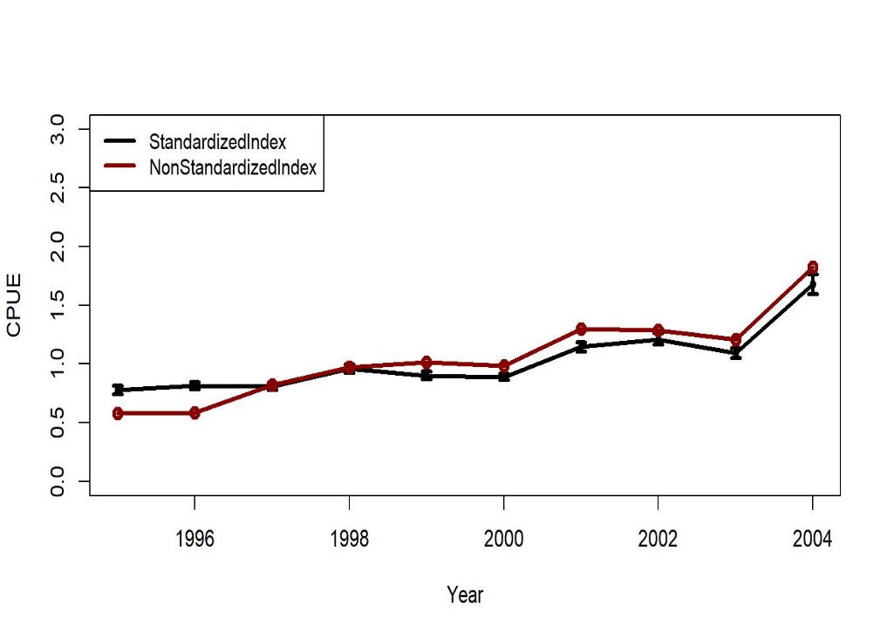
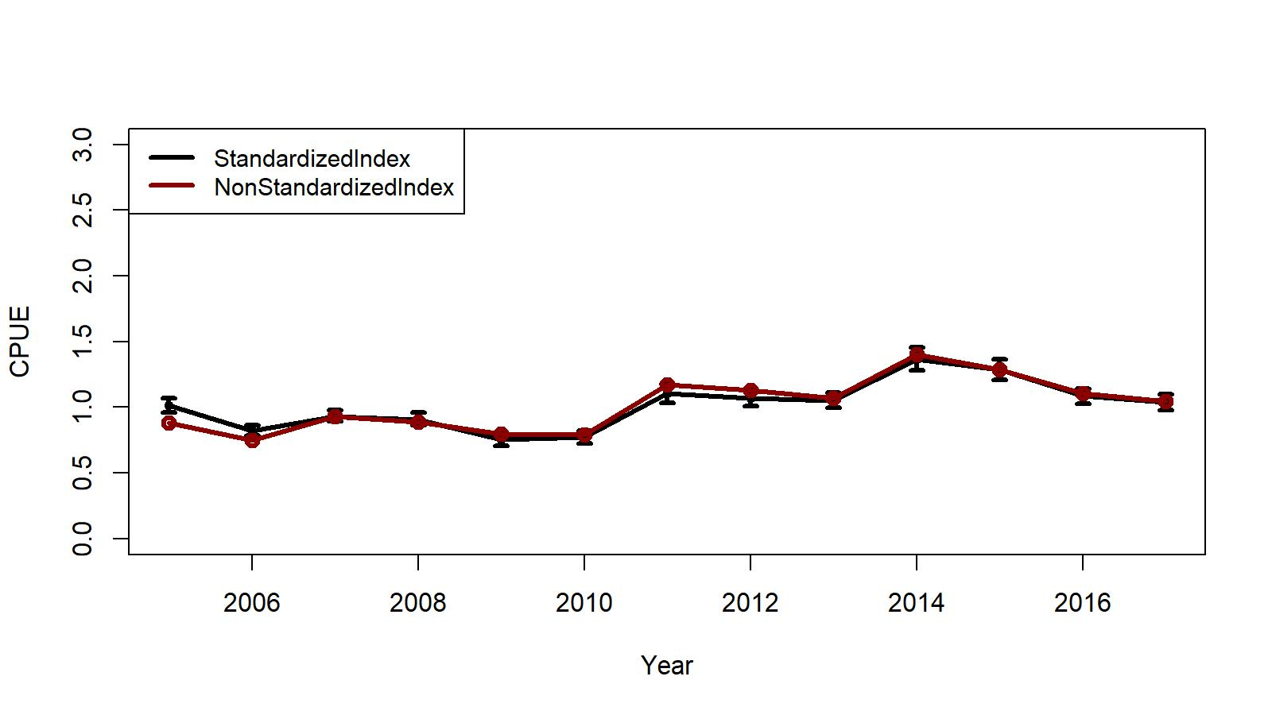



Fig. B.1. Trends in non-standardized and standardized CPUE indices with +/- 2 SE by GLM for EAG. Standardized indices: black line and non-standardized indices: red line. Variables selected by R square criteria.
1995/96 – 2004/05
2005/06 – 2017/18
Initial selection:
$\ln\left(CPUE\right)= Year+Gear+Captain+ns\left(Soak, 4\right)+Month+Area+Vessel$
Initial selection :
$\ln\left(CPUE\right)= Year+Captain+Gear+ ns\left(Soak, 12\right)$
Final selection:
$\ln\left(CPUE\right)= Year+ Captain+Gear+ ns\left(Soak, 12\right)$ )
[$=2.31, R^{2}=0.11]$.
Final selection:
$\ln\left(CPUE\right)= Year+Captain+Gear+ns\left(Soak, 4\right)+Area$
[θ=1.34, $R^{2}=0.22$]

Slide 25
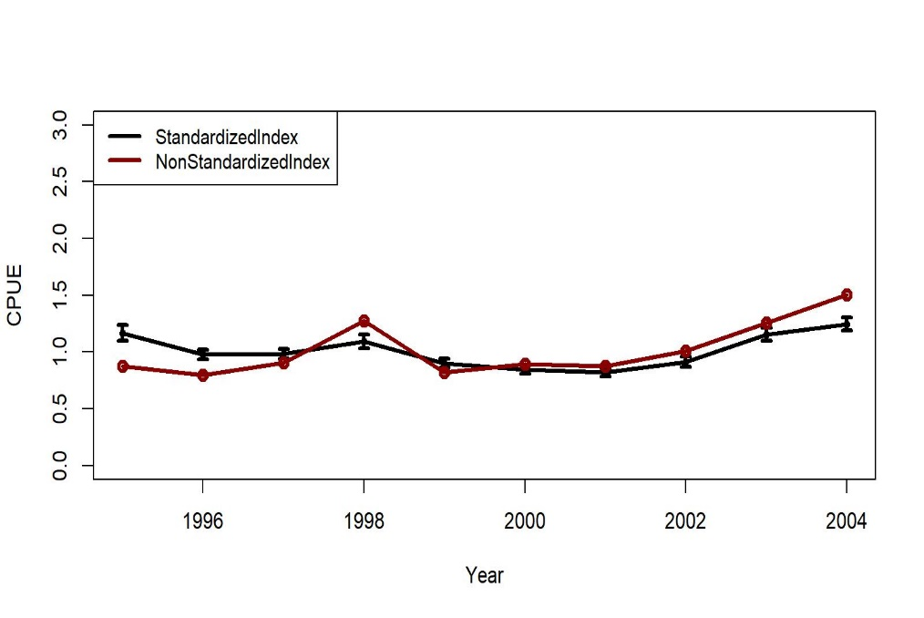
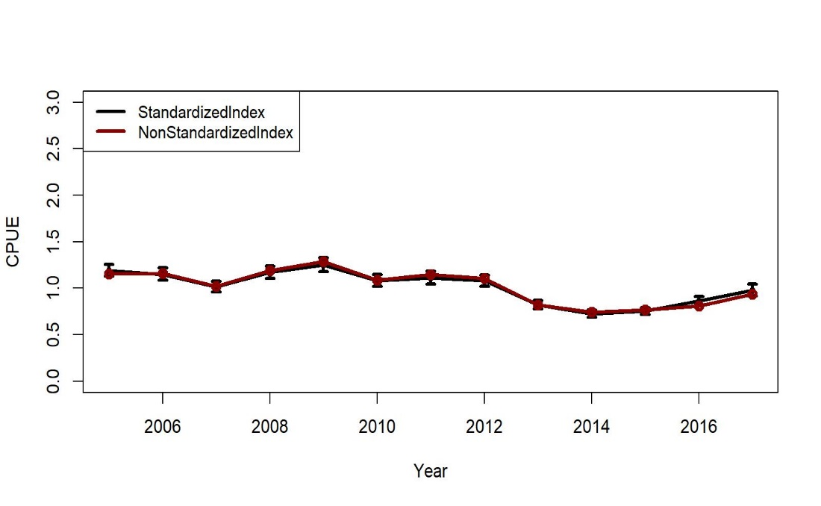


Fig. B.2. Trends in non-standardized and standardized CPUE indices with +/- 2 SE by GLM for WAG. Standardized indices: black line and non-standardized indices: red line. Variables selected by R² criteria.
1995/96 – 2004/05
2005/06 – 2017/18
Initial selection:
$\ln\left(CPUE\right)= Year + Captain+ ns\left(Soak,8\right)+Gear+Month+Vessel+ns\left(Depth, 10\right)$
Final selection:
$\ln\left(CPUE\right)= Year + Captain+ ns\left(Soak,8\right)+Gear$ [θ=0.97, $R^{2}=0.17]$
Initial selection:
$\ln\left(CPUE\right)= Year + Gear+ns\left(Depth,2\right)+Vessel+Month$
Final selection:
$$\ln\left(CPUE\right)= Year + Gear+ns\left(Soak,5\right)$$
[θ=1.13, $R^{2}=0.05, Soak forced in]$

Slide 26
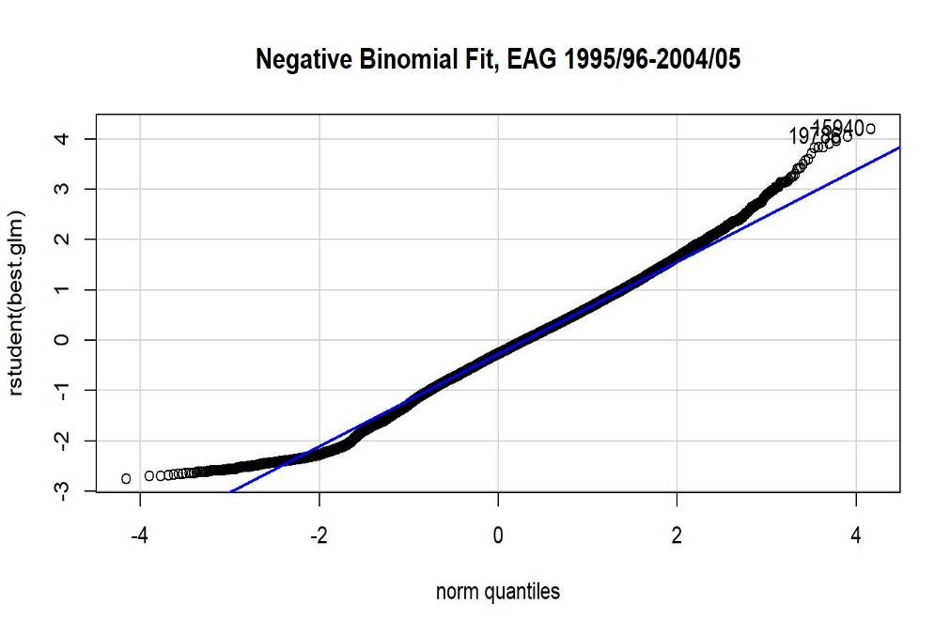
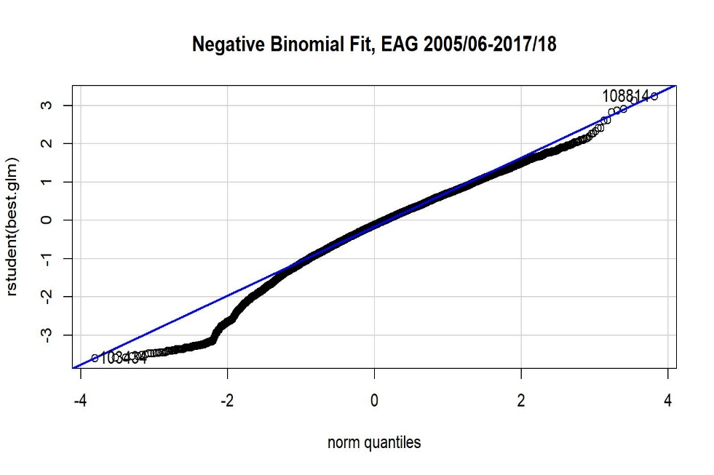
Figure B.3. Studentized residual plots for negative binomial GLM fit for EAG CPUE data.
1995/96 – 2004/05
2005/06 – 2017/18

Slide 27
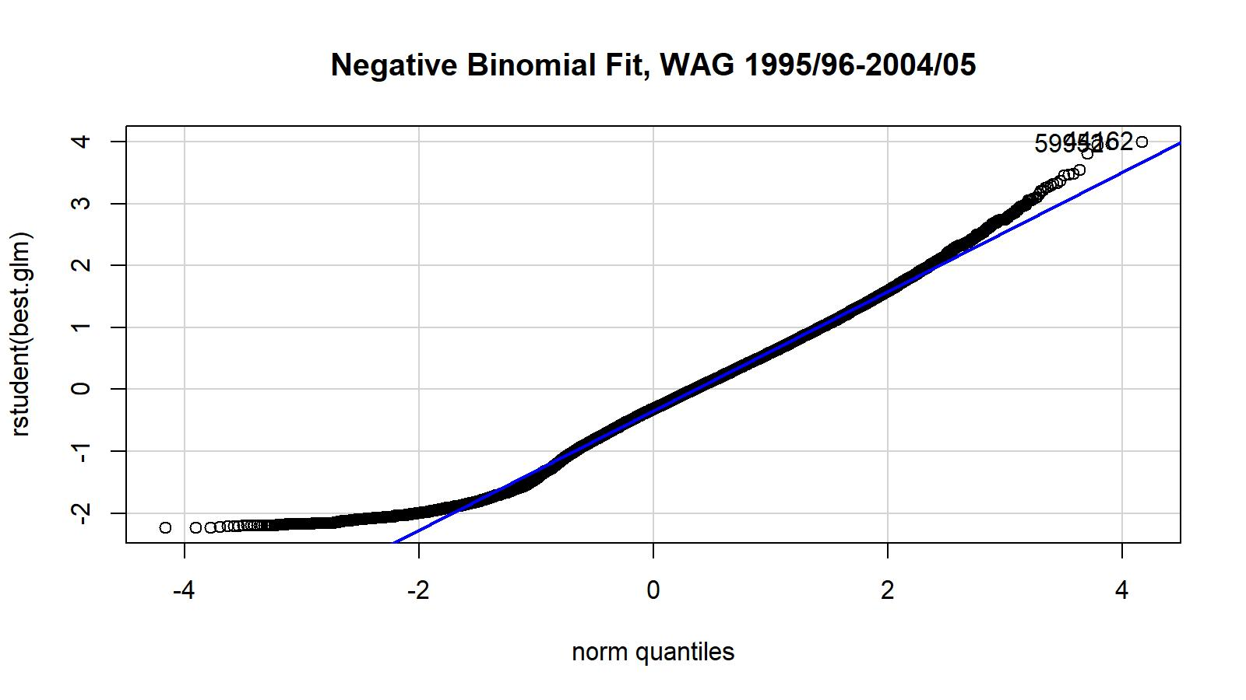
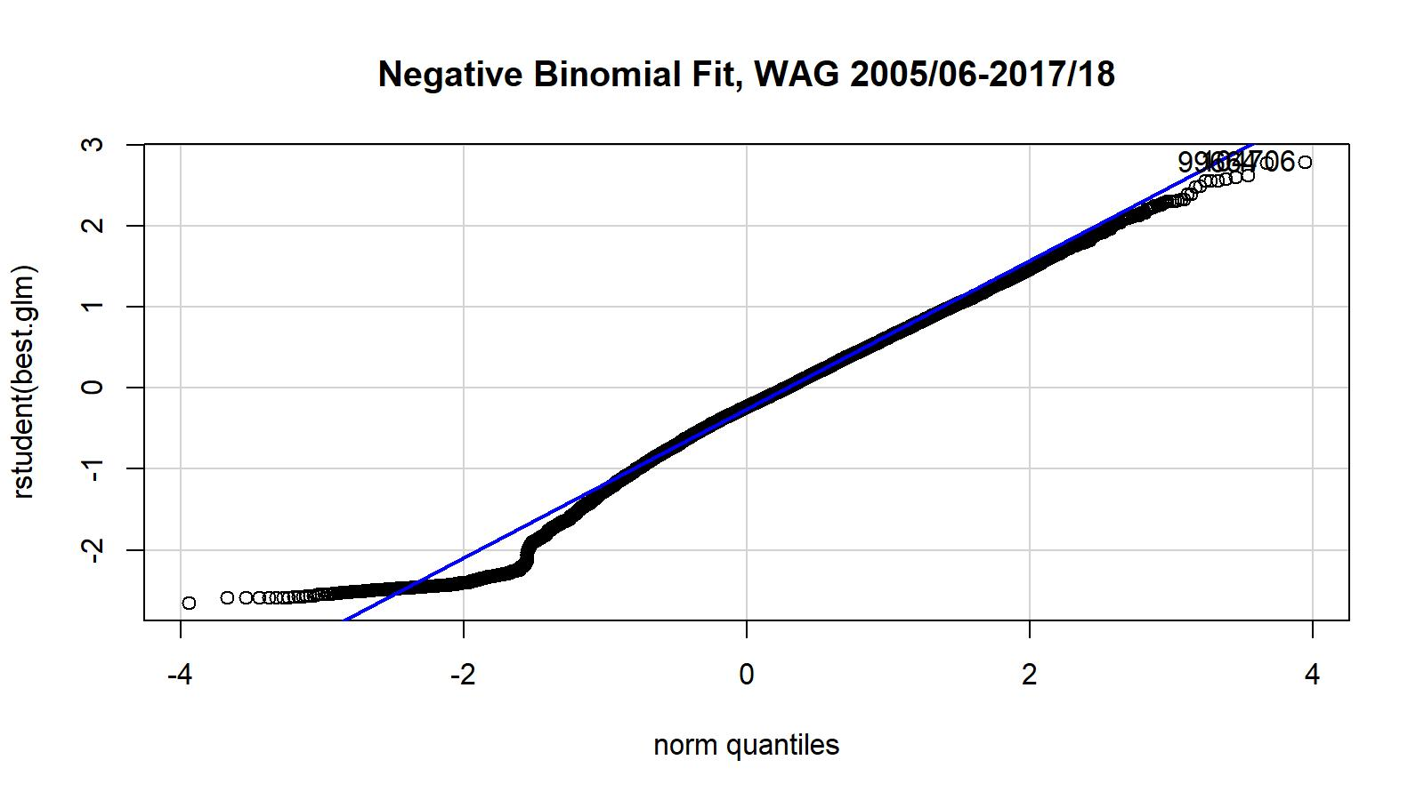
Figure B.4. Studentized residual plots for negative binomial GLM fit for WAG CPUE data.
1995/96 – 2004/05
2005/06 – 2017/18

Slide 28
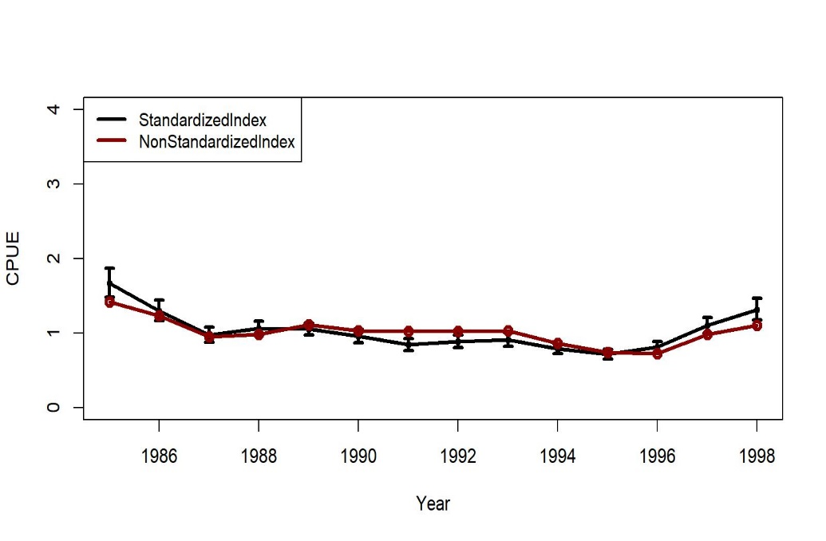
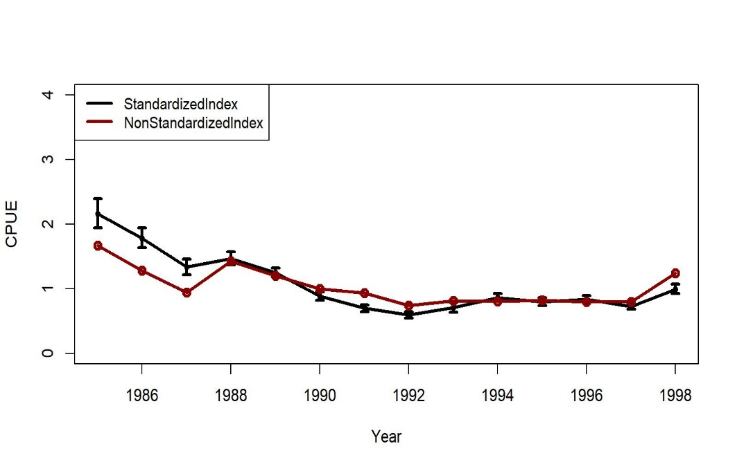


Figures B.9 &10. Trends in non-standardized and standardized CPUE indices with +/- 2 SE by lognormal GLM for EAG (left) WAG (right), 1985/86-1998/99 fish ticket data. Standardized indices: black line and non-standardized indices: red line.
Initial selection:
$\ln\left(CPUE\right)= Year + Vessel+Month$
Final selection:
$\ln\left(CPUE\right)= Year + Vessel+Month$
[$R^{2}=0.37]$
Initial selection:
$\ln\left(CPUE\right)= Year + Vessel$
Final selection:
$\ln\left(CPUE\right)= Year +Vessel [R^{2}=0.37$ ]

Slide 29
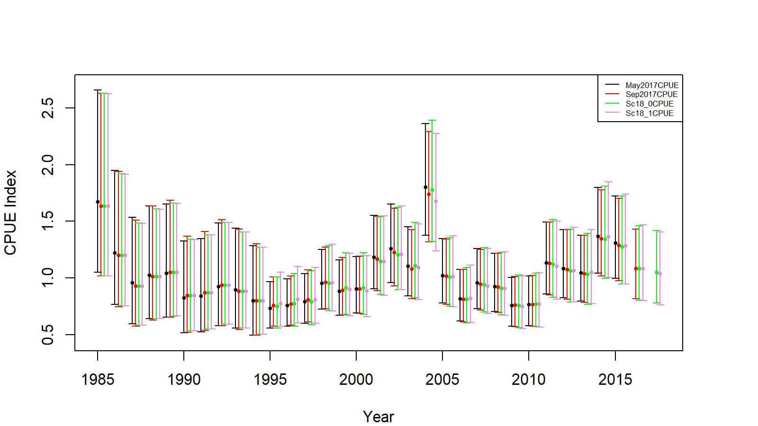
Figure 3. Comparison of input CPUE indices for May 2017 (up to 2015/16 data), September 2017 (up to 2016/17 data), Sc18_0 (Lat and Long positions, up to 2017/18 data), and Sc18_1 (reduced number of gear codes, up to 2017/18 data) for EAG. Model estimated additional standard error was added to each input standard error for 2-standard error confidence interval determination.

Slide 30
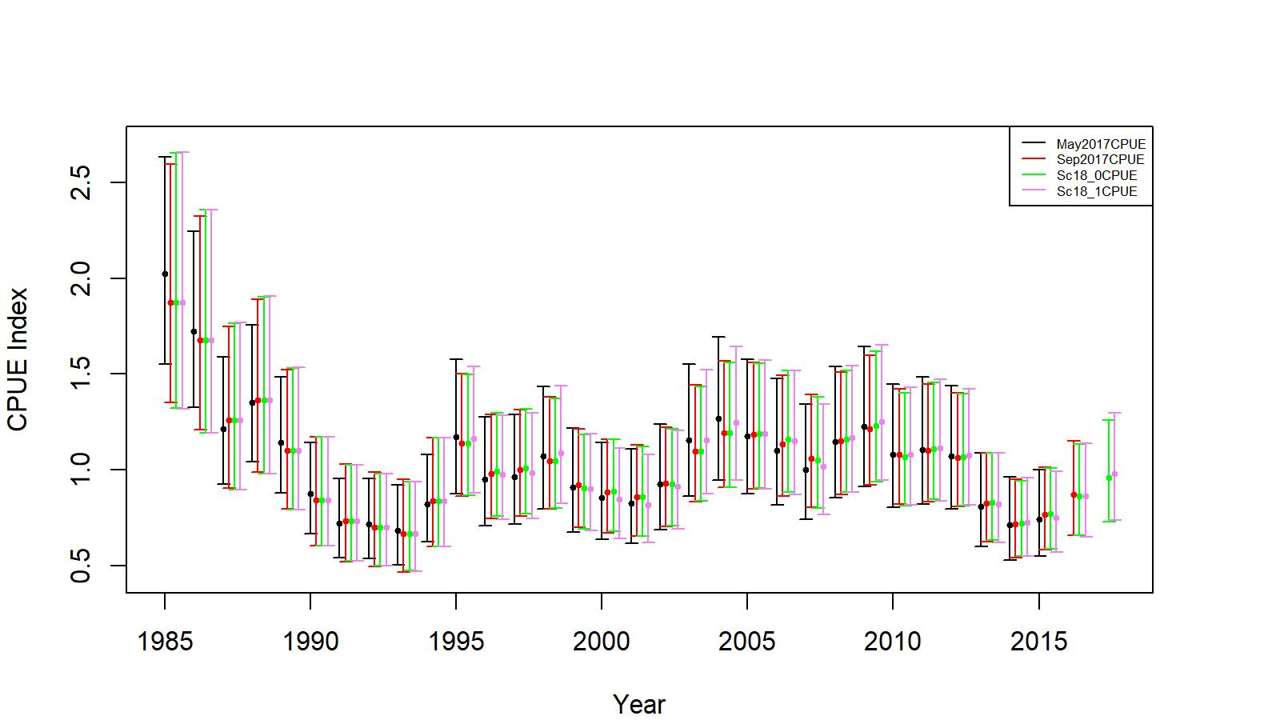
Figure 4. Comparison of input CPUE indices for May 2017 (up to 2015/16 data), September 2017 (up to 2016/17 data), Sc18_0 (Lat and Long positions, up to 2017/18 data), and Sc18_1 (reduced number of gear codes, up to 2017/18 data) for WAG. Model estimated additional standard error was added to each input standard error for 2-standard error confidence interval determination.

Slide 31
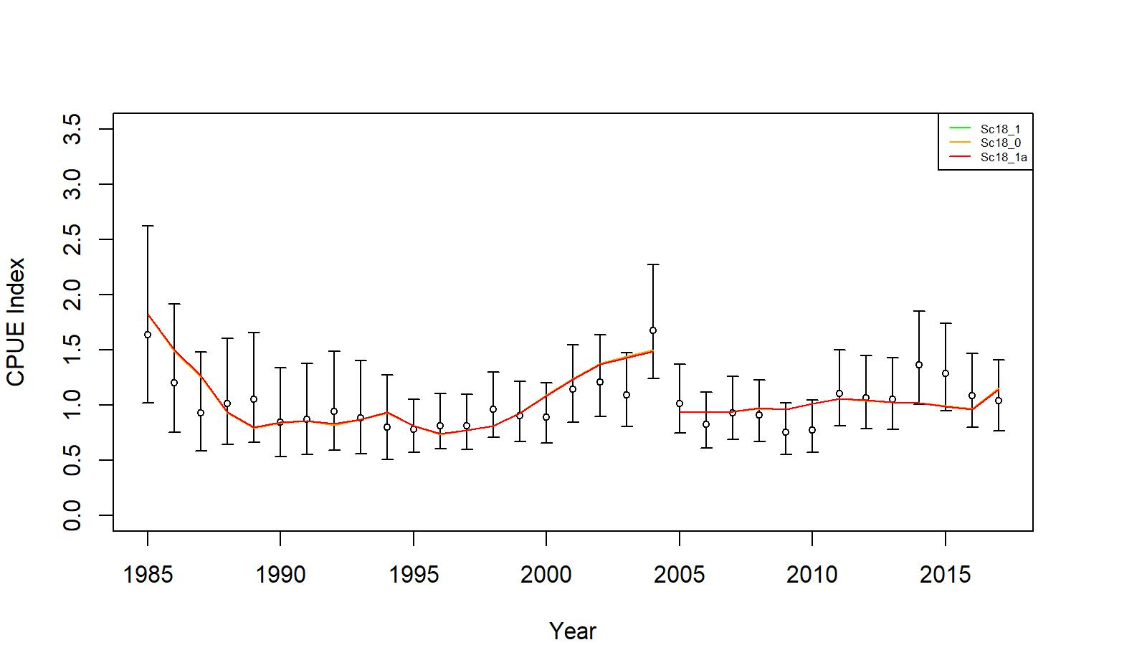
Figure 5. Comparison of input CPUE indices (open circles with +/- 2 SE) with predicted CPUE indices (colored solid lines) for model scenarios Sc18_0, Sc18_1, and Sc 18_1a for EAG golden king crab data, 1985/86–2017/18. Model estimated additional standard error was added to each input standard error.

Slide 32
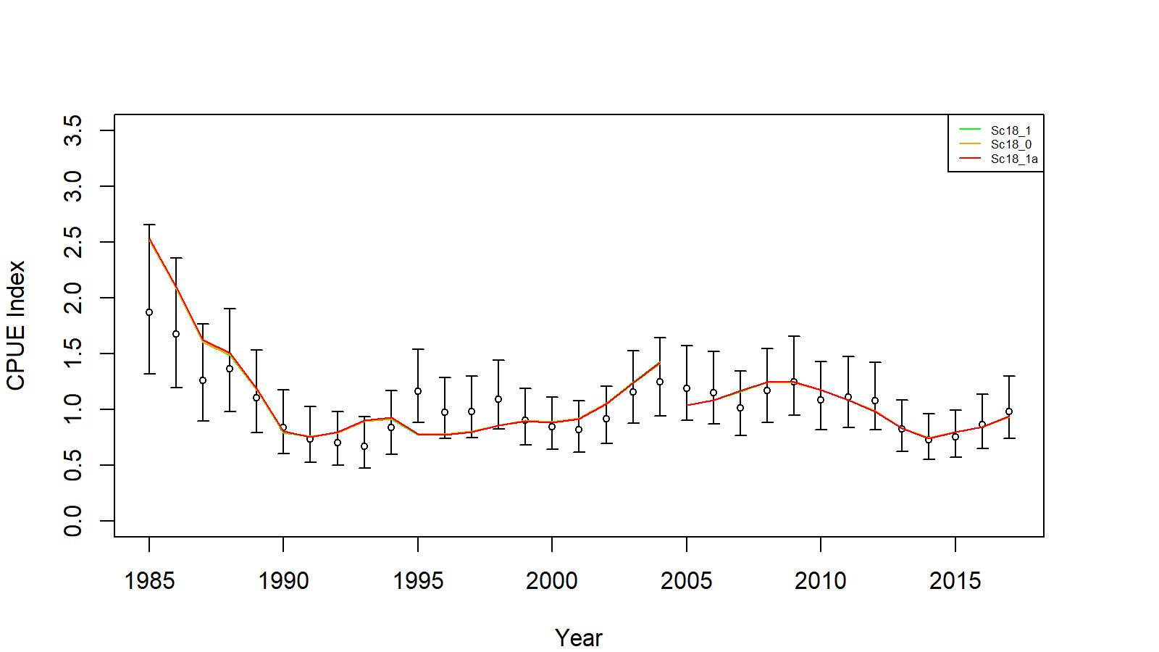
Figure 6. Comparison of input CPUE indices (open circles with +/- 2 SE) with predicted CPUE indices (colored solid lines) for model scenarios Sc18_0, Sc18_1, and Sc 18_1a for WAG golden king crab data, 1985/86–2017/18. Model estimated additional standard error was added to each input standard error.

Slide 33
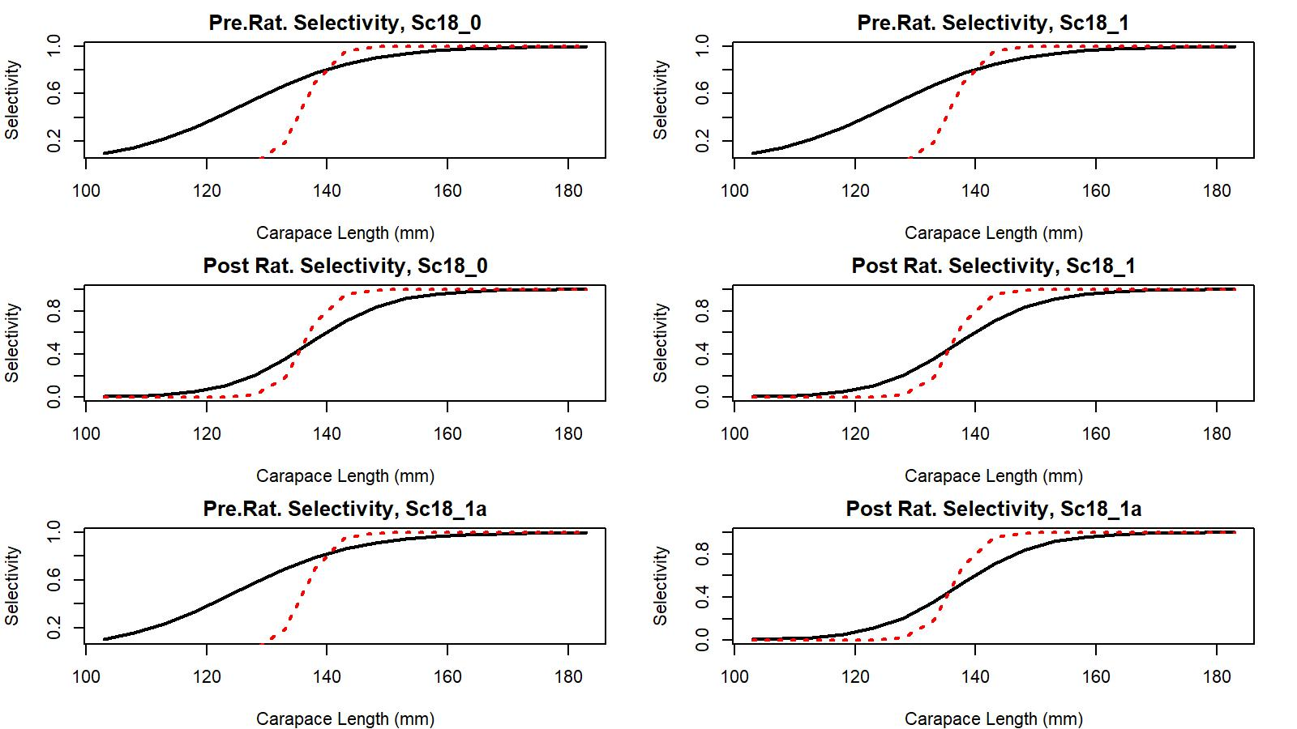
Figure 7. Estimated total (black solid line) and retained selectivity (red dotted line) for pre- and post- rationalization periods under scenarios Sc18_0, 18_1, and 18_1a fit of golden king crab data in the EAG, 1985/86 to 2017/18.

Slide 34
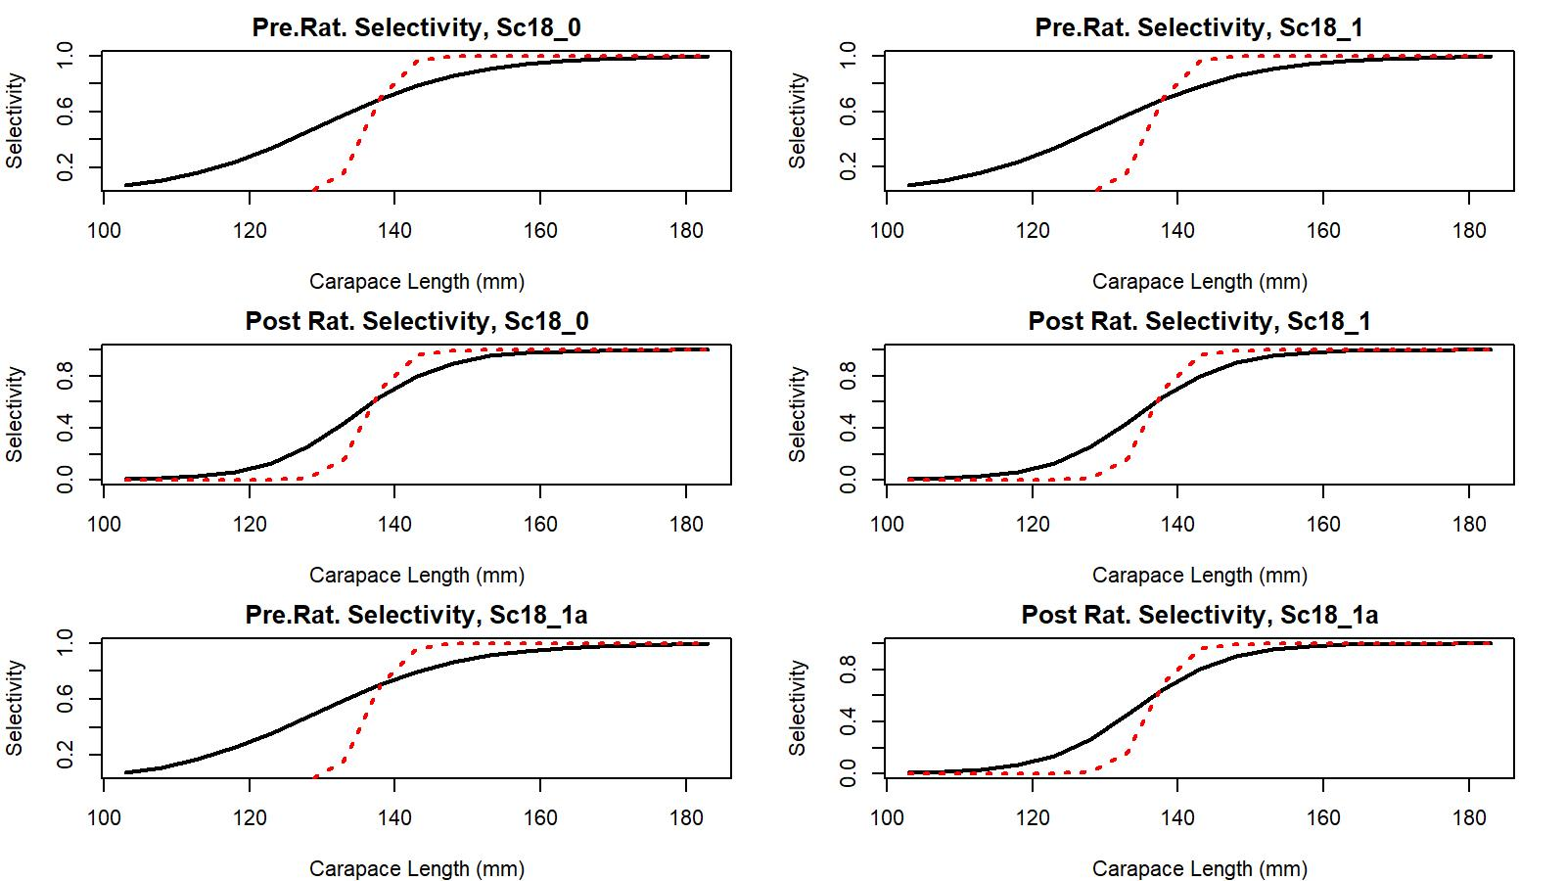
Figure 8. Estimated total (black solid line) and retained selectivity (red dotted line) for pre- and post- rationalization periods under scenarios Sc18_0, 18_1, and 18_1a fit of golden king crab data in the WAG, 1985/86 to 2017/18.

Slide 35
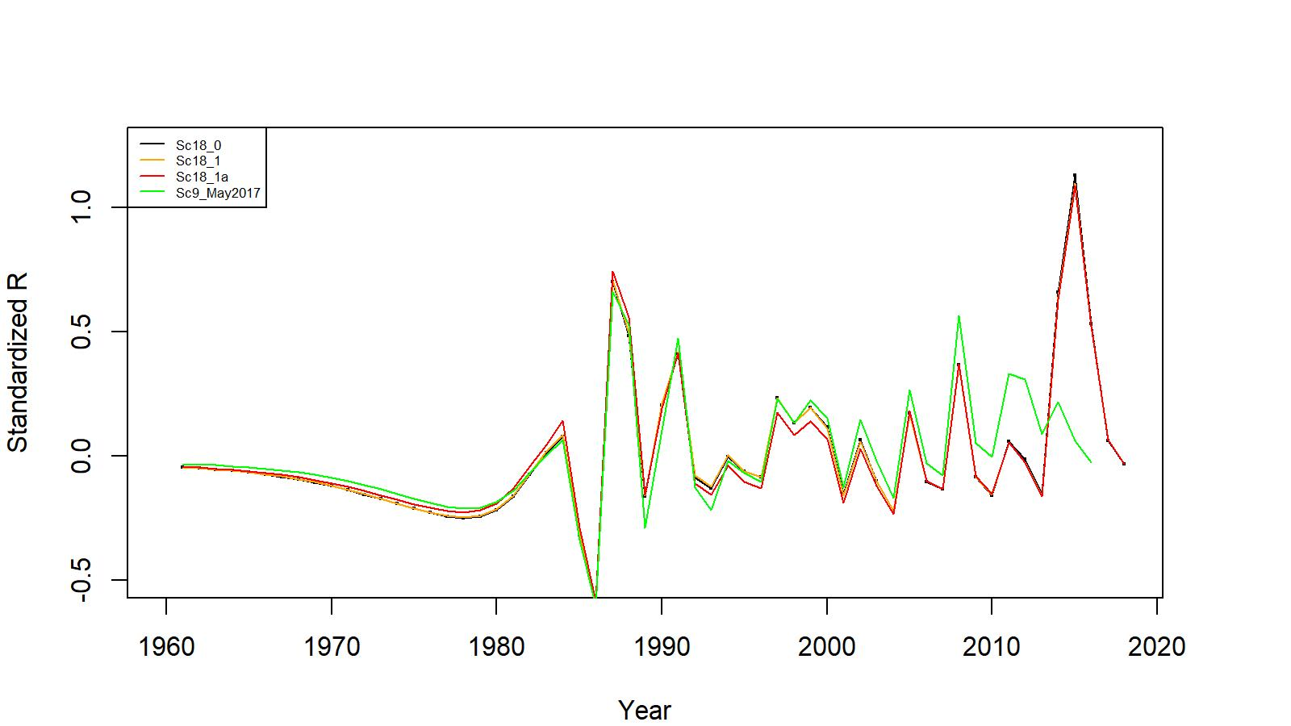
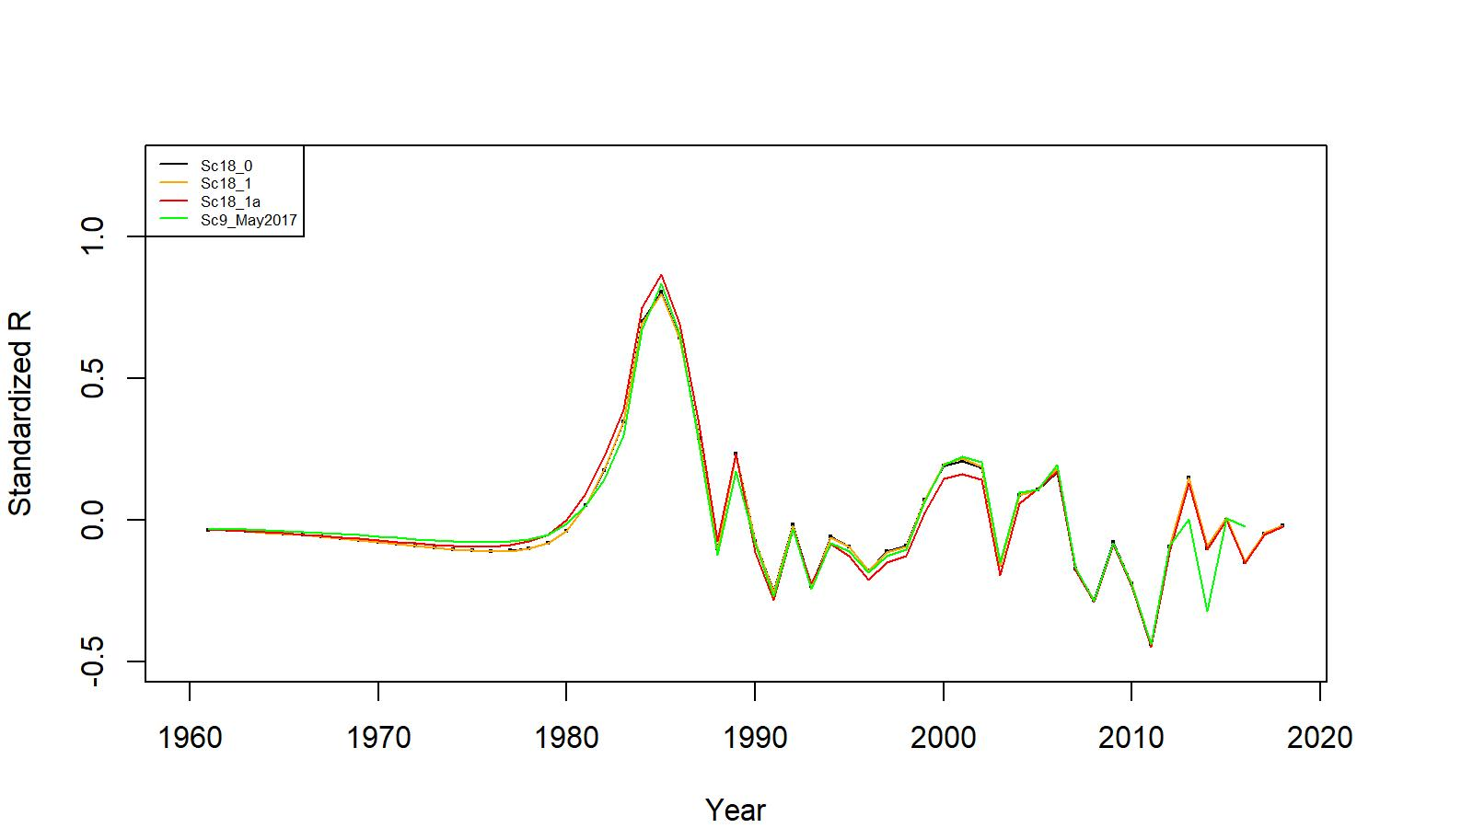
Figures 9 (EAG top) & 10 (WAG bottom). Estimated number of male recruits (crab size ≥ 101 mm CL) to the assessment model for scenarios 18_0, 18_1, and 18_1a fits, 1961–2018. The numbers of recruits are centralized using (R-mean R)/mean R for comparing different scenarios’ results. Scenario 9 model estimated recruits in May 2017 are also shown for comparison.

Slide 36
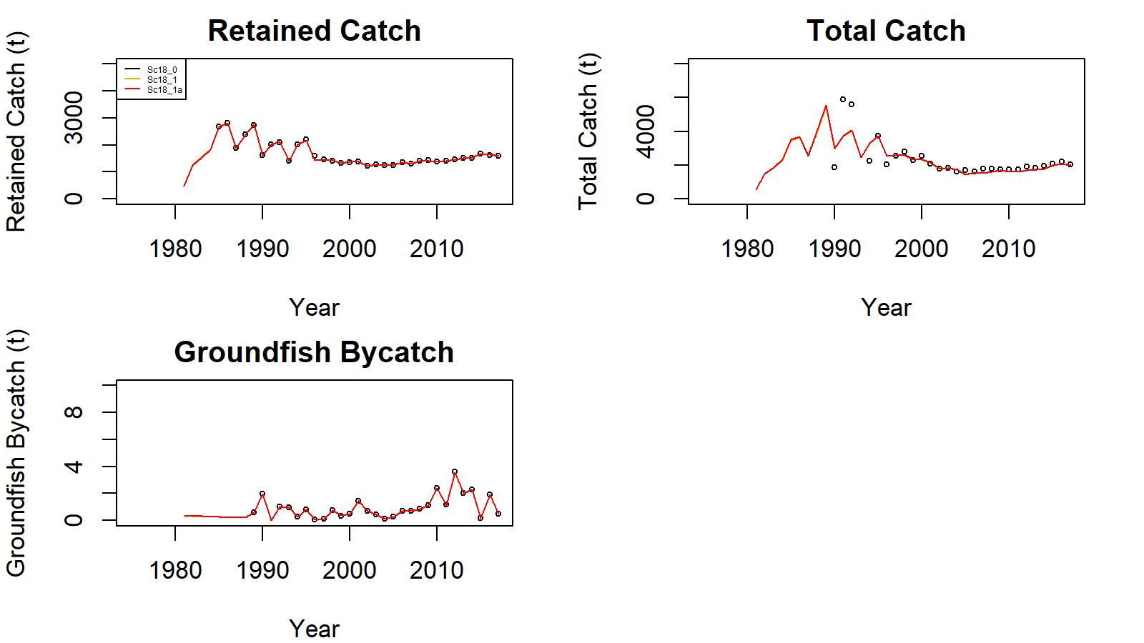
Figure 11. Observed (open circle) vs. predicted (solid line) retained catch (top left in each scenario set), total catch (top right in each scenario set), and groundfish bycatch (bottom left in each scenario set) of golden king crab for scenarios 18_0, 18_1, and 18_1a fits in EAG, 1981–2017.

Slide 37
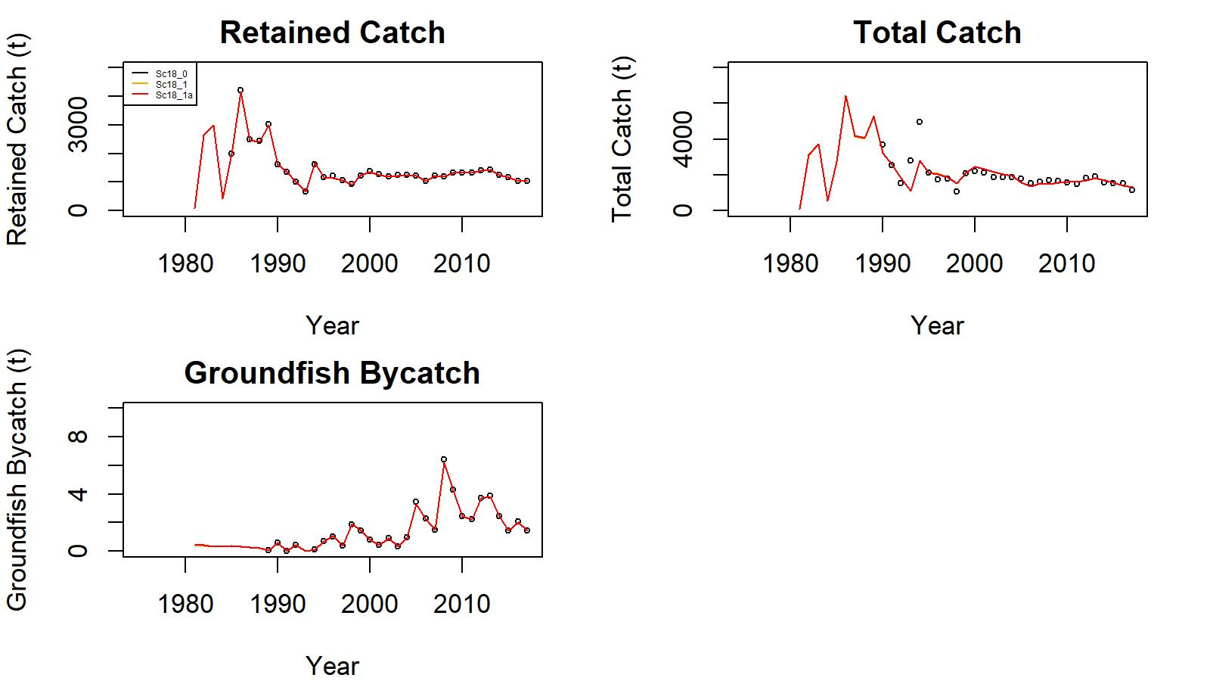
Figure 12. Observed (open circle) vs. predicted (solid line) retained catch (top left in each scenario set), total catch (top right in each scenario set), and groundfish bycatch (bottom left in each scenario set) of golden king crab for scenarios 18_0, 18_1, and 18_1a fits in WAG, 1981–2017.

Slide 38
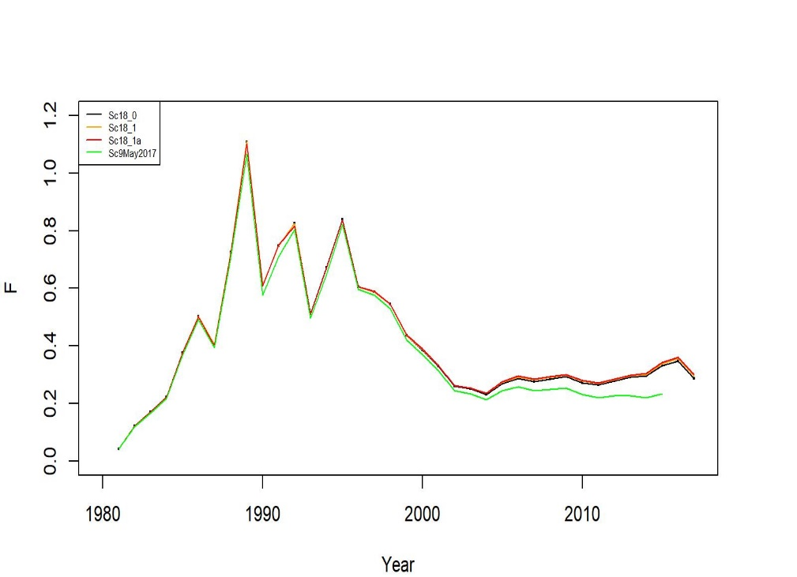
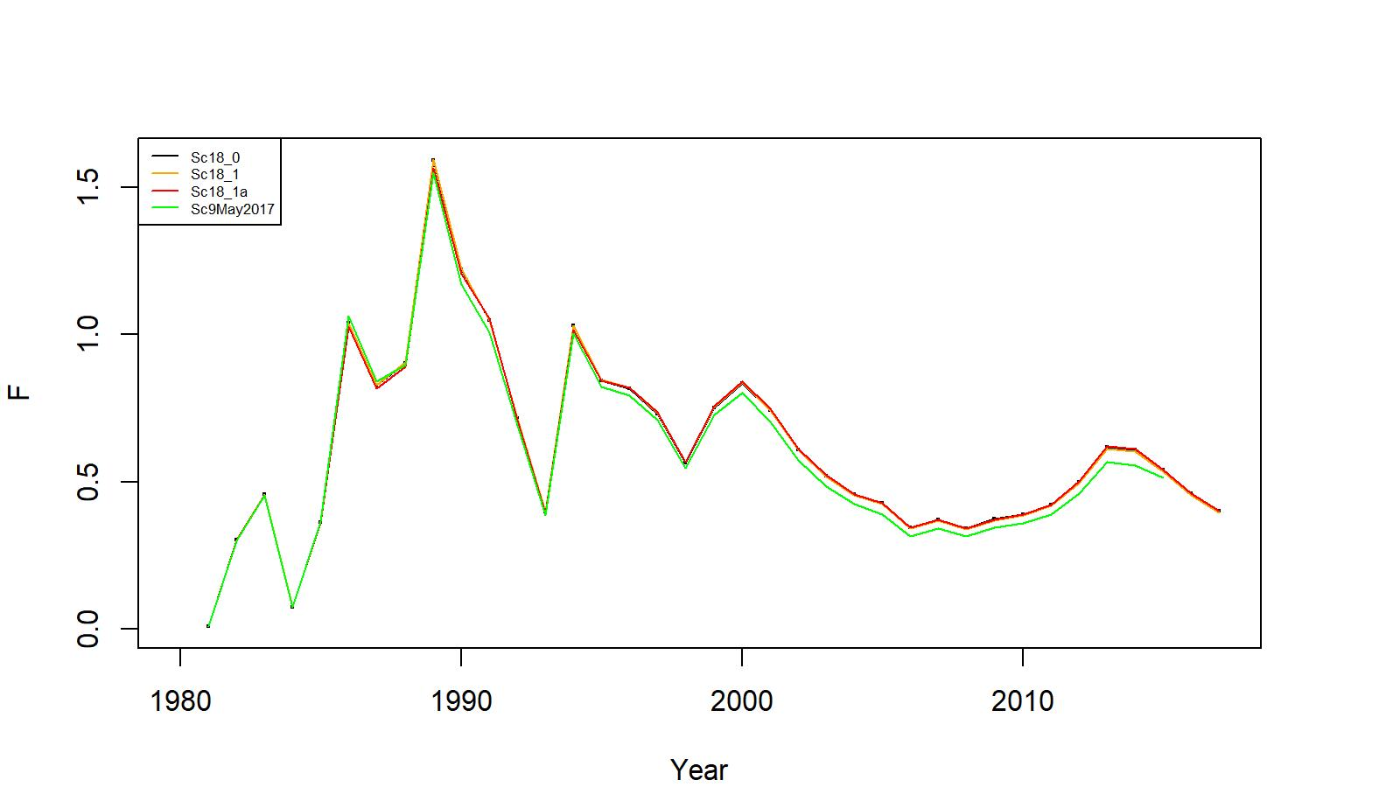
Figures 13 (EAG left) & 14 (WAG right). Estimated pot fishery total fishing mortality (F) for scenarios 18_0, 18_1, and 18_1a fits, 1981–2017. Scenario 9 model estimated F in May 2017 are also shown for comparison.

Slide 39
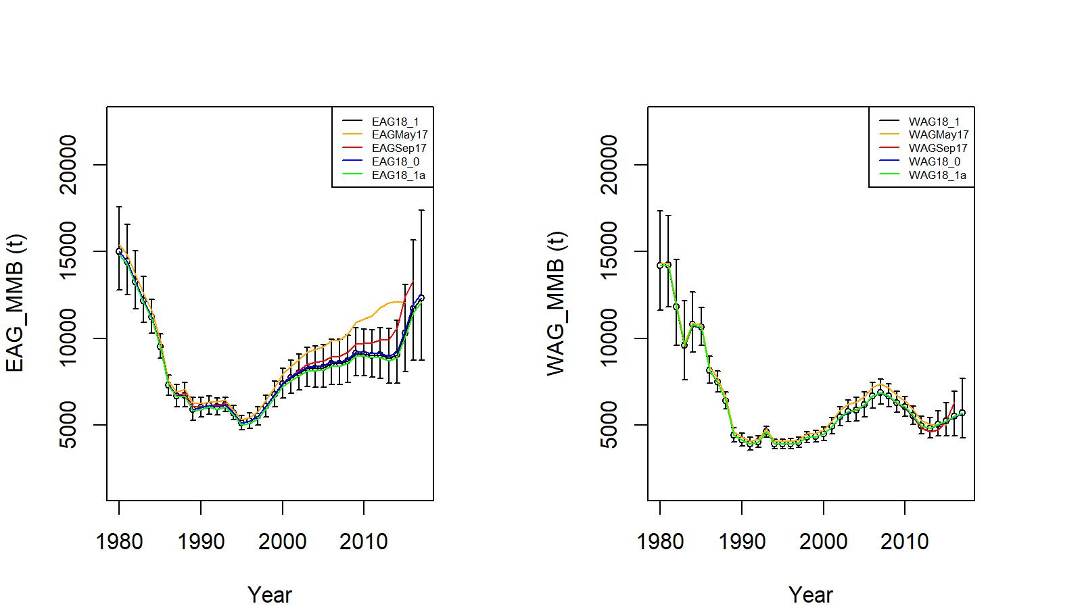
Figure 15. Trends in golden king crab mature male biomass for scenarios Sc9 of May 2017, Sc17AD17 of September 2017, 18_0, 18_1, and 18_1a fits for EAG (left) and WAG (right) golden king crab data, 1980/81–2017/18. Scenario 18_1 estimate have two standard errors confidence limits. The results for May 2017 and September 2017 fits are given for comparisons.

Slide 40
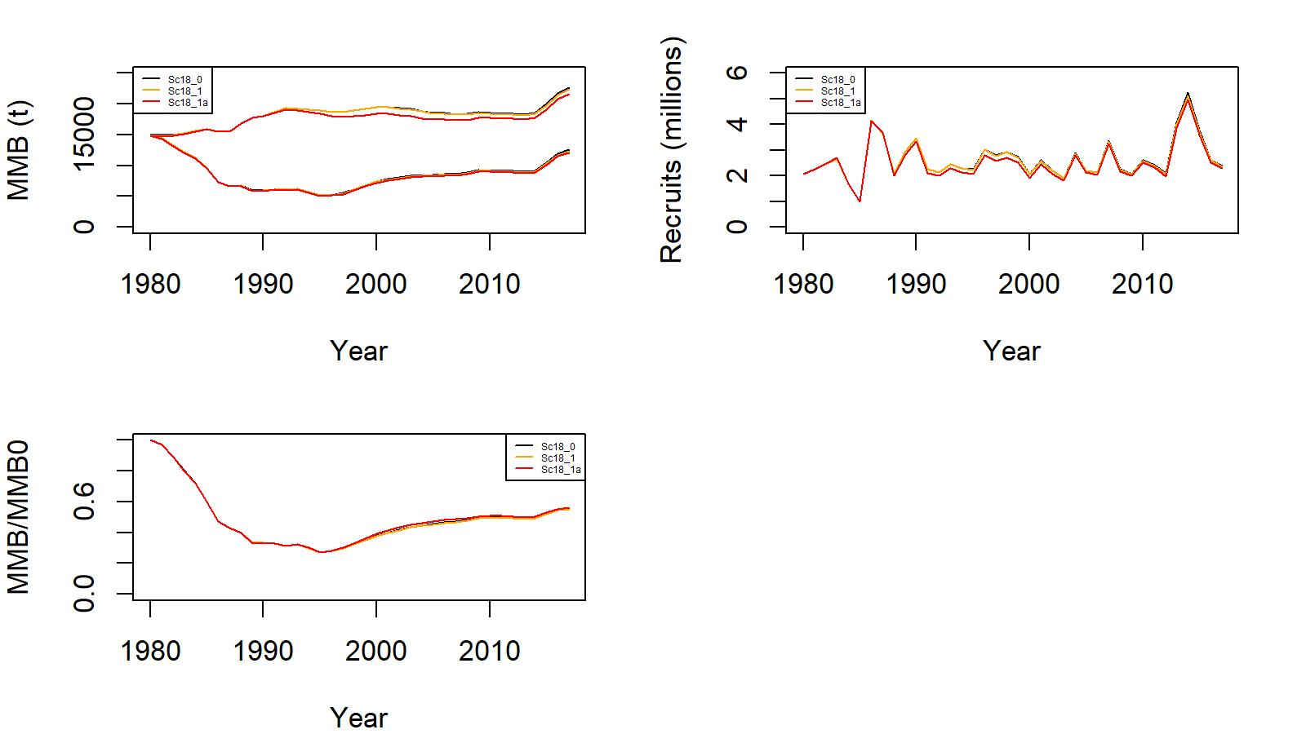
Figure 17. Estimated B0 (t) vs. MMB (t) (top left), trends in recruitment (top right), and MMB/B0 ratio (bottom left) from 1980 to 2017 for scenarios 18_0 (black), 18_1 (orange), and 18_1a (red) for EAG golden king crab data. (Note: 2017 MMB= MMB estimated on 15 February 2018).

Slide 41
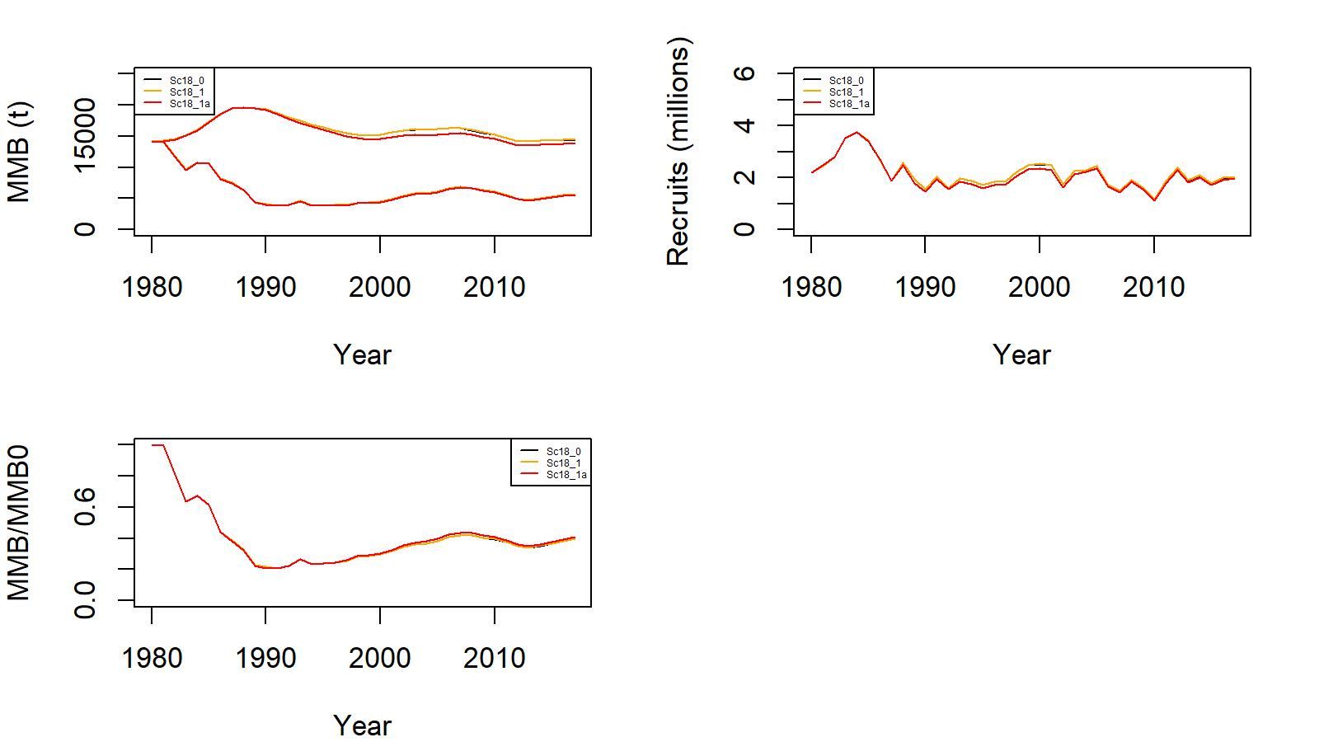
Figure 18. Estimated B0 (t) vs. MMB (t) (top left), trends in recruitment (top right), and MMB/B0 ratio (bottom left) from 1980 to 2017 for scenarios 18_0 (black), 18_1 (orange), and 18_1a (red) for WAG golden king crab data. (Note: 2017 MMB= MMB estimated on 15 February 2018).

Slide 42
Status and catch specifications (1000 t) of Aleutian Islands golden king crab
a. Total catch: retained catch plus estimated bycatch mortality of discarded
bycatch during crab fisheries and groundfish fisheries.
b. 25% buffer was applied to total catch OFL to determine ABC.
c. 17_0 2018/19 accepted scenario with Francis method of re-weighting
d. 18_0 base scenario with Francis method of re-weighting
e. 18_1 scenario 18_0 modified with number of gear code reduced for observer
CPUE standardization
f. 18_1a scenario 18_1 with pot fishery bycatch mortality rate scaled by
annual pot fishery bycatch
Year | MSST | Biomass (MMB) | TAC | Retained Catch | Total Catchª | OFL | ABC^{b}
2015/16 | N/A | N/A | 2.853 | 2.729 | 3.076 | 5.69 | 4.26
2016/17 | N/A | N/A | 2.515 | 2.593 | 2.947 | 5.69 | 4.26
2017/18 | 6.044 | 14.205 | 2.515 | 2.585 | 2.942 | 6.048 | 4.536
2018/19^{c} | 6.046 | 17.952 | 2.883 |  |  | 5.514 | 4.136
2019//20^{d} | 5.976 | 16.095 |  |  |  | 5.159 | 3.948.
2019/20e | 5.990 | 16.000 |  |  |  | 5.086 | 3.892
2019/20^{f} | 5.713 | 15.465 |  |  |  | 4.869 | 3.726

Slide 43
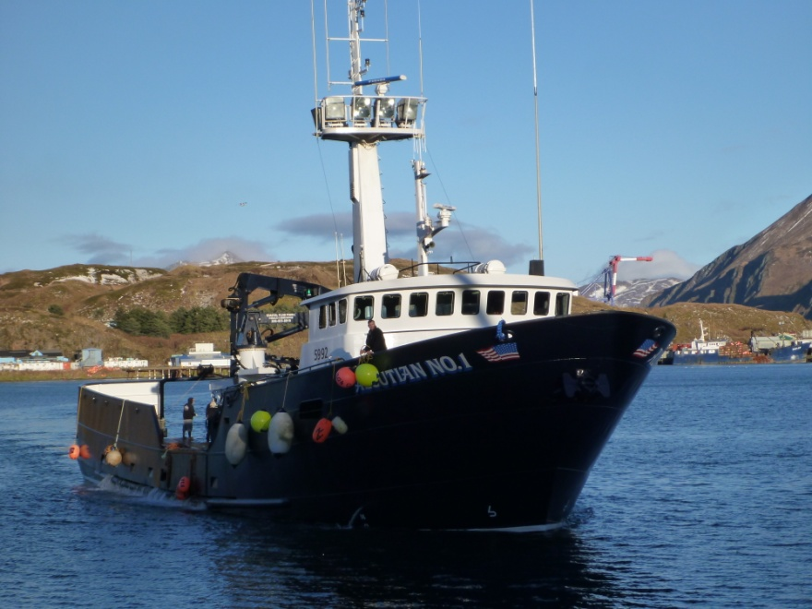
Thank you
Acknowledgement
Leland Hulbert, Ethan Nichols, Robert Foy, Vicki Vanek, Andre Punt, Martin Dorn, William Stockhausen, Sherri Dressel, Hamazaki Hamachan, William Bechtol, CPT and SSC members, industry personnel, and industry consultants.

