Slide 1

Welcome to the Social Science Planning Team Meeting
March 4, 2021
SSPT members and those who wish to speak should connect their audio by phone
  Please mute speakers on your phone and microphone on the computer when you’re not speaking.
Others should connect in the “listen only” mode
SSPT members please turn on your webcams (if you wish)
We will begin with an overview of Adobe connect.
For individual tech support, email npfmc.admin@noaa.gov or use the chat box

Slide 2

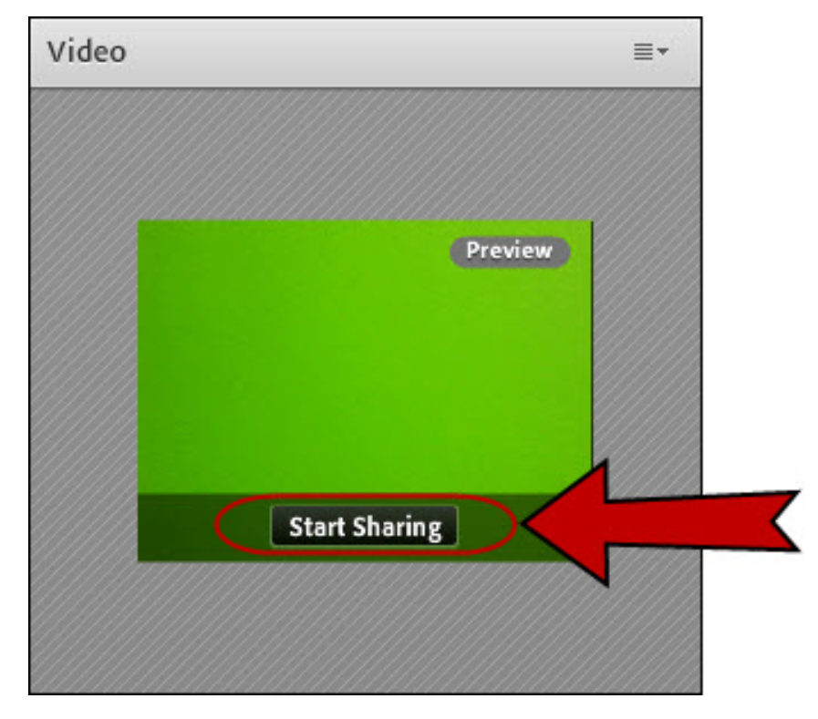
SSPT member webcam use
Only SSPT members, NPFMC staff, or agency staff giving presentations should turn on their webcam.
Members of the public are asked to participate via telephone only.
Join the meeting and click on the webcam button.
In the video pod, you will see a video preview. Line up and focus your camera, then click Start Sharing.

Slide 3
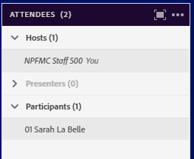
Attendee pod
All attendees are listed in the pod on the right-hand side of the screen.
Hosts are NPFMC staff. You can free up space by clicking on the arrow to hide them.
SSPT members will be listed first under participants.
  Each SSPT member should place “01” before their name when logging in. (A host can also add “01.”)

Slide 4
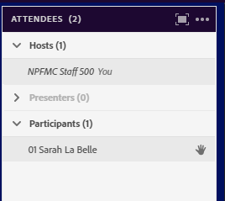
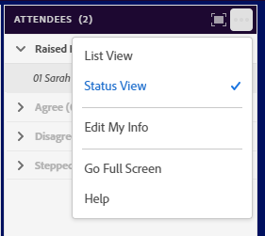
Raising your hand to be acknowledged
The SSPT will use the ‘raise hand’ feature in the app for discussion.
Click on the ‘raise hand’ icon to raise or lower your hand (or use the drop down menu).
You can see your hand is raised in the attendee pod:
Or click the menu to switch to ‘status view’ and see only the raised hands (listed in order):

Slide 5

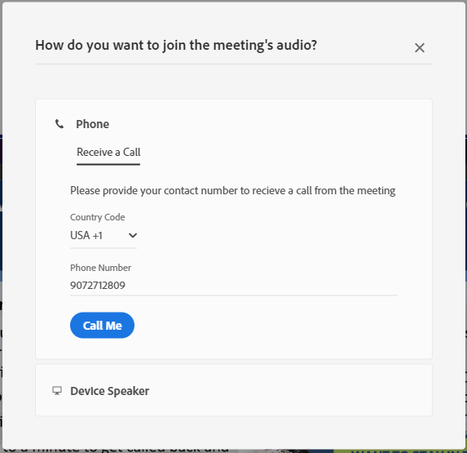
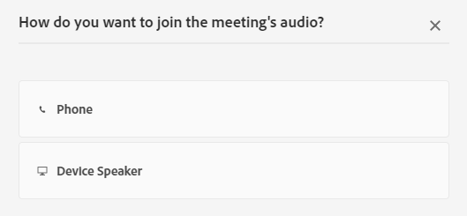
Reconnecting audio after a break
Go ahead and hang up your phone on the breaks, so you can use it for other things.
When you are ready to reconnect, click on the phone icon at the top:
You will get the same “dial out”
option as when you joined.

Slide 6

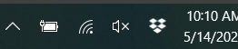

Tips to make everything work better
Keep yourself on mute unless you need to talk
    Pro tip: it’s easier to press the mute button on your phone that to mute yourself from the computer, though both work
Make sure you can only hear the meeting through your phone
    You want to see a sign by your speaker on the top left
    For extra security, mute your computer too
Expect a lag time with presentation visuals
    There can be a delay between the presenter talking about a new slide and you seeing it
You can make some pods full screen by clicking this button in the pod’s top right corner:

Slide 7
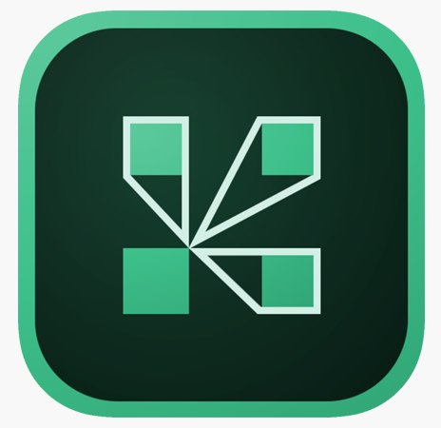
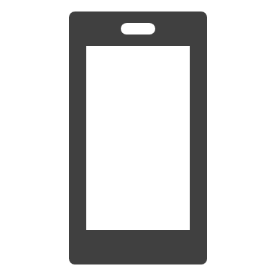

There’s an App for that!
Use the Adobe Connect mobile App to take our meetings on the go.
In your phone open the App Store and search for Adobe Connect
Enter the url for our meeting
Enter your guest login (or user login if you made an account)
And you’re in!

