Slide 1
Bristol Bay Red King Crab Assessment in Spring 2019
J. Zheng and M.S.M. Siddeek
ADF&G, Juneau

Slide 2
Acknowledgements
Drs. Andre Punt, James Ianelli and D’Arcy Webber applied BBRKC data to GMACS for stock assessments and our GMACS scenario mainly comes from their work, especially recent work by Andre.

Slide 3
Outline
4. Recommendations
2. New data and model scenarios
1. Responses to CPT and SSC Review Comments
3. Assessment results

Slide 4
Response to CPT Comments
Response to CPT Comments (from May 2018):
“1) fitting the total catch estimated from at-sea observer data and total retained catch without incorporating the “subtraction” method for estimating legal discards,”
Response: Done.
“2) incorporating time varying fishery selectivity and annual retained proportions,”
Response: Scenarios 18.0, 18.0b and 18.0c in September 2018 address this. The approach of two periods with different retained proportions adopted by the CPT is used for three scenarios in this draft report.
“3) the recruitment in terminal year should not be used for estimating B35% (i.e., mean recruitment is estimated from recruitments from 1984 to endyear – 1).”
Response: Done for all scenarios.

Slide 5
Response to CPT Comments
Response to CPT Comments (from September 2018):
“The CPT requested that the author consider a scenario based on 18.0a in which the asymptote to the retention function is estimated after 2004, rather than fixing it to 1 as it now is.”
Response: Done for all scenarios.

Slide 6
Response to SSC Comments
Response to SSC Comments specific to this assessment (from June 2018):
“to not use the subtraction method moving forward.”
Response: Agree and no subtraction method from now on.
“The SSC also requests that the authors investigate whether groundfish discard information is available for fixed gear prior to 2010. In addition, the document uses inconsistent terminology for pot gear and fixed gear (particularly on figure and table headings), as well as groundfish gear versus crab gear, and the associated mortality rates. The SSC requests that the authors check the document for consistent use of these terms.”
Response: We updated groundfish fisheries bycatch data up to 1991 and separated the bycatch into trawl and fixed gear bycatches starting 1996 when fixed gear data were available.
We went through our SAFE report to check for consistent use of gear terms and corrected them as necessary.

Slide 7
Response to SSC Comments
Response to SSC Comments specific to this assessment (from Oct. 2018):
“The SSC also agreed with the Team’s recommendation that the buffer be raised from 10% to 20%. Justification for this raise is (1) the over-prediction of 2018 observed survey biomass, (2) 20% is the buffer recommended for other crab stocks with similar uncertainty.”
Response: We will use a 20% buffer from now on.
“The SSC notes that a reduction of structural fauna providing protection for small crabs and increase in mobile predators of small crabs was reported from current ecosystem studies. The SSC encourages the author to investigate whether these ecosystem changes are linked to changes in natural mortality or reproductive success.”
Response: This is a good idea. We will look at this issue in the future.

Slide 8
Summary of Major Changes in Spring 2019
Changes to the input data:
  Updated groundfish fisheries bycatch data during 1991-2017.

Slide 9
Summary of Major Changes in Spring 2019
Changes to the assessment methodology:
Recruitment break point analysis is updated (see Appendix B).
Three model scenarios:
  rk18A.D18: the scenario 18.0a in the SAFE report in September 2018, which was adopted for OFL determination.
  rk18A.D18a: the same as scenario rk18A.D18 except for updating the groundfish fisheries bycatch data during 1991-2017 and separating them into trawl and fixed gear during 1996-2017, the period the data are available.
  rk18Aa.D18a: this is the gmacs scenario with the same input data as scenario rk18A.D18a and using the same approach as much as possible.

Slide 10
Some Differences between GMACS & rk18A.D18a
When computing likelihood values, length compositions are generally normalized with the sum to be 1 for each sex and each year under gmacs while the length compositions are normally summed to 1 for both sexes each year under scenario rk18A.D18a.
Likelihood values for catch and survey biomasses include constant terms under gmacs while constant terms except for BSFRF survey biomass are not included in the likelihood values under scenario rk18A.D18a.
It seems that penalties are more extensively used with gmacs than scenario rk18A.D18a.

Slide 11
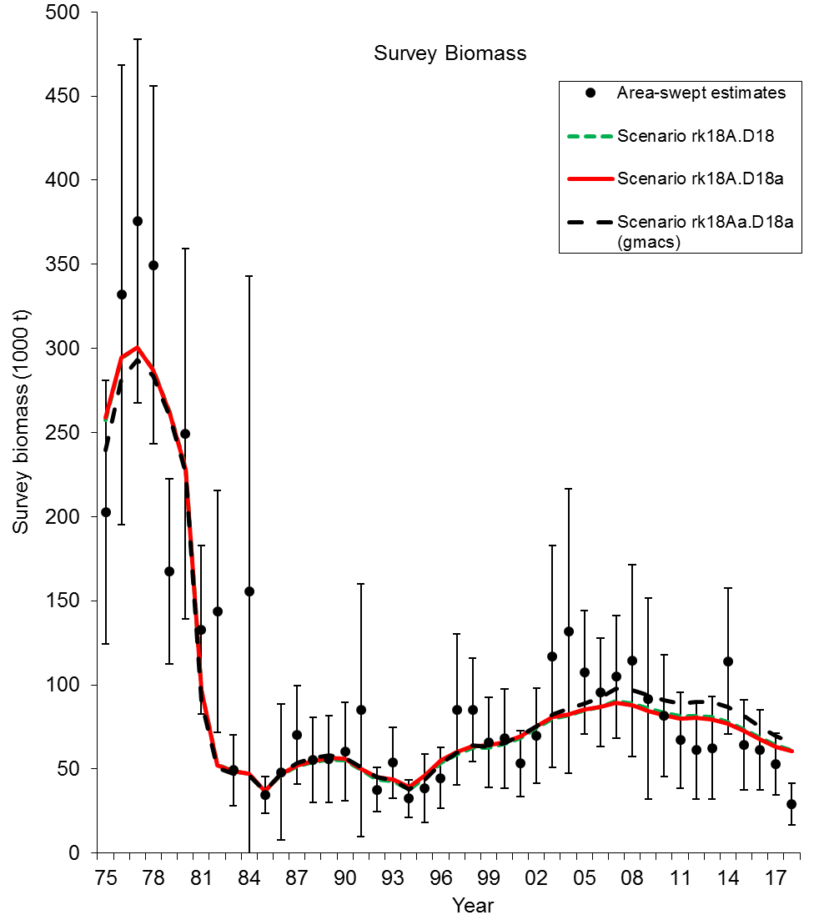
Comparisons of area-swept estimates of total NMFS survey biomass and model prediction for model estimates in 2018 under scenarios rk18A.D18, rk18A.D18a, and rk18Aa.D18a. The error bars are plus and minus 2 standard deviations.

Slide 12
Comparisons of NMFS survey area-swept estimates of male (>119 mm) and female (>89 mm) abundance and model prediction for model estimates in 2018 under scenarios rk18A.D18, rk18A.D18a, and rk18Aa.D18a.

Slide 13
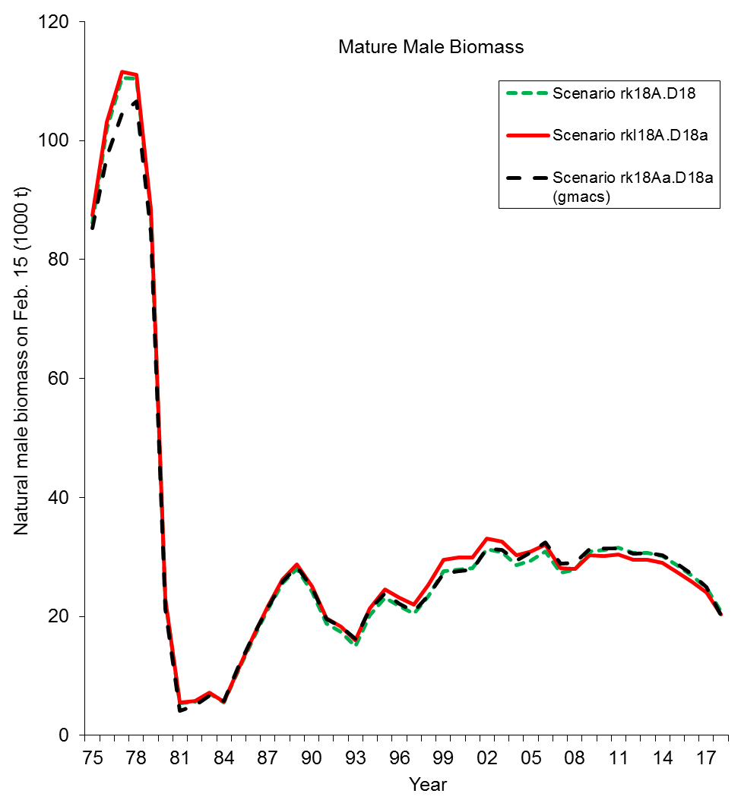
Comparisons of mature male biomass on Feb. 15 under scenarios rk18A.D18, rk18A.D18a, and rk18Aa.D18a.
Estimated trawl survey catchabilities:
Scenario Q
rk18A.D18 0.925
rk18A.D18a 0.923
rk18Aa.D18a 0.935

Slide 14
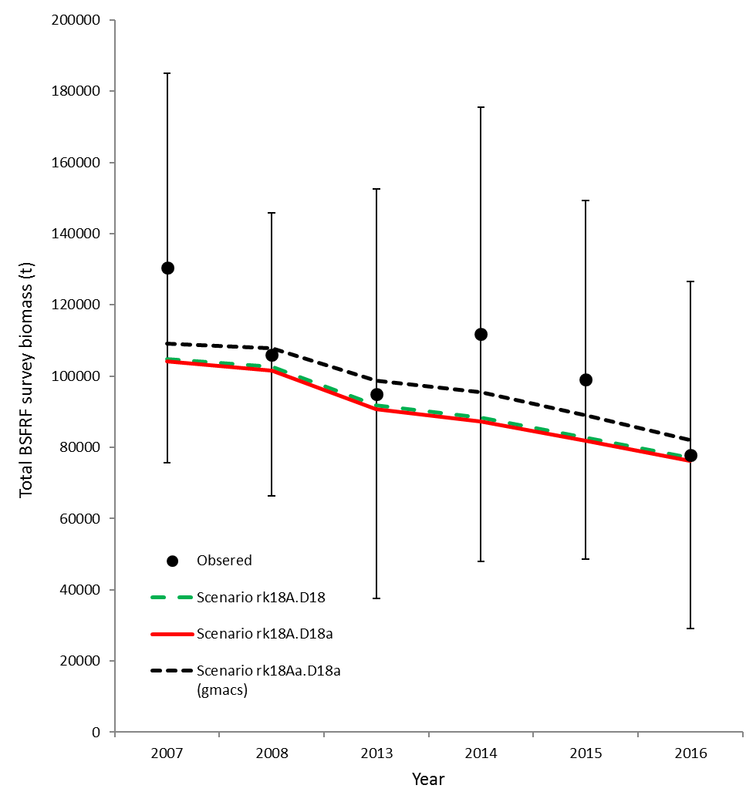
Comparisons of total survey biomass estimates by the BSFRF survey and the model for model estimates in 2018 (scenarios rk18A.D18, rk18A.D18a, and rk18Aa.D18a). The error bars are plus and minus 2 standard deviations of scenario rk18A.D18a.

Slide 15
Comparison of estimated M and directed pot fishing mortality over time

Slide 16
Standardized residuals of total NMFS survey biomass
rk18A.D18a
rk18Aa.D18a (gmacs)

Slide 17
Comparisons of observed and predicted catch mortality biomass under scenarios rk18A.D18, rk18A.D18a, and rk18Aa.D18a. Mortality biomass is equal to caught biomass times a handling mortality rate.

Slide 18
Comparisons of observed and predicted bycatch mortality biomass under scenarios rk18A.D18, rk18A.D18a, and rk18Aa.D18a. Mortality biomass is equal to caught biomass times a handling mortality rate.

Slide 19
NMFS survey selectivities (including catchability)
rk18A.D18a
rk18Aa.D18a (gmacs)

Slide 20
Estimated selectivities of NMFS trawl survey during 1982-2018 with different dataset of BSFRF survey data and five scenarios

Slide 21
Estimated selectivities of BSFRF trawl survey during 2007-08 and 2013-2016 with five scenarios

Slide 22
Fisheries selectivities and retained proportions
rk18A.D18a
rk18Aa.D18a (gmacs)

Slide 23
rk18A.D18a
rk18Aa.D18a (gmacs)

Slide 24
Comparison of area-swept and model estimated NMFS survey length frequencies of Bristol Bay male red king crab by year under scenarios rk18A.D18(solid black) and rk18A.D18a(dashed red).

Slide 25
Comparison of area-swept and model estimated NMFS survey length frequencies of Bristol Bay male red king crab by year under scenario rk18Aa.D18a (gmacs).

Slide 26
Comparison of area-swept and model estimated NMFS survey length frequencies of Bristol Bay female red king crab by year under scenarios rk18A.D18(solid black) and rk18A.D18a(dashed red).

Slide 27
Comparison of area-swept and model estimated NMFS survey length frequencies of Bristol Bay female red king crab by year under scenario rk18Aa.D18a (gmacs).

Slide 28
Comparison of area-swept and model fits of BSFRF survey length compositions
rk18A.D18(solid black) and rk18A.D18a(dashed red)
rk18A.D18a (gmacs)

Slide 29
Comparison of observer and model estimated retained length frequencies of Bristol Bay male red king crab by year in the directed pot fishery under scenarios rk18A.D18(solid black), rk18A.D18a(dashed red), and rk18Aa.D18a (green lines).

Slide 30
Comparison of observer and model estimated total length frequencies of Bristol Bay male red king crab by year in the directed pot fishery under scenarios rk18A.D18(solid black), rk18A.D18a(dashed red), and rk18Aa.D18a (green lines).

Slide 31
Comparison of observer and model estimated discarded length frequencies of Bristol Bay female red king crab by year in the directed pot fishery under scenarios rk18A.D18(solid black), rk18A.D18a(dashed red), and rk18Aa.D18a (green lines).

Slide 32
Comparison of observer and model estimated discarded length frequencies of Bristol Bay male red king crab by year in the groundfish trawl fisheries under scenarios rk18A.D18(solid black) and rk18A.D18a(dashed red).

Slide 33
Comparison of observer and model estimated discarded length frequencies of Bristol Bay male red king crab by year in the groundfish trawl fisheries under scenario rk18Aa.D18a (gmacs).

Slide 34
Comparison of observer and model estimated discarded length frequencies of Bristol Bay female red king crab by year in the groundfish trawl fisheries under scenarios rk18A.D18(solid black) and rk18A.D18a(dashed red).

Slide 35
Comparison of observer and model estimated discarded length frequencies of Bristol Bay female red king crab by year in the groundfish trawl fisheries under scenario rk18Aa.D18a (gmacs).

Slide 36
Comparison of observer & model estimated discarded length freq. of BBRKC males in the GF fixed gear fisheries
rk18A.D18(solid black) and rk18A.D18a(dashed red)
rk18A.D18a (gmacs)

Slide 37
Comparison of observer & model estimated discarded length freq. of BBRKC females in the GF fixed gear fisheries
rk18A.D18(solid black) and rk18A.D18a(dashed red)
rk18A.D18a (gmacs)

Slide 38
Comparison of observer and model estimated discarded length frequencies of Bristol Bay red king crab by year in the Tanner crab pot fishery under scenarios rk18A.D18(solid black), rk18A.D18a(dashed red), and rk18Aa.D18a (green lines).

Slide 39
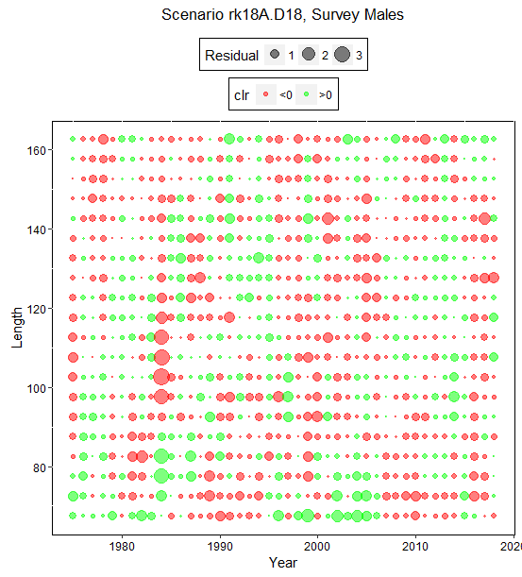

Slide 40
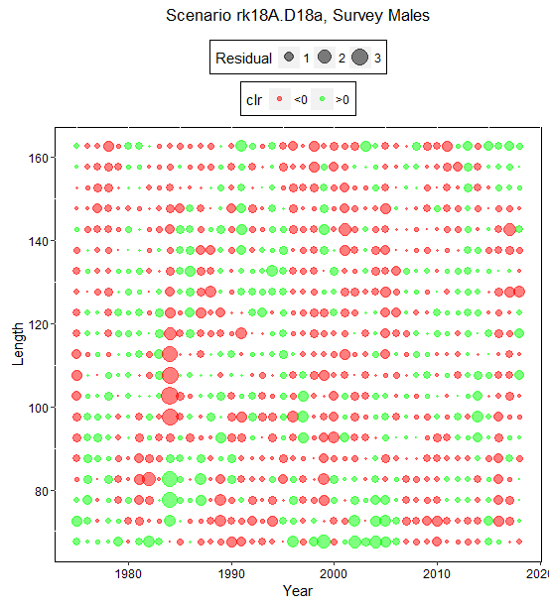

Slide 41
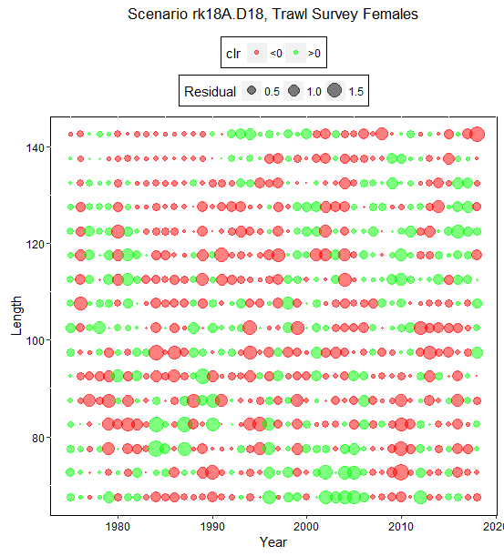

Slide 42
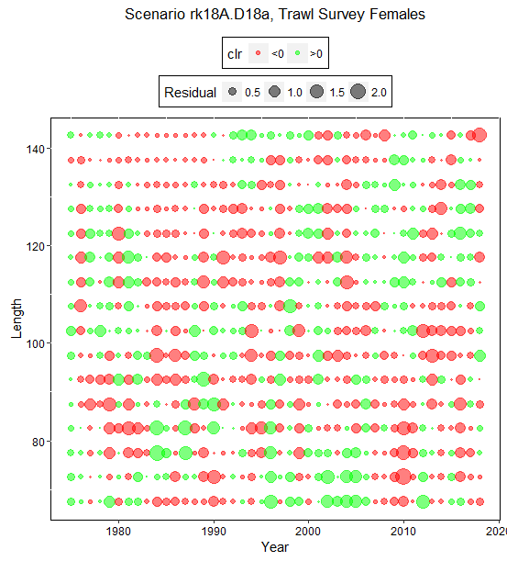

Slide 43
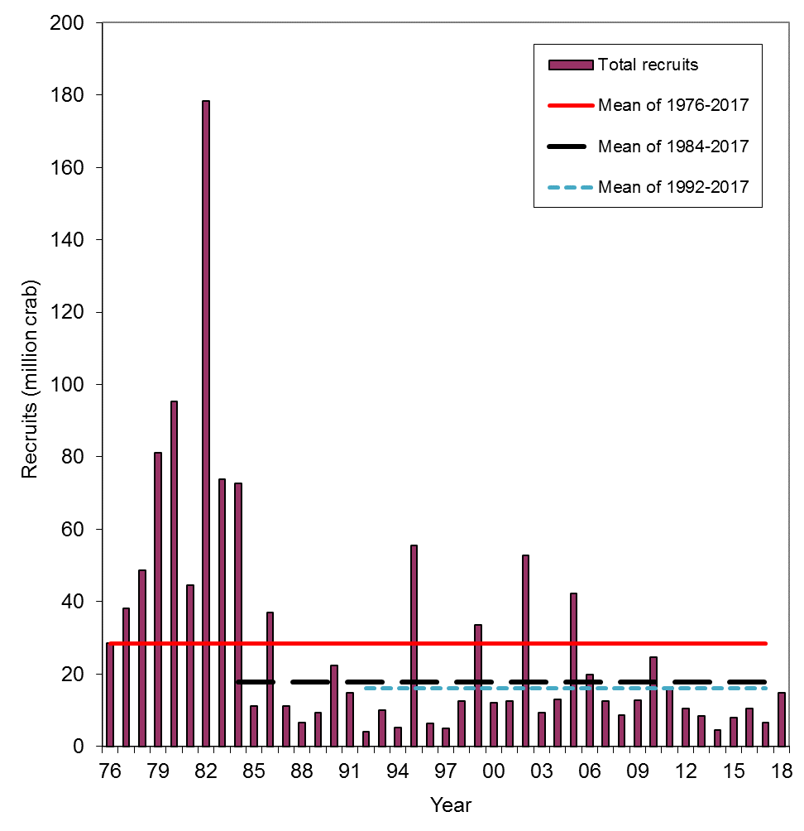
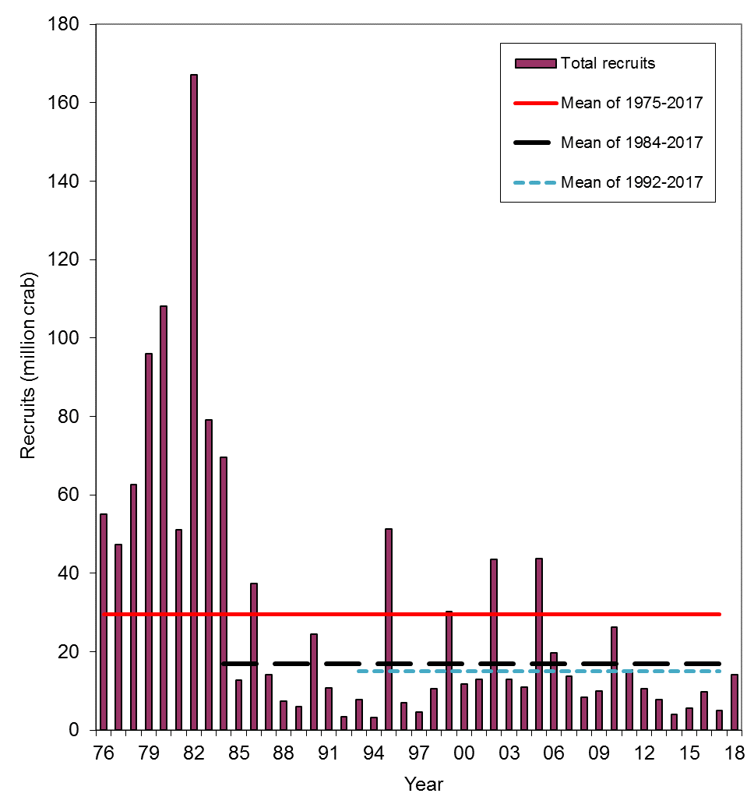
rk18A.D18a
rk18Aa.D18a (gmacs)

Slide 44
rk18A.D18a
rk18Aa.D18a (gmacs)

Slide 46
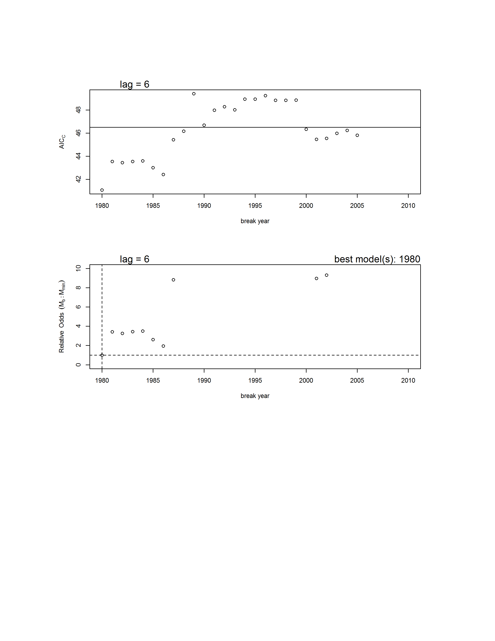
Results from the Ricker stock-recruit breakpoint analysis
Upper graph: AICc vs. year of breakpoint for the 1-breakpoint models (circles) and AICc for the model with no breakpoint (horizontal line). Lower graph: probabilistic odds for all 1-breakpoint models (circles) and the no breakpoint model (horizontal solid line) relative to the model with the smallest AICc score. The dashed lines indicate the value for the model with the lowest AICc score. Not shown are 1-breakpoint models with high odds (>10) of being incorrect.

Slide 47
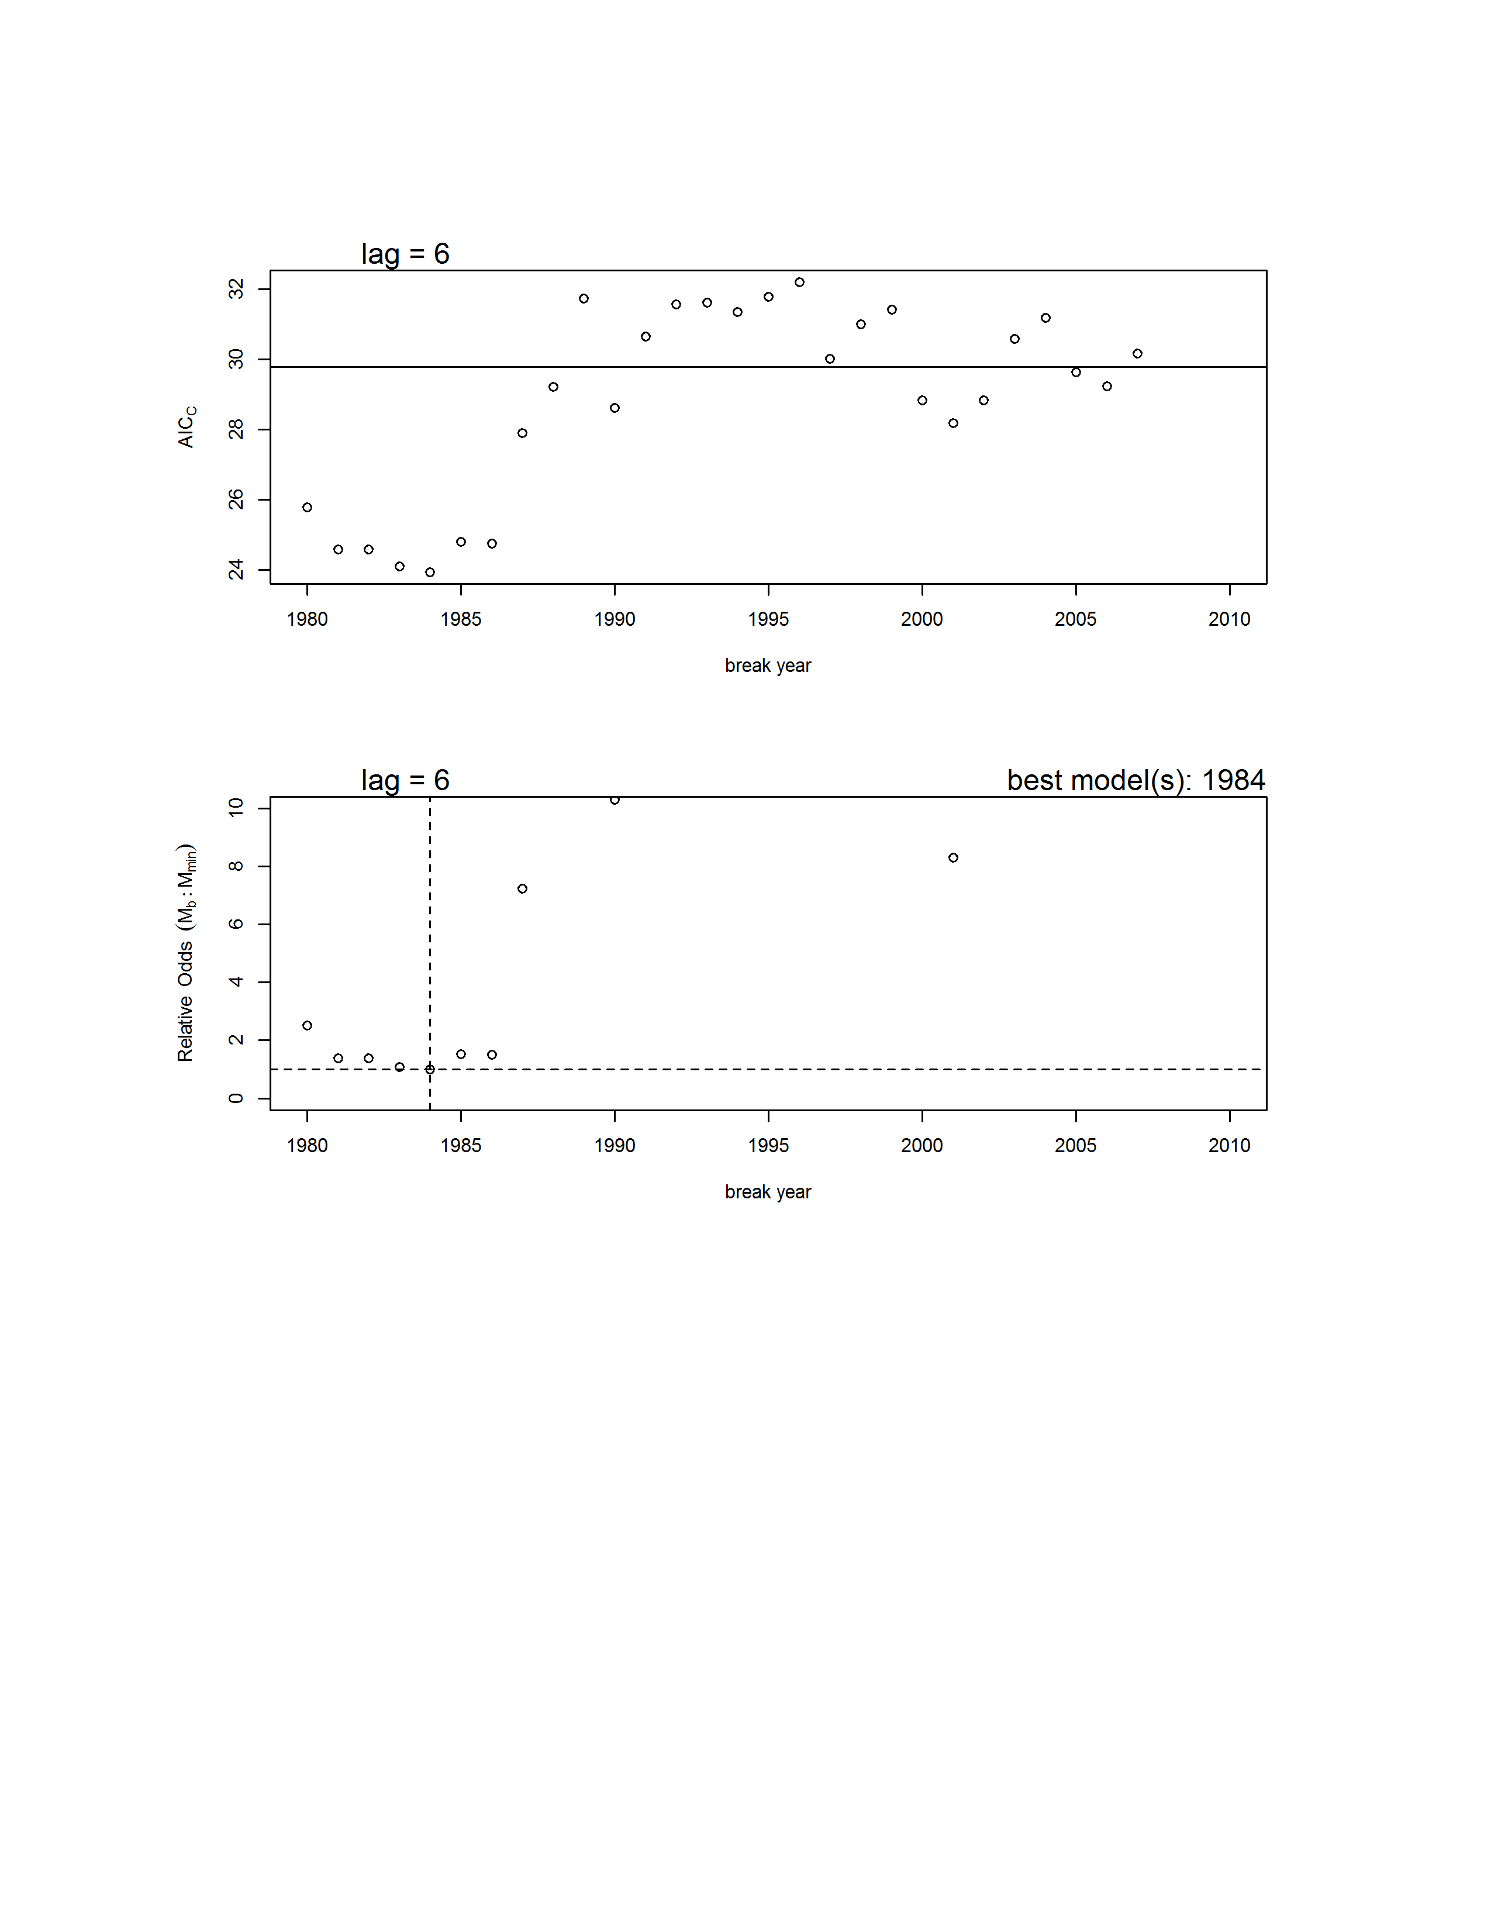
Results from the B-H stock-recruit breakpoint analysis
Upper graph: AICc vs. year of breakpoint for the 1-breakpoint models (circles) and AICc for the model with no breakpoint (horizontal line). Lower graph: probabilistic odds for all 1-breakpoint models (circles) and the no breakpoint model (horizontal solid line) relative to the model with the smallest AICc score. The dashed lines indicate the value for the model with the lowest AICc score. Not shown are 1-breakpoint models with high odds (>10) of being incorrect.

Slide 48
Summary
In 2018, the survey biomass decreases about 50% from 2017, more than expected. All model scenarios have much higher estimated NMFS survey biomass than the observed value in 2018.
Model estimated relative NMFS survey biomasses are very similar between two non-gmacs scenarios, are generally similar among all three scenarios, and fit the survey data reasonably well.
Gmacs (scenario rk18Aa.D18a) results in slightly high relative biomass estimates after 2004 and fits the BSFRF survey biomass better than the other two scenarios. Two non-gmacs scenarios fit NMFS survey biomass better than the gmacs scenario.
The absolute mature male biomass estimates are close among all three scenarios and are lower for scenario rk18A.D18a than the other two scenarios during recent years.
In terminal year, 2018, mature male biomass and OFL estimates are very close among three scenarios.
Update of recruitment breakpoint analysis has similar results with those in 2017 and does not show a recruitment breakpoint in 2006.

Slide 49
Minor Issues to Work on or Be Checked with GMACS Scenario
Estimated length compositions for the initial year are very sensitive to initial parameter values and often have a huge spiked estimated proportion for a length group.
The fits to the female length compositions of the fixed gear bycatch for most years are very bad with extremely high estimated proportions for the last length groups.
Even though the CVs of BSFRF survey biomass (with extra CV) are larger and length composition data seem less consistent than those of NMFS survey, the fits to BSFRF survey biomass are better than the fits to the NMFS survey biomass during the period when both surveys overlapped.
Estimated high female natural mortality values are quite a bit higher than the other scenarios.
Estimated survey selectivities are somewhat different from the other two scenarios.
There is an extremely high estimated directed pot fishing mortality in 1981 (3.3), which seems biologically implausible.
Estimated Tanner crab bycatch biomasses are higher than the other two scenarios before 1990.

Slide 50
Recommendations
Since the results are similar among three scenarios, we recommend scenario rk18Aa.D18a (gmacs) for overfishing definition determination for September 2019.

Slide 51
Thanks

