Slide 1
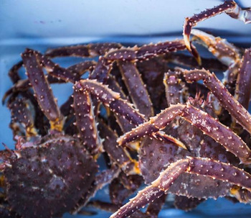

Ecosystem &
Socioeconomic
Profile
Bristol Bay Red King Crab Report Card
Erin Fedewa and Brian Garber-Yonts
ESP Contributors: Kalei Shotwell, Curry Cunningham, Kelly Kearny, Mike Litzow, Jens Nielsen, Darren Pilcher, Jon Richar, Dale Robinson, Abigail Tyrell, Jordan Watson, Ellen Yasumiishi, Leah Zacher, Jie Zheng and Jean Lee

Slide 2

Overview
+
2021 Bristol Bay Red King Crab Report Card
  -Indicators Assessment and Analysis
  -Recommendations and Considerations
  -Plans for next full ESP
CPT Feedback on snow crab ecosystem and socioeconomic indicators presented on Monday
Notes:
Report card template is simple and for annual update only- no new indicators, only updates to existing indicators in 2020 full ESP

Slide 3
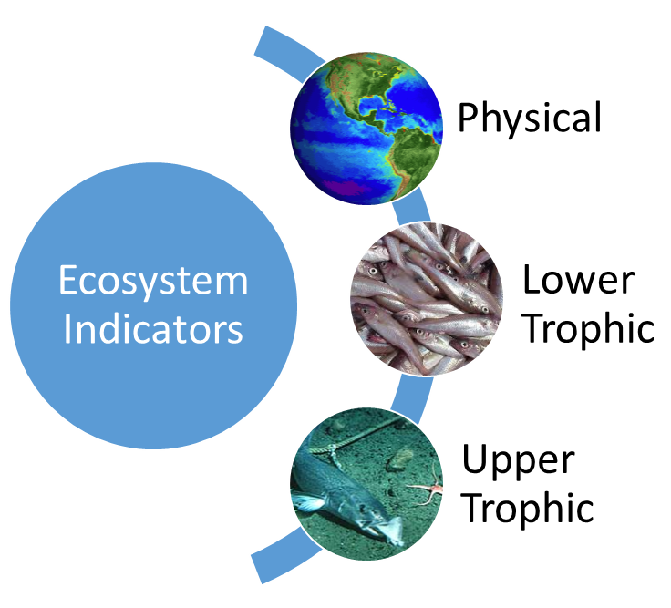
BBRKC Ecosystem Indicators
+
Arctic Oscillation (climate model)
Cold pool extent (BTS)
Summer bottom temperature (BTS)
pH index (ocean model)
Production (chlorophyll a, satellite)
Wind stress (satellite)
Benthic invertebrate biomass (BTS)
Juvenile sockeye salmon abundance (BAS)
Pacific cod biomass (BTS)
Male recruit biomass (BTS)
Area Occupied (BTS)
Catch distance from shore (BBRKC fishery)
+
+
+
+
-
+
-
-
+
-
+
Notes:
+/- signs indicate the proposed directional relationship between the indicator and BBRKC. Data sources for each indicator in parentheses
We are not including the ROMS spring bottom temperature indicator at this time as more seasonal skill testing is necessary before use in a stock assessment context. A ROMS ocean acidification indicator was updated with current-year data, however the whole time series is presented as pH values instead of aragonite saturation states to simplify interpretation. In addition, Bristol Bay summer bottom temperature and cold pool extent indicators were developed for the 2021 BBRKC report card using EBS bottom trawl survey temperature data, whereas in the last full BBRKC ESP, these respective indicators were developed from Bering 10K ROMS model hindcasts due to the cancellation of the 2020 EBS bottom trawl survey.

Slide 4
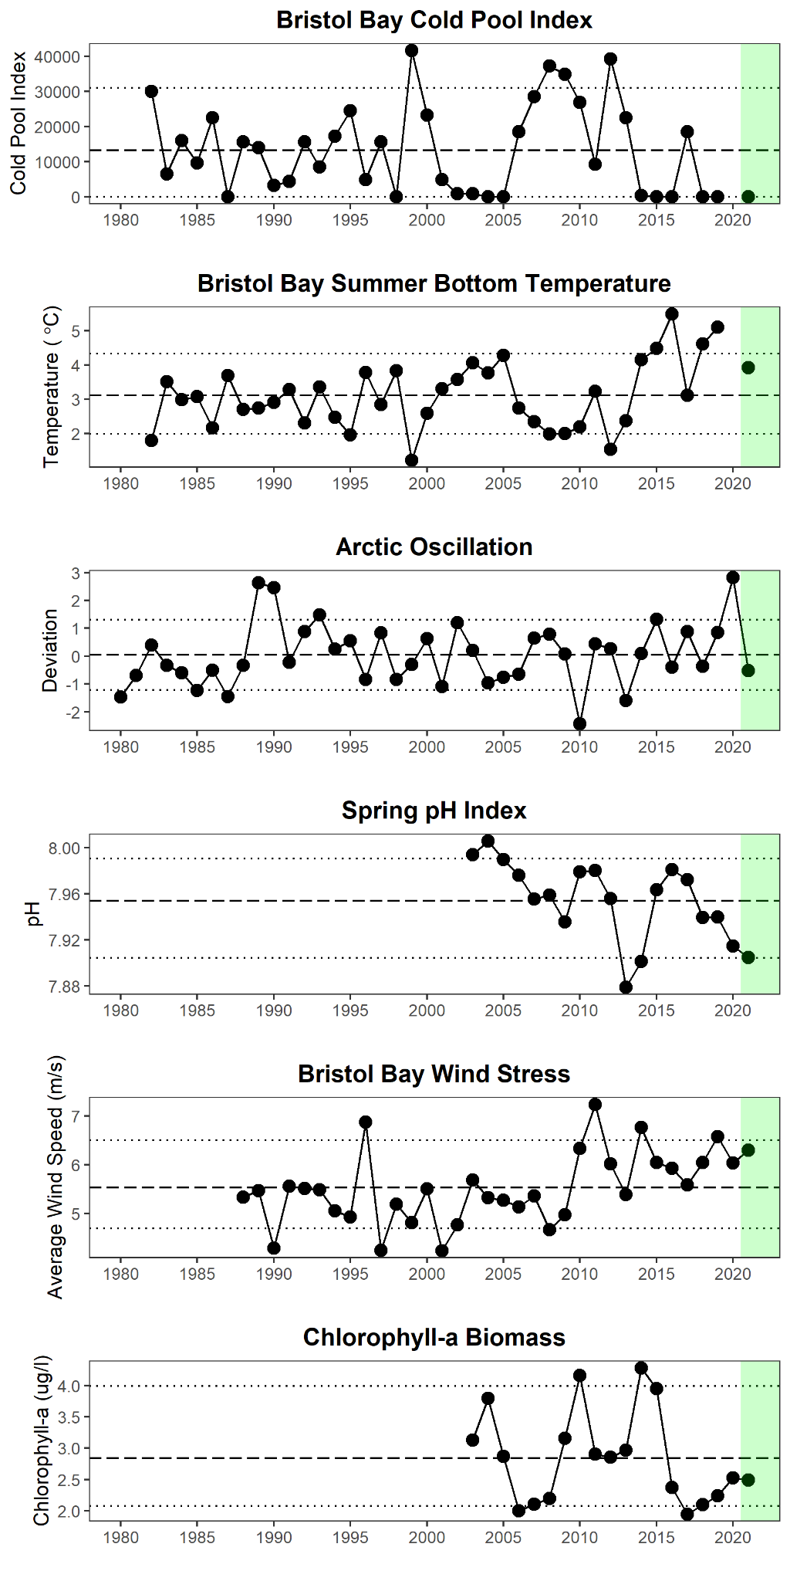
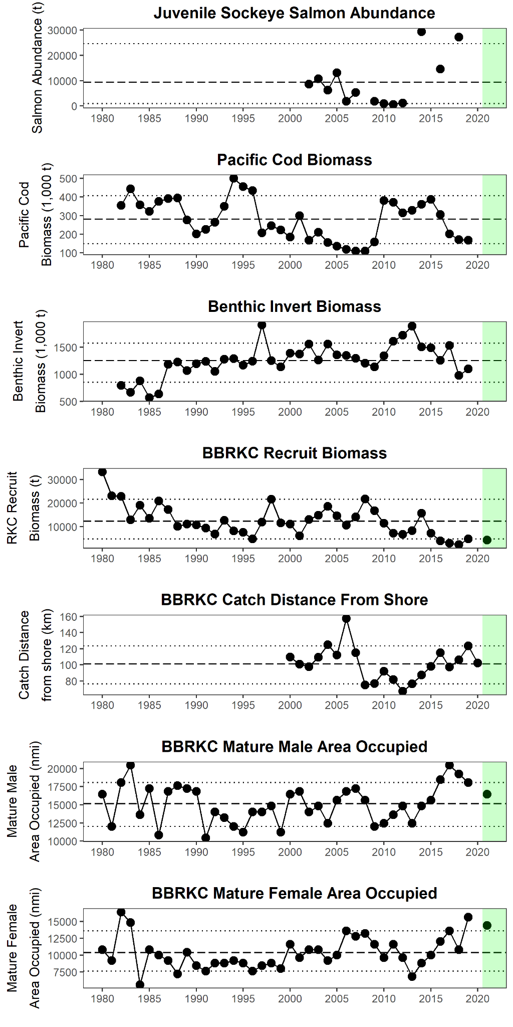
Ecosystem Indicator Time Series

Slide 5
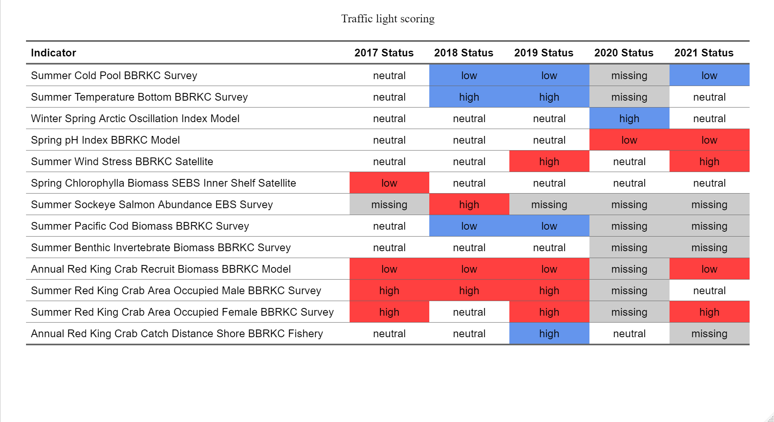
Ecosystem Traffic Light Table
Notes:
The indicator status is designated with high low or neutral text relative to 1 SD of the long term mean. Fill color of the cell is based on the sign of the proposed relationship between the indicator and stock.
Smaller cold pool extent: optimal embryo development and overlap with hatch and spring bloom
Warmer temps: shorter advective distance and higher rates of local retention
Further distance from shore increases likelihood that crab are in the BBRKC closure area and thus bycatch during groundfish fisheries is reduced.

Slide 6
Ecosystem Considerations
Above-average wind stress and persistently low levels of chlorophyll-a in Bristol Bay could indicate poor larval feeding conditions and increased predation on BBRKC early life stages
Delayed spring BBRKC hatching relative to mid-May peak bloom timing may have resulted in a spatiotemporal mismatch between first-feeding larvae and preferred diatom prey.
The cold pool did not extend into Bristol Bay in summer 2021, suggesting optimal conditions for embryo development and potentially greater larval retention within Bristol Bay
Red king crab have experienced a steady decline in bottom water pH in the past 5 years.
Spatial extent of mature female red king crab in Bristol Bay was above average in 2021 despite declines in abundance. Northwest shifts in stock distribution may limit the effectiveness of central Bristol Bay trawl closure areas designated to protect red king crab.
Notes:
Above-average wind stress and persistently low levels of chlorophyll-a in Bristol Bay in combination with substantial increases in juvenile sockeye salmon abundance in the past 5 years could be indicative of poor larval feeding conditions and increased predation on early life stages.
Reproductive cycles were delayed in 2021 due to relatively cold spring bottom temperatures in Bristol Bay. Delayed spring hatching relative to mid-May peak bloom timing may have impacted the spatiotemporal overlap between first-feeding larvae and preferred diatom prey.
The cold pool did not extend into Bristol Bay in summer 2021 and bottom water temperatures were above the long-term average, suggesting optimal conditions for embryo development and potentially greater larval retention within Bristol Bay
Red king crab have experienced a steady decline in bottom water pH in the past 5 years. Continued declines to threshold pH levels of 7.8 could negatively affect juvenile red king crab growth, shell hardening and survival.
Spatial extent of mature female red king crab in Bristol Bay was above average in 2021 despite declines in abundance. The relatively large spatial footprint of mature females in 2021 is likely attributed to high catches of red king crab in the northwesternmost station of the Bristol Bay management area during the AFSC EBS bottom trawl survey. Northwest shifts in stock distribution may limit the effectiveness of central Bristol Bay trawl closure areas designated to protect red king crab.

Slide 7
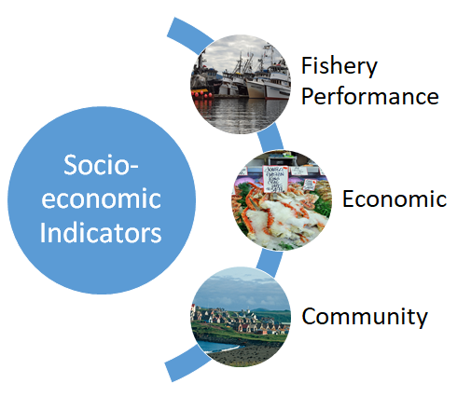
Draft Socioeconomic Indicators
Catch-per-unit-effort (BBRKC fishery)
Total potlifts (BBRKC fishery)
Number active vessels (BBRKC fishery)
Ex-vessel value (BBRKC fishery)
Ex-vessel price/lb (BBRKC fishery)
Ex-vessel revenue share (BBRKC fishery)
No community indicators proposed
Notes:
Five socioeconomic indicators have been discontinued due to concerns over redundancy with the stock assessment model and in an effort to emphasize those indicators that are most closely associated with the health and condition of the stock.

Slide 8
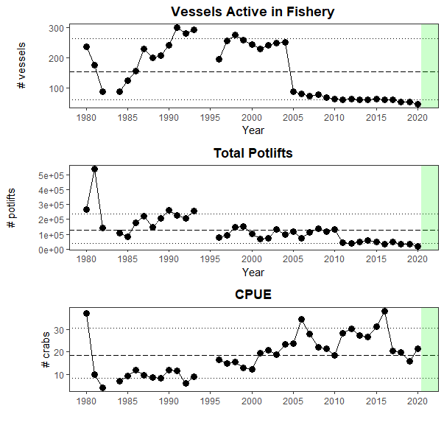
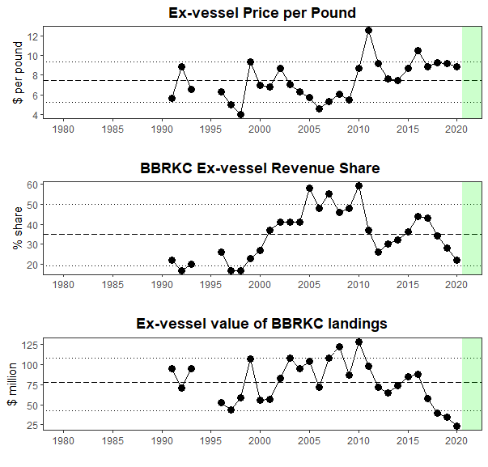
Socioeconomic Indicator Time Series

Slide 9
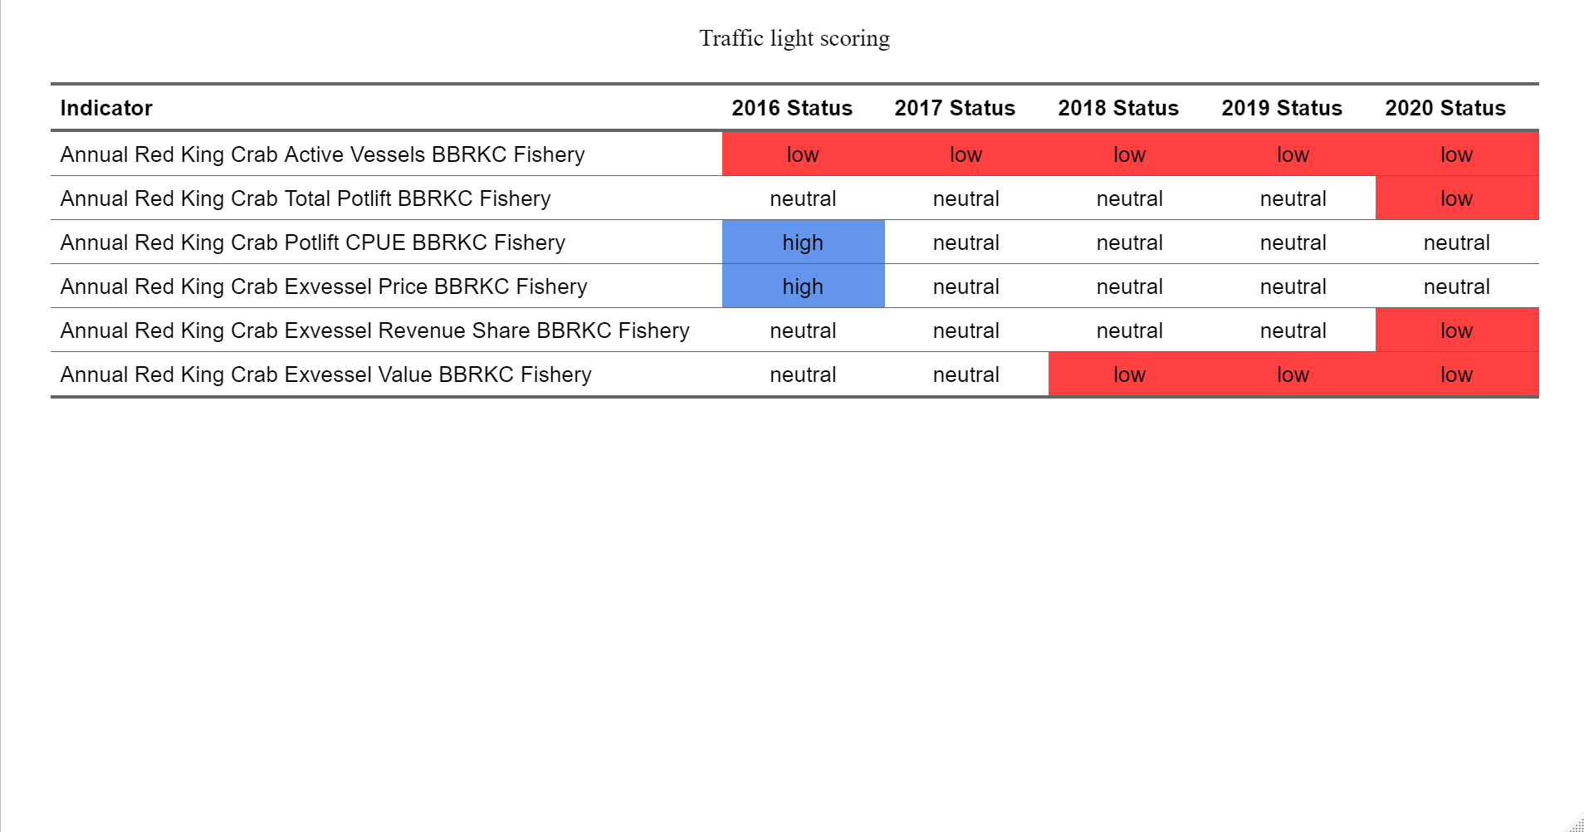
Draft Traffic Light Table
Notes:
The indicator status is designated with high low or neutral text relative to 1 SD of the long term mean. Fill color of the cell is based on the sign of the proposed relationship between the indicator and stock.

Slide 10
Planned ESP Developments
Addressing CPT/SSC recommendations:
        -Improving interpretability of plots to emphasize lags
        -Addressing proposed directional effects on stock
        -Assessing indicators for potential redundancy
        Updating the second stage indicator analysis (Bayesian Adaptive Sampling)
        Produce a Request for Indicators (RFI) in January 2022 to propose new indicator contributions
        Updates to ecosystem and socioeconomic indicators for 2022 Sept CPT Meeting

Slide 11
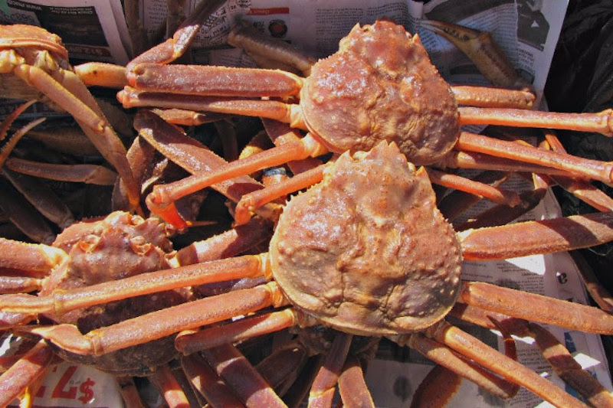
Ecosystem &
Socioeconomic
Profile
Snow Crab Request for Indicators (RFI)
Erin Fedewa and Brian Garber-Yonts
ESP Contributors: Kerim Aydin, Buck Stockhausen, Kalei Shotwell,, Kelly Kearny, Mike Litzow, Jens Nielsen, Darren Pilcher, Jon Richar, Pam Jensen and Jordan Watson,

Slide 12
Discussion
Is there any feedback on the Request for Indicators (RFI) approach and/or ESP schedule for crab?
Are the suggested ecosystem and socioeconomic indicators appropriate for snow crab?
Are there any other indicators we should include in the snow crab RFI?

Slide 13
Proposed Snow Crab Indicators
Snow crab conceptual model
Ecosystem Indicators
Socioeconomic Indicators
Arctic Oscillation (climate model)
Cold pool extent (BTS)
Sea-ice extent/retreat (satellite)
pH index (ocean model)
Production (chlorophyll a, satellite)
Intermolt duration (BTS)
Settlement success (IBM)
Hatch spring bloom overlap (BTS, sat)
Benthic prey biomass (BTS)
Snow crab recruit condition (BTS)
Snow crab area occupied (BTS)
Temperature of occupancy (BTS)
Snow crab center of distribution (BTS)
Pcod consumption of snow crab
Pcod and snow crab overlap (BTS)
Female snow crab size at maturity (BTS)
Male snow crab recruit biomass (BTS)
Snow crab disease prevalence (BTS)
Center of Gravity (snow crab fishery)
Catch-per-unit-effort (snow crab fishery)
Total potlifts (snow crab fishery)
Number active vessels (snow crab fishery)
Incidental catch of snow crab
Ex-vessel value (snow crab fishery)
Ex-vessel price/lb (snow crab fishery)
Ex-vessel revenue share (snow crab fishery)

