Slide 1
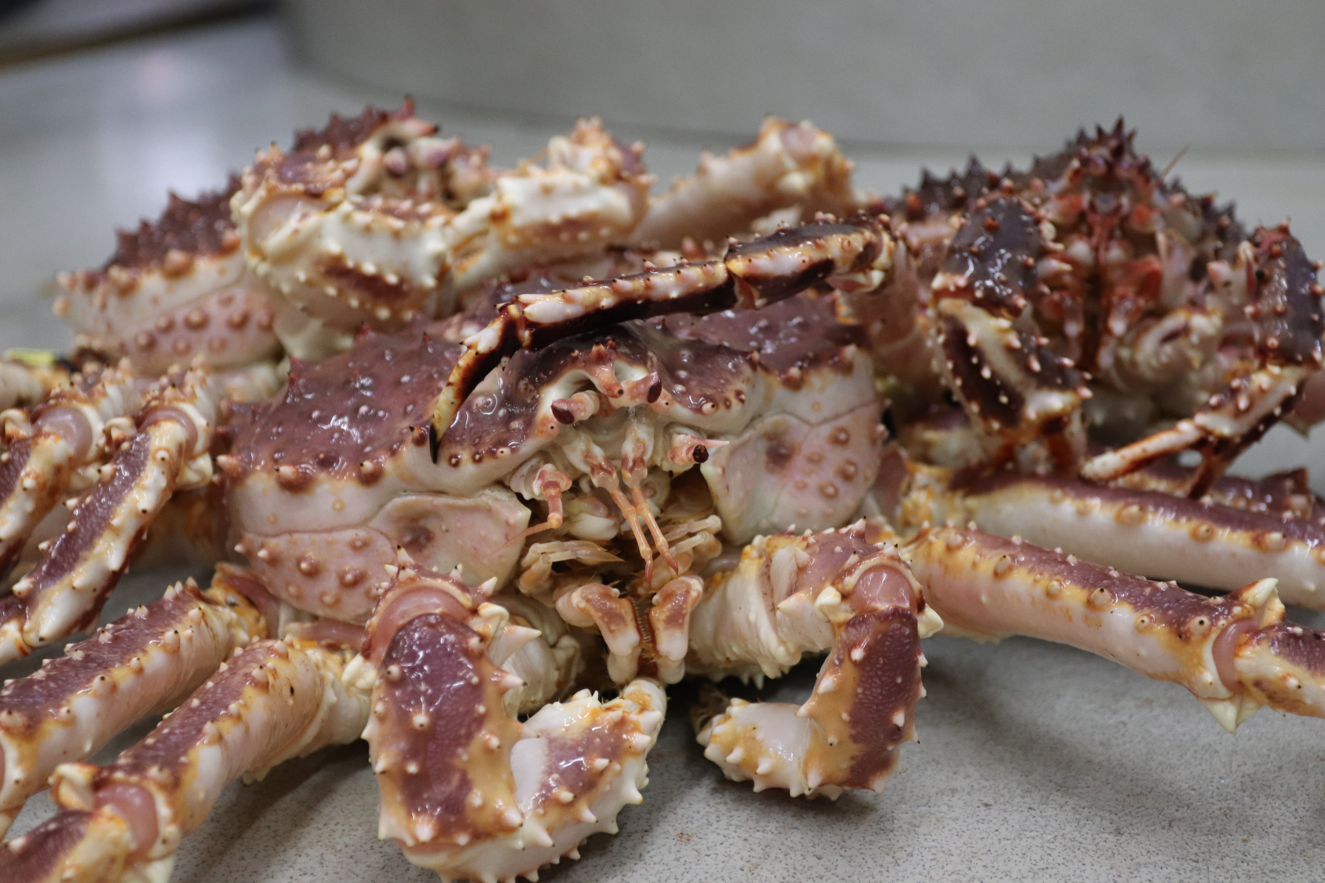
Bristol Bay Red King Crab Resampling Discussion
NOAA-AFSC Shellfish Assessment Program
January 2022 CPT Meeting

Slide 2
Current protocol for resampling Bristol Bay
Rationale for resampling:
To characterize the reproductive status of BBRKC mature females given temperature-driven delays in the molt/mate cycle
To accurately assess the relative abundance of BBRKC mature females given that females may be outside surveyed area when the molt/mate cycle is delayed
Notes:
Hypothesized large-scale redistribution of females from nearshore areas outside of the surveyed area into the resurveyed area in cold years

Slide 3
Current protocol for resampling Bristol Bay
Resample if 10% or more of BBRKC mature females have not completed the molt-mate cycle as determined by egg codes (i.e. empty egg cases, no eggs, hatching, and eyed eggs)
Resample stations are selected based on mature female BBRKC densities (20-30 stations representing 80% of the distribution)
Leg 1 data ONLY used for male BBRKC biomass estimates. Resampled data REPLACE Leg 1 original station data for BBRKC mature female biomass estimates
Barren
Eyed eggs
Notes:
Female red king crab biomass calculated by replacing data collected at the original stations with data collected at the resample stations due to crab movement into the sampling area between the standard survey and the resampling event.

Slide 4
Previous thresholds prompting resampling
 | 2008 | 2009 | 2010 | 2011 | 2012 | 2017 | 2021
Eyed embryos | 29% | 26% | 2% | 3% | 31% | 7% | 1%
Barren | 41% | 22% | 37% | 46% | 34% | 41% | 16%
Hatching | 0% | 0% | 0% | 0% | 0% | 7% | 1%
THRESHOLD TOTAL | 70% | 48% | 39% | 49% | 65% | 55% | 18%
Uneyed embryos | 29% | 52% | 61% | 51% | 35% | 46% | 82%
Notes:
Table shows proportion of total mature females caught on Leg 1 across 4 different clutch conditions in most recent resampling events. Eyed, barren and hatching are considered in the resampling protocol- if 10% or more of females comprise these three clutch conditions, a resampling is done in BB. Note in most years well over 40% (threshold total) of females had not yet molted and mated with the exception of 2021.

Slide 5
Pre/post resampling mature female abundances
 | 2008 | 2009 | 2010 | 2011 | 2012 | 2017 | 2021
Leg 1 abundance | 27.5 | 24.6 | 15.1 | 14.5 | 19.9 | 13.4 | 6.2
Resampling abundance | 36.8 | 35.7 | 31.5 | 29.3 | 19.6 | 17.5 | 6.3
% change in abundance | +34% | +45% | +109% | +102% | -2% | +30% | +2%
Notes:
As mentioned, the resampling protocol was developed in part due to concerns with mature females being unavailable to the survey in relatively cold years. This table shows both leg 1 and resampling abundances of mature females in millions of crab. Only showing the most recent 7 years of resampling here, but noting that in some years, abundance more than doubles between initial and resampling. 2012 was the only year that abundance decreased between Leg 1 and resampling efforts

Slide 6
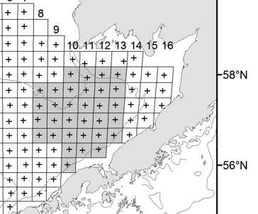
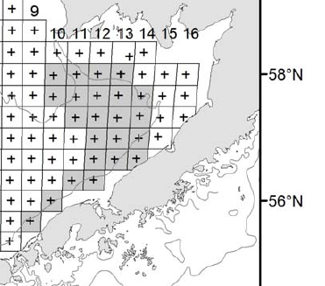
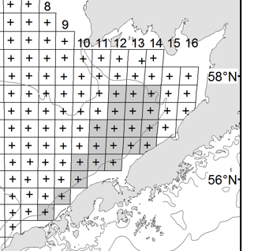
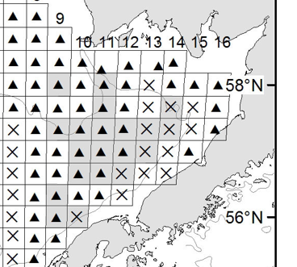
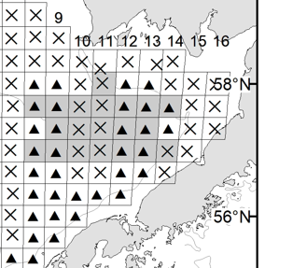
Station locations of past resampling efforts
2008; n=32
2010; n=23
2012; n=20
2017; n=20
2021; n=20
Notes:
Showing most recent 5 years of stations resampled (shaded stations) to illustrate that stations resampled within a given year are determined based on both barren female distributions and overall female distributions during leg 1. Both the # of and stations sampled have differed between each resampling and in recent years only 20 stations have been resampled due to time/vessel days available.
****2021- NW stations with high mature female abundances not included because females had primarily uneyed clutches.

Slide 7
Weigh-in requested from Crab Plan Team
Shellfish Assessment Program Concerns:
Are females still utilizing nearshore areas outside the survey grid to provide rationale for resampling?
  Female BBRKC tags popping up May 1
Is a 10% threshold prompting resampling too low?
  Resampling efforts prior to 2021 were triggered by ~40%+ of mature females having not yet completed the molt-mate cycle
  Weighing data value versus at-sea effort
Inconsistent methodology in resampling protocol
  Timing of resampling has not been consistent across years
  20 vs. 30+ stations resampled
  Location of stations resampled
Notes:
Recognizing the system has changed dramatically since the adoption of the resampling protocol- cold/warm regimes no longer reflect conditions in Bristol Bay. Recent NW shifts in female centers of distribution suggest that northern boundary of survey grid may be the bigger concern. To address this concern, Leah Zacher may be able to provide preliminary data from her cooperative tagging charter at the May CPT meeting which will be informative given that Bering Sea forecasts suggest relatively cold conditions this upcoming spring and under the current protocol, a resampling is likely.
Under the current protocol, a resampling was prompted this past year with only 18% of females with barren, hatching and eyed embryos. While resampling resulted in 100% of mature females with uneyed eggs, the difference in abundance estimates between leg 1 and resampling were negligible and the BBRKC fishery was closed due to low mature female abundances. Emphasizing that we’d like CPT to weigh in on the trade offs between the current 10% threshold and data quality, recognizing that a resampling requires 7-10 extra vessel days and with the NBS and potentially slope stations now on the table, resampling is a significant effort.
Also noting that the resampling protocol was developed when the NBS wasn’t frequently sampled and retows were conducted at the end of July. With the NBS, retows are logistically easier to complete at the end of August when vessels have completed the standard grid stations. Does this matter in regards to crab movement? Because vessel days are often a limitation, in recent years only 20 stations have been resampled and no formal power analysis has ever been conducted to explore potential implications of changing the number of stations resampled. Request that CPT weigh in on trade offs between number of stations sampled and data quality. Lastly, stations tend to represent a core area of barren/overall female distribution and adjacent stations are prioritized to minimize transit time. This meant not including the NW corner mature female “hotspot” during 2021 resampling.
**Recommendation that any change in protocol discussed at May CPT and in place before 2022 BT survey kicks off.

