Slide 1
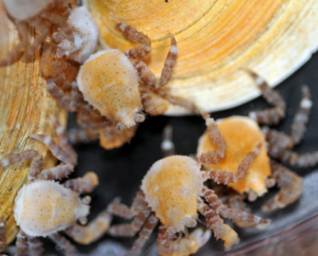
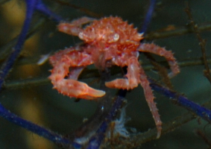
Blue King Crab Biology and Ecology: An Update
ASFC
April 30, 2019

Slide 2
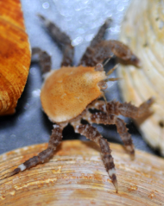
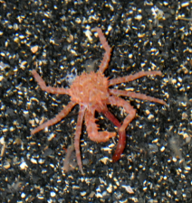
Pribilof Islands King Crab

Slide 3
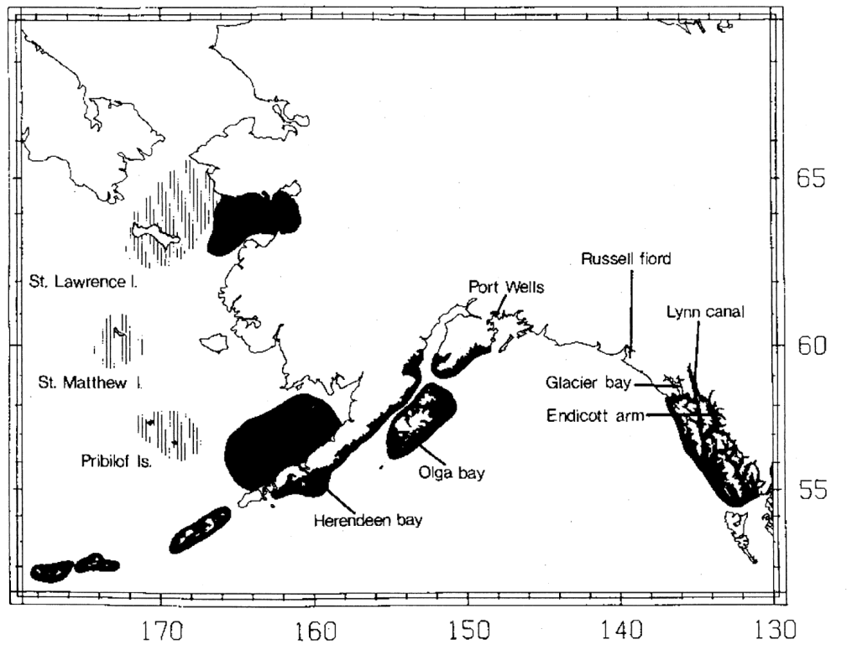

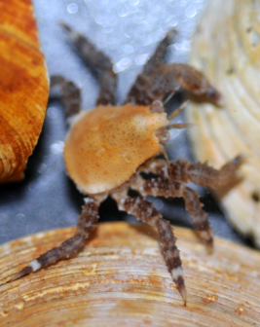
Why don’t red and blue king crab overlap (much)?
Temperature?
Competition?
Predation?
Somerton, D. A. 1985. The disjunct distribution of blue king crab, Paralithodes platypus, in Alaska: some hypotheses. Pages 13-21 in Proceedings of the International King Crab Symposium. University of Alaska Sea Grant Program, Anchorage, AK, USA.

Slide 4
Temperature: RKC vs. BKC
RKC feeding peaks at about 15C
BKC at 8-11C
Long, W. C., and B. Daly. 2017. Upper thermal tolerance in red and blue king crab: sublethal and lethal effects. Marine Biology 164:162.
Stoner, A. W., M. L. Ottmar, and S. A. Haines. 2010. Temperature and habitat complexity mediate cannibalism in red king crab: Observations on activity, feeding, and prey defense mechanisms. Journal of Shellfish Research 29:1005-1012.

Slide 5
Temperature: RKC vs. BKC
Growth
  RKC drops above 12C
  BKC very low above 11C
Long term mortality
  RKC increases above 15C
  BKC increases above 11C
Pejus temp
  RKC:12-15C
  BKC 8-11C
Summer bottom temp in Pribs: ~10C
Long, W. C., and B. Daly. 2017. Upper thermal tolerance in red and blue king crab: sublethal and lethal effects. Marine Biology 164:162.

Slide 6
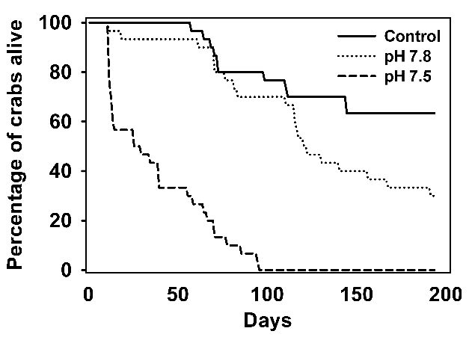
OA: RKC vs. BKC
Experiment
YOY crabs held at 3 pHs
Monitored for 200-350 days
Results
RKC pH threshold ~7.8
BKC pH threshold ~7.5
BKC much more resistant to OA
Long, W. C., K. M. Swiney, C. Harris, H. N. Page, and R. J. Foy. 2013. Effects of ocean acidification on juvenile red king crab (Paralithodes camtschaticus) and Tanner crab (Chionoecetes bairdi) growth, condition, calcification, and survival. PloS one 8:e60959.
Long, W. C., S. B. Van Sant, K. M. Swiney, and R. Foy. 2017. Survival, growth, and morphology of blue king crabs: Effect of ocean acidification decreases with exposure time. ICES Journal of Marine Science 74:1033-1041.

Slide 7
Competition: BKC vs. RKC (YOY crabs)
Experiment:
YOY RKC and BKC reared for 90 d
Single and mixed species treatments
2 different habitats
Results for RKC
Higher survival in Shell
BKC presence increased survival in Shell
RKC do as well or better when BKC are around

Slide 8

Competition: BKC vs. RKC (YOY crabs)
Higher survival in Shell than Cobble
Much lower survival with RKC
RKC can extirpate BKC at the YOY stage
Long, W. C., S. B. Van Sant, and J. A. Haaga. 2015. Habitat, predation, growth, and coexistence: Could interactions between juvenile red and blue king crabs limit blue king crab productivity? Journal of Experimental Marine Biology and Ecology 464:58-67.

Slide 9
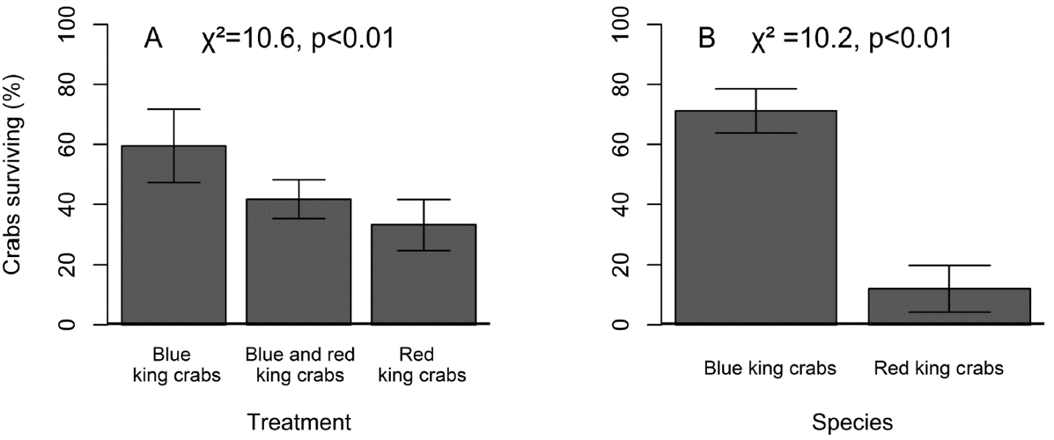
Fish Predation: BKC vs. RKC
Experiment
Halibut predators
Shells and macroalgae mimic
BKC, RKC, and both
Results
BKC had much higher survival than RKC
Lyons, C., G. Eckert, and A. W. Stoner. 2016. Influence of temperature and congener presence on blue (Paralithodes platypus Brandt, 1850) and red (Paralithodes camtschaticus Tilesius, 1815) king crabs habitat preference and fish predation. Journal of Crustacean Biology 36:12-22.

Slide 10
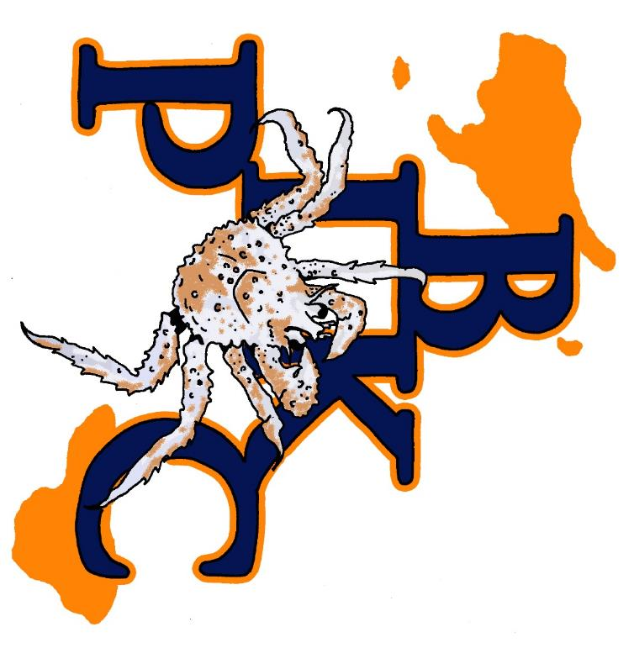

Crab Plan Team Update – May 2019
NPRB #1608
PIs: J. Weems, G. Eckert, W.C. Long

Slide 11
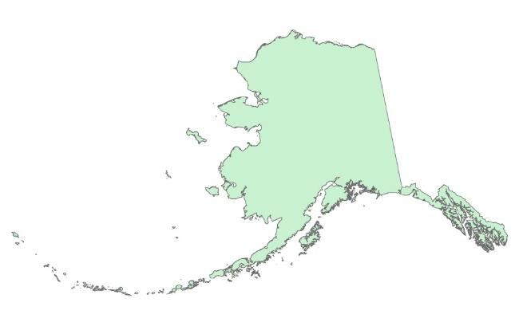
Pribilof Islands blue king crab (Paralithodes platypus) recruitment limitation as a potential bottleneck to rebuilding from overfished status
  https://www.sfos.uaf.edu/research/pribsbluesmuse/
  https://www.instagram.com/pribsbluesmuse/
  Objectives:
  Our overall objective is to investigate if juvenile recruitment limitation and a bottleneck in larval and juvenile stages are occurring and limiting rebuilding efforts of Pribilof Islands blue king crab.
  Quantify larval supply and early juvenile abundance.
  Resample habitat from historical surveys and identify availability of habitat in shallow areas.
  Identify potential juvenile king crab predators and investigate predation potential.
  Identify distribution and overlap of red and blue king crab juveniles.
BKC distribution
St. Paul Island,
Pribilofs study site

Slide 12
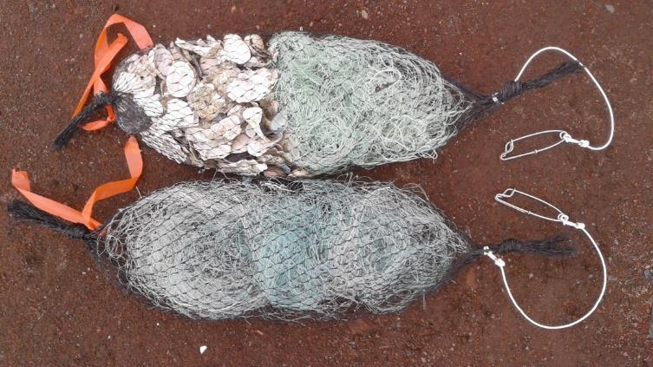
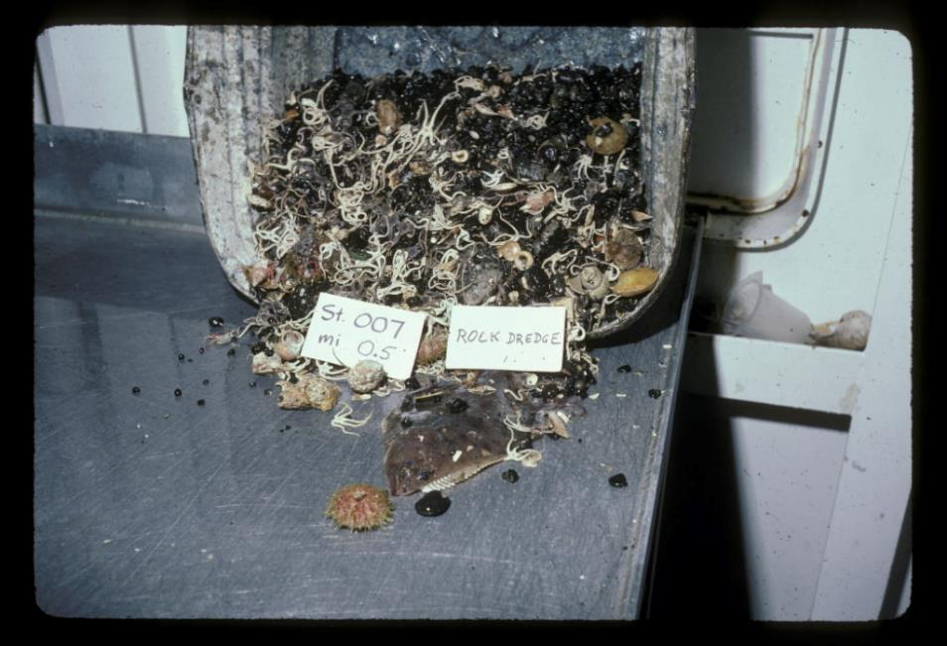
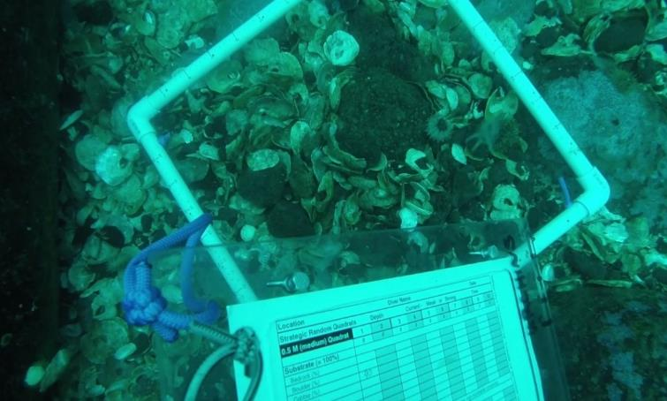
Approach and Methods
Revisit a subset of historical sites around St. Paul Island to compare historical and new data.
Current Sampling – 2017-19
  Shore and small boat sampling
  Settlement Bags, Cameras and SCUBA Diving
Historical Data (NPRB #1321) – 1983-84
  Ship-based sampling
  Rock Dredge and Beam Trawls

Slide 13
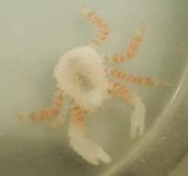
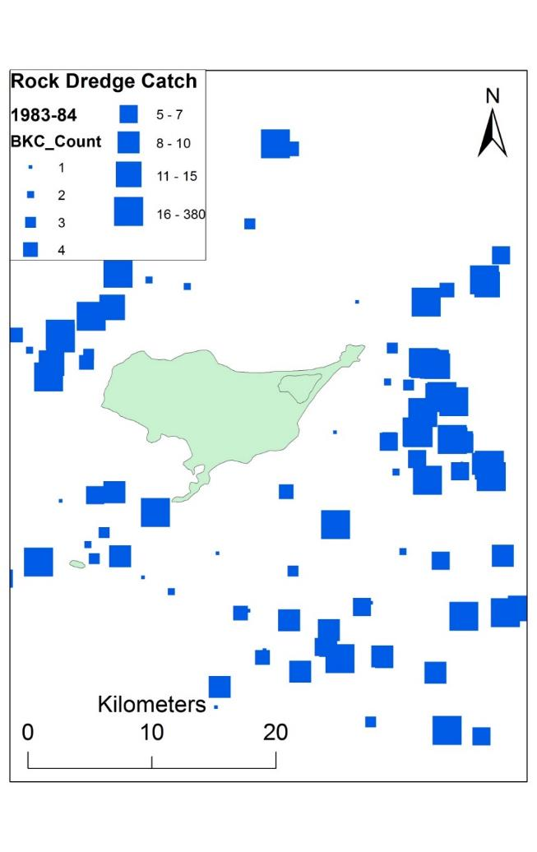
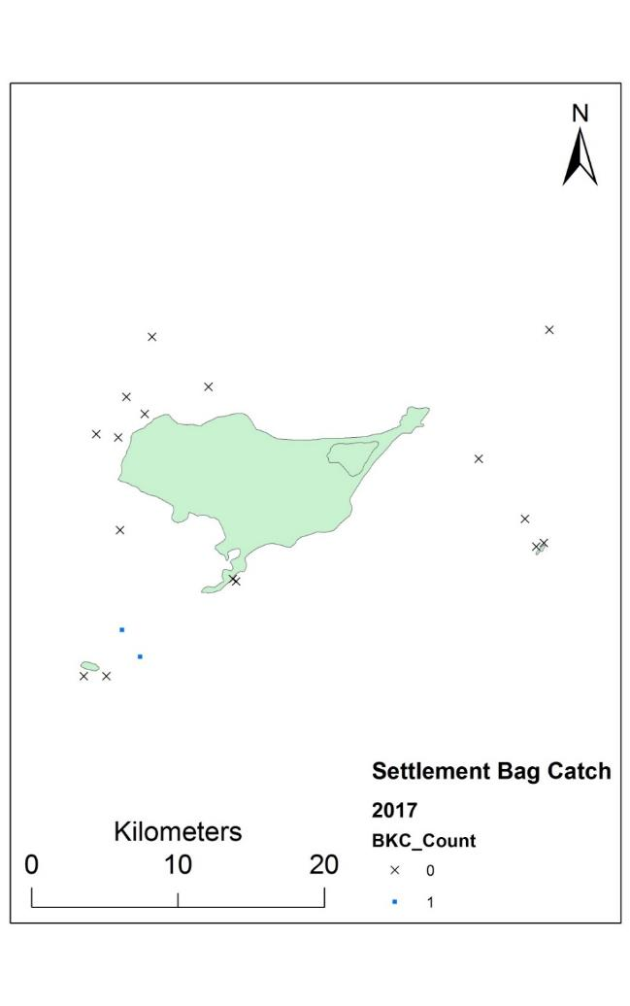
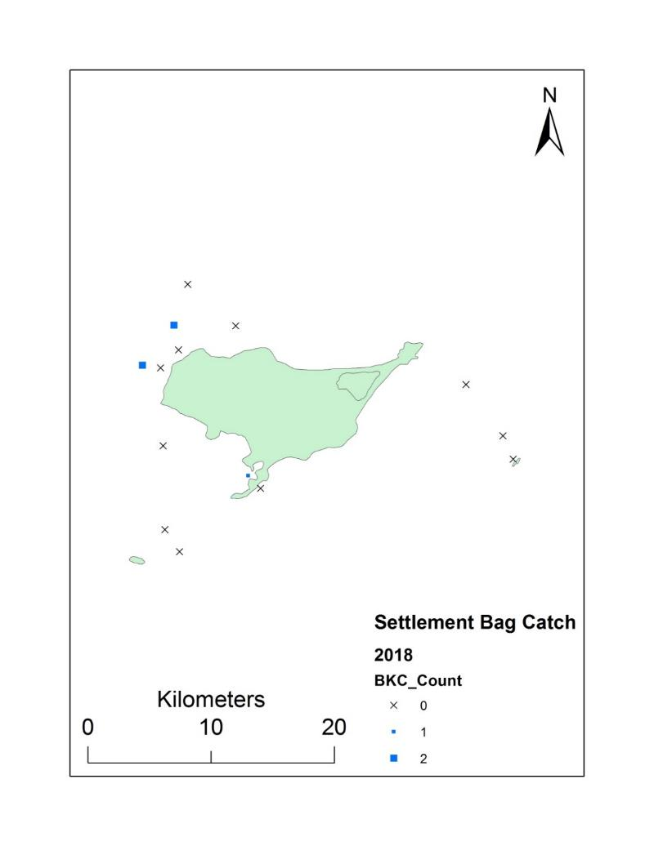
Objective 1 – Quantify BKC Juvenile Supply
Historical Data
Current Preliminary Data

Slide 14
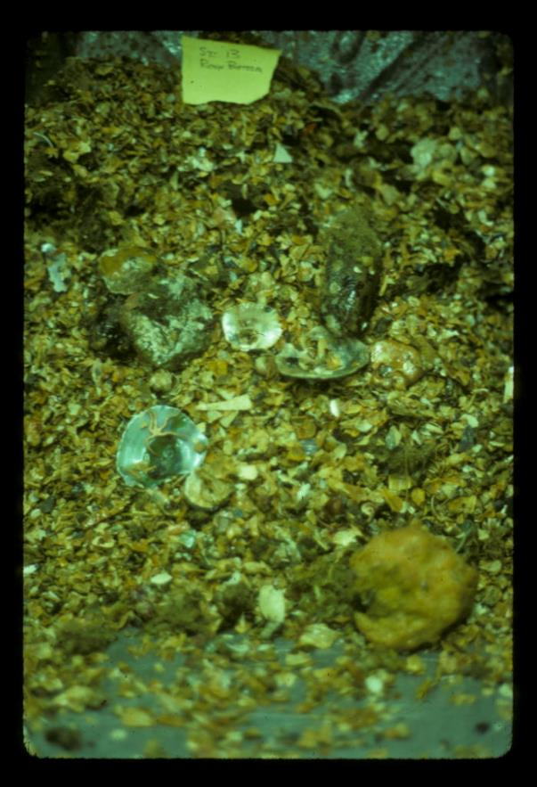
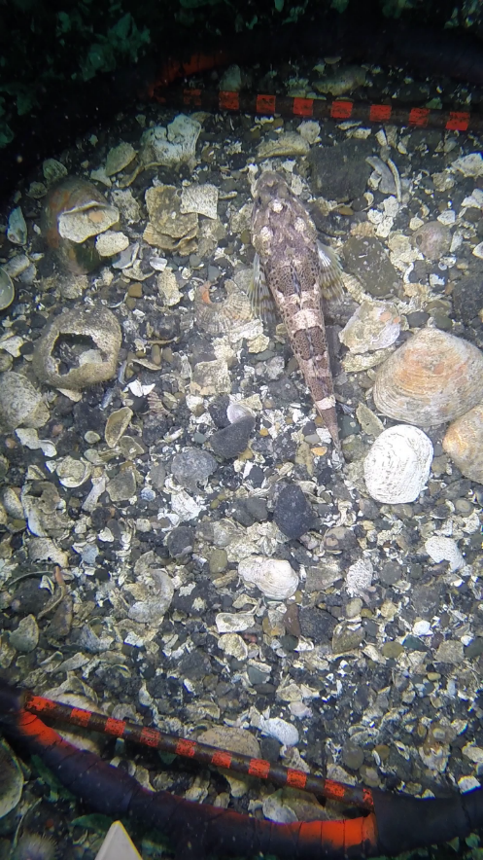
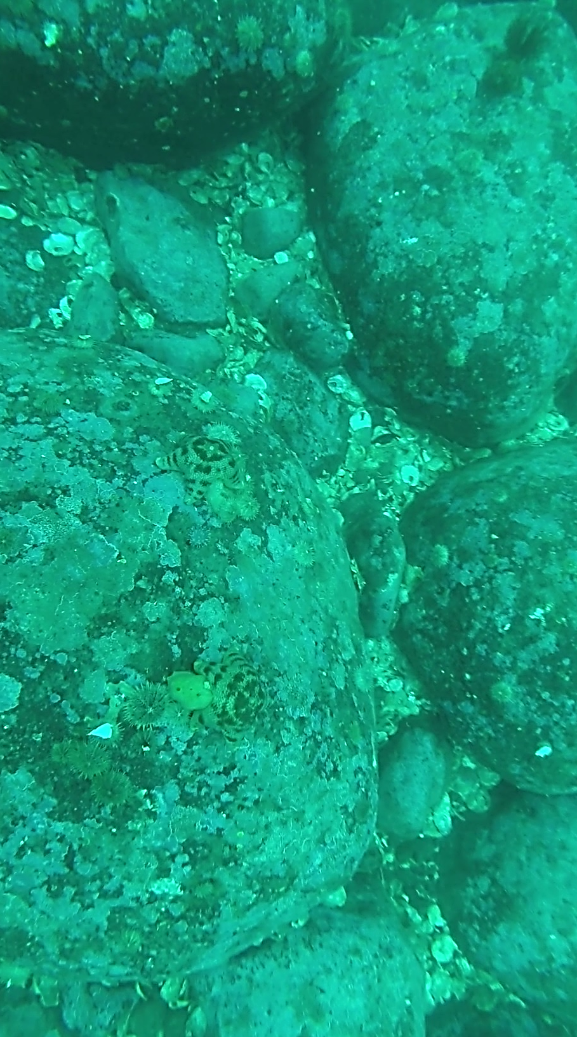
Objective 2 – Assess Habitat Availability / Change
versus
Historical dredged habitat Modern video and diver surveyed habitat

Slide 15
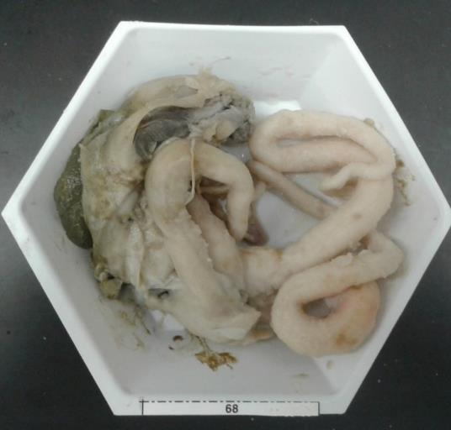
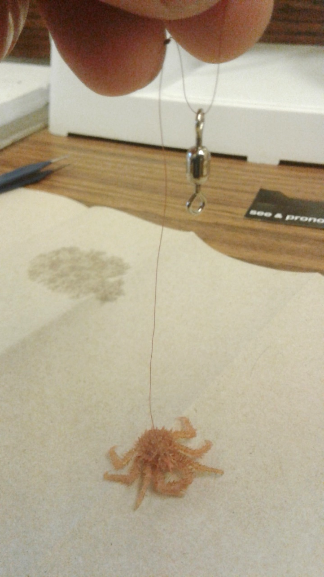
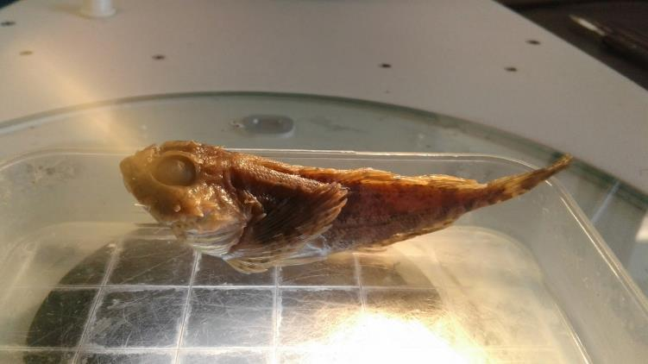
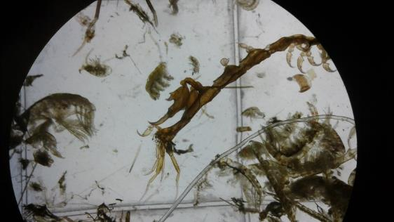
Objective 3 – Predation Potential
Survey data for predators
Fish diet analysis
Crab tethering experiments
Octopus prey in a Halibut Stomach Sample
Tethered Age1 RKC
Scuplin Stomach Sample
Play Tethering Videos!
Small Invertebrate Prey

Slide 16

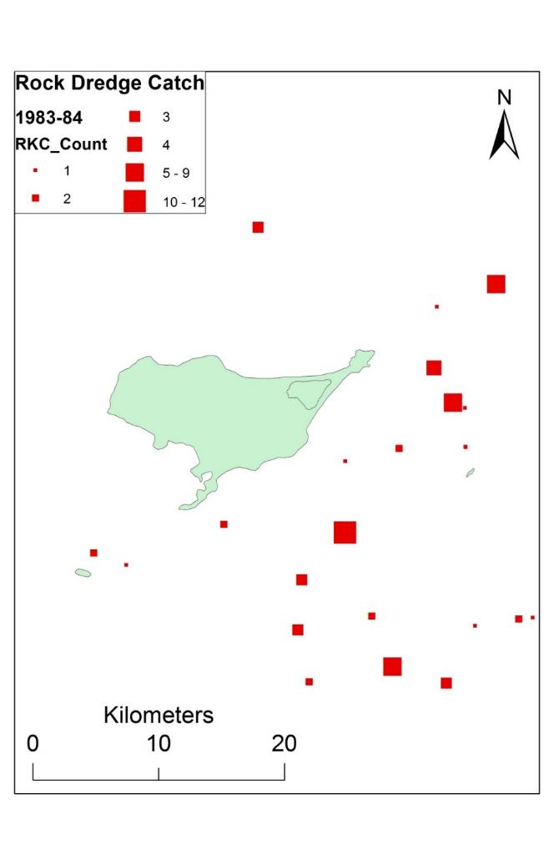
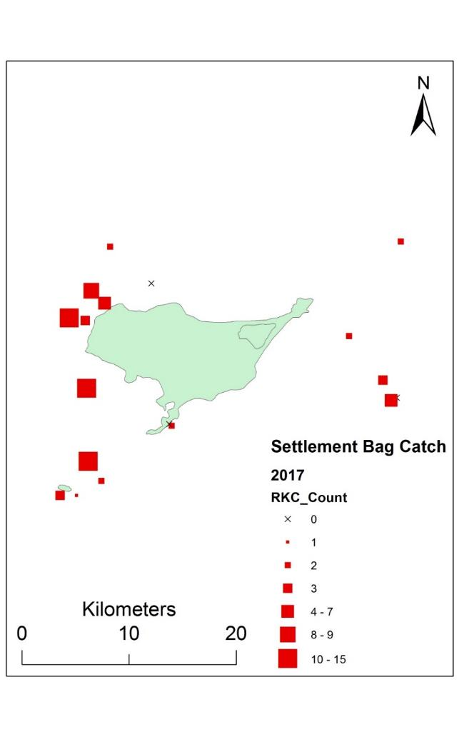
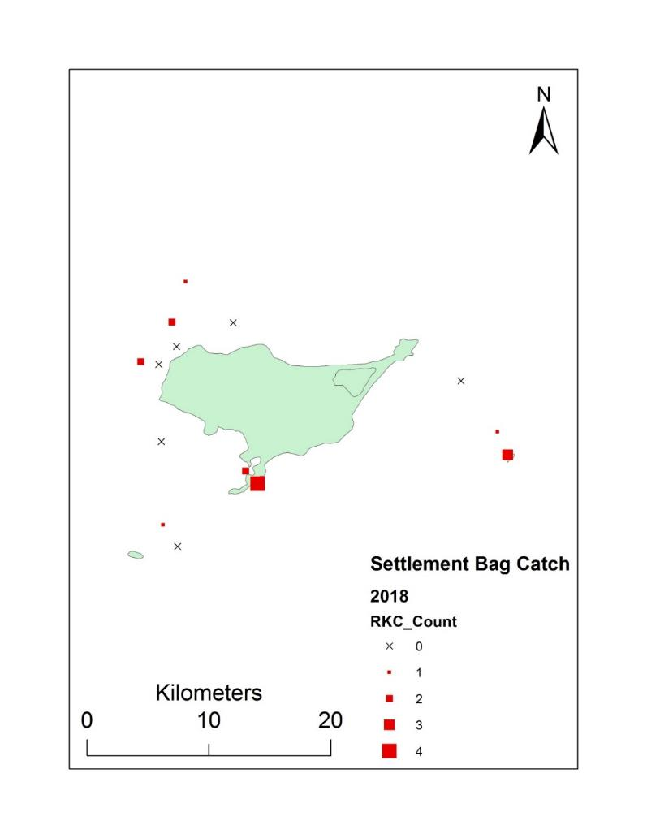
Objective 4 – Overlap of RKC and BKC
Historical Data
Current Preliminary Data

Slide 17
Very preliminary thoughts
Larval supply of BKC is very low
  Larval limitation of population?
RKC larval supply is much higher
  Proof of larval retention?
RKC and BKC are settling in the same areas
  Competition?
Habitat seems good
  In areas of overlap our data shows not much has changed from the 1980s
  Plenty of complex habitat in shallow waters too
Predation?
  Forthcoming

Slide 18

Funding and Support

