Slide 1
Recommended harvest strategy for Aleutian Islands golden king crab
Benjamin Daly¹, M.S.M. Siddeek¹, Mark Stichert¹, Steven Martell², Jie Zheng¹
Alaska Board of Fisheries Meeting
Anchorage, AK
March 9-12, 2019
¹ Alaska Department of Fish and Game, ² Sea State Inc.
Notes:
Good morning, Mr. Chair and members of the Board.
For the record, my name is Ben Daly, I am the shellfish and groundfish research coordinator for the ADFG, Westward Region.
To my left/right is Mark Stichert shellfish and groundfish management coordinator for the ADFG, Westward Region.
It is our pleasure to present our recommendation for the Aleutian Island golden king crab harvest strategy.
This analysis was iterative and stakeholder input was considered throughout the process.
Because this presentation represents a large amount of work I would like to first take a moment to acknowledge my co-authors.
Dr. Sharreef Siddeek of ADF&G is the lead stock assessment author for AIGKC and conducted the forecast simulations presented in this report.
Mark Stichert of ADF&G provided management support on the development of the harvest policies.
Dr. Steven Martell of Sea Sate Inc. provided technical assistance and overall project support.
Dr. Jie Zheng of ADF&G provided technical assistance and overall project support.

Slide 2
State/Federal cooperative management regime
Federal process:
NPFMC FMP: 10 BSAI crab stocks (including AIGKC)
OFL (overfishing level): approximates MSY
ABC (acceptable biological catch): below OFL to account for “the scientific uncertainty in the estimate of OFL and any other specified scientific uncertainty”
State process: harvest levels (TAC) and other management actions
BOF Policy on King and Tanner Crab Resource Management, FMP, MSA national standards
FMP Amendment 38: optimum yield ranges from 0 – <OFL
  Sum of all sources of fishing mortality <ABC
Notes:
AIGKC falls under a federal-state management regime.
The North Pacific Fishery Management Council (NPFMC) Fishery Management Plan (FMP) applies to 10 king and Tanner crab stocks in the BSAI.
Federal process includes stock assessments estimate various biological reference points including the OFL (overfishing level, thought to approximate MSY) and ABC. I’ll talk more about these on the next slide
The state process includes harvest levels and other management actions, guided by ……….
FMP Amendment 38 established the optimum yield (OY) for each crab stock as a range from 0 pounds to less than the OFL.

Slide 3
OFL: Level of fishing mortality that jeopardizes the capacity of a stock to produce the maximum sustained yield on a continuing basis.
Overfishing Level (OFL)
Federal Government
25% buffer
ABC: Level of annual catch that accounts for scientific uncertainty and is set to prevent the OFL from being exceeded.
In practice ABC limits mortality of ALL male and female crabs regardless of size, from all sources of fishery mortality (i.e. retained catch, bycatch in directed and non-directed crab fisheries, and groundfish fisheries).
Acceptable Biological Catch (ABC)
Federal Government
Catch
Below ABC
Total Allowable Catch (TAC)
TAC: Annual catch target for the directed fishery, set to prevent exceeding the ABC for that stock. Limits legal sized males, but must consider all sources of mortality to ensure the ABC is not exceeded. Considers model uncertainty and other factors.
State of Alaska
0
Notes:
More on the OFLs and ABCs……these acronyms stand for Overfishing level and Acceptable biological catch.
They are are products that come out of the federal stock assessment process, and are designed for a very specific function.
OFL: read box………..
Any amount of catch in excess of the OFL results in overfishing.
Annually estimated through assessment process using five-tier system and F_{OFL} control rule
ABC: The level of annual catch that accounts for scientific uncertainty in OFL
Set lower than OFL
25% buffer for AIGKC
ABC is not the TAC
ABC is the limit on mortality of ALL male and female crabs regardless of size, from all sources of fishery mortality:
retained catch
bycatch in directed crab fishery
bycatch in nondirected crab fisheries
bycatch in groundfish fisheries
TAC stands for total allowable catch: business end of this process, and is a State of Alaska function
Annual catch target for the directed fishery: legal sized males
Must consider all sources of mortality to ensure the ABC does not get exceeded.
TAC is typically lower than ABC

Slide 4
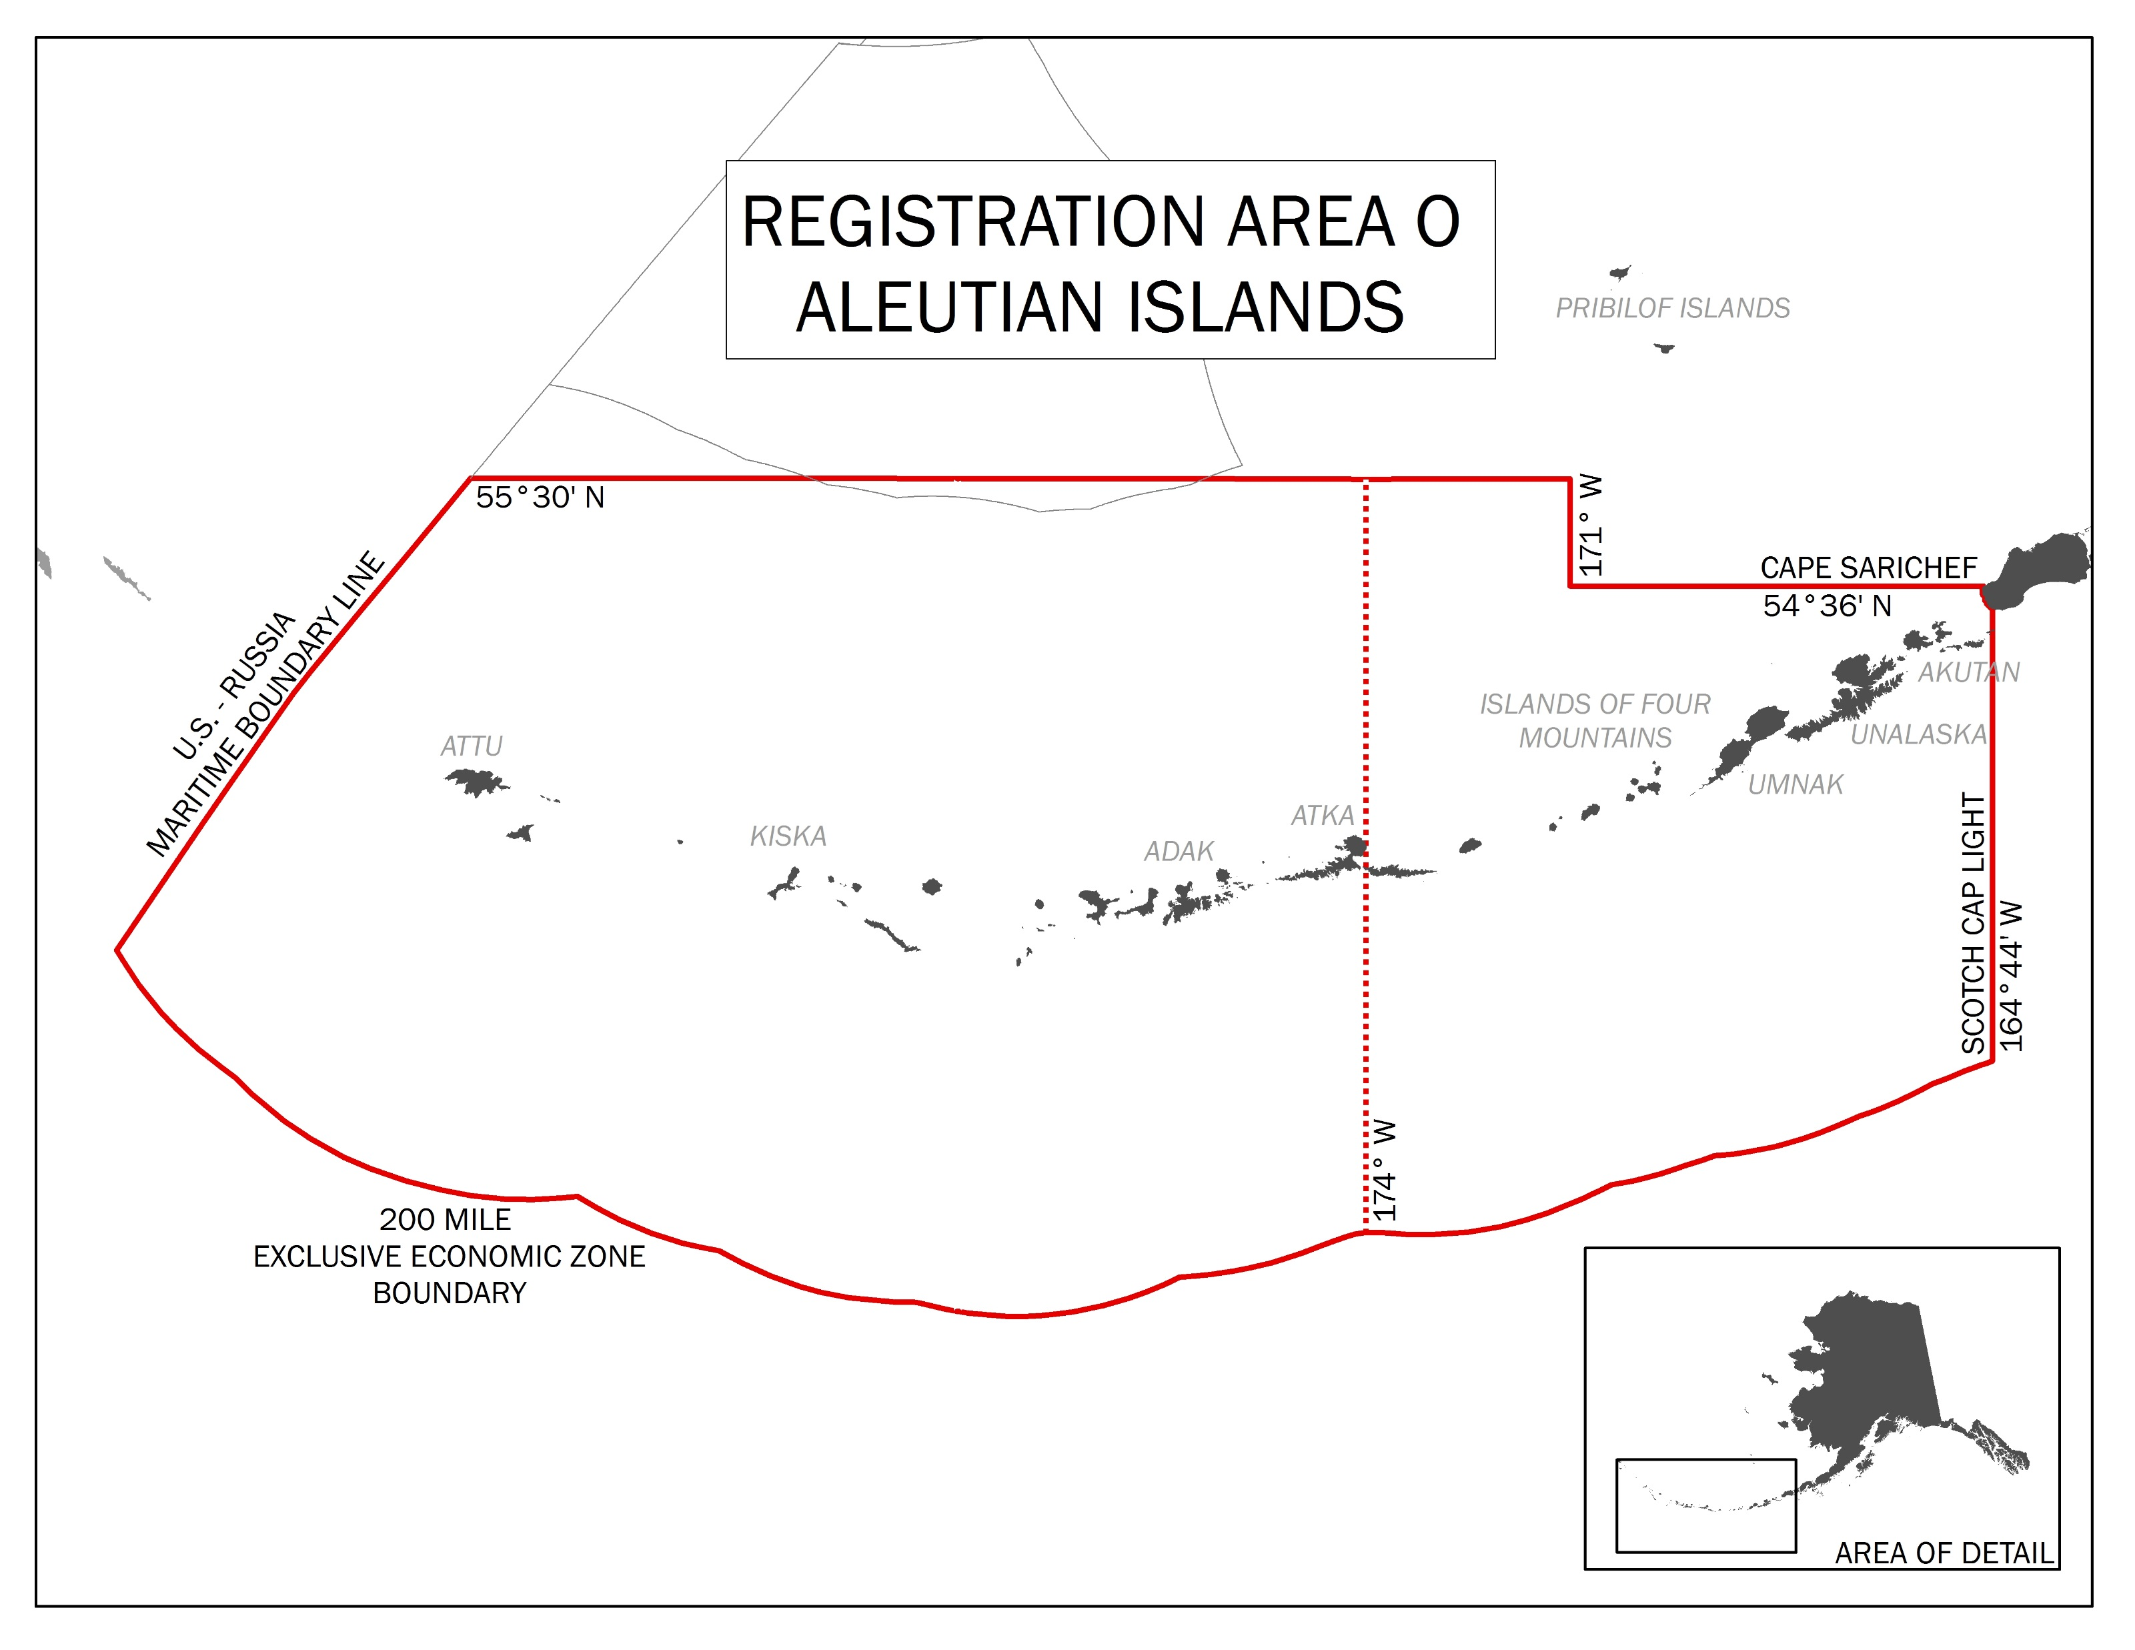
Western Aleutian Islands
Eastern Aleutian Islands
Notes:
The fishery occurs in Aleutian Islands king crab Registration Area O.
Aleutian Island golden king crab is considered one stock, but the fishery has been managed in two areas separated at 174° W longitude.
The stock segment east of 174° W longitude is referred to as EAG (i.e., “eastern Aleutian goldens”) and the stock segment west of 174° W longitude is referred to as WAG (i.e., “western Aleutian goldens”).

Slide 5
Current Fishery Management
Size: 6.0 inches carapace width (152.4 mm)
Sex: Male only
Season: August 1 to April 30
Managed east/west of 174° W longitude
Gear: pots (longline)
Harvest levels (total allowable catch; TAC) fixed in regulation
Small fleet: 5 vessels
Rationalized fishery
Notes:
Mention 5 boats in fishery, lots of stability, rationalized fishery

Slide 6
ADF&G Harvest strategy
The annual TAC is set by state regulation, 5 AAC 34.612 (Harvest Levels for Golden King Crab in Registration Area O), as approved by the BOF in March 2012:
(a) Until the Aleutian Islands golden king crab stock assessment model and a state regulatory harvest strategy are established, the harvest levels for the Registration Area O golden king crab fishery are as follows:
(1) east of 174° W long. (EAG): 3.31 million pounds; and
(2) west of 174° W long. (WAG): 2.98 million pounds;
(b) The department may modify the harvest levels based on the best scientific information available and considering the reliability of estimates and performance measures, sources of uncertainty as necessary to avoid overfishing, and any other factors necessary to be consistent with sustained yield principles.
*Prior to 2018, the word “reduce” was used
Notes:
The annual TAC is set by state regulation.
Section a states: “Until the Aleutian Islands golden king crab stock assessment model and a state regulatory harvest strategy are established…..”
Section “b” states…..
The word “modify” was adopted by the BOF before the 2018/19 fishing season to allow greater flexibility in TAC setting prior to the acceptance of a harvest strategy but when population abundance estimates from the accepted stock assessment model may suggest TAC increases are warranted.
Prior to this the harvest strategy allowed for TAC reductions, but not increases.

Slide 7
AIGKC stock assessment model
In development for nearly 10 years, accepted in 2017 by NPFMC for annual OFL and ABC determination
AIGKC considered 1 stock, managed as 2 areas: east (EAG) and west (WAG) of 174° W long.
  OFL and ABC calculated for each management area separately, then combined for a single stock OFL and ABC
Model-based abundance estimates now available
  Abundance estimates allow TAC to be scaled to stock status: better conservation, maximizes economic and social benefits
  No fishery-independent bottom trawl survey, no abundance estimates prior to model

Slide 8
Objective/purpose
Objective: Develop a state harvest strategy that allows for abundance-based TAC calculations
How can we balance the tradeoff between conservation and economic considerations?
Conducted 30-year forecast simulations to evaluate how thirteen different harvest policies affect stock sustainability and productivity by comparing conservation and economic criteria

Slide 9
Forecast simulations
What the analysis is:
  A tool used to estimate relative differences in population sustainability and productivity under different harvest policies
What the analysis is not:
  A crystal ball that tells us exactly what will happen over the next 30 years
Notes:
It is important to put this analysis in context.
We should think of the forecast simulations as a TOOL …….
The analysis is not a crystal ball…..

Slide 10
Forecast simulations
2018 base model (scenario 18_0)
Projected abundances for 30 years
  Evaluated short term (1-8 years) and long term (1-30 years) results
500 random replicates
Estimated:
  Mature males biomass (MMB)
  Mature male abundance (MMA)
  Legal male biomass (LMB)
  Overfishing level (OFL)
  Acceptable biological catch (ABC)
  Total catch (TOTC)
  Retained catch (RETC)
  Retained catch per unit effort (CPUE)
  Number of annual recruits
Then calculated probabilities of:
exceeding conservation thresholds,
meeting economic goals, etc.
Notes:
The forecast simulations use the 2018 assessment model base scenario, and project population abundances forward 30 years.
We then evaluated both short term (years 1-8) and long term (years 1-30) results.
Each simulation included 500 random replicates, so results (averages and probabilities) were the products of those replicates.
For each simulation, we estimated……

Slide 11
Dealing with uncertainty: sensitivity analysis
Population terminal year abundance: randomized by lognormal random error
Retained catch (implementation error): normal random error - the variability between the TAC and realized RETC during 1996/97-207/18 fisheries
Recruitment: parameter “best estimates” + low and high values
  Hockey stick SR model (4 parameters): slope, mean number of recruits, standard deviation, autocorrelation (*last two parameters varied)
  Ricker SR model (5 parameters): spr0 (spawning biomass per recruit at unfished equilibrium), R0 (number of recruits at unfished equilibrium), recruitment standard deviation, autocorrelation, steepness (*last three parameters varied)

Slide 12
Model scenarios
14 state Policies
1 Control (zero harvest)
5 ramps X 2 legal caps
2 special-case ramp (newly added 17.5% + 22.5%)
1 fixed rate (based on historical removals)
Hockey stick SR: 18 total scenarios per policy
2 recruitment + 1 catch implementation error parameters: recruitment stdev (R_sigma1), recruitment autocorrelation (R_rho1), stdev of implementation error on retained catch (C_sigma1)
Ricker SR: 54 total scenarios per policy
3 recruitment + 1 implementation error parameters: recruitment stdev (R_sigma1), recruitment autocorrelation (R_rho1), stdev of implementation error on retained catch (C_sigma1), steepness parameter (h)
1,008 scenarios per area!
=(14*18)+(14*54)
Each scenario projected 30 years with 500 replicates!
“Best estimates” for values recruitment parameter and implementation error values included (scenario 1 for each policy)
Other scenarios include low and high values as a “sensitivity analysis”
  Results suggest model simulations are robust to changes in values
  Focus on scenarios with “best estimate” values (i.e., scenario 1)

Slide 13
Evaluating State Harvest Policies
Management criteria: 2-tiered approach
Conservation
Overfished: probability that MMB < MSST
Overfishing: probability that RETC + bycatch_mort > OFL (and ABC)
Probability that MMB < B_{MSY}
Economic
Probability of fishery closure: MMB < 0.5MSST
Average retained catch (RETC)
Annual variability in retained catch
Probability that retained catch < historical mean catch
Probability that retained catch is within desired range
  EAG: 4 mill lb ± 20%; WAG: 3 mill lb ± 20%
Mean CPUE
Probability that CPUE < historical mean CPUE
Relative fishing effort (RETC/CPUE)
Stock status: Probability that MMA < MMA_{AVE}
  Indicator of where we are on the exploitation “ramp”
Notes:
In order to evaluate the state harvest policies, we used a 2-tier approach where we considered a set of conservation and economic criteria.
The really neat thing about this analysis is that we can look at multiple criteria, and assess the trade-offs between conservation and economic considerations.
The conservation criteria included:
Probability of the stock being overfished, the probability of exceeding OFL, the probability of exceeding ABC, the probability of MMB being less than Bmsy
The economic criteria included:

Slide 14
Harvest Control Rules
Notes:
We evaluated a total of 13 harvest policies, summarized here.
Each policy had three elements: 1) a threshold for opening or closing the directed fishery (MMA 25% of long term average), 2) an exploitation rate on mature male abundance, and 3) a maximum exploitation rate on legal male abundance.
We evaluated a range of exploitation rates from 10%-30%. The range was informed by historical fishing practices, which I’ll touch on in the next couple of slides.
We looked at 2 legal caps, these types of caps are common in BSAI crab harvest strategies. These two levels used here were informed by preliminary analyses. They generally didn’t impact these results of the simulations, so I wont focus too much on the legal caps here.
Policies 11 and 12, 17.5% and 22.5% ramps were “add-ons” as requested by the industry to help refine the recommendations.
We incorporated industry feedback and included policies 11 and 12 (17.5 and 22.5 ramps), to refine the analysis.
Policy 13 used a fixed exploitation rate, Policy 0 was a control: zero fishing.

Slide 15
* Includes 25% and 30% exploitation “caps” on legal male abundance
Notes:
This is a visual depiction of the sloping control rules. You can see the threshold for opening the fishery (25% MMAave). The slope or “ramp” reduces exploitation rate when the population abundance is low relative to the past, and is meant to act as an added layer of protection.

Slide 16
Historical TAC and MMB model estimates
Population abundances fluctuate
The TAC fixed in regulation
Notes:
This figure shows model estimates of mature male biomass and historical TACs in the EAG and WAG from 1996-2018.
While the TACs were fixed in regulation, there were some relatively small changes to the fixed levels during that period.
You can see that in both areas, MMB fluctuates over time, yet the TACs are relatively constant over time.

Slide 17
Estimates of historical exploitation rates
23%
15%
Exploitation rates have changed over time within the EAG and WAG
Exploitation rates have been consistently higher in the WAG vs the EAG
Notes:
We can compute the historical exploitation rates based on the actual historical TACS and the model hindcast estimates of mature male biomass.
Two points to emphasize here:
1. Because MMB fluctuated over time, yet the TACs were relatively constant, the estimated exploitation rates changed over time within each area.
2. The exploitation rates in the WAG were consistently higher than those in the EAG.
We are not trying to reinvent the wheel with the harvest policies. This fishery has had lots of stability, despite some fluctuating exploitation rates. Our polices that we evaluated fall within the historical ranges

Slide 18
EAG
Notes:
Of the different metrics we evaluated, I will focus on a few here. The full set can be found in the white paper.
I’ll show the EAG and WAG results separately.
This figure shows the short (years 1-8, in white) and long term (years 1-30, in black) probability of exceeding the area-specific OFL.
As a reminder, the OFL is part of the federal process that the state is bound to. The OFL is an important reference point. “Overfishing” occurs when total removals exceed the OFL.
Exceeding OFL is BAD, thus big bars are bad. So, we can use these results to eliminate policies that fail to meet conservation objectives.
Here, we can see that polices 5, 10, and even 12 are a bit too aggressive. We really need to stay under the federal OFL.

Slide 19
WAG
Notes:
The same set of results for the WAG. Policies 5, 10, 12, and 13 are a bit too aggressive.
Again, we use these results to start to eliminate certain policies for failing to meet conservation objectives.

Slide 20
EAG
Notes:
This figure is showing short and long term average retained catch in the EAG for each of the 13 policies.
In general, average retained catch increases with exploitation rate.

Slide 21
EAG
Notes:
This figure is also showing retained catch as a function of exploitation rate.
You can see that average retained catch increases with exploitation rate, but those increases are reduced at higher exploitation rates.
For example, doubling the exploitation rate does not correspond to doubling the retained catch.

Slide 22
WAG
Notes:
Average retained catch in the WAG. Again, increasing the exploitation rate increases the retained catch.

Slide 23
WAG
Notes:
However, like in the EAG, the relationship is not linear, as increases in retained catch taper off as you increase exploitation rates.

Slide 24
EAG
Notes:
In our discussions with industry, we found that total retained catch is not the only economic consideration. The power of this analysis is the ability to evaluate the economic tradeoffs. Its not necessarily ALL about big TACs, there are tradeoffs that are important to consider.
One of the metrics we looked at was relative fishing effort, as defined by RETC/CPUE (there's no units here, its simpley a relative scale), where small RETC with high CPUE yield low effort (i.e., the quota is caught quickly), where as high retained catch with low CPUE would yeild high effort (take longer to catch the quota).
We looked at the relative fishing effort of all the policies and it was apparent that double fishing effort does not correspond to double the retained catch.
There is likely a “sweet spot” that balances fishing effort and retained catch. We are aiming for a policy in that “sweet spot”.
We’ll talk about this more in a few slides, but I circled our recommended policy for the EAG in red, and you can see that this policy is in that “middle zone”.

Slide 25
WAG
Notes:
A similar pattern exists in the WAG, were fishing effort must increase fairly dramatically to gain modest additional amounts of RETC.
The three recommended policies are circled in red here, to show how they fall relative to the others.

Slide 26
Decision Matrix
Distill the conservation and economic risk metrics into a single decision table based on policy ranks
Notes:
I mentioned that we evaluated a suite of conservation and economic metrics, and were evaluating the trade-offs.
We distilled those metrics into a single “decision matrix” by grouping those metrics into 3 broad categories: conservation, catch, and catch stability. (shown here)
We ranked the policies for each metric and averaged the ranks, so that all of this information could get captured in a single table.

Slide 27
EAG: Decision Matrix
Notes:
This is the decision matrix for the EAG, its is broken down for both short and long term results, and shows policy ranks within each category.
Green indicates ranks 1–4, orange indicates ranks 5–9, and red indicates ranks 10–13. In each category 1 is always good, 13 is always bad.
This table is meant to be a tool that is trying to allow the decision makers to see those tradeoffs.
I’ll talk about this more in the next few slides, but our recommended EAG policy, policy 3, falls in the middle in all three categories (as indicated by orange color).
I think this is important to highlight: ADFG is not endorsing the most conservative, and industry is not endorseing the moist aggressive. As such, this moderate policy liklkey optimizes the conservation and economic tradeoff.

Slide 28
WAG: Decision Matrix
Notes:
This is the decision matrix for the WAG, set up the same way.
Again, I’ll take about this in the next few slides, but our recommended policies are “moderate” in all three categories, which may imply that this reaches a balance between the conservation and economic considerations.

Slide 29
Summary: EAG
The 30% and 22.5% ramps (both L caps) are aggressive with moderate/high probability of exceeding OFL
  Moderate probability to being overfished (i.e., MMB<MSST) under some recruitment scenarios
The 17.5% and 20% ramps (25% L cap) and 15% fixed (No L cap) have moderate/high probability of exceeding ABC
The 10% and 12.5% ramps are “safe” (low probability of exceeding conservation thresholds) but may not optimize yield
The 15% ramp (with either the 25% or 30% legal cap) is likely the best trade-off between meeting conservation objectives and optimizing yield
  Moderate levels of conservation risk
  Simulations predict TACs around 3.7 mill lbs with moderate annual variability (~10-12%) without high increases in fishery effort relative to the 10% and 12.5% ramps
  Approximates historic exploitations rates
Notes:
In this process, we used a process of elimination, where we ruled out the policies that failed to meet conservation objectives.
Then we looked at the most conservative policies and ruled those out for not optimizing yield.
The results is the more moderate policies.

Slide 30
Summary: WAG
The 30% and 22.5% ramps (both L caps) and the 23% fixed rate is aggressive with moderate/high probability of exceeding OFL
  Moderate probability to being overfished (i.e., MMB<MSST) under some recruitment scenarios
All policies with 15% ramps or higher have high probabilities of exceeding the ABC
The 10% and 12.5% ramps are “safe” but may not optimize yield
The 15%, 17.5%, and 20% ramps (with either legal cap) likely the best trade-off between meeting conservation objectives and optimizing yield
  Increasing conservation risk within the 15%-20% range
  Predicted TACs are similar (2.6-2.7 mill lb)
  Annual catch variation is similar
  TACs will likely flirt with area-specific ABC
    Simulation results are sensitive to how bycatch mortality is estimated
  Relative fishing effort has to increase dramatically for modest catch increase
Notes:
In the WAG, we approached the recommendation the same way…….

Slide 31
ADF&G Recommendation
EAG: 15% ramp with a 25% legal cap
WAG: 15%, 17.5%, or 20% ramp with a 25% legal cap
Notes:
I glossed over the legal caps because they didn’t impact the results in any meaningful way.
We feel that the lower (25%) legal cap and the ramped control rule (as opposed to the fixed rule, policy 13) provides additional protection while balancing economic considerations.
In our conversations leading up this meeting, stakeholders endorsed this recommendation in the EAG.
In the WAG, we feel any of these 3 policies meets conservation objectives.
We looked closely at how the combined retained catch in EAG and WAG fair relative to the combined OFL and ABC. Assuming policy 3 in the EAG simulations suggest that any of these 3 policies in the WAG would yield combined EAG+WAG values below the combined OFL and ABC.
The department recommends against ay policy that exceeds 20% in the WAG.
The department feels any of these 3 policies provides adequate protection for the conservation of the stock.
But there are some economic differences across these three options that may be important to the industry, so the dept. defers to the board to establish a final recommendation.

Slide 32
BOF Final Action
EAG: 15% ramp with a 25% legal cap (Policy 3)
WAG: 20% ramp with a 25% legal cap (Policy 4)

Slide 33
Regulatory Language

Slide 34
March 2020 BOF Meeting
Proposed season date changes:
Current dates: August 1 – April 30
Proposed dates: March 1 – October 31
  This means a shift in the assessment cycle:
  New cycle:
  AIGKC model scenarios discussion by CPT at September meeting
  Final OFL/ABC recommended by CPT at January meeting
  Final OFL/ABC adopted by SSC/Council in February
  TAC setting in February

