Slide 1
Modeling size at age for BSAI northern rockfish
Paul Spencer

Slide 2
Outline
Current method of modeling size at age
Spatial and temporal variation in size at age
Updated methodology of modeling size at age, accounting for spatial differences in growth curves
Results
  Modeled size at age
  Age compositions

Slide 3
How are size at age data used in the assessment?
Convert modeled numbers to biomass
Produce age compositions

Slide 4
Current method of modeling size at age
The age-length key is based on all age samples from the AI trawl survey for a given year. (Otoliths sampled from AI subareas do not reflect spatial differences in population abundances).
The estimated survey length composition is applied to the age-length key, and mean size at age and age compositions are obtained.
A “global” estimate (i.e., all years, all AI areas) of the weight-length relationship is used to convert length at age to weight at age.

Slide 5
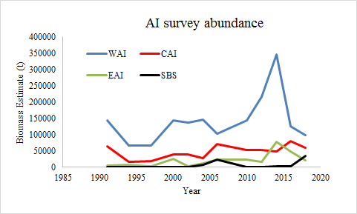
Current method of modeling size at age
Current method weights the otolith data by the spatial differences in otolith sample sizes, which does not reflect spatial differences in abundances

Slide 6
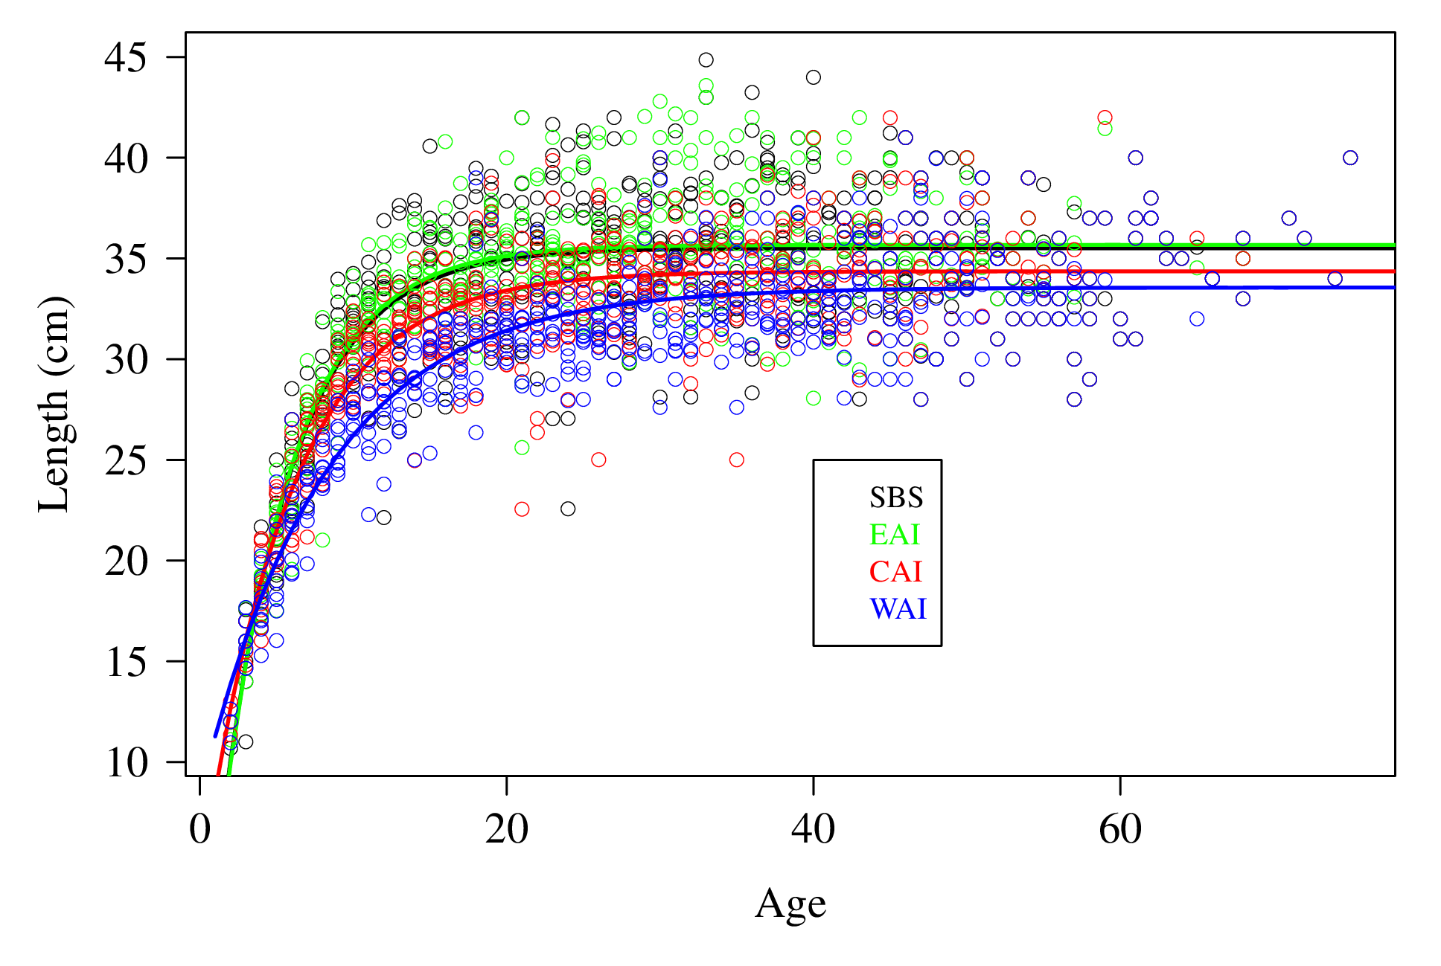
Estimated size at age (1991 – 2016)

Slide 7
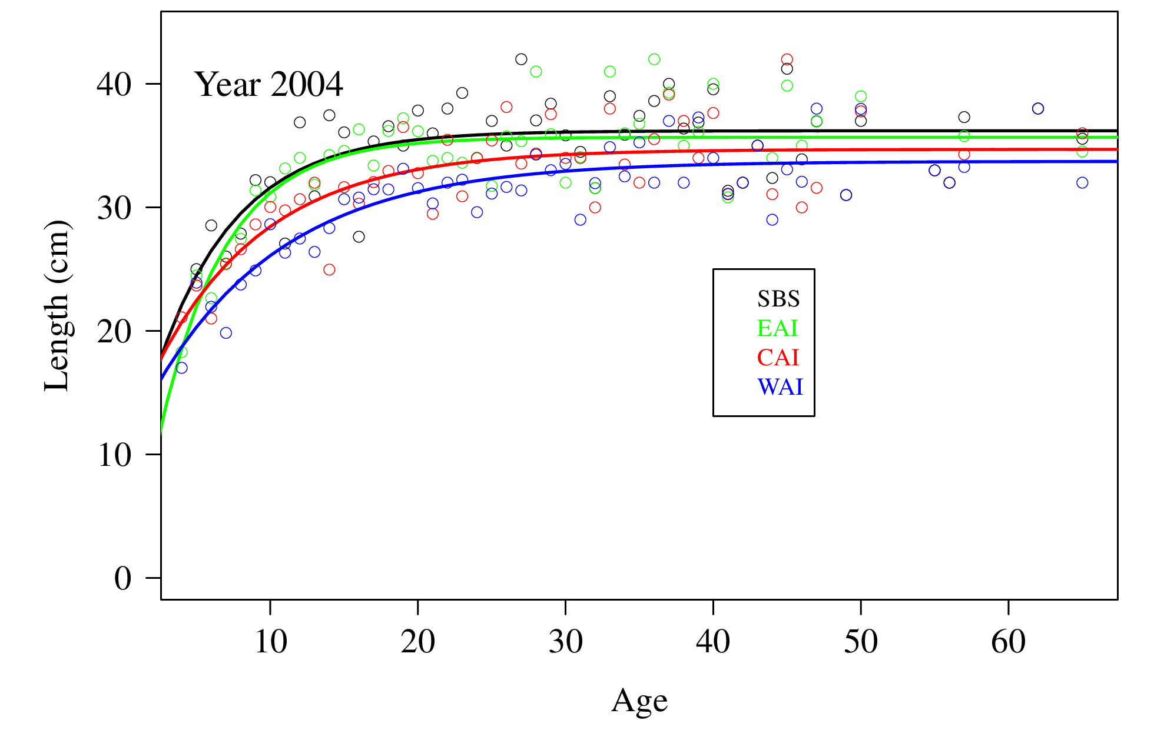
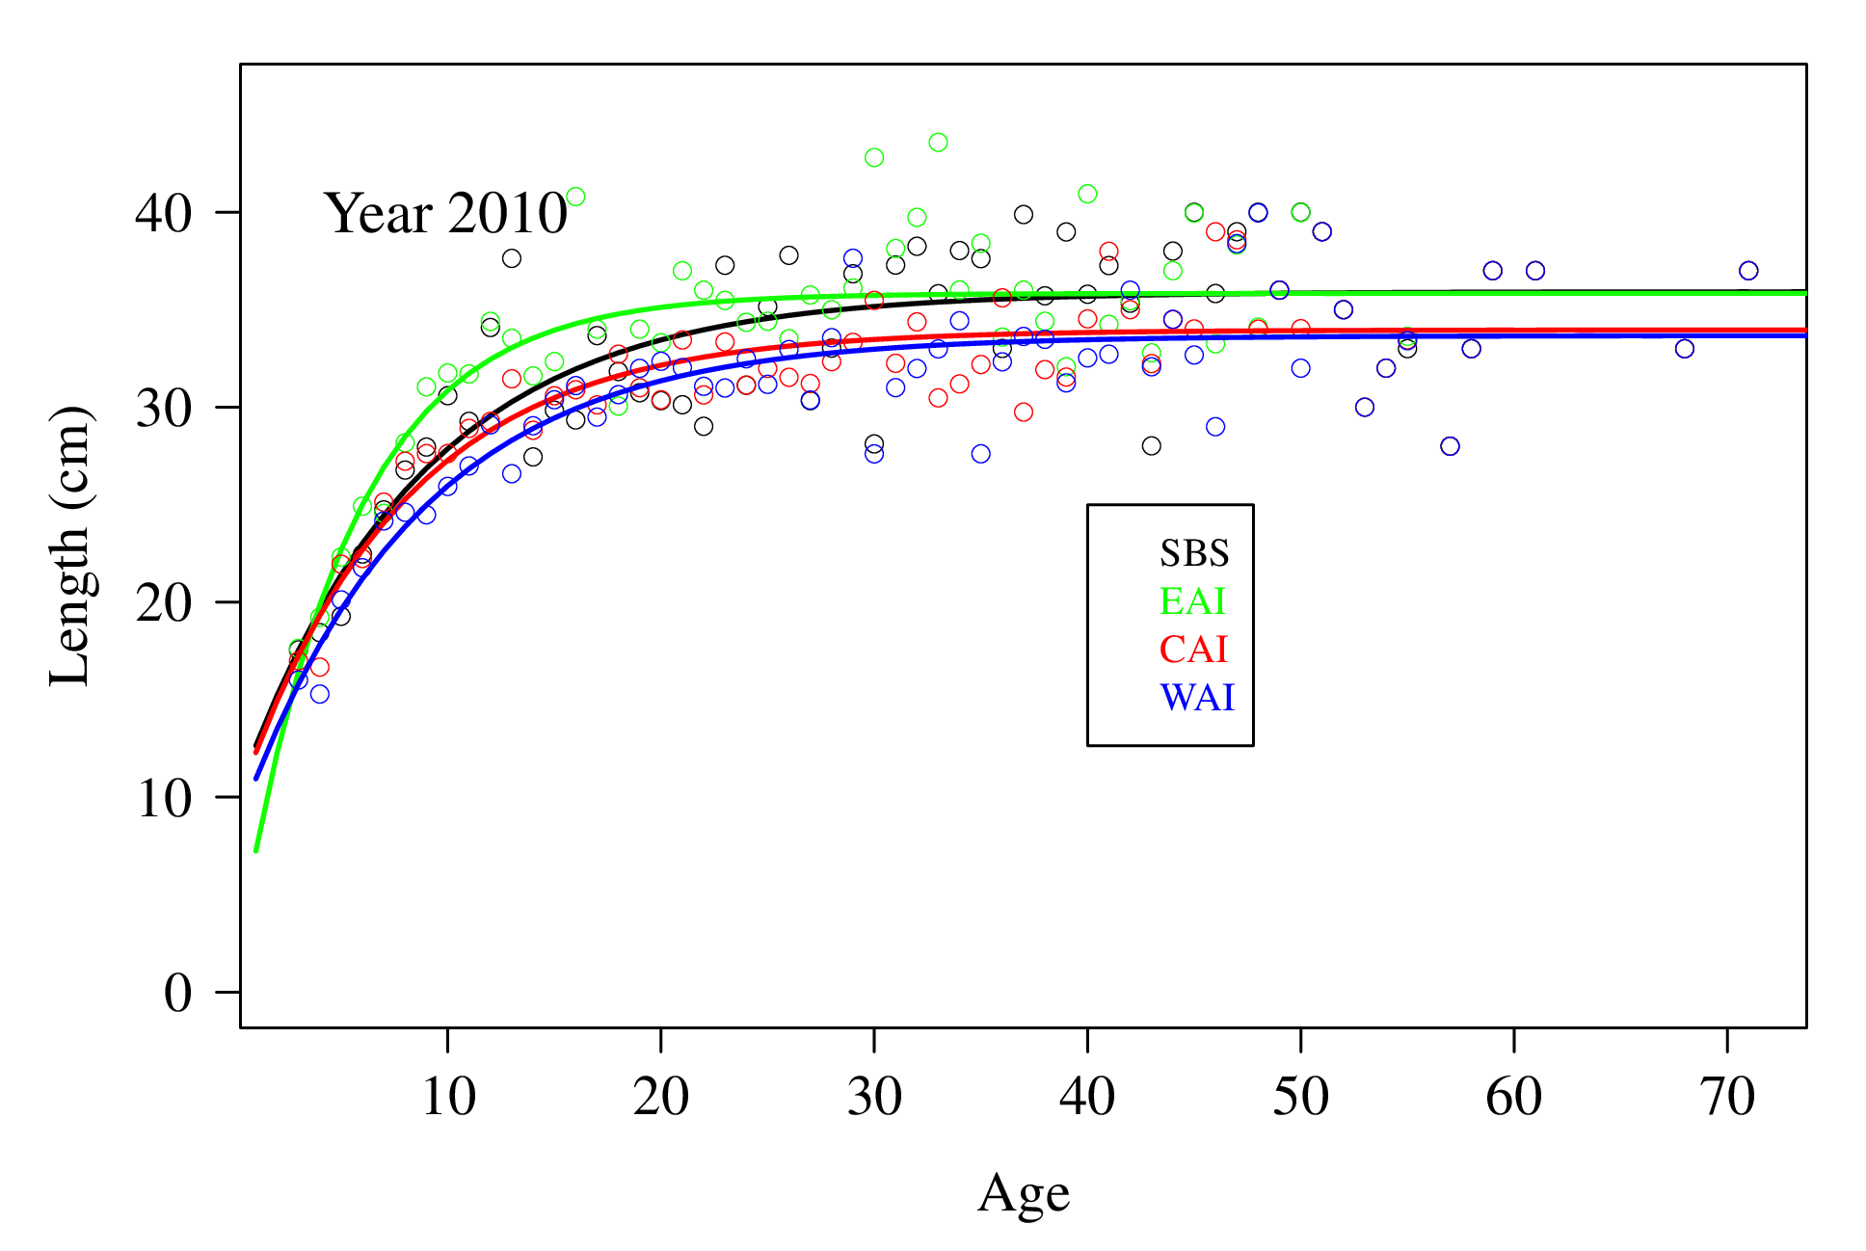
Estimated Size at Age, Specific Years

Slide 8
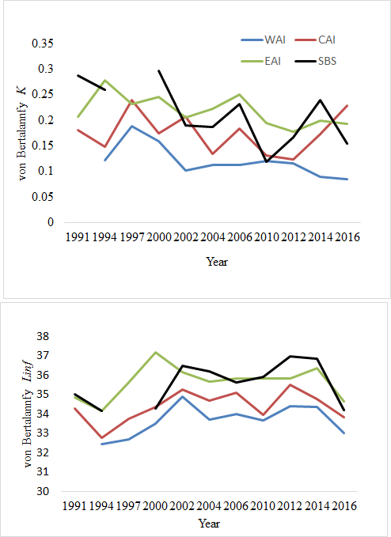
Estimates of VB parameters, by year and area

Slide 9
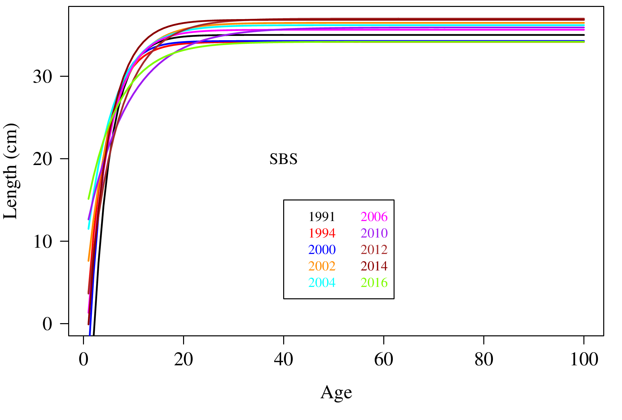
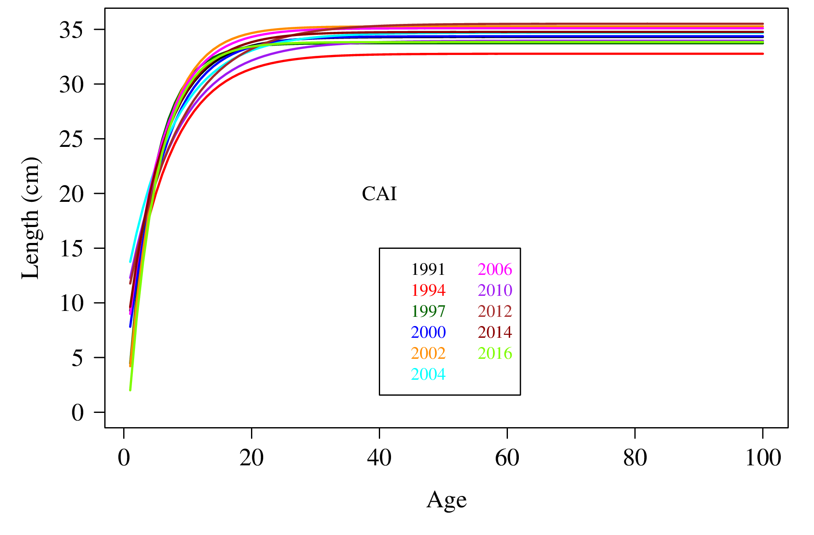
Little practical differences between years, within areas

Slide 10
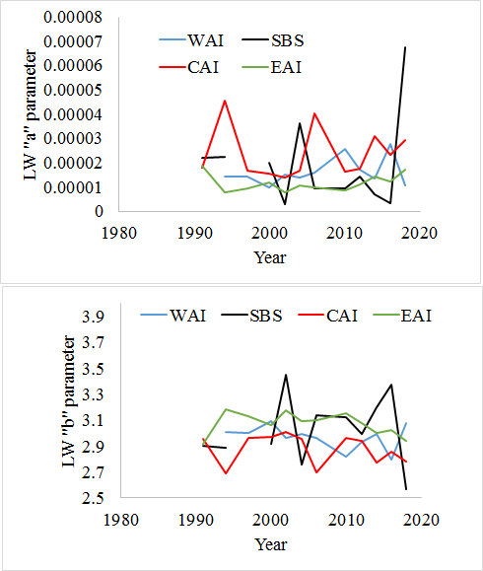
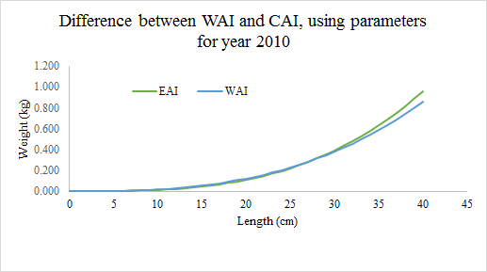
The estimated “condition” also varies spatially
W = aL^{b}

Slide 11
Proposed method
For each year and area, compute the mean length at age and the age composition using the area-specific age length key.
Estimate weight at age for each area using all years of estimated mean lengths at age and length-weight data
Calculate an average weight-at-curve for each year, and age composition, weighting by the estimated survey numbers by spatial area

Slide 12
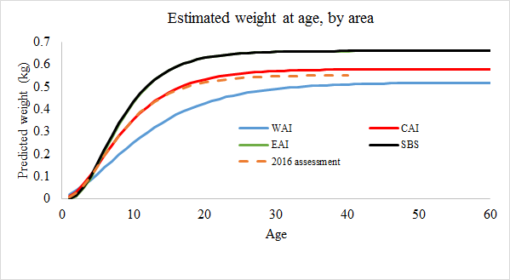
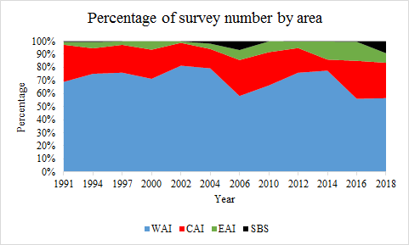
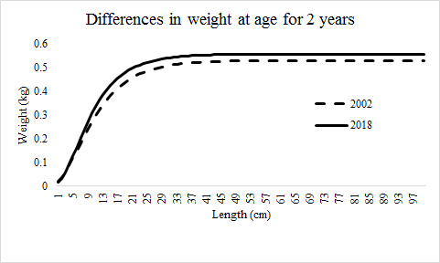
Demonstration of Calculation

Slide 13
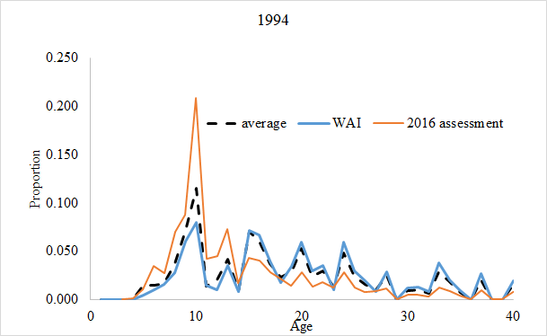
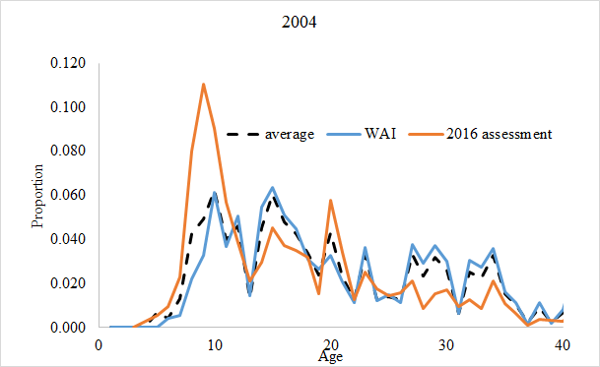
The effect on estimated age compositions

Slide 14
Questions?

