Slide 1

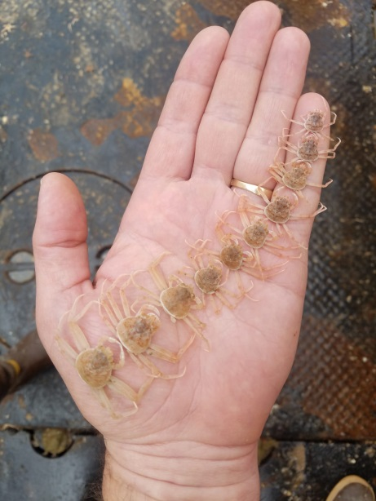
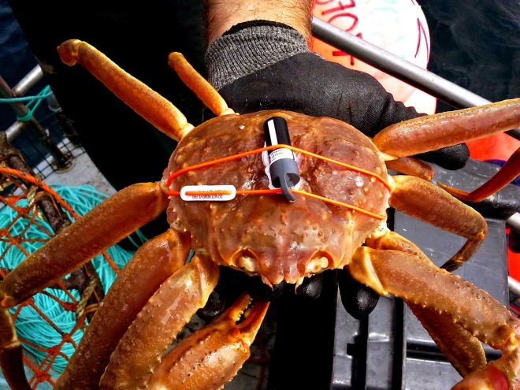

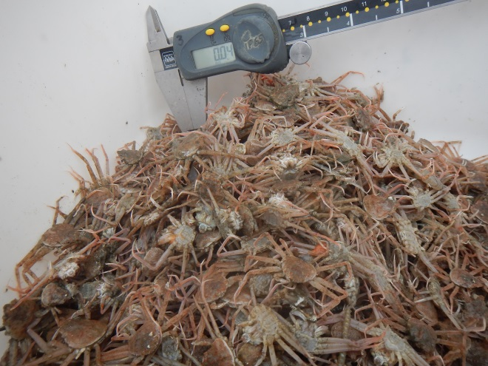
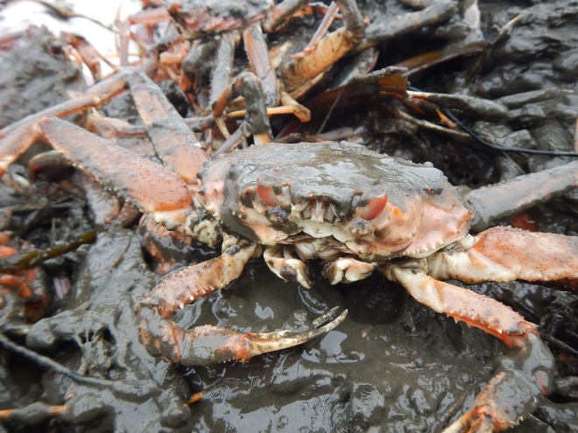
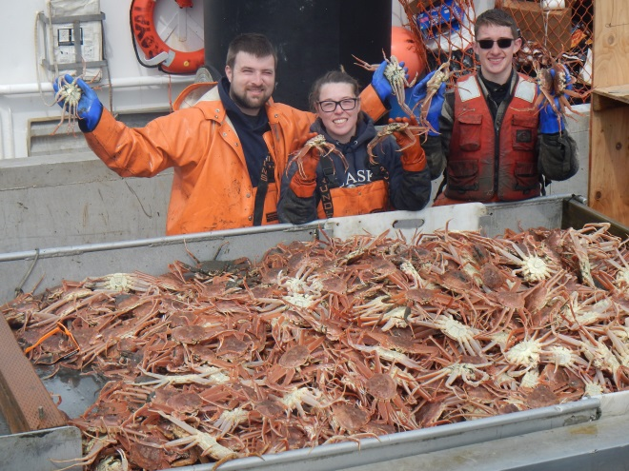
BSFRF Research Update - 2019
Scott Goodman | Executive Director
CPT Anchorage | 04.30.19
Scott Goodman, BSFRF

Slide 2









BSFRF Research
Post-Doc
Research/Support
Bycatch Reduction
Research
Pre-recruit
Surveys
Ocean Acifification
Research
Life History
Research
Trawl Selectivity
Research
Stock Assessment
Support
Bairdi Trawl Index
Area Sampling – final yr
Movement Research
Tagging RD & Support
Crab Aging
Research
Growth Project
Sampling OPI/BRD
HS Collaboration
MSE Project Status
Discard - Handling
Mortality
Natural
Mortality
High Resolution
CPUE Data
Develop New
Co-op Partners
Who We Are…
Harvesters - Processors
Cooperative Research Partners

Slide 3
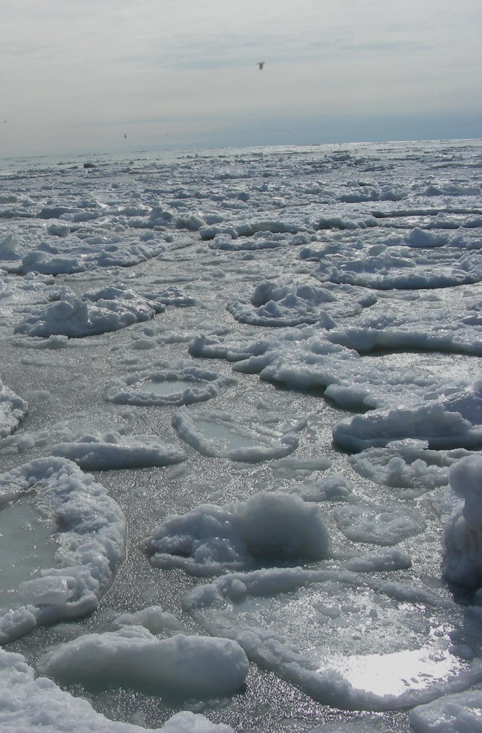

BSFRF Research Update - 2019
Growth studies / sampling update
Movement research / tag RD and project support
Spatial research / trawl index area sampling
Management support / bairdi MSE project update

Slide 4

Growth Studies – Sampling Update
Bering Sea Sampling History
April 2019 Sampling
2011 Opilio Focus
2012 Opilio Focus
2013 Opi/Bairdi Focus
2015 Opilio Focus
2017 Opi/Bairdi Focus
2019 Opi/Bairdi Focus
F/V Half Moon Bay
Nephrops trawl <4 m/tow
6 days total, 4/7-4/12
464 study crab retained
Brd 113/132, Opi 100/119
Special boat ride to KOD
<50 at sea mortalities
4/17 @ KOD – crab condos
Fill gaps / increase samples
About 35 so far…

Slide 5
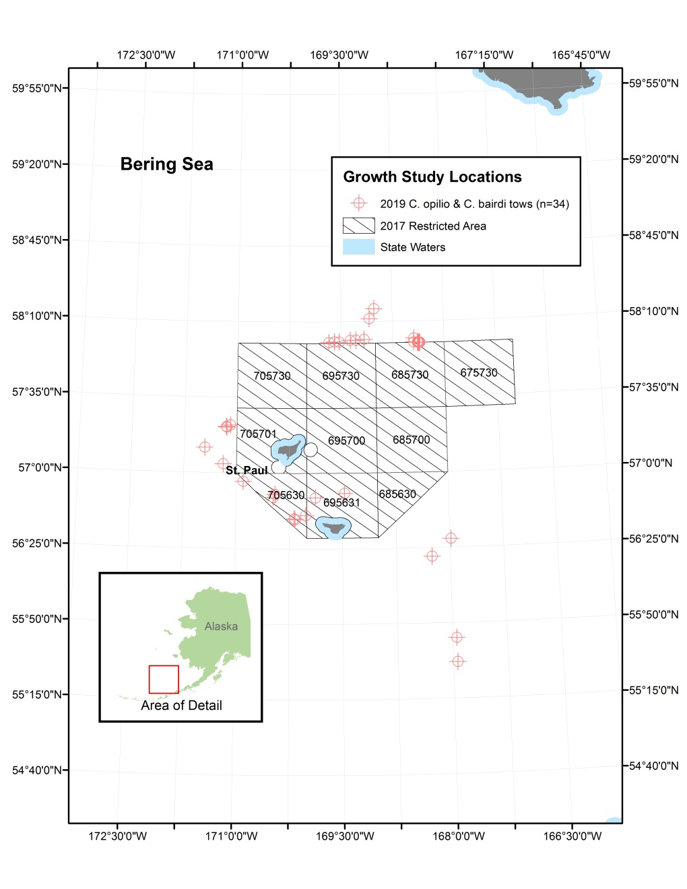
Growth Studies – Sampling Update
Highlight ability to
combine objectives
“Adding Projects”
OPI growth data
BRD growth data
OPI condition samples
OPI black eye samples
OPI <10 mm OA samples
Pollock juv. tissue samples

Slide 6
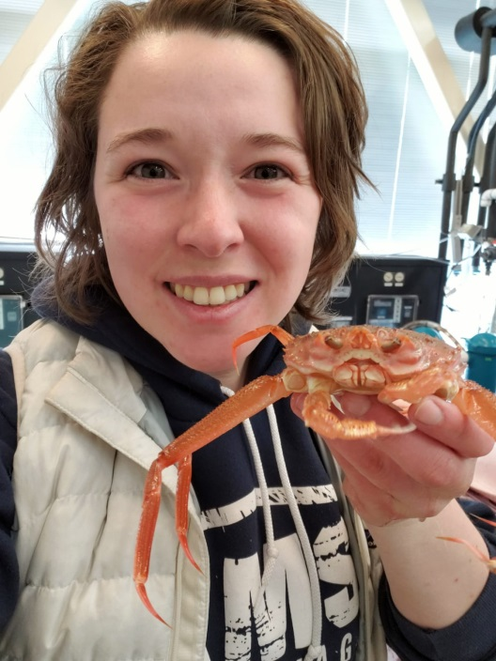
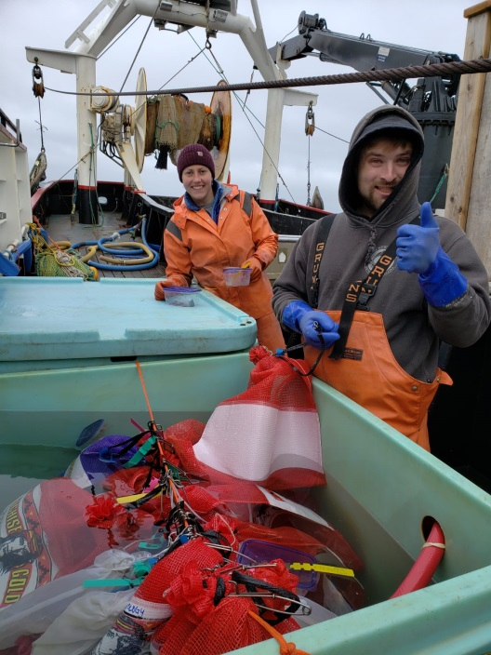
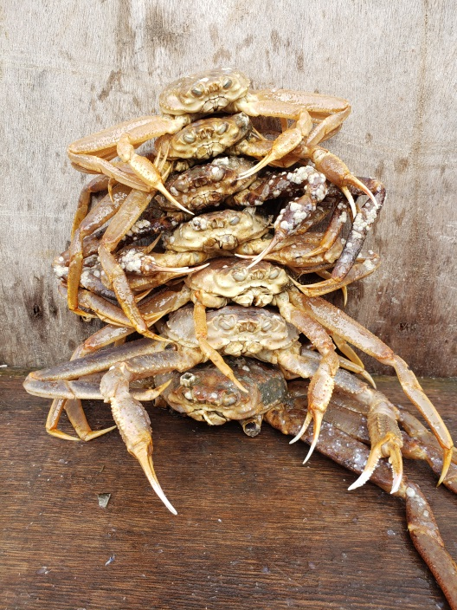
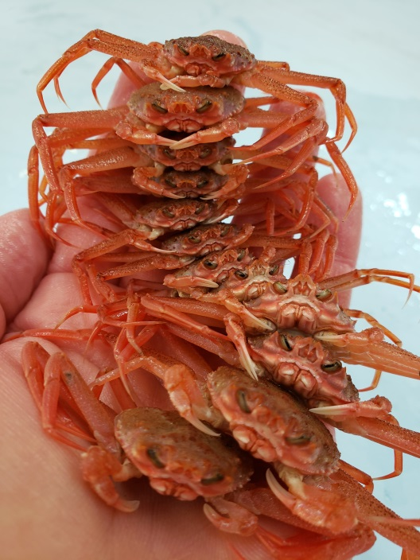
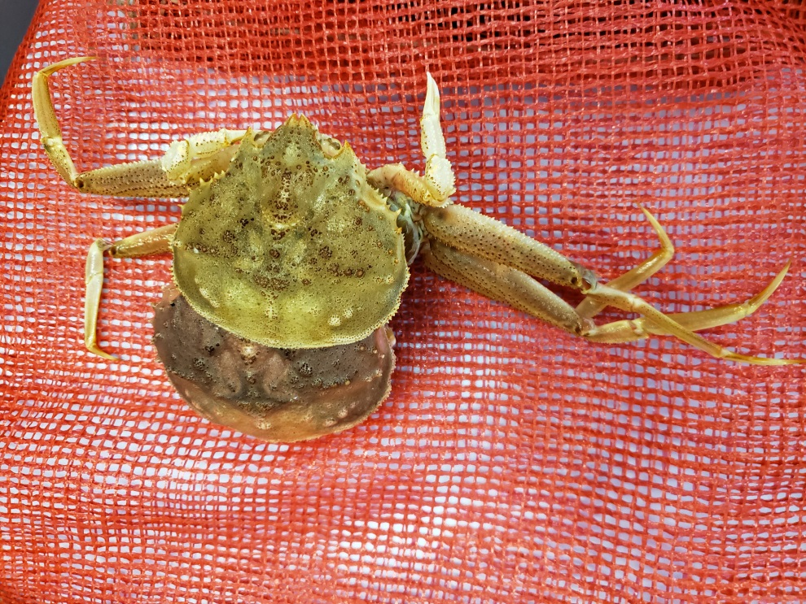
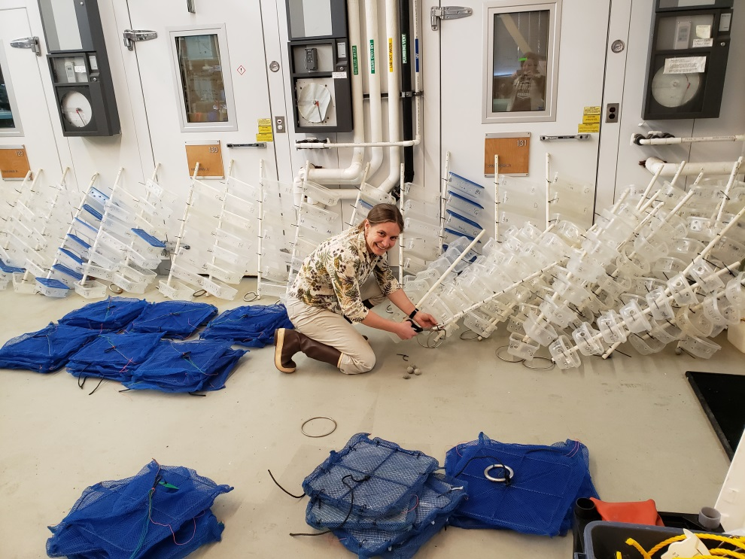
Growth Studies – Sampling Update

Slide 7
Movement Research – Tagging Crabs
Traditional Approach – Current Tech/Focused Project
  Balancing effort on tags released and recovered
  Overcoming challenges of low recovery
  Leveraging existing resources and tech
New Approach – Tags R&D, Acoustics /Focused Project
  Focusing on acoustic tech for maximizing “recovery”
  Getting more than 1 sample “ping” per recovery
  Leveraging existing resources and tech
  Multi-year remote sensing methods

Slide 8
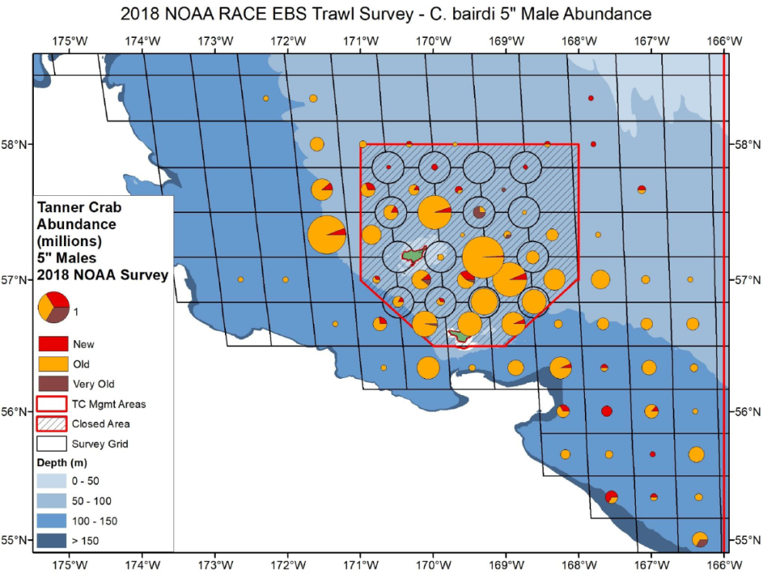
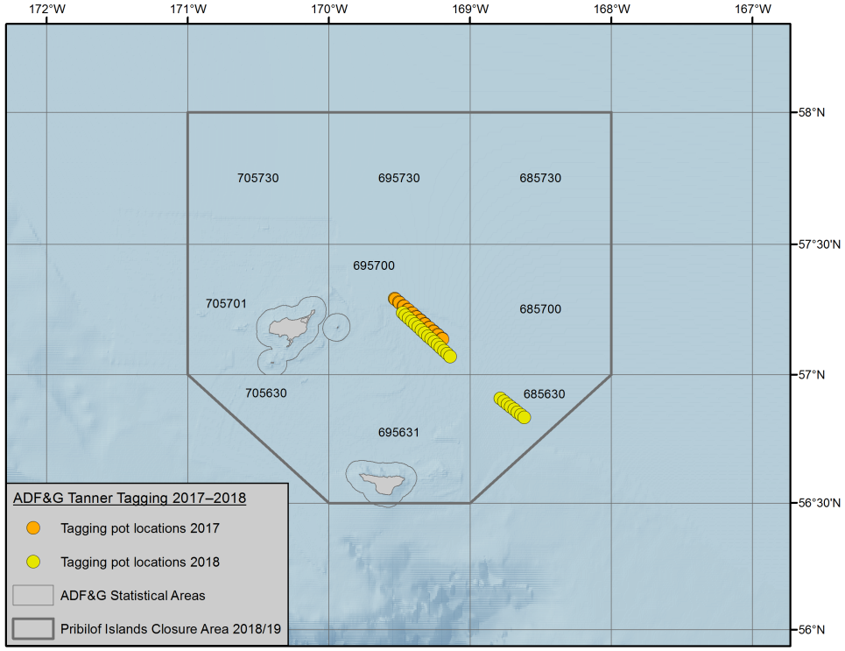
Movement Research – Tagging Crabs
Traditional Approach – Current Tech/Focused Project
  Balancing effort on tags released and recovered
  Overcoming challenges of low recovery
  Leveraging existing resources and tech
  Limited scale but potentially high impact results

Slide 9
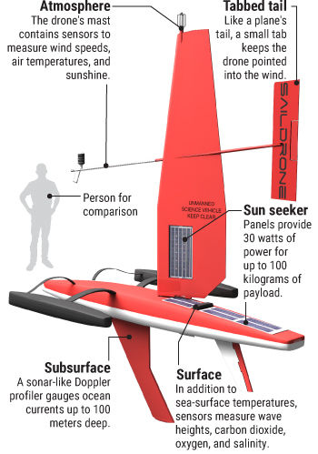
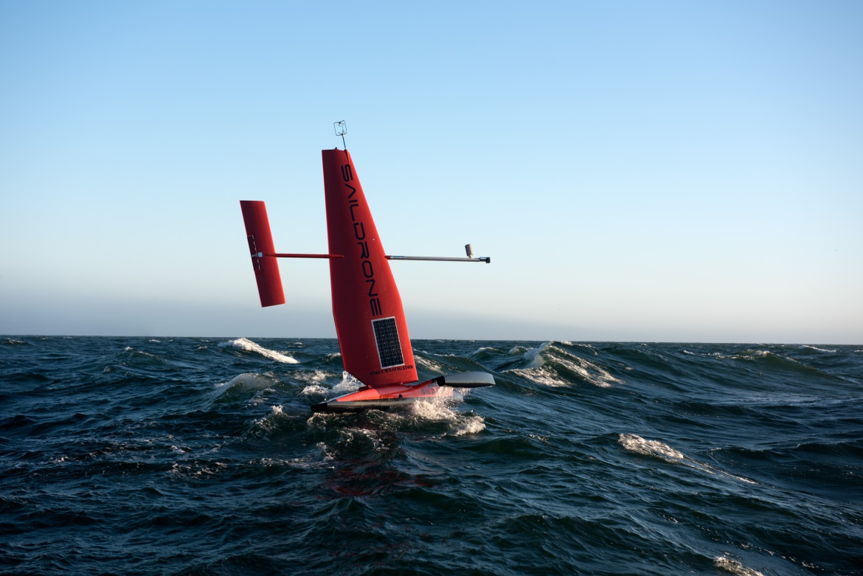
Movement Research – Tagging Crabs
New Approach – Tags R&D, Acoustics /Focused Project
  Focusing on acoustic tech for maximizing “recovery”
  Overcoming challenges of low recovery
  Leveraging existing resources and tech

Slide 10

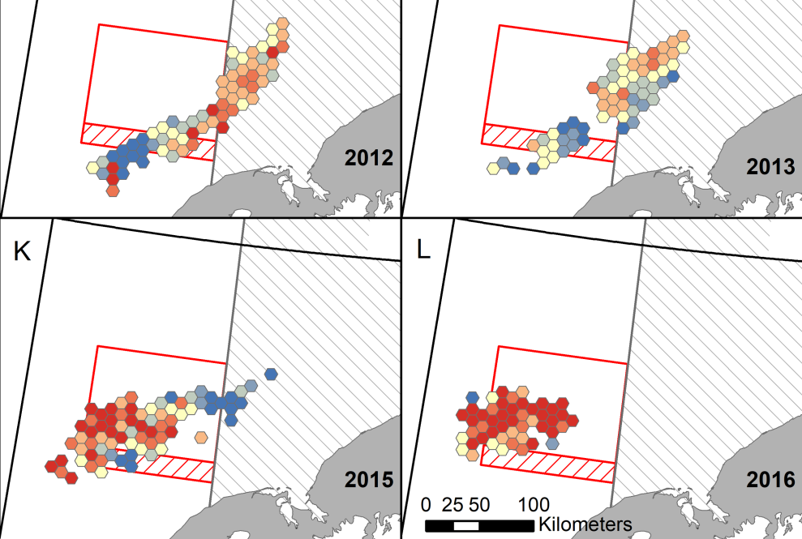
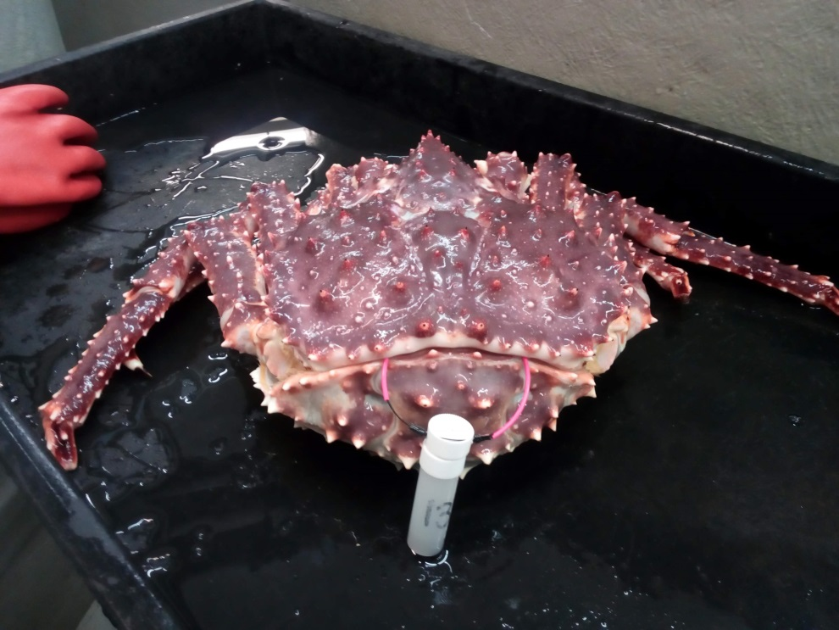
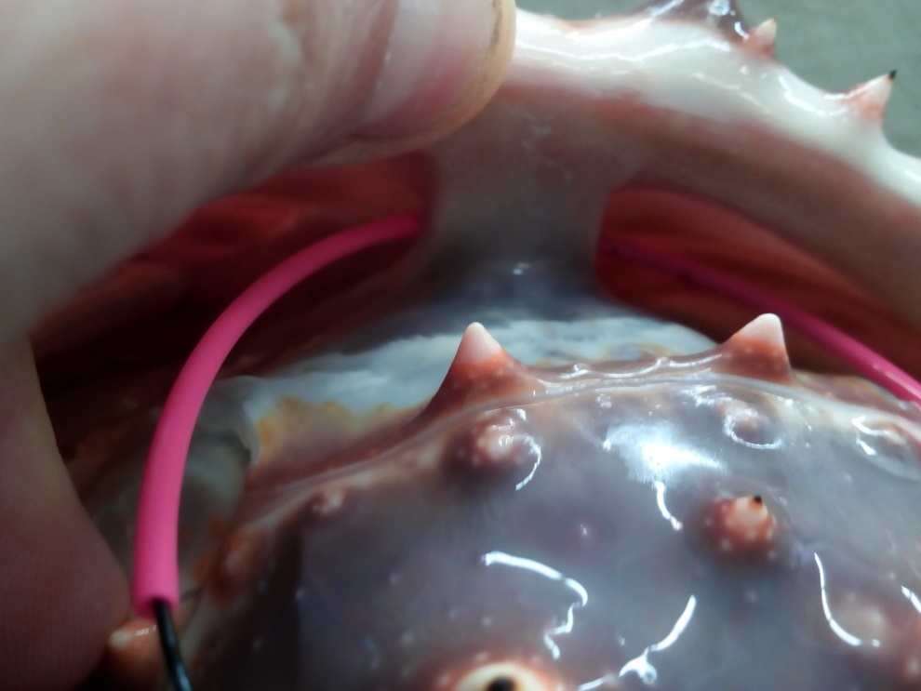
Movement Research – Tagging Crabs

Slide 11
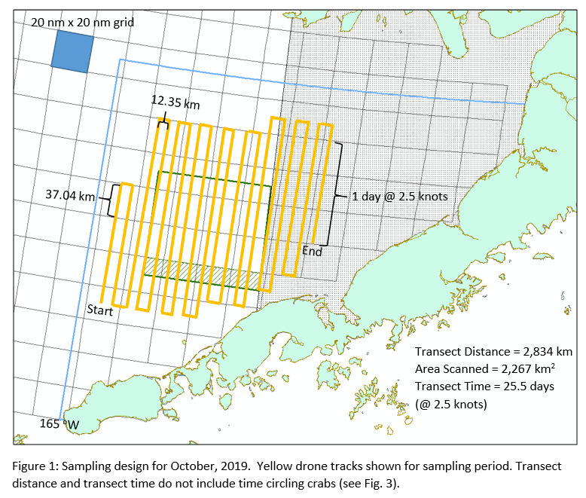
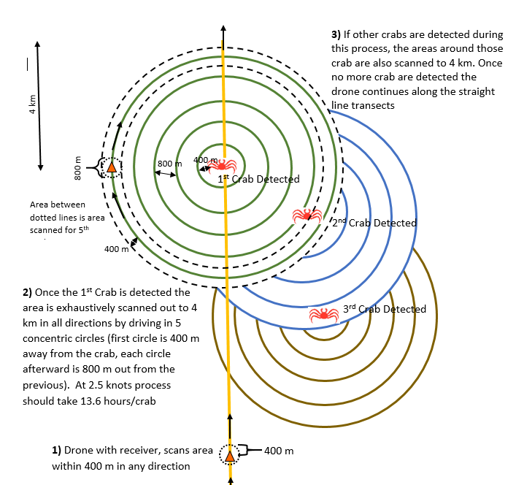
Movement Research – Tagging Crabs
New Approach – Tags R&D, Acoustics /Focused Project
  Focusing on acoustic tech for maximizing “recovery”
  Shifting to new paradigm on resources and tech

Slide 12
Movement Research – Tagging Crabs
New Approach – Tags R&D, Acoustics /Focused Project
  Locating RKC for tag and release
  Coordinate with NMFS survey – and Fall fishery?
  High survey catch was “8” LGM, fishery was < 5m lbs
  Deploy drones (2x) Oct 1-15, 2019
  Monitor progress, pings, ocean, weather, etc.
  Redeploy drones Mar-Apr 2020 to relocate crabs
  Hope to monitor same group of 150 crabs right before fishery occurs and then in winter
  Progress to more tags released in following years if acoustic reception concept for crab tracking is +
  Shift to movement other Bering Sea crab stocks

Slide 13
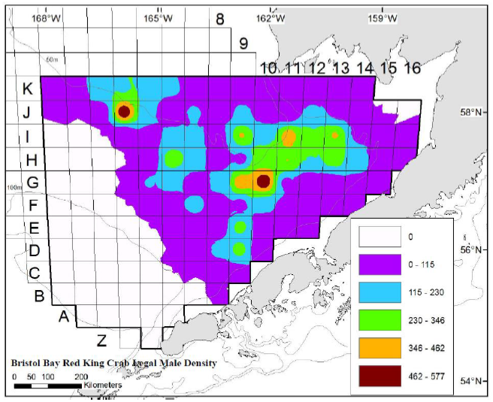
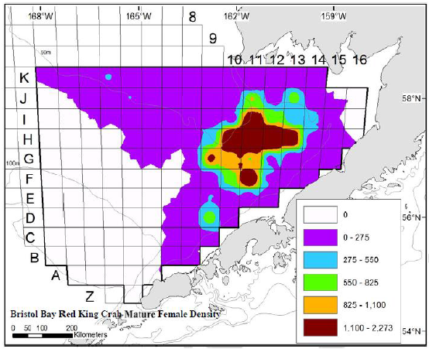
Movement Research – Tagging Crabs
New Approach – Tags R&D, Acoustics /Focused Project
  Locating RKC for tag and release
  Coordinate with NMFS survey – and Fall fishery?
  High survey catch was “8” LGM, fishery was < 5m lbs

Slide 14
Spatial Research / index area sampling
Focused on index area sampling in high abundance juvenile area for bairdi, some overlap with opilio
Objective: capture third year snapshot of high abundance as selectivity/growth/mortality data
One survey vessel chartered v. two from prior years
Jun 5 – Jun 27 sampling period, earlier by 7-10 days
Index sampling occurs “off center” in 4 quartiles of NMFS standard stations, semi randomly
Sampling follows prior methods w/ Nephrops trawl
Data to be included with prior years’ index area sampling – provided to and considered by the bairdi assessment model, ultimately

Slide 15
Spatial Research / index area sampling
Quick review on side by side v. index survey sampling

Slide 16
Bairdi Trawl Selectivity 2018 – Expanded Side by Side

Slide 17
Bairdi Trawl Selectivity 2017 – Expanded Side by Side

Slide 18
Bairdi Trawl Selectivity 2018 – Expanded Side by Side

Slide 19
Bairdi Trawl Selectivity 2017 – Expanded Side by Side

Slide 20
Spatial Research / index area sampling
2017, 2018, and 2019 index area, what we are planning

Slide 21
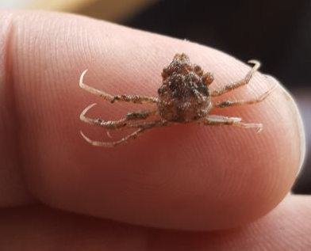
Bairdi Trawl Selectivity 2017/18
Two Surveys – Selectivity & Index Areas
2017
2017
Juvenile bairdi (5 mm wide) BSFRF index surveys
2018
2018

Slide 22
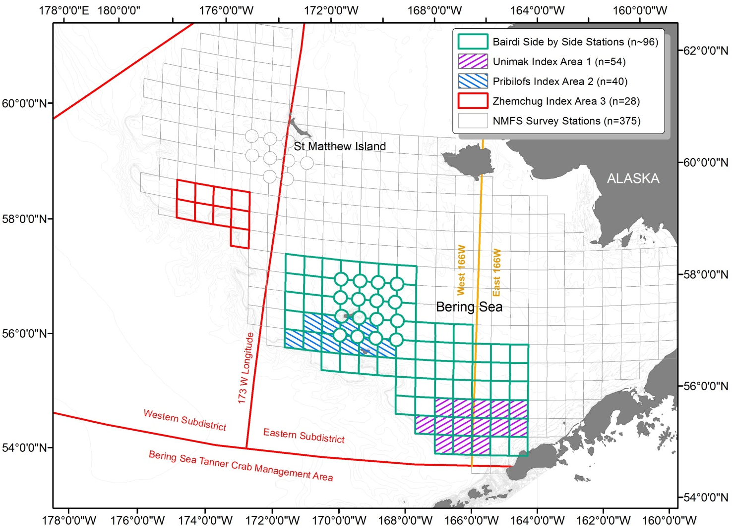
Bairdi Projects – Planned for 2017-2018

Slide 23
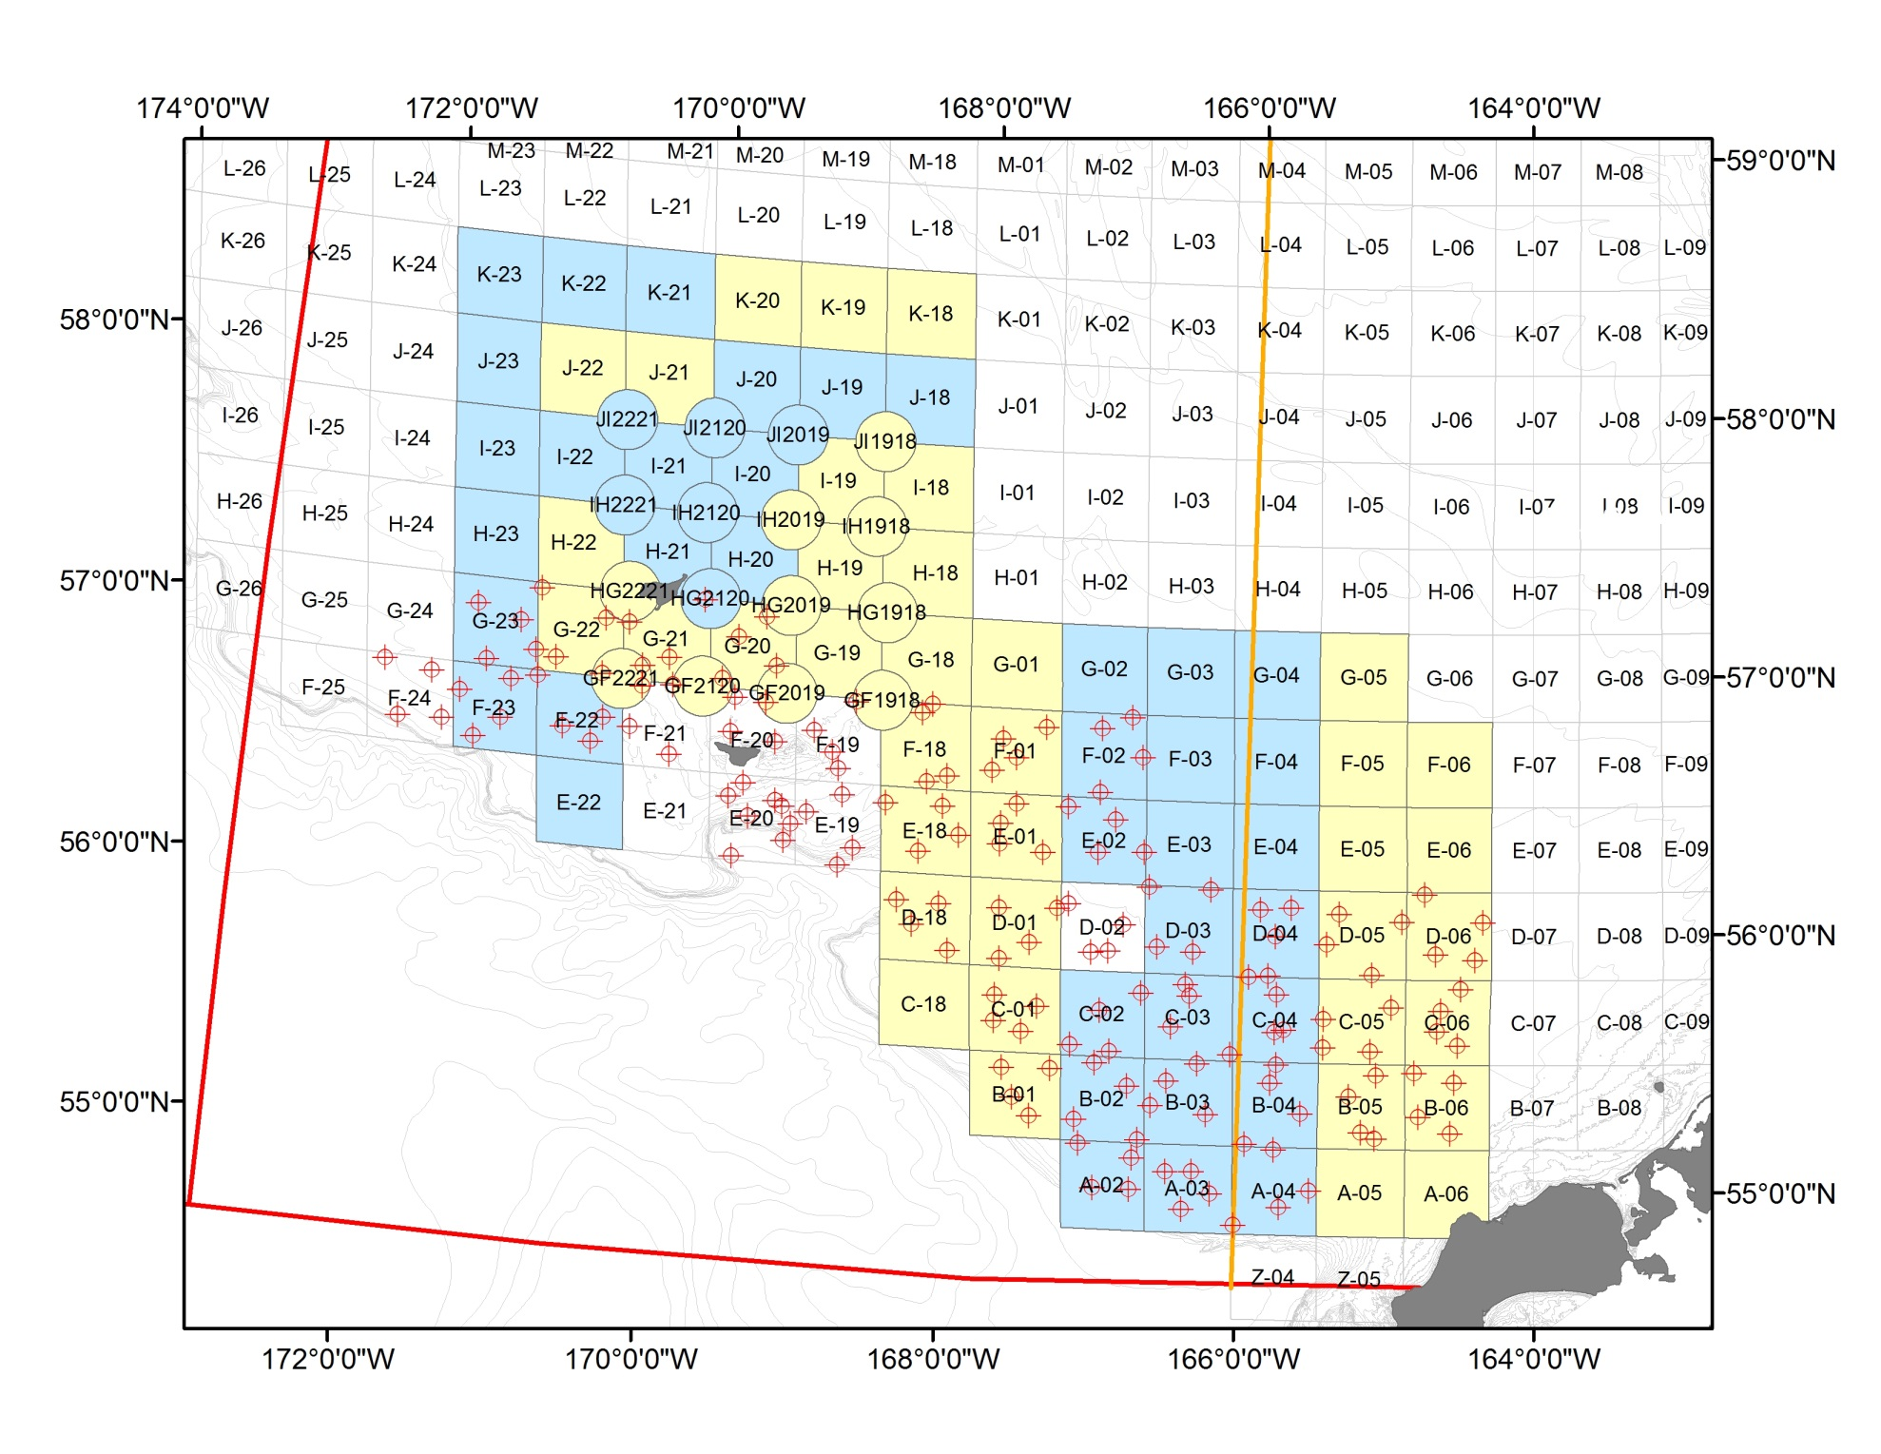
Bairdi Survey Stations – Actual 2017

Slide 24
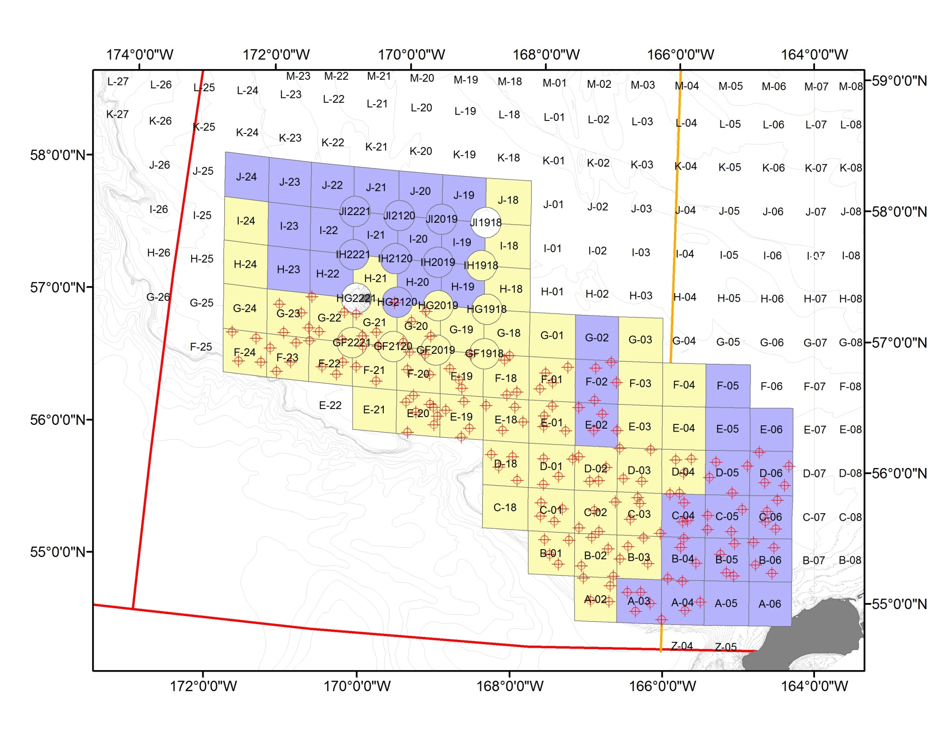
Bairdi Survey Stations – Actual 2018

Slide 25
Combined objectives June 2019
Index area sampling early, given timing window
Switch to pots for capture of BBRKC (n=150)
Tag, release, detect acoustic tags (test in June)
Capture/retention of crab for other studies
  Condition/lipids
  Live holding crab for gear/bycatch research

Slide 26
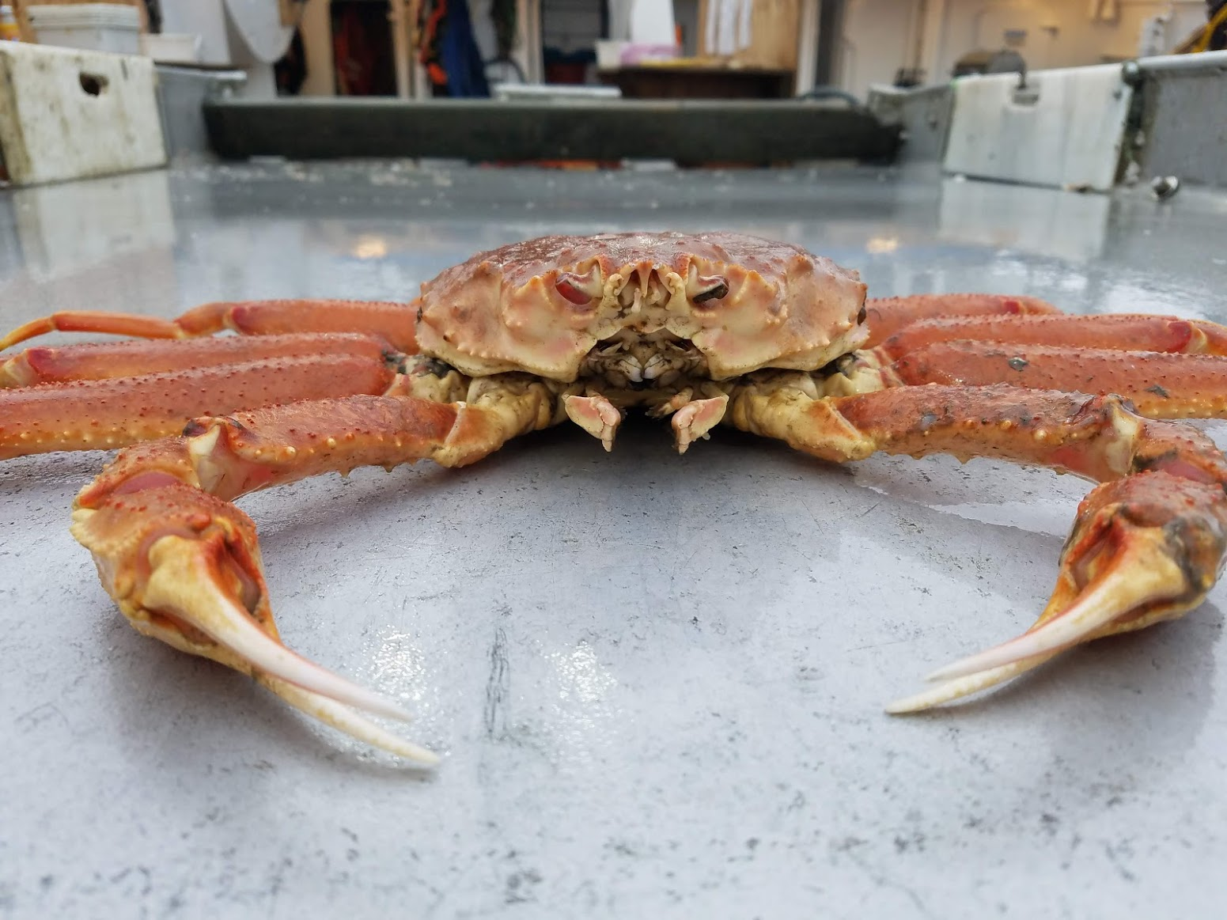
Tanner Crab MSE Update
Madison Shipley
Master’s Research
January CPT 2019

Slide 27
Schedule
Winter 2019
Update Operating Model and Run Simulations
Spring 2019
Analysis and Preliminary Results and Write Up
Apr. 2019
Framework Place Holder for Board of Fish
Sep. 2019
Presentation of Results to ADFG and CPT
Sep. 2019
White Paper Full Draft
Mar. 2020
Selected HCR Presented to Board of Fish

Slide 28
BSFRF Research Update - 2019
Scott Goodman | Executive Director
CPT Anchorage | 04.30.19
Scott Goodman, BSFRF

