Slide 1
B_{MSY} recruitment or survey time periods by crab stock
May CPT
5/2/2019
Coast Hotel, Anchorage

Slide 2
Consistency across stocks or individual productivity analyses?
Previously default is full time period of data absent analyses otherwise
Should all assessments include a consideration of the appropriate productivity period over which to evaluate B_{MSY}?
What about environmental conditions and co-variates?

Slide 6
PIBKC
1980/81-1984/85 and 1990/91-1997/98 represent production potential of stock
Previous consideration of different time periods but have not been adopted

Slide 7
2010 SAFE (no model) Bmsy based on 1969-1980
High and low periods of stock
(stock declared overfished)
Model developed in conjunction with rebuilding analysis
2012 model accepted and CPT requested analysis of alternative recruitment periods
Andre additional breakpoint analysis led to selection of 1990-current (= breakpoint in 1985 for recruitment in 1990)
When did we move to 1982-on?
Tanner Crab

Slide 8
Snow crab
1982 – end year -1 (same with Tanner)

Slide 9
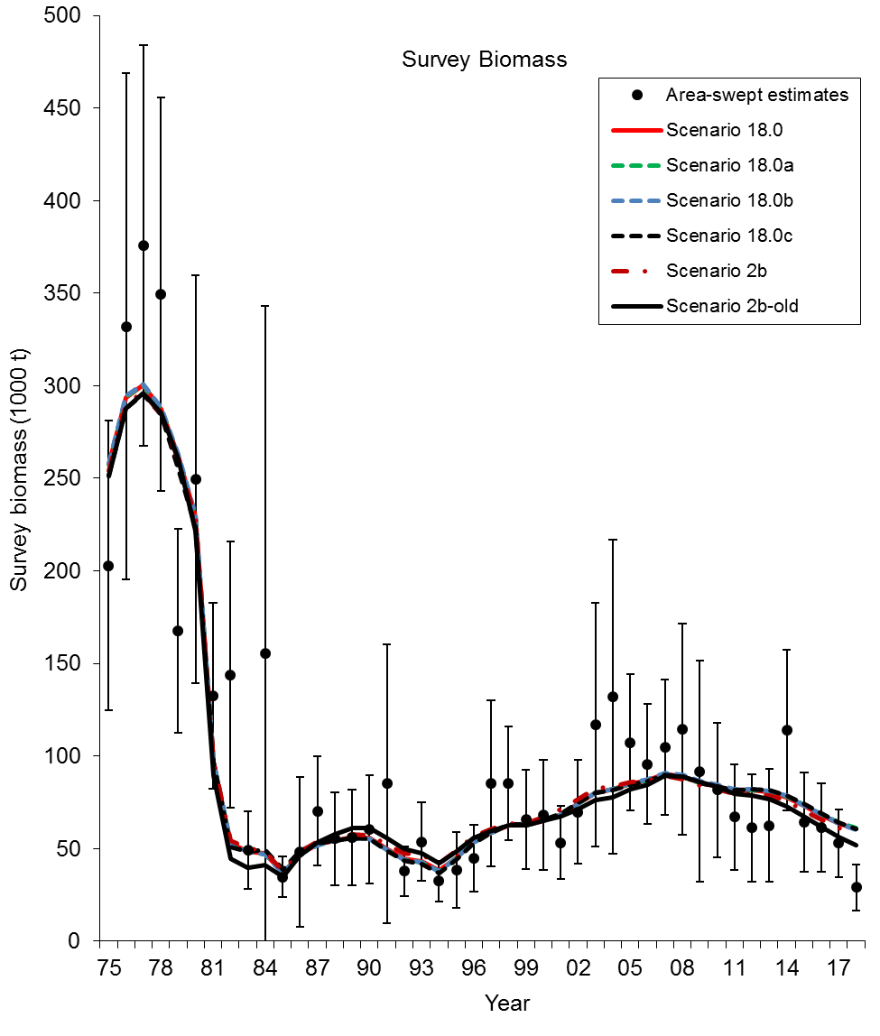
BBRKC
2011 change to Bmsy years after Jie’s breakpoint analysis shows change in productivity following 1977 regime shift and thus recruitment beginning in 1984

Slide 10
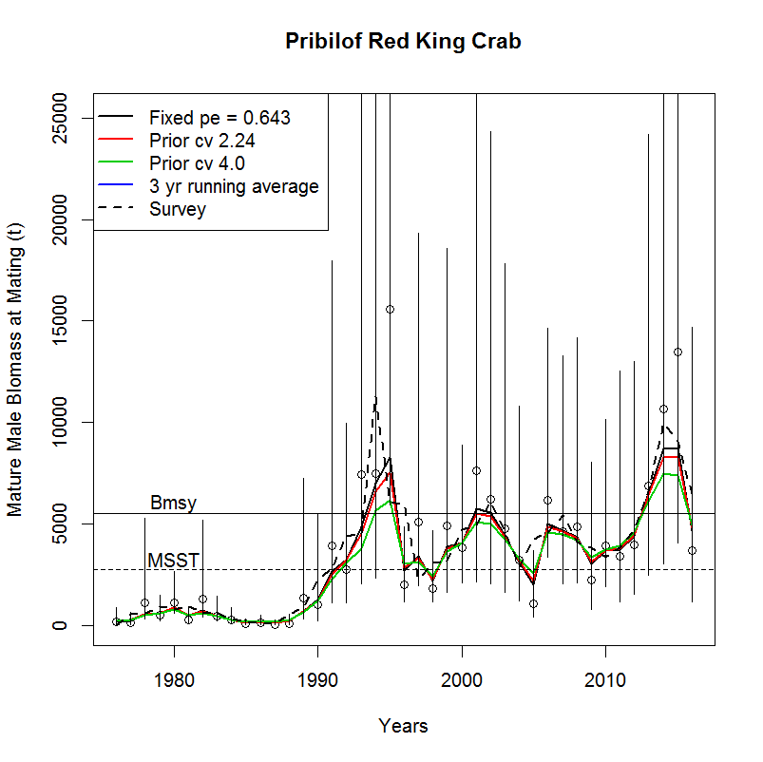
PIRKC
1991/92- 2017

Slide 11
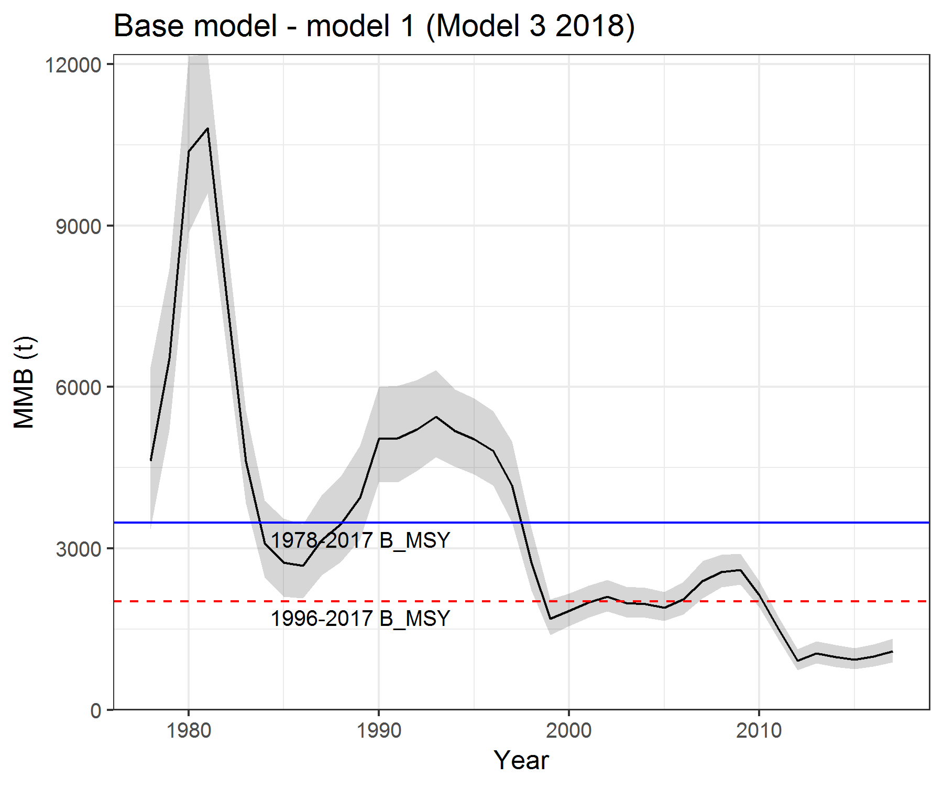
SMBKC
1978-2017 full time series

Slide 12
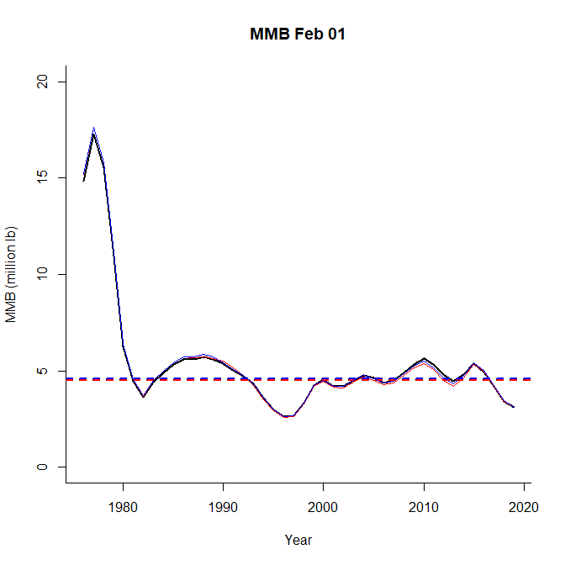
NSRKC
1980-2019
Avoid very high pre-1980
But why most current year included?

Slide 14
Consistency across stocks or individual productivity analyses?
Previously default is full time period of data absent analyses otherwise
Should all assessments include a consideration of the appropriate productivity period over which to evaluate B_{MSY}?
What about environmental conditions and co-variates?

