Slide 1

Council Communication Group
May 22-23, 2018
Sitka, Alaska
Notes:
Test notes

Slide 2
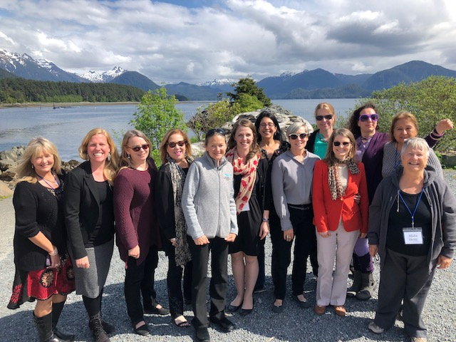
CCG
Diana Martino, CFMC
Alida Ortiz, CFMC
Jennifer Gilden, PFMC
Sandra Krause, PFMC
Emily Muehlstein, GMFMC
Sylvia Spalding, WPFMC
Maria Shawback, NPFMC
Peggy Kircher, NPFMC
Mary Sabo, MAFMC
Janice Plante, NEFMC
Kim Iverson, SAFMC
Cameron Rhodes, SAFMC
Notes:
Two main goals: 1. sharing information, best practices effective procedures and technologies, 2. how we can best promote the RFMC and educate those we serve

Slide 3
Communication tools and procedures

Slide 4
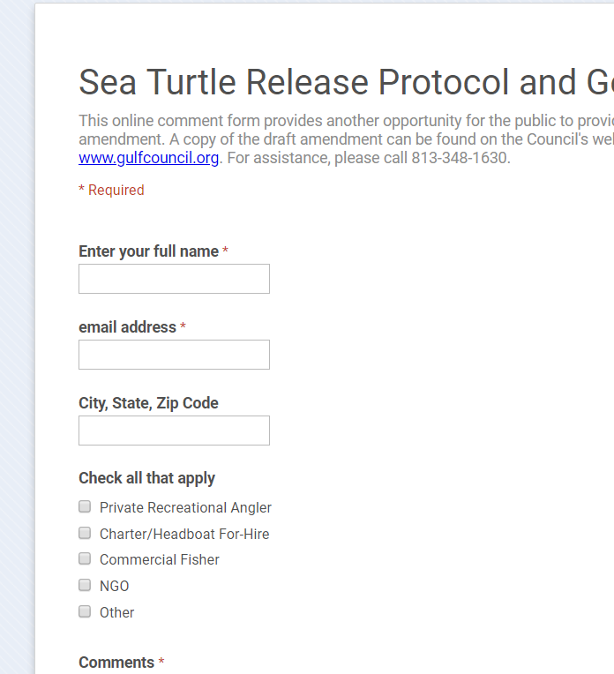
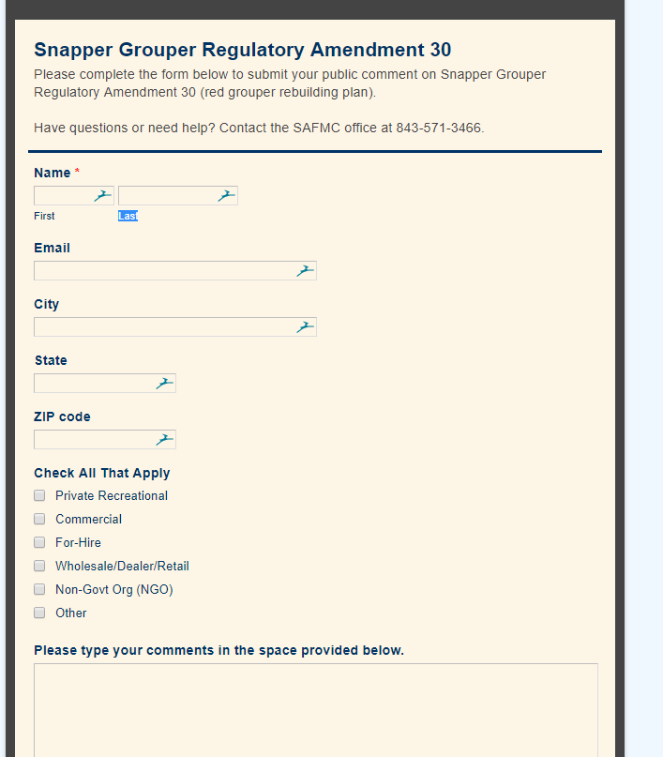
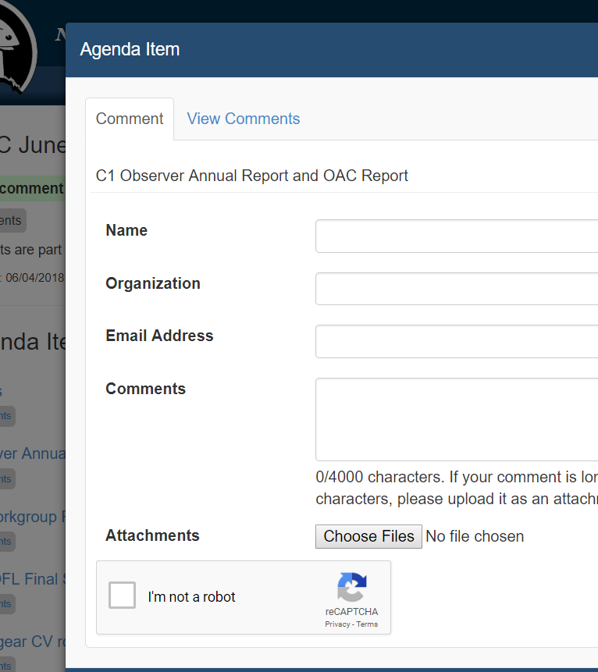
Public comment portals
Notes:
5 councils have public comment forms

Slide 5
Best Practices
Understand where all electronic comments and other data are stored and where they are backed up regardless of what application is in use.
Ensure that data is searchable for FOIA purposes.
Create and use a style guide for website postings to ensure clarity and uniformity across the site.
Internet speeds and connectivity issues should be written into hotel contracts.
Meeting broadcasts can be conducted over Council wifi hotspots when the hotel internet is unreliable.
Notes:
Concern on broadcasting SSCs in reauthorization – 3 RFMC already broadcast

Slide 6
Promoting the regional council system
Providing a unified voice among all regions

Slide 7

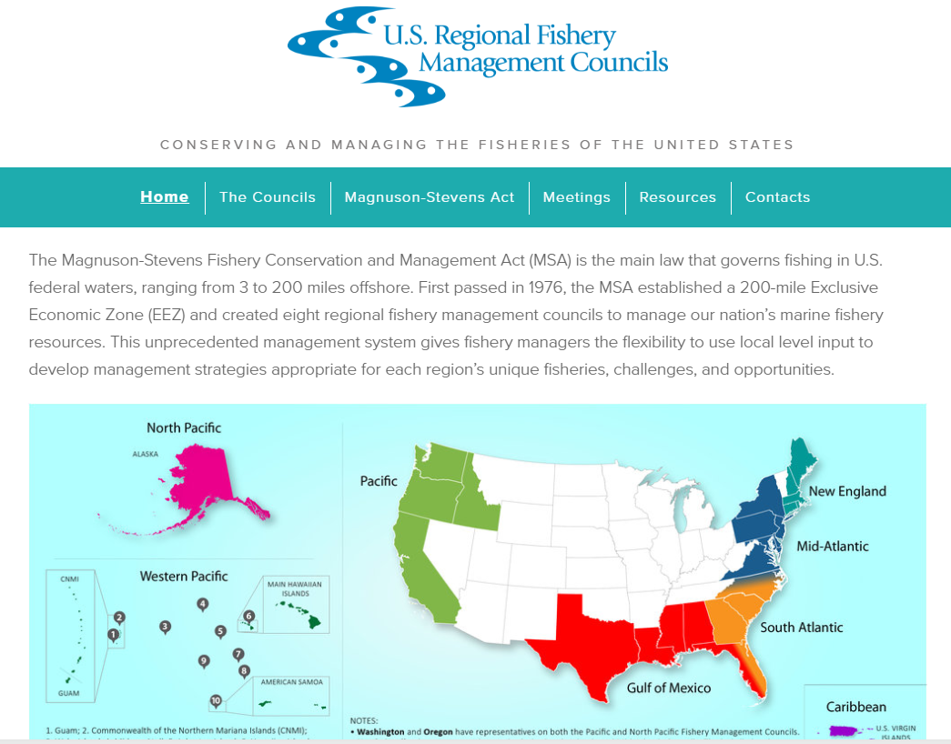
Recommendation: Continue to host and maintain fisherycouncils.org as the repository for all CCC, SCS, and joint Council materials.
Notes:
NMFS website has archived materials and no longer available,
Site designed and easy to maintain,
All legislative information included
Repository for all CCC and SCS meeting documents

Slide 8
Communicating effectively using social media

Slide 9
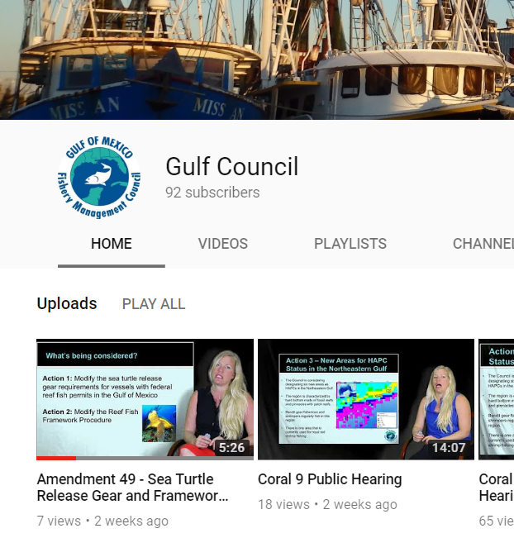
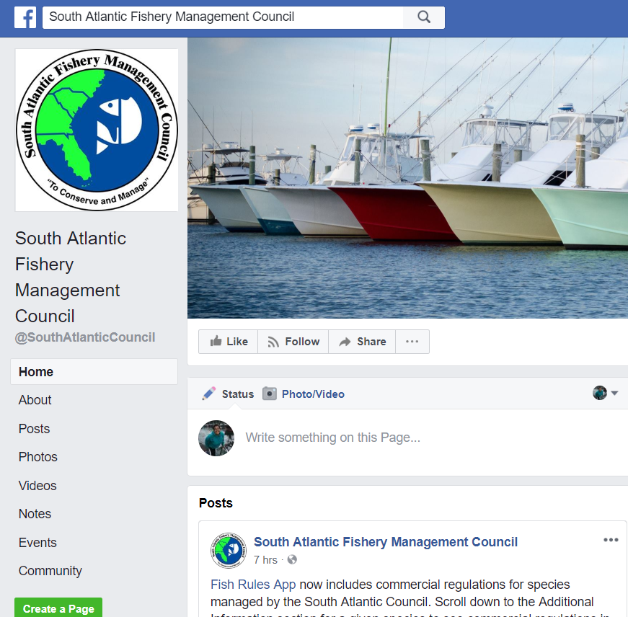
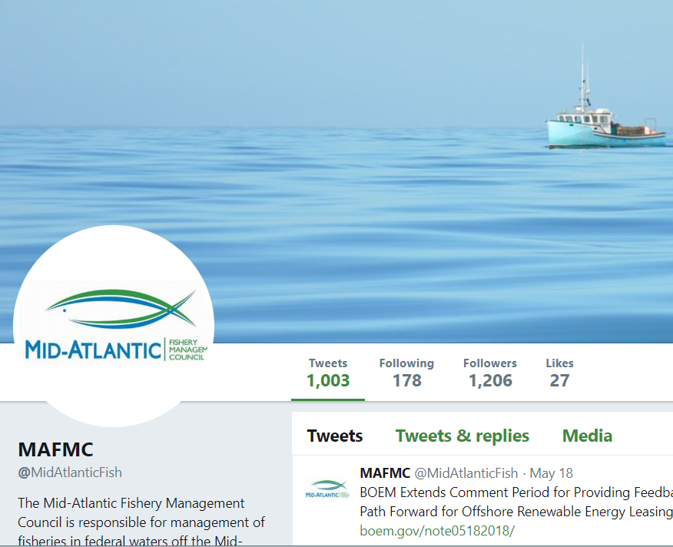
Best Practices
Engage the public with the appropriate social channels for a given Council’s audience
Notes:
FISH Rules – serving fishermen
84K views on social media post

Slide 10
Best Practices
Draft and keep “rules of (social) engagement.”
Engage the public with the appropriate social channels for a given Council’s audience (Facebook, Twitter, Instagram, etc.).
Keep track of analytics.
Write articles to answer FAQs on specific items that can be referred to over time.
Use a content management system to monitor/post across platforms.
Understand algorithms to be most effective on Facebook.
If there are no resources to monitor Facebook/Youtube comments, turn them off.

Slide 11
Working effectively with news media

Slide 12
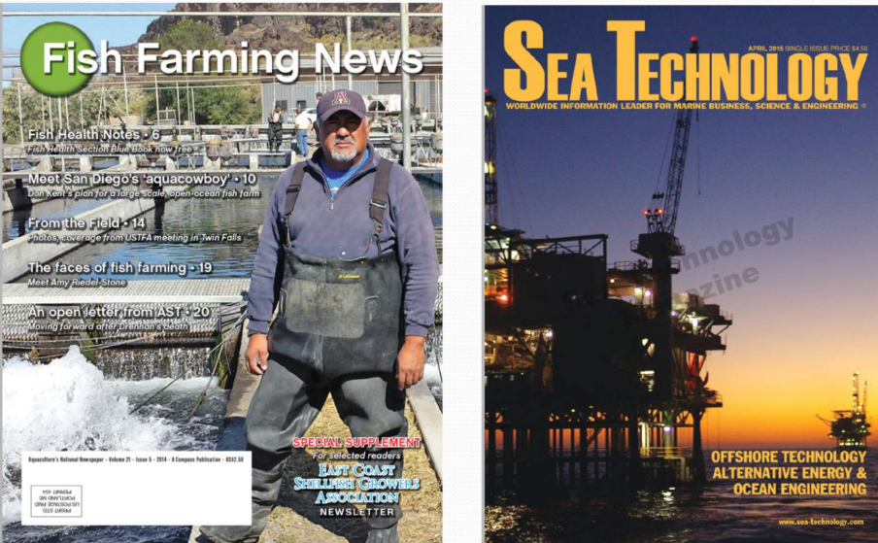
Know your reporters and media representatives and develop relationships.
Send out positive news stories often.

Slide 13
Regional and national communications between Councils and NOAA Fisheries

Slide 14
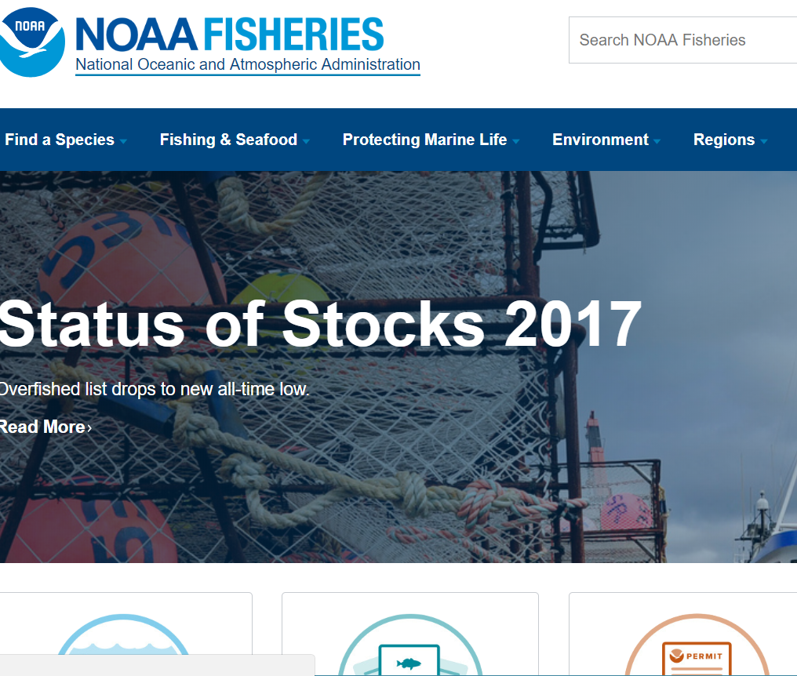
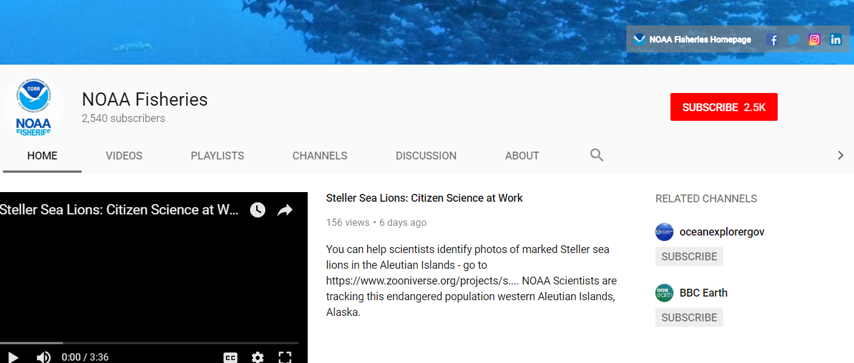
Notes:
More effective ways to get information out rather than press releases – stories and messages
Work with individual councils to get stories on the page

Slide 15
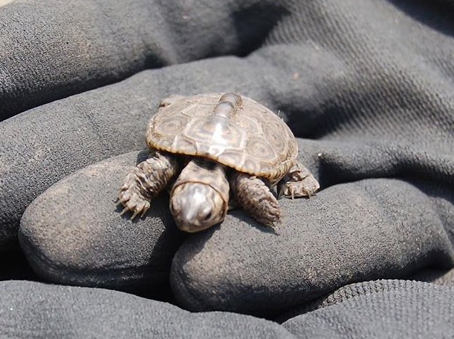
Best Practice
Recommendation
Councils should use short, informative, 508 Compliance tutorials available on NOAA Fisheries website.
All NOAA photos and videos are public domain and can be used in publications
NOAA Fisheries Communications should include the communication specialist or public information officer from each RFMC
Notes:
Contact NOAA fisheries when RFMC have stories to feature
Know and work with comms person in NOAA fisheries

Slide 16
Council and advisory body meeting and protocols

Slide 17
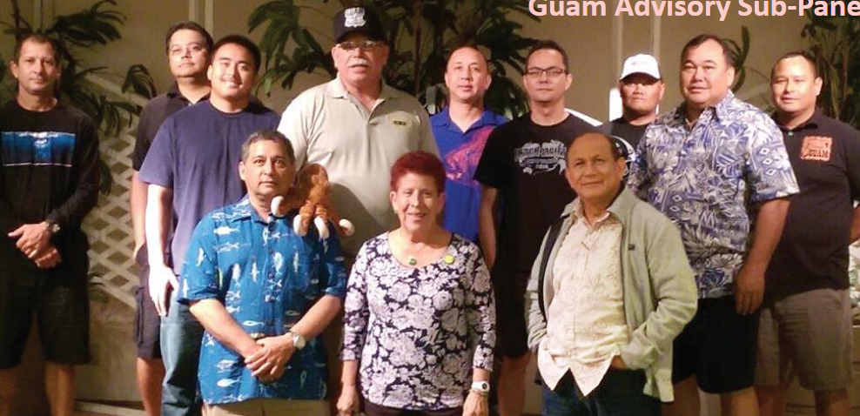
Round table discussion on Advisory bodies
WPFMC has 20 APs
Some AP members sit in on SSC meetings as observers
Some committees may be reluctant to be recorded or broadcast – may inhibit open dialogue
A few APs meet only via webinar
Notes:
General discussion regarding advisory bodies

Slide 18
Education programs and training
Notes:
MREP most successful PFMC, Gulf and SAFMC, and CFMC running them
Wanted to take the success of program to educate other fishers

Slide 19
MREP and Communicating Science
Recommendations
The MREP steering committee should consider congressional staffers and other non-fishery groups for participation in MREP workgroups
Offer a session at the SCS workshop on communicating science

Slide 20
Publications and outreach
Notes:
One of the prevailing themes is the necessity to do education and outreach
Educated, informed, and prepared public that is ready to engage

Slide 21
Education and Outreach
Best practice: Understand audience and distribution before you publish printed material.
Recommendations: The CCC and NOAA reconsider the 2009 request for additional, dedicated funding for education, outreach, and engagement.

