Slide 1
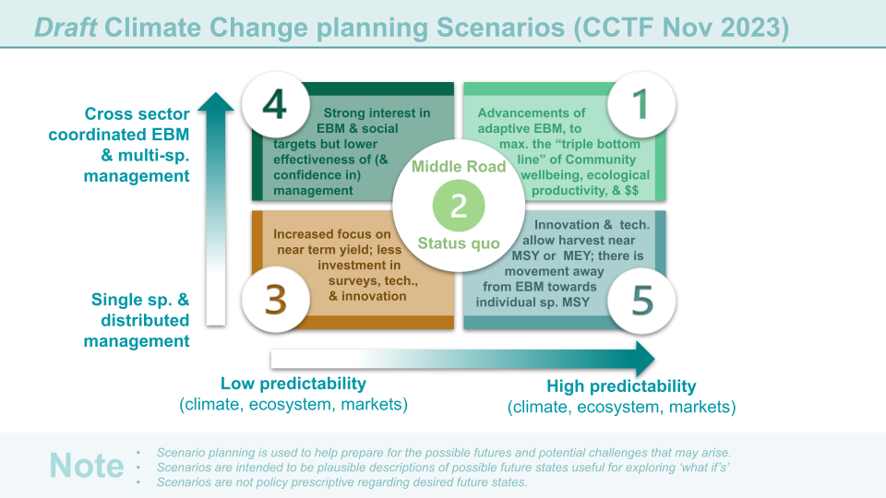
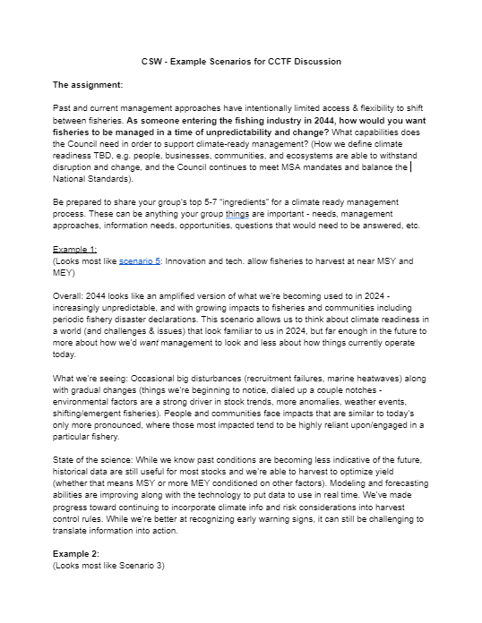
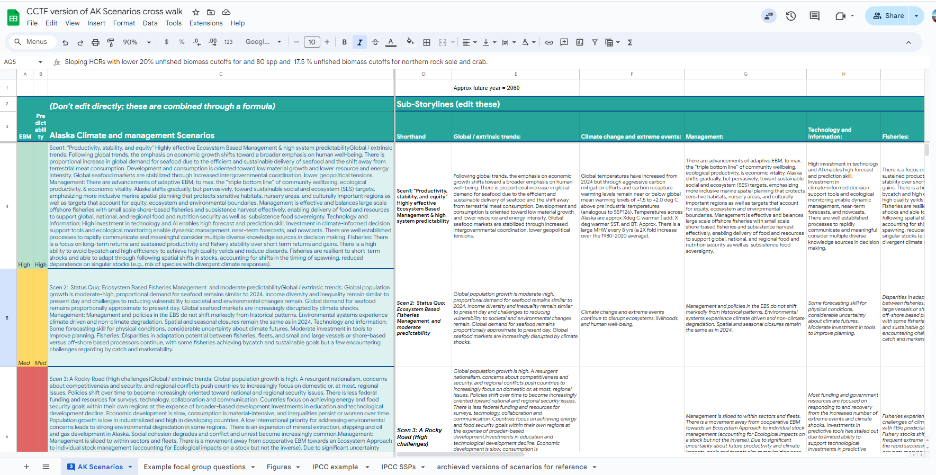
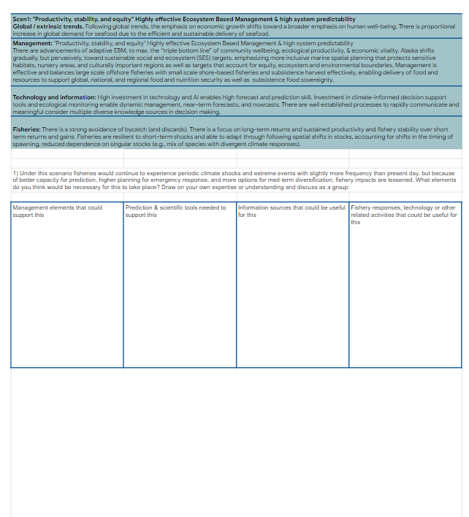
Climate Scenarios Workshop
Last meeting: ID’d the axes
Basis for group discussions
RESPONSE
Climate-informed advice for fisheries planning, preparation, & response
INFORMATION
Key Knowledge and Information sources, predictions, and planning information
Today- populate scenarios
Key Council Processes & Planning for Climate Readiness
Outcome:
Select 1-2 draft scenarios
CSW planning committee
Finalize scenarios
TOOLS
Climate-integrated tools (predictive maps, ecosystem forecasts, climate linked assessments; skill tested & validated)

Slide 2





Draft Climate Change planning Scenarios
Cross sector coordinated EBM & multi-sp. management
Strong interest in
. EBM & social targets but lower effectiveness of (&
confidence in)
management
Advancements of
adaptive EBM, to
. max. the “triple bottom
. line” of community
. wellbeing, ecological
. productivity, & $$
Middle Road
Status quo
Increased focus on
near term yield; less investment in surveys, tech., & innovation
Innovation & tech. . allow harvest near
. MSY or MEY; there is
movement away
from EBM towards individual sp. MSY
Single sp. management
Low predictability
(climate, ecosystem, markets)
High predictability
(climate, ecosystem, markets)
Note
Scenario planning is used to help prepare for the possible futures and potential challenges that may arise
Scenarios are intended to be plausible descriptions of possible future states, useful for exploring ‘what if’s’
Scenarios are not policy prescriptive regarding desired future states

Slide 3
Climate Scenarios Workshop
Last meeting: ID’d the axes
Basis for group discussions
RESPONSE
Climate-informed advice for fisheries planning, preparation, & response
INFORMATION
Key Knowledge and Information sources, predictions, and planning information
Today- populate scenarios
Key Council Processes & Planning for Climate Readiness
Outcome:
Select 1-2 draft scenarios
CSW planning committee
Finalize scenarios
TOOLS
Climate-integrated tools (predictive maps, ecosystem forecasts, climate linked assessments; skill tested & validated)

Slide 4
Climate Scenarios Workshop
Last meeting: ID’d the axes
Basis for group discussions
RESPONSE
Climate-informed advice for fisheries planning, preparation, & response
INFORMATION
Key Knowledge and Information sources, predictions, and planning information
Today- populate scenarios
Key Council Processes & Planning for Climate Readiness
Outcome:
Select 1-2 draft scenarios
CSW planning committee
Finalize scenarios
TOOLS
Climate-integrated tools (predictive maps, ecosystem forecasts, climate linked assessments; skill tested & validated)

Slide 6
Climate Scenarios Workshop
Last meeting: ID’d the axes
Basis for group discussions
RESPONSE
Climate-informed advice for fisheries planning, preparation, & response
INFORMATION
Key Knowledge and Information sources, predictions, and planning information
Today- populate scenarios
Key Council Processes & Planning for Climate Readiness
Outcome:
Select 1-2 draft scenarios
CSW planning committee
Finalize scenarios
TOOLS
Climate-integrated tools (predictive maps, ecosystem forecasts, climate linked assessments; skill tested & validated)

Slide 7
RESPONSE
Climate-informed advice for fisheries planning, preparation, & response
INFORMATION
Key Knowledge and Information sources, predictions, and planning information
Key Council Processes & Planning for climate readiness
TOOLS
Climate-integrated tools (predictive maps, ecosystem forecasts, climate linked assessments; skill tested & validated)
Notes:
Figure as png

Slide 8
Notes:
Figure as png

Slide 9
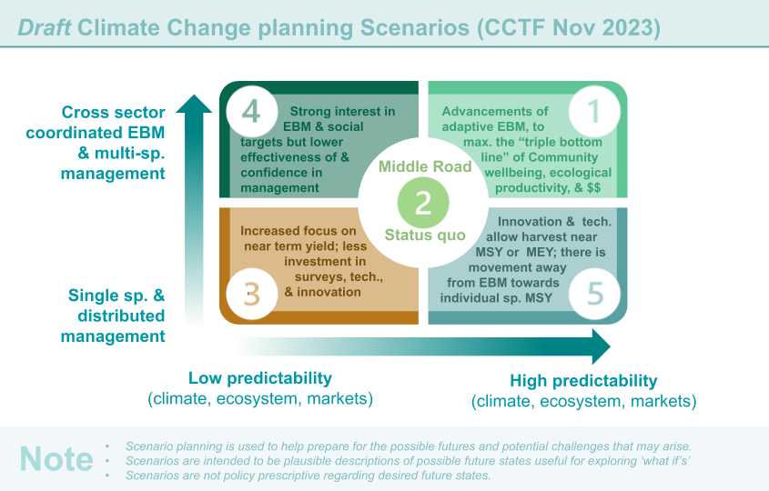
Notes:
Figure as png

Slide 10




Case studies to explore in each scenario
CRS Categories
Climate driven changes to fish distributions (& fishing grounds)
Species with shifting distribution VS Stationary species
Species with increased abundance/access VS species with decreased abundance
Stock assessment
Climate impacts on survival & abundance
Management/process
Information & knowledge
Climate impacts on growth & condition
Notes:
Scenarios are intended to be plausible descriptions of possible future states in order to explore what if’s not to drive desired future states. Scenario planning is used to help prepare for the possible futures.

Slide 11
OTHER EXAMPLES FOR REFERENCE

Slide 12
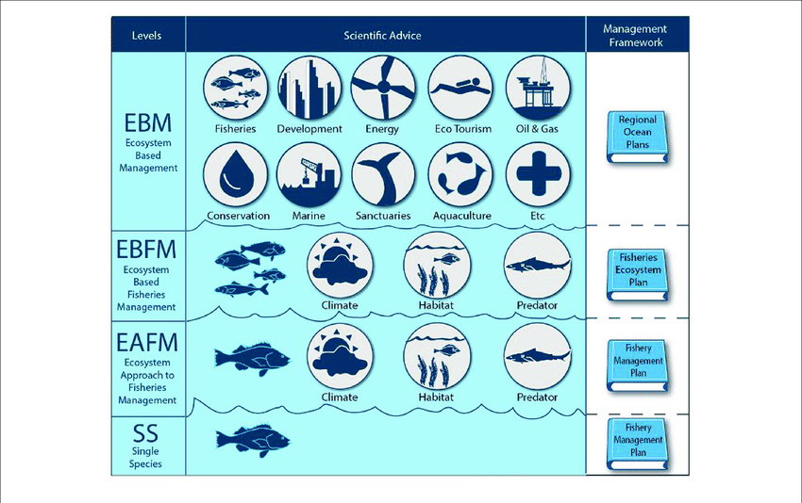
Dolan et al. https://www.frontiersin.org/articles/10.3389/fmars.2019.00550/full

Slide 13
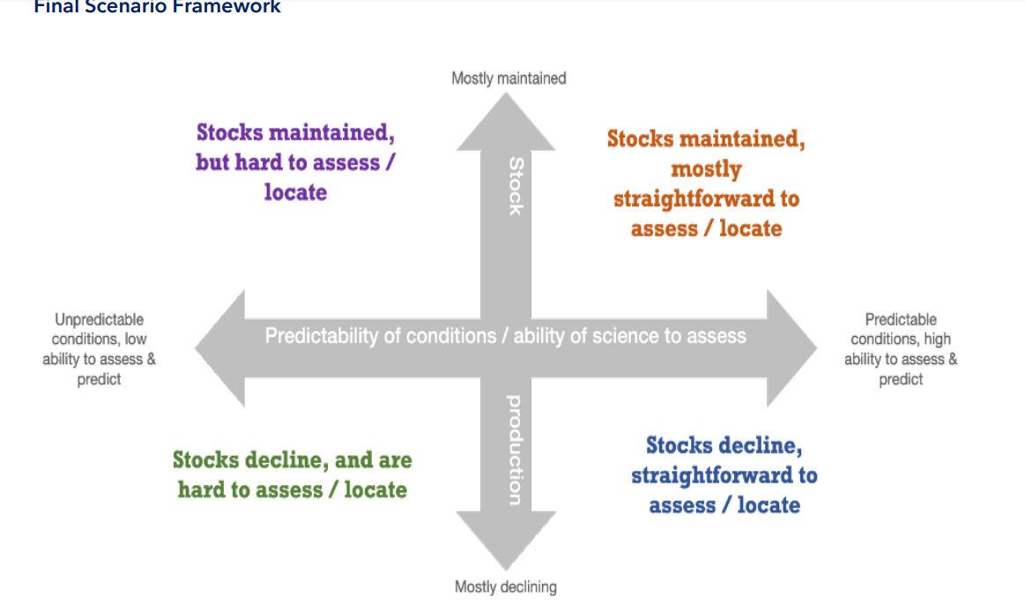
Example from the NW Atlantic
Link to NE Scenarios planning doc : https://meetings.npfmc.org/CommentReview/DownloadFile?p=fc431a20-ccea-483e-b862-efd796c24e03.pdf&fileName=ECSP%2BScenario%2BNarratives_Nov%2B2022.pdf

Slide 14
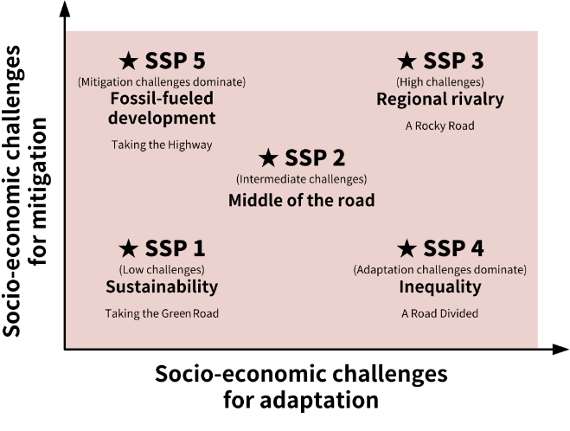
IPCC AR6 Example
O’neil et al. 2016

Slide 15
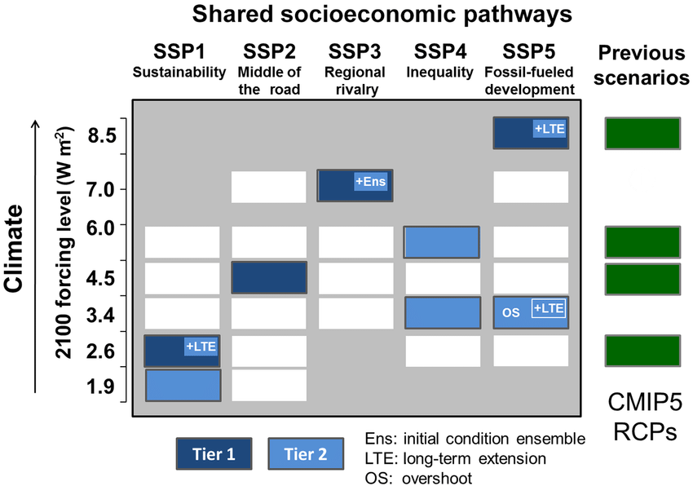
IPCC AR6 Example
The Social pathways / storylines were developed to help parameterize the earth system components (e.g. forest cover, development, population growth)
The climate modelers had standardized radiative forcings
The Tier 1 runs were used to form the basis for evaluation of risk, impacts and adaptation effectiveness under standardized climate x social scenarios
(WGII AR6)
O’neil et al. 2016
Notes:
O'Neill, Brian & Tebaldi, Claudia & Vuuren, Detlef & Eyring, Veronika & Friedlingstein, Pierre & Hurtt, George & Knutti, Reto & Kriegler, Elmar & Lamarque, Jean-François & Lowe, Jason & Meehl, Gerald & Moss, Richard & Riahi, Keywan & Sanderson, Benjamin. (2016). The Scenario Model Intercomparison Project (ScenarioMIP) for CMIP6. Geoscientific Model Development. 9. 3461-3482. 10.5194/gmd-9-3461-2016. https://gmd.copernicus.org/articles/9/3461/2016/

