Slide 1
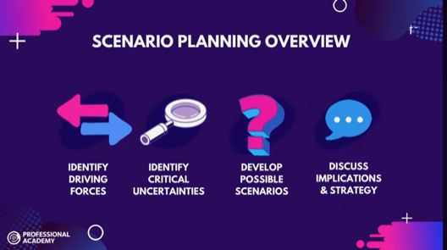
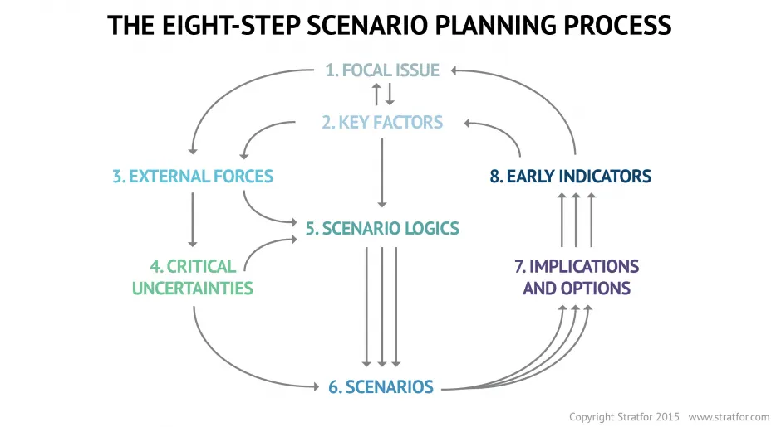
What is scenario planning?
Good Scenarios
A good set of scenarios will contain two to five different narratives. More than five scenarios tend to get confused with one another. Three scenarios run the danger that people will try to pick the most moderate or most apparently plausible and forget about the other two. Four is a good number — neither too many nor too few.
Each scenario should contain enough detail to assess the likelihood of success or failure of different strategic options.
-forbes
https://www.youtube.com/watch?feature=shared&v=ukr9ItEQX2Y
Outcomes: council process, products, tools, information (and yes indicators)
workshop
today

Slide 2
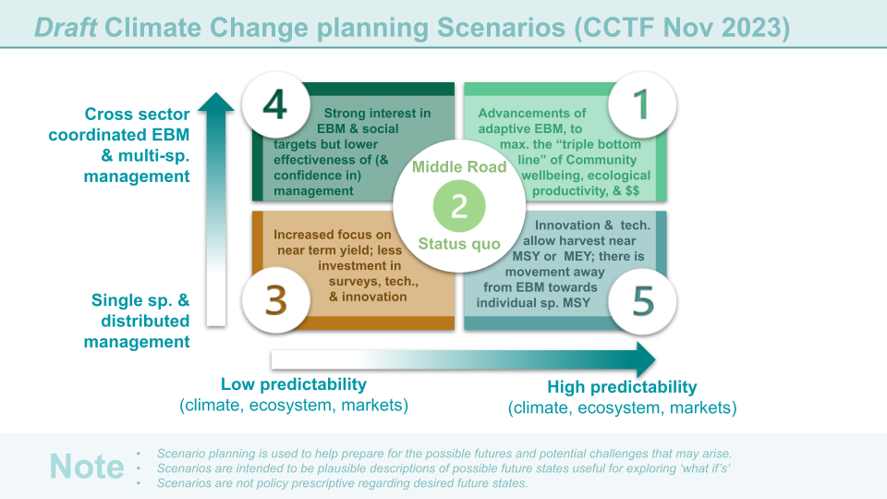
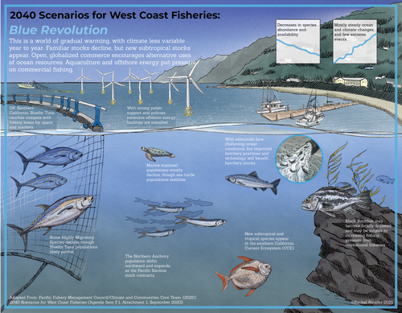
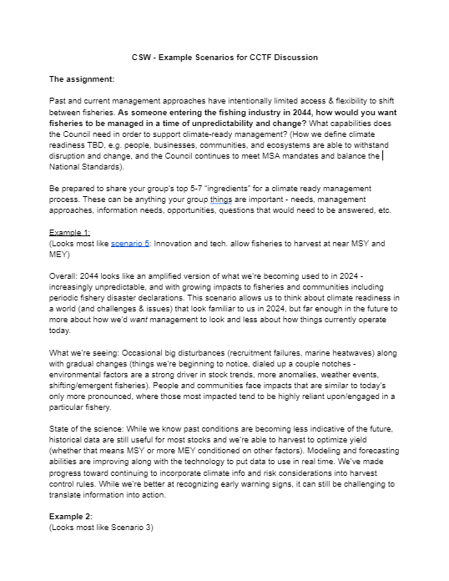
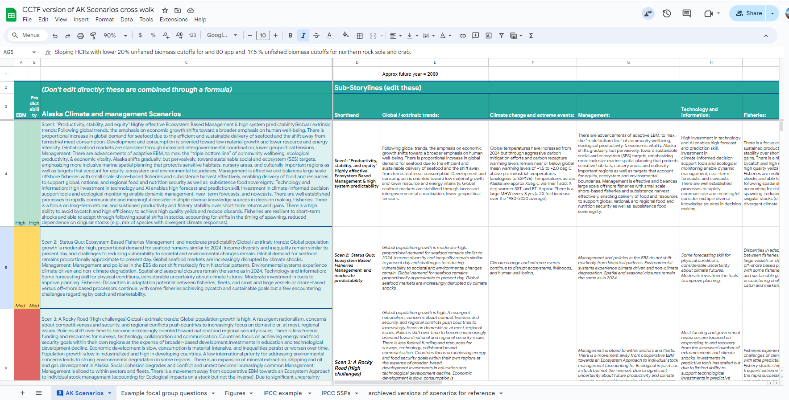
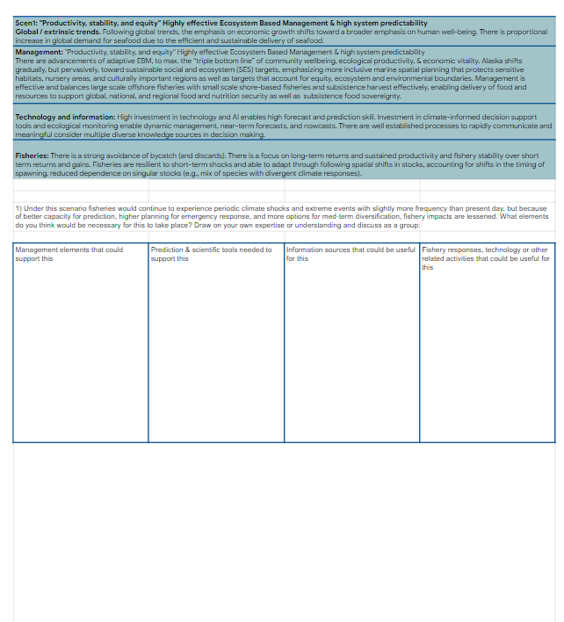
Climate Scenarios Workshop
Last meeting: ID’d the axes
Basis for group discussions
RESPONSE
Climate-informed advice for fisheries planning, preparation, & response
INFORMATION
Key Knowledge and Information sources, predictions, and planning information
Today- populate scenarios
Key Council Processes & Planning for Climate Readiness
Outcome:
Select 1-2 draft scenarios
CSW planning committee
Finalize scenarios
TOOLS
Climate-integrated tools (predictive maps, ecosystem forecasts, climate linked assessments; skill tested & validated)

Slide 3





Draft Climate Change planning Scenarios
Cross sector coordinated EBM & multi-sp. management
Strong interest in
. EBM & social targets but lower effectiveness of (&
confidence in)
management
Advancements of
adaptive EBM, to
. max. the “triple bottom
. line” of community
. wellbeing, ecological
. productivity, & $$
Middle Road
Status quo
Increased focus on
near term yield; less investment in surveys, tech., & innovation
Innovation & tech. . allow harvest near
. MSY or MEY; there is
movement away
from EBM towards individual sp. MSY
Single sp. management
Low predictability
(climate, ecosystem, markets)
High predictability
(climate, ecosystem, markets)
Note
Scenario planning is used to help prepare for the possible futures and potential challenges that may arise
Scenarios are intended to be plausible descriptions of possible future states, useful for exploring ‘what if’s’
Scenarios are not policy prescriptive regarding desired future states

Slide 4
Climate Scenarios Workshop
Last meeting: ID’d the axes
Basis for group discussions
RESPONSE
Climate-informed advice for fisheries planning, preparation, & response
INFORMATION
Key Knowledge and Information sources, predictions, and planning information
Today- populate scenarios
Key Council Processes & Planning for Climate Readiness
Outcome:
Select 1-2 draft scenarios
CSW planning committee
Finalize scenarios
TOOLS
Climate-integrated tools (predictive maps, ecosystem forecasts, climate linked assessments; skill tested & validated)

Slide 5
Draft Climate Change planning Scenarios (CCTF Nov 2023)
Advancements of adaptive EBM, to maximize the “triple bottom line” of community wellbeing, ecological productivity, & $$
There is proportional increase in global demand for seafood. Investment in
predictive tools and effective monitoring enable dynamic management, near-
term forecasts, and nowcasts. The Bering Sea shifts gradually, but pervasively, toward sustainable ecosystem (SES) targets and community well-being targets, emphasizing more inclusive marine spatial planning that protects sensitive habitats, nursery areas, and culturally important regions as well as targets that account for ecosystem and environmental boundaries. There is strong avoidance of bycatch through (and discards) increased technological, information, and management support. There is a focus on long-term returns and sustained productivity over short term returns and gains. Management is effective, and flow of economic and nutritional resources to regional coastal communities increases, following global trends the emphasis on economic growth shifts toward a broader emphasis on human well-being. Driven by an increasing commitment to achieving EBM and equity goals, inequality is reduced both across and within fleets, communities and sectors. Consumption is oriented toward low material growth and lower resource and energy intensity.
Draft starting place (not for public review) as an example of how we will build out the scenarios for the workshop over the next few months

Slide 6
LINK (internal presently)

Slide 7
Climate Scenarios Workshop
Last meeting: ID’d the axes
Basis for group discussions
RESPONSE
Climate-informed advice for fisheries planning, preparation, & response
INFORMATION
Key Knowledge and Information sources, predictions, and planning information
Today- populate scenarios
Key Council Processes & Planning for Climate Readiness
Outcome:
Select 1-2 draft scenarios
CSW planning committee
Finalize scenarios
TOOLS
Climate-integrated tools (predictive maps, ecosystem forecasts, climate linked assessments; skill tested & validated)

Slide 9
Last meeting: ID’d the axes
TODAY
Draft 3 Storylines/narratives - share with public for comment - now Mar 1
Draft outcomes from workshop
Draft Questions to lead to outcomes
Draft columns in the matrix for graphics
Today- populate scenarios
Today Outcome:
Select 1-2 draft scenarios
CSW planning committee
Mar-April
Finalize scenarios

Slide 10
Last meeting: ID’d the axes
Mar-April
Columns used to create storyline graphics
Today- populate scenarios
Outcome:
Select 1-2 draft scenarios
CSW planning committee
Finalize scenarios

Slide 11
Climate Scenarios Workshop
Last meeting: ID’d the axes
Basis for group discussions
RESPONSE
Climate-informed advice for fisheries planning, preparation, & response
INFORMATION
Key Knowledge and Information sources, predictions, and planning information
Today- populate scenarios
Key Council Processes & Planning for Climate Readiness
Today Outcome:
Select 1-2 draft scenarios
CSW planning committee
Mar-April
Finalize scenarios
TOOLS
Climate-integrated tools (predictive maps, ecosystem forecasts, climate linked assessments; skill tested & validated)

Slide 12
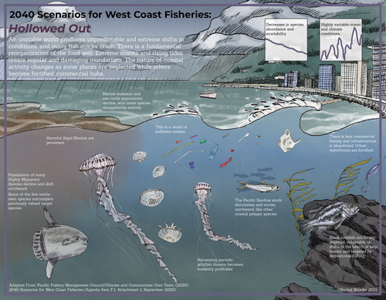
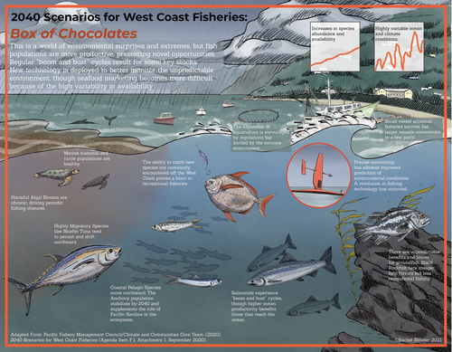
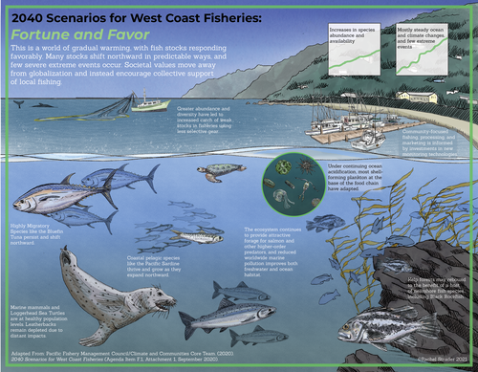
West Coast Scenarios Visual Example
https://www.rachelstrader.com/blog/2021/3/21/2040-climate-scenarios-for-west-coast-fisheries

Slide 13


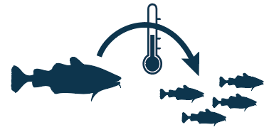

Case studies to explore in each scenario
CRS Categories
Climate driven changes to fish distributions (& fishing grounds)
Species with shifting distribution VS Stationary species
Species with increased abundance/access VS species with decreased abundance
Stock assessment
Climate impacts on survival & abundance
Management/process
Information & knowledge
Climate impacts on growth & condition
Notes:
Scenarios are intended to be plausible descriptions of possible future states in order to explore what if’s not to drive desired future states. Scenario planning is used to help prepare for the possible futures.

Slide 14
OTHER EXAMPLES FOR REFERENCE

Slide 15
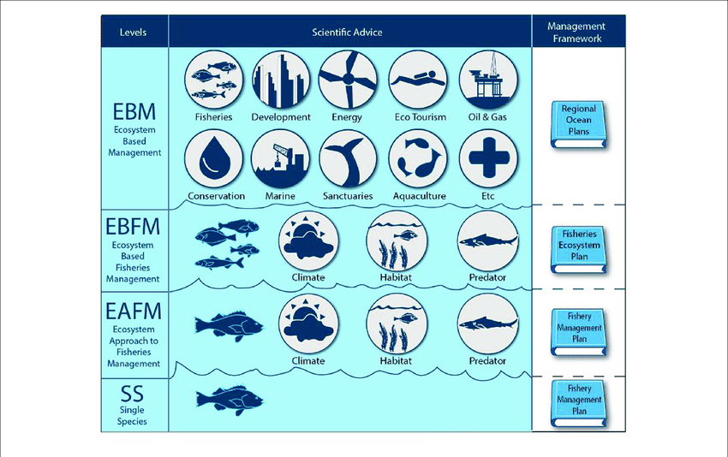
Dolan et al. https://www.frontiersin.org/articles/10.3389/fmars.2019.00550/full

Slide 16
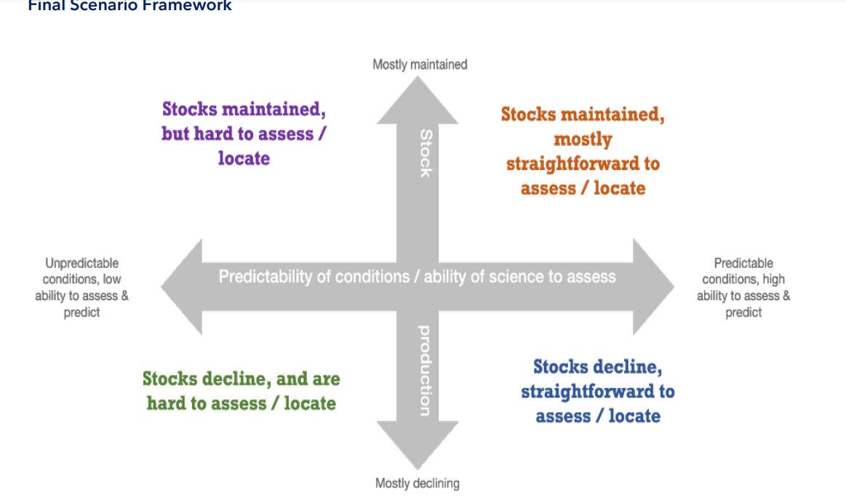
Example from the NW Atlantic
Link to NE Scenarios planning doc : https://meetings.npfmc.org/CommentReview/DownloadFile?p=fc431a20-ccea-483e-b862-efd796c24e03.pdf&fileName=ECSP%2BScenario%2BNarratives_Nov%2B2022.pdf

Slide 17
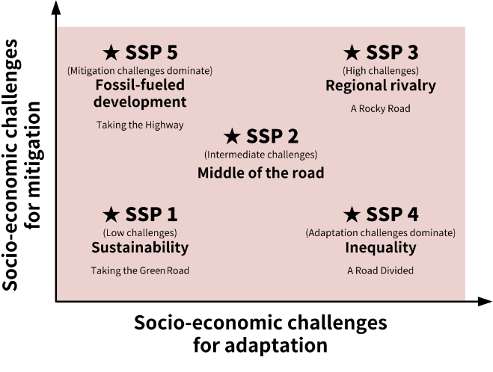
IPCC AR6 Example
O’neil et al. 2016

