Slide 1
FEP Climate Change Module
D3
January Council 2020

Slide 2
Climate Change Taskforce (CCTF) members:
Lauren Divine Aleut Community of Saint Paul Island
Scott Goodman Natural Resources Consultants/Bering Sea Fisheries Research Foundation
Kirstin Holsman co-Chair AFSC-Seattle
Steve Martell SeaState
Joe Krieger NMFS-Regional Office
Brenden Raymond-Yakoubian Sandhill.Culture.Craft
Mike LeVine Ocean Conservancy
Jeremy Sterling AFSC Marine Mammal Lab
Diana Stram co-Chair NPFMC

Slide 3
Original agenda
2 ½ day in–person meeting planned in Seattle
Emphasis on background information on current climate initiatives
Breakout groups
Time allotted to draft specific progression plan moving forward

Slide 4
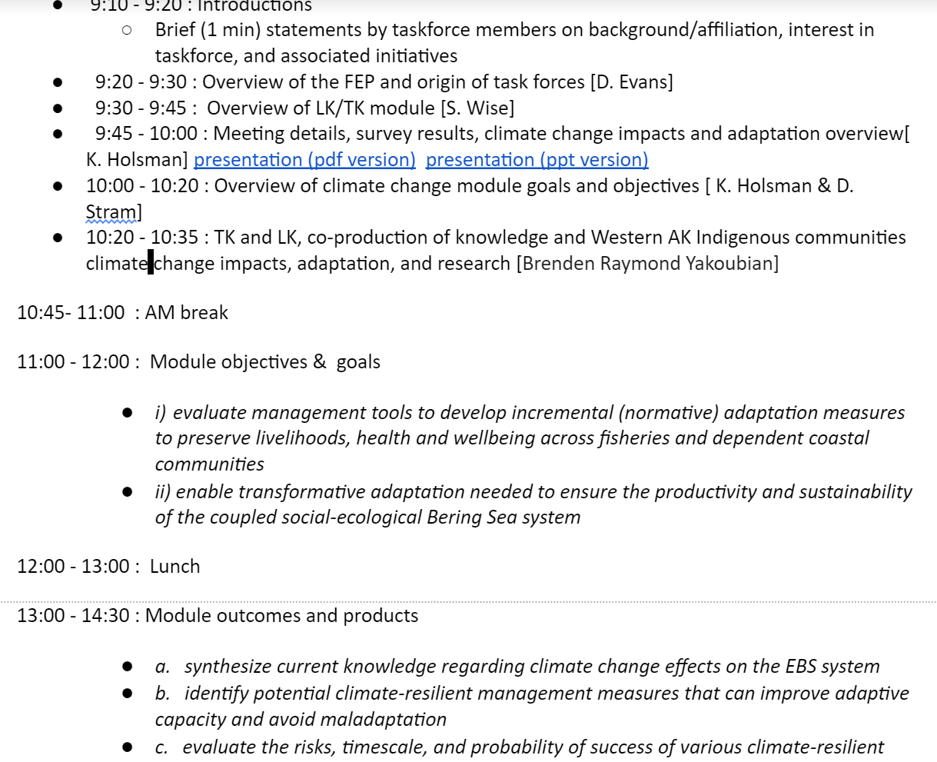
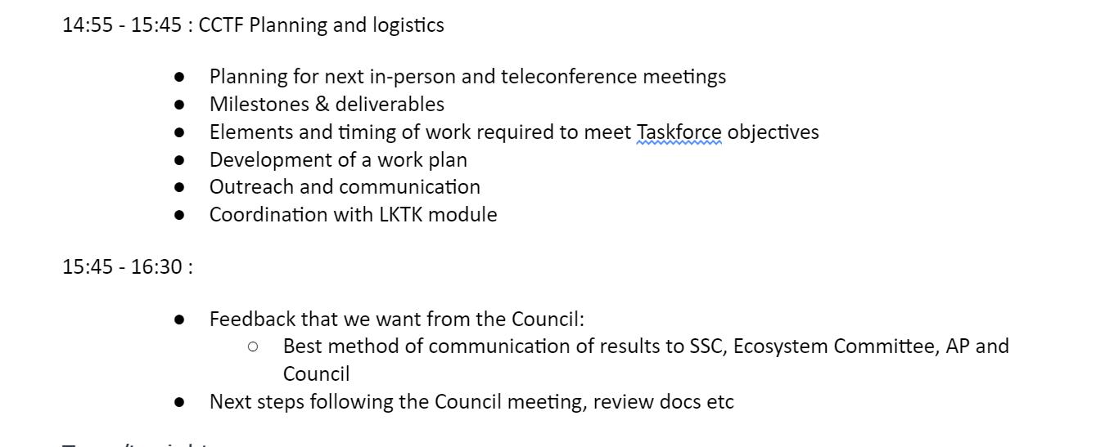
Kickoff CCTF Meeting January 21st
Abbreviated webex

Slide 5
Module goal (page 1 workplan):
” facilitate equitable climate change adaptation pathways, transparent communication, and broad engagement to support short- and long-term resilience for the coupled social-ecological system of the Bering Sea ”
evaluate management tools to develop incremental (normative) adaptation measures to preserve livelihoods, economies, health and wellbeing across fisheries and dependent coastal communities,
enable transformative adaptation needed to ensure the productivity and sustainability of the coupled social-ecological Bering Sea system, and
encourage transparent, effective, and dynamic communication and engagement of communities, fishers, managers and other stakeholders and the Council.
Notes:
The goal of the climate change module is to facilitate and support equitable climate change adaptation pathways and long-term resilience for the coupled social-ecological system of the Eastern Bering Sea (see geographic description in the FEP [ add link] ) . This module will support the capacity to i) evaluate management tools to develop incremental (normative) adaptation measures to preserve livelihoods, health and wellbeing across fisheries and dependent coastal communities, and, ii) enable transformative adaptation needed to ensure the productivity and sustainability of the coupled social-ecological Bering Sea system. To achieve this, the climate change module will be used to synthesize current knowledge regarding climate change effects on the EBS system, identify potential climate-resilient management measures that can improve adaptive capacity and avoid maladaptation (Figure 1), evaluate the risks, timescales, and probability of success of various climate-resilient management policies under future scenarios of change; and provide prioritized recommendations for actions that could be taken to advance the goals and minimize the risks identified.

Slide 6
Development of framework for climate-resilient management
systematic review of new and emergent climate change information, both immediate and long-term in scope (most long-term information is currently not included in ESRs and other reports),
synthesis and evaluation of key issues, emergent trends, and potential red flags relevant to the Council,
coordination and iterative review with the LK TK Subsistence taskforce and FEP Team to support the plurality of perspectives needed for evaluation of risk and tradeoffs,
recommendations of climate-resilient management actions to enable adaptation to climate-driven change

Slide 7
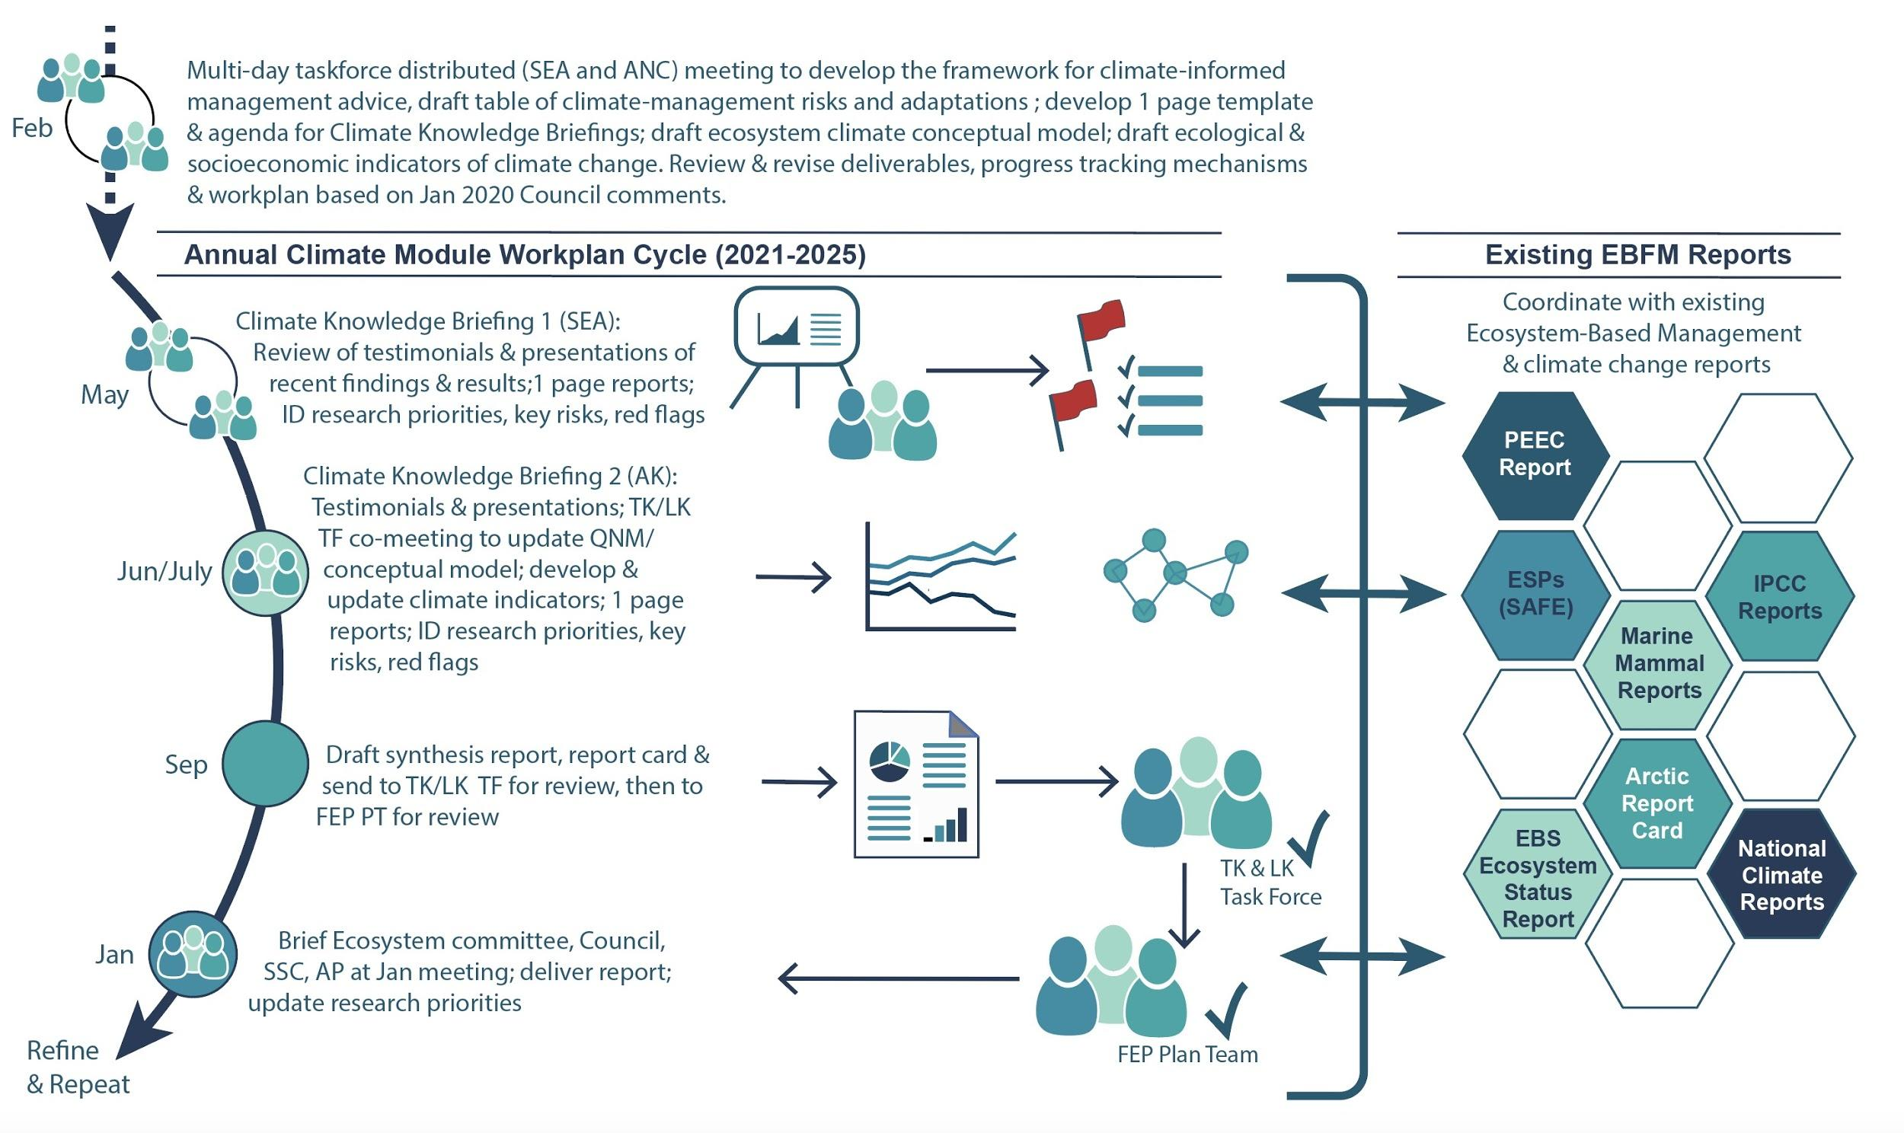

Slide 8
Deliverables and tracking progress
A framework for exploring a range of management actions across a range of climate scenarios(e.g., periodic review of existing and alternative management strategies/policies).
Synthesis report of climate change impacts and adaptive strategies of interest and within the purview of the Council; authored by the climate module taskforce, contributing authors, and collaborators.
Communication and engagement plan (in collaboration with LK TK Subsistence Taskforce)
Periodic update of recommendations of Council’s climate-specific research priorities (with Council cycle)
Notes:
[BRY] Think some language could be added in here that is very general about integration with some other as-of-yet not finalized efforts which will have long-term Council impacts and will add to where these interfaces can occur, especially the results of current and upcoming work in the LK/TK/Subsistence AM TF, the CEC, and the ongoing work of the Ecosystem Committee and the SSPT.
Meetings/ joint meetings?
TORs for our group
Deliverables:
New: Proposed plan of action for evaluation and implementation of management tools [ML]
“Annual climate change hot-topics/ red flags/ considerations for the coming year?” (e.g., via the ESR?) [BRY: Would this potentially be where the ongoing re-evaluations of management strategies would also fall?]

Slide 9
Milestones
Feb 26-28, 2020 (tent) ~3 day meeting ANC/SEA dual locations/web coordinated taskforce meeting to develop framework, begin to draft list of short-medium and long-term projects and scenarios to explore; draft table of climate-management risks and adaptations by species or focal components; develop one-page template and tasking for climate knowledge briefing reports; agenda for proposed Climate Knowledge Briefing 1 meeting in May and Climate Knowledge Briefing 2 workshop with LK TK taskforce; draft ecosystem climate conceptual model; draft ecological and socioeconomic indicators of climate change. Review and revise deliverables and progress tracking mechanisms. Revise workplan based on Jan 2020 Council comments.
Proposed Climate Briefing Workshops 1 and 2

