Slide 1
Observer data, catch estimation, and future assessment needs
Ben Daly and Katie Palof
Crab Plan Team Meeting
April 29 – May 3, 2019
Anchorage, AK

Slide 2
Today’s presentation
Overview of total catch estimation
Needs of assessment authors with respect to discards?
Potential challenges with “subtraction” method
Future work and assessment needs

Slide 3
Observer data reminder
Current protocol :
No more retained/not retained categories
Using the following codes:
0 = sublegal
Smaller than legal size based on legal stick measurement
1 = legal
Legal size based on legal stick measurement

Slide 4
At-sea total catch expansion
Data source:
Observer pot CPUE
x
total fishery effort
x
mean crab weight
count pots OR measure pots, depending on desired sex/size/SC category
Fish tickets
Measure pot size comps, L-W regression
Notes:
Its important to understand what pots are being used to make calculations (measure or count pots), and how average weight is determined.
Observer CPUE and mean crab weight can change based on Size/sex/SC category being calculated

Slide 5
At-sea total catch expansion
Prior to 2018/19: 4 categories: females, sublegal males, legal-Ret males, legal_NR males
  Discards = females + sublegal males + legal_NR males
  Total catch = females + sublegal males +legal_Ret + legal_NR males
2018/19 - : 3 categories: females, sublegal males, legal males
  Discards = females + sublegal males + (legal males – retained catch)
  Total catch = females + sublegal males + legal males

Slide 6
What about estimates of discards?
Females: discards = total catch estimate
Males:
  Either sublegal or legal based on “legal stick” (i.e., by CW)
  Sublegal sizes: discards = total catch estimate
  Legal sizes?
    Subtraction method (just need legal size info):
      Use observer data to estimate legal catch number at sea and subtract fish-ticket estimate of delivered catch number.
      Number and/or weight

Slide 7
More on subtraction method……
2 ways of implementing this for males:
Subtract retained catch from total catch of all males (subL and Legal): Male total catch - total retained catch
Subtract retained catch from total catch of Legal males: Male legal size total catch - total retained catch
  Assume all sublegal males are discarded
  Feedback from CPT?

Slide 8
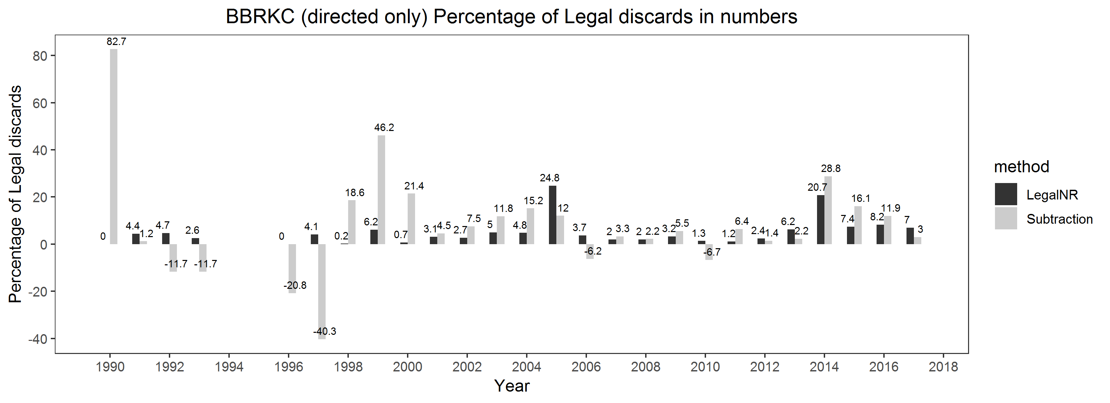


Challenges with subtraction method: negative discards
${\% L discards}_{LNR}$ = $\frac{Total LegalNotRetained}{Total legal}$
${\% L discards}_{subtraction}$ = $\frac{Total Legal −Retained catch}{Total legal}$

Slide 9
Challenges with subtraction method: negative discards
Negative discard estimates occur when the observer pot CPUE is lower than the fishery CPUE
  Yet, we would expect the observer CPUE estimates to be higher because they include crab that are then discarded
  *These data are imperfect

Slide 10
Discards are needed for:
1. Estimating total fishery mortality for stock status determination (critical)
2. Estimating discard rates on a fishery and vessel level (important, but not critical)
  Tool for evaluating fishery performance/behavior (i.e., high grading)
3. Assessments (?)

Slide 11
Currently provide:

Slide 12
Assessment data needs?
Are discards needed for assessments?
  If yes, thoughts on subtraction method?
  Discard size comps?......is this possible?
    At each 5 mm size bin: total catch – retained catch?
How is error structure about total/discard estimates characterized in the models?
  Error structure can accommodate negative discards?
What are the assumptions (by assessment authors) about the variance of observer CPUE, total catch, etc?
Do assessment authors want/need better estimates of the variability for observer CPUE or discard estimates?

Slide 13
Ongoing effort by ADF&G related to catch estimates…
Variance estimates:
  Confidence intervals for observer CPUE
    Would give a range of estimates: mean CPUE ± 95% CI (mean, lower, upper)
    Calculate expansions based on these upper, lower CPUEs
  Other approach such as “Delta method”?
Automate and standardize catch timeseries in a consistent format, host on AKFIN (or other)…
  BUT….this is difficult if stock assessment authors require different estimates, different formats, etc.
    Has been provided annually to SA authors after “by hand” calculations
      Has led to confusion about historical estimates…different versions of estimates floating around with little or no documentation
  Raw files vs expanded estimates?
  Level of expansion: by size/shell condition categories?, in space?, etc

Slide 14
Questions for the group
Can ADF&G standardize catch data for all assessments?
  Are the assessment too unique in how they are coded, etc.?
  Will GMACS require standardized catch data?
Do assessment authors want expanded estimates of total catch or raw data files (calculations being performed in models?) ?
Do assessment authors need estimates of discards?
  Subtraction method: how to deal with negative discards
  If we create a standard timeseries, should we recalculate historical estimates with subtraction method or utilize “legal not retained” data?
How important are estimates of variance?
Other guidance from assessment authors?
Future direction?
Timeline for standardized catch timeseries? ……Sometime between Jan 2020 and May 2020?

