Slide 1

Population Genetics of Tanner Crab (Chionoecetes bairdi ) in Alaskan Waters
Genevieve M. Johnson
Presented to BSAI Crab Plan Team: May 3, 2019

Slide 2
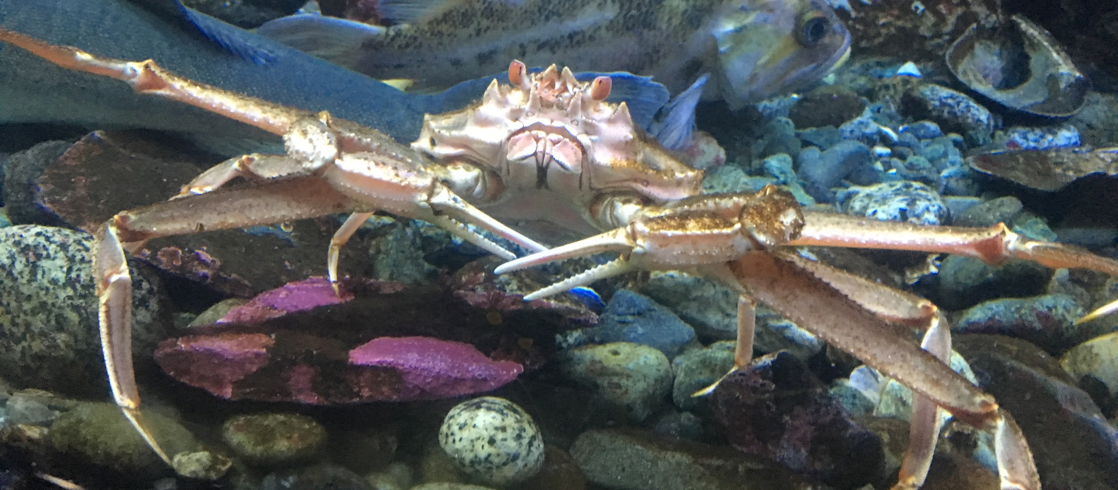
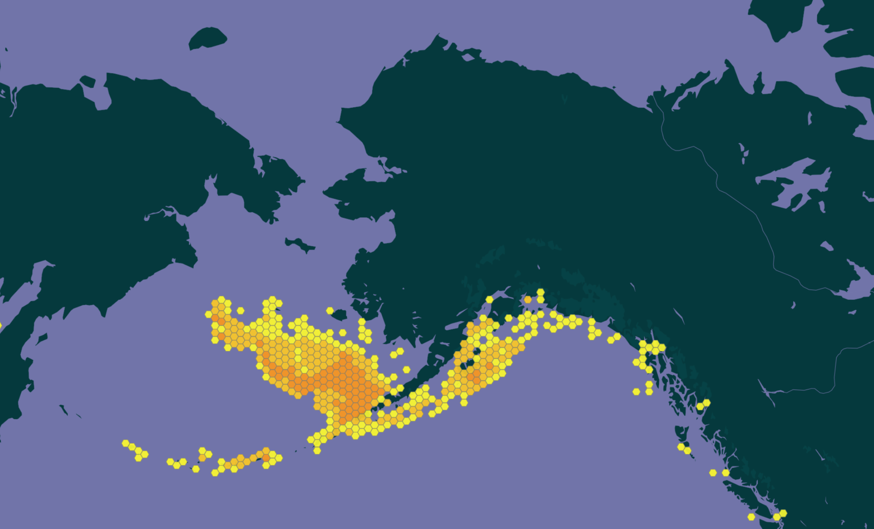
Chionoecetes bairdi Rathbun, 1924 in GBIF Secretariat (2017). GBIF Backbone Taxonomy. Checklist Dataset https://doi.org/10.15468/39omei accessed via GBIF.org on 2018-01-12.

Slide 3
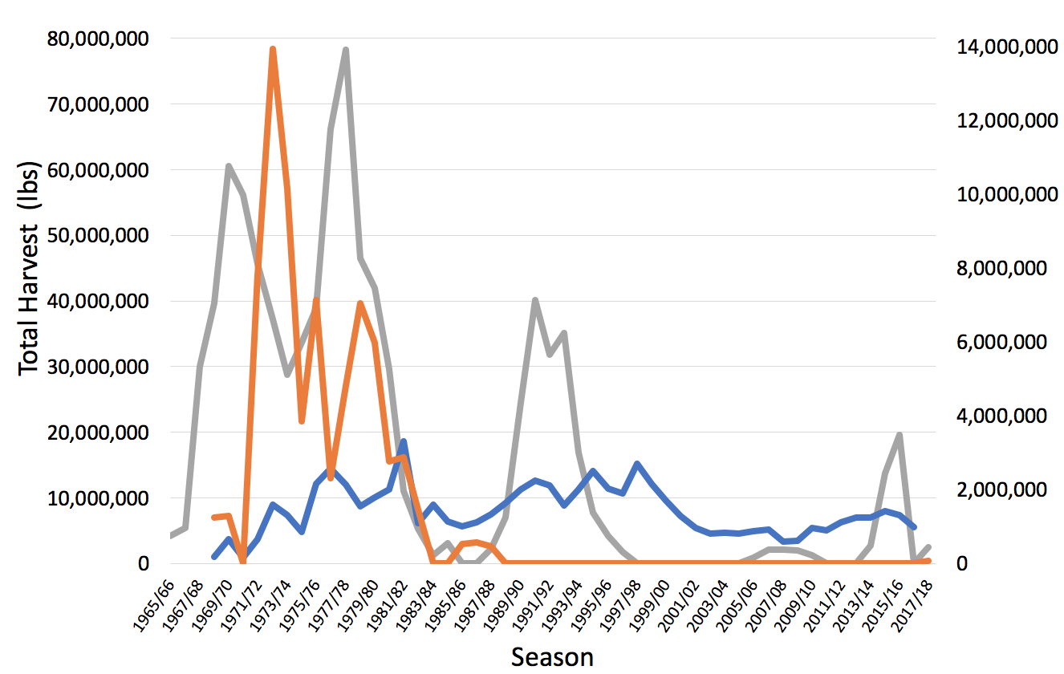
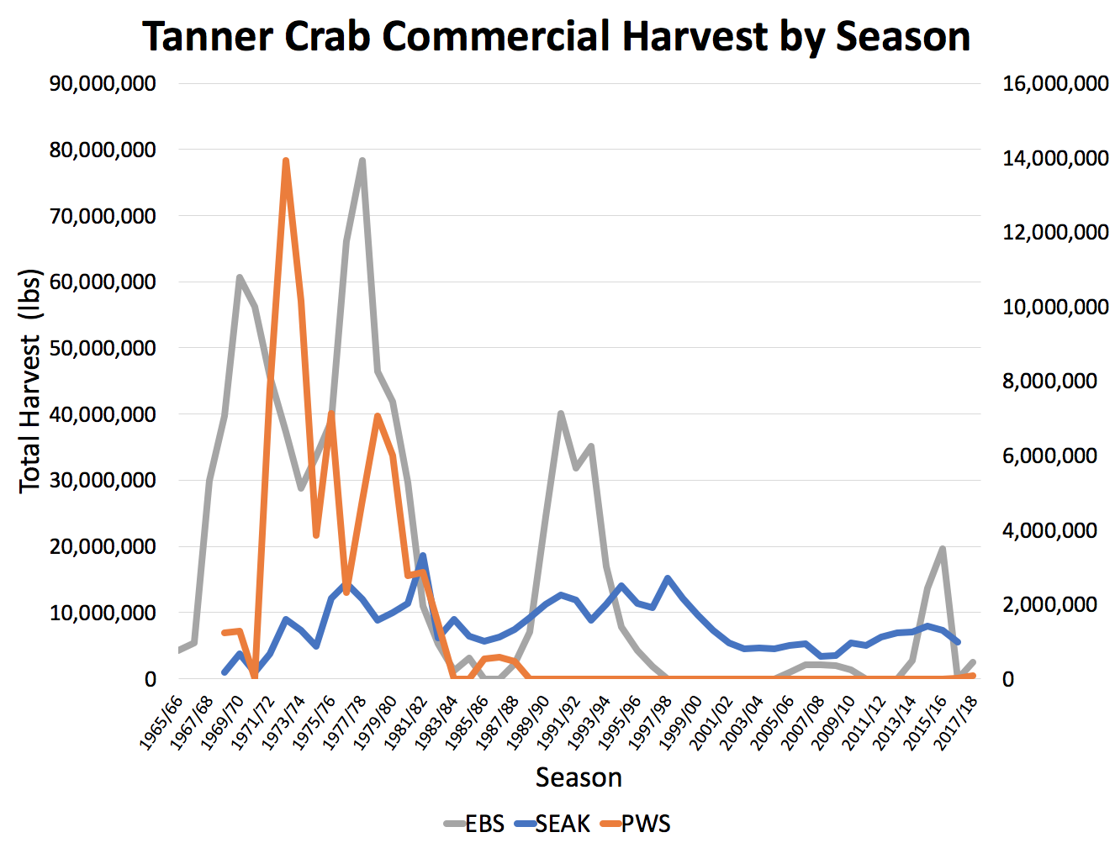
Tanner Crab Commercial Harvest by Season
Notes:
Southeast Alaska (SEAK), Prince William Sound (PWS), and the Eastern Bering Sea (EBS; East and West of 166° W combined) districts. SEAK and PWS harvest totals are represented on the scale in the right axis, while EBS harvest is represented on that in the left axis. Harvest records are compiled from Rumble et al., 2014, Stockhausen, 2018, and Wood et al., 2017.

Slide 4
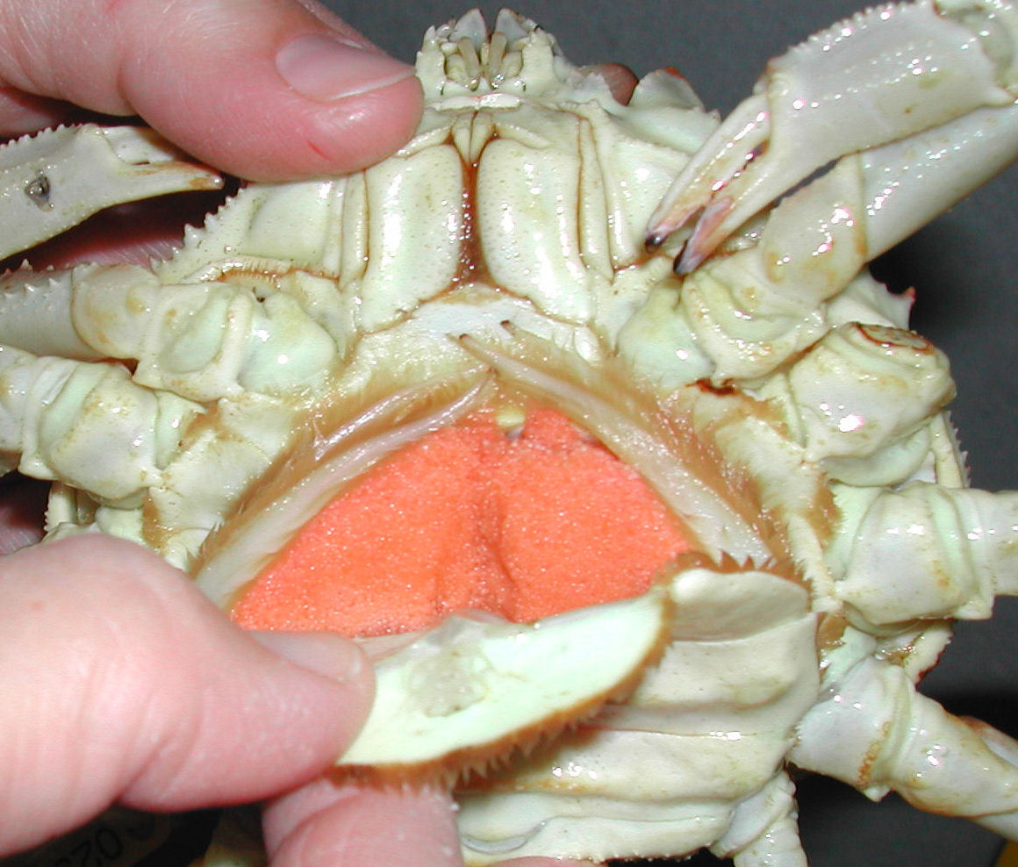

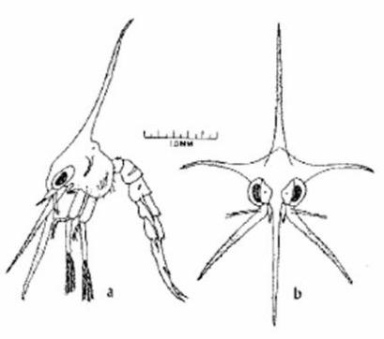
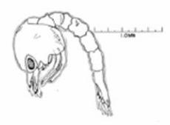
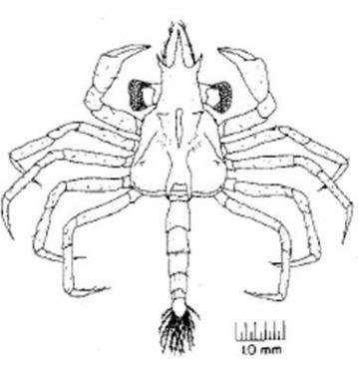
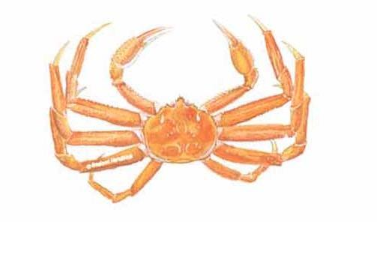
Life History
Long pelagic larval duration
Possibly advected by currents
Need to settle in suitable habitat
Juveniles vulnerable to predation
Photo credit: NOAA NMFS

Slide 5
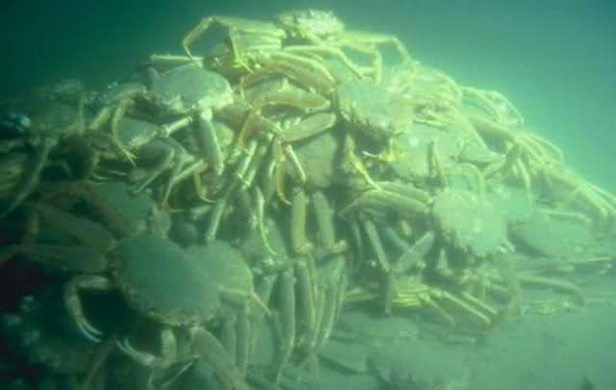
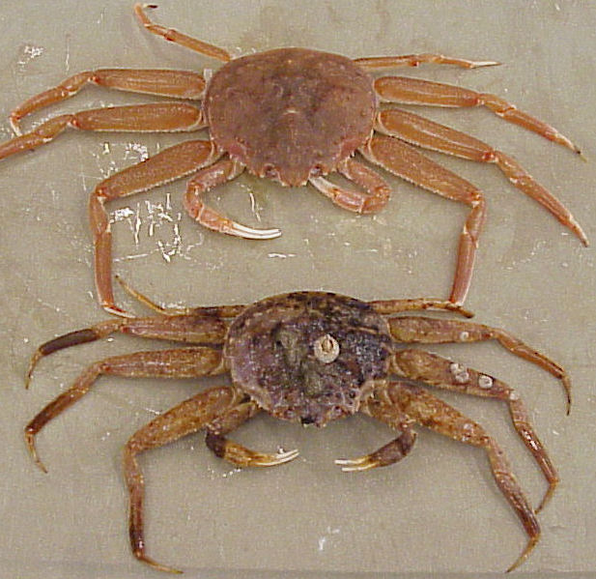
Life History
Photo credit: NOAA NMFS
Photo credit: NOAA NMFS

Slide 6
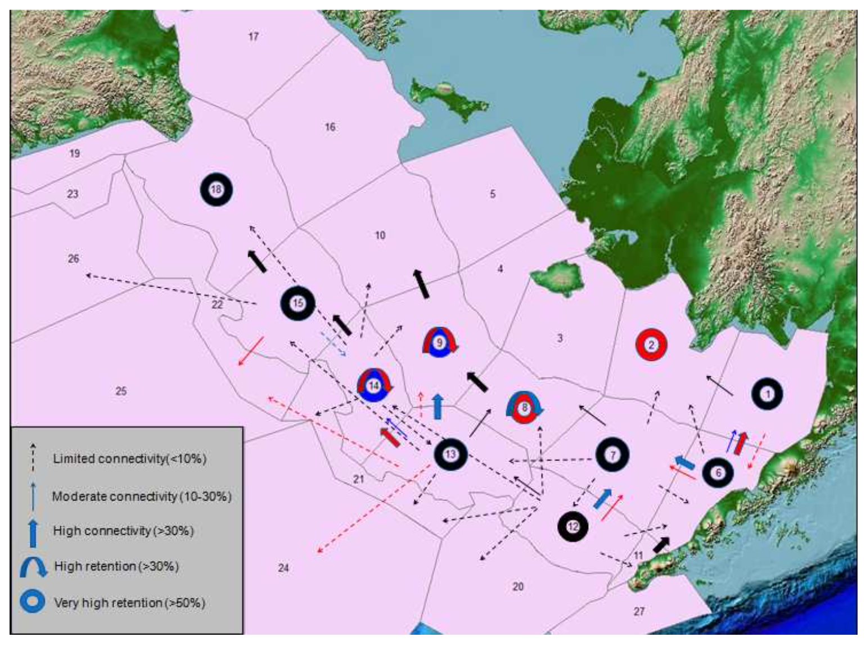
Richar et al. (2015) Progress in Oceanography
Simulated drift from 1978 - 2004
High retention in Bristol Bay
Asymmetric, northwesterly flow
1978-2004
1978-1990
1991-2004

Slide 7
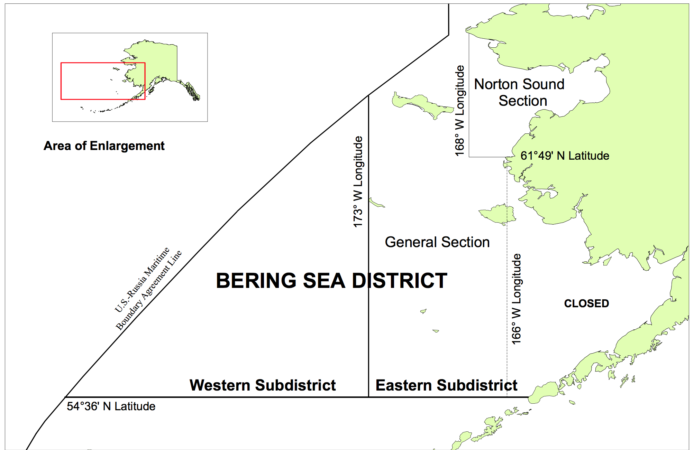
Eastern Bering Sea: 166°W Longitude
West 166
East 166
Figure modified from Bowers et al. (2008) Fishery Management Report No 08-73
Notes:
Bowers, F. R., Schwenzfeier, M., Coleman, S., Failor-Rounds, B., Milani, K., Herring, K., ... & Albert, M. (2008). Annual management report for the commercial and subsistence shellfish fisheries of the Aleutian Islands, Bering Sea and the westward region’s shellfish observer program, 2006/07. Alaska Department of Fish and Game, Division of Commercial Fisheries, Fishery Management Report, 08-01.

Slide 8
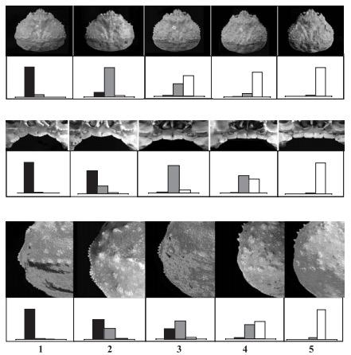
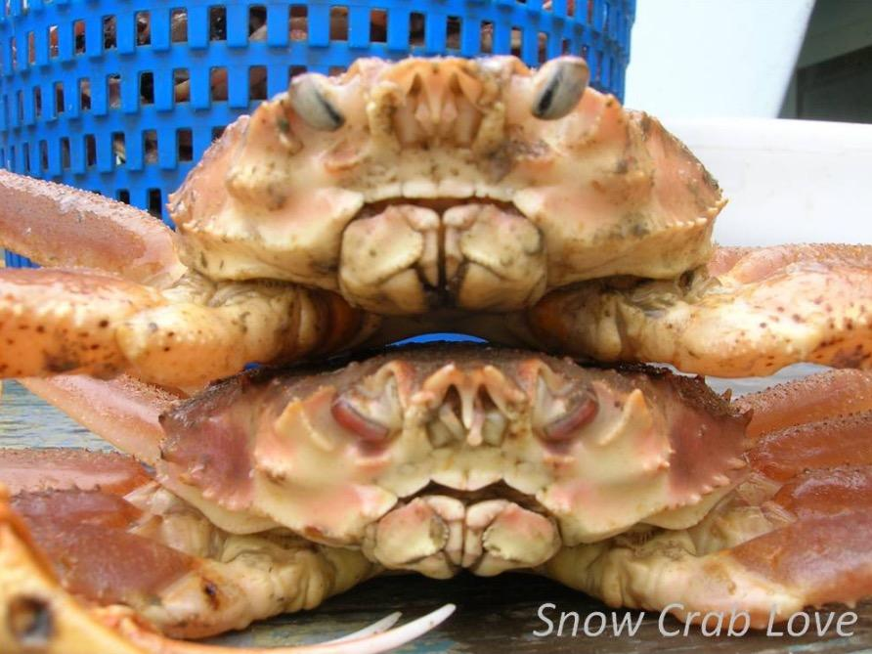
Bering Sea:
Hybridization with Chionoecetes opilio
Photo credit: Molly Zaleski
C. bairdi
C. opilio
Urban et al. (2002) Crabs in coldwater regions
Notes:
Urban, D., Pengilly, D., Jadamec, L., & Byersdorfer, S. C. (2002). Testing carapace morphology characteristics for field identification of Chionoecetes hybrids. In A. J. Paul, E. G. Dawe, R. Elner, G. S. Jamieson, G. H. Kruse, R. S. Otto, & B. Sainte-Marie (Eds.), Crabs in coldwater regions: biology, management and economics. Lowell Wakefield Fisheries Symposium Series. Alaska Sea Grant College Program University of Alaska, Fairbanks (pp. 97-113).

Slide 9
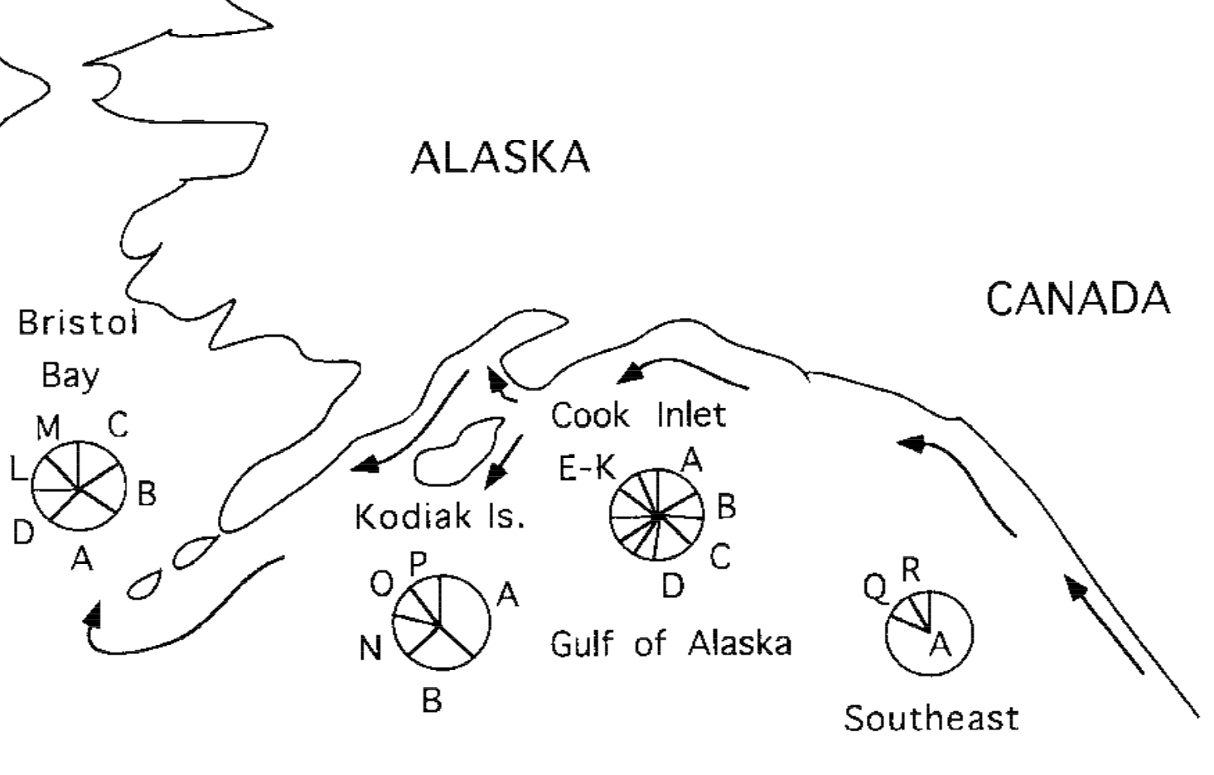
Bunch et al. (1998) Mol Mar Bio & Biotech
mtDNA CO1 gene
18 distinct haplotypes
Haplotype diversity differed among regions
Possible transport by ACC
Notes:
Transition: Stevens 2003 - observed females off Kodiak time larval release with tidal patterns, postulated that this could increase uptake into ACC
Previous work: mtDNA
Only used mitochondrial CO1 gene (Cytochrome C Oxidase) 413bp
52 individuals and detected 18 different haplotypes
No independent variant was unique to a region, but some haplotypes were
Haplotype diversity was significantly different between regions, but genetic diversitywas only significantly different between southeast and cook inlet
The most common haplotype (A) was present in every region
Southeast AK was majority haplotype A
Combination of haplotypes arising and being retained in certain regions and haplotypes occurring in multiple regions
It was interpreted to mean evidence of ACC transport, but the evidence was weak (would expect a trend from high haplotype diversity to low if it was a true source/sink across geographic distance)

Slide 10
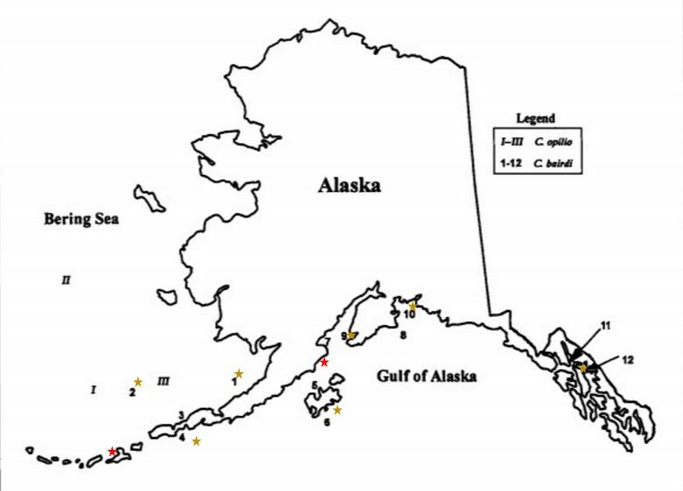
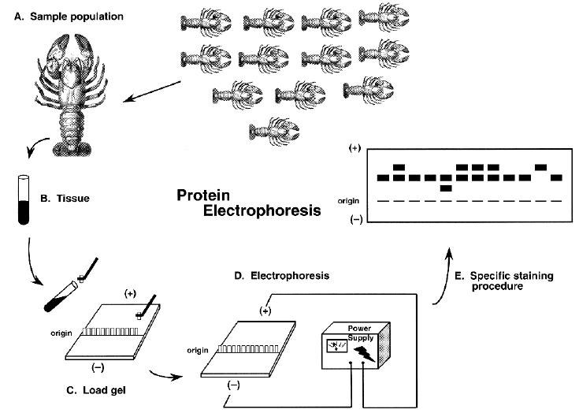
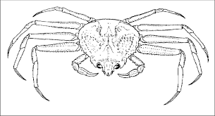
Allozymes (proteins with variation)
Merkouris et al. (1998) Fishery Bulletin
27 loci: 12 uniform, 15 variable
Significant differentiation between regions: Bering Sea/Gulf of Alaska/Southeast Alaska
Allele frequencies of 3 loci differed east and west of 166 ° W
Figure modified from Fetzner & Crandall (2001) Biology of Freshwater Crayfish
Notes:
Previous work: allozymes
Significant differentiation between major regions EBS/GOA/SE
Significant differentiation between 3 loci EBS east and west of 162 degrees W longitude

Slide 11
Objectives
Measure genetic diversity with genome-wide genotypes
Test for genetic differentiation among major regions

Slide 12
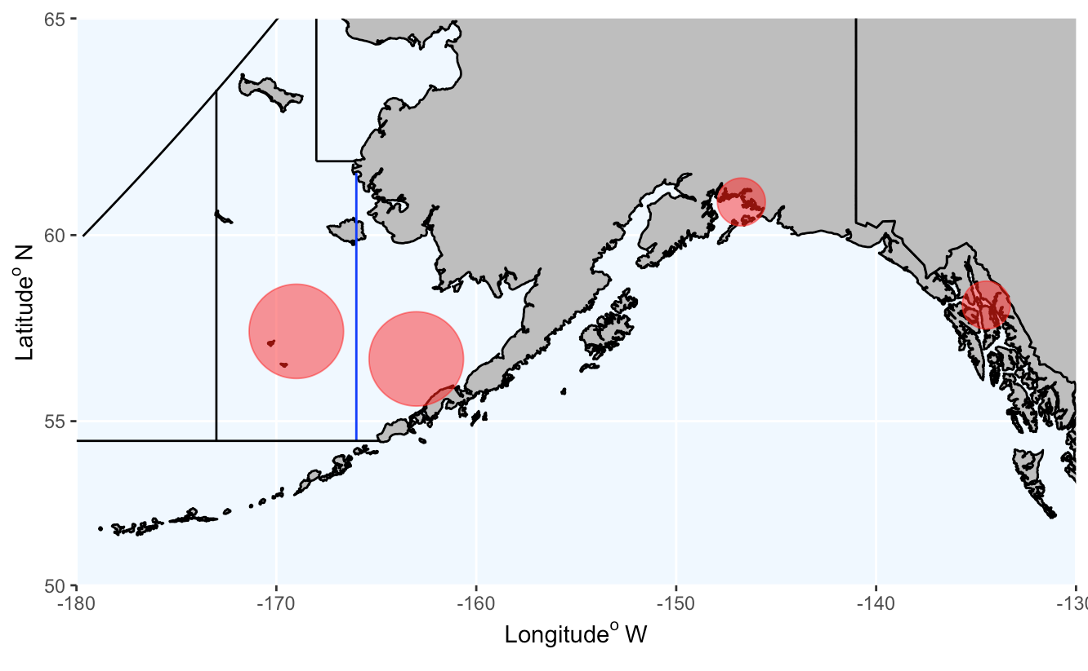
PWS
n = 21
EBS_NW
n = 23
SEAK
n = 21
EBS_SE
n = 24
Notes:
EBS samples do not have geo-reference data. Circles do not reflect exact regions (so not necessarily Pribilof Islands)

Slide 13
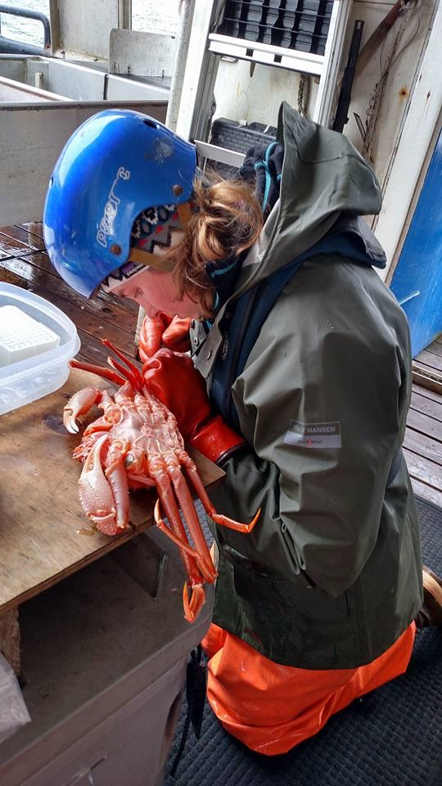
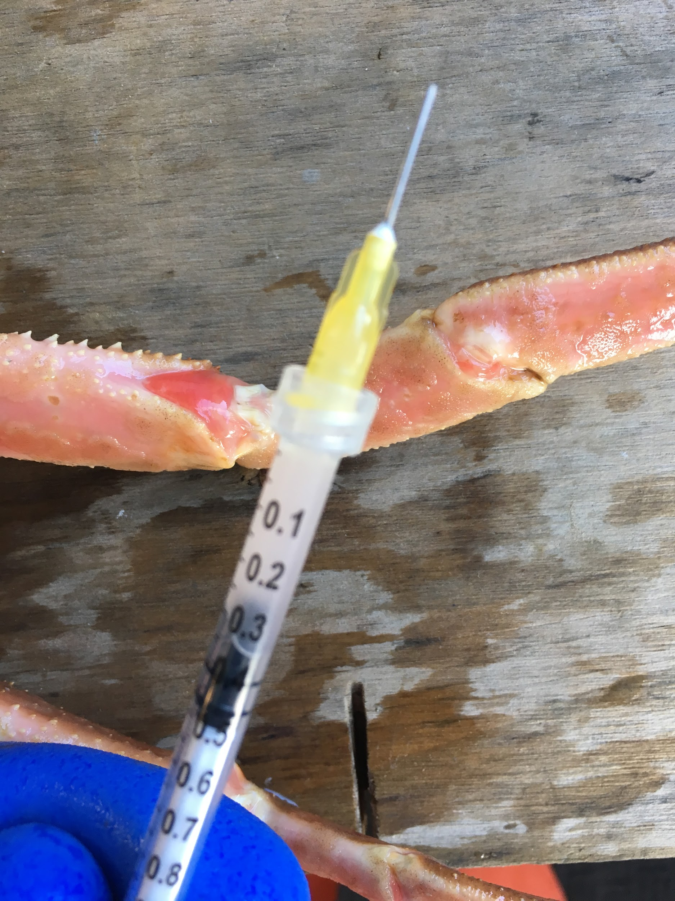
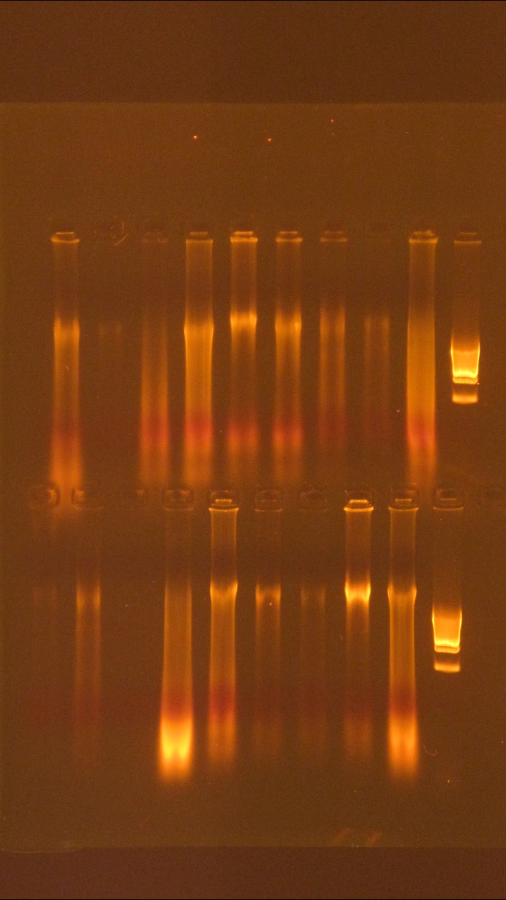
Sampling

Slide 14
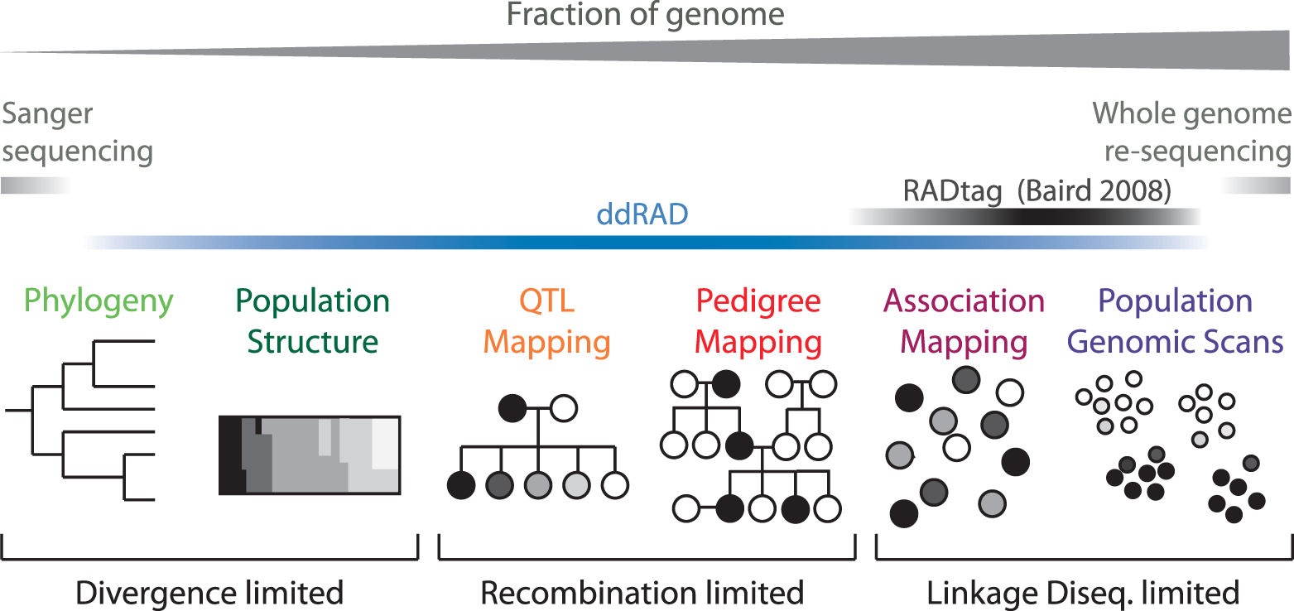
Reduced representation sequencing
Figure modified from Peterson et al. (2012) PloS one

Slide 15
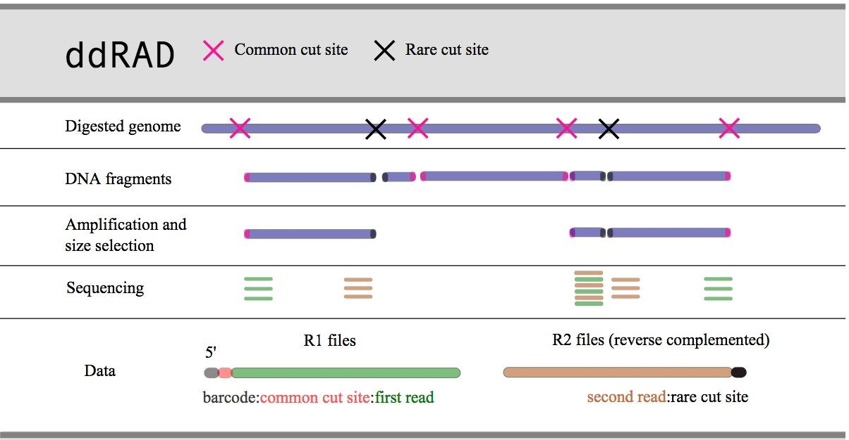






Double digest restriction associated DNA sequencing
EcoRI-HF
MspI
Figure modified from D. Eaton pyrad tutorial

Slide 16
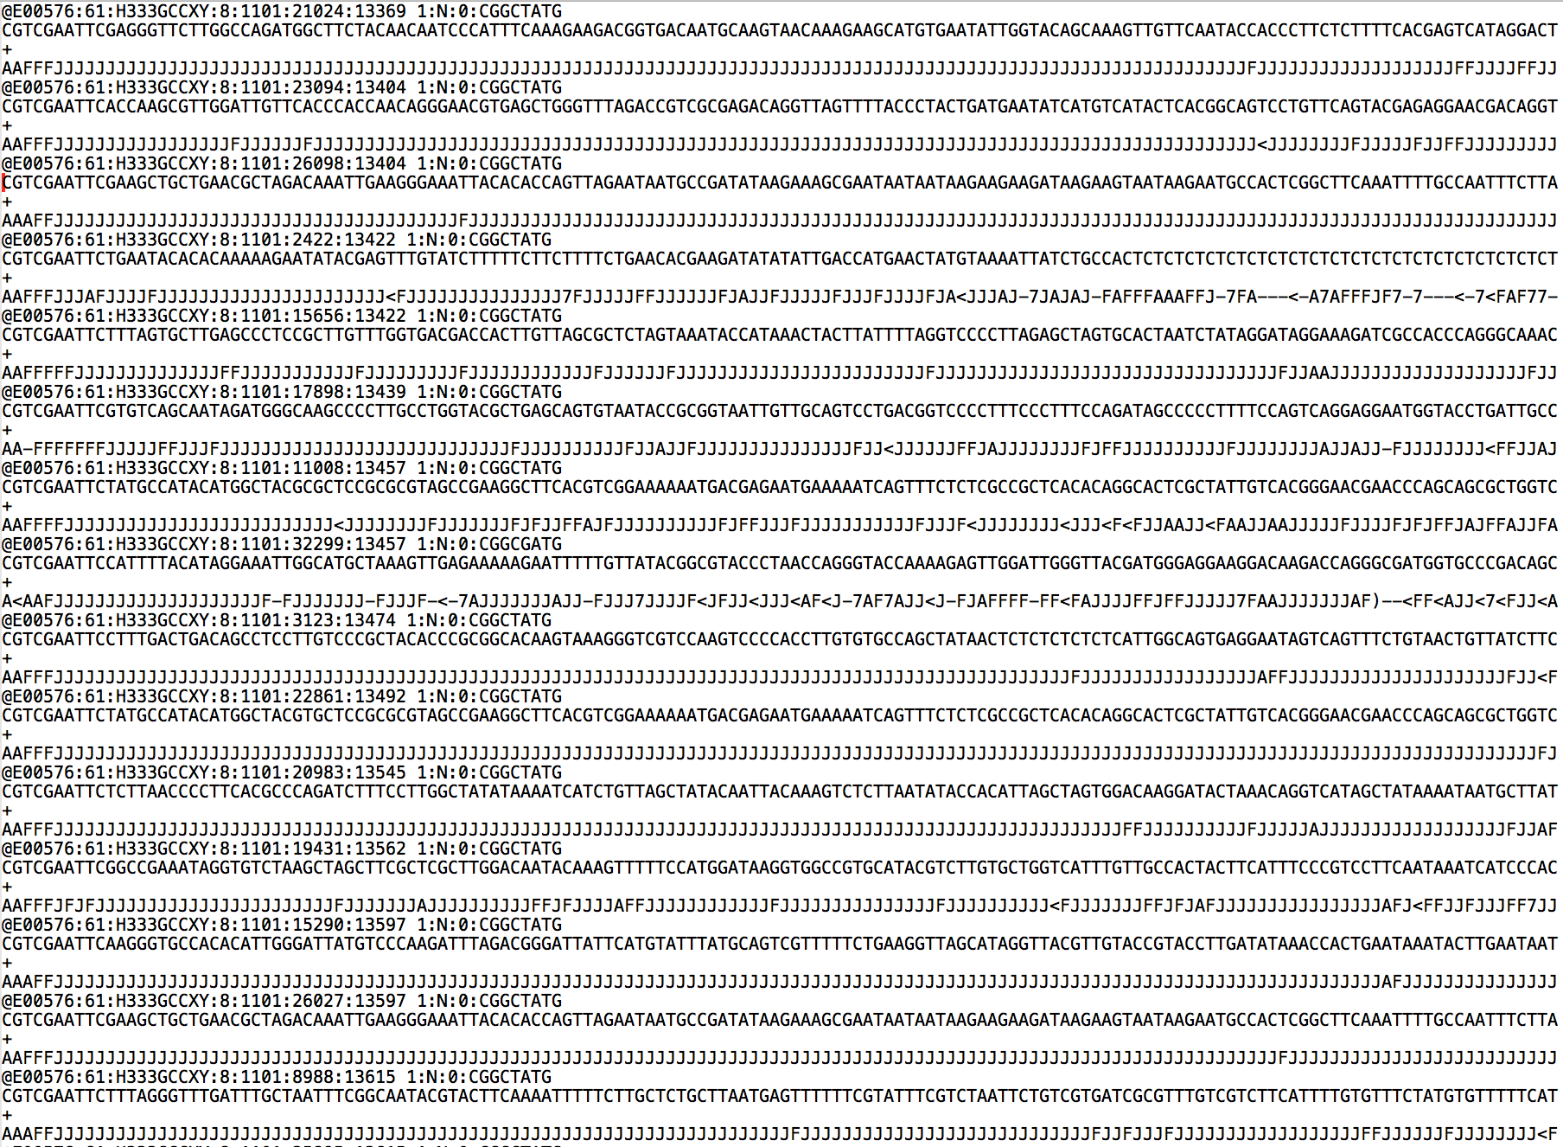

Slide 17
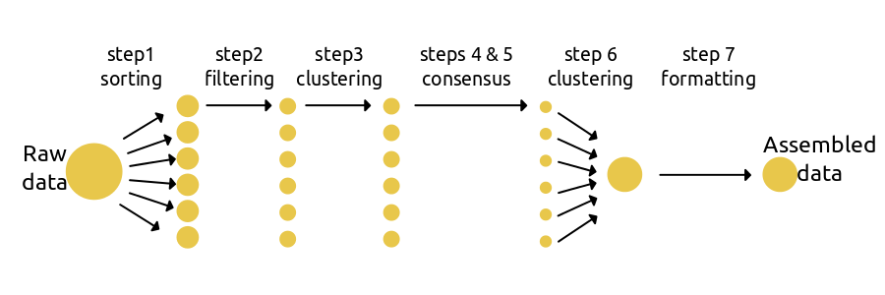
Bioinformatic processing
Figure from D. Eaton ipyrad tutorial

Slide 18
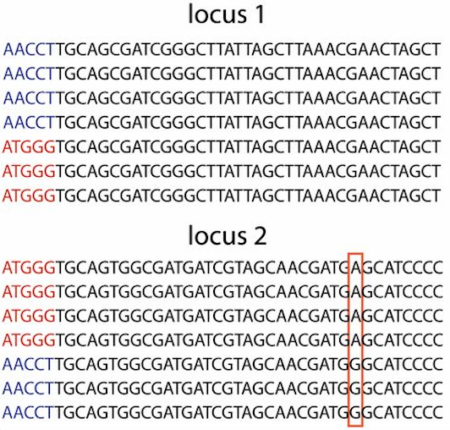
Bioinformatic processing
Figure from D. Eaton ipyrad tutorial
& Recknagal et al. (2013) G3

Slide 19
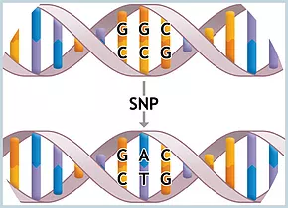
Bioinformatic processing
Single Nucleotide Polymorphism
Figure from D. Eaton ipyrad tutorial
& Recknagal et al. (2013) G3

Slide 20
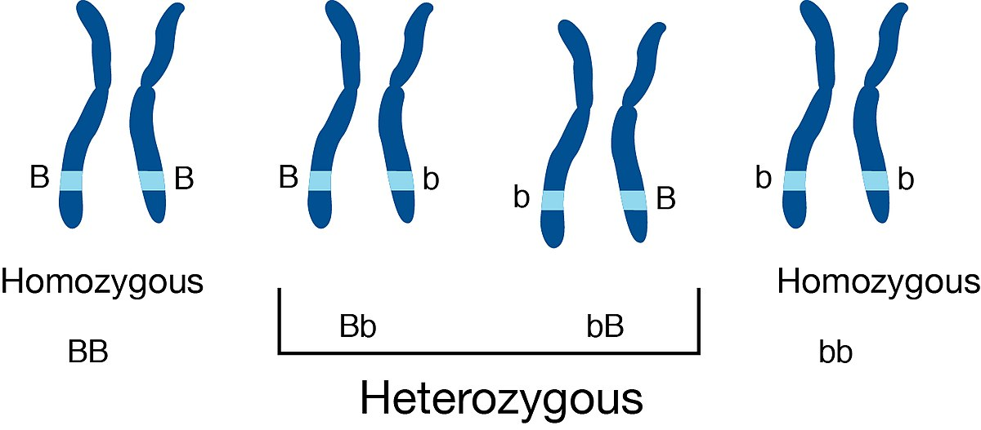
Genotypes
C
C
C
T
T
T
T
C
CT
TC
CC
TT
0 1 2

Slide 21
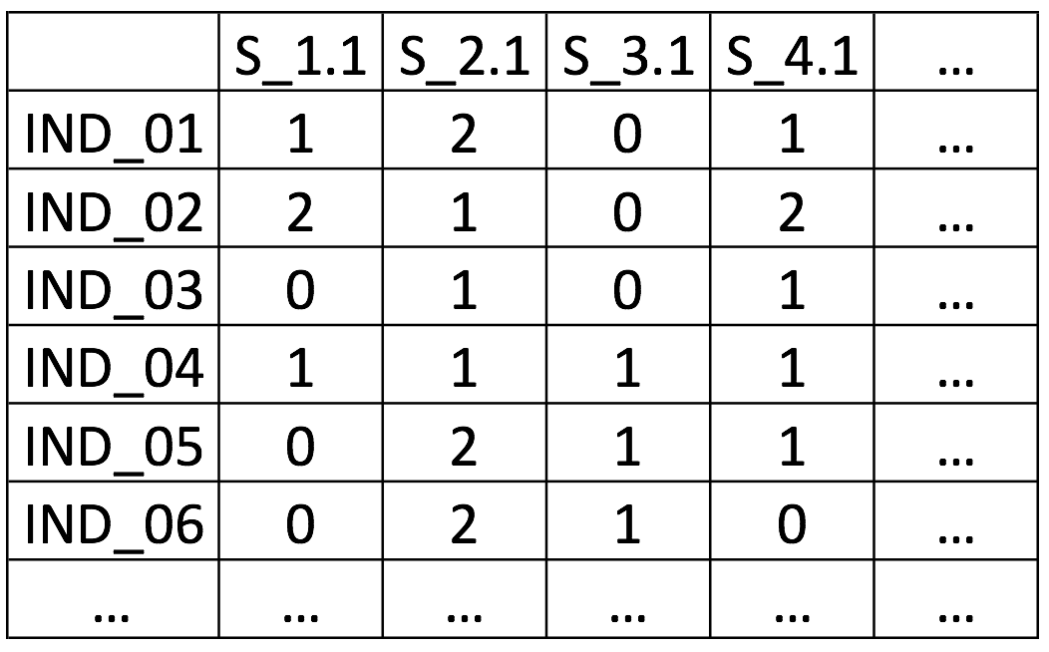
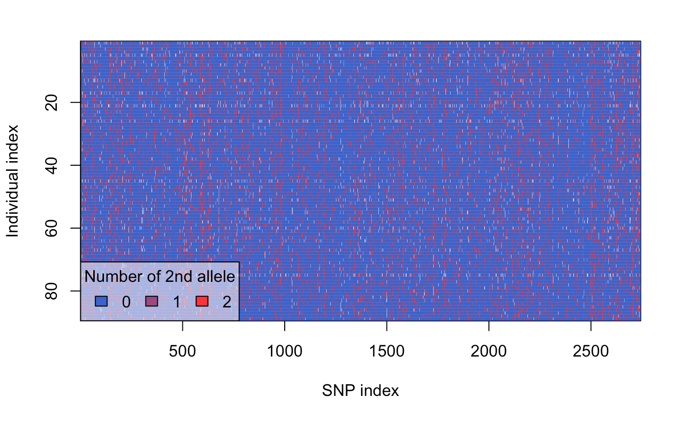

Slide 22
89 Individuals genotyped at
2,740 SNP sites in final assembly

Slide 23
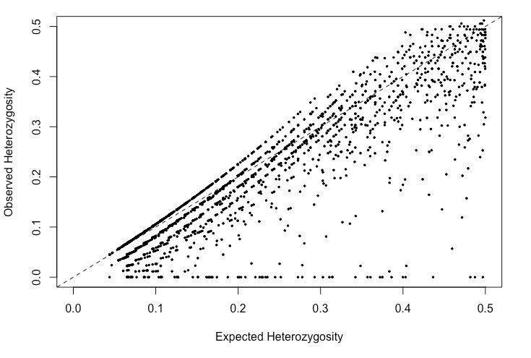
Heterozygosity by locus
Mean HExp = 0.186
Mean HObs = 0.164
Difference: -0.022*

Slide 24
Gene diversity (Mean HExp)
0.178
0.184
0.182
0.183

Slide 25
Mean Observed Heterozygosity (HObs)
0.161
0.166
0.163
0.165

Slide 26
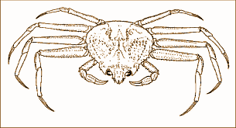

Hierarchical Organization of Genetic Diversity
Within-population
variation
Individual
AACTTGG
AATTTGG
Between-population variation
Chromosomes
Polymorphic sites
Within-individual variation

Slide 27
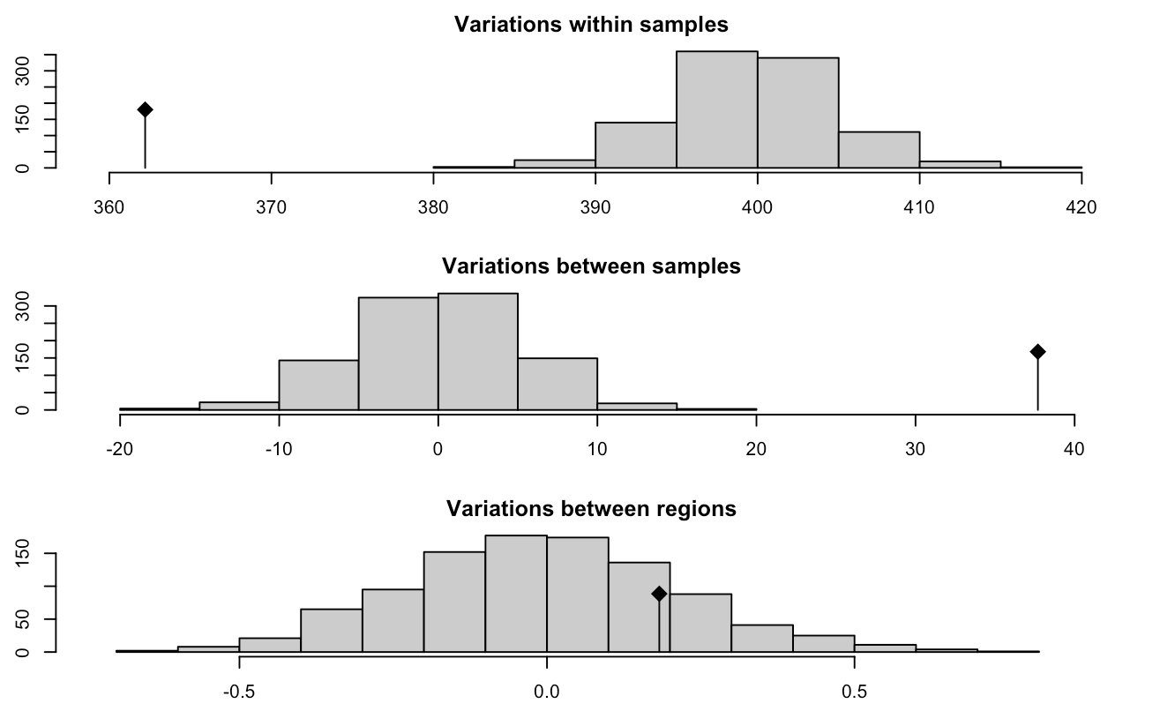
Analysis of Molecular Variance (AMOVA)
90.53%
p.value < 0.001
9.42%
p.value < 0.001
0.05%
p.value = 0.184

Slide 28
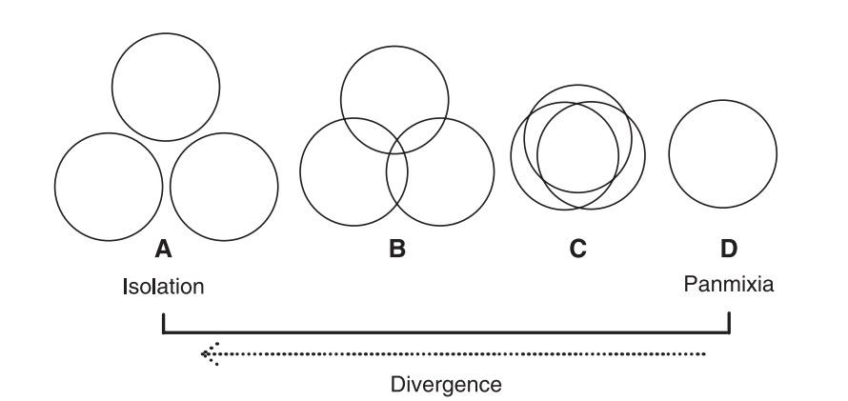
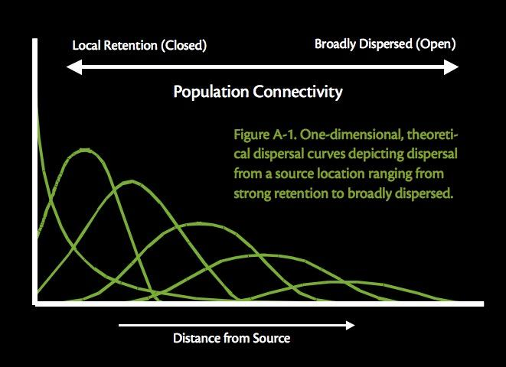
FST is a classic population genetics statistic used to measure genetic differentiation among groups
Waples & Gaggioti, (2006) Mol Eco
Cowen et al. (2007) Oceanography
FST ≈ 1 FST ≈ 0

Slide 29
Hierarchical Structure F-statistics
Correlation of alleles within an individual
relative to the entire population
FIT
Individual
Subpopulation
Total Population
FIS
FST
Correlation of alleles within an individual
relative to its subpopulation
Proportion of genetic diversity due to allele frequency differences among populations

Slide 30
Hierarchical Structure F-statistics
FIT
Individual
Subpopulation
Total Population
FIS
FST
0.000229
Notes:
Jasonowicz, A. (2015). Genomic signatures of natural selection and population structure in West Coast and Alaskan sablefish (Anoplopoma fimbria)(Doctoral dissertation).

Slide 31
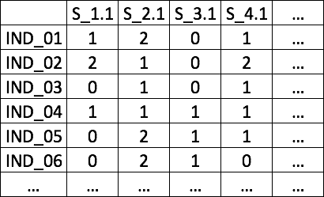
Hierarchical Structure
ϕIT
Individual
Subpopulation
Total Population
ϕIS
ϕST

Slide 32
Hierarchical Structure
0.0947
ϕIT
Individual
Subpopulation
Total Population
ϕIS
ϕST
0.0943
0.000456

Slide 33
Pairwise FST

Slide 34
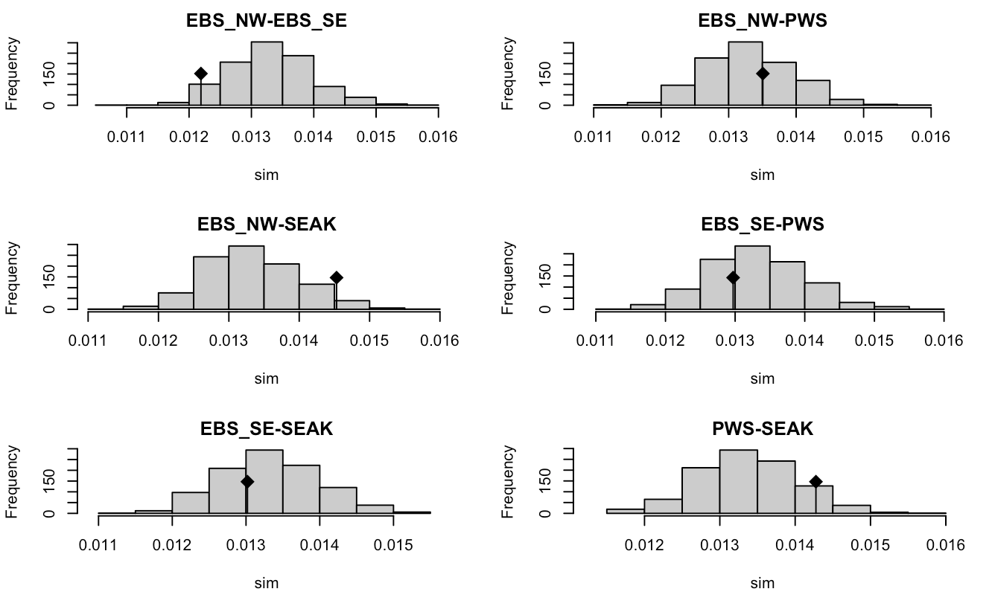
Pairwise FST

Slide 35
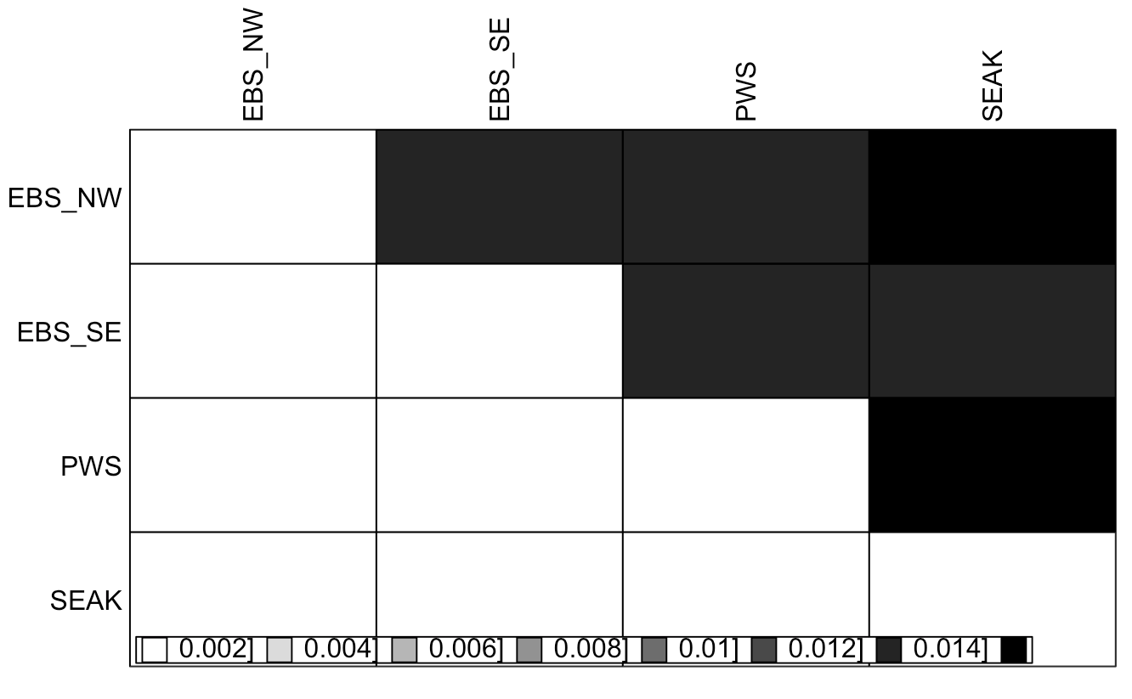
Pairwise FST
0.0122 0.0135 0.0145
0.0130 0.0130
0.0143
0.97
0.36 0.68
0.046 0.67 0.10

Slide 36
Testing for population partitioning with nonparametric and parametric methods

Slide 37
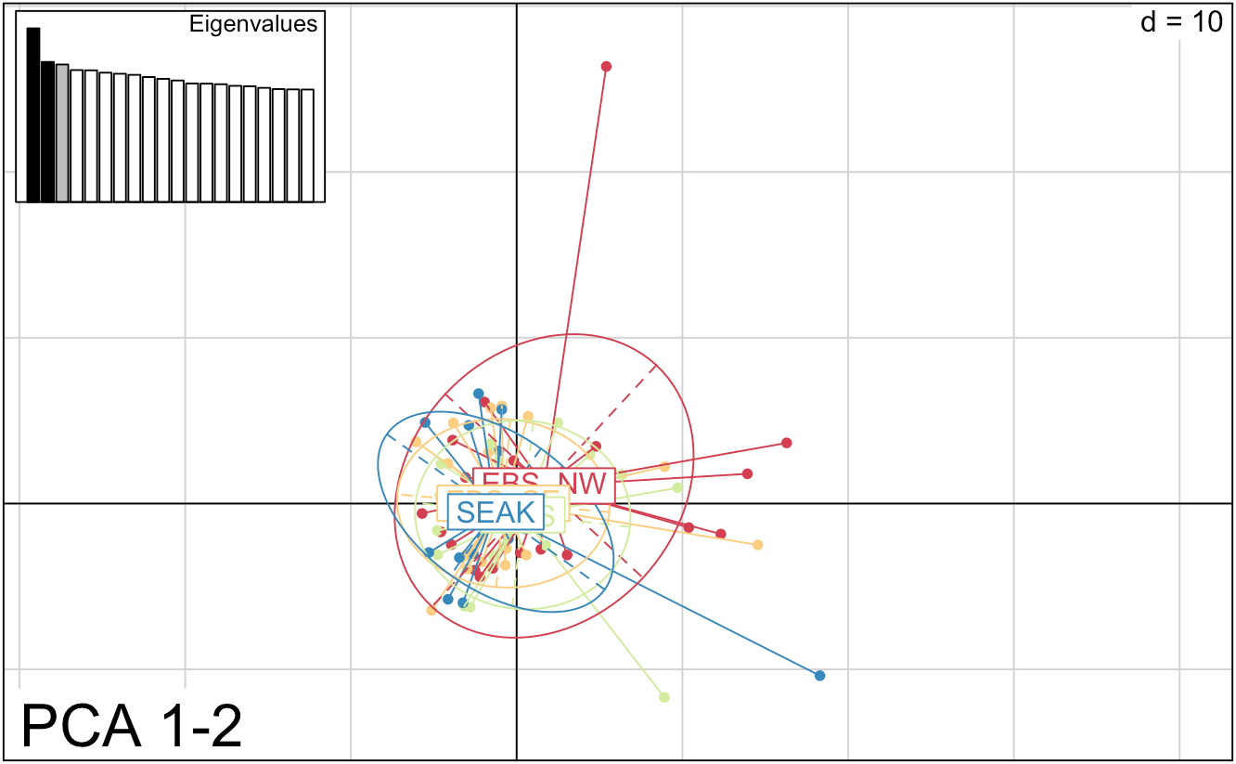
Principal Components Analysis
PC2 (1.7%)
PC1 (2.1%)

Slide 38
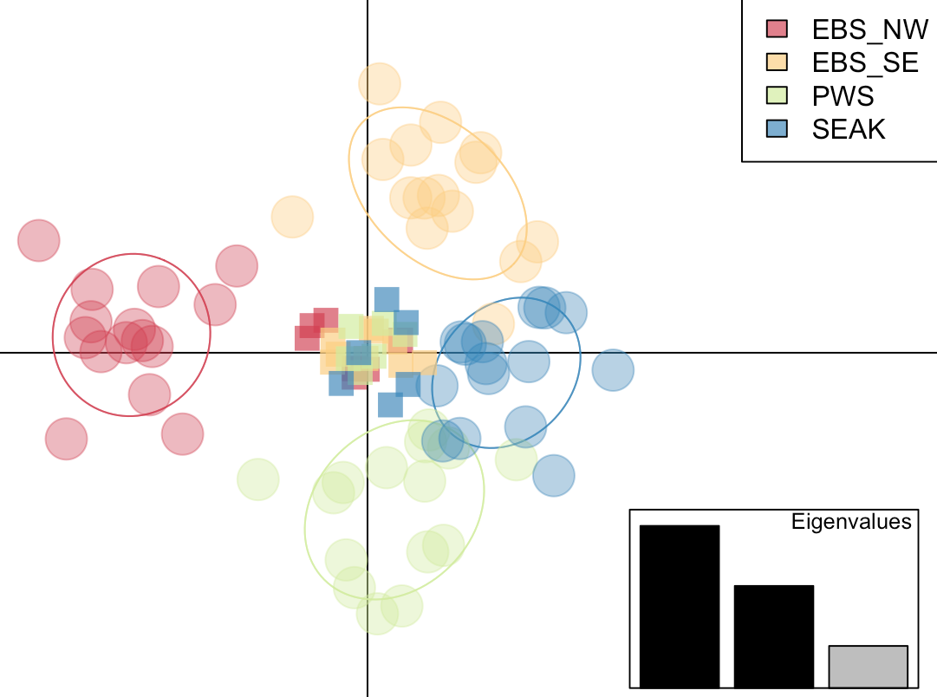
Discriminant Analysis of
Principal Components (DAPC)
Method to summarize variation between groups while overlooking variation within groups
Tests assignment back to groups
Assignments by DAPC
did not perform better
than random assignment

Slide 39
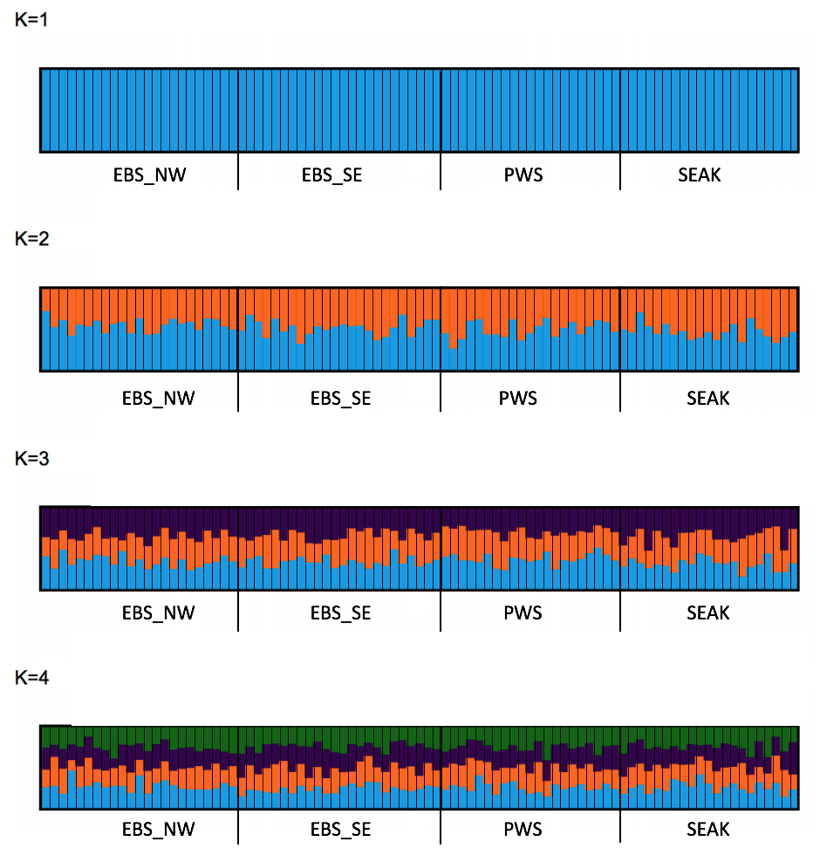
STRUCTURE
Parametric Bayesian clustering algorithm
Found no support for more than one cluster

Slide 40
What does all of this mean?
Waples & Gaggioti, (2006) Mol Eco
Could not reject panmixia
Other panmictic species in AK
Allozyme differentiation?
Cowen et al. (2007) Oceanography
Fst ≈ 1 Fst ≈ 0

Slide 41
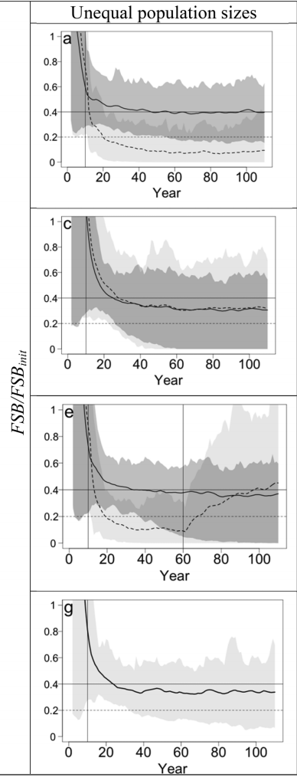
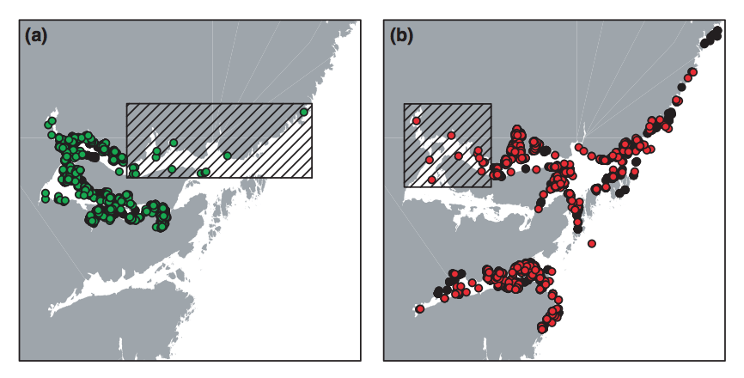
How are genetic insights relevant to management?
Knutsen et al. (2011) Mol Eco
Low but significant FST in Atlantic Cod matched spatial movement patterns
Spies et al. (2015) CAN Jour Fish Aqu Sci
Notes:
Are low but statistically significant levels of genetic differentiation in marine fishes ‘biologically meaningful’? A case study of coastal Atlantic cod
Fig. 2

Slide 42
Takeaways
Observed heterozygosity is within range of marine species, but significantly lower than expectations under Hardy-Weinberg assumptions
Did not detect significant genetic differentiation between sampling regions
Clustering analyses did not support subpopulation partitioning

Slide 43










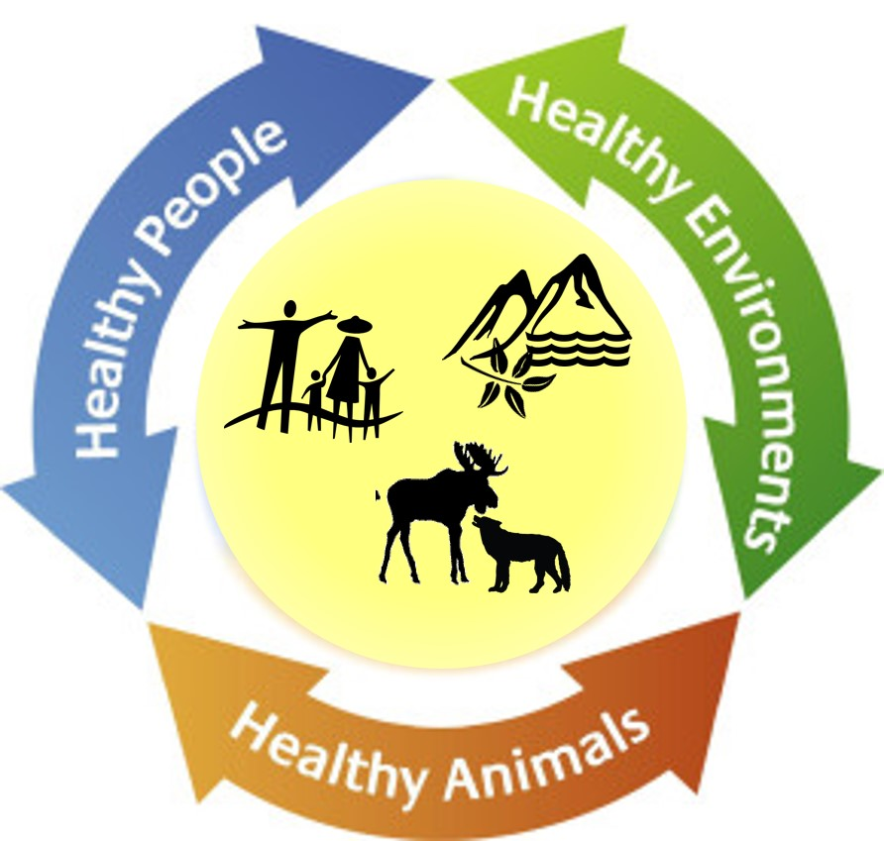


Acknowledgements & funding
Sampling:
Thesis committee:
J. Andrés López^{1,2}
Sarah Hardy¹
Ginny Eckert¹
Funding:
1
2
Computing resources:
UAF GI Research Computing Systems
Northern Gulf of Alaska Applied Research Award donation
And a special “thank you” to the past members of the López Lab who helped me learn genetics lab techniques!
Research reported in this publication was supported by the National Institute Of General Medical Sciences of the National Institutes of Health under Award Numbers UL1GM118991, TL4GM118992, or RL5GM118990. The content is solely the responsibility of the authors and does not necessarily represent the official views of the National Institutes of Health. BLaST is supported by the NIH with the linked awards; TL4GM118992, RL5GM118990, UL1GM118991. UA is an AA/EEO employer and educational institution and prohibits illegal discrimination against any individual: www.alaska.edu/titleIXcompliance/nondiscrimination
Research reported in this publication was supported by an Institutional Development Award (IDeA) from the National Institute of General Medical Sciences of the National Institutes of Health under grant number P20GM103395. The content is solely the responsibility of the authors and does not necessarily reflect the official views of the NIH.

