Slide 1
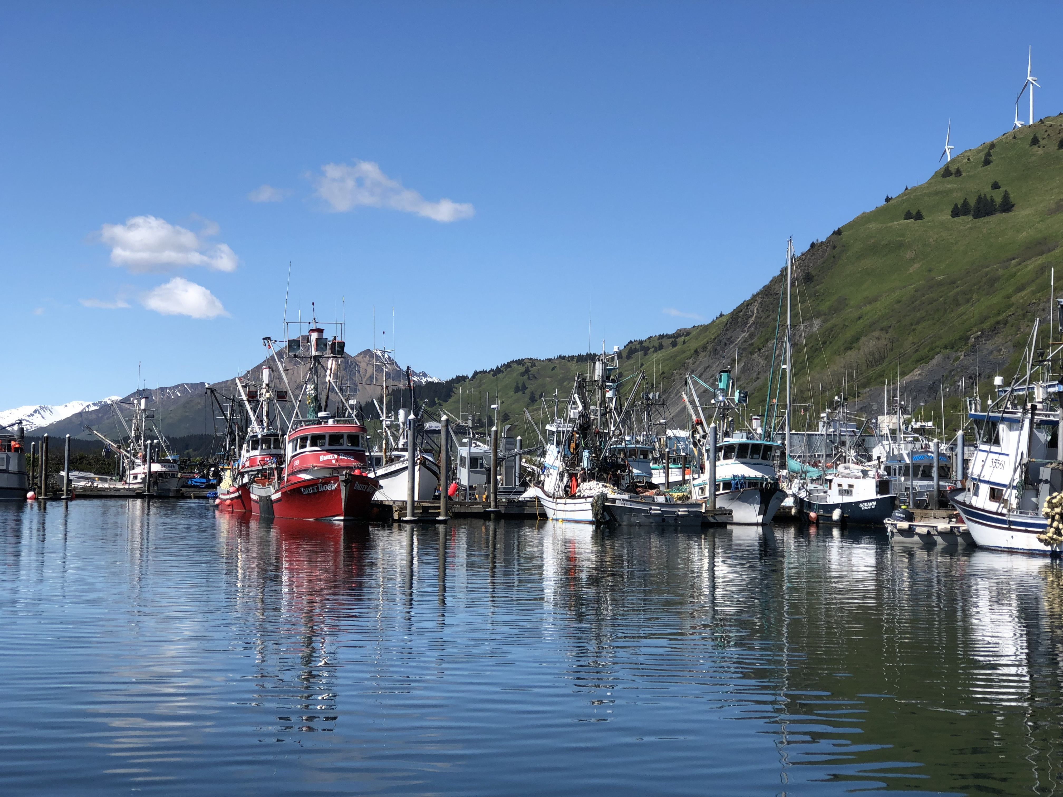
Welcome to the Adobe Connect platform!
This training is geared to the Adobe Connect app that you use on your computer.
    On an iPad, the layout looks a little different.
Terminology: we call each window on the screen a pod.
For individual tech support, email npfmc.admin@noaa.gov

Slide 2
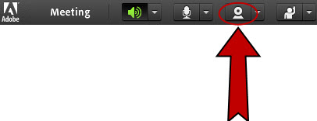
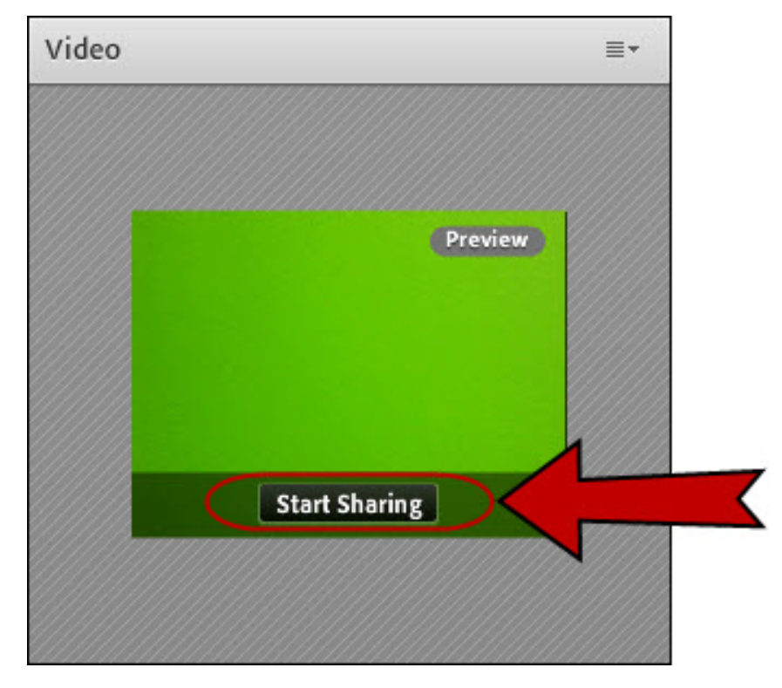
Committee member webcam use
Only Committee members, NPFMC staff, or agency staff giving presentations should turn on their webcam. This is optional, but preferred.
Members of the public are asked to participate via telephone only.
Join the meeting and click on the webcam button.
In the video pod, you will see a video preview. Line up and focus your camera, then click Start Sharing.

Slide 3
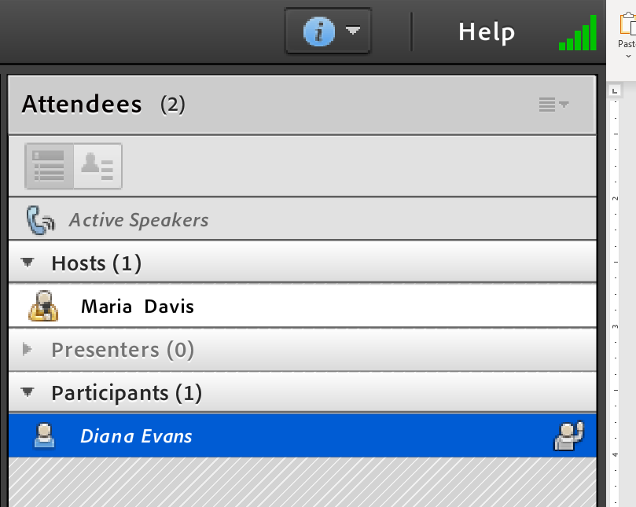
Attendee pod
All attendees are listed in the pod on the right-hand side of the screen.
Hosts are NPFMC staff. You can free up space by clicking on the arrow to hide them.
Committee members will be listed first under participants.
  Each Committee member should place “01” before their name when logging in. (A host can also add “01.”)

Slide 4
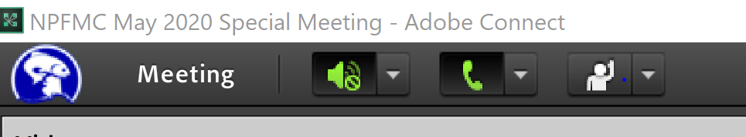
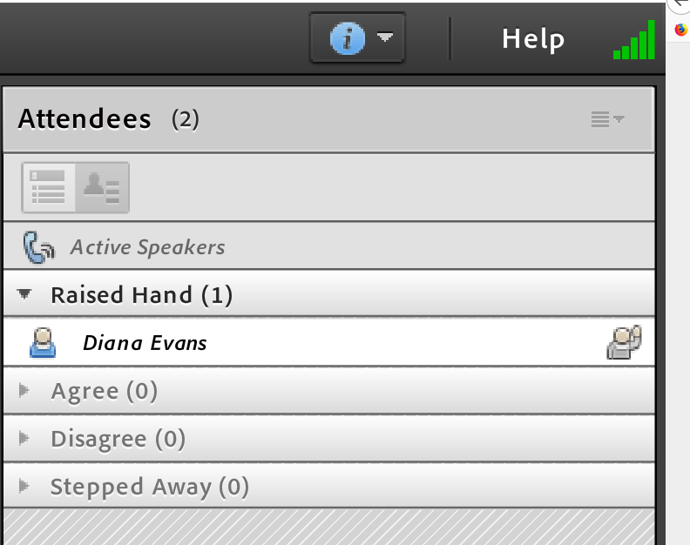
Raising your hand to be acknowledged
The Committee will use the ‘raise hand’ feature in the app for discussion.
Click on the ‘raise hand’ icon to raise or lower your hand (or use the drop-down menu).
You can see your hand is raised in the attendee pod:
Or toggle to ‘attendee status view’ and see only the raised hands (listed in order):

Slide 5
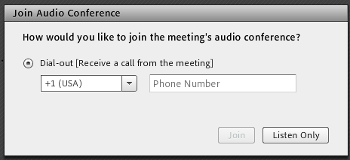
Reconnecting audio after a break
Go ahead and hang up your phone on the breaks, so you can use it for other things.
When you are ready to reconnect, click on the phone icon at the top:
You will get the same “dial out” option as when you joined.

Slide 6

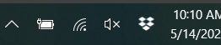

Tips to make everything work better
Keep yourself on mute unless you need to talk
    Pro tip: it’s easier to press the mute button on your phone that to mute yourself from the computer, though both work
Make sure you can only hear the meeting through your phone
    You want to see a sign by your speaker on the top left
    For extra security, mute your computer too
Expect a lag time with presentation visuals
    There can be a delay between the presenter talking about a new slide and you seeing it
You can make some pods full screen by clicking this button in the pod’s top right corner:

