Slide 1
Crab SAFE: Economic Status Report 2020
Presented by:
Brian Garber-Yonts
Alaska Fisheries Science Center
Economics and Social Science Research Program
January 10, 2022

Slide 2

2020 Crab Economic SAFE Overview
Executive Summary (SAFE Report extract)
Economic Status and Trends
  Economic output
    TACs, landings, ex-vessel and finished product volume
    Ex-vessel and first wholesale revenue and average prices
  Income and employment
  Operating costs and Income Statement
  Quota Market and Holdings
  Fishing capacity and effort
  International trade
Notes:
Exec sum to be reshaped into reportcards?

Slide 3
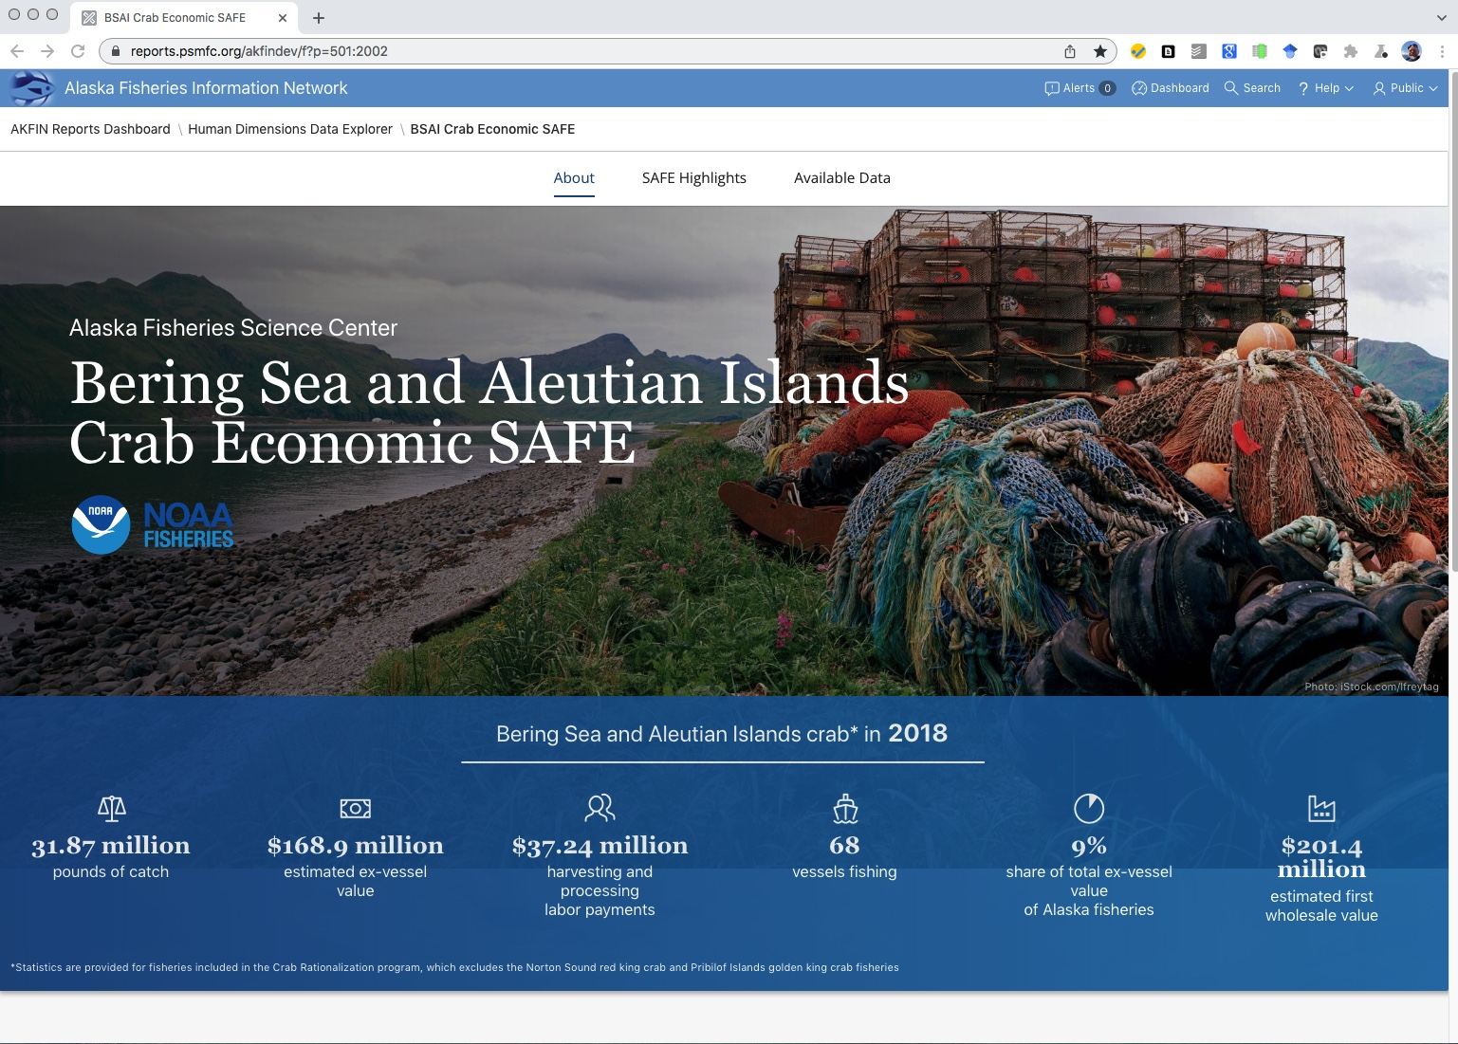
Economic SAFE availability
https://www.afsc.noaa.gov/REFM/Socioeconomics/SAFE/default.php
https://reports.psmfc.org/akfindev/f?p=501:2002

Slide 4
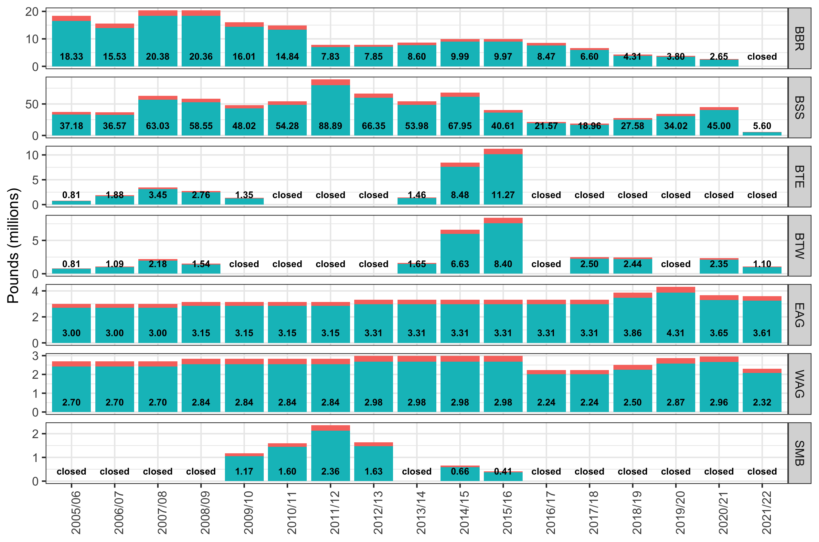
TAC 2005/06 – 2021/22

Slide 5
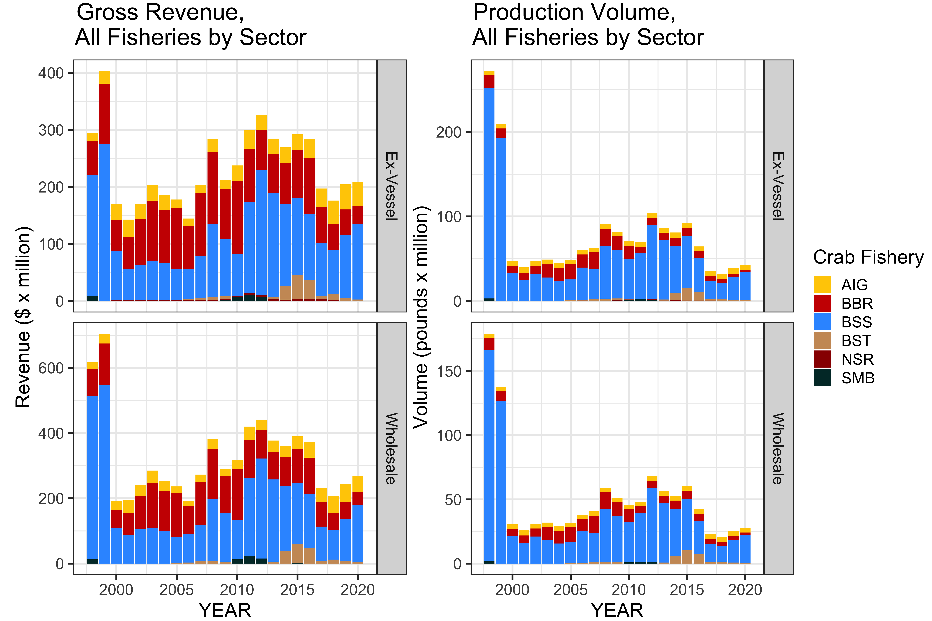
Production & Value
Notes:
Exv
Production: 42.6 million lbs +9%
Value: $208 million +2%
WS
27.9 million lbs +9%
$270 million +10%

Slide 6
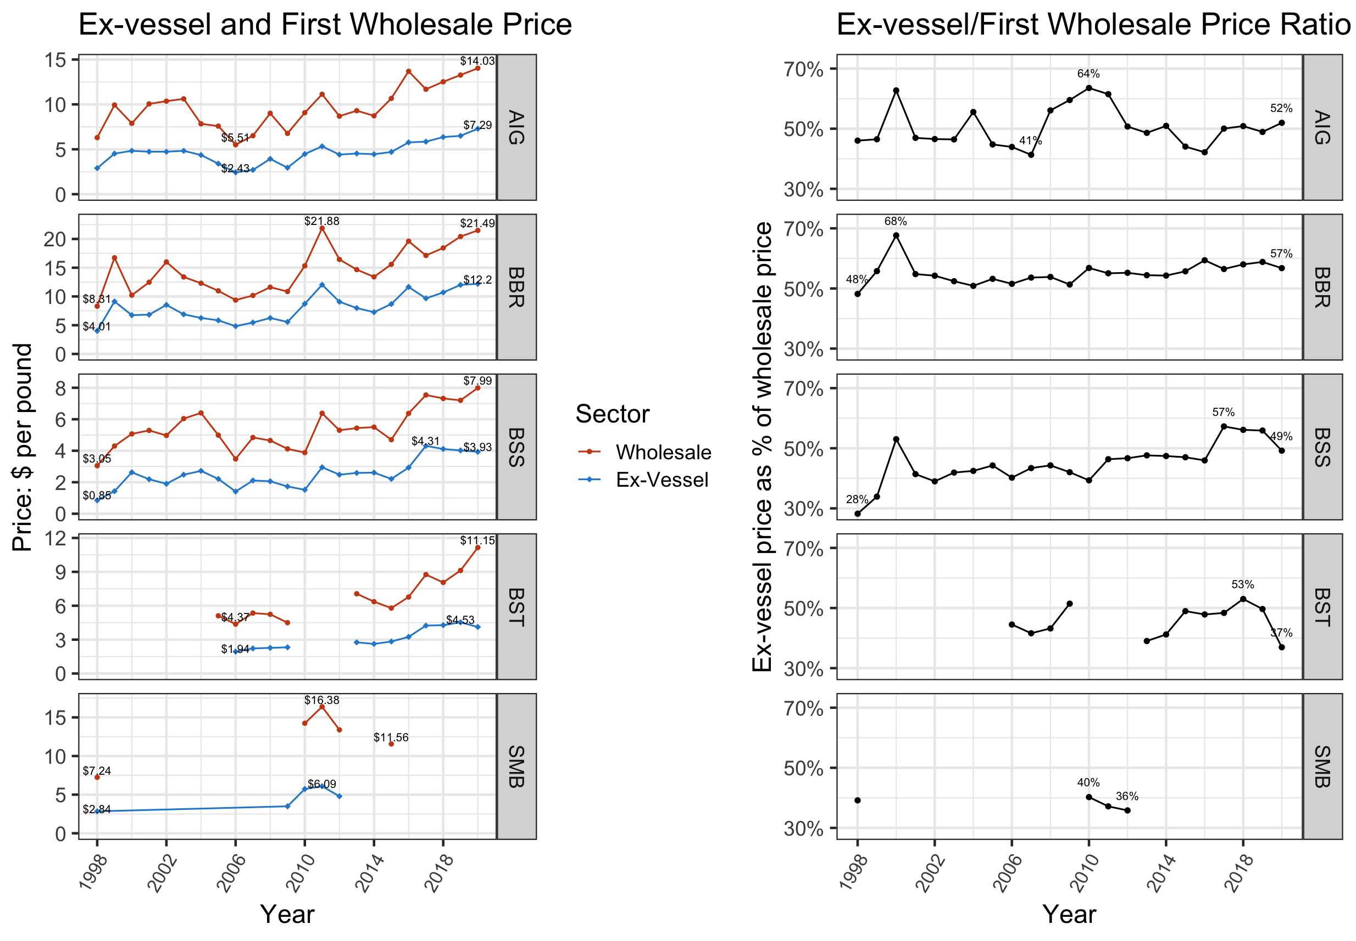
Ex-vessel & Wholesale Price
Notes:
Record price in AIG
$7.29 +12% / $14.03 +6%
Divergence of ExV/WS in BSS & BST
Prices remained strong in 2021, no. final numbers
Price ratios: generally stable, but slight upward trend over long term, although BSS trending down in <3 years
Stability is result of arbitration, coop management
Doesn’t control for affiliated sales (AIG particlularly vert integrated)
Should be particular focus for further development

Slide 7
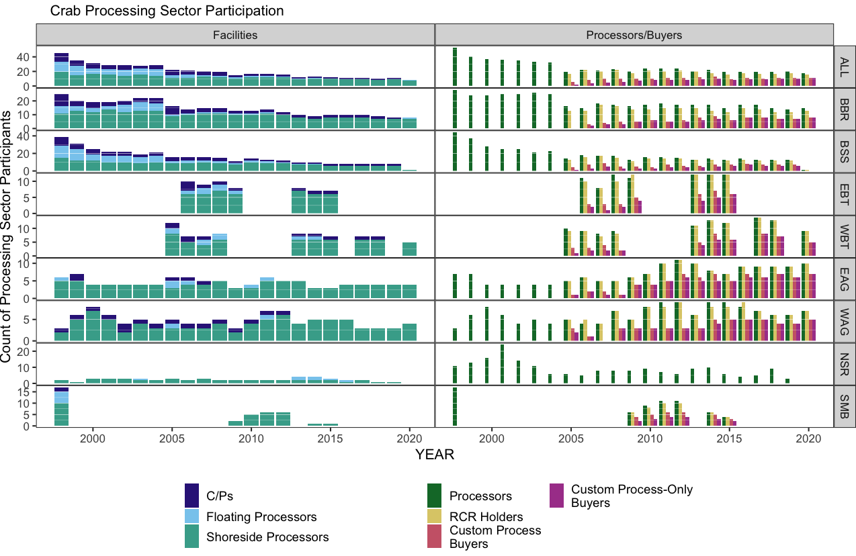
2020 Processing Capacity

Slide 8
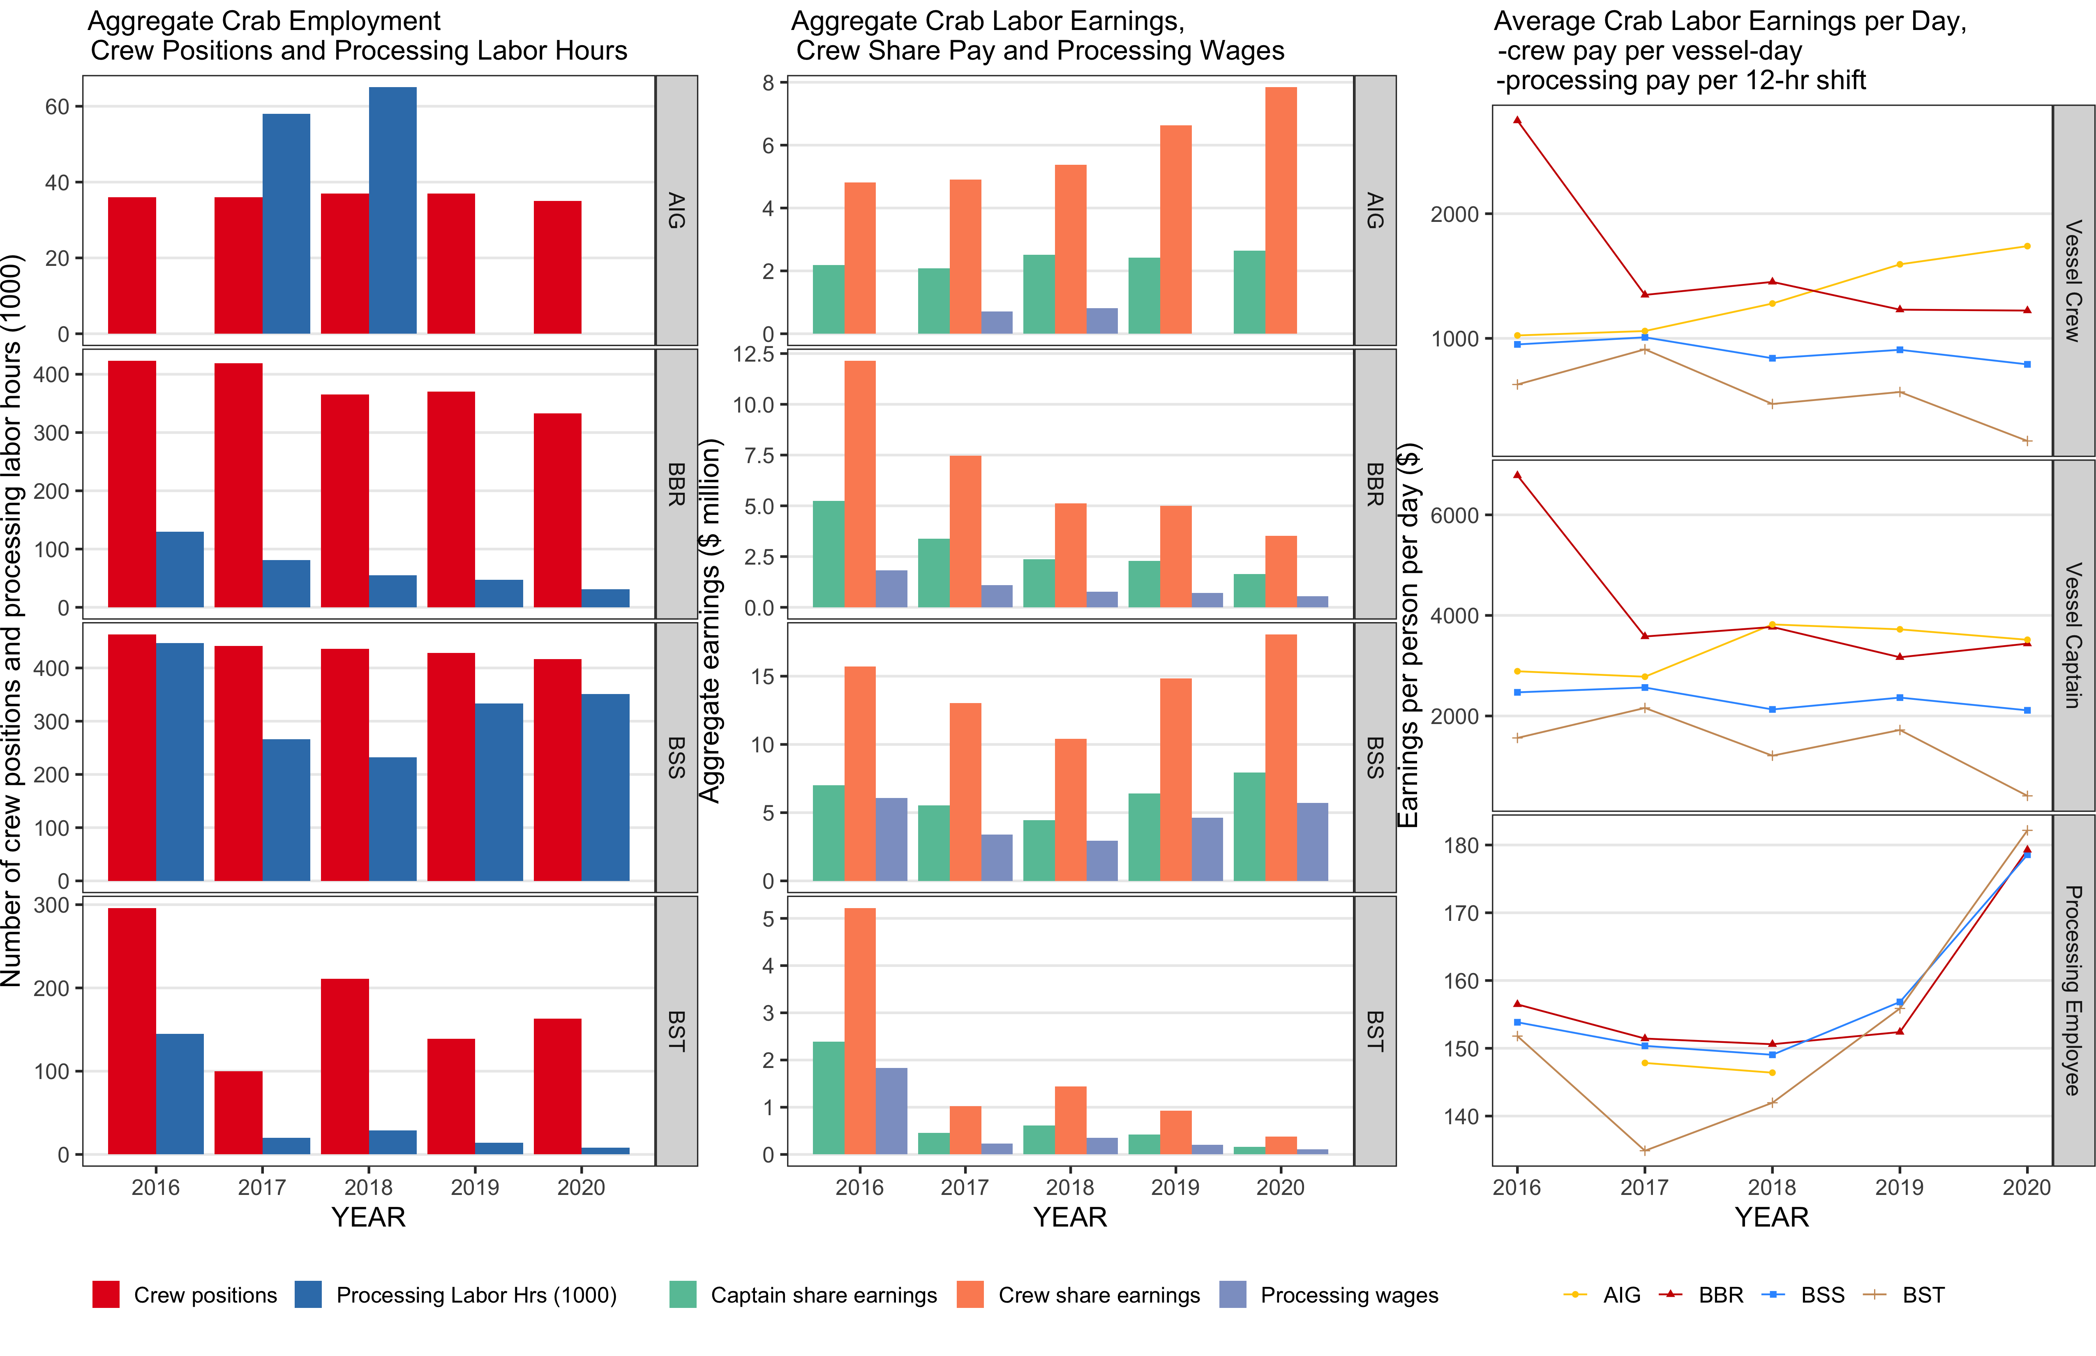
2020 Employment & Income (CR program)
Notes:
Exv
64 vessels – lowest in history
948 positions
Captrain pay $12.4 million +7%
Crew $29.8 million +9%
Proc
7 Plants – 2019/2020 historic low
452 thousand hrs 0%
$7.24 million +15%
$14.95/hr +15%

Slide 9
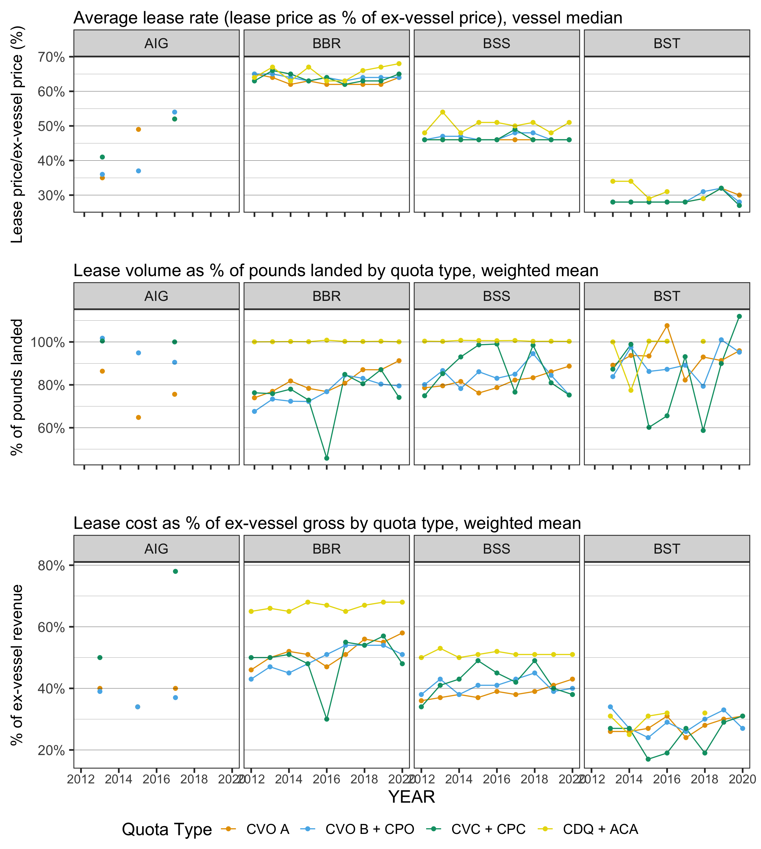
IFQ Lease Activity and Rates
  BBR CVO A: 62-63%
  BSS CVO A: 46%
  Over all QS:
    81-88% Leased
    39-42% Gross
Notes:
Lease rate is voluntarily capped
Red line is A share – 90% of IFQ
Increase over time in %of lbs leased -> consolidation
Distribution of earnings – shift toward QS

Slide 10
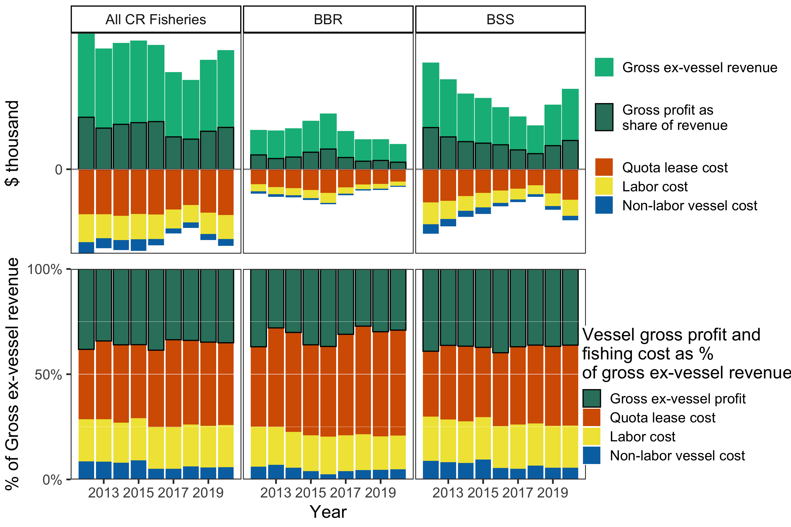
Vessel Income Statement

Slide 11
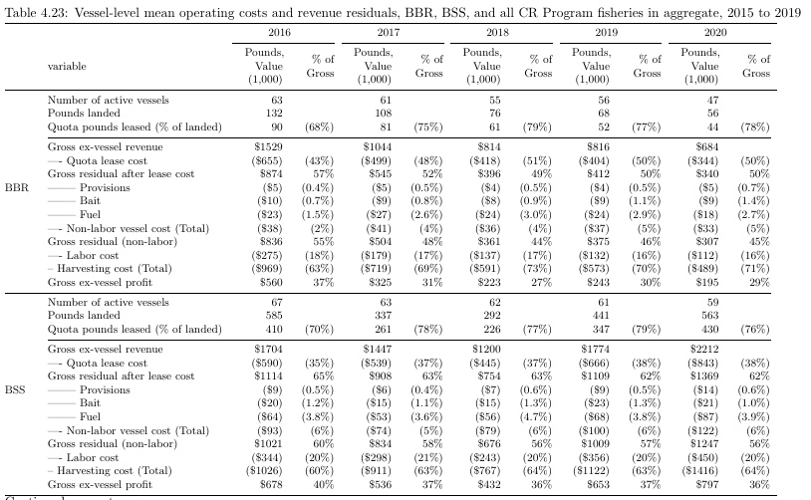
Vessel Income Statement

Slide 12
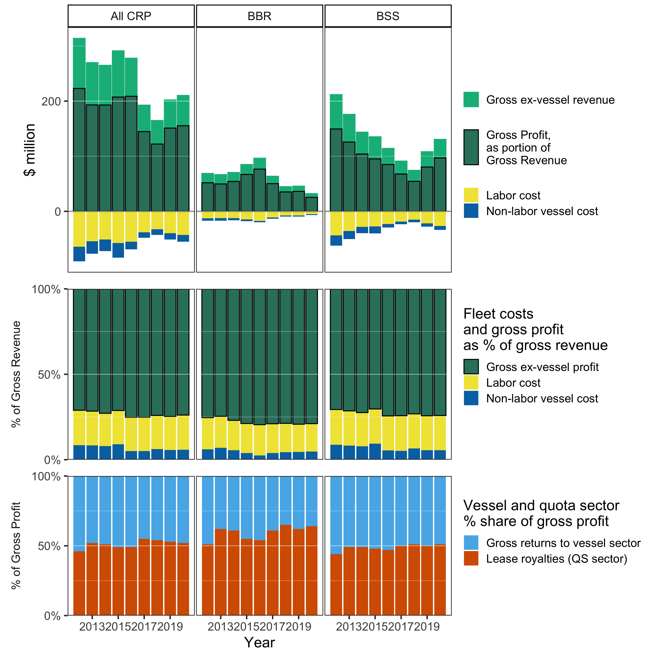
Fleet Income Statement
Notes:
Cost accounting limited to fuel, provisions, and bait; capital maintenance and investment, overhead, other business costs not included, hence gross profit
Quota costs are transfer rather than economic cost

Slide 13
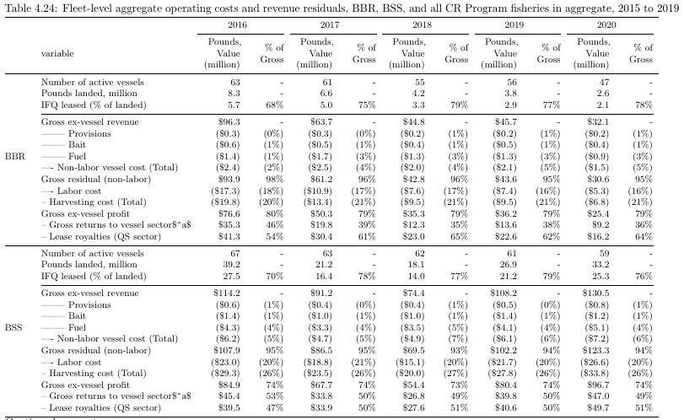
Fleet Income Statement
Notes:
Cost accounting limited to fuel, provisions, and bait; capital maintenance and investment, overhead, other business costs not included, hence gross profit
Quota costs are transfer rather than economic cost

Slide 14
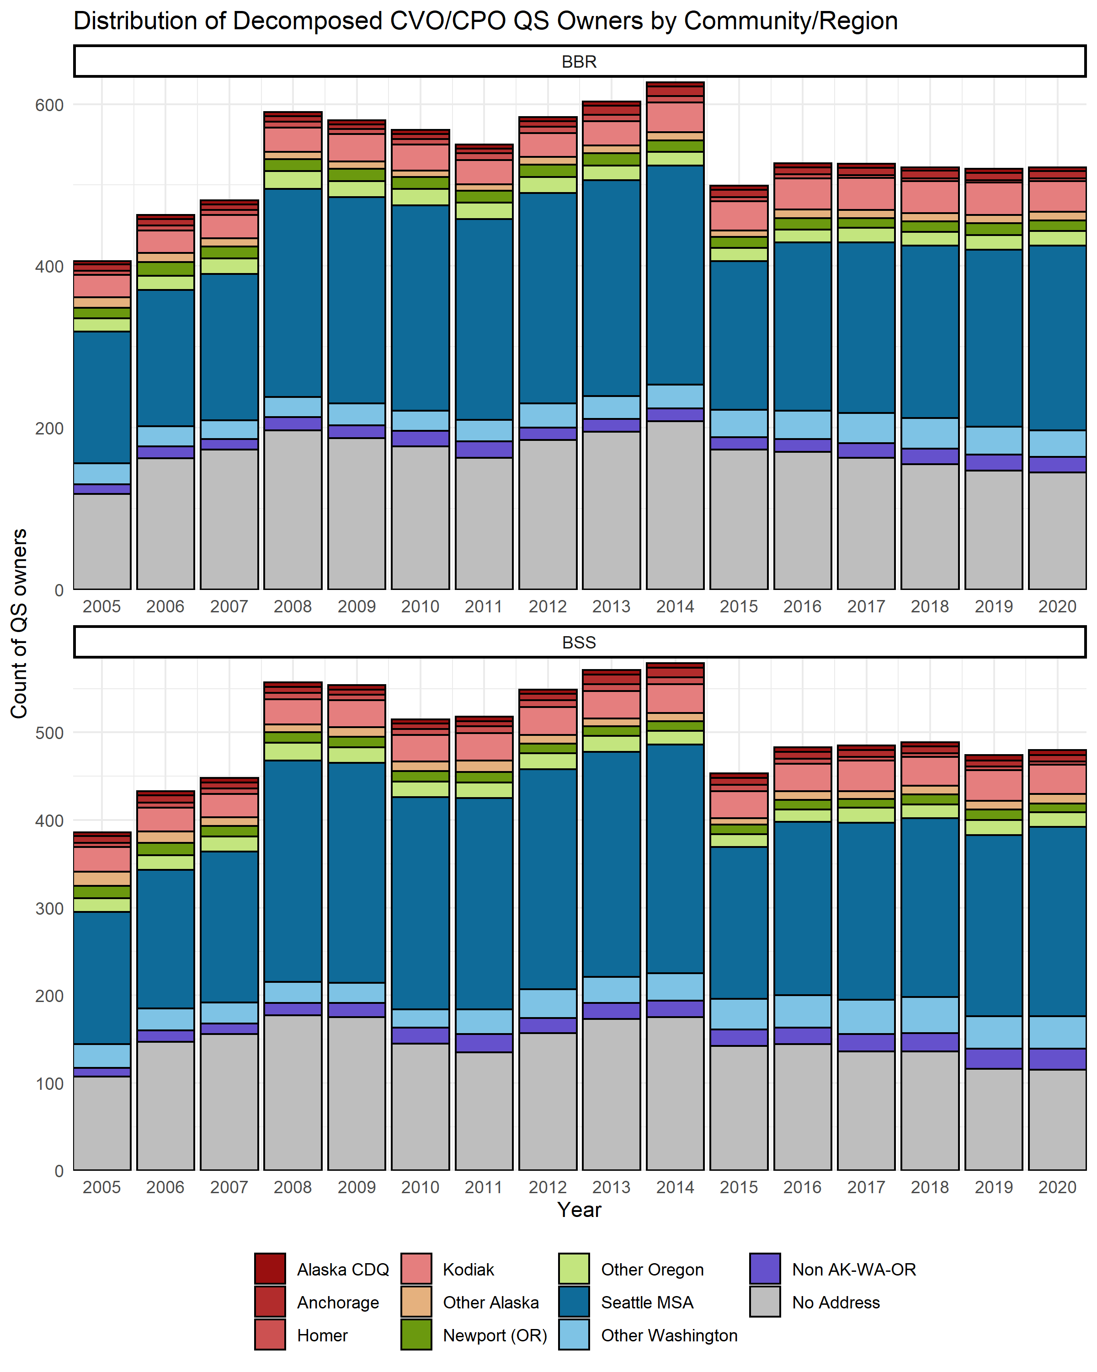
Owner QS Decomposition – Community

Slide 15
Owner QS Decomposition – Owner type
Notes:
BBR BSS
CRAB_SEASON_YEAR Entities Owners Entities Owners
2020 241 481 266 444

Slide 16
Owner QS Decomposition – Owner type

Slide 17
Owner QS Decomposition – Concentration

Slide 18
Owner QS Decomposition – Concentration

Slide 19
Crew QS Decomposition – Community

Slide 20
Crew QS Decomposition – Concentration

Slide 21
Discussion
Priorities for 2022 SAFE:
Report card metrics, ESP integration
Price forecasts & current-year estimates
Processing sector income analysis
Council CRP Review - 2023

