Slide 1
Crab SAFE: Economic Status Report 2018
Presented by:
Brian Garber-Yonts
Alaska Fisheries Science Center
Economics and Social Science Research Program
May 1, 2019
Anchorage, AK

Slide 2

Crab Economic SAFE Introduction
Produced annually as appendix to NPFMC’s Crab Plan Team SAFE report
Full report released for February Council meeting (1+ year lag); Executive summary included in October Crab Plan Team SAFE report
Intended as annual summary of general economic status and trends in crab fisheries, but follows framework of Crab Rationalization Program Review analyses as ongoing synthesis program performance data and indicators
Covers all FMP stocks/fisheries, with greater detail for CRP fisheries
Primary audience: Council, with SSC as primary review; AKR and other economic analysts
Notes:
Developed distinct from GF Econ SAFE; more closely associated w/ CRP and EDR
Uses CRP 5 Year Review and AKR’s CRP Annual Report as primary templates
Note that there is no applicable guidance on what Econ SAFE should be; “required” by National Std 2:
Sect 600.315 National Standard 2, Scientific Information (e) SAFE Report. (1) The SAFE report is a document or set of documents that provides Councils with a summary of information concerning the most recent biological condition of stocks and the marine ecosystems in the FMU and the social and economic condition of the recreational and commercial fishing interests, fishing communities, and the fish processing industries. It summarizes, on a periodic basis, the best available scientific information concerning the past, present, and possible future condition of the stocks, marine ecosystems, and fisheries being managed under Federal regulation.
but no comparable guidance that applicable to annual stock assessment.

Slide 3
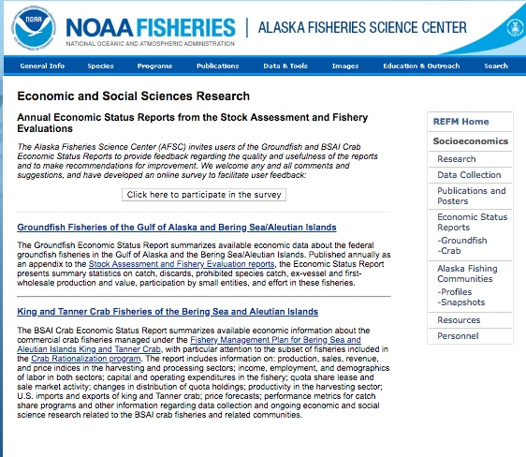
Economic SAFE availability
https://www.afsc.noaa.gov/REFM/Socioeconomics/SAFE/default.php

Slide 4
Crab Economic SAFE Introduction
Produced annually as appendix to NPFMC’s Crab Plan Team SAFE report
Full report released for February Council meeting (1+ year lag); Executive summary included in October Crab Plan Team SAFE report
Intended as annual summary of general economic status and trends in crab fisheries, but follows framework of Crab Rationalization Program Review analyses as ongoing synthesis program performance data and indicators
Covers all FMP stocks/fisheries, with greater detail for CRP fisheries
Primary audience: Council, with SSC as primary review; AKR and other economic analysts
Notes:
Developed distinct from GF Econ SAFE; more closely associated w/ CRP and EDR
Uses CRP 5 Year Review and AKR’s CRP Annual Report as primary templates
Note that there is no applicable guidance on what Econ SAFE should be; “required” by National Std 2:
Sect 600.315 National Standard 2, Scientific Information (e) SAFE Report. (1) The SAFE report is a document or set of documents that provides Councils with a summary of information concerning the most recent biological condition of stocks and the marine ecosystems in the FMU and the social and economic condition of the recreational and commercial fishing interests, fishing communities, and the fish processing industries. It summarizes, on a periodic basis, the best available scientific information concerning the past, present, and possible future condition of the stocks, marine ecosystems, and fisheries being managed under Federal regulation.
but no comparable guidance that applicable to annual stock assessment.

Slide 5
SSC Comments (Feb, 2018)
…recommends that [net earnings] be developed for the processing sector as well.
…report card indices that parallel those in the groundfish [Economic] SAFE
…recommends that data presented in the Crab Economic SAFE tables be available for download by the public, similar to the data in the Groundfish SAFE.”
  Very limited cost data available for crab processors.
  Report card indices to be discussed at May CPT meeting
  Data download page being developed by AKFIN

Slide 6
SSC Comments (June, 2018)
… [in] crab SAFE analysis of the extent of quota leasing, the degree to which quota is being fished by leaseholders rather than quota owners, and how ownership patterns have changed over time should include a disaggregation to the community level where possible.
…Vessel ownership by community should be similarly tracked on an annual basis in the SAFE document to allow the identification of trends, as should the number of reductions in the amount of employment throughout the fisheries noted (e.g., the number of crew positions decreasing by 10%).”
…SSC suggests that information on average daily and total seasonal wages be provided by community and tracked over time.
  Ownership decomposition still in development
  Spatial/community disaggregation of results constrained by
    Confidentiality of detailed economic data at community level
    Need consistent spatial units larger than community

Slide 7
SSC Comments (2018, NSR)
SSC requests that a quantitative baseline of annual community engagement and dependency for Norton Sound red king crab is developed and requests that it includes the following considerations:
  community/regional protection/enhancement measures
  area closures…; …license limitation program; …winter GHL
  primary buyer changed the minimum size accepted to a 5-inch or greater carapace width (larger than legal size limit) in 2005
  c) The different fisheries, the summer commercial fishery, the CDQ fishery, the winter commercial fishery, and the subsistence fishery, which has its own summer and winter fisheries, have different characteristics, including differing participation patterns by community.
SSC discussed whether this information should go into the SAFE but concluded that the best place for this information would be Environmental Socio-economic Profiles (ESPs), if ESPs are developed for crabs[…] appropriate to include in the Crab Economic SAFE
…recommends incorporating time series data in the future for a limited number of indicators showing a quantitative baseline of annual community engagement and dependency (ideally from 1977 to date) by fishery type (e.g., vessel counts/characteristics and harvest levels by community for the summer fisheries), along with mapped changes in fishery spatial extents over time, where feasible.

Slide 8
2018 Crab Economic SAFE Overview
Executive Summary (SAFE Report extract)
Introduction
Economic Status and Trends
  Economic output
  Income and employment
  Operating costs and Income Statement (New)
  Quota Market and Holdings
  Fishing capacity and effort
  International trade

Slide 9
Economic Status and Trends
Economic output
  Catch allocations
  Landings
  Ex-vessel and finished product volume
  Ex-vessel and first wholesale revenue and average prices

Slide 10
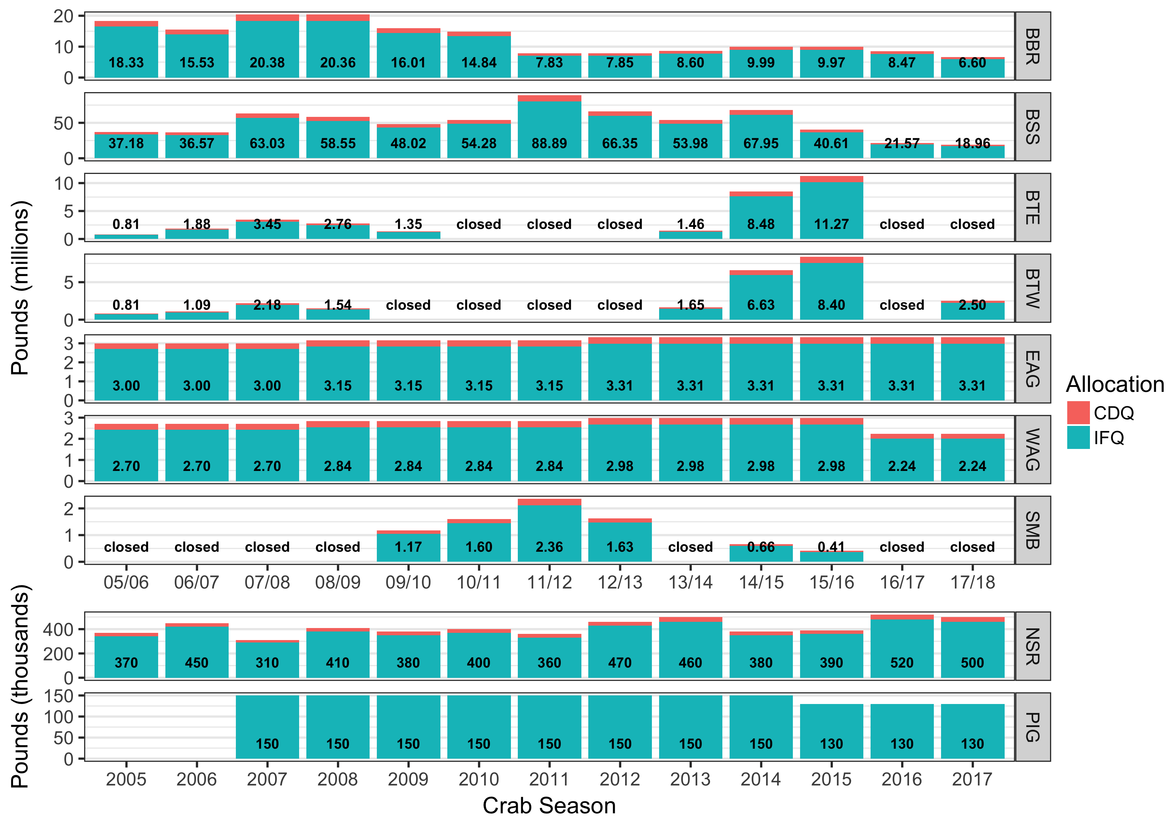
TAC 2005/06 – 2017/18
Notes:
Note TAC redux for 2016/17 and 2017/18 and recent price info

Slide 11
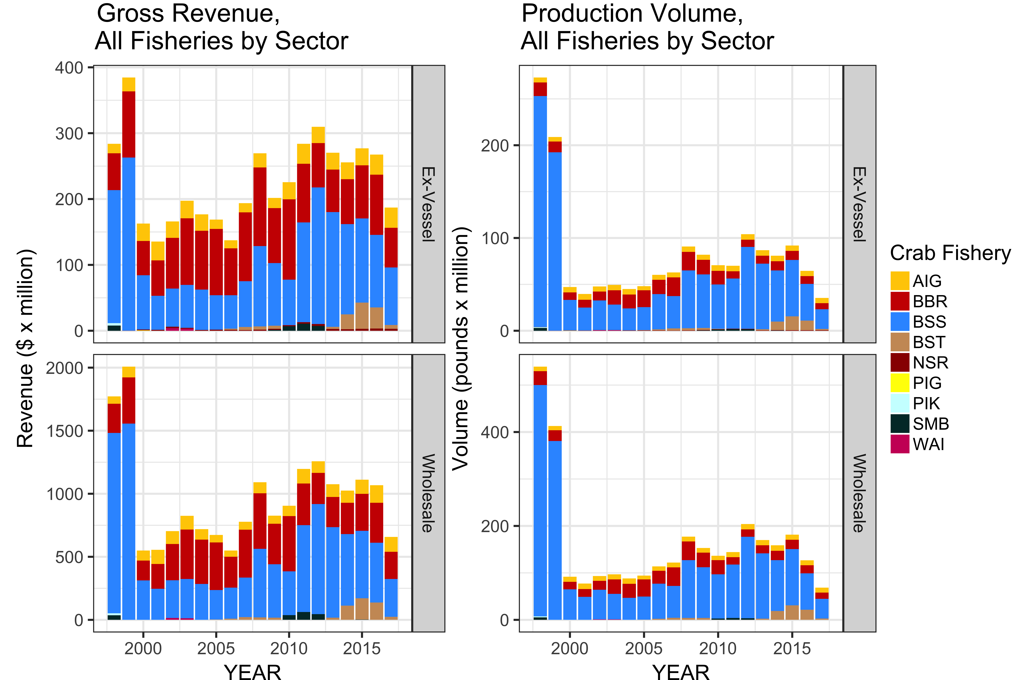
1998-2017 Production & Value
Notes:
All BSAI Crab
Volume: EXV 34.8 million lbs -46%; WS 22.9 million pounds -46%
Rev: EXV $184 million -30%; WS $219 million -38%
Offsetting (serendipitous) effect of P change on TAC redux in previously years not strong in 2017
Note TAC redux for 2016/17 and 2017/18 and recent price info

Slide 12
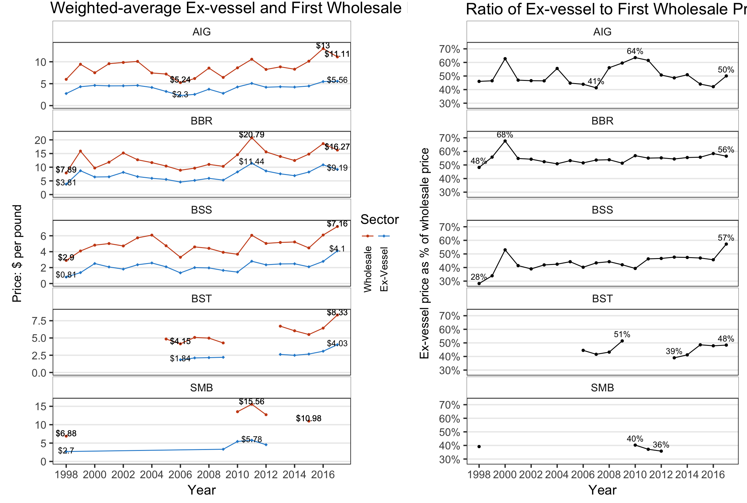
1998-2017 Ex-vessel & Wholesale Price
Notes:
AIG ExV:$5.56 ~+% WS: $11.11 -14%
BBR ExV: $9.19 -15.4% WS $16.27 -12.6%
BST Exv: $4.03 (+ 30%) WS: $8.33 (+30%) ** NOTE YEAR/SEASON ISSUE
BSS ExV: $4.10 (+47%) WS: $7.16 (+17%)
Also, Ex-vessel price received for BST (Tanner crab) in 2016 remained higher than BSS (opilio snow crab)price for a second year.

Slide 13
1998-2017 Ex-vessel & Wholesale Price
Notes:
Note arbitration process
AIG price ratio historically volatile, increased in 2017
BBR essentially stable post-rat
BSS shift up in 2010, sharp incr in 2017; need to investigate if due .to differential lag in EXV vs WS data

Slide 14
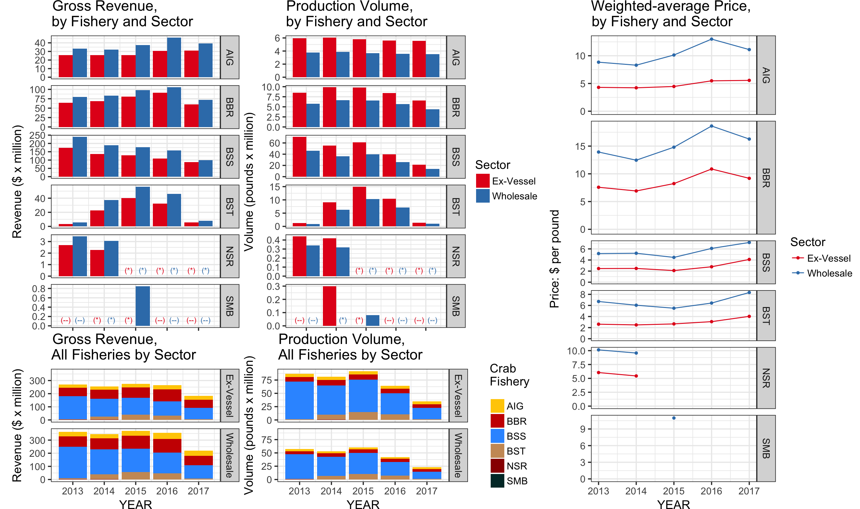
2013-2017 Production & Value Summary
Notes:
All BSAI Crab
Volume: EXV 34.8 million lbs -46%; WS 22.9 million pounds -46%
Rev: EXV $184 million -30%; WS $219 million -38%
Offsetting (serendipitous) effect of P change on TAC redux in previously years not strong in 2017
Note TAC redux for 2016/17 and 2017/18 and recent price info

Slide 15
Economic Status and Trends
Employment and income
  Crew and processing employment
  Wages and remuneration indices
  Rent distribution effects on crew earnings
  Season length effects on earnings
  Crew and processing employee demographics
Notes:
Table 4.14 reports residence of crew and captains – stable over recent years
2013:Crew: 33% AK resident 65% Non AK resident Capt. 25%

Slide 16
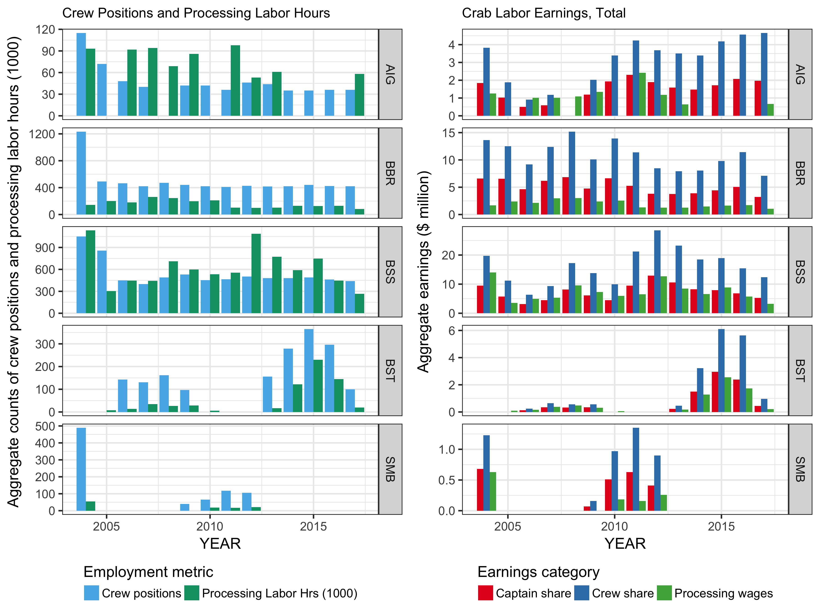
2017 Employment & Income (CR program)
Notes:
Note, crew vs proc employment metrics are different, captured in same panels (bad)
Employment declines more pronounced in processing than crew, but hrs vs positions, crew assoc w/ # of vessels
Crew: Estimated 996 (incl all crew) positions in aggregate across all 72 (-8) vessels in CR: -222, -18%
Proc emp: 426 thousand hrs -46% despite an increase from 8 to 9 active plants
Pay
Crew All CR $10.9 million / Captain $25.1 million, both -1/3
Proc $5.2 million, -49%

Slide 17
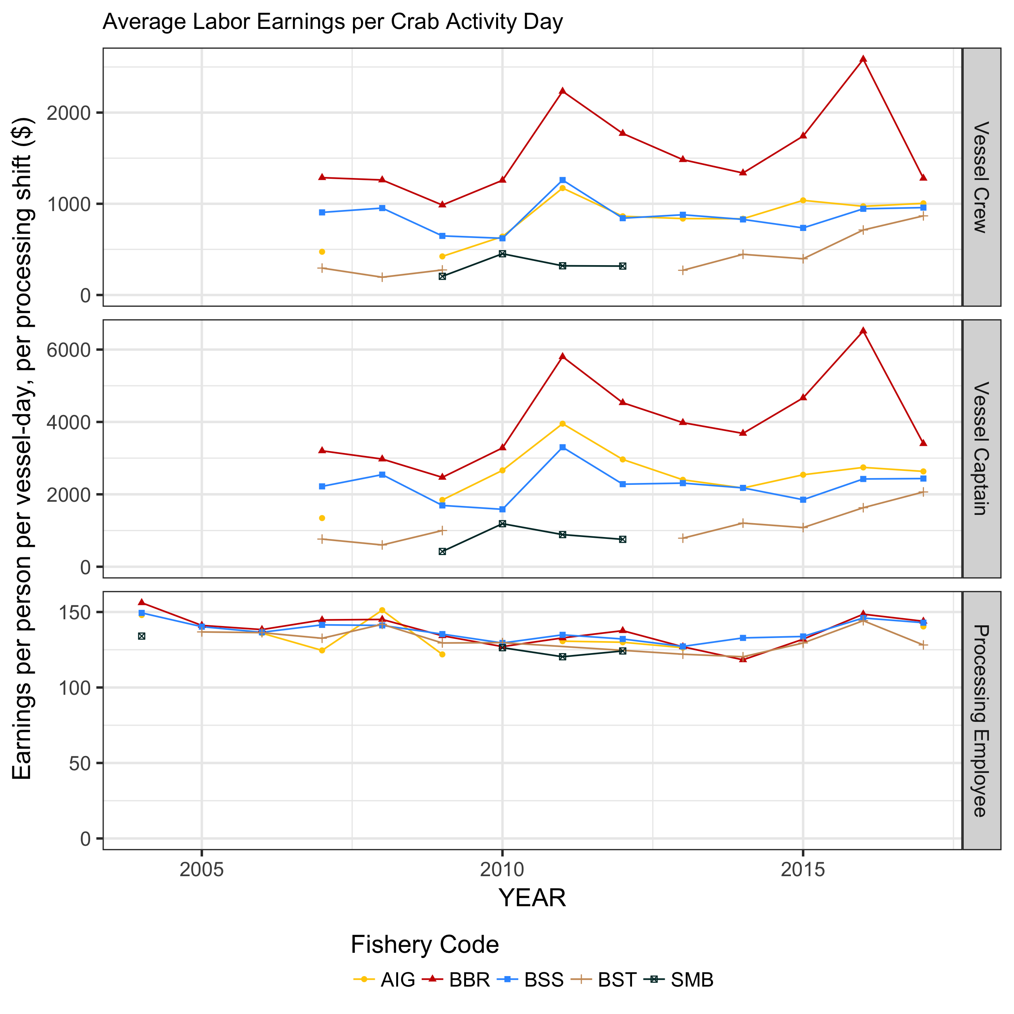
2017 Employment & Income (CR program)
Notes:
Proc pay/12hr shift:
Modest decline up to 2014
2015&16: +5% to +12% in annual average wages
BBR $12.38 / BSS $12.17 per hour
in the 2016 BBR and BSS fisheries, the highest reported wage rates since 2004.
Alaska State minimum wage increase beginning January 1, 2015 minimum hourly wage increased from $7.75 to $8.75 for 2015 and $9.75 for 2016; annual inf adj > 2017
Average hourly crab processing wages declined for 2017, by 3.2% to
BSS $11.99/hr -3.25% / BBR $11.91 -2.1% (can’t show AIG)
Crew
BSS crew $960 /day Capt $2,440/day, same as 2016 due to fewer days
BBR crew $1280 /day / Capt $3400/day -50%; ’17 BBR was only price decl, reflected in –daily rate

Slide 18
Economic Status and Trends
Harvest Sector Cost & Net Earnings
Vessel operating costs
Vessel/fleet net earnings indices

Slide 19
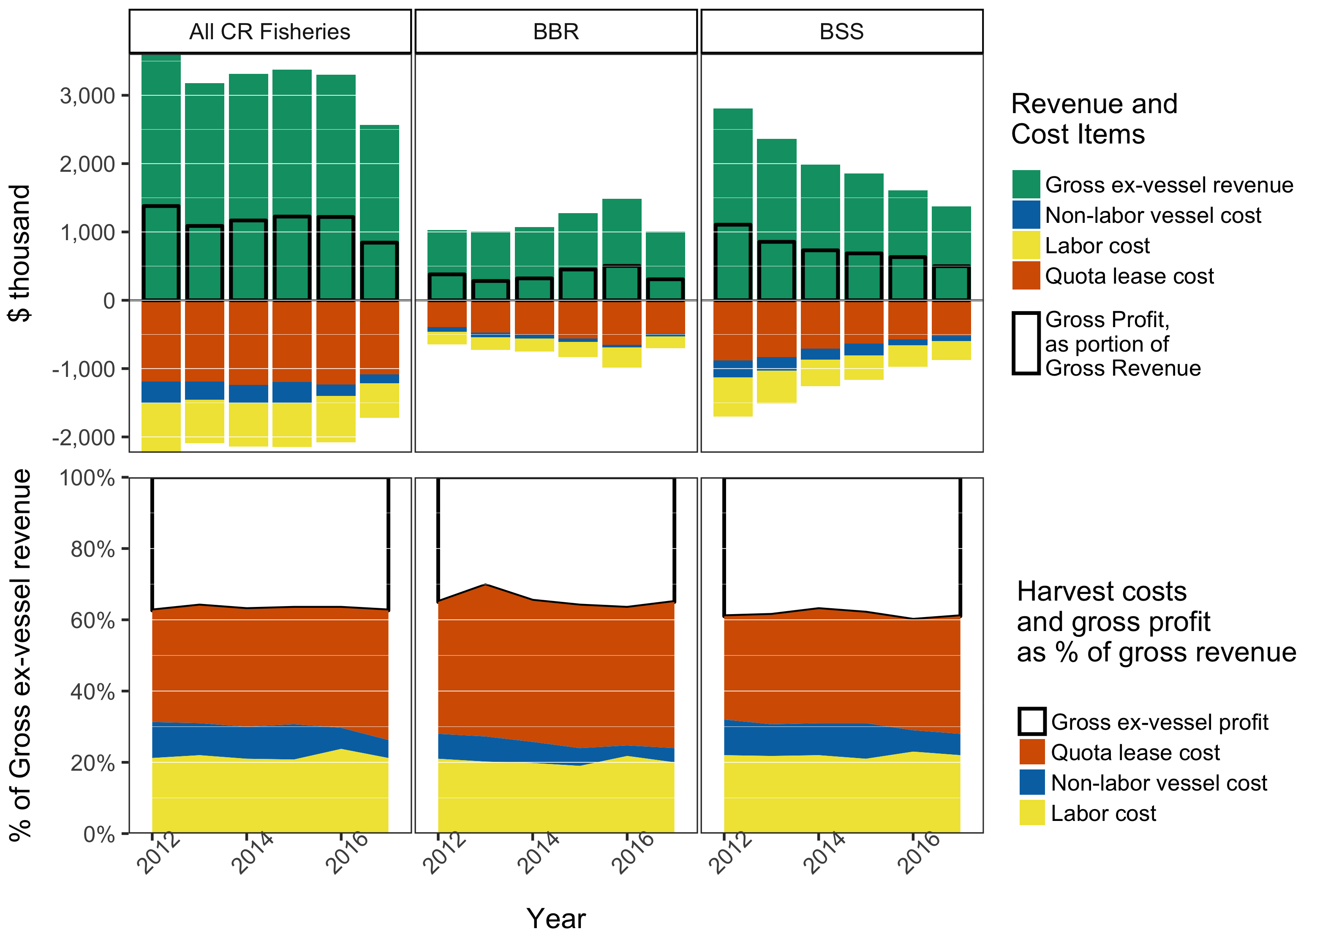
Vessel Income Statement

Slide 20
Vessel Income Statement

Slide 21
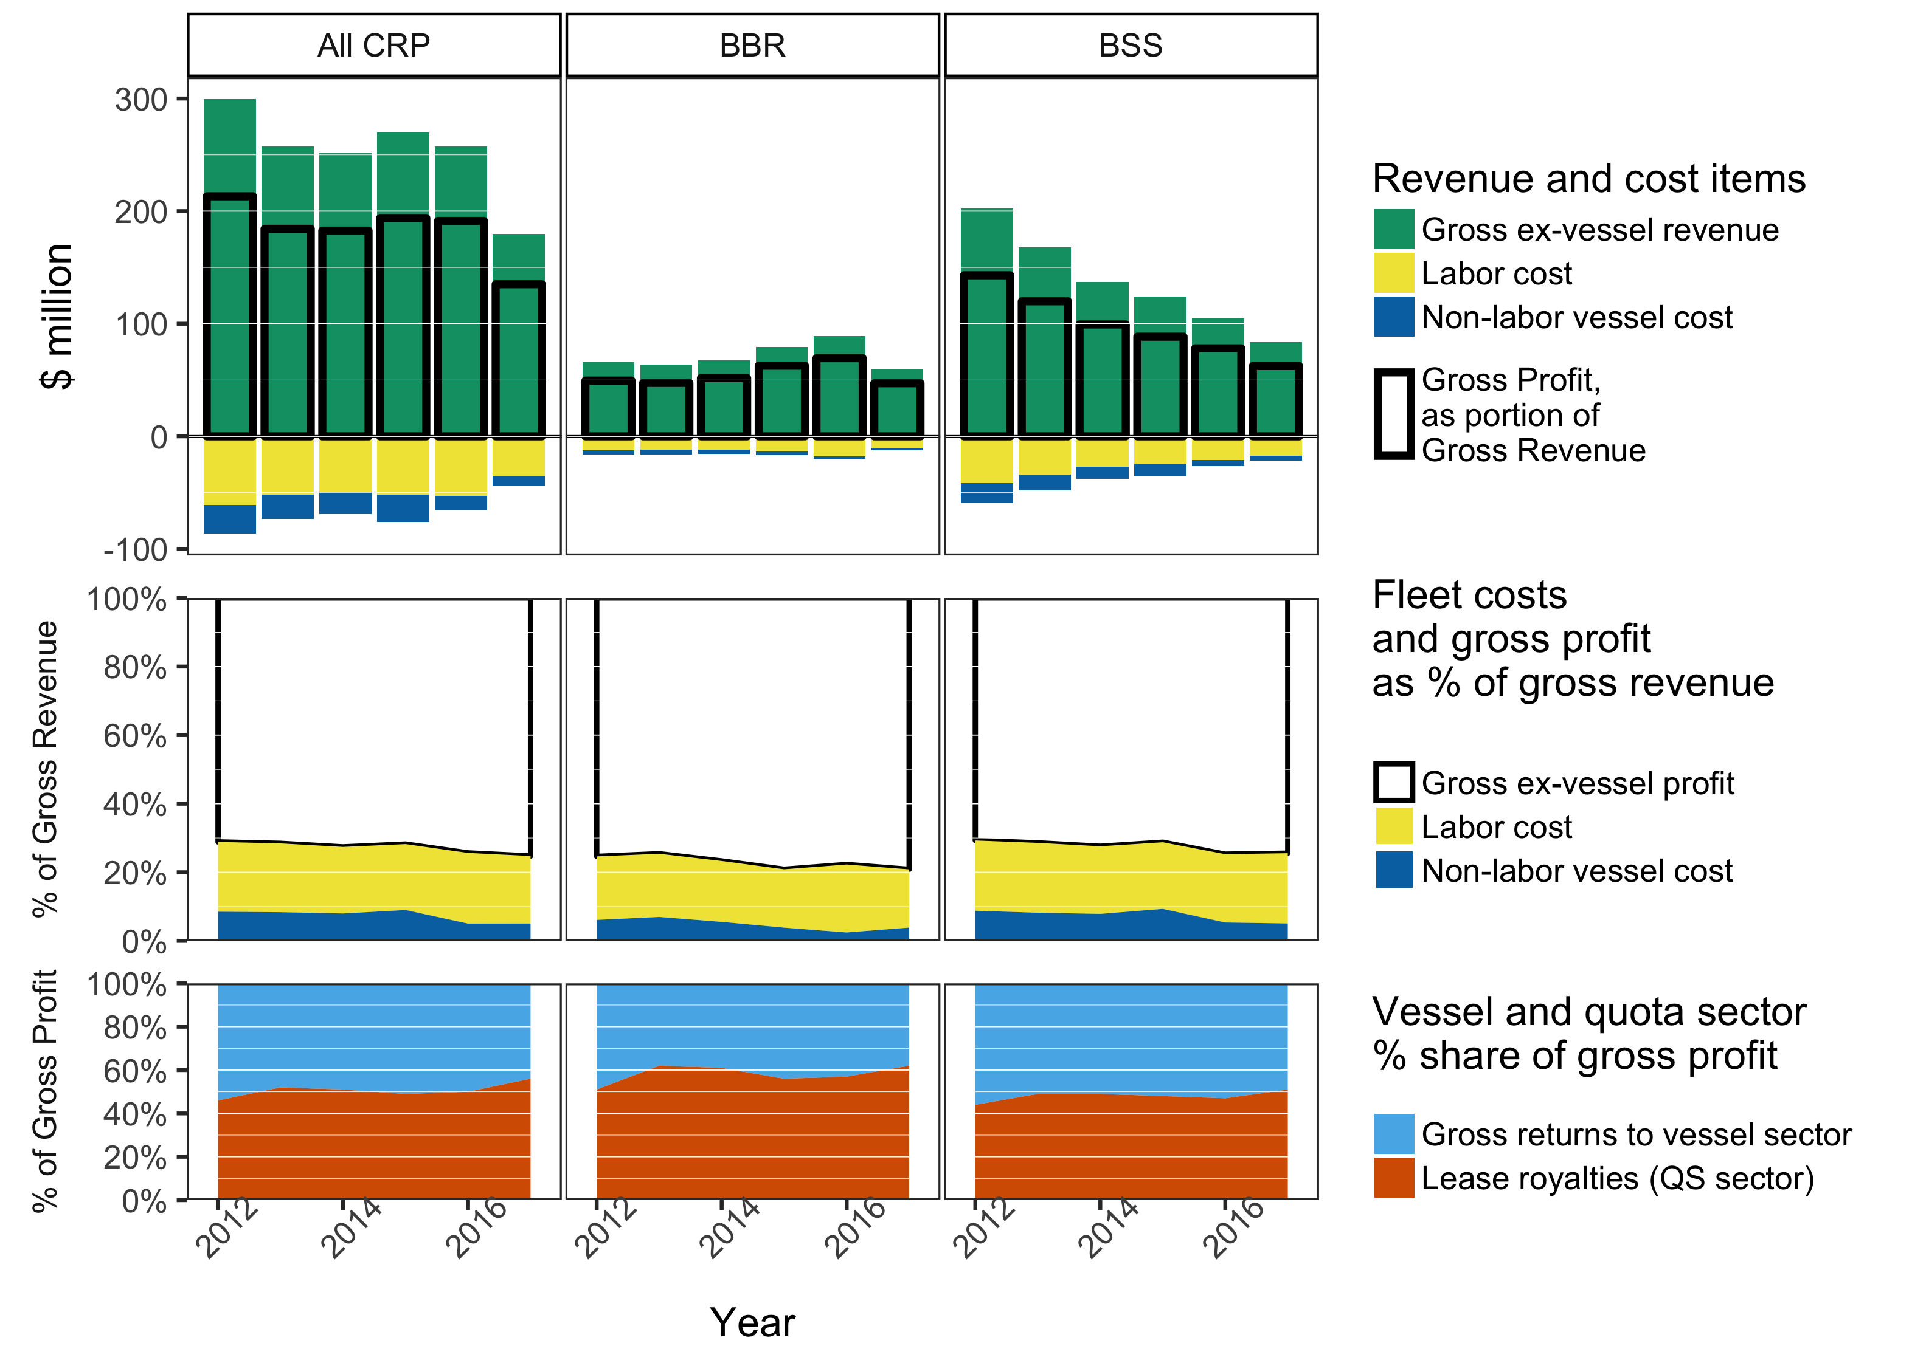
Fleet Income Statement

Slide 22
Economic Status and Trends
IFQ leasing and QS Holdings
Lease volume and prices
QS/PQS holdings, sales and prices
IFQ/QS price comparison
Quota holders - demographics and ownership concentration
Ownership decomposition
Notes:
Several perspectives on quota use, transfer, and holdings presented in tables/figures
Despite limited time series, more analytical content

Slide 23
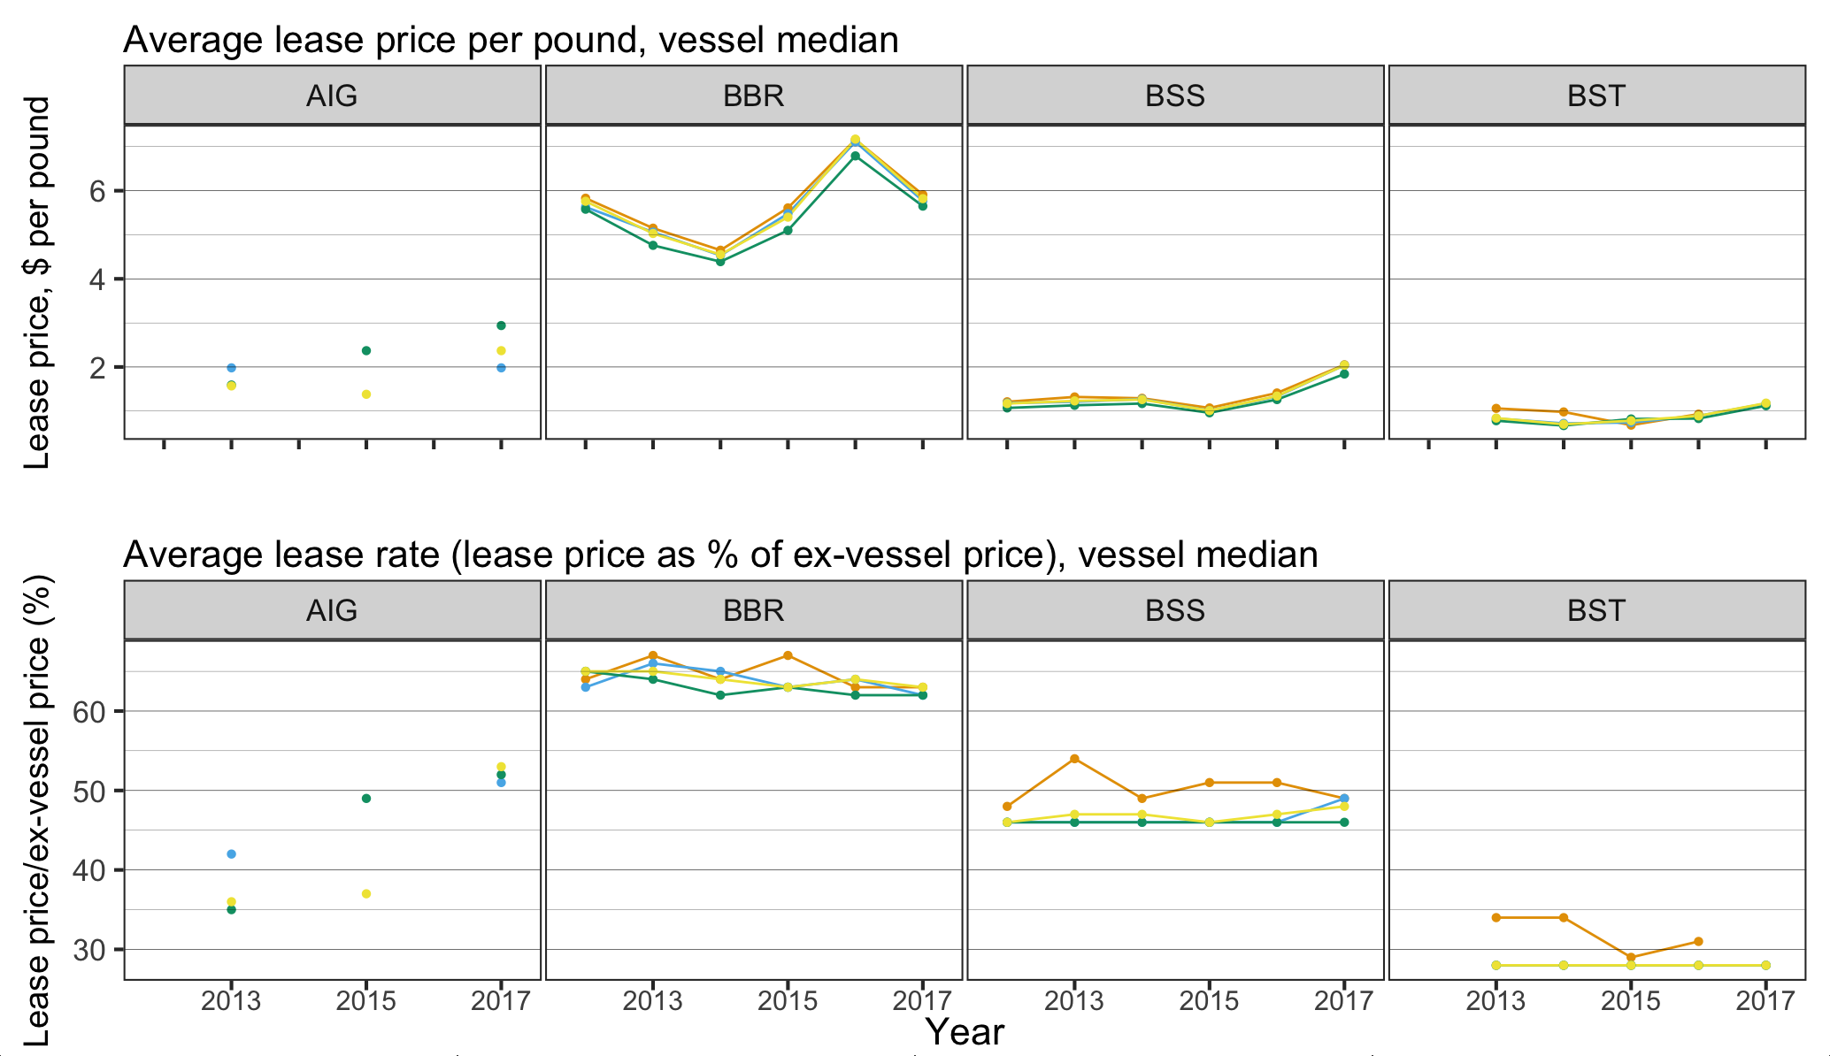
Quota Lease Activity and Price
Notes:
AIG fishery
CVC/CPC IFQ: $1.86 per pound (41% of ex-vessel value)
CVO B Class: $1.48 per pound (35% of ex-vessel value)
BBR fishery
CDQ: $4.86 per pound (65% of ex-vessel value)
CVO A Class: $4.49 per pound (64% of ex-vessel value)
BSS
CDQ: $1.24 (54% of ex-vessel value)
CVO A Class IFQ: $1.07 per pound (46% of ex-vessel)

Slide 24
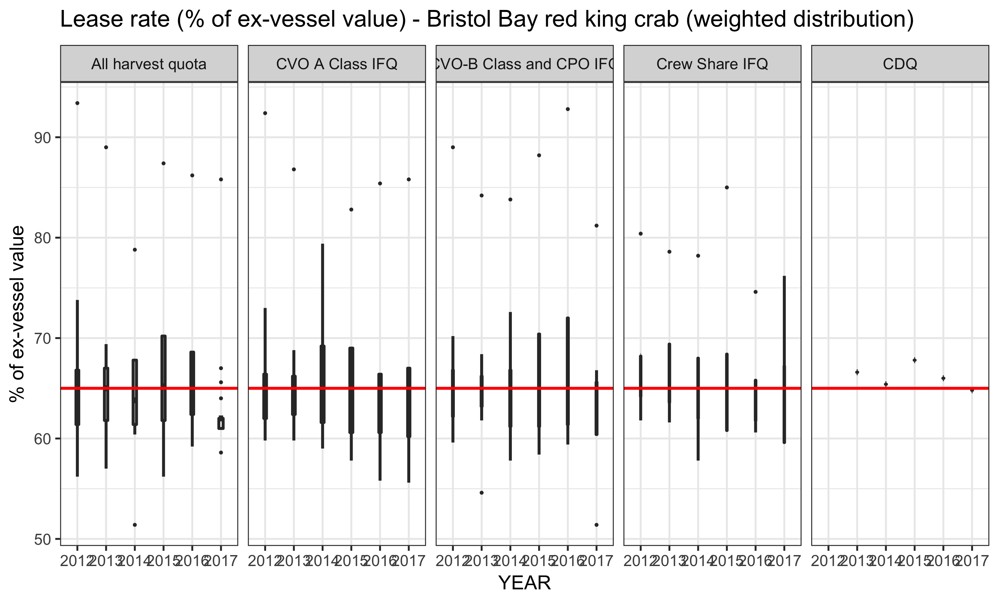
Quota Lease Activity and Price
Notes:
AIG fishery
CVC/CPC IFQ: $1.86 per pound (41% of ex-vessel value)
CVO B Class: $1.48 per pound (35% of ex-vessel value)
BBR fishery
CDQ: $4.86 per pound (65% of ex-vessel value)
CVO A Class: $4.49 per pound (64% of ex-vessel value)
BSS
CDQ: $1.24 (54% of ex-vessel value)
CVO A Class IFQ: $1.07 per pound (46% of ex-vessel)

Slide 25
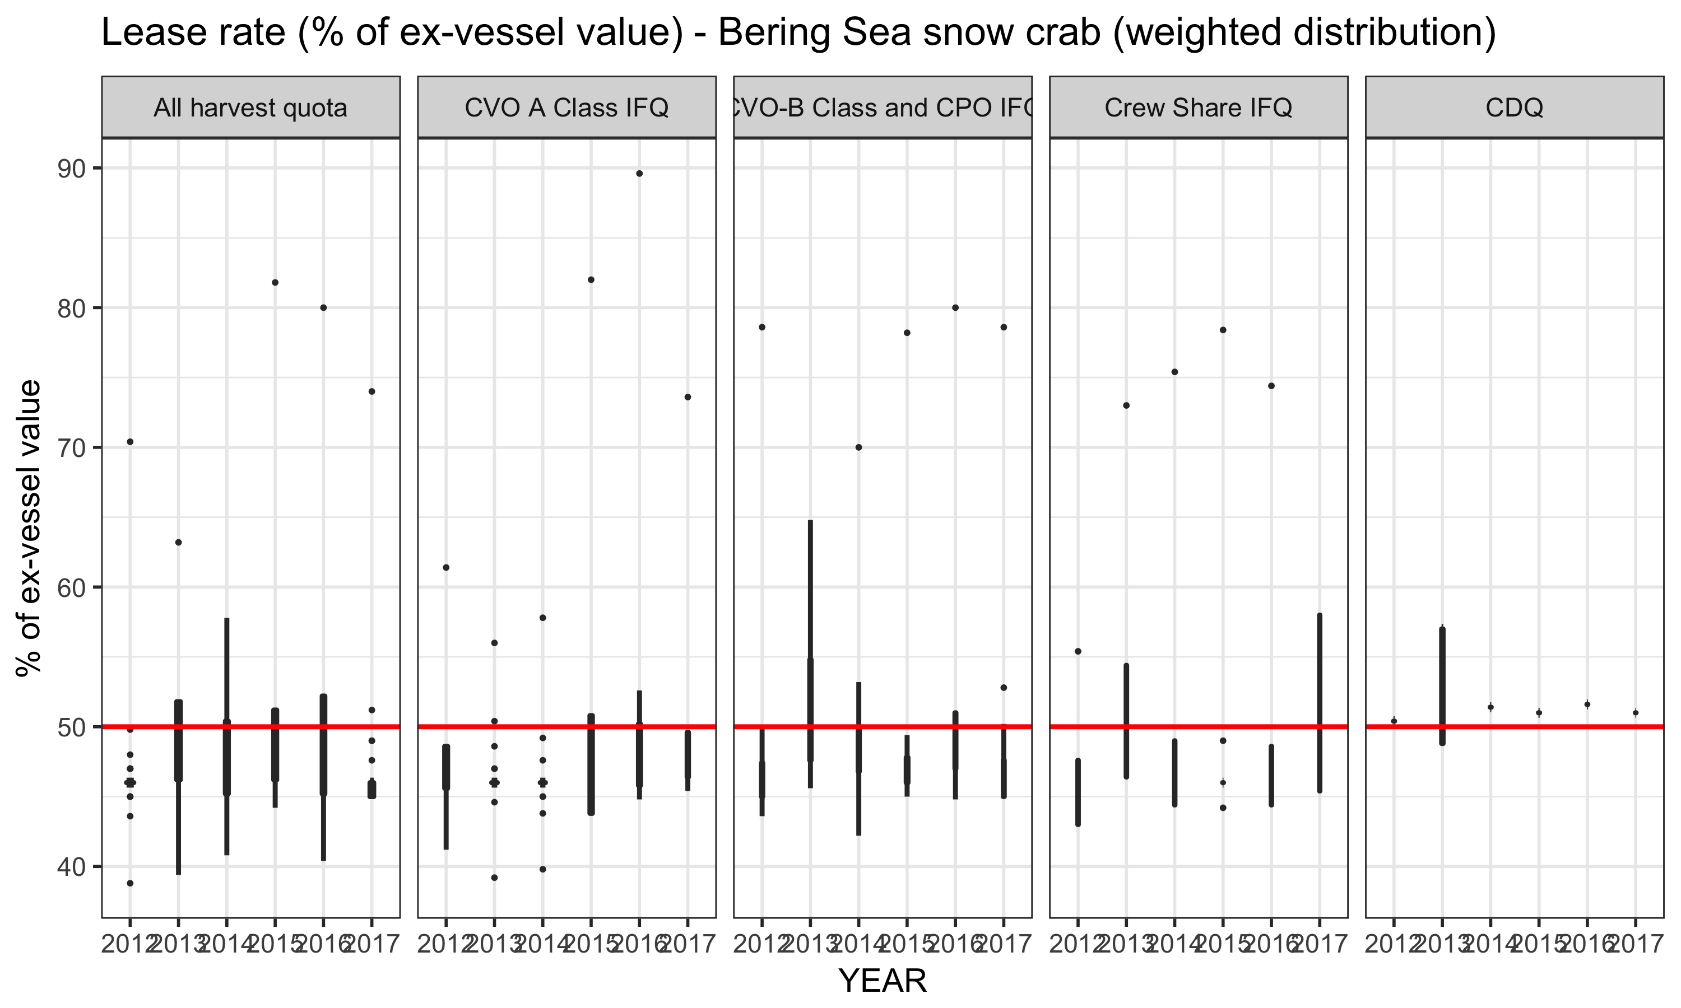
Quota Lease Activity and Price
Notes:
AIG fishery
CVC/CPC IFQ: $1.86 per pound (41% of ex-vessel value)
CVO B Class: $1.48 per pound (35% of ex-vessel value)
BBR fishery
CDQ: $4.86 per pound (65% of ex-vessel value)
CVO A Class: $4.49 per pound (64% of ex-vessel value)
BSS
CDQ: $1.24 (54% of ex-vessel value)
CVO A Class IFQ: $1.07 per pound (46% of ex-vessel)

Slide 26
Economic Status and Trends
Production capacity
  Processing sector participation
  Fishing capacity – fleet composition
Effort
  Vessel activity days
  Landings by week

Slide 27
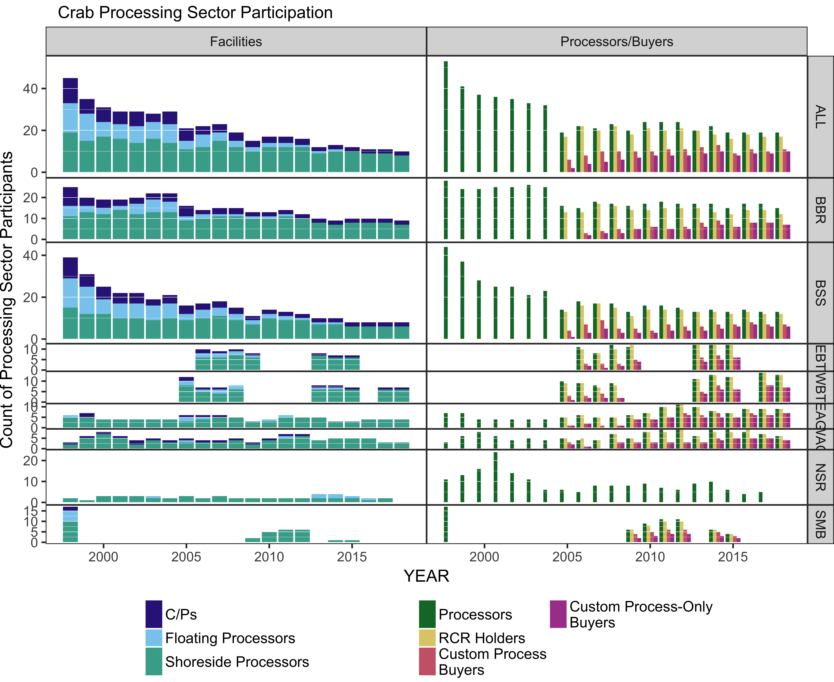
Processing Sector Participation

Slide 28
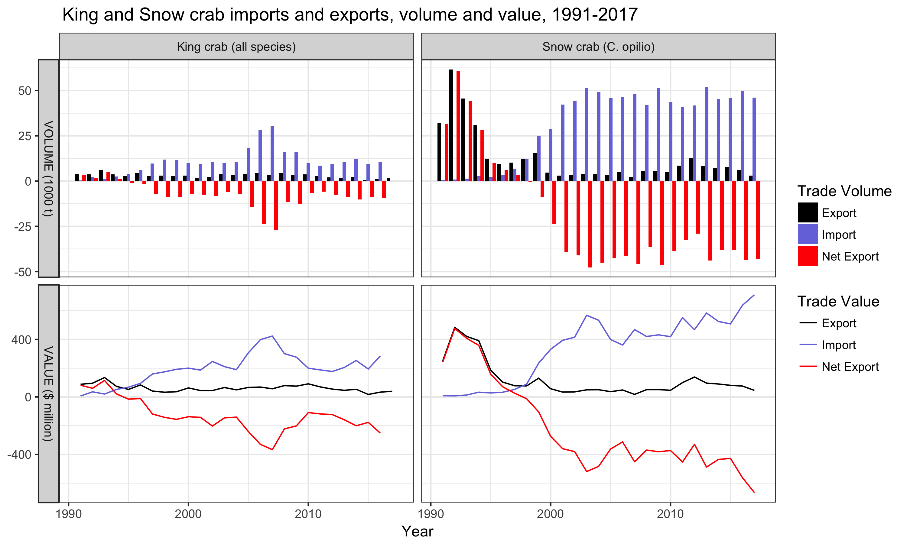
International trade
Notes:
U.S. foreign trade statistics for frozen, processed king and snow crab
are summarized for the period 1991-2017 in Table ~\ref{impexp}
and depicted graphically in Figure ~\ref{fig:impexp}.
For most of the last two decades, the U.S. has been a net importer of
both king and snow crab product, with a negative trade gap beginning in
1995 for king crab and 1998 for snow crab. Over the last 10 years, U.S.
frozen king crab exports by volume have varied from a high of
4,330 \emph{t} in 2006 to a low of 1,780 metric tons (\emph{t}) in 2013, and
in value terms between \$88.6 million in 2010 to a low of \$44.26
million in 2013.
Imports over the same period have been more variable, surging to
30,000 \emph{t} at a value of \$405 million in 2007, from which point
they have tapered on an annual basis to the lowest recent amount in 2011
of 8.5 thousand \emph{t} and \$180 million, with imports increasing from that level
during 2012 - 2014. U.S. exports of frozen snow crab
product since 2003 has varied from a low in 2007 of 2,120 \emph{t} with
a value of \$16.7 million, to the recent peak in 2012 of \$12,720 t with
a value of \$133 million; the most recent figures show a decline from 2012
export levels to 7,200 \emph{t}, and \$86.4 million. Snow crab imports
have been somewhat less volatile in volume terms than those of king crab,
varying between a 41 - 52 thousand \emph{t}; total value has varied more widely, between a low
of \$345 million in 2006 to a high of \$559 million in 2013. In 2012,
the net trade deficit in snow crab product reached its lowest level
since 2000, falling to 28,960 \emph{t} and \$315 million in negative net
exports.

Slide 29
Discussion
Priorities for 2019 SAFE (SSC):
Report card metrics
Price forecasts & current-year estimates
Demographics
Processing sector income analysis
CPT recommendations…
Economic Performance Reports
Ecosystem & Socioeconomic Reports
  Start with NSRKC?
  Other candidates?

