Slide 1

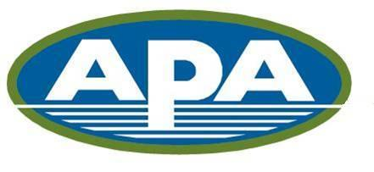
CP Chinook and chum salmon bycatch reduction Incentive plan agreement Amendments
D1 Salmon Bycatch-Report on new Chum IPA Measures 2022
December 2022
NPFMC
Presenters: Stephanie Madsen
Austin Estabrooks

Slide 2
New CP IPA Amendments
New chum salmon Bycatch Avoidance Areas may be implemented on Monday for a Tuesday to Friday closure
  Allows for a more reactive approach, as chum salmon is known to be more dynamic than Chinook, with large pulses of chum showing up on the fishing grounds in a matter of days.
Restrictions for all vessels from fishing in known areas of “extremely” high chum bycatch (defined as 5 chum/mt pollock).
  Periodic spikes in chum salmon bycatch will be reduced and lightning strike tows of chum salmon by multiple vessels in known high bycatch areas will be minimized.
Include chum salmon to the “outlier provision” to create incentives for chronic poor chum bycatch performers to improve bycatch rates.
  Increases accountability for all vessels and provides further incentives to reduce chum salmon bycatch

Slide 3
New Monday (Tuesday-Friday) Closures
There were a total of 5 new closures implemented on Monday following new data from the weekend and one advisory closure area.
The new closures excluded 17 vessels from fishing in areas of known high bycatch
The IPA was able to significantly more responsive to new data and curtail large chum bycatch spikes.

Slide 4
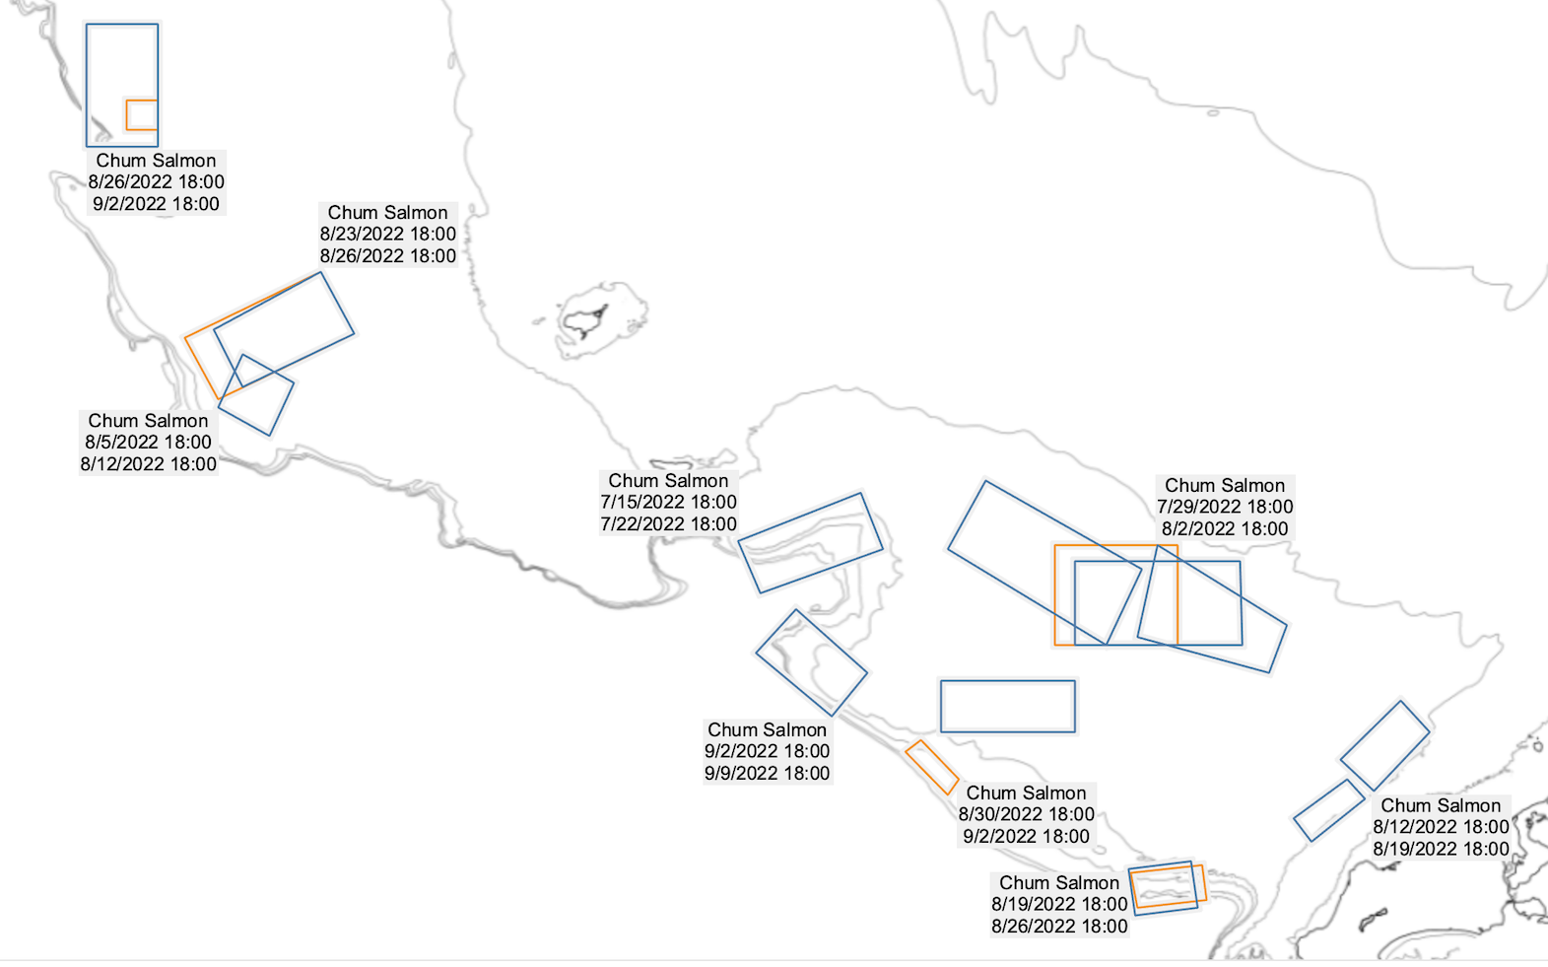
MAP of 2022 CP Chum B-season Bycatch Avoidance Areas
New Monday Closures in Orange

Slide 5
New “ExtremeLy High” Chum Bycatch areas excluding all CP vessels
Chum bycatch rates in the 2022 B-season were relatively low across all weeks except for the last 2 weeks in August
There was only one stat area week with a chum bycatch rate greater 5 chum/metric ton pollock
On August 15, 2022, ADFG stat area 655500 had a weekly bycatch rate of 5.051 N/mt, however this area is located within the CVOA where no CP vessels were fishing and thus was not closed.
Shoreside and mothership vessels were subject to a large closure although they remain under different IPA rules.

Slide 6
New chum salmon outlier provision
There was one vessel outlier during the 2022 B-season, this vessel had a series of mechanical issues that caused it fish much later in the B-season
The vessels with the lowest bycatch rates finished the B-season prior to mid-August
Outlier penalties only apply after two consecutive seasons of poor bycatch performance.

Slide 7
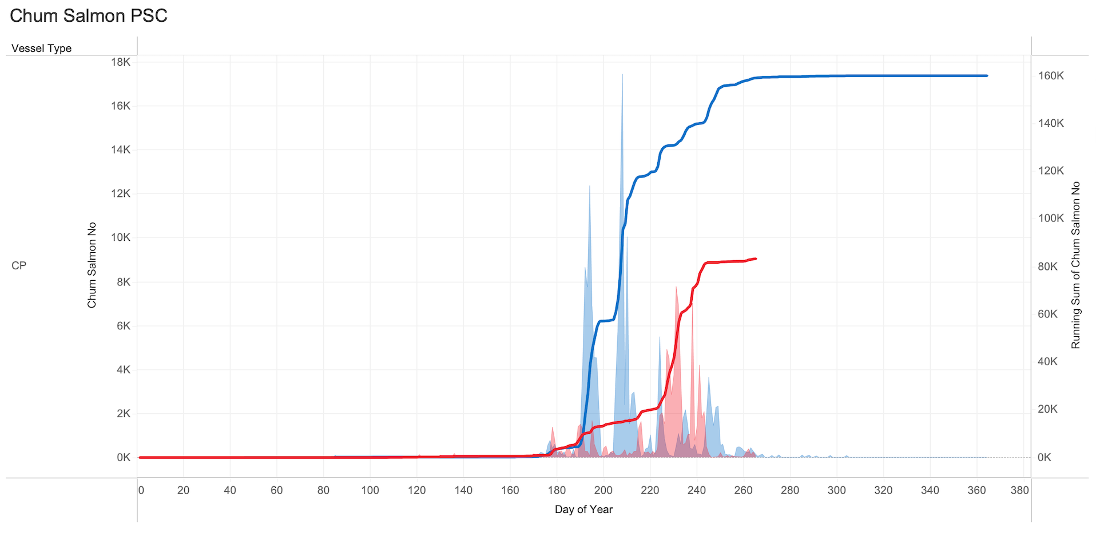
General CP Chum Bycatch Trends 2021 vs. 2022
Chum bycatch was minimal in 2022 until August 15th when the fleet moved deeper towards the shelf break and chum catch increased.
In 2021, large chum spikes occurred earlier in the season, despite the spatial footprint remaining similar year over year

Slide 8
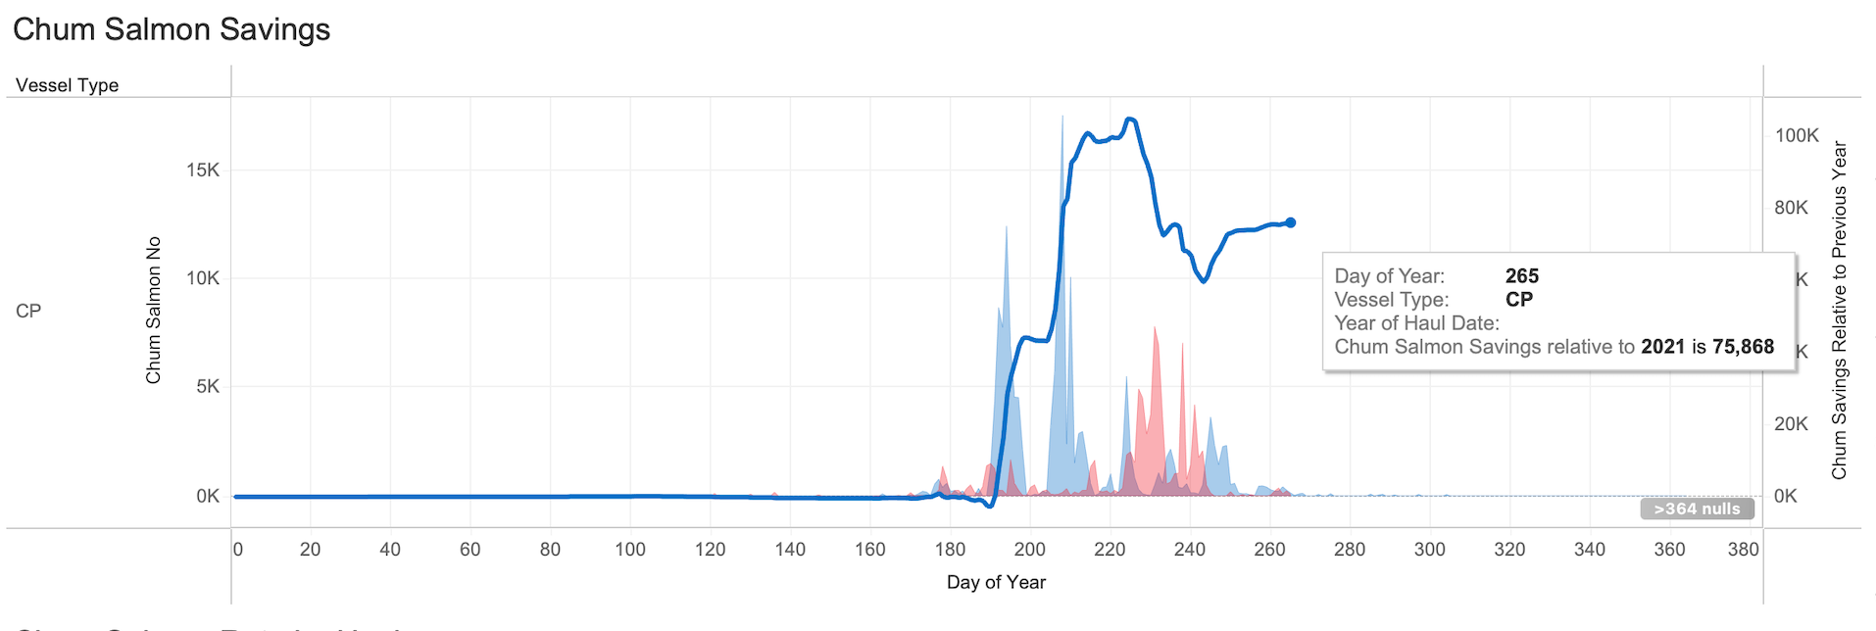
General CP Chum Bycatch Trends 2021 vs. 2022
There were 75,868 fewer chum caught in 2022 vs. 2021, however this cannot all be attributed to new IPA measures
Average bottom temperature and cold pool extent in the EBS exhibits an extremely strong correlation to chum salmon catches in the pollock fishery, 2022 was a colder year relative to 2021, therefore chum catches were reduced.

Slide 9
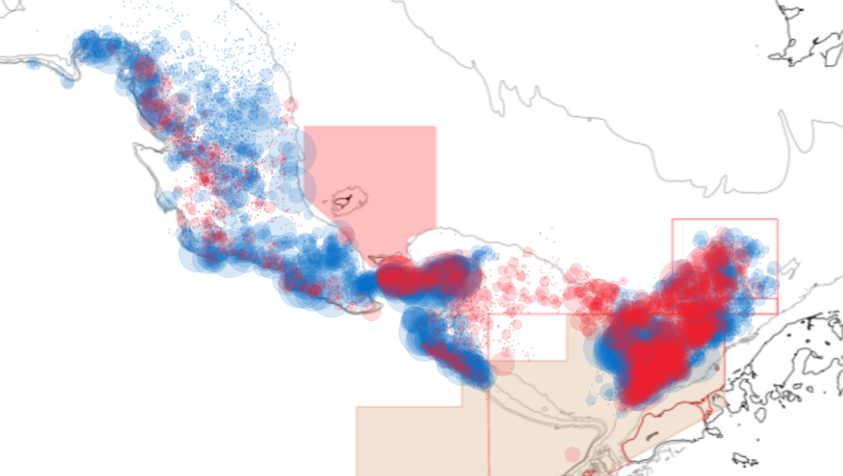
Spatial Distribution Of Chum Bycatch 2021 vs. 2022
Orange is 2022, Blue is 2021, all pollock fishing, majority of chum catch occurs in the CVOA and along the shelf break.

Slide 10
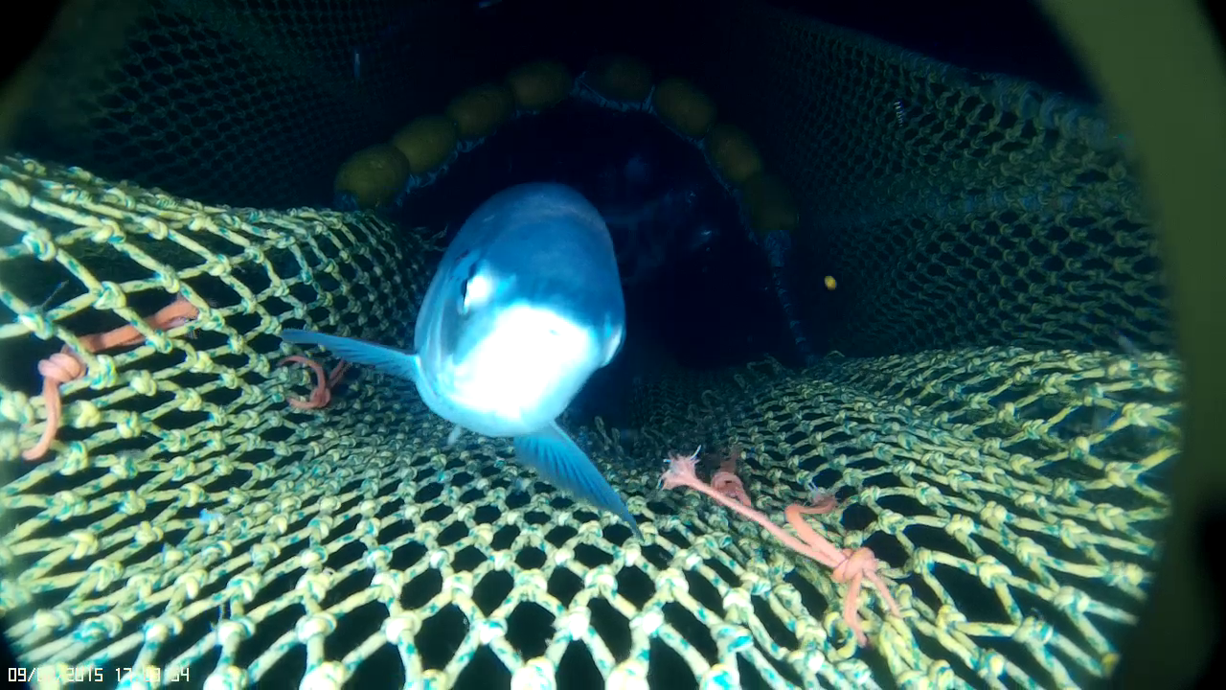
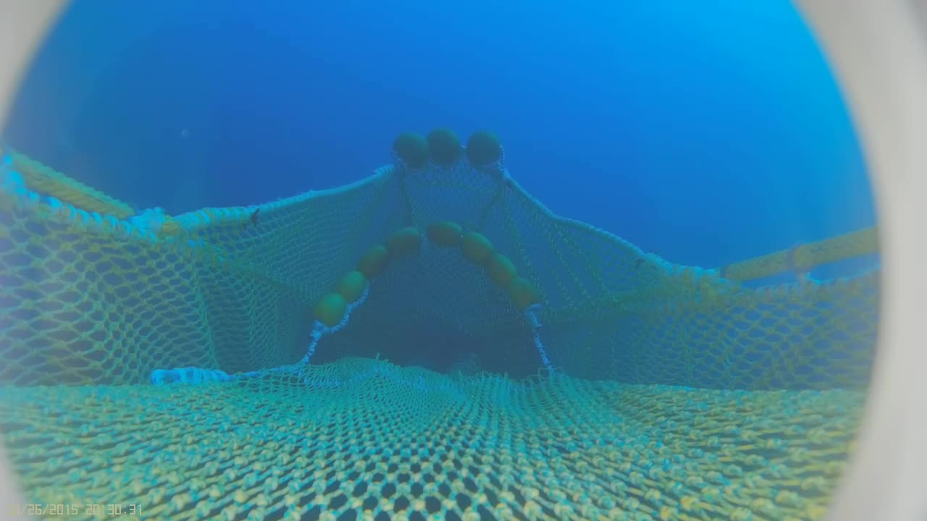
Questions

