Slide 1

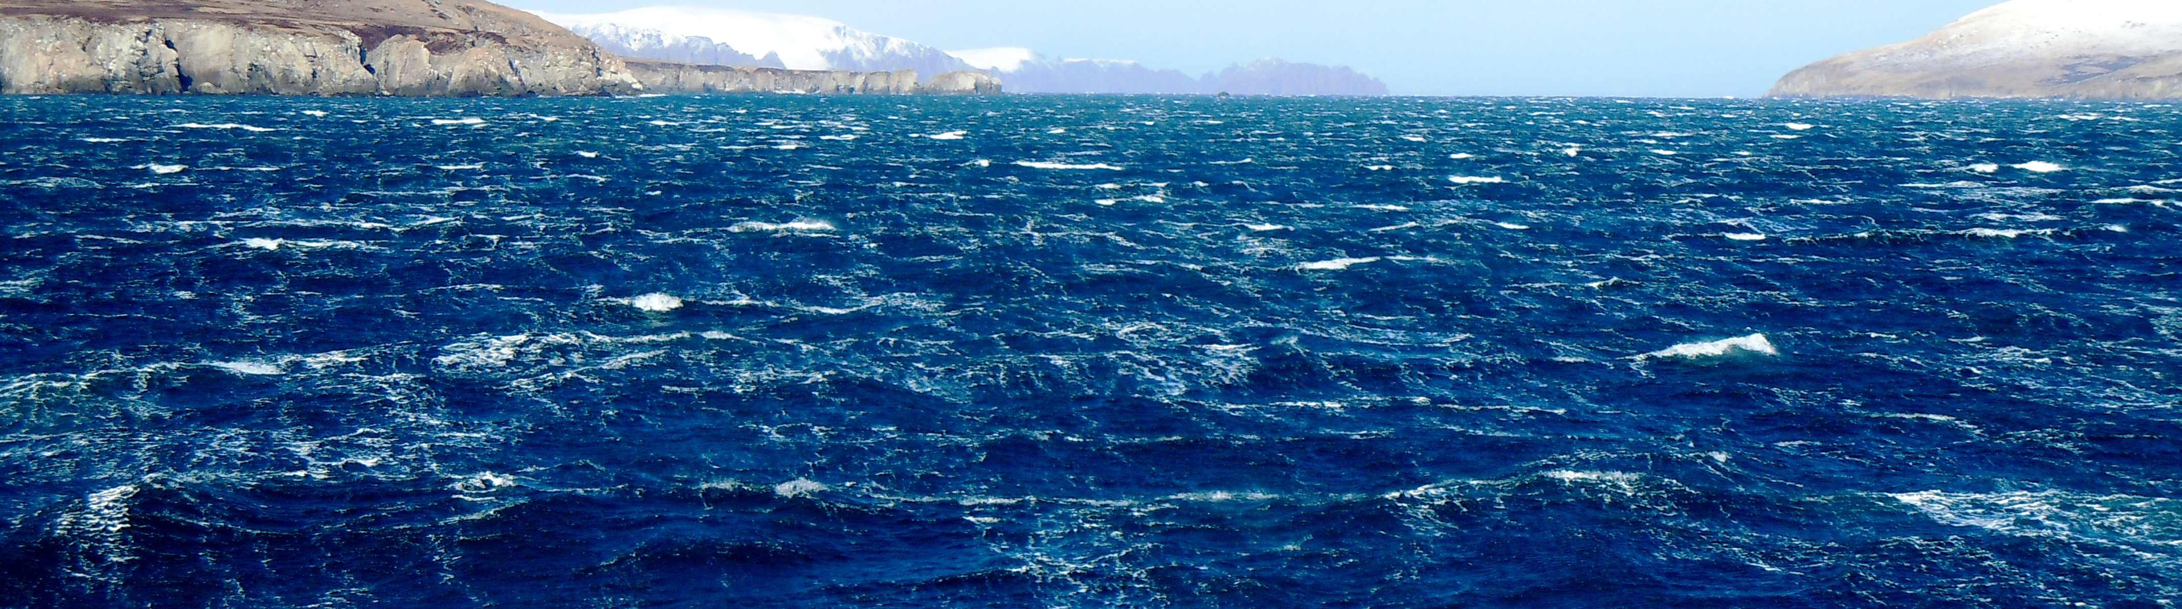
Update on Risk Table for 2019 Assessment Cycle
Martin Dorn and Stephani Zador
AFSC
Sept 18, 2019
Observer Training Room 1055, AFSC

Slide 2
Risk Table Approach – documenting relevant information/concerns that are not addressed within the assessment model
 | Assessment-related Considerations | Population dynamics Considerations | Ecosystem Considerations
Level 1: Normal | Typical to moderately increased uncertainty/minor unresolved issues in assessment | Stock trends are typical for the stock; recent recruitment is within normal range. | No apparent environmental and/or ecosystem concerns relevant to the stock
Level 2: Substantially increased concerns | Substantially increased assessment uncertainty/ unresolved issues. | Stock trends are unusual; abundance increasing or decreasing faster than has been seen recently, or recruitment pattern is atypical. | Some indicators showing adverse signals for the stock, but the pattern is not consistent across all indicators.
Level 3: Major Concern | Major problems with the stock assessment, very poor fits to data, high level of uncertainty, strong retrospective bias. | Stock trends are highly unusual; very rapid changes in stock abundance, or highly atypical recruitment patterns. | Multiple indicators showing consistent adverse signals a) across the same trophic level as the stock, and/or b) up or down trophic levels from the stock
Level 4: Extreme concern | Severe problems with the stock assessment, severe retrospective bias. Assessment considered unreliable. | Stock trends are unprecedented. More rapid changes in stock abundance than ever seen previously, or very long stretch of poor recruitment compared to previous patterns. | Extreme anomalies in multiple ecosystem indicators that are highly likely to impact the stock. Potential for cascading effects on other ecosystem components

Slide 3
Risk Table – 2018 test cases
 | Assessment-related Considerations | Population dynamics Considerations | Ecosystem Considerations | Fishery Performance Considerations
Level 1: Normal | EBS pollock, BSAI Atka Mackerel | BSAI Atka Mackerel | BSAI Atka Mackerel | NA
Level 2: Substantially increased concerns | Alaska sablefish, GOA pollock, GOA Pacific cod | EBS pollock, GOA pollock | Alaska sablefish, EBS pollock, GOA pollock, GOA Pacific cod | NA
Level 3: Major Concern | NA | NA | NA | NA
Level 4: Extreme concern | NA | GOA Pacific cod, Alaska sablefish | NA | NA
SSC suggested GOA cod should be Level 2 because control rule already strongly reduces F at low biomass
Notes:
the SSC considered that perhaps the population dynamics score could be reduced to Level 2 because most of the consideration was based on stock status and much of that was already built into the harvest control rule.

Slide 4
December Council meeting outcomes
The SSC, Advisory Panel, and the NPFMC took the risk table under consideration at the December 2018 Council meeting
The SSC agreed with the recommended ABC reductions that came from the example risk tables for GOA pollock, GOA Pacific cod, sablefish, and Bering Sea pollock.
But recommended the maximum permissible ABC for Bering Sea cod, rather than the recommended reduction in ABC resulting from the plan team’s application of the risk table.

Slide 5
December Council meeting outcomes
After a discussion of the potential benefits of wider application of the risk table, the SSC requested that all authors fill out the risk table for the 2019 assessment cycle.
The SSC considered the table to be an efficient way to organize concerns regarding an assessment.
Reiterated that it should be used reach a decision rather than to justify that decision that has already been made.
The SSC also requested that an additional column be added to the risk table to evaluate concerns related to fishery performance and behavior, considering both quantitative fishery metrics and local/traditional knowledge for a broader set of observations.

Slide 6
December Council meeting outcomes
The AP also recognized the benefit of the risk table in promoting greater transparency in the ABC recommendations by providing a clearly articulated and transparent list of concerns. Concerns for the AP included:
  A reluctance to allow the assessment authors and the plan teams to recommend a reduction from the maximum permissible ABC, preferring instead to entrust that responsibility to SSC. [compared to current procedure]
  Concern was that application of the risk table would lead to more situations where a reduction is recommended. [Not the intention of the table]
  The AP wanted to emphasize that the existing tier system is designed to implement precautionary fisheries management, that the reductions in the ABC from the maximum permissible should be infrequent. [this is current procedure]

Slide 7
December Council meeting outcomes
The AP ultimately ended up endorsing the SSC’s recommendation.
The Council received the comments from SSC and the AP and likewise recommended that that all authors fill out the risk table for the 2019 assessment cycle.

Slide 8
COUNCIL
Other council processes
Ecosystem-Based
Fisheries Management (EBFM)
ACLIM
Annual harvest specification process
FEP
EFH
LME-based
Stock-based
…
Ecosystem Status
Report (ESR)
Stock
Assessment
Risk
Table
Ecosystem and
Socio-economic
Profile (ESP)
ESR in brief
risk
table
risk
table
Notes:
Dashed line = to be developed
SA = stock assessment
ESP = appendix to stock assessments; ecosystem and socio-economic profile
ESR= ecosystem status report
Risk table = within each stock assessment; framework that includes summary of information from ESRs and ESPs relevant to the assessed species
Health report card = new product to be developed; not on annual harvest specification cycle!
Brief = 4 page summary of the ESR and how eco info was used in harvest specification

Slide 9
Risk Table Approach
 | Assessment-related Considerations | Population dynamics Considerations | Ecosystem Considerations | Fishery Performance Considerations
Level 1: Normal | Typical to moderately increased uncertainty/minor unresolved issues in assessment | Stock trends are typical for the stock; recent recruitment is within normal range. | No apparent environmental and/or ecosystem concerns | No apparent fishery/resource-use performance and/or behavior concerns
Level 2: Substantially increased concerns | Substantially increased assessment uncertainty/ unresolved issues. | Stock trends are unusual; abundance increasing or decreasing faster than has been seen recently; or recruitment pattern is atypical. | Some indicators showing adverse signals for the stock, but the pattern is not consistent across all indicators. | Some indicators showing adverse signals but the pattern is not consistent across all indicators.
Level 3: Major Concern | Major problems with the stock assessment; very poor fits to data; high level of uncertainty; strong retrospective bias. | Stock trends are highly unusual; very rapid changes in stock abundance; or highly atypical recruitment patterns. | Multiple indicators showing consistent adverse signals a) across the same trophic level as the stock, and/or b) up or down trophic levels from the stock | Multiple indicators showing consistent adverse signals a) across different sectors, and/or b) different gear types
Level 4: Extreme concern | Severe problems with the stock assessment; severe retrospective bias; assessment considered unreliable. | Stock trends are unprecedented; More rapid changes in stock abundance than ever seen previously, or very long stretch of poor recruitment compared to previous patterns. | Extreme anomalies in multiple ecosystem indicators that are highly likely to impact the stock; potential for cascading effects on other ecosystem components | Extreme anomalies in multiple performance indicators that are highly likely to impact the stock.

Slide 10
Fishery performance evaluation (GOA Pollock example)
Fishery observer data were used calculate CPUE, which was quantified as the catch of pollock in tons/hour.
Data were filtered to exclude catches less than 80% pollock, and gears other than pelagic gear.
The geometric mean CPUE was calculated by taking the log of the CPUE and then exponentiating.
Mean CPUE was calculated for the first trimester (Jan-April), and the third trimester (Aug-Dec, mostly Aug.-Oct.).

Slide 11
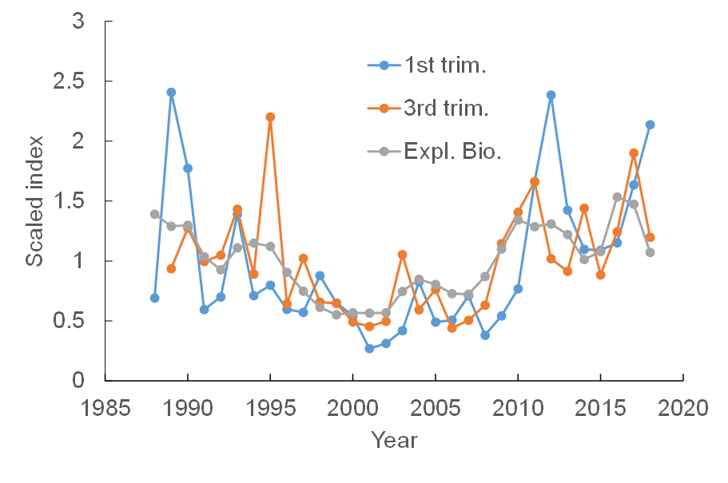
Geometric mean CPUE for the 1st and 3rd trimester compared to model estimates of exploitable biomass (sum of the product of numbers at age, fishery selectivity, and fishery weight at age).

Slide 12
Recommended 2019 process for ecosystem considerations column for assessment authors
Assessment authors can either work independently to assemble ecosystem information, or work collaboratively with a designated point of contact.
Use the point of contact table Risk table assignment 2019 to identify the ecosystem expert assigned to help with risk table (Ebett, Steph, Ellen, Kalei).
Set up a meeting (ideally face-to-face) with the ecosystem POC in late Sept to early Oct to plan a way forward.
The ecosystem POC (and others as needed) will assist in writing a short paragraph and bullets for the ecosystem considerations column of the risk table.
Scoring for this column can be a collaborative endeavor. Aim for consensus if possible, but assessment author is ultimately responsible for recommendations.

