Slide 1
Appendix E: EAG 21.1a model implementation in Gmacs
CPT virtual meeting, January 11, 2022,

Slide 2
Topics
To modify EAG golden king assessment model EAG21.1a to model EAG21.6 and implement it in Gmacs.

Slide 3

Gmacs Working Session
A working session on AIGKC model implementation in Gmacs was conducted by Andre Punt during 1$−$3 December 2021 in Juneau.
In person participants: Andre Punt, Shareef Siddeek, and Katie Palof,
Participants via google virtual: Cody Szuwalski, William Stockhauson, Martin Dorn, and Michael Martinez.

Slide 4
Gmacs Working Session continued
a bridging analysis was done between models EAG21.6 and EAG21.1a.
Table 2 | EAG21.1a | EAG21.6 | EAG21.1aSid1 | EAG21.1aSid2 | EAG21.1aSid3 | EAG21.1aSid4
Model Changes | Base model (May 2021 model) | Modification of base model for gmacs | EAG21.1a+ Retained, Total, and GF (by) catch likelihoods changed to EAG21.6 form | EAG21.1aSid1+ Retained and Total size comps likelihoods changed to EAG21.6 form | EAG21.1aSid2+ Rec_dev bias correction factor introduced as in EAG21.6 | EAG21.1aSid3+ CPUE likelihoods changed to EAG21.6 form
M | 0.21 | 0.21 | 0.21 | 0.21 | 0.21 | 0.21
R₀ (millions) | 2.55756 | 2.17147 | 2.44195 | 2.46983 | 2.43102 | 2.43102
B₀ (t) | 19,376 | 17,031 | 18,581 | 18,845 | 18,577 | 18,577
B₃₅ (t) | 6,767.93 | 6,606.73 | 6,490.46 | 6,553.45 | 6,448.36 | 6,448.36
Bcurrent/B₃₅ | 1.299 | 1.095 | 1.222 | 1.233 | 1.067 | 1.067
F₃₅ | 0.61 | 0.57 | 0.55 | 0.55 | 0.55 | 0.55
F_{ofl} | 0.61 | 0.57 | 0.55 | 0.55 | 0.55 | 0.55
Mean Trawl Byc F | 0.00021 | 0.00023 | 0.00022 | 0.00022 | 0.00023 | 0.00023
Total catch OFL (t) | 2,928.87 | 2,165.33 | 2,390.62 | 2,431.11 | 2,007.42 | 2,007.42

Slide 5
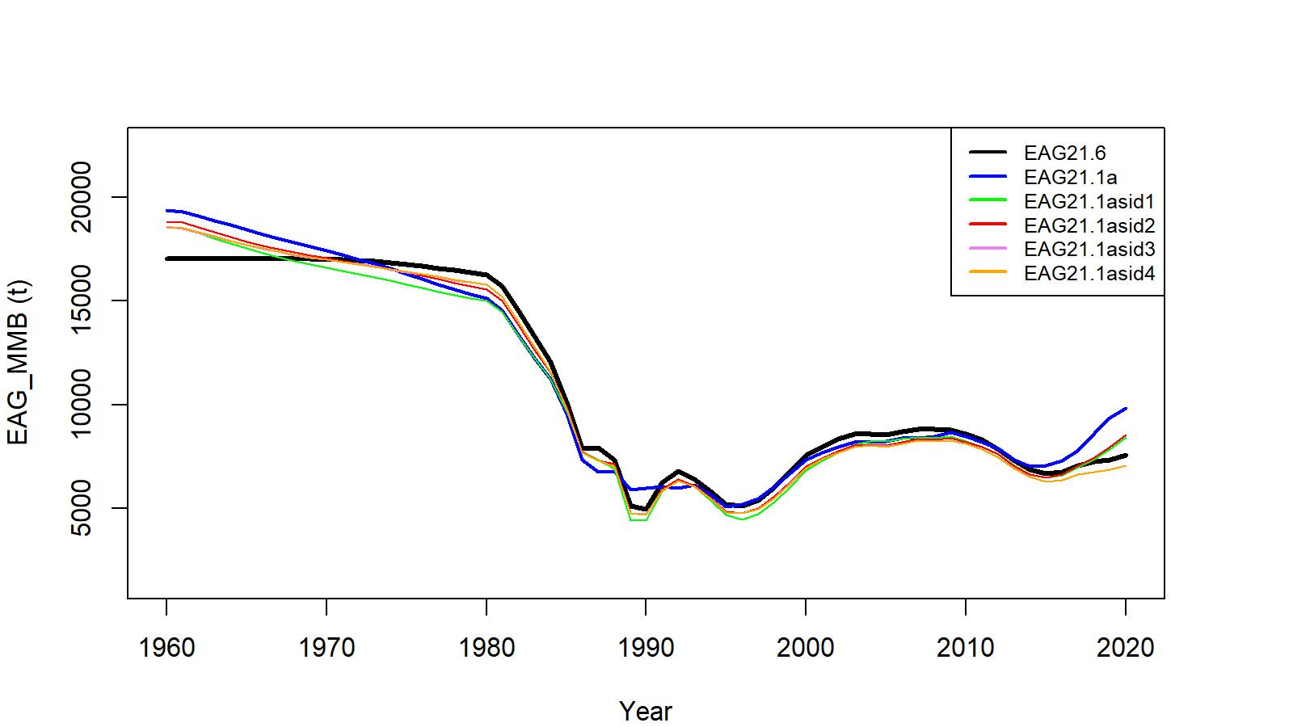
Gmacs Working Session continued
Figure 1. Comparison of MMB trends.

Slide 6
Gmacs Working Session continued
After the working session, a bridging analysis was done to assess the progress of model EAG21.6 toward model EAG 21.7. The model EAG21.7 made a few improvements to EAG21.6, one-step-at a time:
SigmaR was changed from 0.3535 to 0.5,
growth parameters were estimated in the model,
observer CPUE indices were updated, and
These progressions were implemented in Gmacs.

Slide 7
Gmacs Working Session continued
Table 3 | EAG21.1a Update | EAG21.6 | EAG21.7 | EAG21.7b | Gmacs6 | Gmacs7 | Gmacs7b
Model Changes | Base model EAG21.1a data with updated observer CPUE indices [Gmacs version of R0 and CPUE, and CPUE likelihood] | Modification of EAG21.1a for Gmacs, EAG21.1a data with status quo observer CPUE indices [Gmacs version of R0, size comp, catch, CPUE, and bycatch likelihoods] | EAG21.6+ Use EAG21.1a data with status quo CPUE indices | EAG21.7+ Use EAG21.1a data with updated observer CPUE indices | Convert EAG21.6 estimated par. values for input to Gmacs6.ctl, use Gmacs6.dat | Convert EAG21.7 estimated par. values for input to Gmacs7.ctl, use Gmacs6.dat | Gmacs7+ convert EAG21.7b par. values for input to Gmacs7b.ctl, update observer CPUE in Gmacs6.dat
Additional Changes | SigmaR= 0.5 bias correction | sigmaR=0.3535, Growth parameters fixed to previously estimated values | sigmaR=0.5, Growth parameters estimated
R₀ (millions) | 2.83536 | 2.17147 | 2.12642 | 2.15601 | 2.56546 | 2.63074 | 2.67558
B₀ (t) | 25,937 | 20,166 | 19,871 | 20,135 | 19,634 | 20,160 | 20,586
B₃₅ (t) | 9,297.68 | 6,606.73 | 6,600.20 | 6,708.63 | 6,871.88 | 7,055.85 | 7,205.20
Bcurrent/ B₃₅ | 1.187 | 1.095 | 1.317 | 1.428 | 1.286 | 1.302 | 1.359
F₃₅ | 0.640 | 0.570 | 0.530 | 0.520 | 0.613 | 0.600 | 0.587
F_{ofl} | 0.640 | 0.570 | 0.530 | 0.520 | 0.613 | 0.600 | 0.587
Total catch OFL (t) | 3,795.01 | 2,165.33 | 2,714.19 | 3,056.69 | 2,835.64 | 3,060.24 | 3,358.88

Slide 8
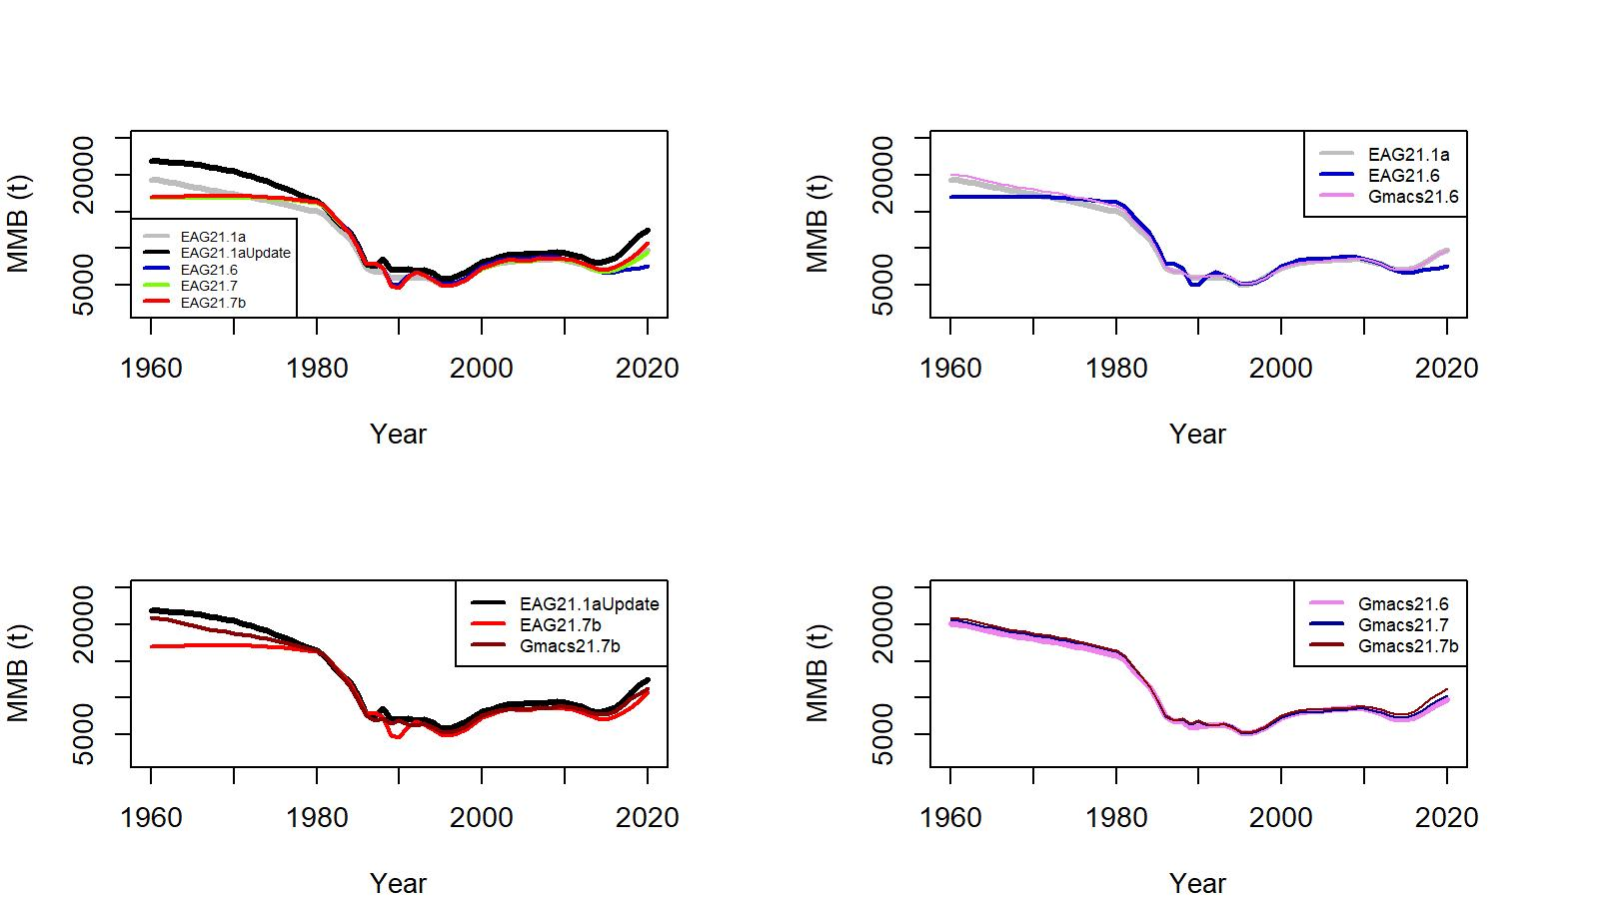
Gmacs Working Session continued
Figure 2. Comparison of MMB trends for various modifications of EAG model and parallel Gmacs runs. EAG21.1a refers to the model accepted at the May/June 2021 CPT/SSC meeting whereas EAG21.1aUpdate refers to the updated model (observer CPUE updated).

Slide 9
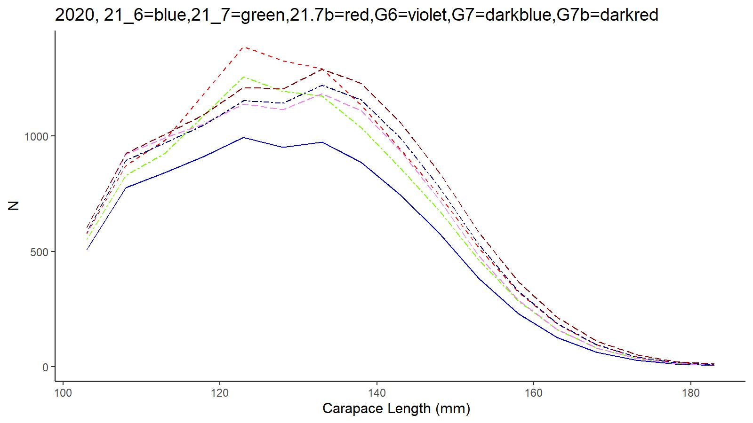
Gmacs Working Session continued
N matrix: 2020
Color key for curves in this and subsequent figures is defined here. G6 = Gmacs6;

Slide 10
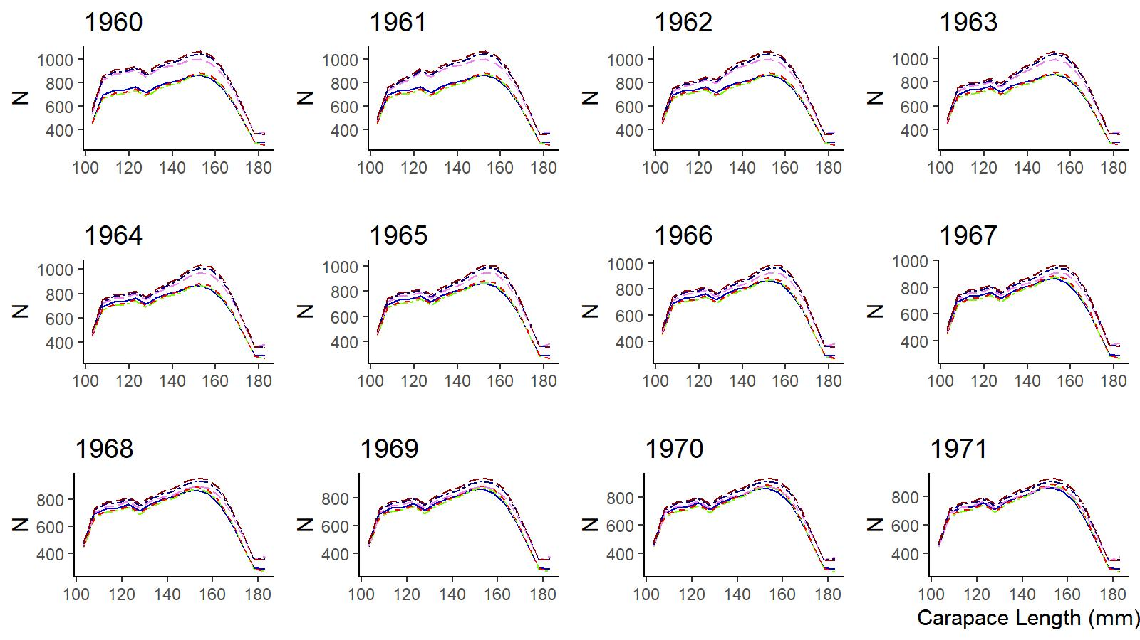
Gmacs Working Session continued
N matrix: 1960-1971

Slide 11
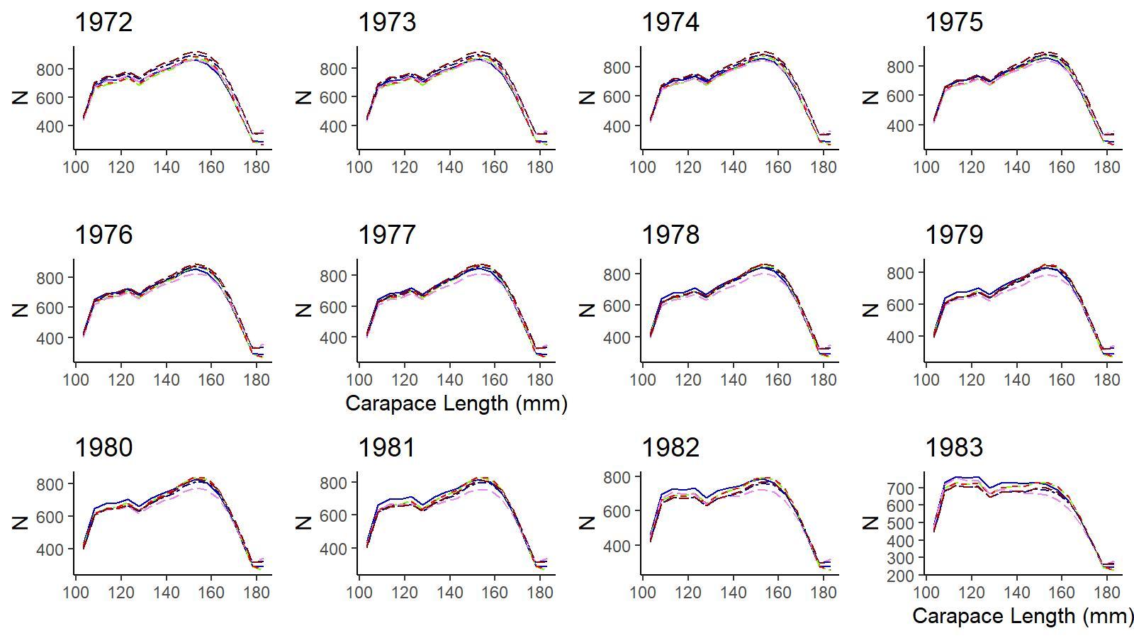
Gmacs Working Session continued
N matrix: 1972-1983

Slide 12
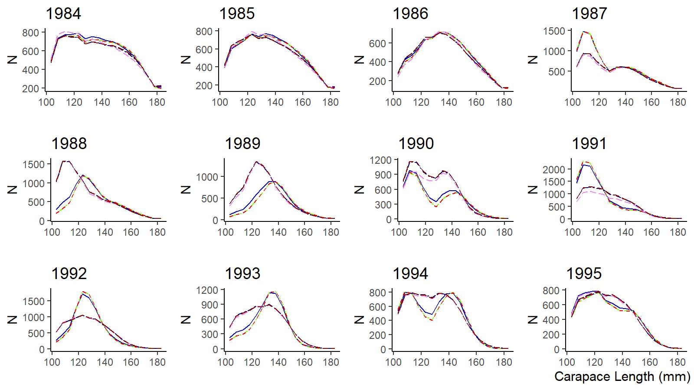
Gmacs Working Session continued
N matrix: 1984-1995

Slide 13
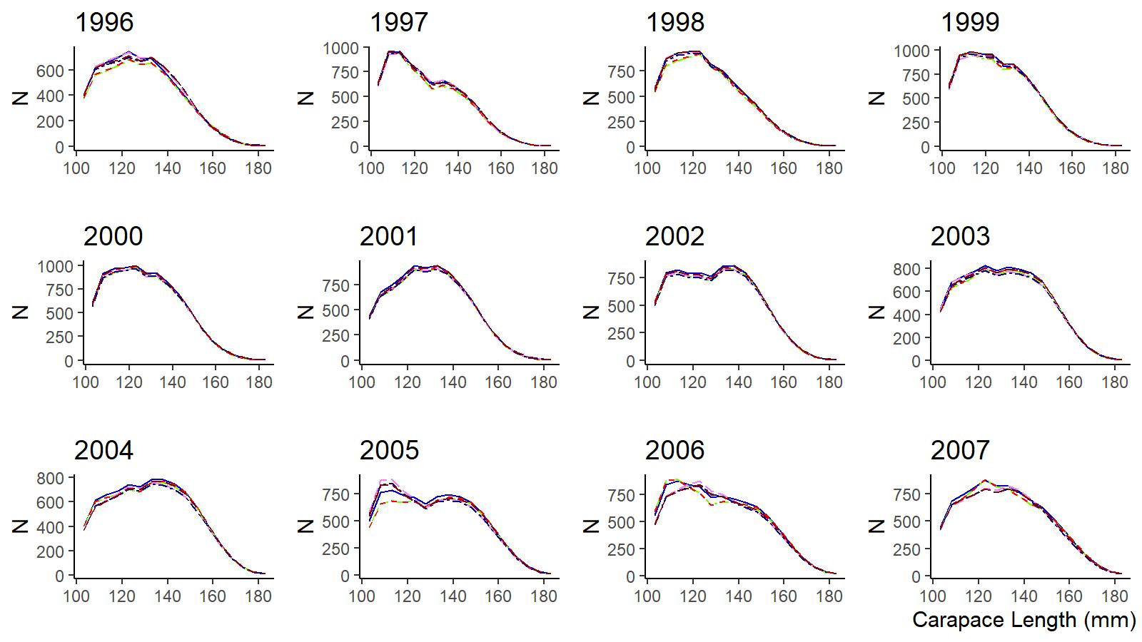
Gmacs Working Session continued
N matrix: 1996-2007

Slide 14
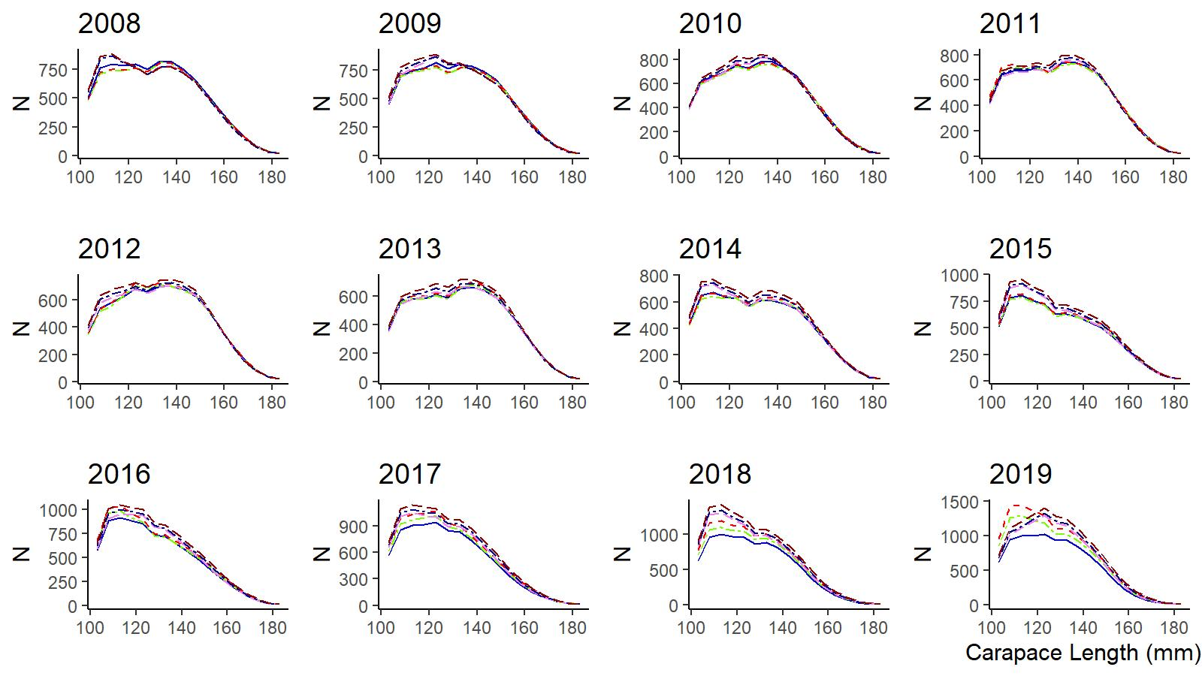
Gmacs Working Session continued
N matrix: 2008-2019

Slide 15
Thank you

