Slide 1

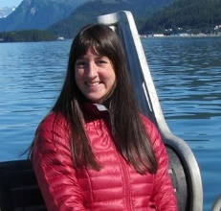
2022 Essential Fish Habitat (EFH) 5-Year Review
Component 1 Descriptions and Identification
NMFS Alaska Region (AKRO) and Alaska Fisheries Science Center (AFSC)
Jodi Pirtle, AKRO, Habitat Conservation Division
Ned Laman, AFSC, Groundfish Assessment Program
Jeremy Harris, AFSC, Groundfish Assessment Program, Lynker
Margaret Siple, AFSC, Groundfish Assessment Program
Molly Zaleski, AKRO, Habitat Conservation Division
Gretchen Harrington, AKRO, Habitat Conservation Division
Jim Thorson, AFSC, Habitat and Ecological Processes Research Program

Slide 2
Orientation to EFH Component 1 Documents
We have provided the EFH Descriptions and Maps Stock Author Review Report as an agenda attachment for this meeting (Attachment 1).
The following documents are also shared with additional details on the new EFH descriptions and maps available for the 2022 EFH 5-year Review:
Discussion Paper (DP) on Advancing Model-based EFH Descriptions and Maps for the 2022 5-year Review (An overview document with supporting attachments 1-5)
Attachment 1: Stock Author Review Report (the focus of this presentation)
Attachment 2: EFH Area Comparison Maps (set of image files to download comparing 2017 and 2022 EFH areas)
Attachment 3: EFH Descriptions and Maps for the Bering Sea (Tech Memo)
Attachment 4: EFH Descriptions and Maps for the Aleutian Islands (Tech Memo)

Slide 3
EFH Components of Fishery Management Plans
NMFS has prioritized the seven EFH components in bold for the 2022 5-Year Review and will present progress on components 1 and 2 today:
EFH descriptions and identification (maps)
Fishing activities that may adversely affect EFH
Non-MSA fishing activities that may adversely affect EFH
Non-fishing activities that may adversely affect EFH
Cumulative impacts analysis
EFH conservation and enhancement recommendations
Prey species list and locations
Habitat Areas of Particular Concern (HAPC) identification
Research and information needs
Review EFH every 5 years
An EFH 5-Year Review Summary Report will be presented to the Council in October 2022 (T).

Slide 4
Report of Stock Assessment Author Review of EFH Component 1
Report of Stock Assessment Author (SA) Review of Essential Fish Habitat (EFH) C1 and C7 for the 2022 EFH 5-Year Review
  THANK YOU to ALL STOCK AUTHORS and EXPERT REVIEWERS!!!
Draft report presented to the November 2021 JGPT Meeting
An eAgenda attachment for this EFH presentation
The goal of this report is to present a complete picture of the SA Review of EFH C1 and C7 (prey species habitat). Today’s focus is C1.
What is in the report?
  Description of and new information developed for EFH C1 (Chapter 1), and the review of C1 by SAs at this stage of the iterative EFH 5-Year Review process (Chapter 2).
  Summary of communications between all SAs and EFH analysts receiving reviews and responding to concerns, questions, and comments (Chapter 3).
  Details of the changes made to the C1 information based on the SA review (Chapter 3).
Report and all other EFH C1 reporting will be reviewed by the SSC in February 2022.

Slide 5
Timeline – Progress to Date
2022 EFH 5-year Review Plan to Crab Plan Team
Proposed Approach for Component 1 (C1) Species Distribution Models (SDMs) to SSC
2022 EFH 5-year Review Proposed Approach to EC
C1 Stock Author Review Meeting
Launch C1 Stock Author Review
April 2019
June 2020
January 2021
May 2021
April 2020
September 2020
April 2021
September 2021
2022 EFH 5-year Review Proposed Approach Update to Council
Progress on C1 SDMs to Groundfish Plan Teams
2022 EFH 5-year Review Plan to SSC
C1 Stock Author Review Completed

Slide 6
Timeline – Progress and Next Steps
Stock Assessment Authors Conduct Fishing Effects Assessment (C2)
Groundfish Plan Teams Review of C1 Progress & C2 Plan
Council Review of EFH 5-year Review Summary Report
Groundfish Plan Teams Review of C1 Progress
September 2021
November 2021
Spring 2022
October (T) 2022
October 2021
January and February 2022
June (T) 2022
TBD
SSC Review of C1
SSC Review of C2 Assessment & C1 Additional Contributions
Complete FMP Amendment process
CPT, EC, and SSC Review of C1 & C2
Complete C1 Analyst Follow-up with Reviewing Stock Authors & Experts

Slide 7
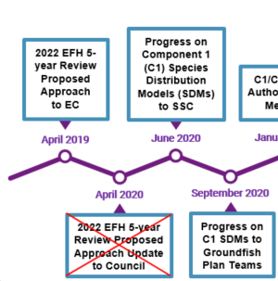
Iterative Review Process to Develop Methods
Iterative review of EFH C1 began in April 2019 with presentation of the DRAFT 2022 EFH 5-year Review Plan to the Council’s Ecosystem Committee (EC) for review and input.
Next, the EFH C1 DRAFT plan and proposed methods for the ensemble SDM EFH study (Laman et al. study) and three other studies was presented to SSC in June 2020 and to JGPT in September 2020 for review and input with additional stakeholder participation.
SSC review of the methods was comprehensive and JGPT also provided helpful recommendations, where the Laman et al. study responded by modifying our approach, which led to improvements.
Following these early reviews, the Laman et al. study refined the modeling code and produced the first draft of ensemble SDM EFH methods and results for the SA Review.
SA Review of C1 complete set of draft methods and results is a new and co-developed approach in this 5-Year Review.

Slide 8
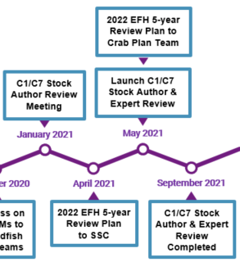
Stock Assessment Author Review Process
Chapter 2 of the SA Review Report describes the SA review process for EFH C1 and Section 2.2 lists what the EFH analysts provided the SAs for their review (e.g., FMP EFH text and tables; 2017 SDM EFH maps and new ensemble SDM EFH maps for comparison).
Iterative review by SAs and other experts is a critical element of the EFH 5-Year Review process.
We initiated the SA review of EFH C1 with the January 2021 Workshop to co-develop the review process with focus on expectations and timing (Section 2.1).
We provided the SAs with the SDM ensemble draft methods and first set of results with the plan of working iteratively with all participating and interested reviewers.
Addition of SA review of draft methods and results and inclusion of crab species experts as additional reviewers were innovations of this EFH 5-Year Review that strengthened the research products, process, and collaboration.

Slide 9
Iterative Review Process Milestones
In 2021, as the Laman et al. study was finishing the first set of draft SDM ensemble results for the EFH C1 SA Review, two additional iterative review milestones were completed that improved the SA Review process.
SSC review and input on the EFH 5-year Review Plan presented in April 2021 with a discussion paper.
  Discussion paper included EFH C1 analyst responses to SSC June 2020 review and input on SDM draft methods and results examples.
  SSC provided guidance for analysts to prepare for SSC C1 evaluation in October 2021 (now February 2022).
CPT review and input on the EFH 5-year Review Plan presented in May 2021.
  Presented SDM ensemble draft methods and results examples for crabs and discussed the plan for SA review of EFH C1.
  CPT requested that crabs be reviewed first due to assessment timing and to add species experts as reviewers, which we happily accommodated.

Slide 10
Stock Assessment Author Review
We launched the SA Review of EFH C1 in May 2021 (Chapter 2)
  Reviewed current FMP EFH C1 maps, text, and tables
  Reviewed SDM ensemble draft methods and species draft results chapters with new EFH maps
  Completed September 1, 2021 with 100% engagement
Chapter 3 presents the SA Review Results:
  30 SAs reviewed 3 regional methods sections and 125 SDM ensemble EFH species or species complex draft results chapters with 1-3 life stages each
  211 individual species’ life stages modeled:
    27 species (out of 60) received model re-runs as determined by our internal evaluation or by SA review (e.g., revise life stage breaks = 22 species; reevaluate ensemble constituents and revise EFH map = 1 species)
  SAs and other experts provided input as comments, questions, and concerns.

Slide 11
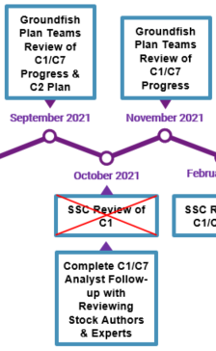
Stock Assessment Author Review
September 2021 JGPT:
  Provided an SDM ensemble EFH project update and summarized main areas of SA review concerns and our overall plan to address those.
  Previewed our response to common issues raised (e.g., replace single ensemble performance metric with 3 conventional metrics to more comprehensively assess ensemble performance).
  Communicated that we would work with individual SAs.
Post-Sept. 2021 JGPT:
  Continued to respond to all reviewers; largely completed by November 1.
  Discussed concerns, answered questions, offered future research recommendations, and indicated that revised species results chapters would be provided when completed.
  Addressed ensemble performance concerns with 8 SAs requiring more in-depth communication (provided revised ensemble performance methods/results and reached resolution).
  Communication is documented in Chapter 3.
  We responded to all reviewers to address questions and concerns. Thank you, for your engagement and collaboration.

Slide 12
Stock Assessment Author Review
Examples of EFH analyst consultations to address larger concerns (Chapter 3).
  Ensemble and EFH map was revised for 1 species.
    EFH analysts investigated options and removed an ensemble member
    EFH analysts and SA engaged in further iterative communication and reached resolution for this 5-Year Review.
  EFH maps for 3 species were not advanced by EFH analysts
    EFH analysts met with SA and reached resolution for this 5-Year Review.
    These were all data-limited species that did not have an SDM EFH map in 2017.
Data caveat statements were added to revised species results chapters where an SA had recommended using additional catch data sources in future EFH mapping efforts.
Future research recommendations will be included to address e.g., data limited species and combining catch data sources in the SDM ensemble framework.
Thank you all SAs for your collaboration, which led to improvements.
Revisions were made available for reviewers upon request.
NMFS Technical Memoranda for the Bering Sea, Aleutian Islands, and Gulf of Alaska are in the publication process.

Slide 13
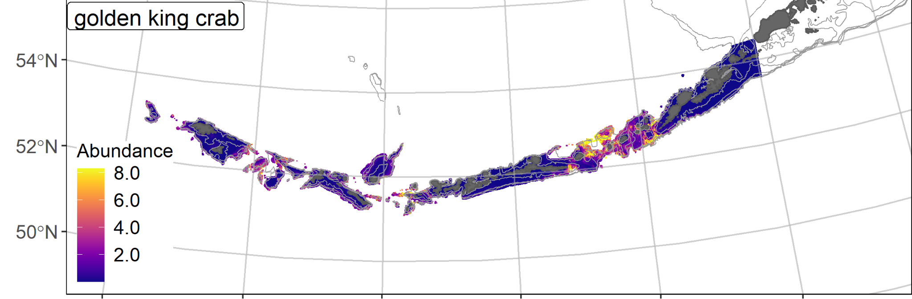
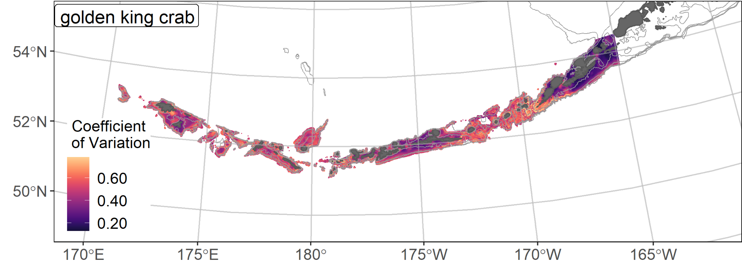

Ensemble-Predicted Abundance and CV
𝝆 = 0.56
AUC = 0.89
PDE = 0.48

Slide 14
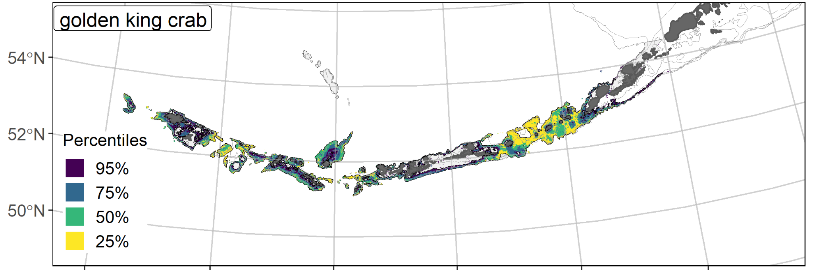
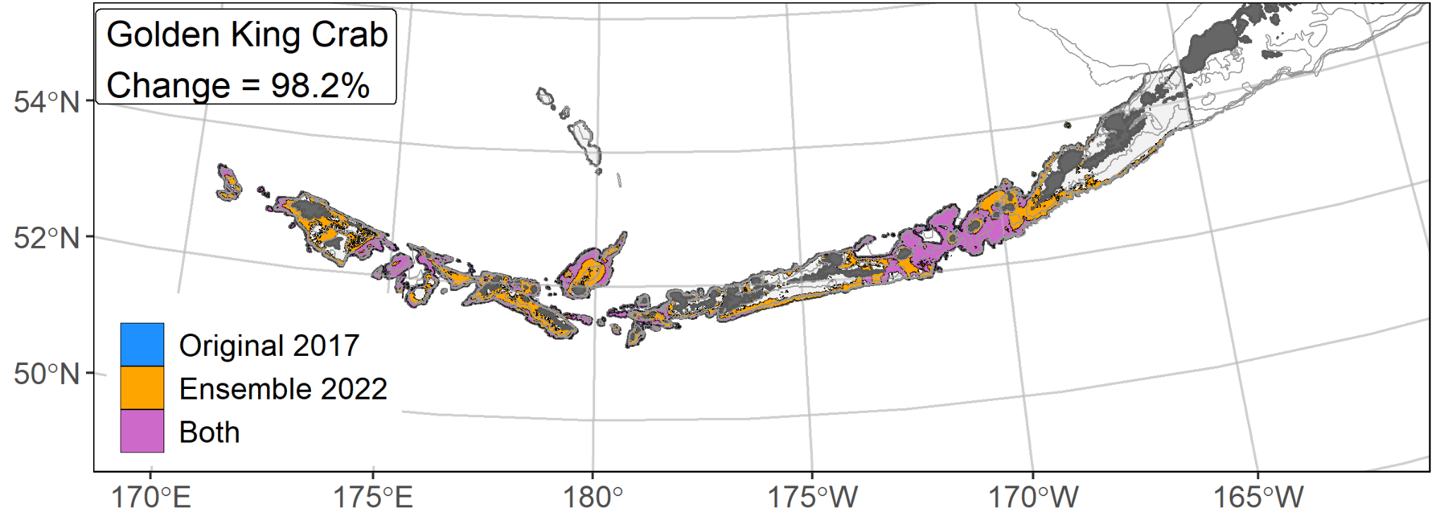
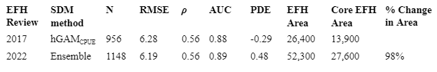
EFH Comparison 2017 versus 2022

Slide 15
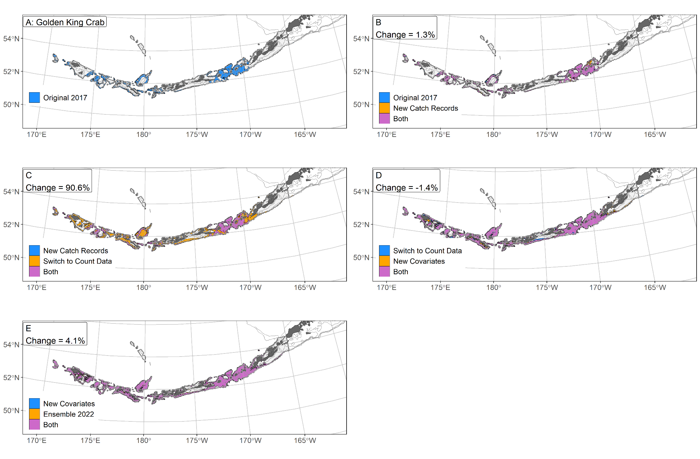
Golden King Crab Bridging Sequence

Slide 16
2022 SDM Ensemble EFH Results Overview
Crab EFH (5 species in the Bering, 2 in the Aleutians, 0 in the Gulf)
  giant Pacific octopus EFH in all 3 regions
Groundfish EFH (32 in the Bering, 25 in the Aleutians, 42 in the Gulf)
  up to 3 life stages for each species.
229 new or revised EFH Level 1, 2, or 3 maps
  representing 211 unique species’ life stage combinations
  EFH for 7 stock complexes
Habitat-based ensembles describe environmental conditions affecting patterns of species distribution and abundance
  influential covariates varied by region, species, and life stage
Ensemble modeling approach mitigates observed dependence of EFH areal extent on SDM type
SDM ensemble performance was generally an improvement compared to 2017 single SDMs.

Slide 17
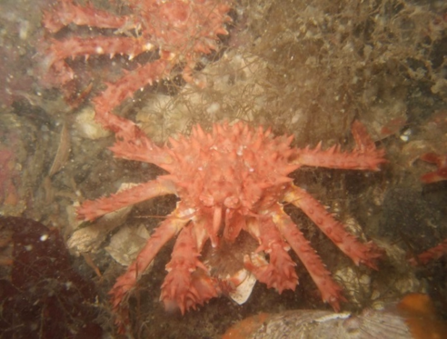
Future Research Directions
Future Research Directions:
  Data
    Model crab life stages (immature/mature)
    Explore additional/new environmental variables
  Modeling
    Combine disparate data sets in the SDM ensemble framework
    Exploring new predictor variables
    Focus on data-limited species
    SDMs to address climate change and shifting species distributions on reduced temporal scales
Future EFH Process Recommendations:
  Automation
    Reproducible code
    Automated reports
  Working Group

Slide 18
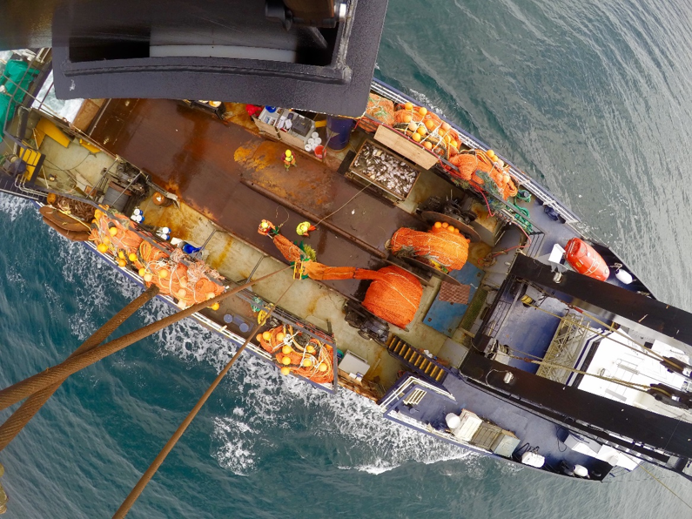
THANK YOU
JODI PIRTLE
JODI.PIRTLE@NOAA.GOV
NED LAMAN
NED.LAMAN@NOAA.GOV

Slide 19
SDM EFH Methods Overview
2022 Ensemble SDM
Response Variable
Fish numerical abundance (1982-2019 catches)
Models
MaxEnt, paGAM, hGAM, Poisson GAM, Negative Binomial GAM
Constituents applied comprehensively
Ensemble:
Constituent models retained based on RMSE
Performance Metrics: (applied to all)
k-fold cross validation to generate RMSE and other fit metrics
Provided for Stock Author review of methods/results = Spearman’s rho-squared
Added based on Stock Author review to improve comprehensive results communication = Spearman’s correlation (ρ), AUC, Poisson deviance explained (PDE)
2017 SDM
Response Variable
4th root transformed CPUE (1982-2014 catches)
Models
MaxEnt, hGAM, GAM
Selected a priori
Ensemble:
New for 2022
Performance Metrics
Applied based on model
MaxEnt (AUC); GAMs (Deviance Explained)
80/20 training/testing data fit metrics examined for out of sample comparison
Provided for Stock Author review = None

Slide 20
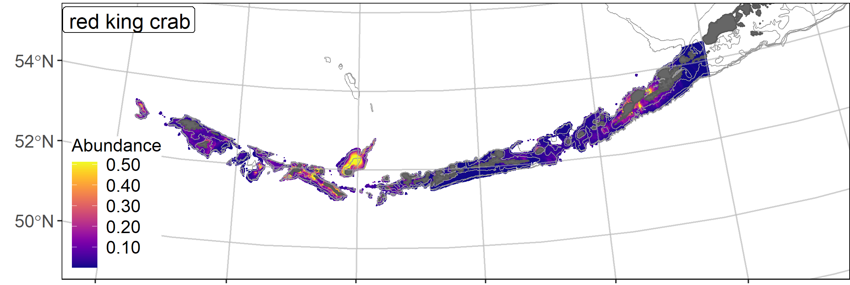
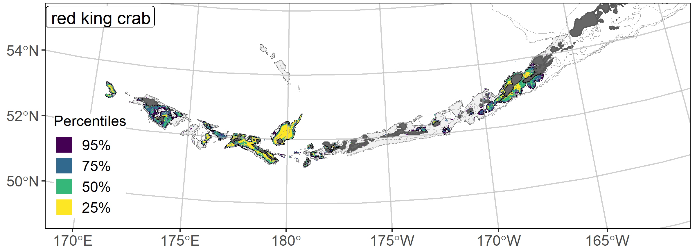
Red king crab ensemble predicted abundance and distribution, and EFH area percentiles for the Aleutian Islands
𝝆 = 0.14
AUC = 0.82
PDE = 0.27
The overall ensemble fit to observed RKC distribution and abundance was fair. The ensemble was poor at predicting high and low catches abundance (ρ = 0.14), good at discriminating presence-absence (AUC = 0.82), and fair at explaining deviance (PDE = 0.27). Geographic location, bottom depth, and maximum tidal current accounted for the majority (74%) of the deviance in the ensemble-predicted RKC numerical abundance. An EFH map was not available in 2017.
20

Slide 21
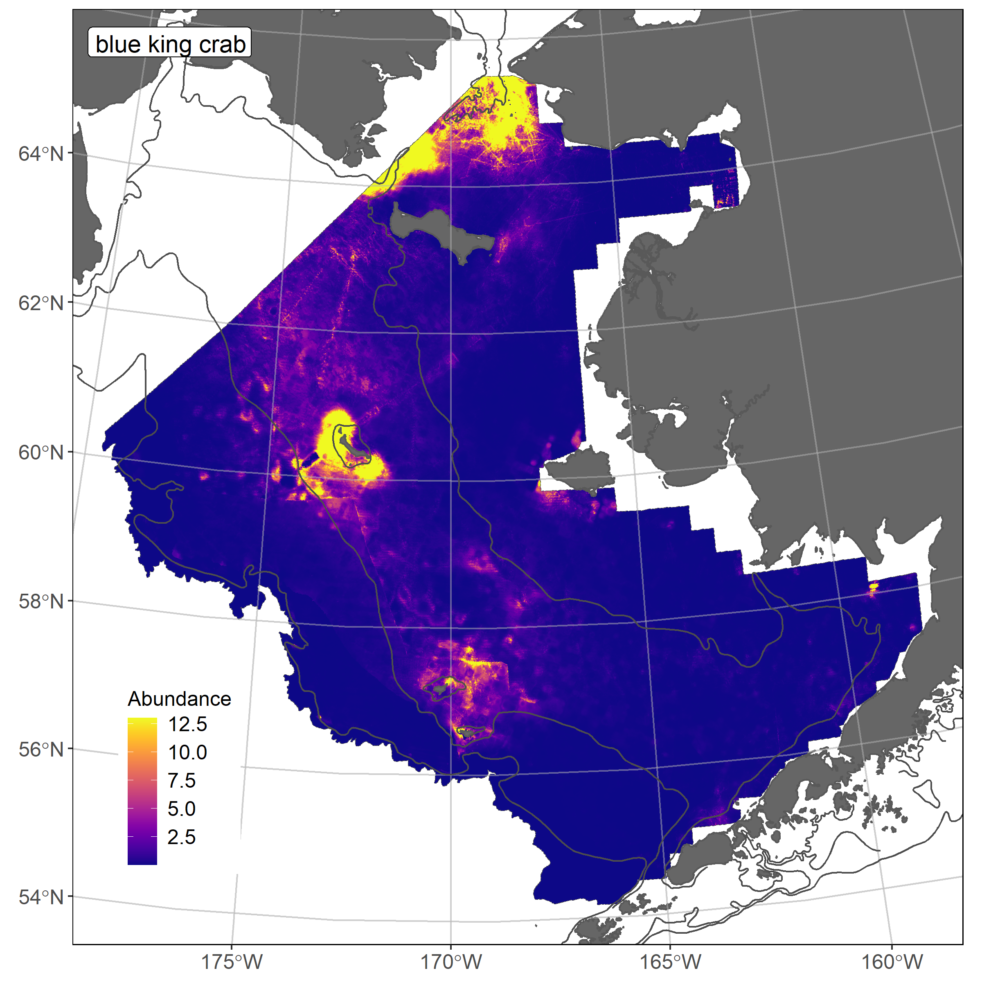
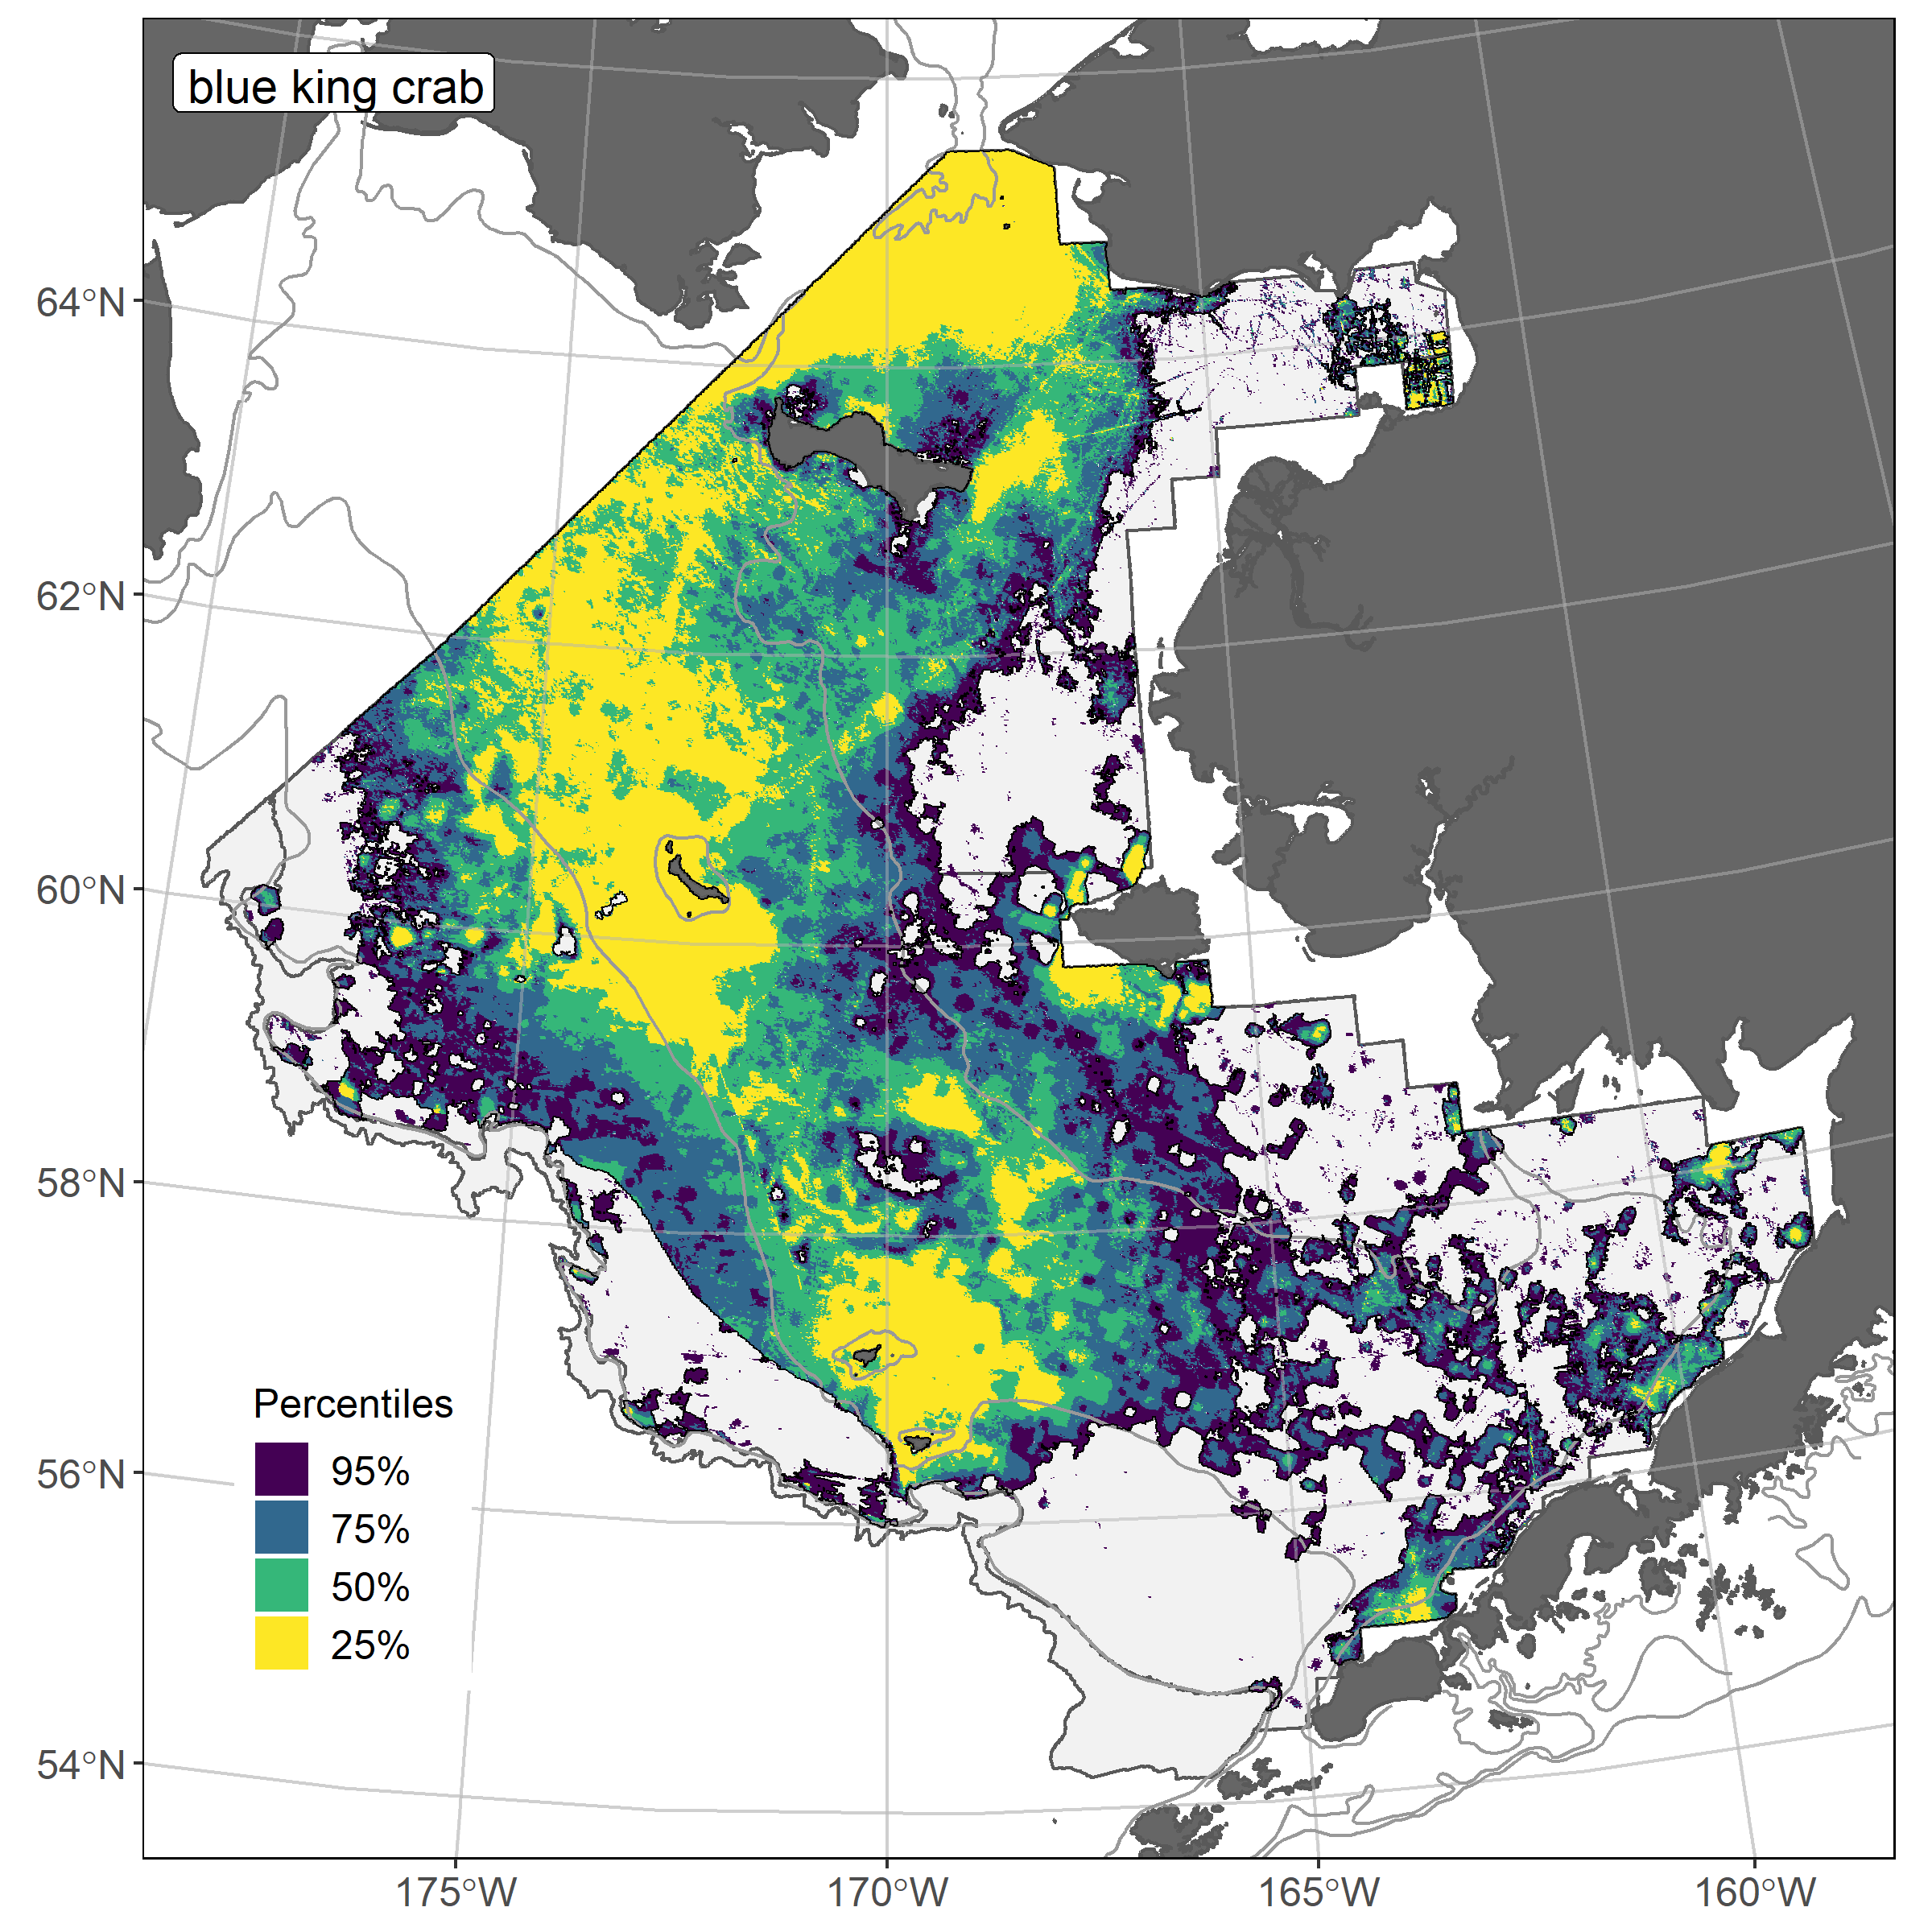
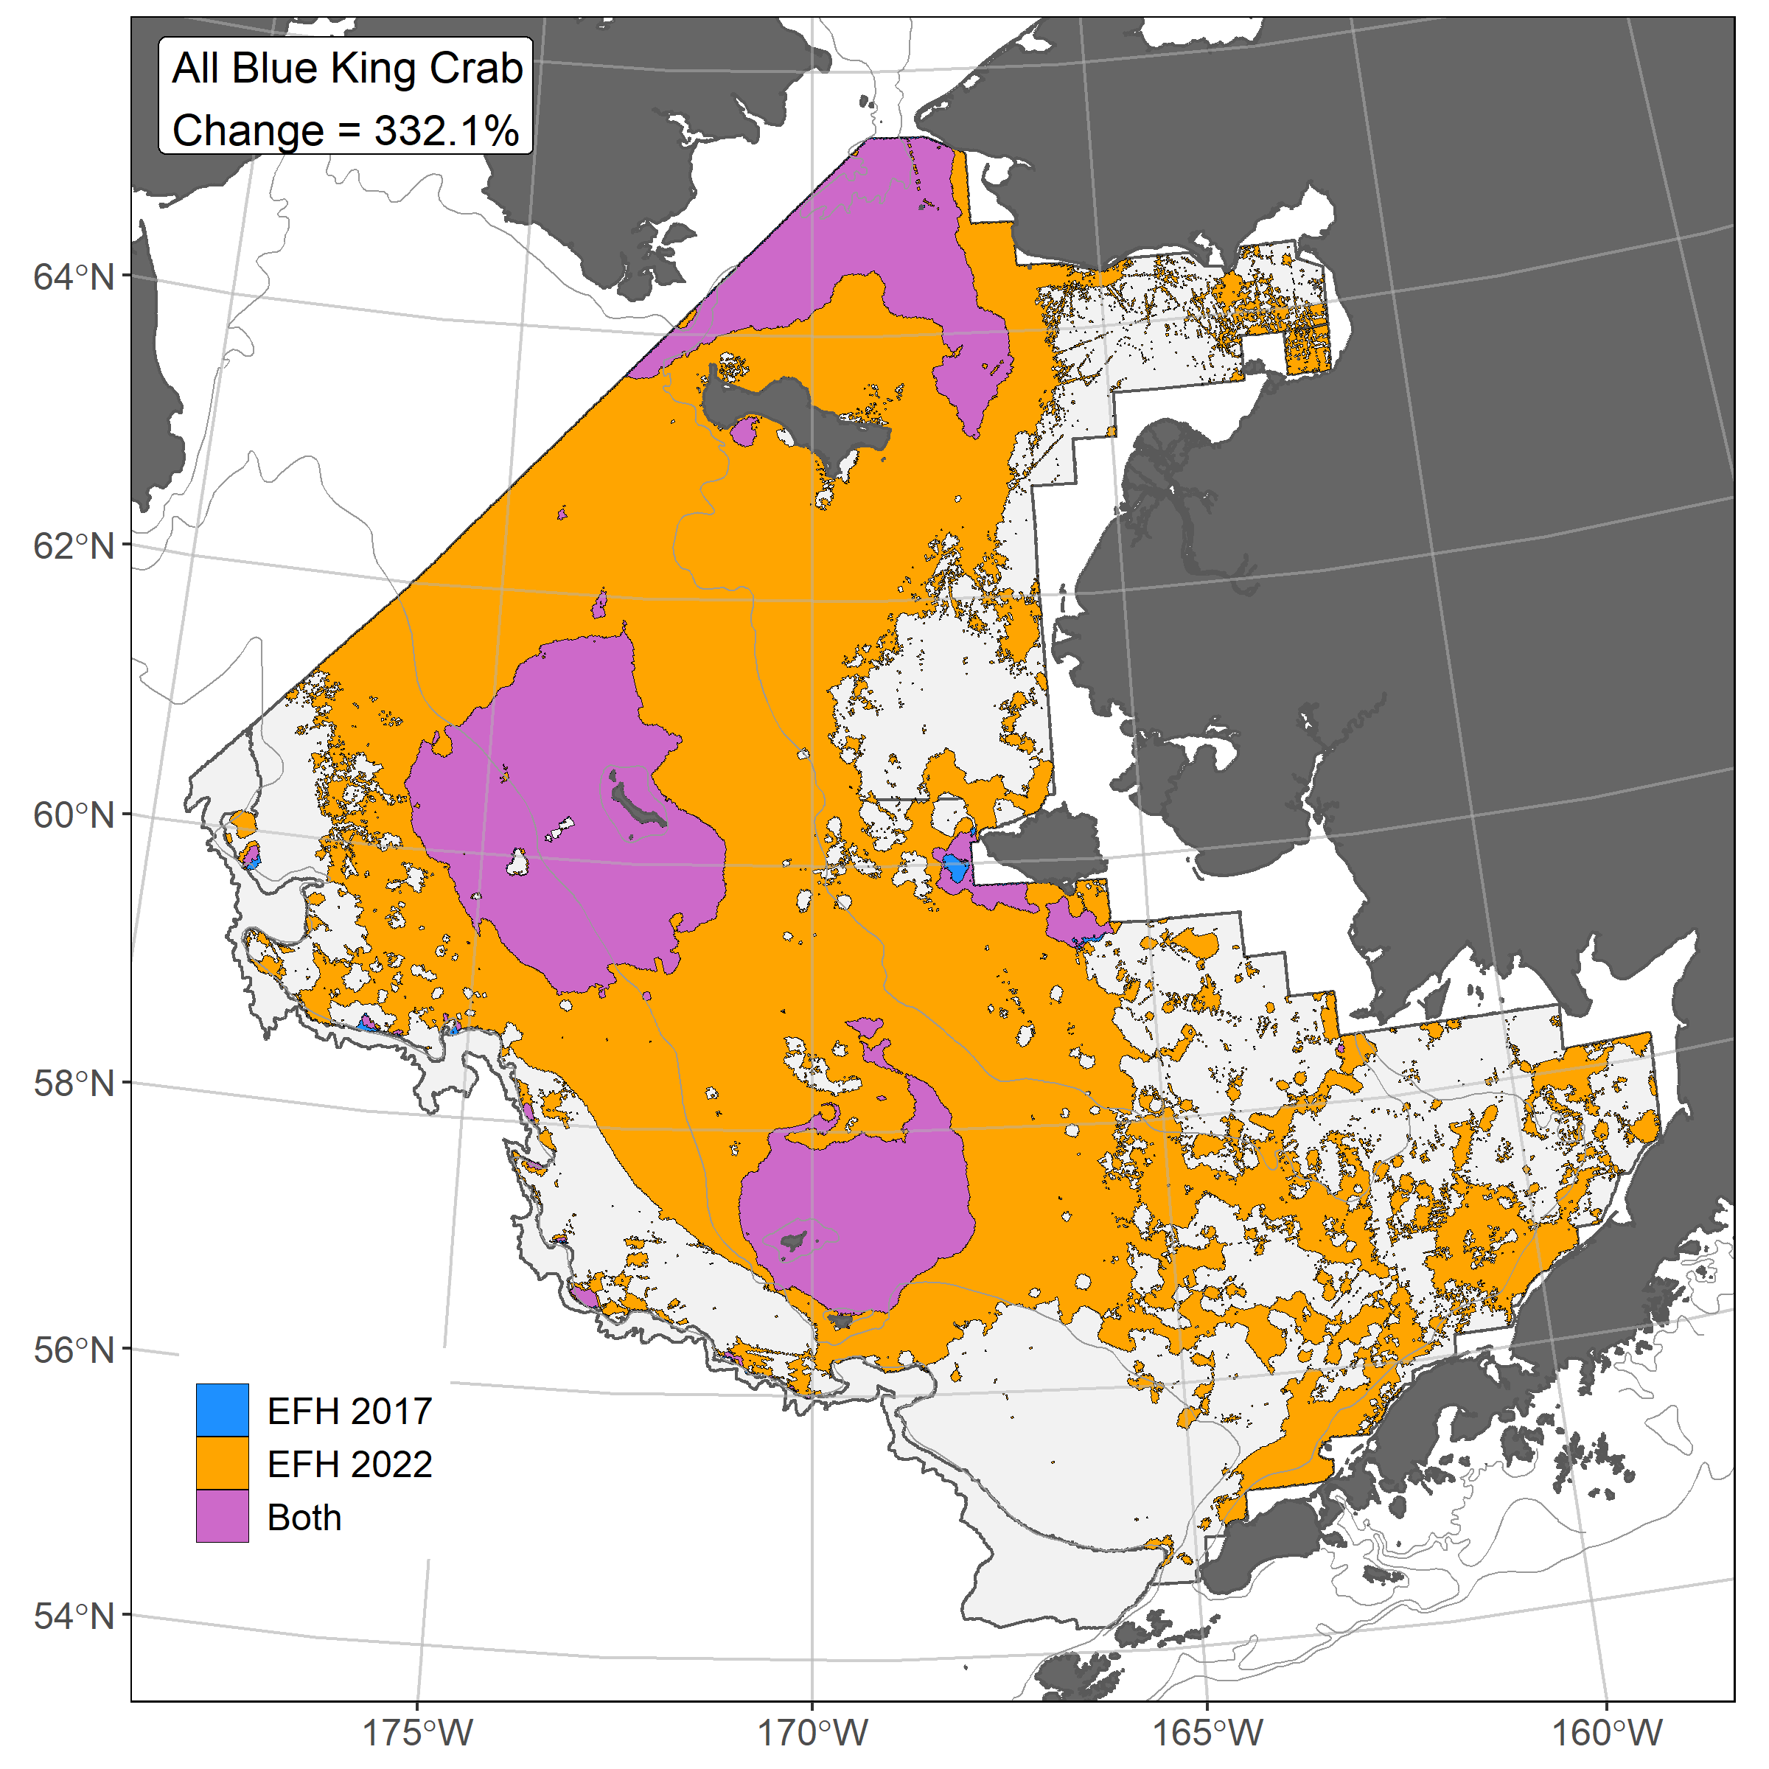
Blue king crab ensemble predicted abundance and distribution, EFH area percentiles, and 2017/2022 EFH area comparison for the eastern Bering Sea
𝝆 = 0.47
AUC = 0.94
PDE = 0.52
The overall ensemble fit to observed BKC distribution and abundance was good. The ensemble was good at predicting high and low catches abundance (ρ = 0.47) and at explaining deviance (PDE = 0.52), and excellent at discriminating presence-absence (AUC = 0.94). Geographic location, sediment grain size, bottom depth, and currents (maximum tidal current and Bering10K ROMS bottom current) accounted for the majority (> 80%) of the deviance in the ensemble-predicted BKC numerical abundance. EFH area increased 332% with the 2022 ensemble; the 2017 SDM type (hGAM) had a large effect on EFH area.
21

Slide 22
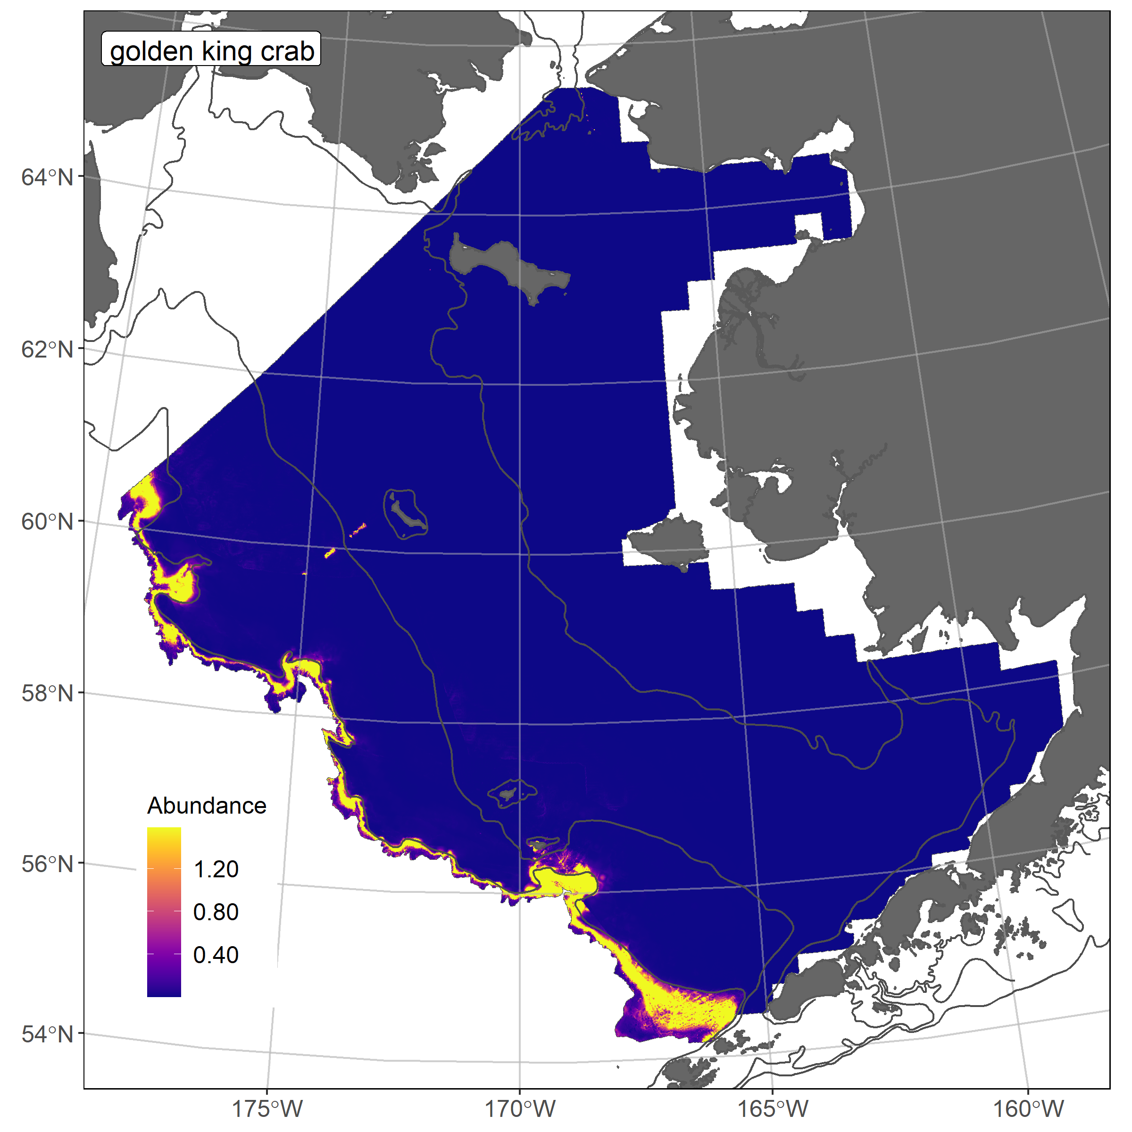
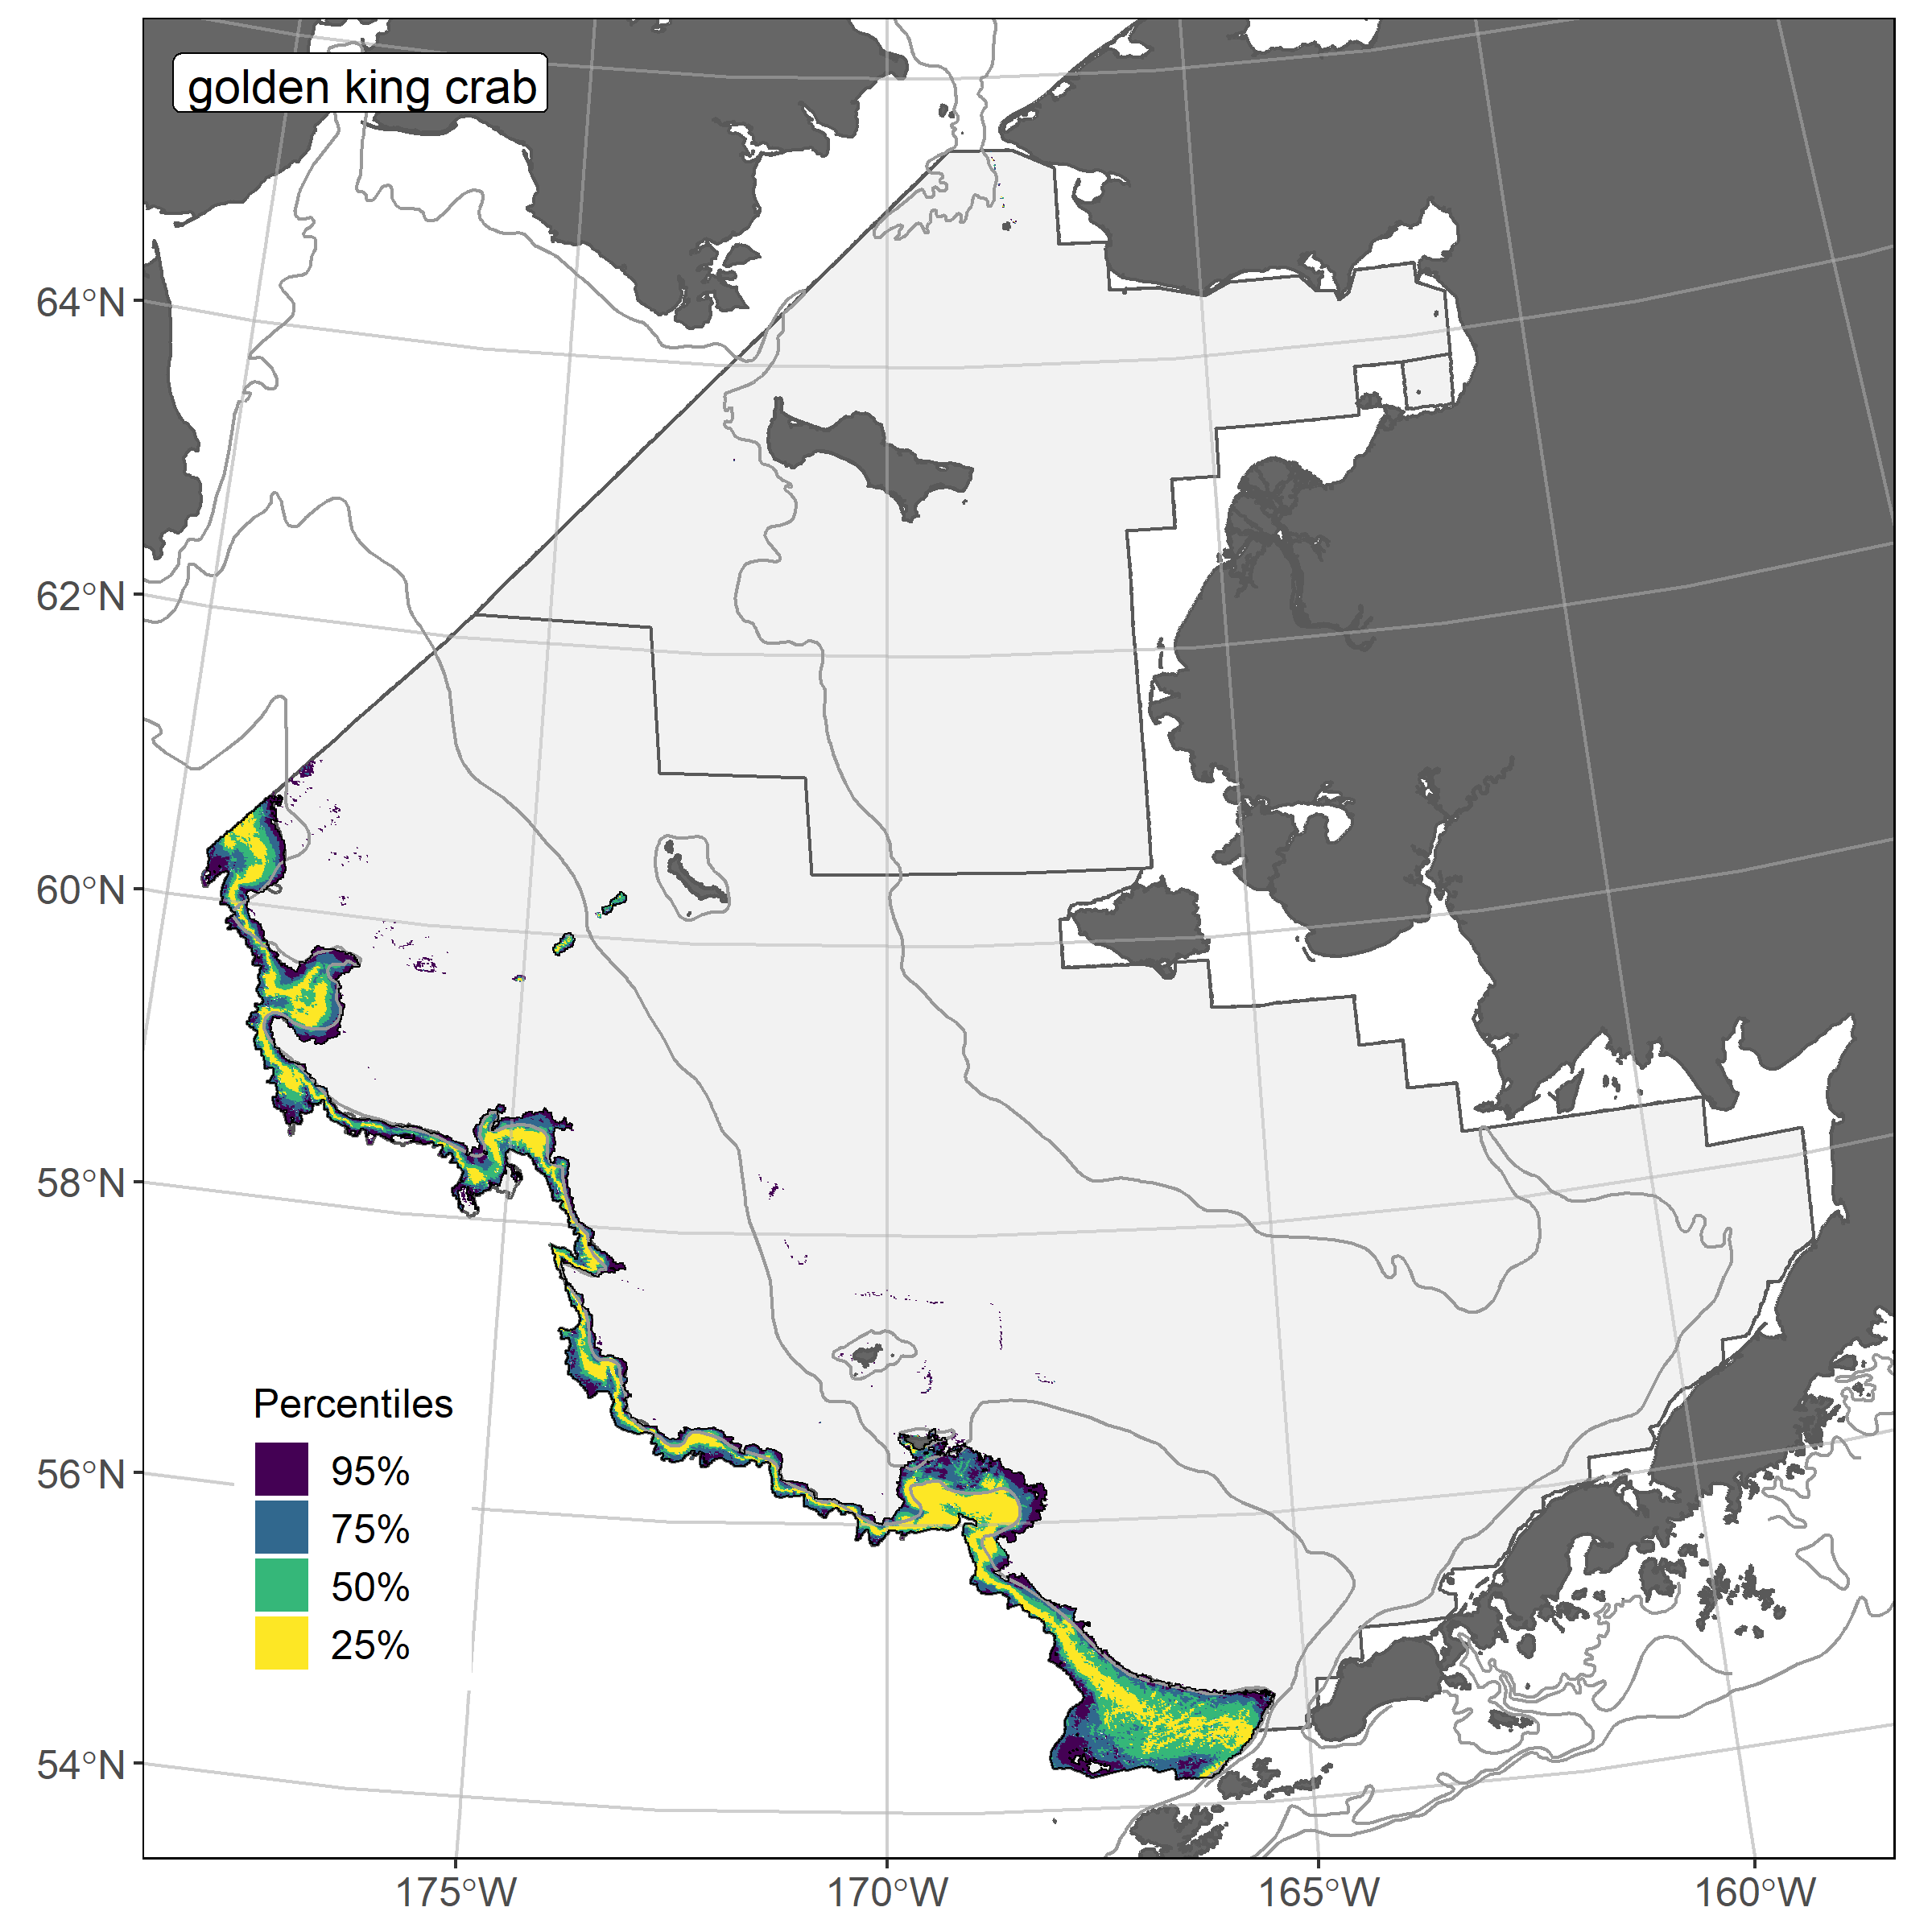
Golden king crab ensemble predicted abundance and distribution, and EFH area percentiles for the eastern Bering Sea
𝝆 = 0.35
AUC = 0.99
PDE = 0.85
The overall ensemble fit to observed GKC distribution and abundance was good. The ensemble was fair at predicting high and low catches abundance (ρ = 0.35), and excellent at discriminating presence-absence (AUC = 0.99), and explaining deviance (PDE = 0.85). Bottom depth, Bering10K ROMS bottom current, geographic location, and slope explained 78% of the deviance in the ensemble-predicted GKC numerical abundance. An EFH map was not available in 2017.
22

Slide 23
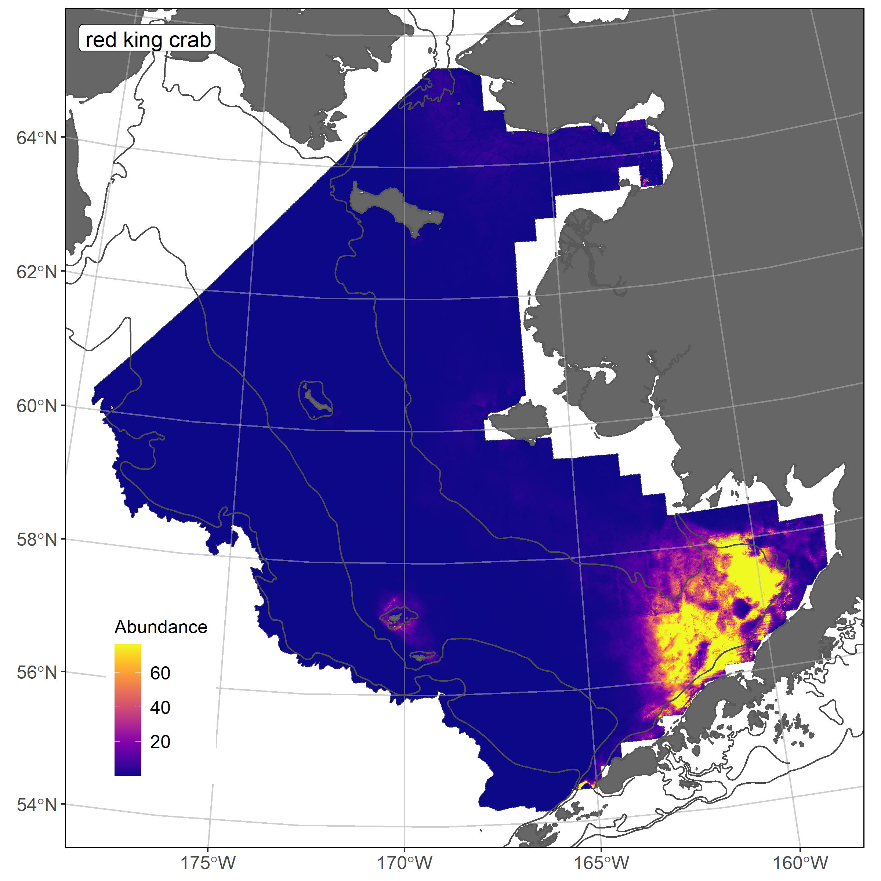
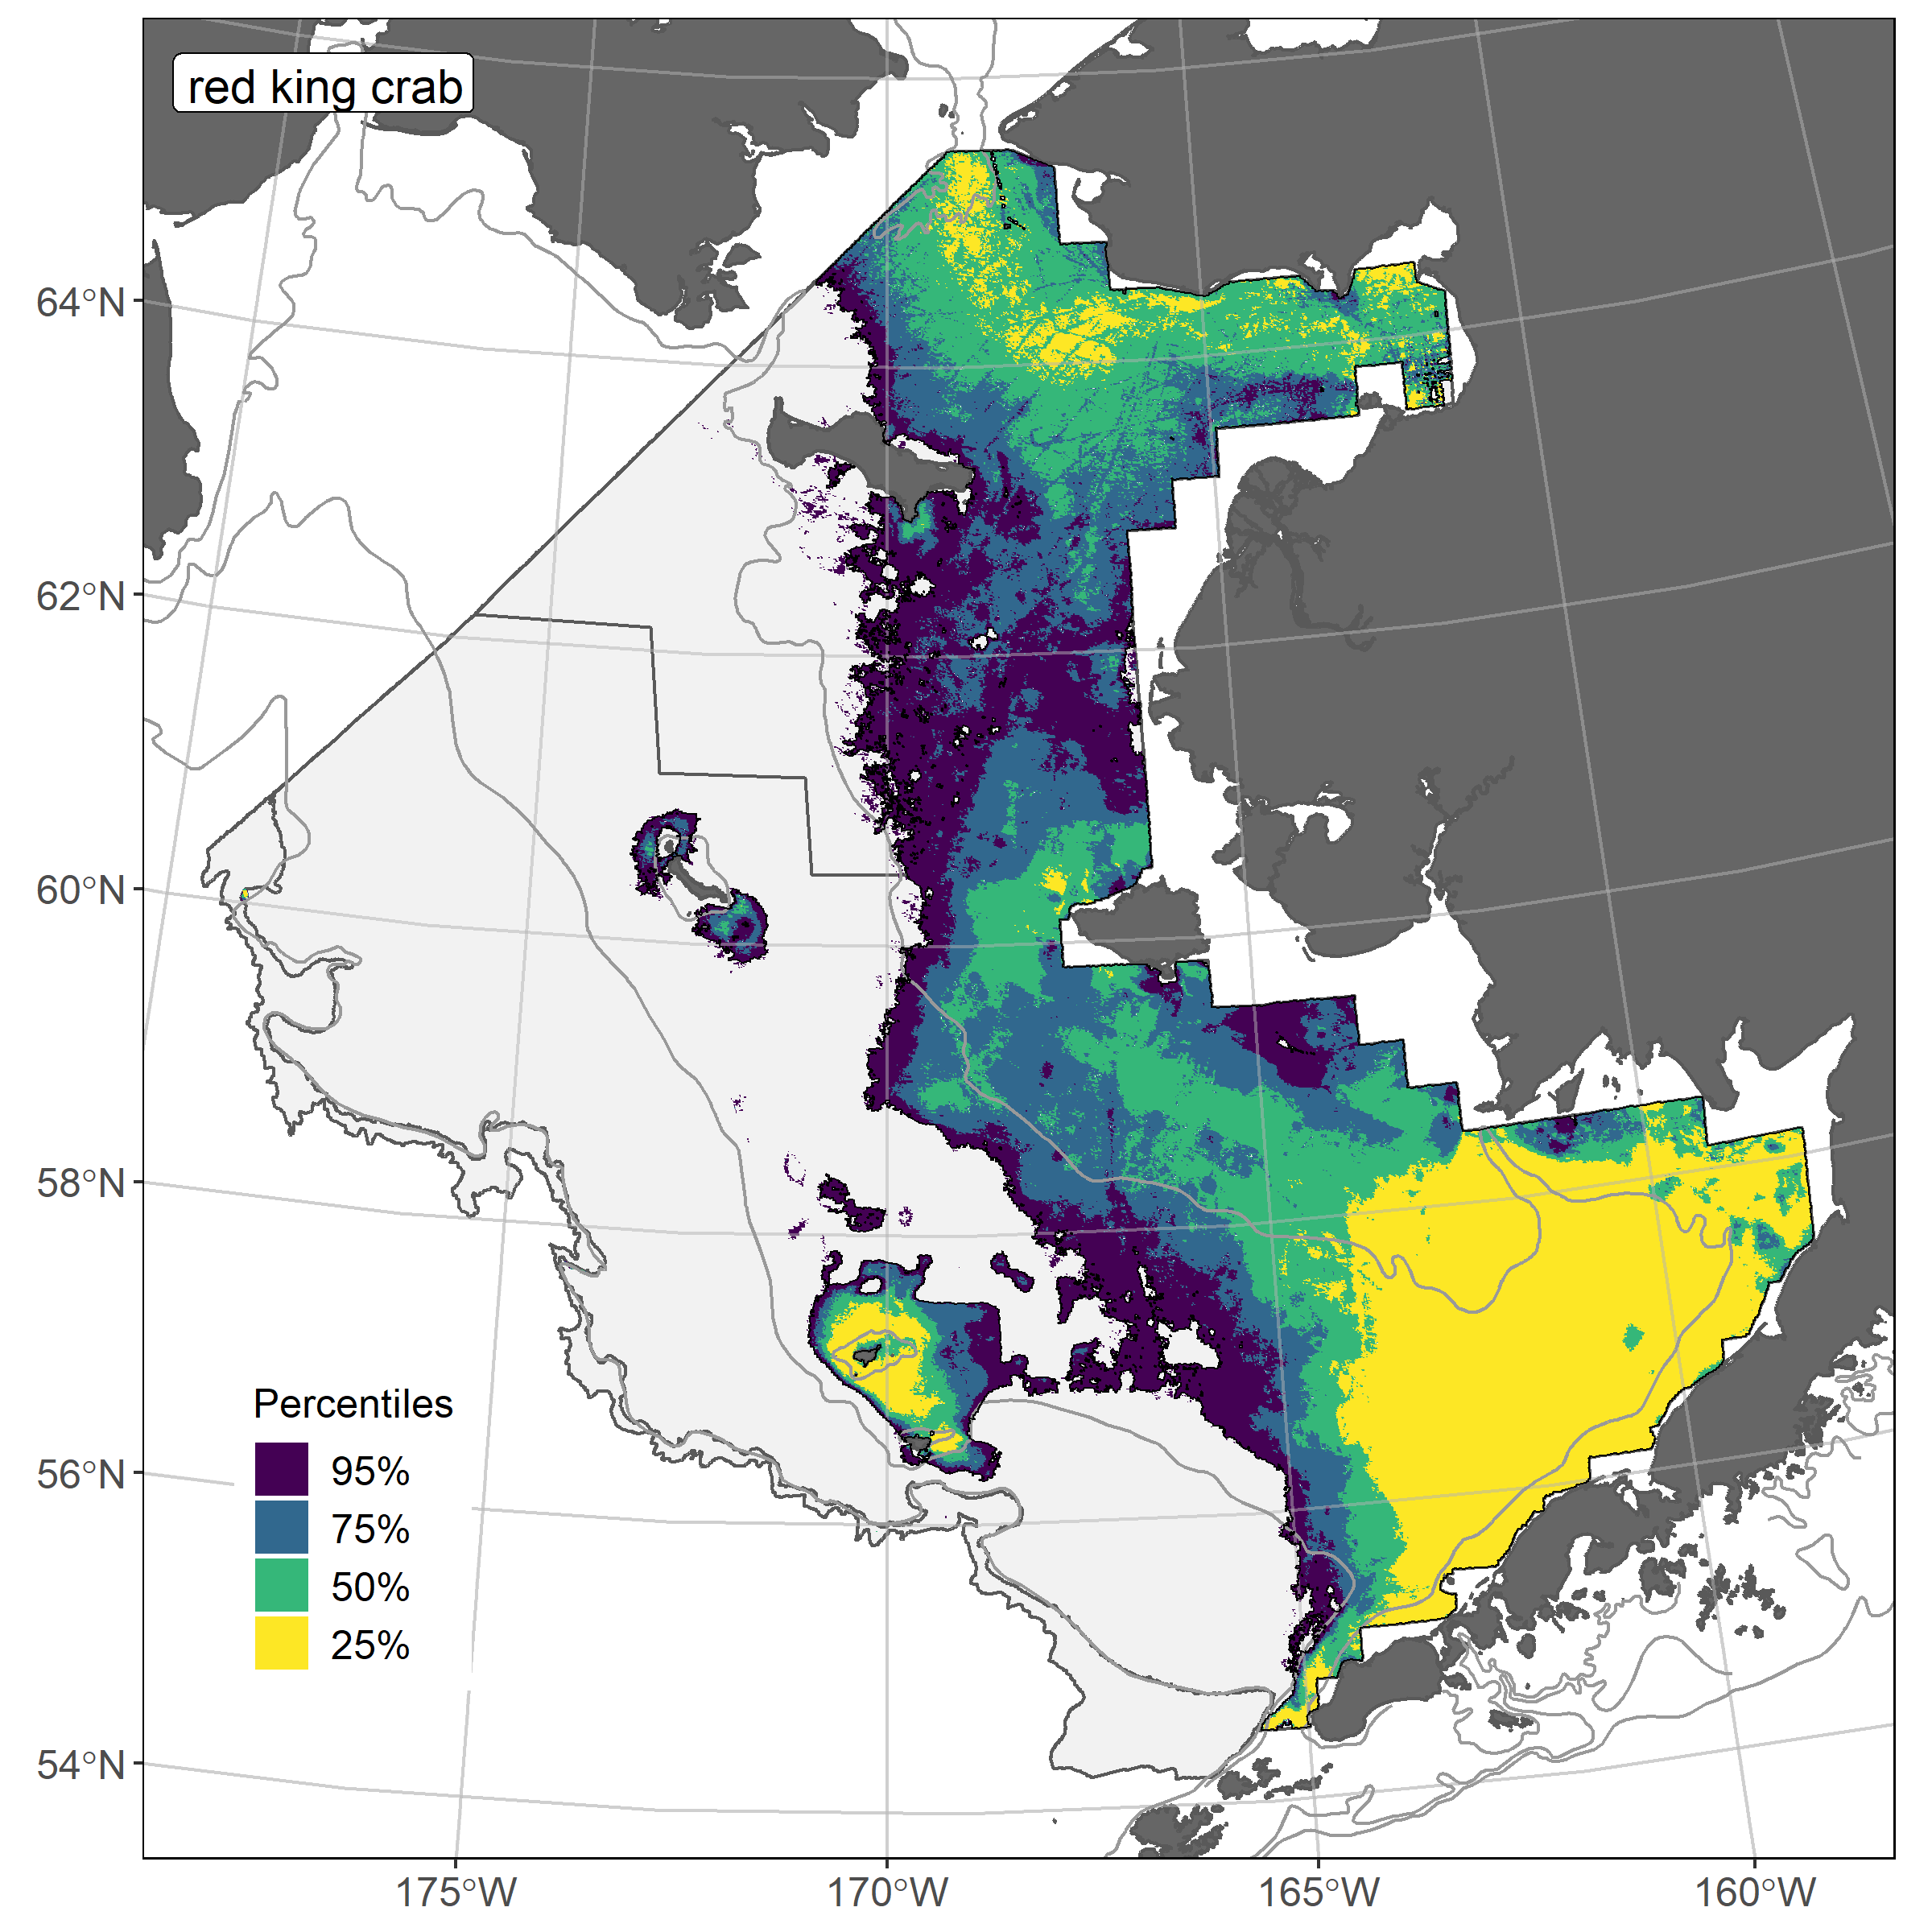
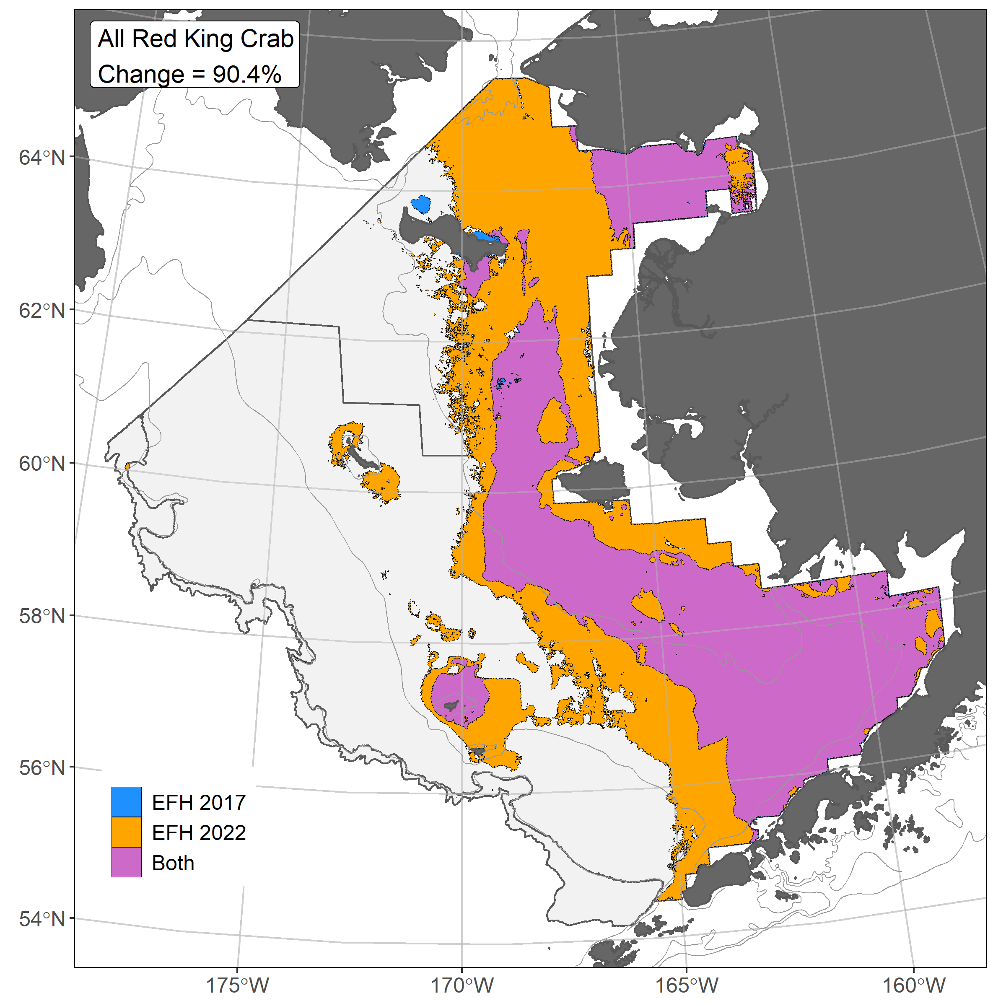
Red king crab ensemble predicted abundance and distribution, EFH area percentiles, and 2017/2022 EFH area comparison for the eastern Bering Sea
𝝆 = 0.67
AUC = 0.95
PDE = 0.52
The overall ensemble fit to observed RKC distribution and abundance was good. The ensemble was excellent at predicting high and low catches abundance (ρ = 0.67) and discriminating presence-absence (AUC = 0.95), and good at explaining deviance (PDE = 0.52). Maximum tidal current, geographic location, bottom depth, and sediment grain size accounted for 82% of the deviance in the ensemble-predicted RKC numerical abundance. RKC EFH area increased 90% with the 2022 ensemble; the 2017 SDM type (hGAM) had a large effect on EFH area.
23

Slide 24
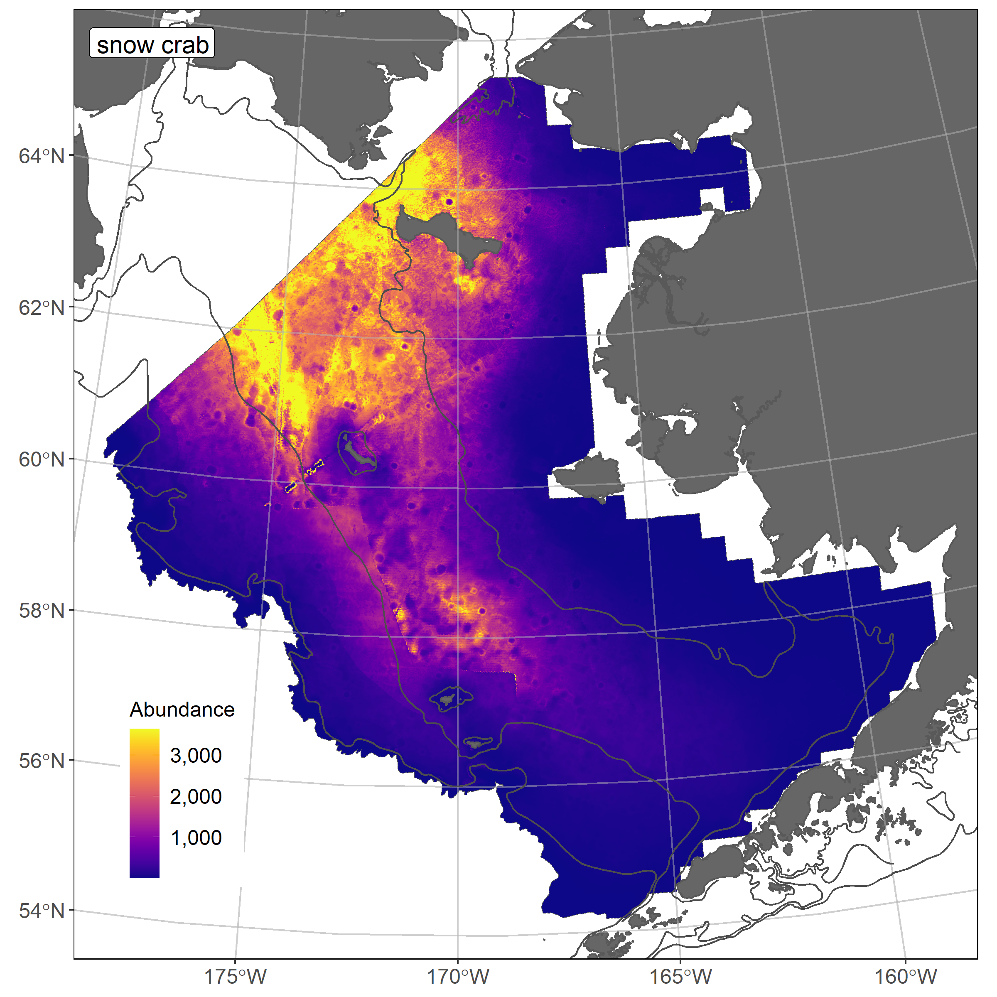
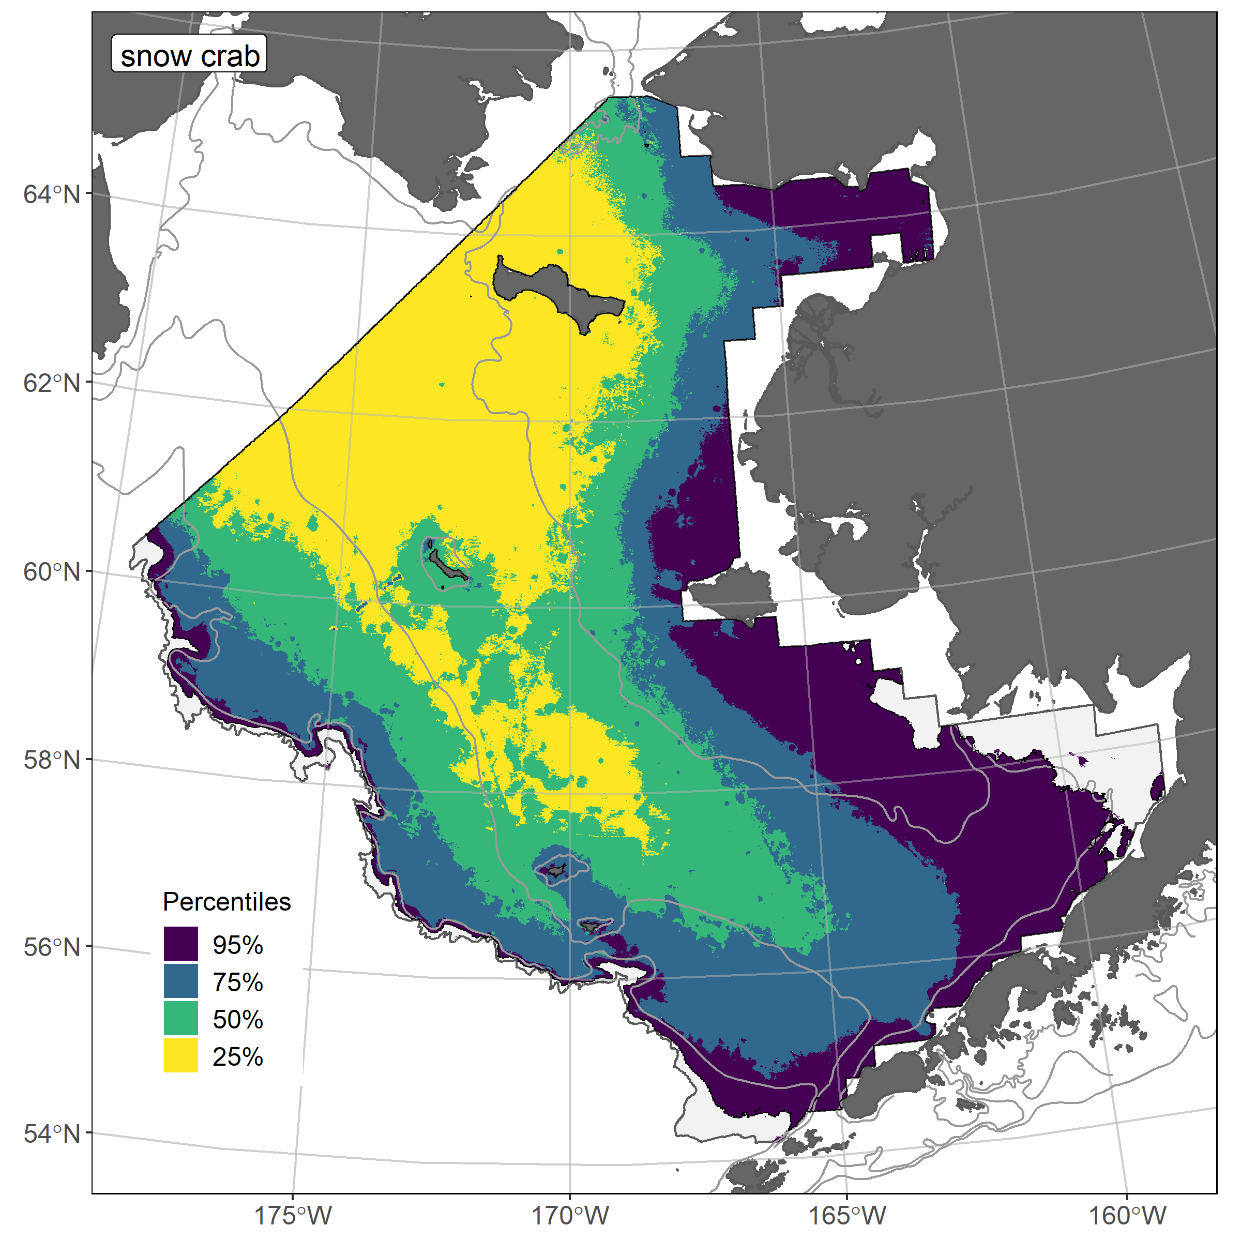
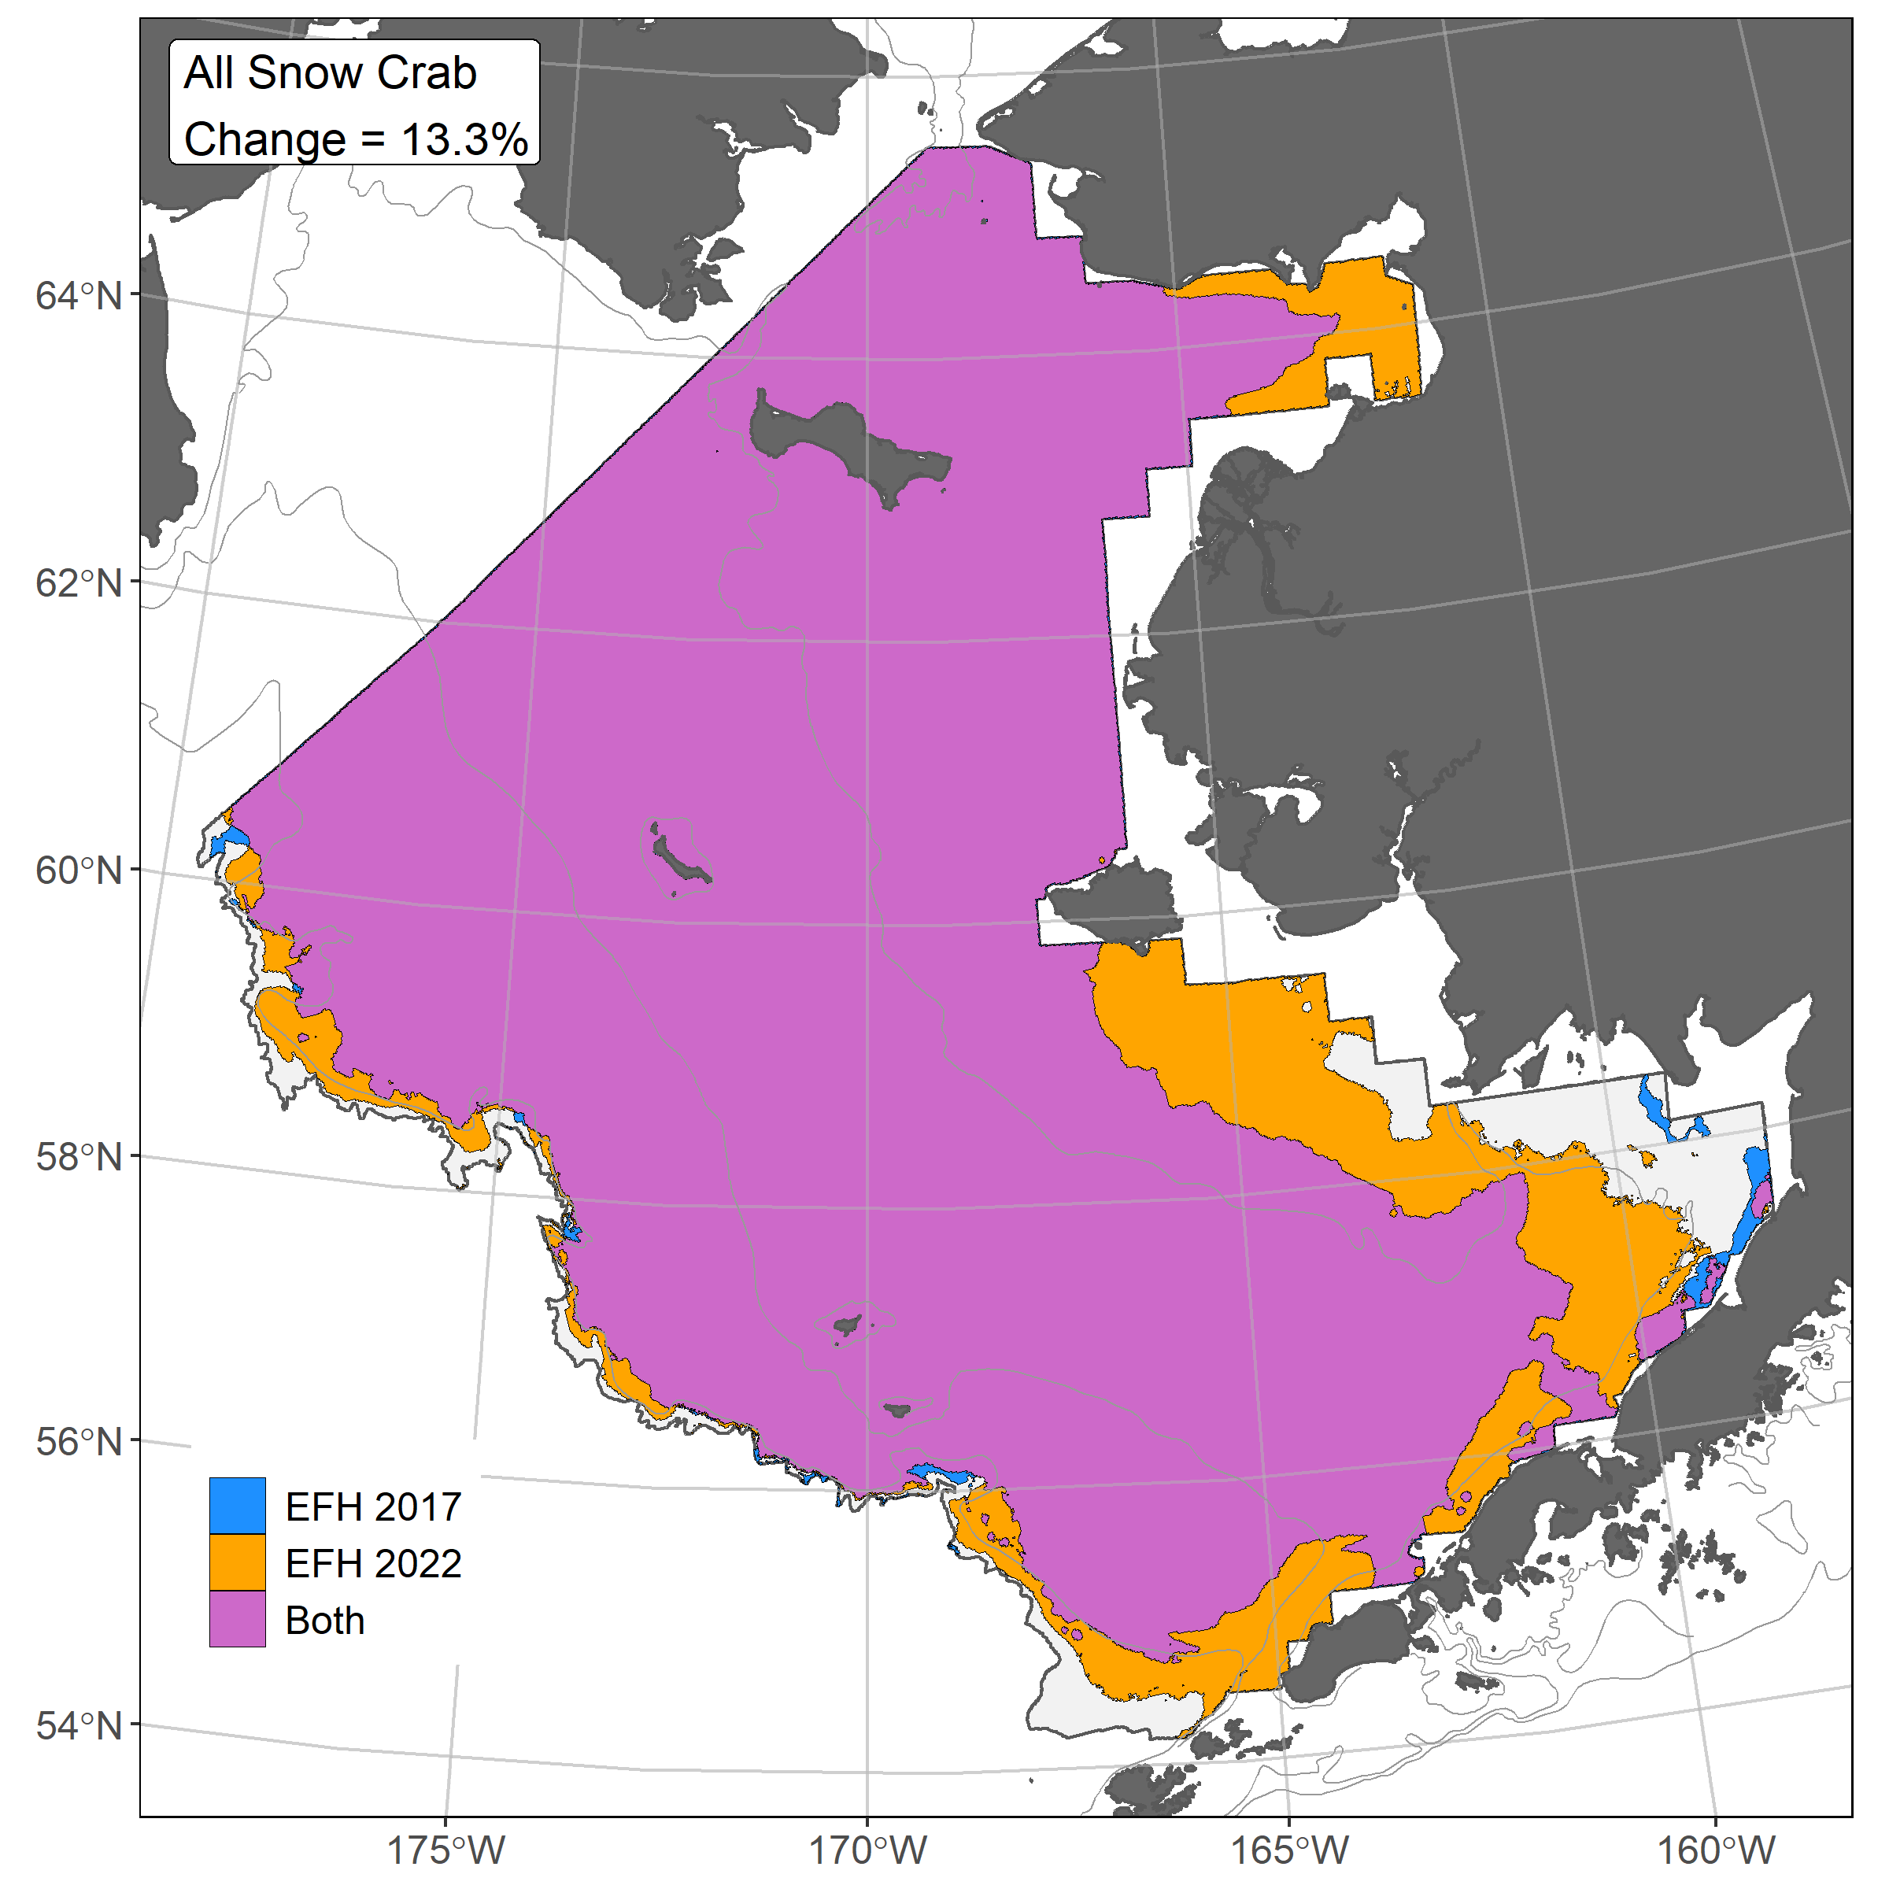
Snow crab ensemble predicted abundance and distribution, EFH area percentiles, and 2017/2022 EFH area comparison for the eastern Bering Sea
𝝆 = 0.84
AUC = 0.85
PDE = 0.43
The ensemble fit to observed snow crab distribution and abundance was good. The ensemble was excellent at predicting catches (ρ = 0.84), and a good at discriminating presence-absence (AUC = 0.85) and explaining deviance (PDE = 0.43). Geographic location, bottom depth, bottom temperature, and maximum tidal current accounted for 83% of the deviance explained by the snow crab final ensemble. Snow crab EFH area increased 13% with the 2022 ensemble; the 2017 SDM type was a GAM.
24

Slide 25
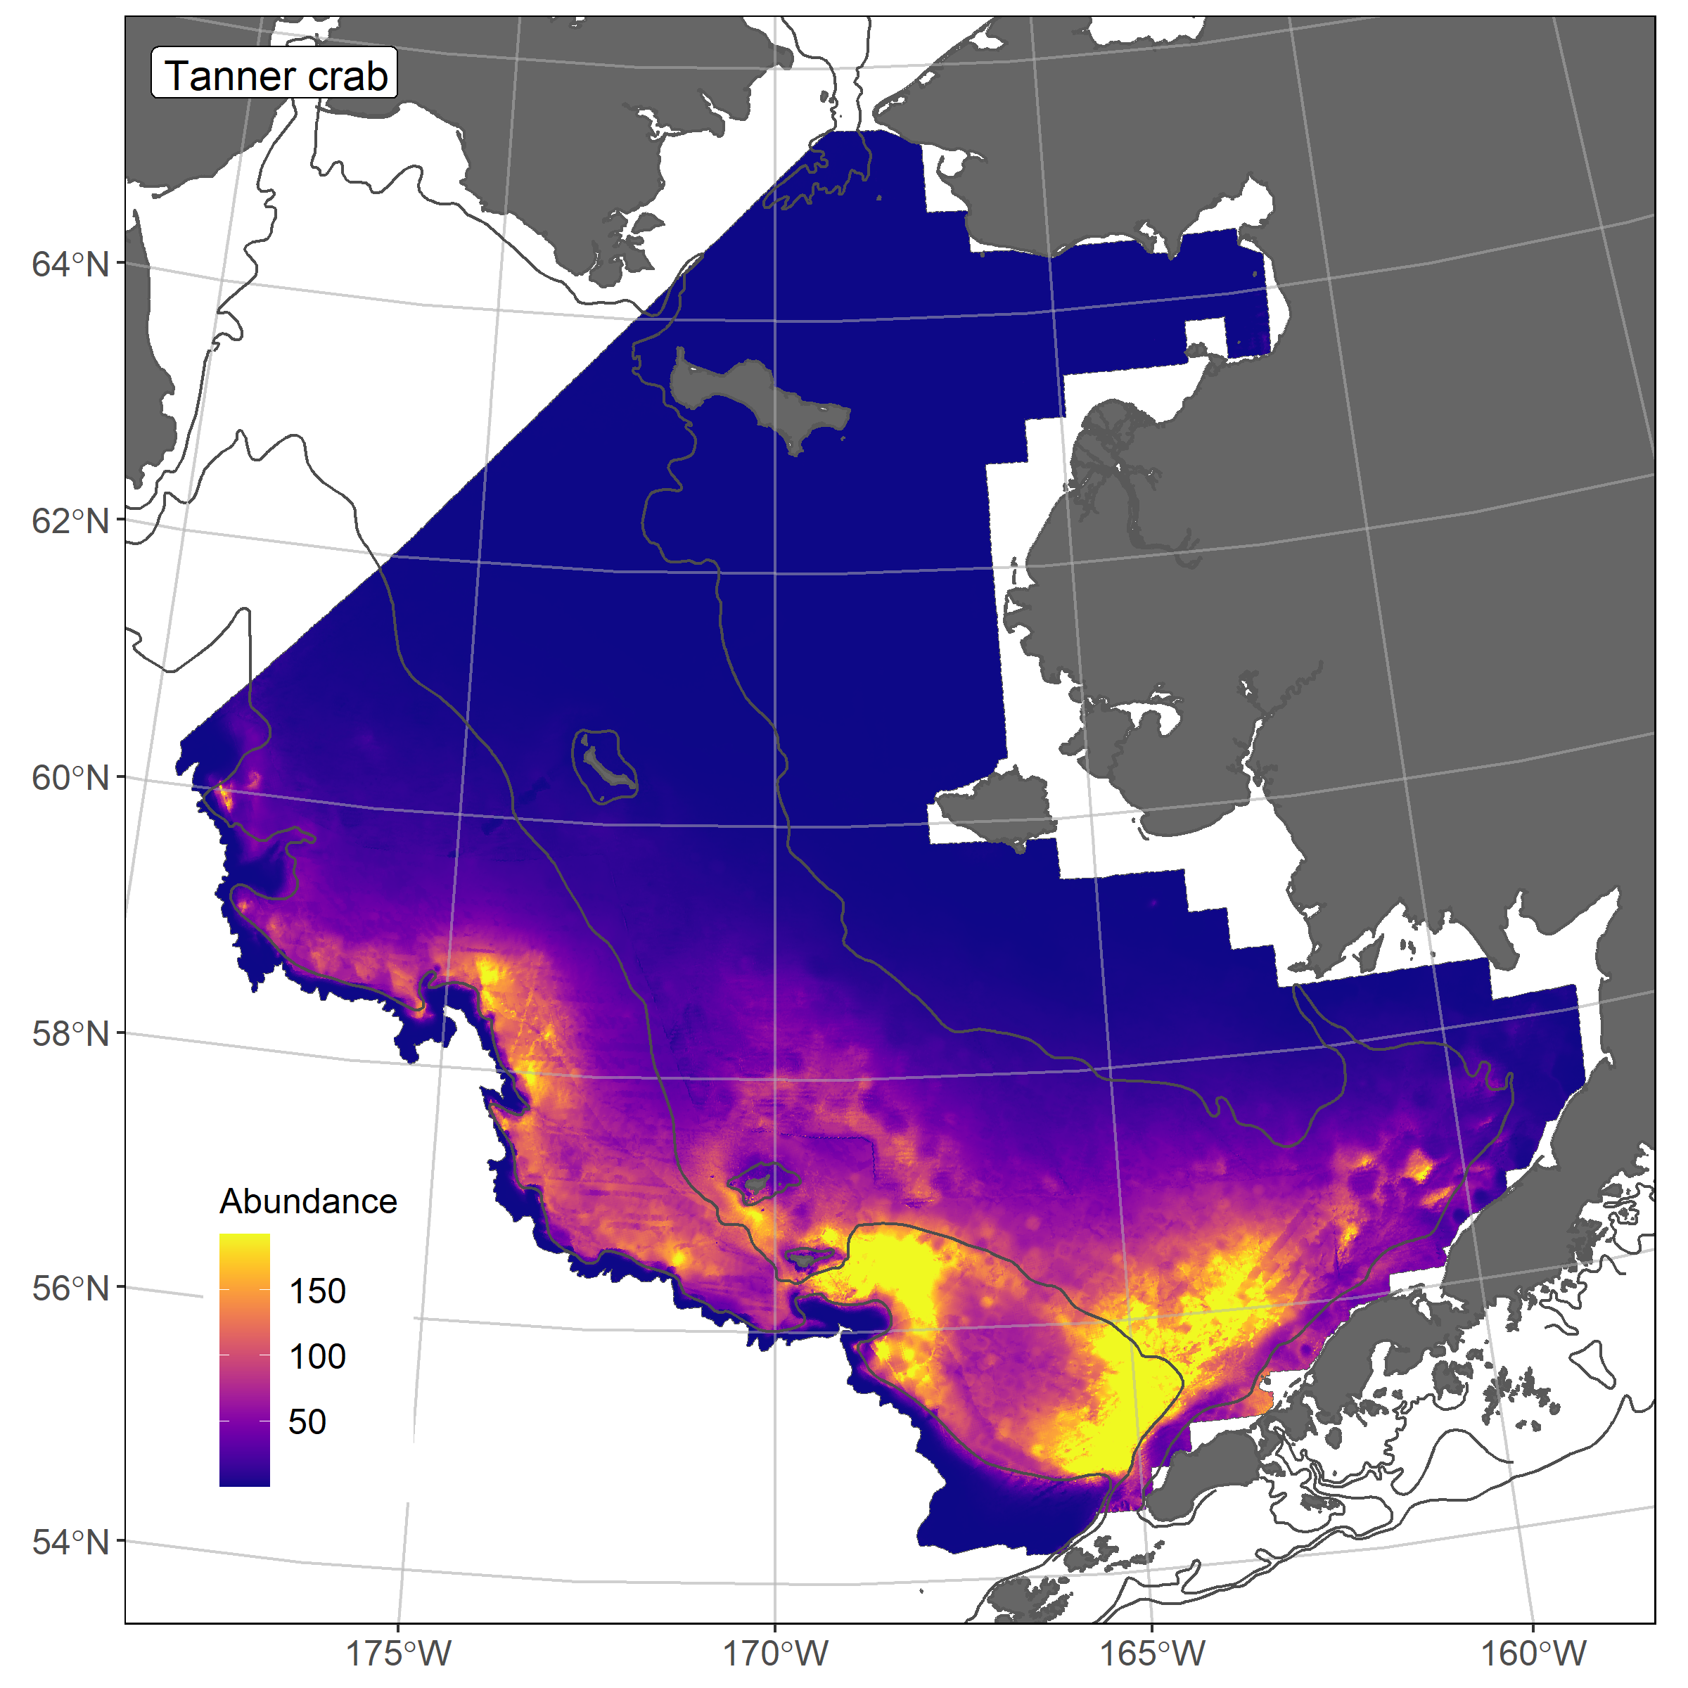
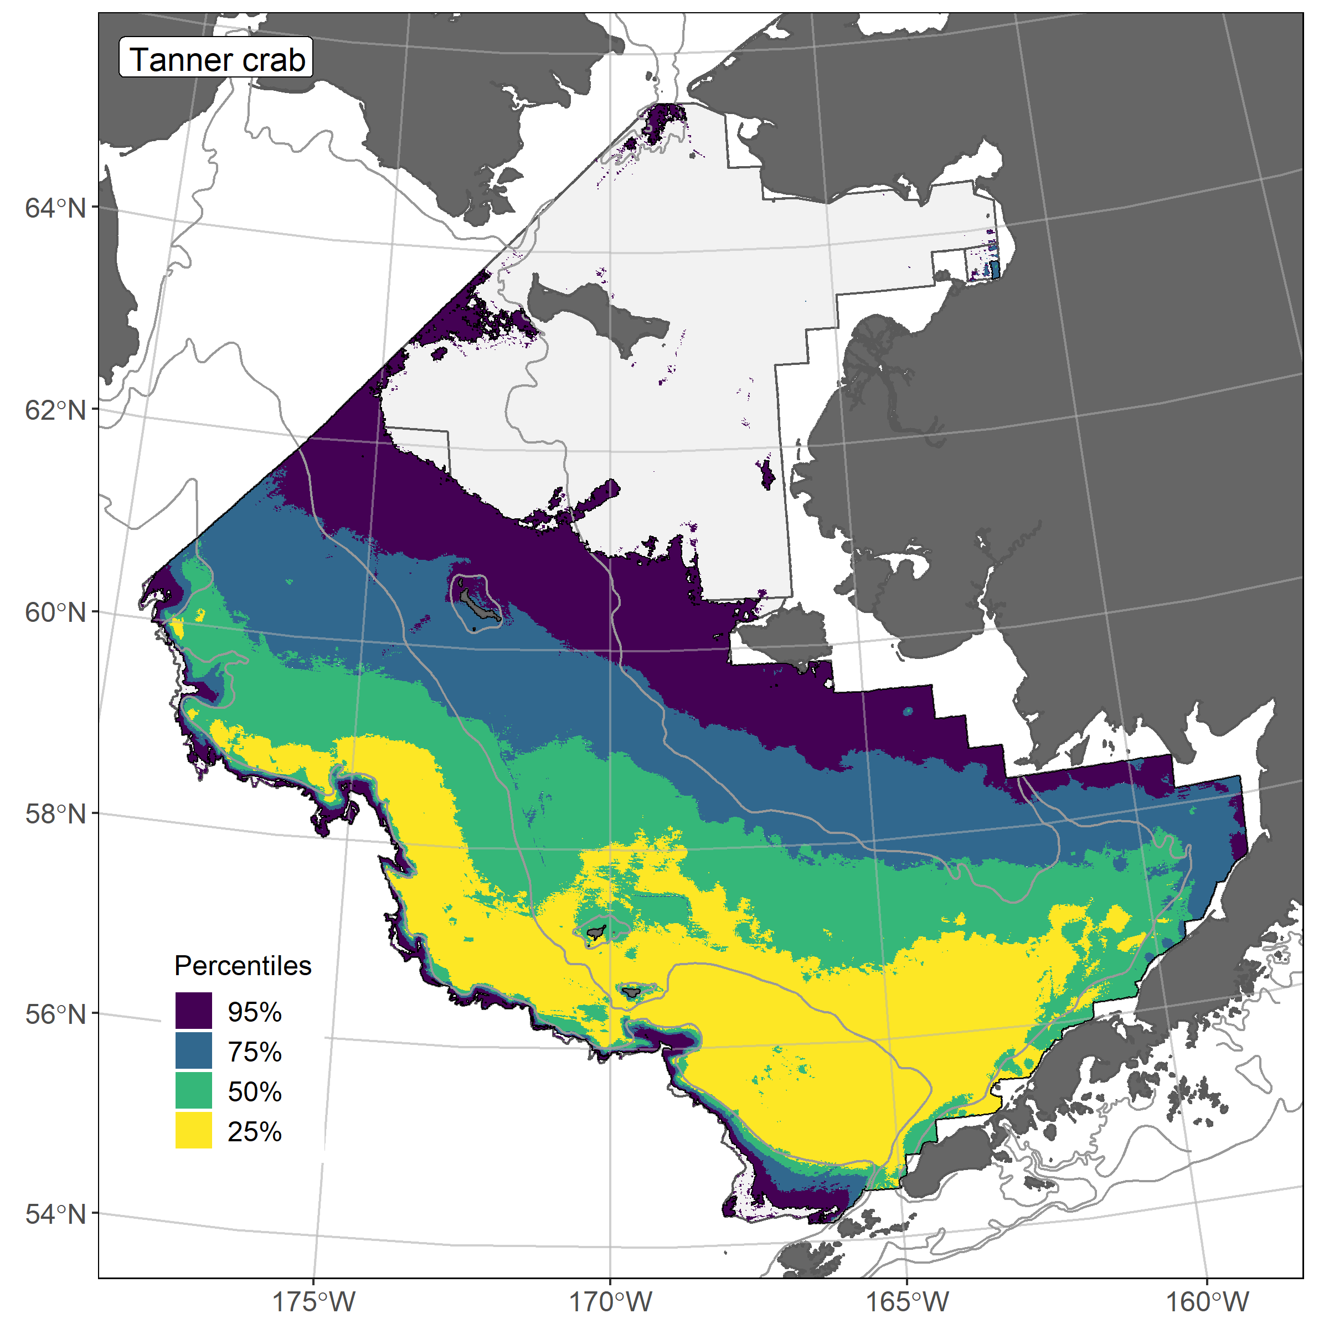
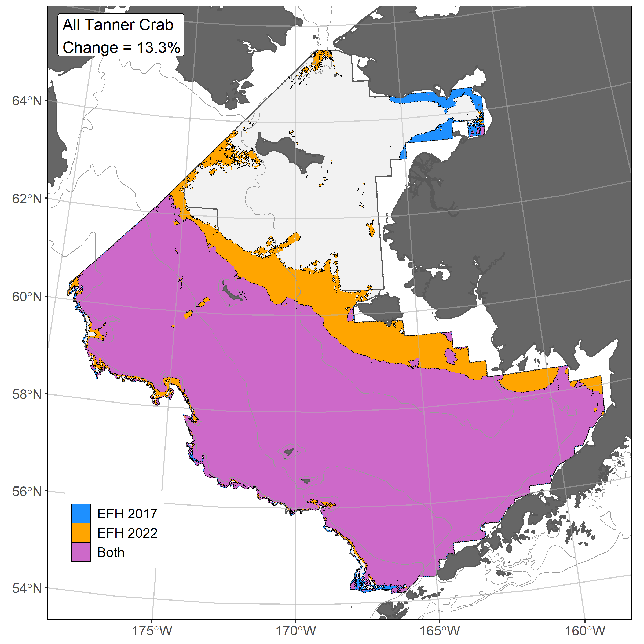
Tanner crab ensemble predicted abundance and distribution, EFH area percentiles, and 2017/2022 EFH area comparison for the eastern Bering Sea
𝝆 = 0.80
AUC = 0.93
PDE = 0.35
The ensemble fit to observed Tanner crab distribution and abundance was good. The ensemble was excellent at predicting catches (ρ = 0.80), and a good at discriminating presence-absence (AUC = 0.93) and explaining deviance (PDE = 0.35). Geographic location, bottom depth, and sediment grainsize accounted for 85% of the deviance explained by the Tanner crab final ensemble. Tanner crab EFH area increased 13% with the 2022 ensemble; the 2017 SDM type was a GAM.
25

