Slide 1
ESA
Section 7 Consultation Process for
Council Actions
Alaska Region

Slide 2
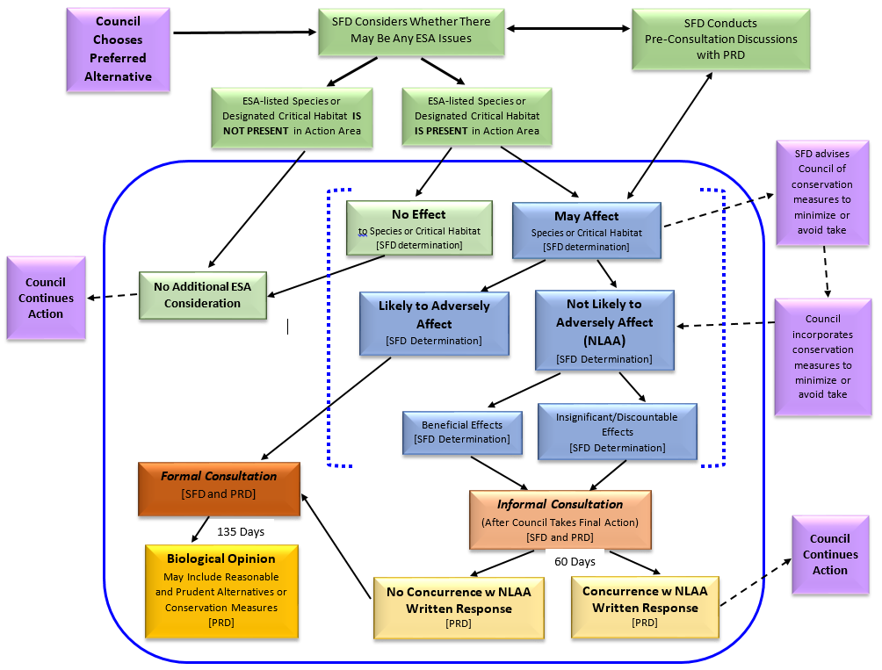
ESA Consultation Process

Slide 3
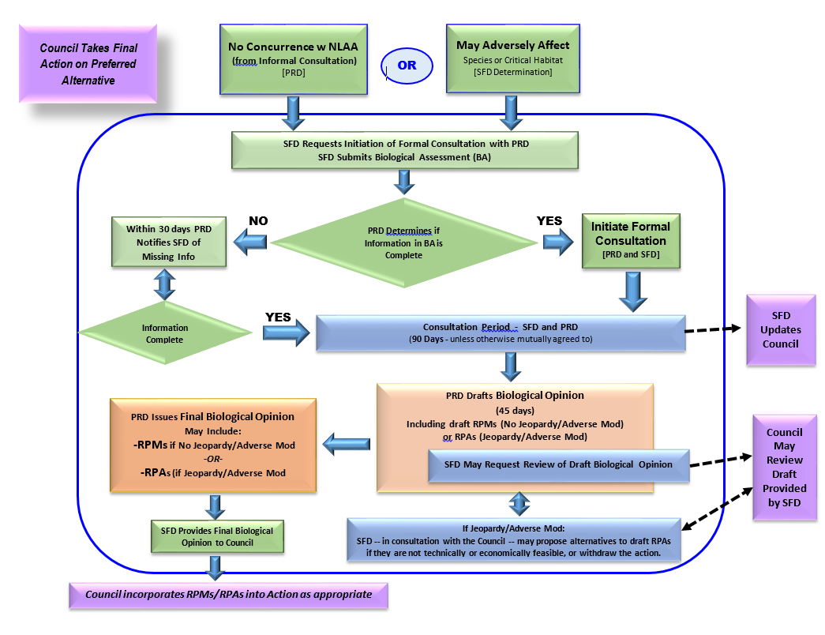
ESA Section 7 - Formal Consultation

