Slide 1
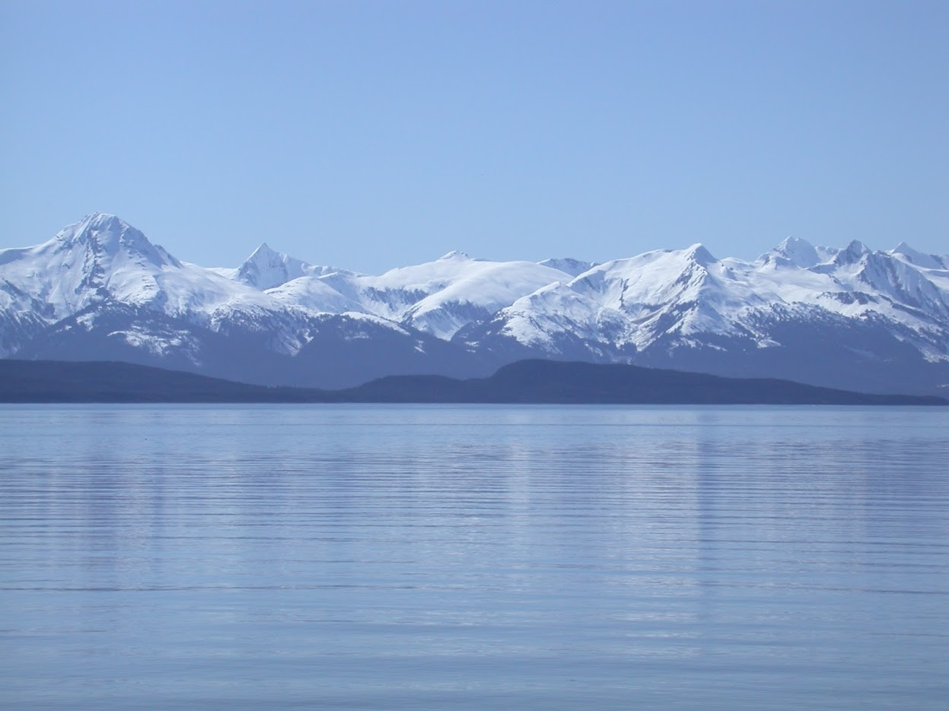

Ecosystem Socioeconomic Profile (ESP)
Update
ESP Definition: A standardized framework that facilitates the integration of ecosystem and socioeconomic factors within the stock assessment process and acts as a proving ground for use in management advice.
Kalei Shotwell, NOAA-AFSC
Kalei.Shotwell@noaa.gov

Slide 2
ESP Update Overview
Workshops
  Advice workshop, March 15-17, 2021
  Final follow up one-day session with PEEC in May
ESP Operations
  Annual schedule and reporting templates finalized
  Request for indicators (RFI) and ESP indicator submission tool developed (through AKFIN)
  ESP teams and contributors roles defined
  National ESP Initiative started
Notes:
ESP Schedule begins with request for indicators (RFI) in January and is separated from fall stock assessments and coordinated with ESR indicator requests
Three ESP Report templates: 1.) Full template completed when ESP initiated, ~5 years, 2.) Partial template is reduced and based on SAFE format, potentially initiated for a “red flag” response, and 3) Report card template is simple and for annual update

Slide 3
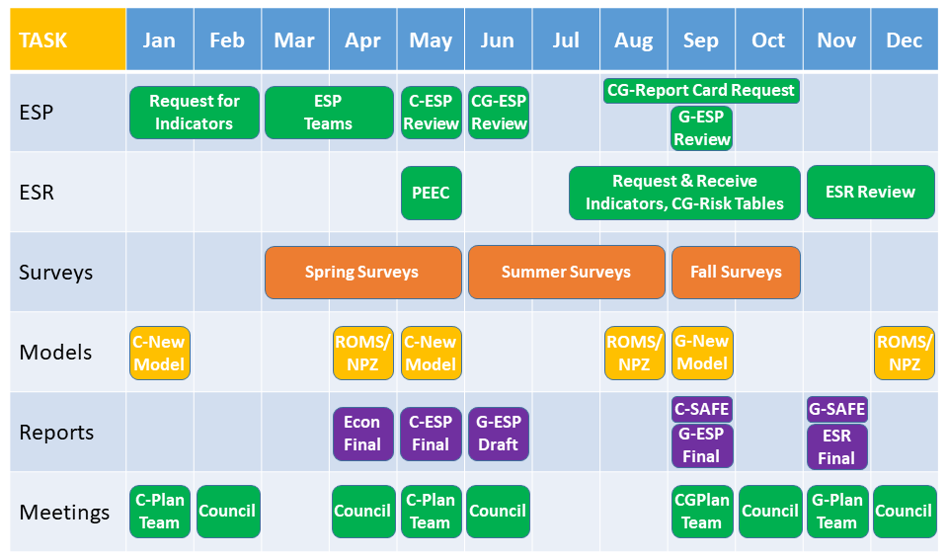
ESP Timeline
C = Crab, G = Groundfish
Notes:
The ESP process and product fit within an annual schedule that is aligned with the annual harvest specification process for the crab and groundfish fisheries in Alaska. In this 12 month timeline graphic we have mapped out the general annual process for conducting ESPs, ESR, Surveys, Models, primary related Reports, and the standard Council Meetings. It doesn’t include everything, but it gives you an overall concept of when things happen throughout the year. Note that since crab and groundfish are on separate cycles, we have denoted a crab item with a C and a groundfish item with a G.

Slide 4
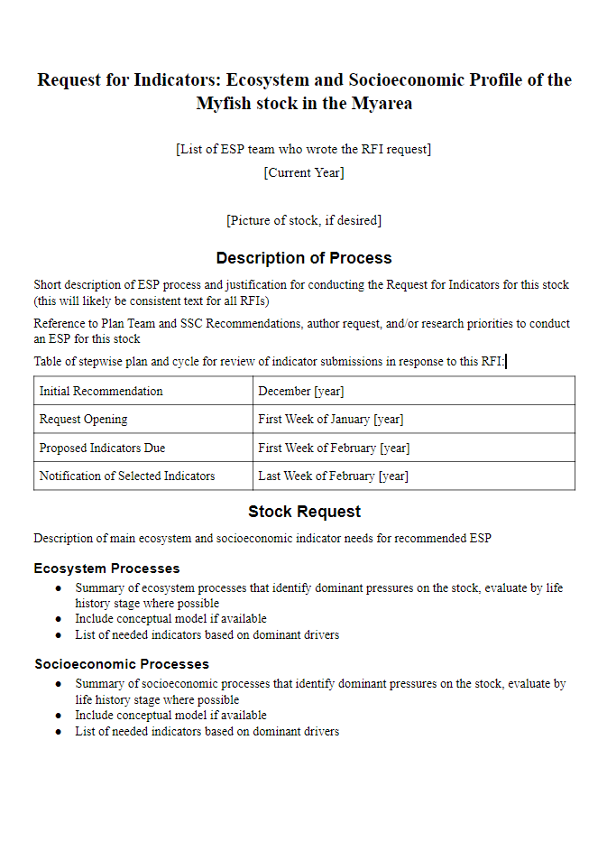
Request for Indicators (RFI)
Request Jan, Review Feb
Description: process, cycle
Request: stock ecosystem and socioeconomic needs
Contributions: data fields and submission instructions
Review and Responsibilities: teams & contributor roles, use and credit
Notes:
Providing guideline criteria for ESPs is critical. Our timeline includes a Request for Indicators that provides these guidelines. The RFI starts with a description of the request process and the timing of the cycle. The next section is the main request for the specific ESP being developed that year and this will be developed by the ESP team. It first summarizes the ecosystem and socioeconomic processes that identify the dominant pressures on the stock, by life history stage where possible, then lists the needed indicators based on those dominant pressures. This is basically the bulk of the metrics assessment and gives the ESP teams a jump on creating the ESP document. Also, if a conceptual model can be built, then this would also be included in the RFI. The next section is the directions for how and what to provide if you contribute an indicator. This links to the AKFIN submission tool and goes through the required data fields and instructions for submission. The RFI ends with guideline criteria on how the indicators will be reviewed, and what the roles are for the ESP teams and the contributor. There is also information on how the contributed indicator will be used and acknowledged. The RFI also establishes the line of sight required between the ESP teams and the contributors as the ESP is developed.

Slide 5
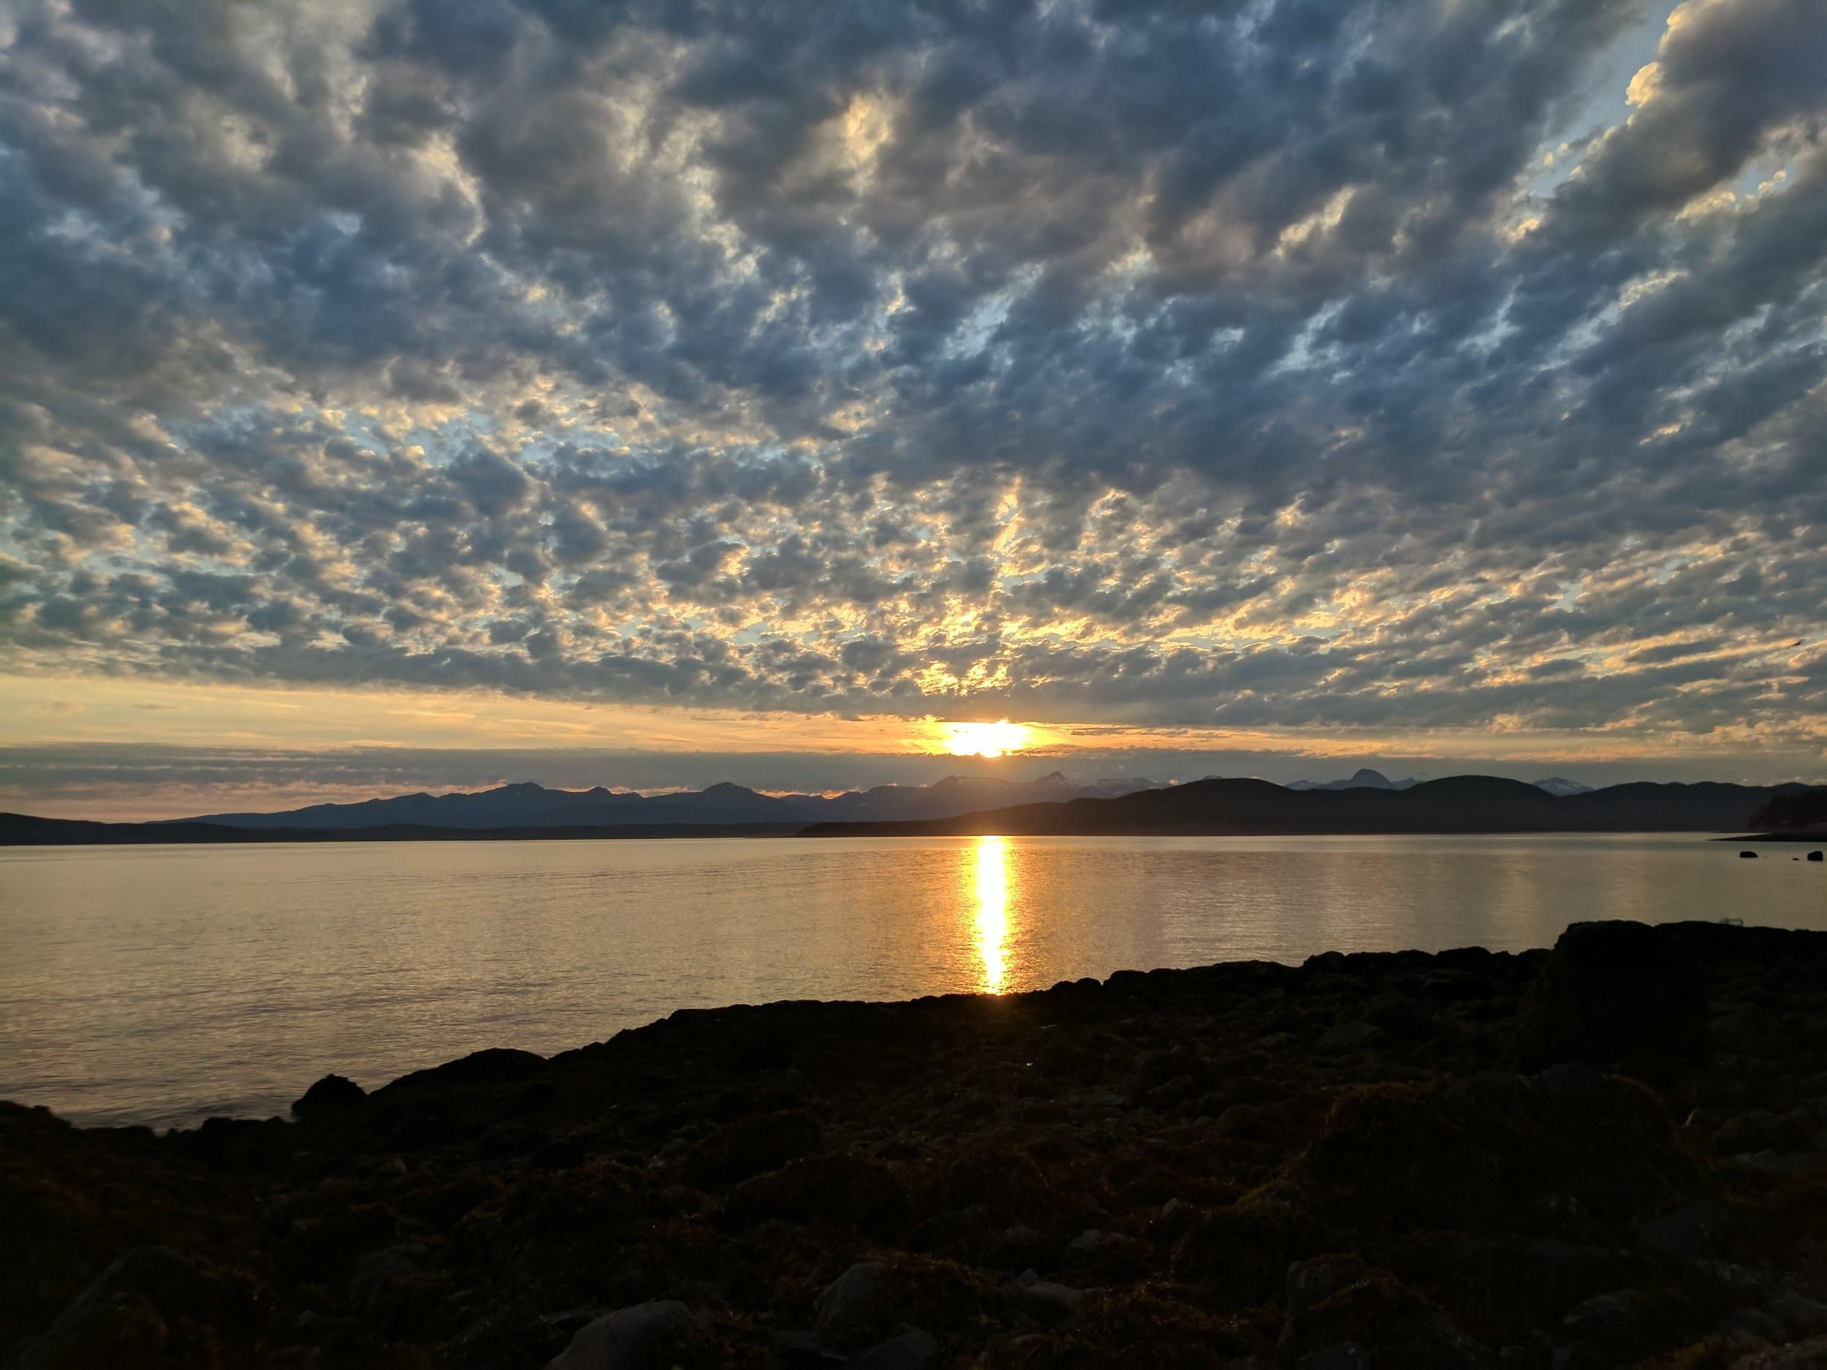
Questions?

Slide 6
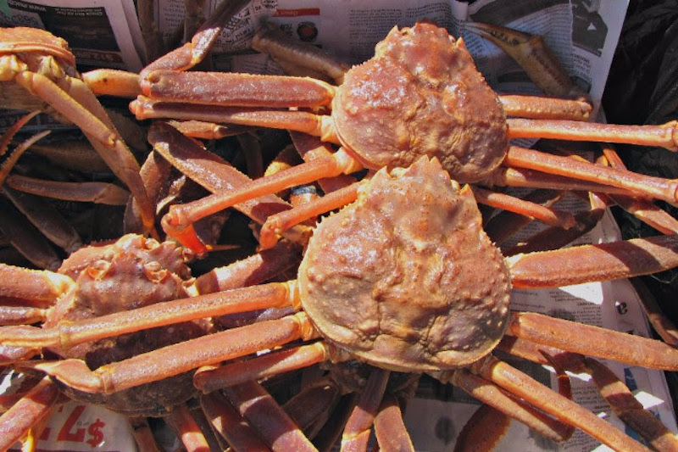
Ecosystem &
Socioeconomic
Profile
Snow Crab Request for Indicators (RFI)
Erin Fedewa and Brian Garber-Yonts
ESP Contributors: Kerim Aydin, Buck Stockhausen, Kalei Shotwell,, Kelly Kearny, Mike Litzow, Jens Nielsen, Darren Pilcher, Jon Richar, Pam Jensen and Jordan Watson,
Notes:
RFI: Standardized template for initializing an ESP and formalizes the request and contributions for an ESP

Slide 7
Overview
Review draft RFI for snow crab
  Snow crab conceptual model
  Proposed ecosystem indicators
  Focused discussion on select ecosystem indicators
  Proposed socioeconomic indicators
  Traffic light indicator summary
CPT discussion on ESP timing and proposed indicators
Notes:
Will finalize draft RFP for January 2022 ESP cycle based on CPT discussion

Slide 8
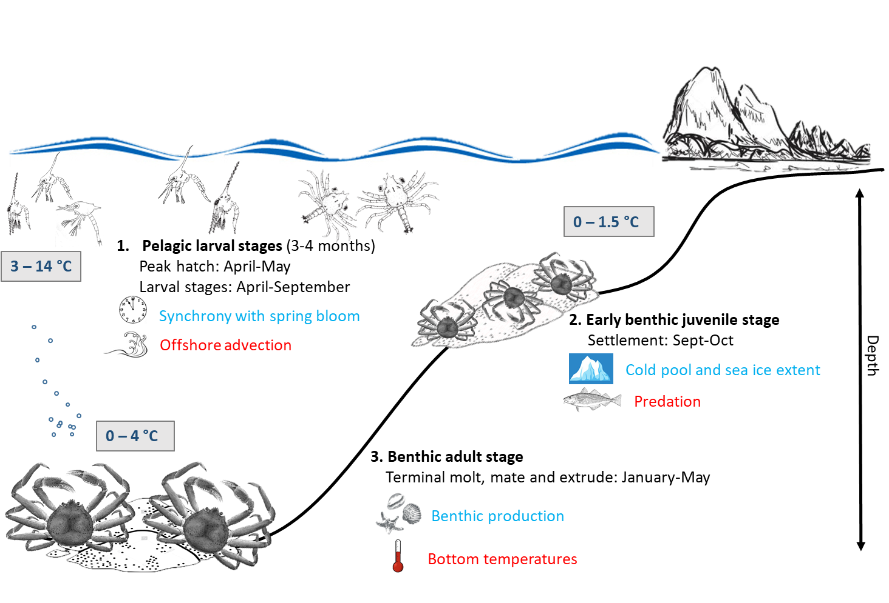
Conceptual Model

Slide 9
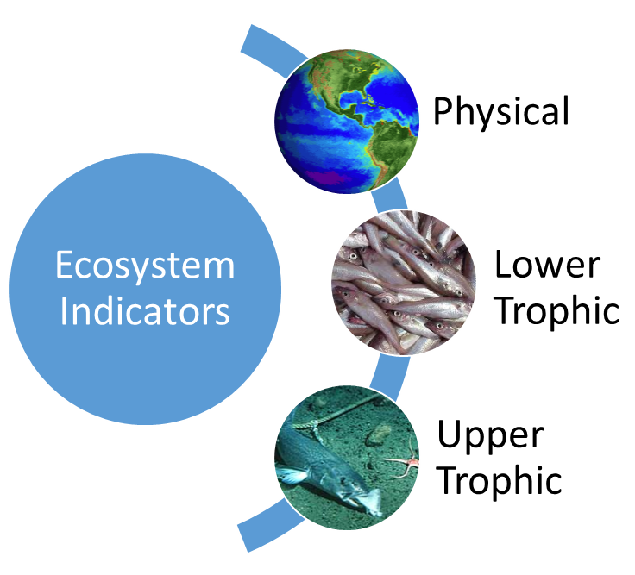
Draft Ecosystem Indicators
-
Arctic Oscillation (climate model)
Cold pool extent (BTS)
Sea-ice extent/retreat (satellite)
pH index (ocean model)
Production (chlorophyll a, satellite)
Intermolt duration (BTS)
Settlement success (IBM)
Hatch spring bloom overlap (BTS, sat)
Benthic prey biomass (BTS)
Snow crab recruit condition (BTS)
Snow crab area occupied (BTS)
Temperature of occupancy (BTS)
Snow crab center of distribution (BTS)
Pcod consumption of snow crab
Pcod-snow crab spatial overlap (BTS)
Female snow crab size at maturity (BTS)
Male snow crab recruit biomass (BTS)
Snow crab disease prevalence (BTS)
+
+
+
+
-
+
+
+
+
-
-
-
+
+
-

Slide 10
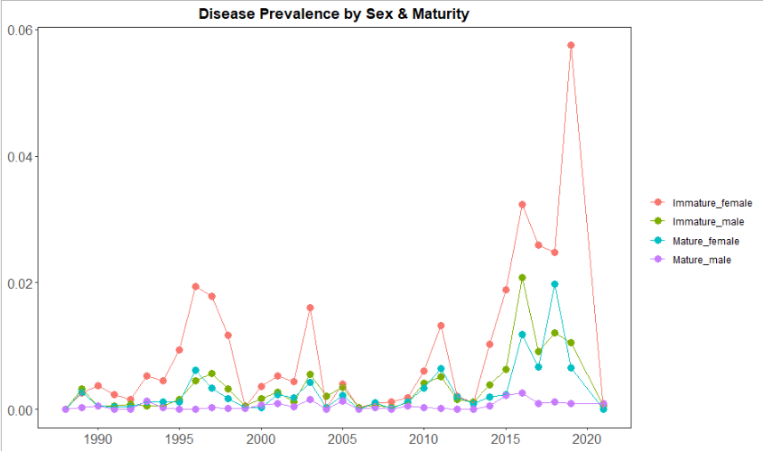
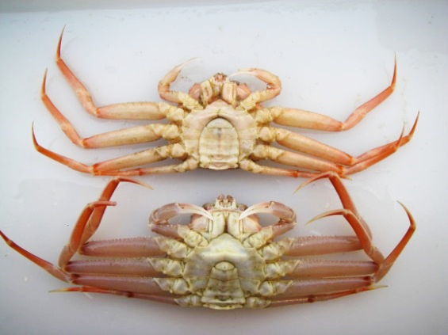
Disease Prevalence
-Increased disease prevalence since 2015
-Dramatic increase for immature females in 2019

Slide 11
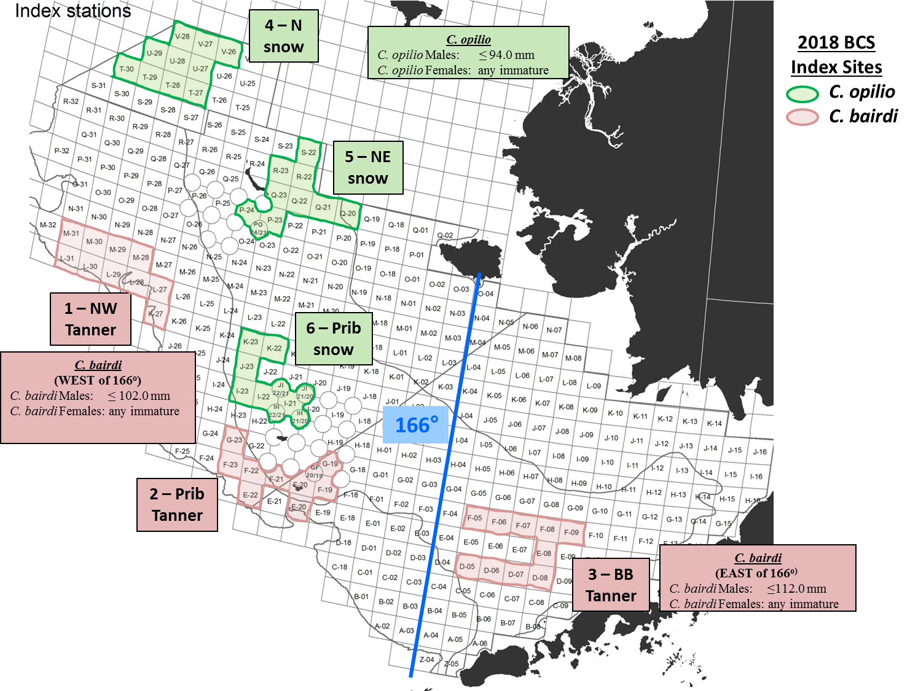
Blood samples have been collected at 6 index sites in the EBS (2014-2019) for DNA tests to detect the presence of the parasite Hematodinium sp., the causative agent of Bitter Crab Syndrome
+
Contribution: Pam Jensen
Notes:
This dataset contains crab data from a field survey of Chionoecetes bairdi and C. opilio collected at six designated index sites in the Bering Sea during the 2015 NOAA/NMFS/AFSC/RACE crab-groundfish bottom trawl surveys of the eastern Bering Sea. Each of the six index sites were made up of approximately 10 survey stations and chosen based on historical incidences of the parasite Hematodinium sp., the causative agent of Bitter Crab Syndrome (BCS). Blood samples were taken from collected crab using non-lethal methods and were preserved in 100% ethanol. Samples were tested in a laboratory with a DNA test to detect the presence of the parasite Hematodinium sp., the causative agent of Bitter Crab Syndrome (BCS) to evaluate any changes in intensity of disease within the index sites that may provide information as to how the disease is moving or changing within EBS crab populations. The data includes sampling year, index site, species, crab morphometrics, Hematodinium sp. parasite presence/absence based on PCR assay results.

Slide 12
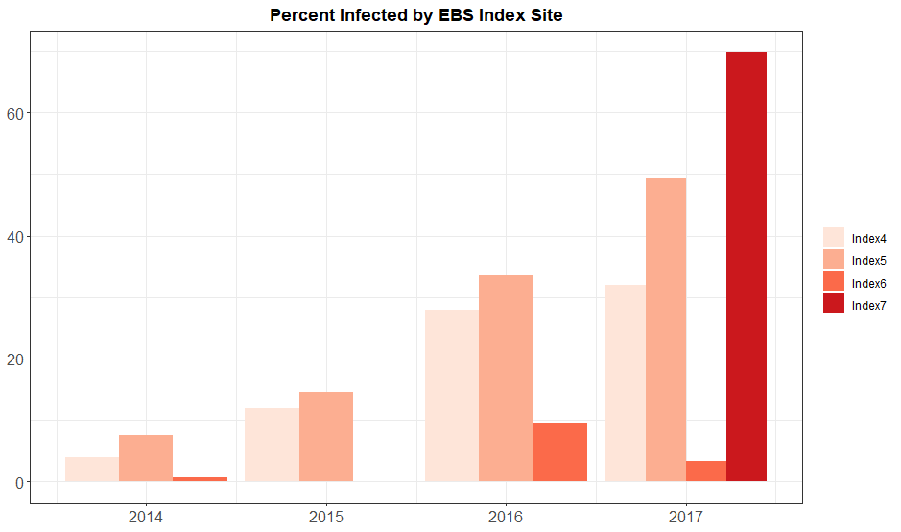
Overall, prevalence of bitter crab syndrome at index sites has increased annually from 2014-2017
+
% Infected
Contribution: Pam Jensen
Notes:
Note that visual prevalence data underestimate actual infection rates determined via PCR assays. Also note the increase in BCS prevalence as the survey progresses north, which reflects the increasing sensitivity in detecting hemato. Infections as the disease progresses.

Slide 13
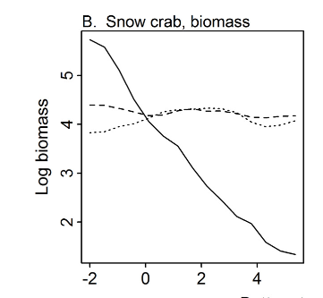


Cold water habitat indicators
Cold water habitat availability (<2 °C) has been proposed as a critical recruitment bottleneck for snow crab
Juvenile snow crab are highly sensitive to bottom temperatures and 2°C is an important maximum temperature threshold for immature females
Murphy 2020

Slide 14
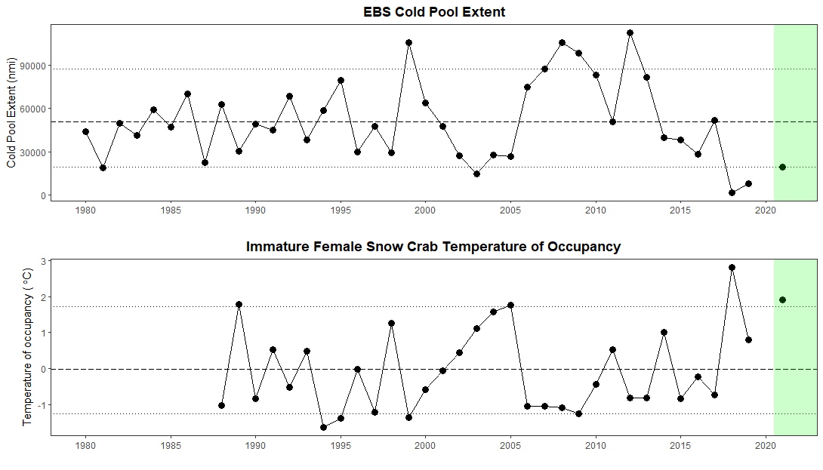
In 2018, temperatures occupied by immature females were well above preferred temperatures <2°C

Slide 15
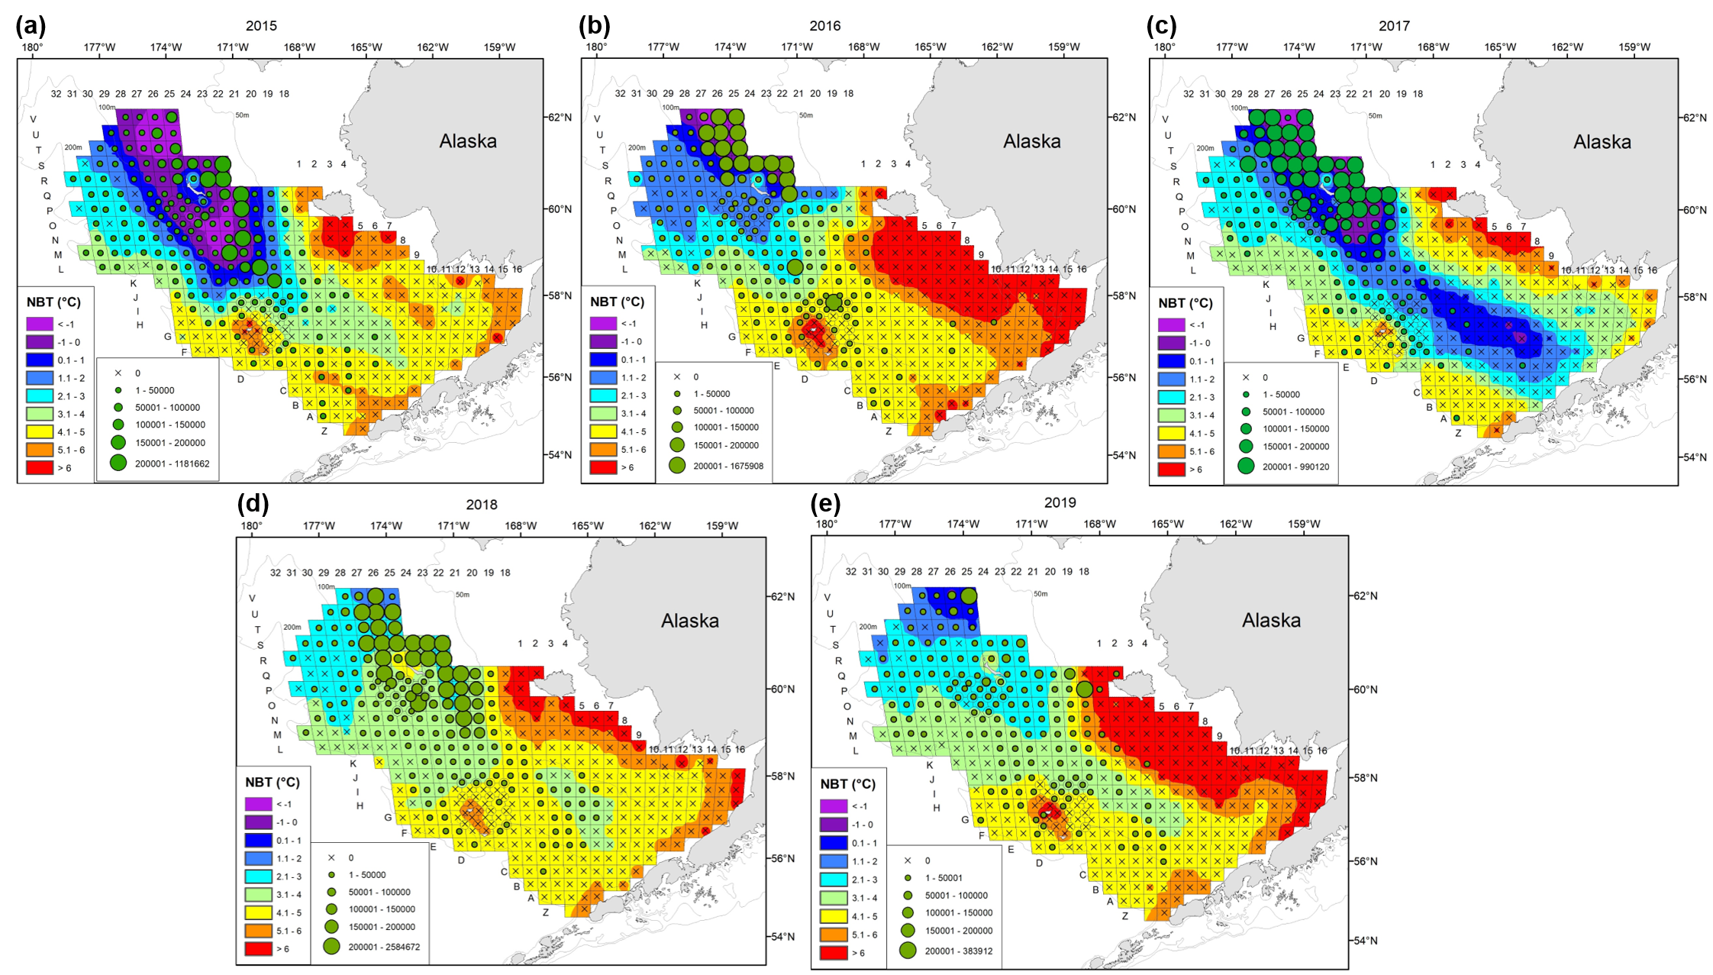
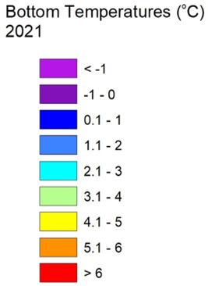
Juvenile snow crab thermal distributions (2015-2019)
2015
2016
2017
2018
2019
    Cold water habitat <2°C nearly absent in juvenile nursery grounds in 2018, and greatly reduced again in 2019 (and 2021)
Notes:
High catches of immature females and small males at EBS survey stations >3 ◦C in 2018 (Lang et al., 2018) followed by dramatic declines in 2019 at the same stations (Zacher et al., 2020) may suggest mortality rates that are sensitive to water temperatures and cold pool area.

Slide 16
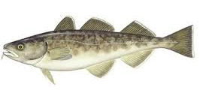
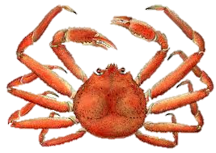
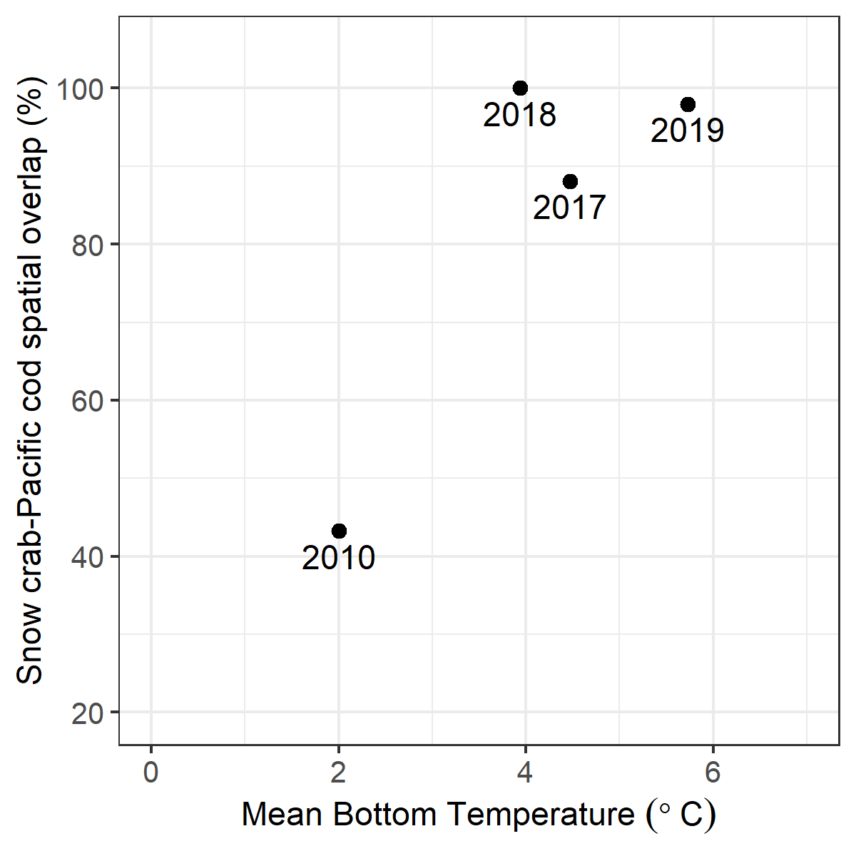
Pacific cod-snow crab spatial overlap
Spatial overlap in the NBS increased from 43% to 88% from 2010 to 2017
Increased predation via climate-driven changes in predator-prey spatial overlap?

Slide 17
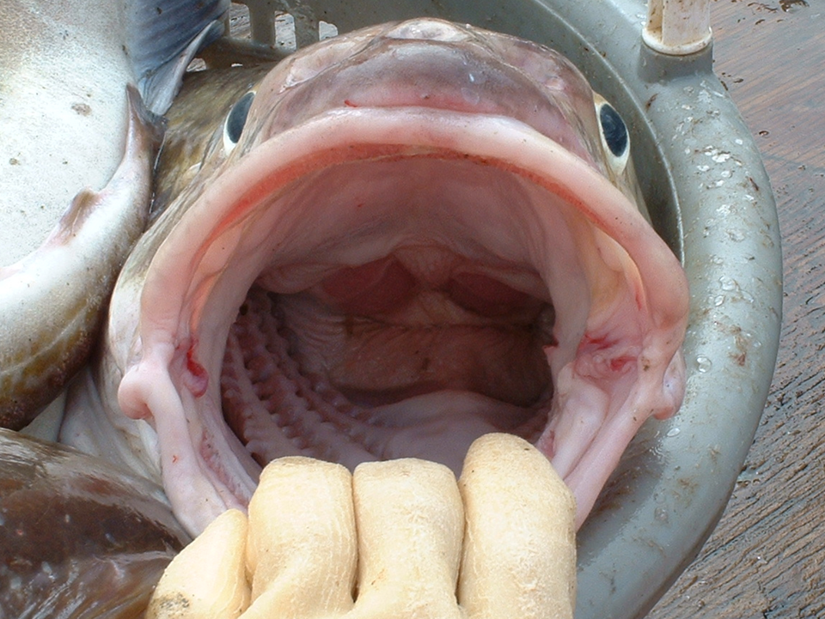
Consumption of snow crab by cod
Contributor: Kerim Aydin
50,772 Pacific cod stomachs collected in EBS/NBS 1985-2019
Summer bottom trawl survey samples only
Estimate snow crab consumption of crab by:
  BTS-estimated number of cod (length,stratum,year) *
  Temperature-adjusted daily ration(length, stratum, year) *
  % by weight of snow crab in cod stomachs (length, stratum, year)
Examine size of snow crab prey

Slide 18
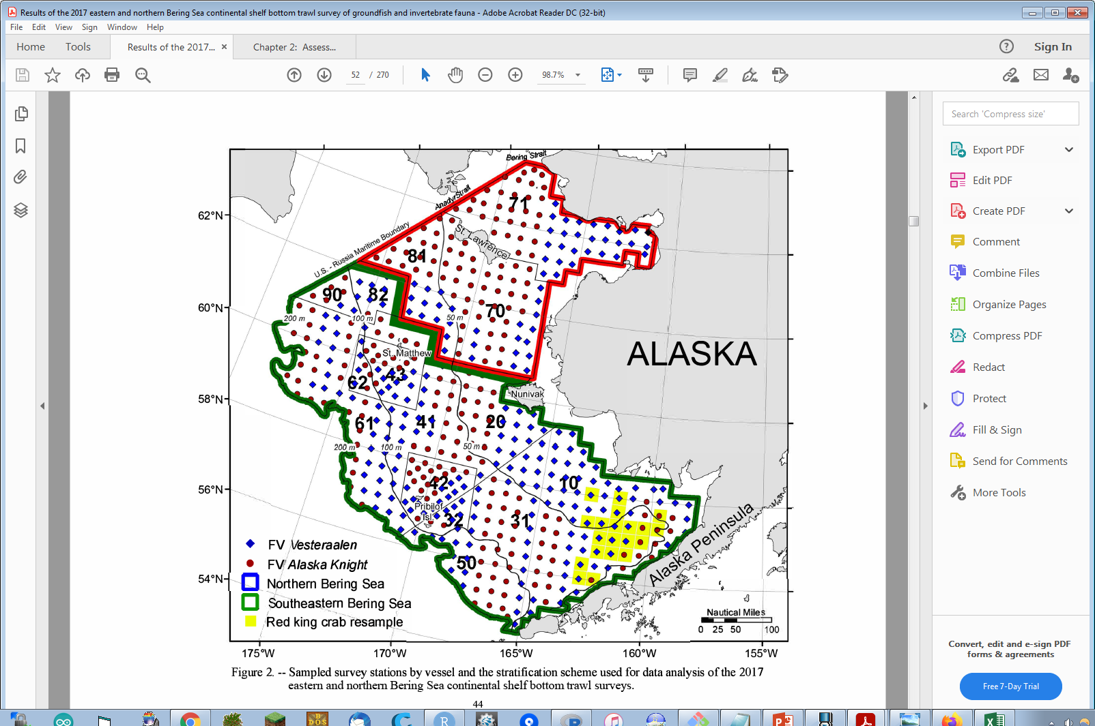
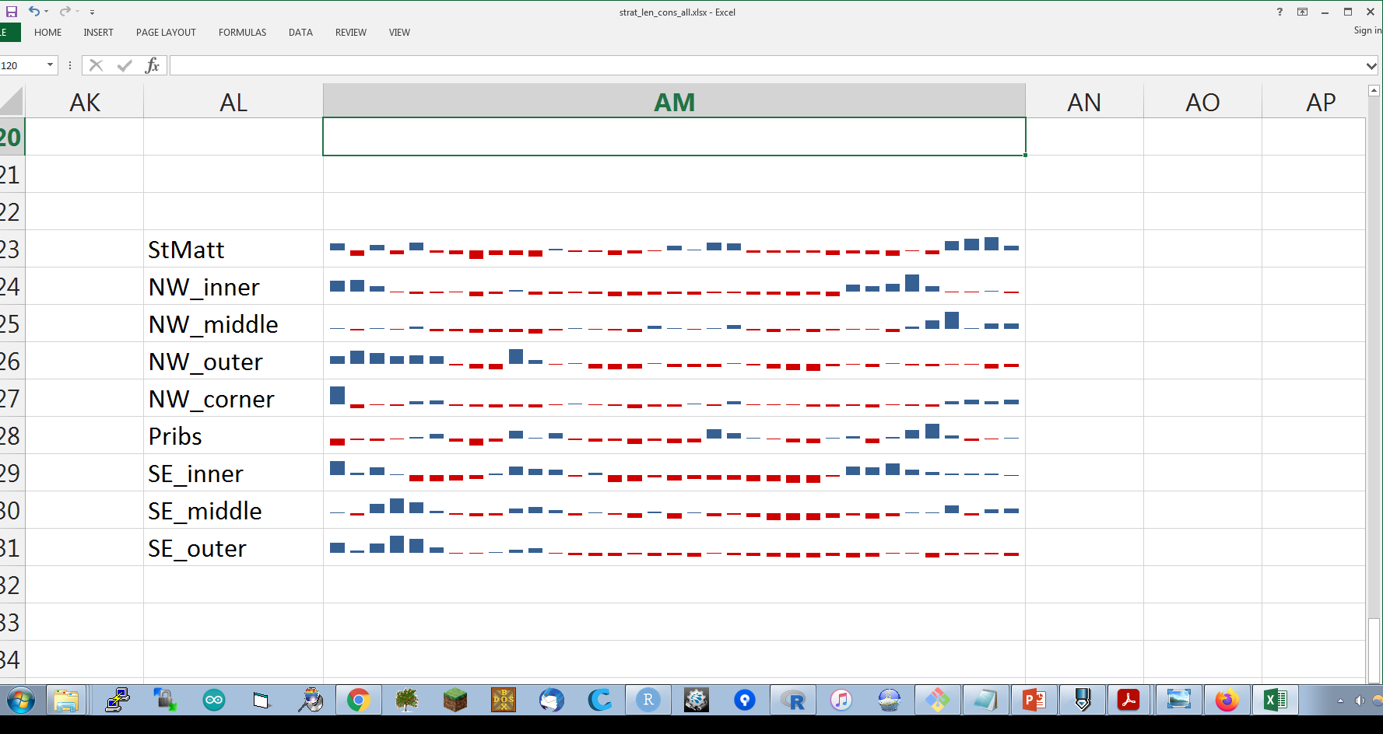
Patterns in cod distribution and diets
Supplemental slides detail the following observations from survey/diet data:
Increase in total consumption by larger cod in the St. Matthew Island and northwest middle domain survey strata.
Recent shifts of cod diets in these northern EBS strata, from pollock towards snow crab.
Generally high rates of snow crab consumption by cod in the NBS.

Slide 19
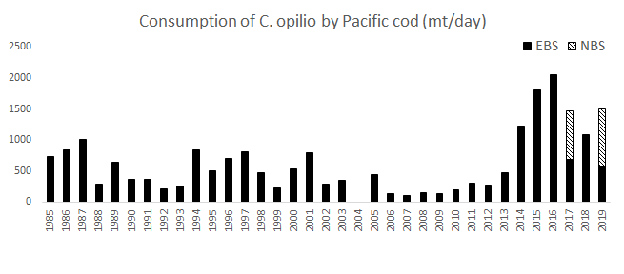
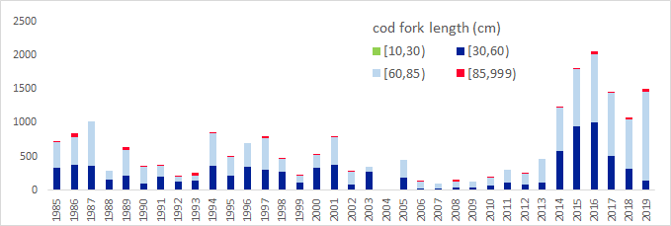
Overall result - trends in daily summer consumption of snow crab by Pacific cod
nd
nd

Slide 20
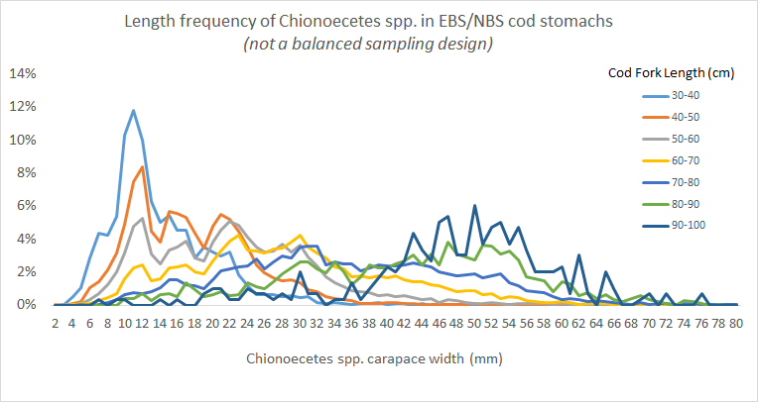
Prey size as a function of predator size

Slide 21
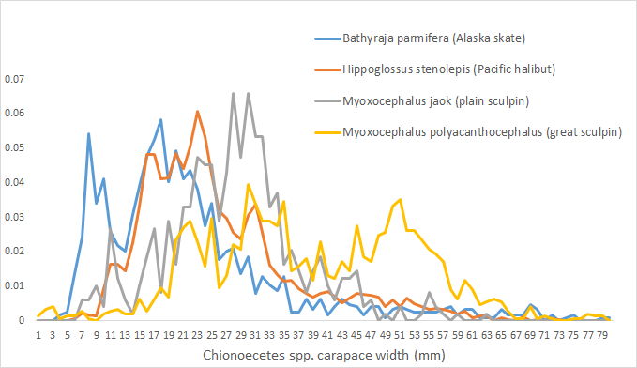
Other predators to consider
Many other predators (smallmouth flatfish, eelpouts, pollock) eat crab <20mm CW

Slide 22
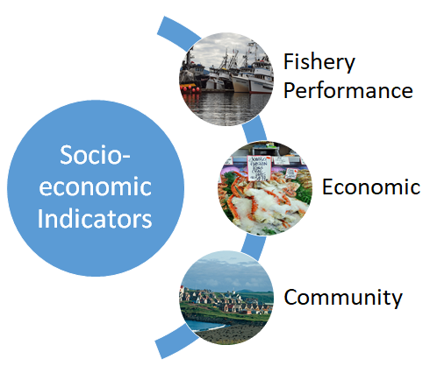
Draft Socioeconomic Indicators
Center of gravity (snow crab fishery)
Catch-per-unit-effort (snow crab fishery)
Total potlifts (snow crab fishery)
Number active vessels (snow crab fishery)
Incidental catch of snow crab
Ex-vessel value (snow crab fishery)
Ex-vessel price/lb (snow crab fishery)
Ex-vessel revenue share (snow crab fishery)
No community indicators proposed

Slide 23
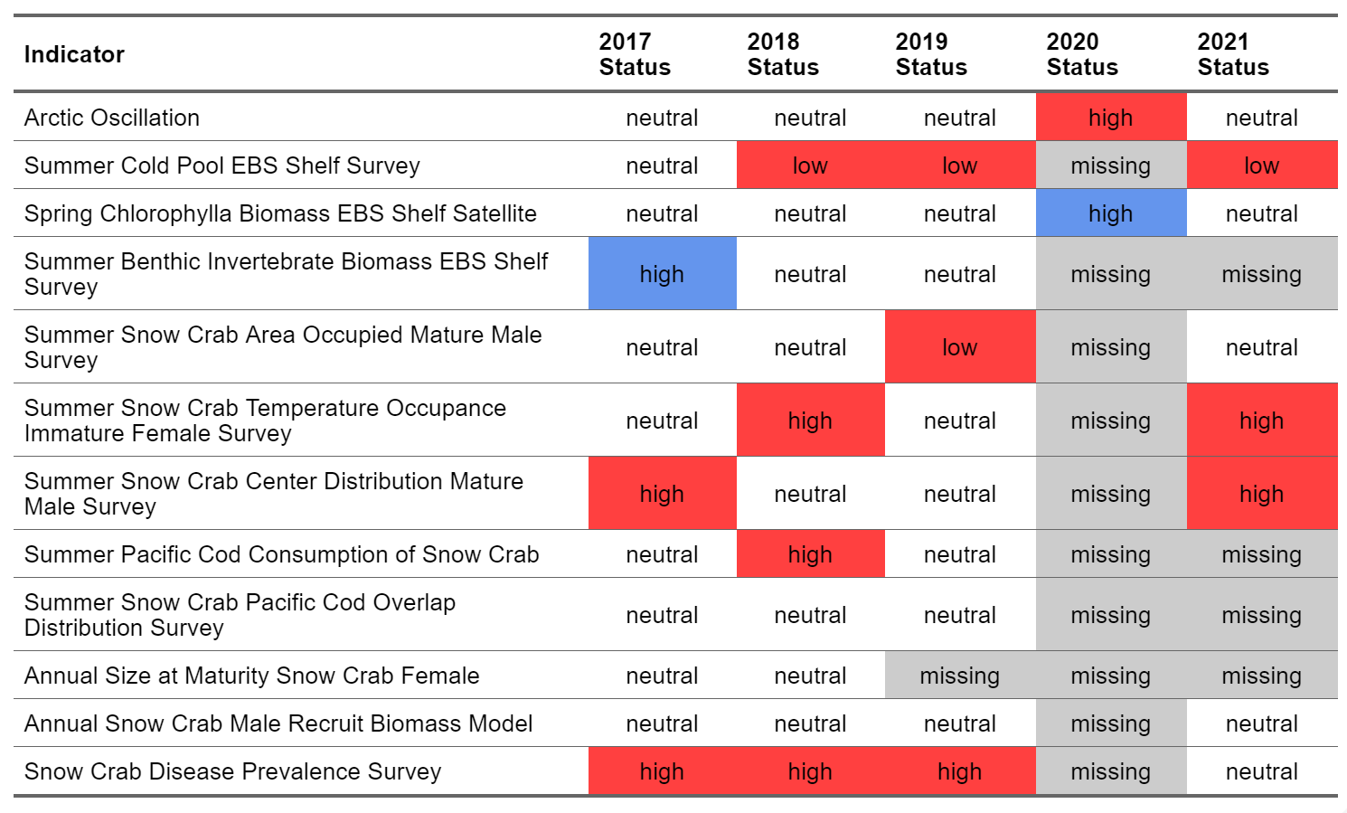
Draft Traffic Light Table
Notes:
Draft traffic light table for proposed ecosystem indicators already developed or in development. See RFI for full indicator timeseries figures.

Slide 24
Discussion
Is there any feedback on the Request for Indicators (RFI) approach and/or ESP schedule for crab?
Are the suggested ecosystem and socioeconomic indicators appropriate for snow crab?
Are there any other indicators we should include in the snow crab RFI?

Slide 25
Proposed Snow Crab Indicators
Snow crab conceptual model
Ecosystem Indicators
Socioeconomic Indicators
Arctic Oscillation (climate model)
Cold pool extent (BTS)
Sea-ice extent/retreat (satellite)
pH index (ocean model)
Production (chlorophyll a, satellite)
Intermolt duration (BTS)
Settlement success (IBM)
Hatch spring bloom overlap (BTS, sat)
Benthic prey biomass (BTS)
Snow crab recruit condition (BTS)
Snow crab area occupied (BTS)
Temperature of occupancy (BTS)
Snow crab center of distribution (BTS)
Pcod consumption of snow crab
Pcod and snow crab overlap (BTS)
Female snow crab size at maturity (BTS)
Male snow crab recruit biomass (BTS)
Snow crab disease prevalence (BTS)
Center of Gravity (snow crab fishery)
Catch-per-unit-effort (snow crab fishery)
Total potlifts (snow crab fishery)
Number active vessels (snow crab fishery)
Incidental catch of snow crab
Ex-vessel value (snow crab fishery)
Ex-vessel price/lb (snow crab fishery)
Ex-vessel revenue share (snow crab fishery)

Slide 26
Questions?

Slide 27
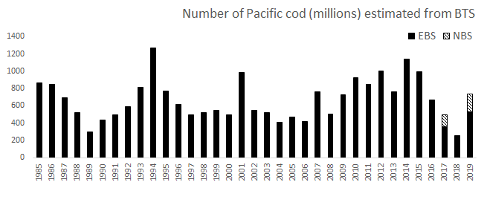
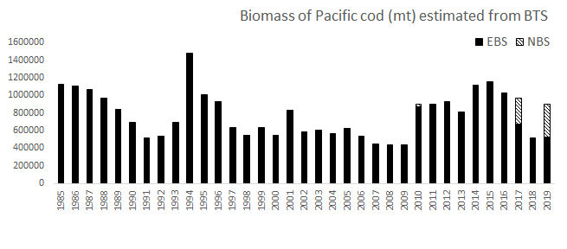
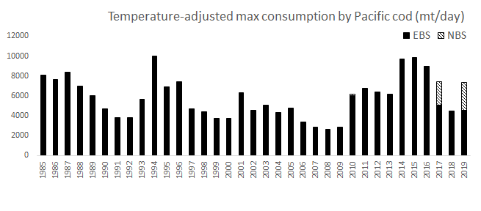
Total consumption of all prey by cod
Survey numbers (by 1cm cod size bins)
Survey biomass N * a_{w}L^{bw}
Consumption N * a_{c}(a_{w}L^{bw})^{bc} * f(gear temp)

Slide 28
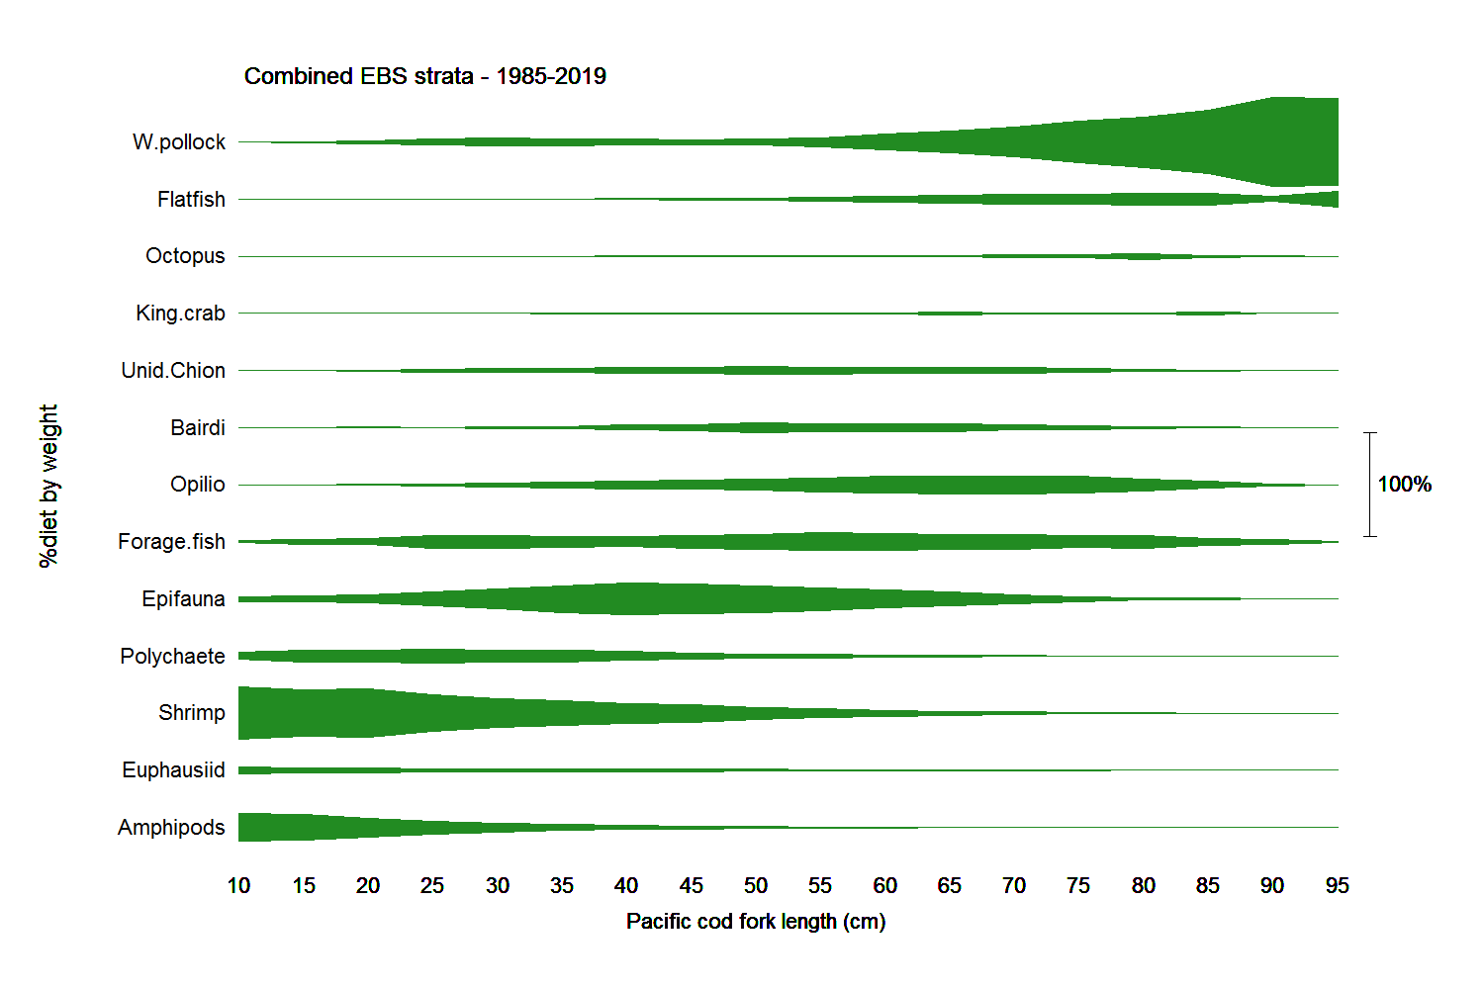
Cod diets by cod length

Slide 29
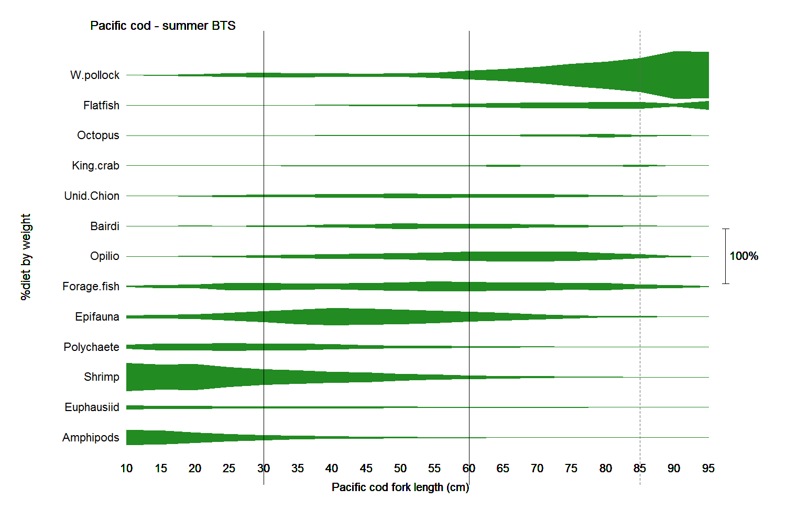
Cod diets by cod length
planktivorous
benthivorous
piscivorous

Slide 30
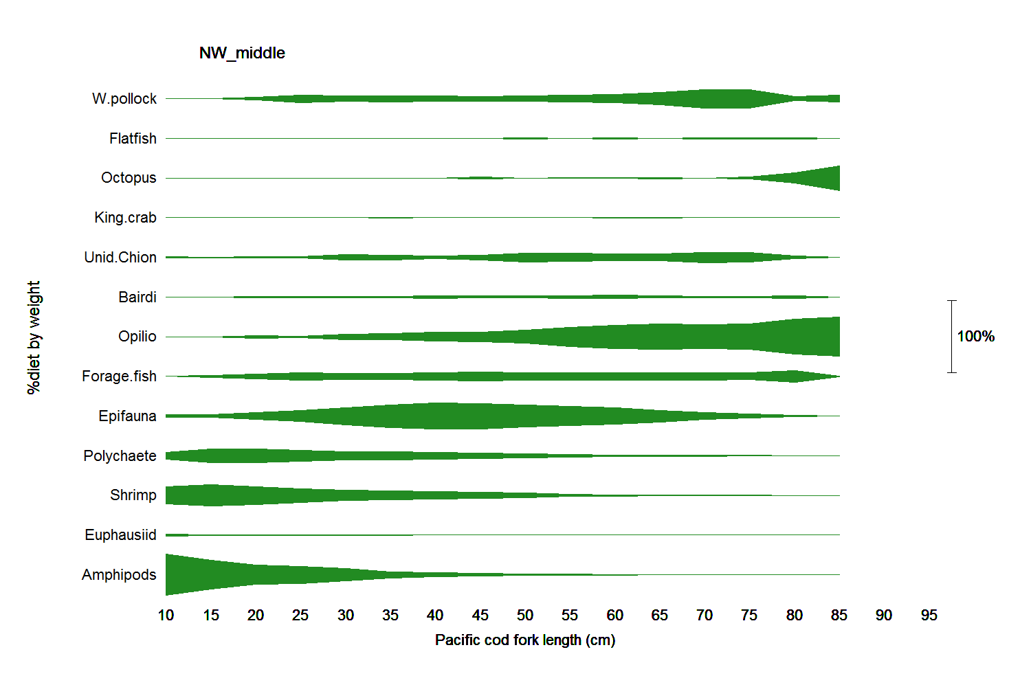
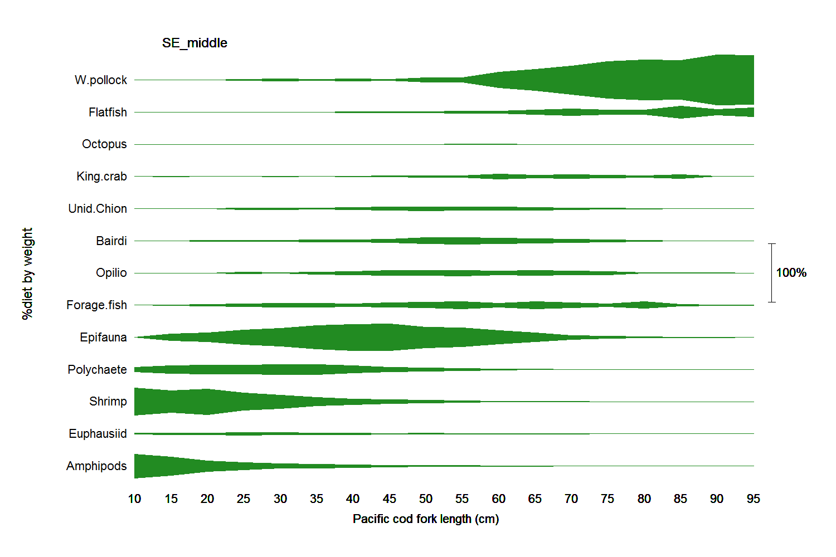
Location matters -
N versus S middle domains

Slide 31
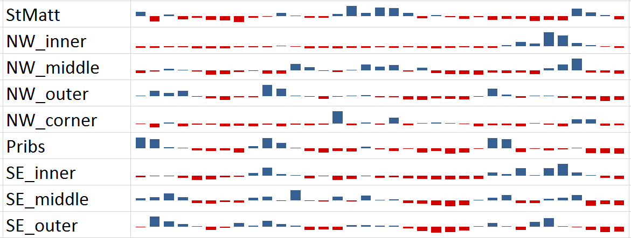
Trends in total EBS consumption
by stratum and cod length
1985 2019
Benthivorous cod (30-60cm fl)
Piscivorous cod (60-85cm fl)

Slide 32
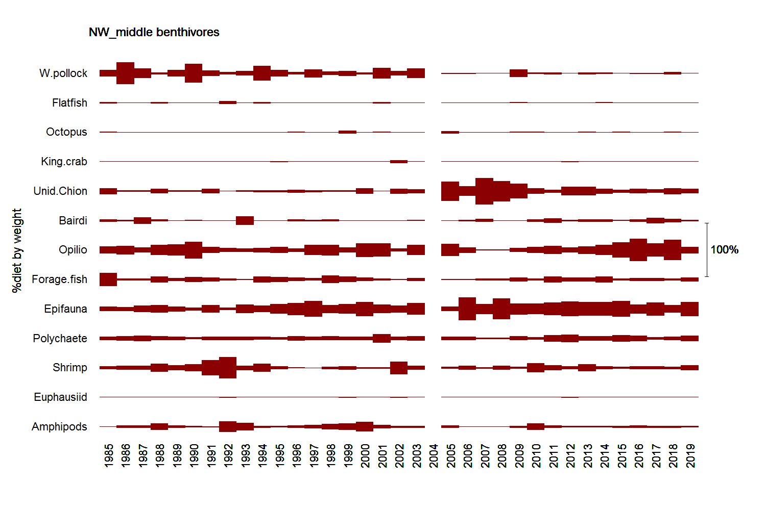
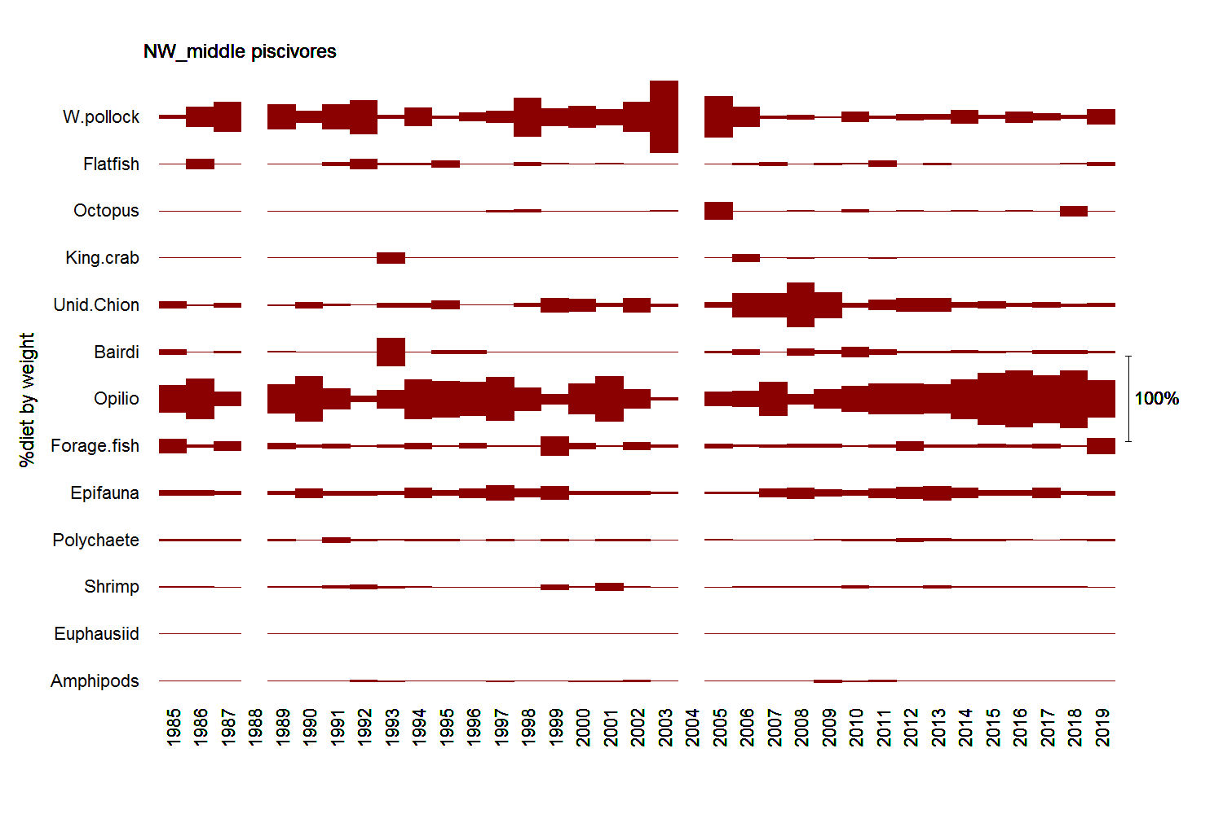
Time x predator size matters
(N middle domain)
30-60cm cod
60-85cm cod

Slide 33
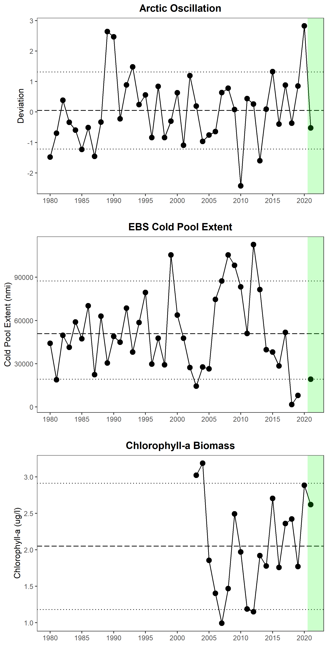
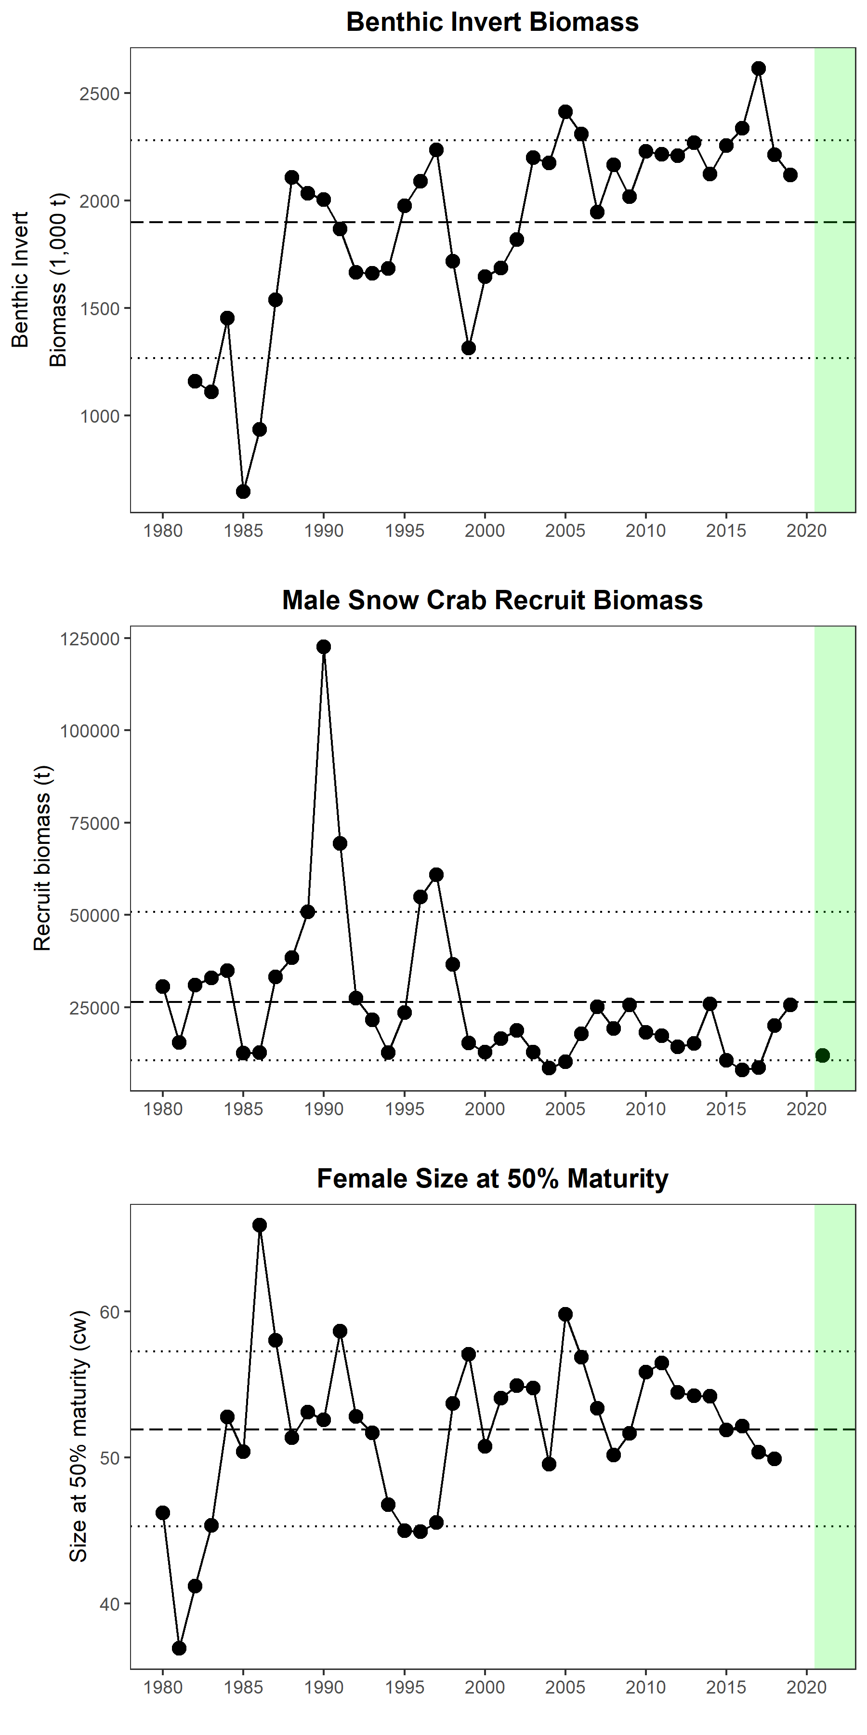
Indicator time series

Slide 34
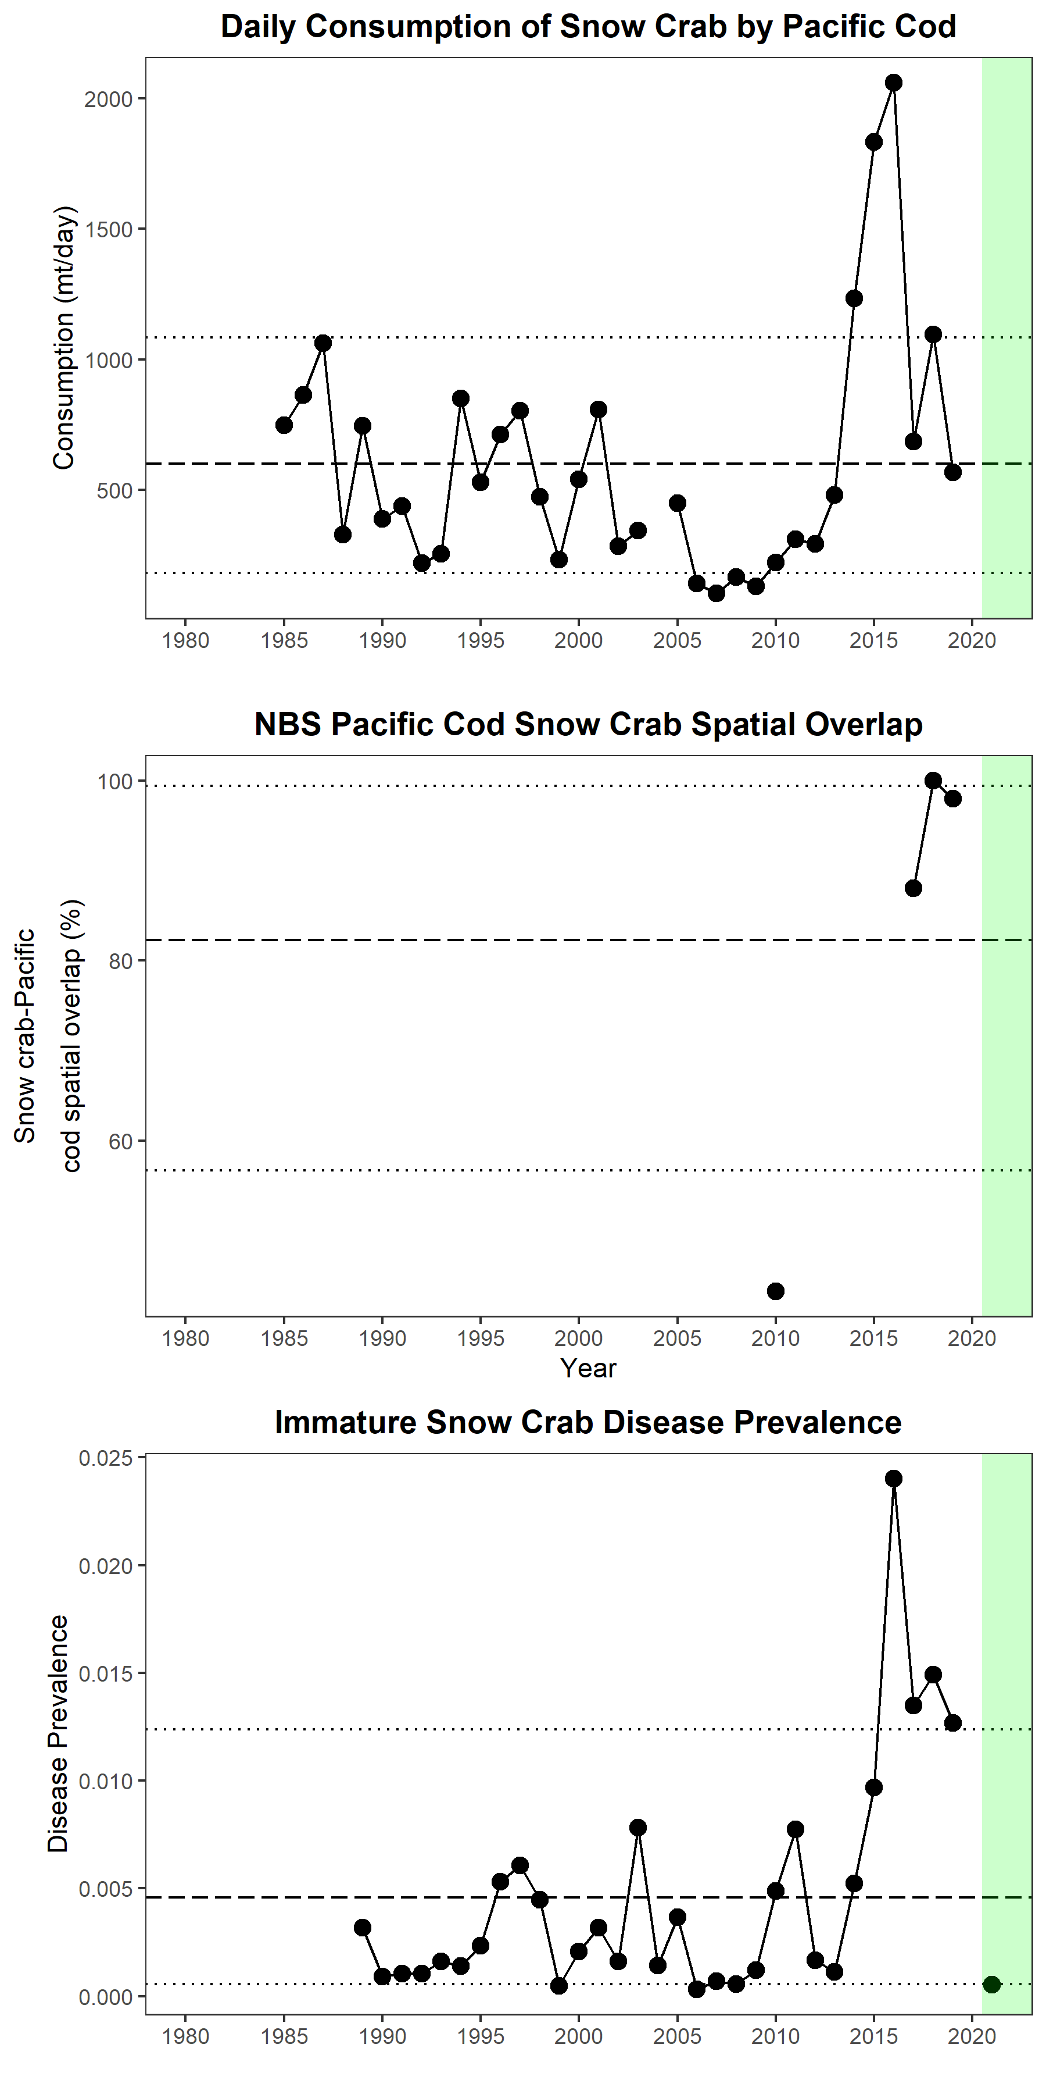
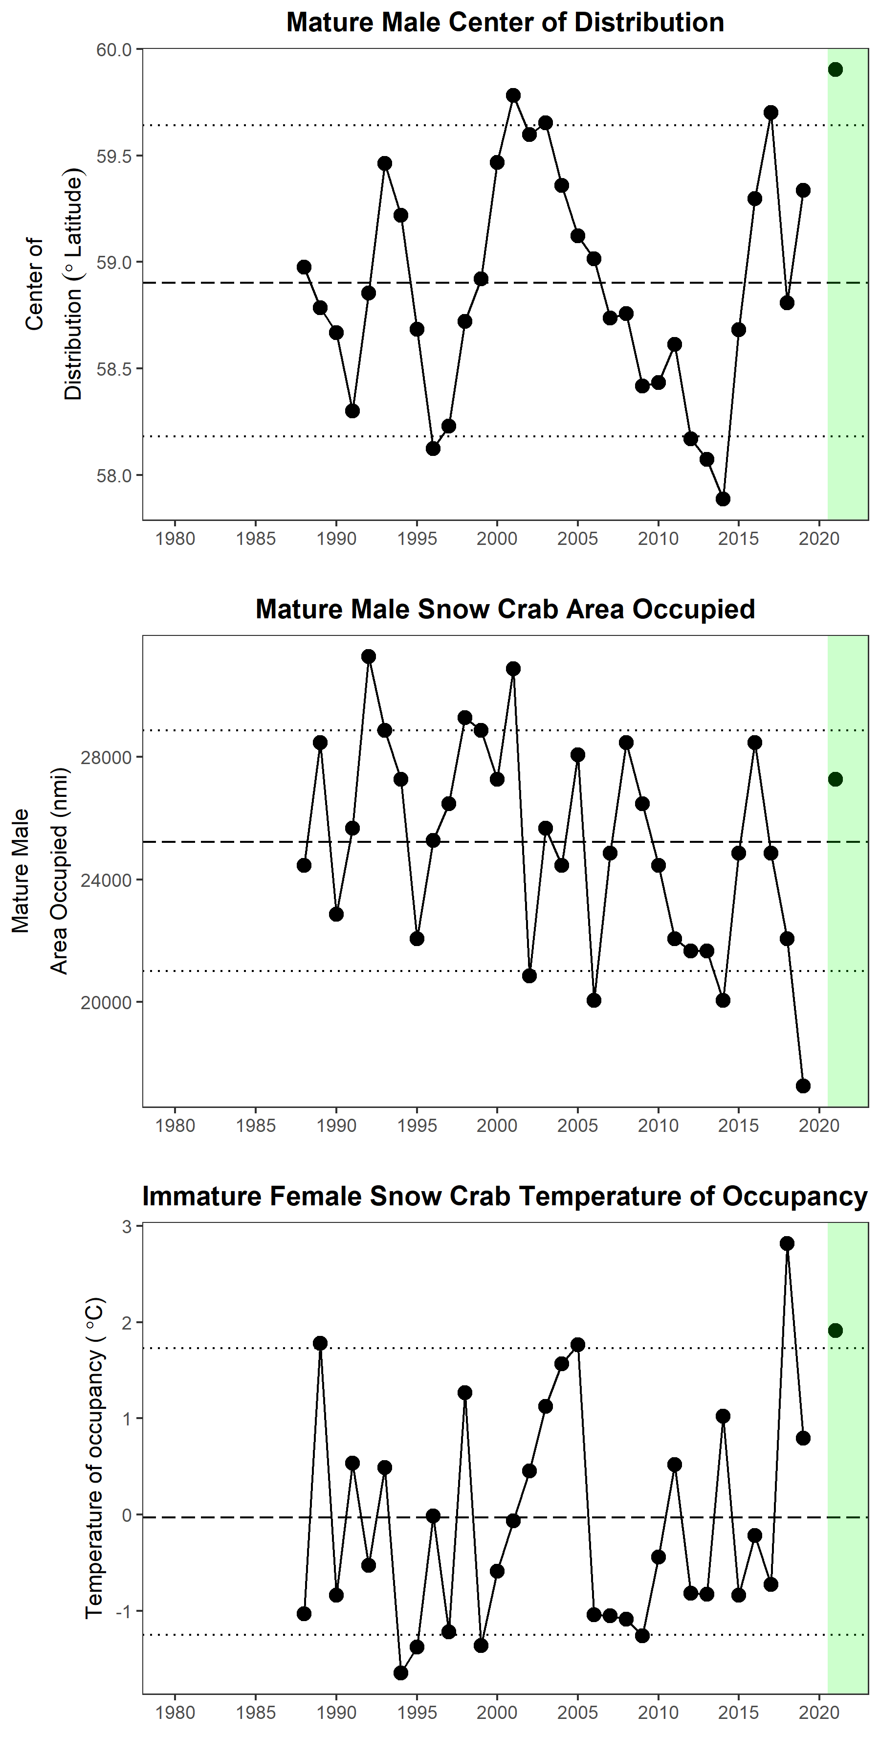
Indicator time series

