Slide 1
Eastern Bering Sea snow crab
Cody Szuwalski
April 29, 2019

Slide 2
Road map
Model output is unstable
Addressing issues in the current model has been challenging
More questions than answers
Back to basics—build up complexity
Work on simple model and GMACS
(a couple of bonus runs not in the documents)
What to use in September?
What are the ‘burdens of proof’ for changing parameter assumptions, etc.?

Slide 3
A condensed list of requests from the SSC and CPT:
Think about:
Natural mortality and priors
Catchability in the survey and northern Bering Sea
Growth, instability in the kinked model, and alternative models
Shell condition and
Skip molting
Recruitment and deviations among sexes
Data weighting
Fishing mortality equations
Parameter correlations
Maturity estimates and chela height

Slide 4
A condensed list of requests from the SSC and CPT:
Think about:
Natural mortality and priors
Catchability in the survey and northern Bering Sea
Growth, instability in the kinked model, and alternative models
Shell condition and
Skip molting
Recruitment and deviations among sexes
Data weighting
Fishing mortality equations
Parameter correlations
Maturity estimates and chela height

Slide 5
Response
Runs
Requests for information
A simple model

Slide 6
Model | % converge | % at minium
New Data | 27 | 5
Fix fem M | 36 | 4
Loose prior M | 37 | 4
Looser prior M | 43 | 3
Sep devs | 27 | 5
Sep devs + loose prior M | 34 | 4
Sep devs + looser prior M | 23 | 6
Sep devs + loose + growth | 3 | 50

Slide 8
CPT requests
Examine the possibility and implications of skip molting.
Consider moving to the “GMACS catch equation” as is now the case for the assessment of EBS Tanner crab.
Explore parameter correlation matrices to better understand possible reasons for model instability. In addition, examine how the values for each likelihood component change among jittered solutions with similar objective function values.
Consider a model in which growth differs for animals that are about to mature.
The level of recruitment is likely correlated with immature M. This should be explored in future analyses.
Further explore the basis for the existing priors for M; for example, from the estimated ages post terminal molt.
Consider including the chela height data in the same manner as for EBS Tanner crab.
Explore alternative options for weighting the growth data to achieve a more expected fit to the data (i.e., linear).

Slide 9
CPT requests
Examine the possibility and implications of skip molting.
Consider moving to the “GMACS catch equation” as is now the case for the assessment of EBS Tanner crab.
Explore parameter correlation matrices to better understand possible reasons for model instability. In addition, examine how the values for each likelihood component change among jittered solutions with similar objective function values.
Consider a model in which growth differs for animals that are about to mature.
The level of recruitment is likely correlated with immature M. This should be explored in future analyses.
Further explore the basis for the existing priors for M; for example, from the estimated ages post terminal molt.
Consider including the chela height data in the same manner as for EBS Tanner crab.
Explore alternative options for weighting the growth data to achieve a more expected fit to the data (i.e., linear).

Slide 10
Models presented in appendix 1
18.1: 2018 Accepted model (separate recruitment deviations for males and females)
19.1: 18.1 + a prior on the sex ratio for recruitment
19.2: 19.1 + fixing growth to a linear model
19.3: 19.2 + weighting growth twice as heavily
19.4: 19.1 + fitting to VAST survey estimates and CVs

Slide 11
Sneak peak
18.1: Converged
19.1: Converged (but little rationale for specification of the prior)
19.2: Did not converge
19.3: Did not converge
19.4: Did not converge

Slide 12
Model overview
July 15
Survey
Logistic selectivity in 2 ‘eras’
Linked to BSFRF data
Size composition and biomass index
7.5/12 M
Directed fishery
Non-directed fishery
Mating
4.5/12 M
Molting
Growth
Recruitment

Slide 13
Model overview
Survey
Mature males, immature for both sexes, mature females
Estimated with a prior
7.5/12 M
Directed fishery
Non-directed fishery
Mating
4.5/12 M
Molting
Growth
Recruitment

Slide 14
Model overview
Survey
7.5/12 M
Directed fishery
Logistic selectivity
Retention selectivity
Discard mortality equal to 30%
Data in:
Retained catch in t and #s
Discard numbers
Retained catch length comps
Non-directed fishery
Mating
4.5/12 M
Molting
Growth
Recruitment

Slide 15
Model overview
Survey
7.5/12 M
Directed fishery
Logistic selectivity
Retention selectivity
Discard mortality equal to 30%
Fit to:
Retained length comps
Total length comps
Retained biomass
Male and female discard biomass
Non-directed fishery
Mating
4.5/12 M
Molting
Growth
Recruitment

Slide 16
Model overview
Survey
7.5/12 M
Directed fishery
Non-directed fishery
Logistic selectivity
Discard mortality equal to 80%
Mating
4.5/12 M
Molting
Growth
Recruitment

Slide 17
Model overview
Survey
7.5/12 M
Directed fishery
Non-directed fishery
Mating
Freely estimated maturity curves
Smoothing penalties
February 15
4.5/12 M
Molting
Growth
Recruitment

Slide 18
Model overview
Survey
7.5/12 M
Directed fishery
Non-directed fishery
Mating
4.5/12 M
Molting
All immature crab assumed to molt
Terminal molt to maturity
Growth
Recruitment

Slide 19
Model overview
Survey
7.5/12 M
Directed fishery
Non-directed fishery
Mating
4.5/12 M
Molting
Growth
Two piece linear growth models estimated for both sexes (except 1 model)
Recruitment

Slide 20
Sex ratio prior

Slide 21
VAST
VAST provided similar point estimates, smaller CVs
Model did not converge with VAST estimates
General issues with VAST
Modifies ‘data’ from a station in a given year
Considers only correlation between stations in adjusting values, not fishing, temperature, predation, etc.

Slide 22
A condensed list of requests from the SSC and CPT:
Think about:
Natural mortality and priors
Catchability in the survey and northern Bering Sea
Growth, instability in the kinked model, and alternative models
Shell condition and
Skip molting
Recruitment and deviations among sexes
Data weighting
Fishing mortality equations
Parameter correlations
Maturity estimates and chela height

Slide 23
Natural mortality
A mean of 0.23 and a prior of 0.054.
Based on maximum age of 20 years
  Crab mature at 7-9; additional 7-8 beyond terminal molt observed under fishery
  14-17 years ‘observed’; added a few years based on a small sample size
  Negative exponential depletion to 1% of initial population size
Last year’s estimates:
  Immature crab: 0.27
  Mature females: 0.36
  Mature males: 0.26
Models with looser priors on M fit the data better (and estimated higher M than above), but the CPT was uncomfortable with them given apparent lack of justification.

Slide 24
Shell condition
Radiometric dating could be useful for better determination of maximum ages.

Slide 25
Natural mortality
Methods for empirical estimation of natural mortality from maximum age
Estimated from fits to observed values for fish (not crab) species
Then et al. (2015)
  “Evaluating the predictive performance of estimators of natural mortality…”
  Maximum age does the best
  M = 4.899(max_age)^-0.916
Hamel (2015) and Dick et al. (2018)
  “A method for calculating a meta-analytical prior for natural mortality…” &
  “The combined status of Blue and Deacon Rockfishes in U.S. waters…”
  Recalculated Then and force through the intercept
  M = 5.4/(age_max)
Hoenig (1983):
  ln(Z) = 1.44 – 0.982(max_age)
  4.374/(max_age) (Hamel reparameterization)

Slide 27
Natural mortality

Slide 28
BONUS RUNS
M prior mean | Hessian | Gradient
0.19 | No | 92
0.21 | No | NAN
0.23 (base) | Yes | 0.003
0.27 | Yes | 0.002
0.32 | Yes | 0.003
0.37 | Yes | 0.003

Slide 30
The prior on M appears to be determining q, not the BSFRF data.

Slide 31
Estimation of time varying natural mortality
Murphy et al. 2018
Mean female M = 0.49
Mean male M = 0.36 (0.03 to 0.91)
Potential problems –variation in catchability and recruitment soaked up in estimated M

Slide 32
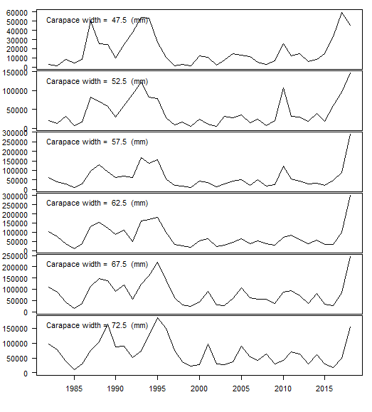
Old shell mature males
Mature males

Slide 33
Abundance
Year

Slide 34
Options for moving forward
Ln(max_age)
Changing M can have large impacts on management quantities (Thorson et al., Szuwalski et al.)
What is maximum age?
Uncertainty in maximum age
Uncertainty in prediction from maximum age
If this uncertainty is put in the prior, M is estimated higher
Confounding with other processes
Incorporating chela height data and revisiting catchability might stabilize estimates of M
Ln(nat Mort)

Slide 35
Catchability
Estimated parameter (q)
Scales the survey
Determines how large of an impact the fishery has on the population
If q is 1, the survey is a perfect representation of the population; fishery appears to impact the dynamics strongly.
If q < 1, the population is larger than the survey estimates; fishery appears to impact less strongly.

Slide 36
What is the average catchability for the survey?
Does catchability vary over time in the survey?
If so, what drives variation in catchability?

Slide 37
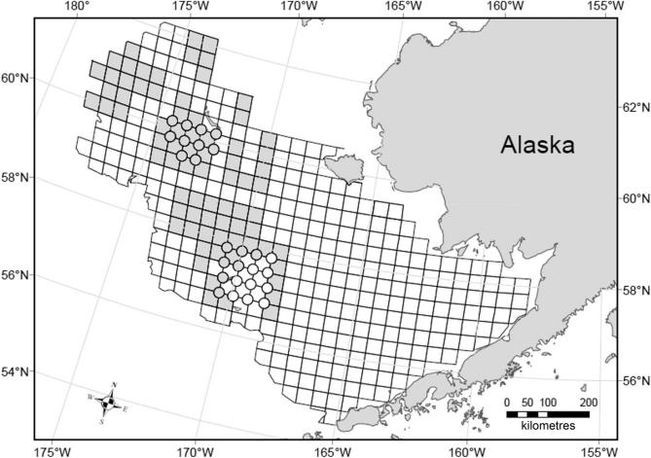
92 side by side tows with NMFS gear and nephrops trawls
Conclusions:
Selectivity isn’t logistic
Catchability is much lower than 1

Slide 38
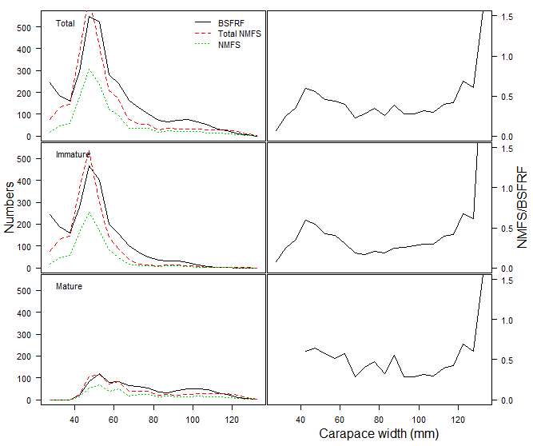
Catchability
Input data (→)
Total NMFS is in millions of crab
BSFRF calculated more crab in the study area than the total NMFS

Slide 39
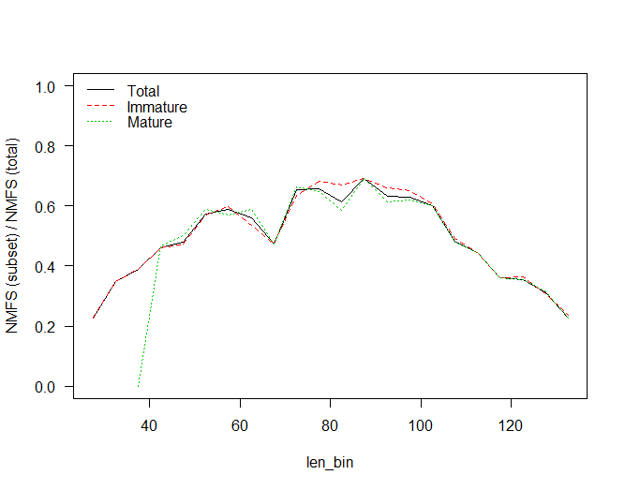
Estimated vs. empirical availability

Slide 40
Time variation in q
Length composition data suggests there are years in which survey biomass varies, but not as a result of M or recruitment (e.g. 2014)
Several hypotheses:
  Sediment and depth influence catchability (Somerton et al., 2013)
  Food availability and bottom temperature influence body position on the bottom (Goodman)
  Crab move in and out of the surveyed area from the north (Foy)

Slide 41
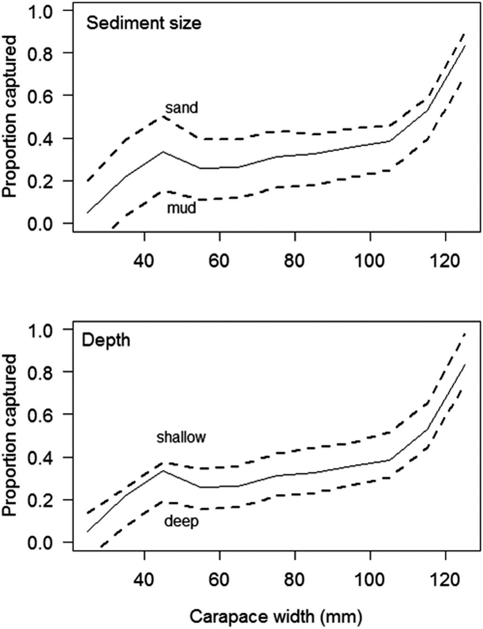
1. Develop an index of time-variation based on the spatial survey data and Somerton et al.’s results.
2. Insert into assessment, see if fits improve.

Slide 42
Northern Bering Sea
High densities in 2018
VAST?
  Cod and Pollock
Index of the densities at the border?
Need to know possible movement better

Slide 43
Two more bonus runs…
Build on natural mortality prior = 0.32 (lowest likelihood)
  Fix catchability to 0.4 in the survey (approximately what is suggested by the BSFRF data)
  Fix the probability of maturing to that estimated in the ‘accepted’ model from 2018

Slide 46
Moving forward
Use new BSFRF data to calculate observed selectivity
conversation about the observed selectivity and the use of the BSFRF data in the model
Proposal to look at range of hypotheses behind time varying catchability
  Use the observed differences in sediment and depth with the spatial survey data to develop an index of time-variation in catchability
  Insert into the assessment to determine if it improves fits
  VAST and northern Bering Sea data

Slide 47
Growth
Growth is currently modeled with a piece wise linear models with estimated changepoints
Changes in molt increment associated with maturity.
Instability in growth resulted in bimodal management quantities

Slide 48
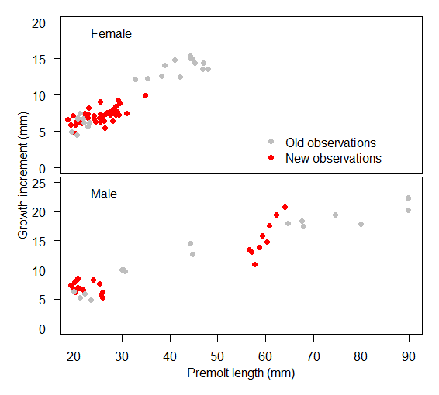
Growth
New data suggest that growth (for females at least, which is the problem process) is very linear
More data coming soon to fill in the holes (thanks to Madi and co.!)
Going to see if maturity height data are available for existing growth data

Slide 49
Growth
A single change point is not consistent with the idea that the molt to maturity is ‘different’ because the molt to maturity occurs over a range of sizes.

Slide 50
Maturity
Estimates of natural mortality and growth are related to the division between ‘mature’ and ‘immature’ crab, which is input data

Slide 51
Summary
Natural mortality might be higher than assumed
The prior on M appears to influence estimates of catchability
Catchability is estimated higher than the BSFRF data suggest
Estimated probability of maturing often adjusts to accommodate changes in M and q
Confounding and interactions are hard to characterize in the current model given instability

Slide 52
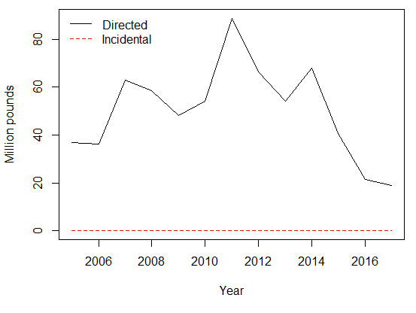

Slide 53
Given
Prior on M appears to be influencing catchability
BSFRF data suggest catchability is much lower than estimated
Kinked growth curves are a source of instability, but removing them produced inviable models
Probability of maturing shifts to accommodate the other processes in the model

Slide 54
What data inform what processes?
Are the data informing the processes we think they are?

Slide 55
Simple model
Removes females
  Problems with growth and instability
  Problems with recruitment and retrospective patterns
  Play little role in current management
Condenses data file over shell condition
Linear growth curve
  Data look linear
Removes BSFRF data
  Begin simple, add complexity

Slide 67
Take aways from simple modeling
Stable models can be fit to (at least some) of the snow crab data
Linear growth models can be used
Response to adding the BSFRF data was interesting
The model is not ready for use in management, but to be used to understand data contributions and stability.

Slide 68
Decisions for September/things I need help thinking about
More questions than answers
BSFRF data: history, worries, alternative methods
Treatment of natural mortality
Changes in management advice
Thoughts on only including males to get around problems with growth and recruitment

