Slide 1

Crab Plan Team
May 2019
Bering Sea Crab Ecosystem Indicators:
Stock-specific ecosystem status report cards
Erin Fedewa
Alaska Fisheries Science Center-Shellfish Assessment Program, Kodiak

Slide 2
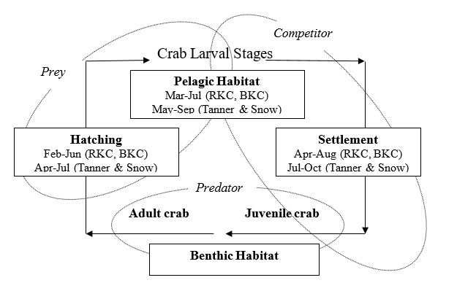
Ecosystem status reports and ecosystem report cards
“Monitoring ecosystem indicators provides an early warning system for managers, signaling human or climate-induced changes that may warrant management action”

Slide 3
Talking Points for Today
Review of previous crab ecosystem efforts
Selected indicators for stock-specific report cards
Draft report cards:
  Bristol Bay red king crab
  Tanner crab (east and west)
  EBS snow crab
Future indicator development & ongoing discussion
Next steps/moving forward

Slide 4
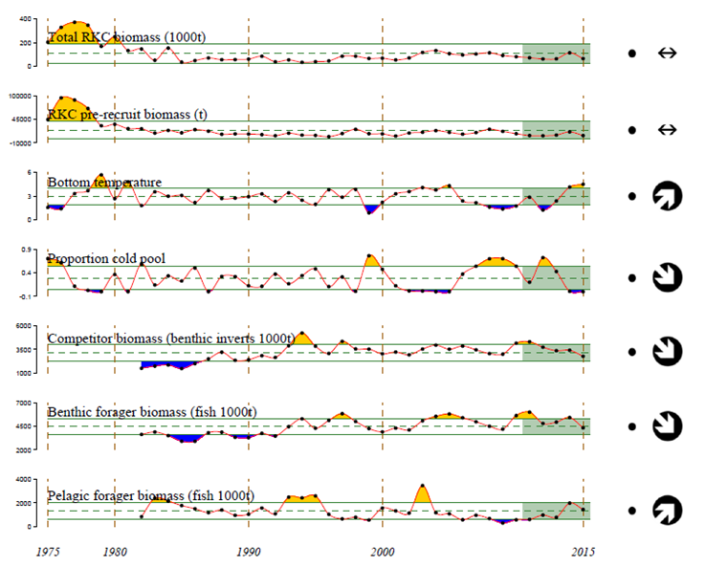
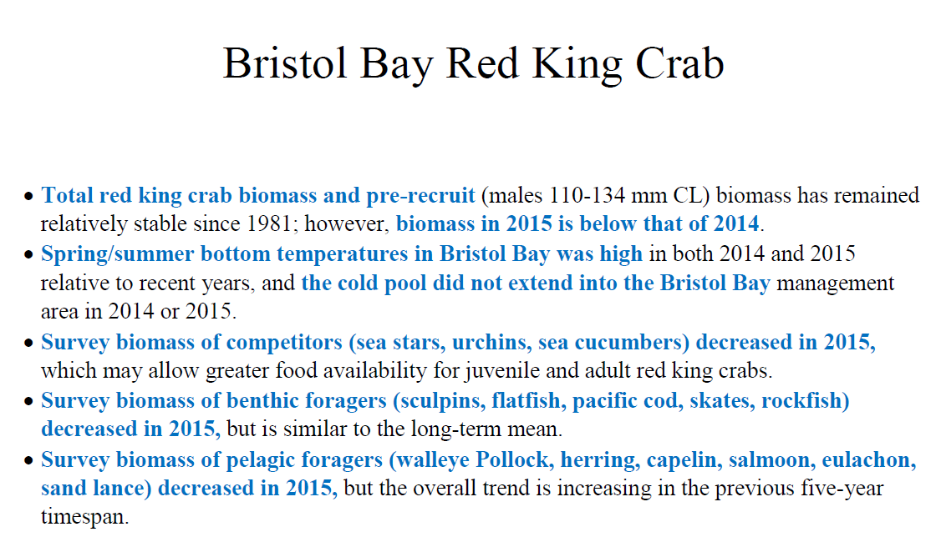
Where we are now and how we got here
Crab Ecosystem Considerations Chapter draft presented to CPT in 2014 by Liz Chilton
Pilot Bristol Bay Red King Crab report card draft presented to CPT in 2016 by Ben Daly

Slide 5
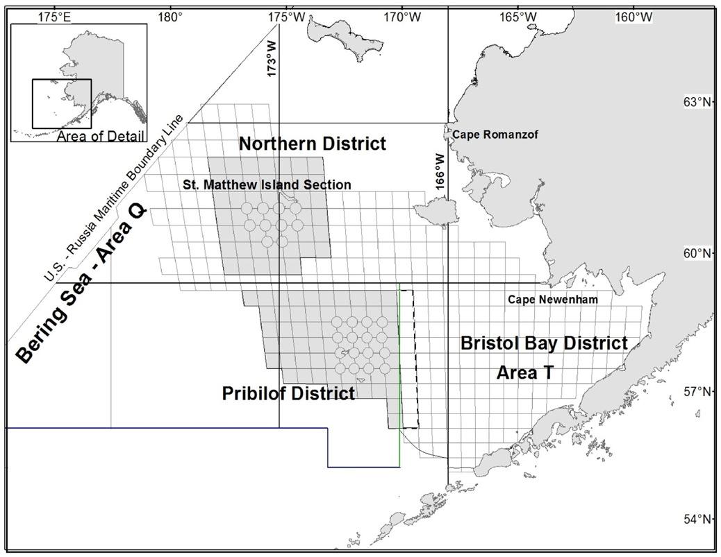
Methodology for developing stock specific report cards
1) Spatial extent of stock specific indicators restricted to stock management boundaries
2) General indicators selected that are applicable to all 4 stocks

Slide 6
Selected indicators for BBRKC, tanner and snow crab draft report cards
Total crab biomass: All sizes + sexes
Pre-recruit crab biomass: Males only
CV (%) of pre-recruit biomass: (σ/µ) * 100
Total fishery removals: Total catch + bycatch estimates
Bottom temperature: Summer temps from NOAA EBS BT survey
Proportion cold pool: # of stock stations w/ bottom temps < 2°C total # of stock stations
Benthic invert biomass (competitors): sea stars, hermits, urchins ect.
Benthic forager biomass (predators): sculpin, flatfish, pcod, skate
Pacific cod predation index: pcod abundance*proportion crab in diet
Pelagic forager biomass (predators): pollock, herring, capelin ect.

Slide 7
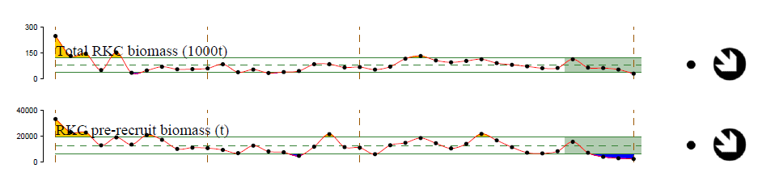
Bristol Bay Red King Crab
The 2018 total BBRKC biomass was the lowest ever in the 39-year time series
Pre-recruit biomass has also remained well below the long-term average
5-year mean: within 1 sd of long-term mean
5-year trend: decrease by 1 s.d.

Slide 8
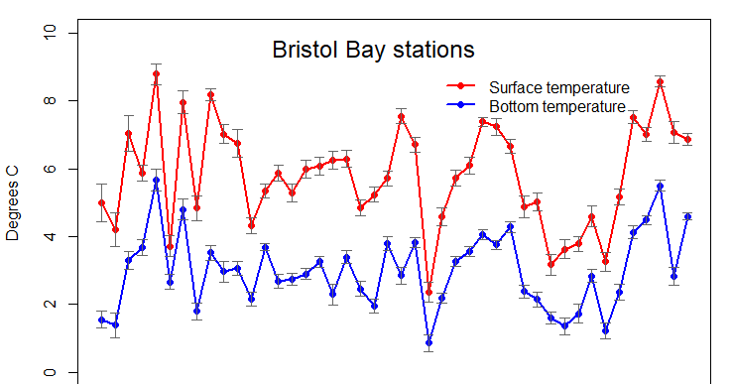
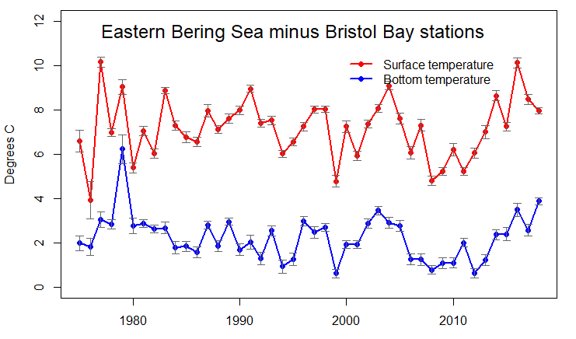
Bristol Bay temperatures
Summer bottom temperatures in Bristol Bay were above average during four of the past five years
The cold pool did not extend into the Bristol Bay management area during these four warm years

Slide 9
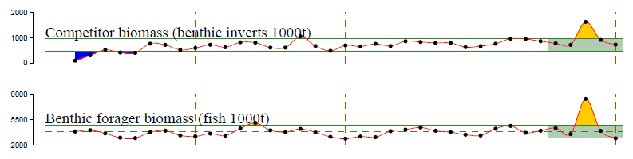
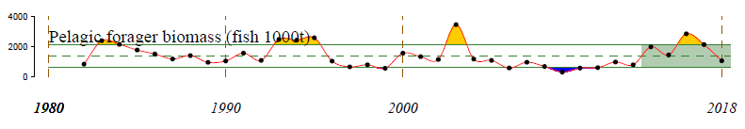
Bristol Bay foraging guilds
Survey biomass of competitors, benthic foragers, and pelagic foragers in Bristol Bay all increased in 2016 and since then, the overall trend in biomass is decreasing

Slide 10
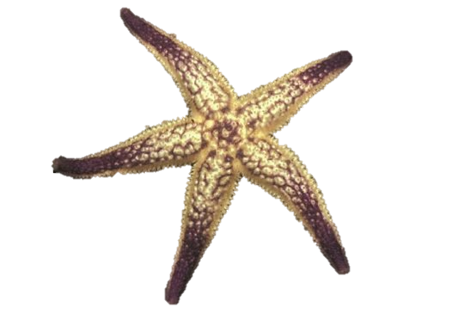
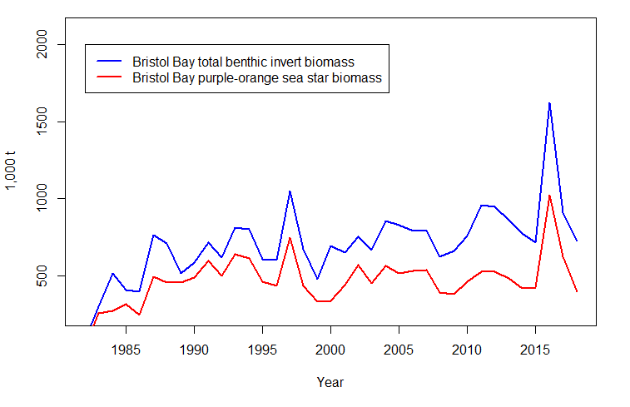
Benthic invert biomass
Benthic invert biomass increases in 2016 primarily due to very high catches of purple-orange sea stars

Slide 11
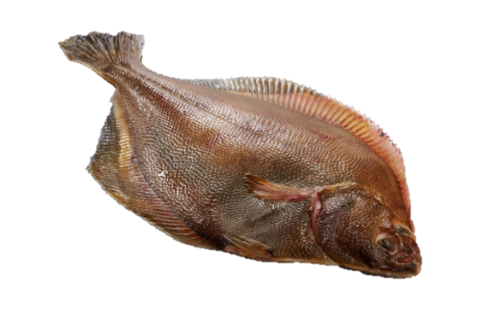
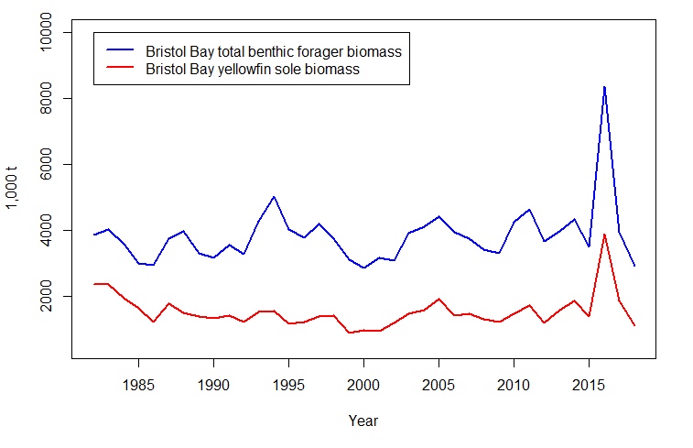
Benthic forager biomass
Benthic forager biomass increases in 2016 primarily due to very high catches of yellowfin sole and northern rock sole. Increased flatfish and/or benthic invert competition potentially driving recent declines in RKC pre-recruit biomass?

Slide 12
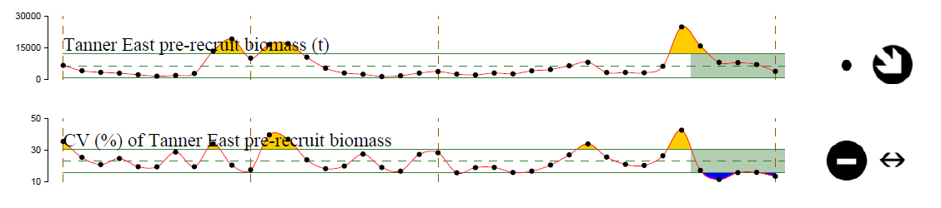
Tanner Crab East
Pre-recruit (males 113-124 mm CW) biomass has remained below the long-term average, with a decreasing trend in the past 5 years.
The CV of pre-recruit biomass indicates a decrease in spatial variability of tanner crab abundances east of 166W over the past 5 years.

Slide 13
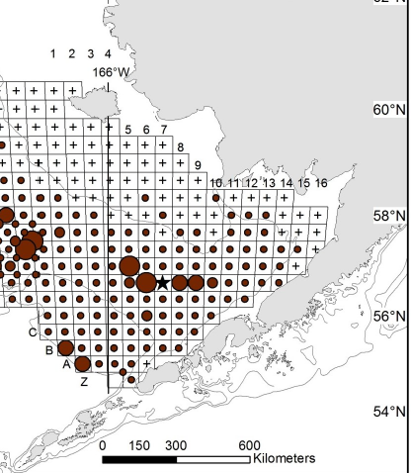
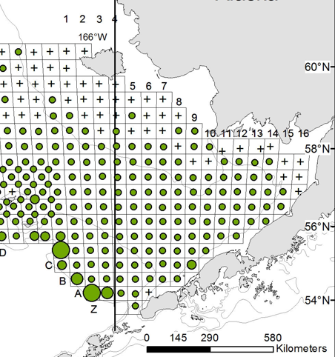
CV of Tanner crab pre-recruit biomass
2013 Tanner crab density
2017 Tanner crab density

Slide 14
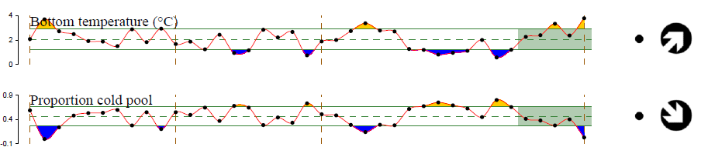
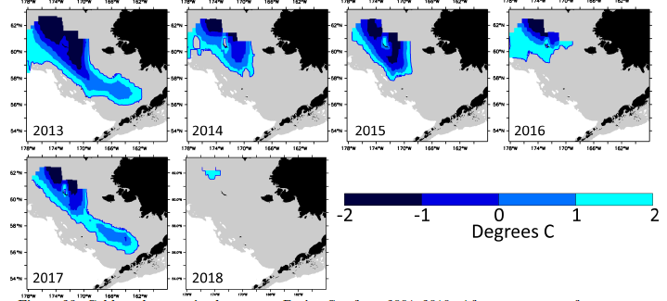
Tanner Crab West
Summer bottom temperatures were above average in 2018, and the warmest in the 39-year time series.
The cold pool extent was also one of the lowest on record in the west of 166°W management area.

Slide 15
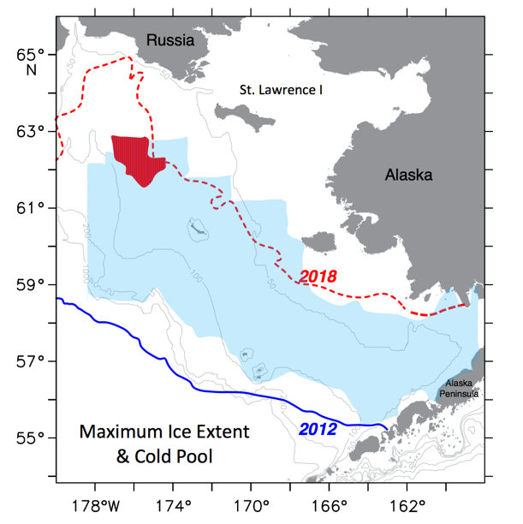

Slide 16
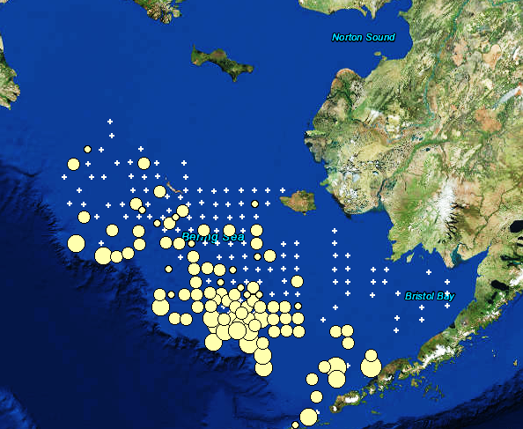
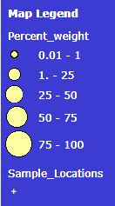
Pacific cod predation
Pacific cod predation on tanner crab has remained high since 2010

Slide 17
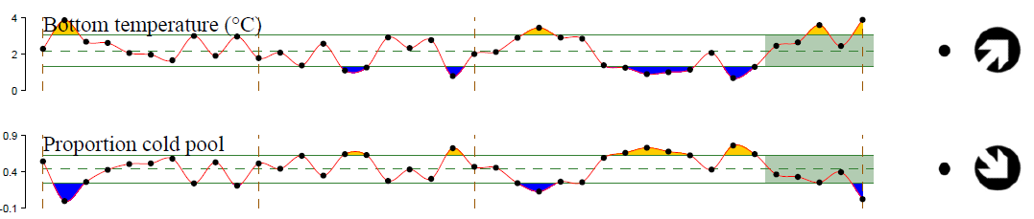
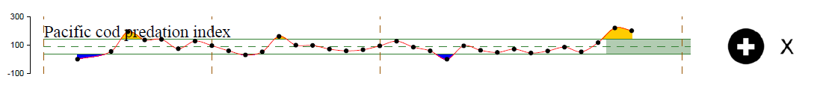
Snow crab
The 2018 total snow crab biomass was well above the long-term average but what effects will warming and reduced sea ice have on snow crab?

Slide 18
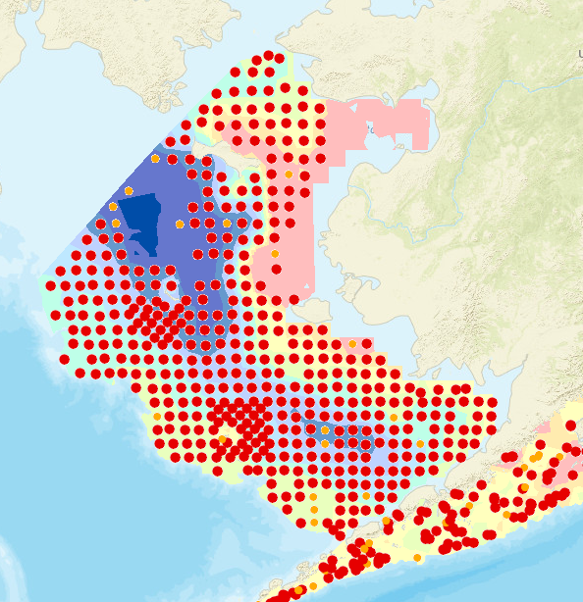
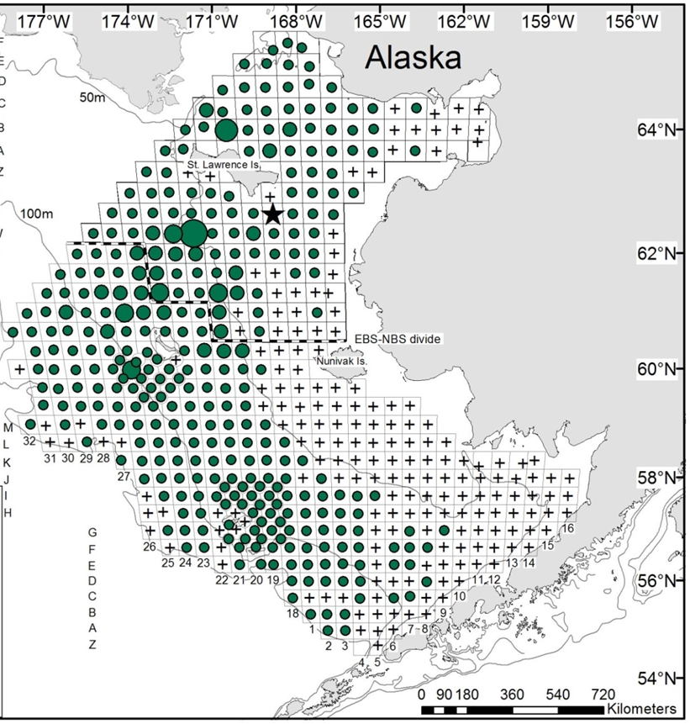
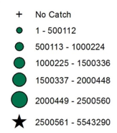
2017 Pacific cod catches
2017 snow crab density
Catch > 1 KG/HA

Slide 19
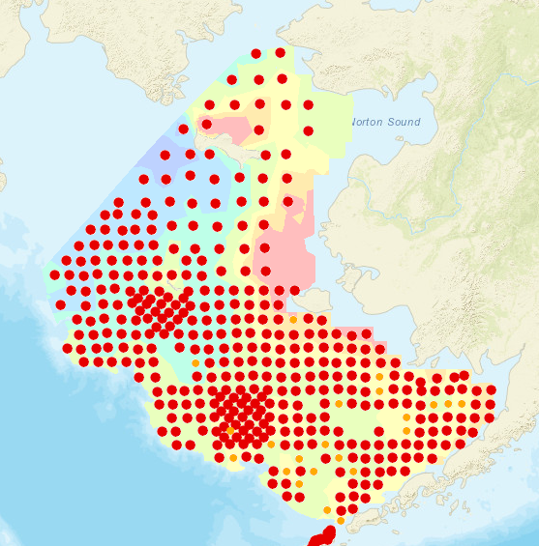
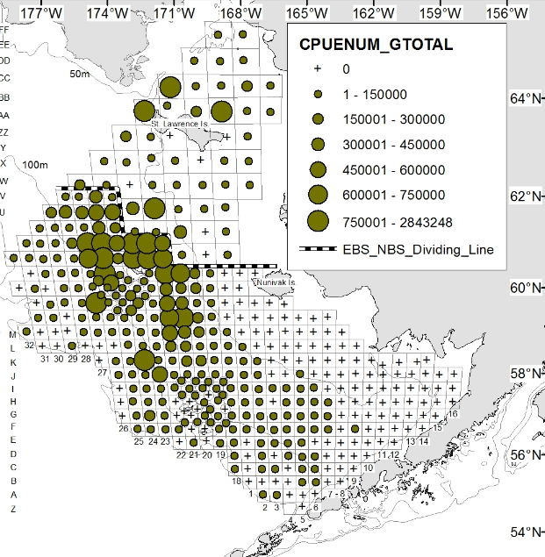
2018 Pacific cod catches
2018 snow crab density
What will predation index look like for 2018? Data coming soon!

Slide 20
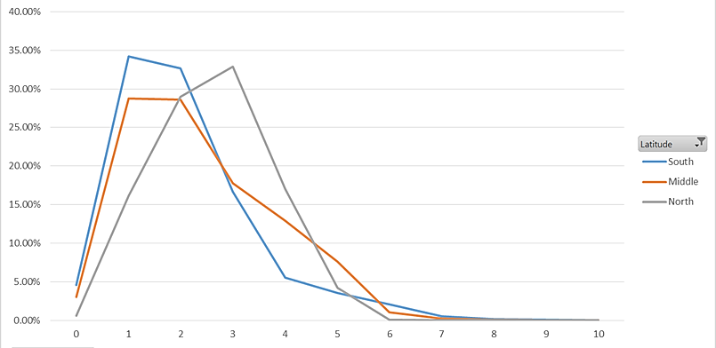
% Frequency of snow crab in Pacific cod stomachs
40%
35%
30%
25%
20%
15%
10%
5%
0%
EBS Domains:
South
Middle
North
% frequency
0 10 20 30 40 50 60 70 80 90 100
C. opilio CW (mm)

Slide 21
Indicator development:
Revisions to current indicators
Further refine species included in foraging guilds?
Predation index
  Incorporate predator/prey lengths
  Determine annual average Partial Fullness index (BF) values for crab prey by weighting by NOAA BT survey biomass estimates (Buckley et al. 2016)
CV of pre-recruit biomass: Likely not appropriate due to highly skewed biomass data
  Instead, use standard deviation of log-transformed data (Litzow et al. 2013)

Slide 22
Ongoing discussion:
Identify and develop additional indicators for each stock
Ben Daly indicator development efforts for BBRKC
Spatially refine additional indicators used in Ecosystem Considerations chapter?
Any additional crab-relevant time series?
Ongoing/future data collection for additional indicators

Slide 23
BBRKC ovigerous female dispersion indicator
Extent of population relative to total abundance
Loher and Armstrong 2005
ACWD (Average Central Weighted Distribution):
Lat + Long weighted by RKC abundance, then averaged
Implications for larval advection, mating success, spatial overlap with predators, etc

Slide 24
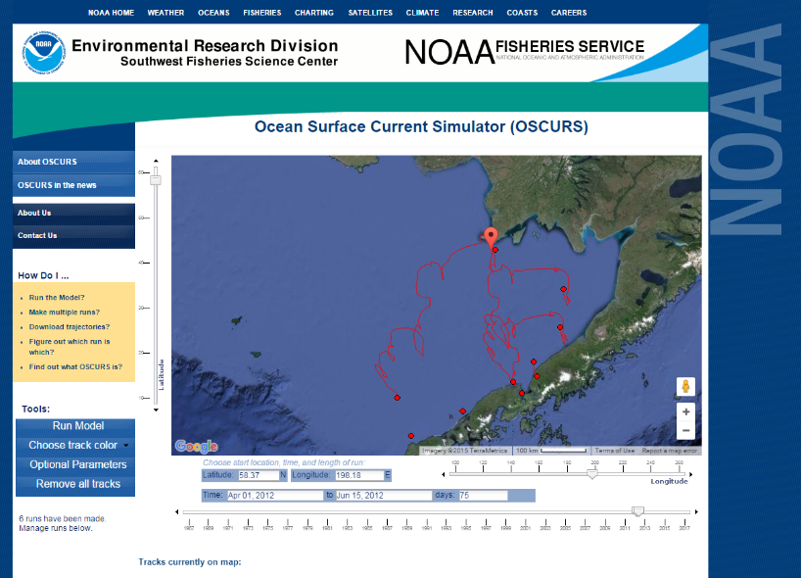
Larval advection indicator
Impacts larval advection trajectories, settlement strength, recruitment
OSCURS or ROMS model time series runs
  Pick a spot, track advection for a set time span
  Quantify distance traveled, direction, etc.

Slide 25
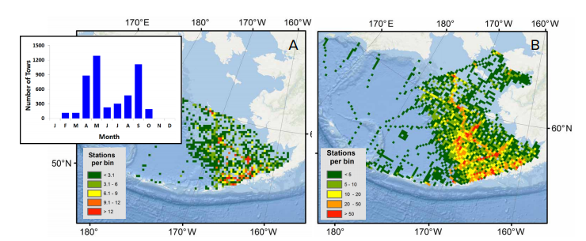
Larval crab abundance indicator
Potential indication of recruitment strength
EcoFoci spring ichthyoplankton survey likely overlaps temporally with early life history stages of EBS crab stocks

Slide 26
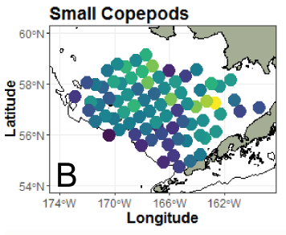
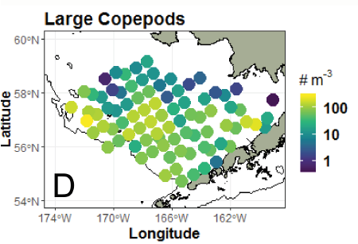
Primary/secondary production indicator
Index for food availability for crab larvae
Phytoplankton- Chl a estimates
Zooplankton- EcoFoci Rapid Zooplankton Assmt

Slide 27
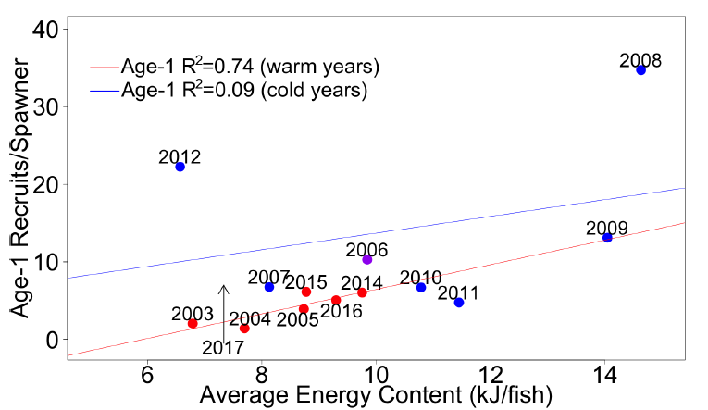
Body condition indicator for crab stocks?
Energetic condition of pollock prior to their first
winter predicts their survival to age-1

Slide 28
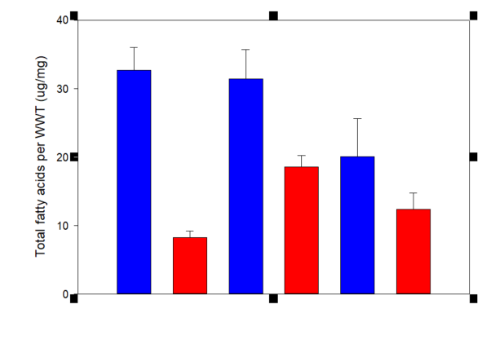
Chionoecetes body condition indicator
P<0.001
P=0.02
P=0.25
Snow Hybrid Tanner
C. opilio
C. bairdi
Snow and tanner crab showed a decrease in lipids (i.e. body condition) between 2012 (cold) and 2014 (warm)
Copeman et al.

Slide 29
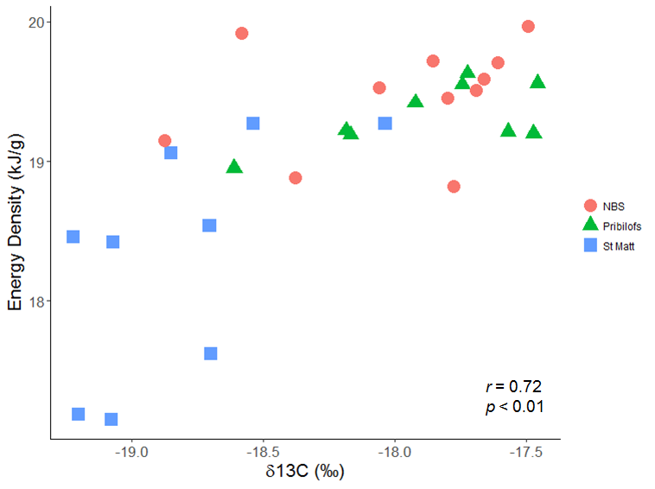
Benthic prey indicator?
A significant positive correlation between snow crab energy density and stable δ¹³C isotope values suggests that energetic condition is improved with the use of benthic (i.e. algal and detrital-based) carbon sources

Slide 30
Next Steps
Continued empirical data collection
  Indicator development and selection directly influenced by the extent of knowledge and available data
Develop additional indicators for each stock and produce report cards for remaining stocks
  -Indicator selection, threshold setting and evaluation
Long term vision: develop quantitative multivariate indicators for inclusion in stock assessment development and decision making during annual quota setting

Slide 31
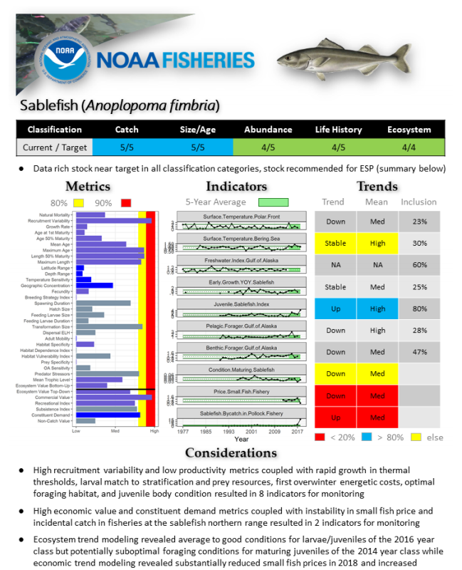
New Direction: ESP’s
A new standardized framework termed the ecosystem and socioeconomic profile (ESP) has recently been developed to serve as a proving ground for testing ecosystem and socioeconomic linkages within the stock assessment process
(Shotwell et al., In Prep).

Slide 32
Questions moving forward:
Additional indicators?
Priorities for ongoing/future empirical data collection?
Are these spatially explicit report cards of value to management decisions/quota setting?
Proceed with additional stocks or prioritize indicator development for current 4 stocks?
Adopt ESP framework for each stock moving forward?
Timeline:
  Annual report cards and supporting documentation produced annually for May CPT meeting?
  Update for September to include in SAFE chapters?

