Slide 1
Errors in shell condition classification
Jon Richar and Chris Long
NOAA/AFSC

Slide 2
Shell condition used as a proxy for time since last molt
Classification based on established standards but…
  Remains highly subjective
  Many borderline crab due to environmental and biological factors
    (SC2/3, 3/4/,4/5)
As a consequence, classification errors are expected

Slide 3
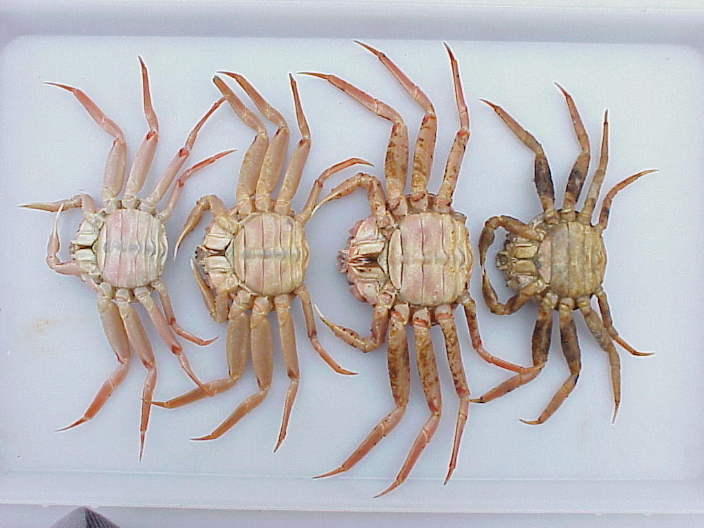
SC 2-5

Slide 4
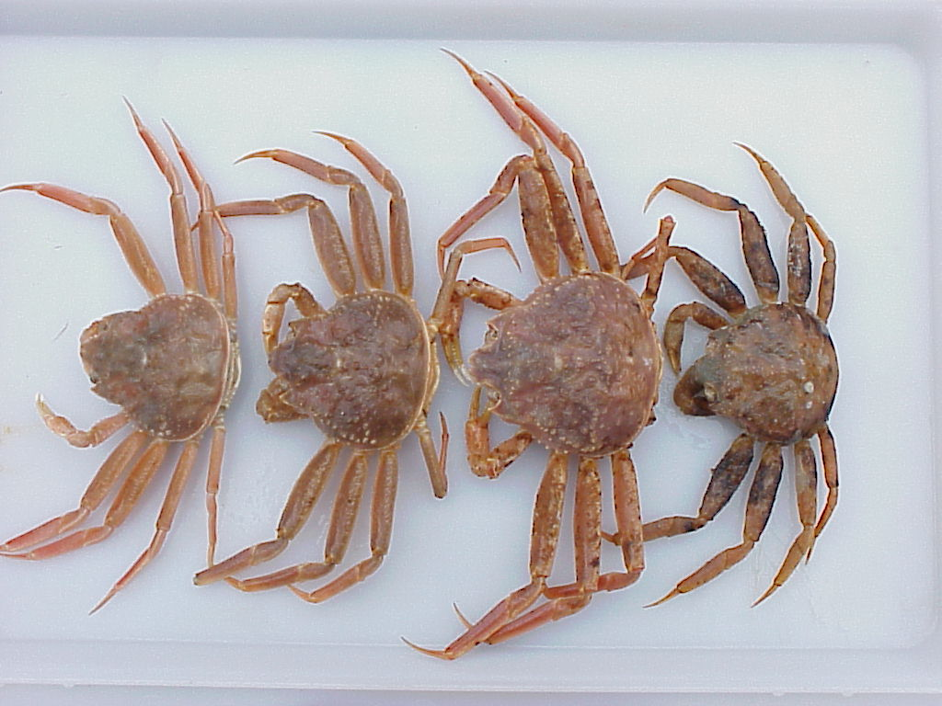
SC 2-5

Slide 5
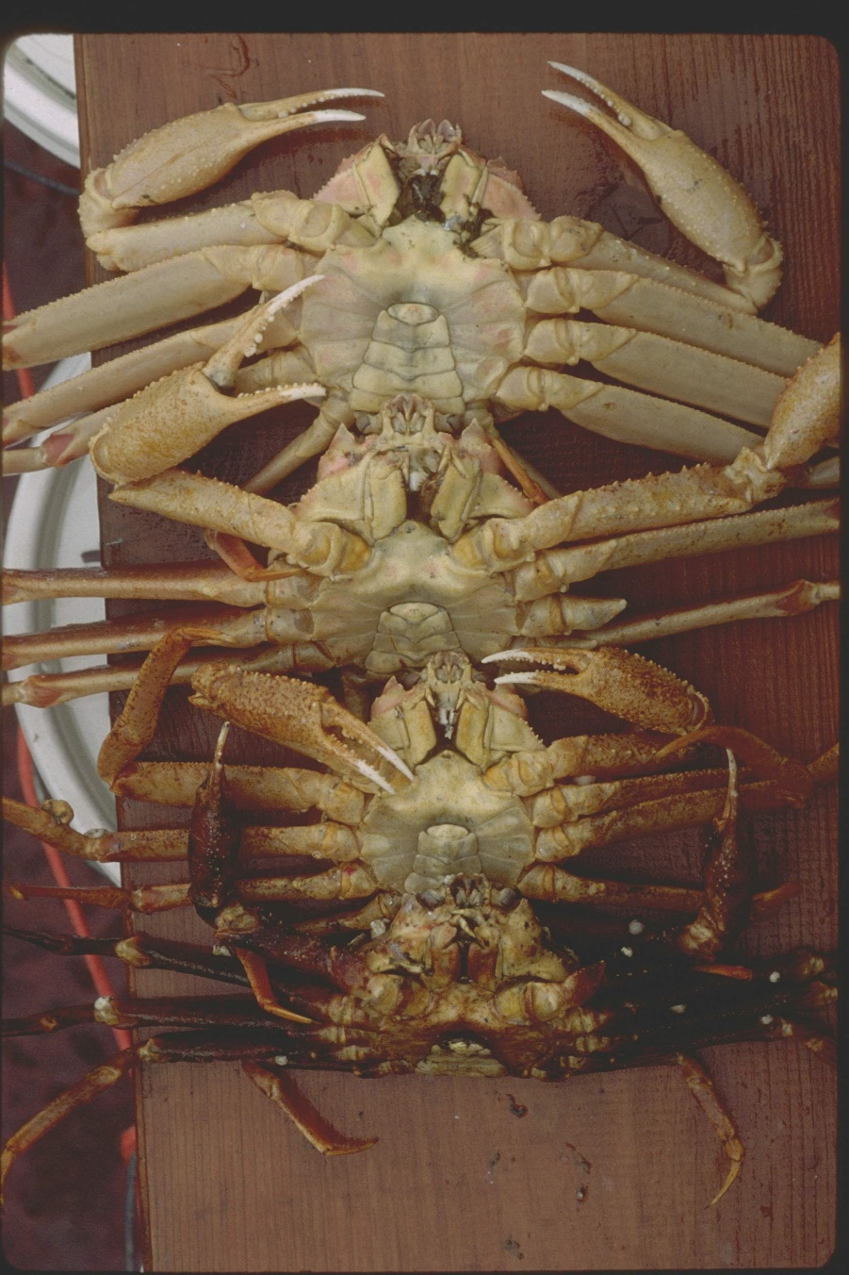
SC 2-5
Color
Degree of wear (scratches, worn chela/dactyls)
  Differs with substrate
Epifauna
  Temperature dependent
  Habitat dependent
Shell disease

Slide 6
Despite likelihood of errors, little focused research
Fonseca et al. 2008
  Opilio crab tagged and released
  27 recaptured shortly thereafter by same crew
  25 assigned same SC as at capture
    One SC3 crab reclassified as SC2 at recapture,
    One SC4 crab reclassified as SC3
  Error rate of ~7.5%

Slide 7
Consequences of classification errors dependent on
  Directionality of error
  How data are being used
  Fishery management most affected by errors in SC2/3 crab
    Harvest rates
    Limited potential to be affected by SC5 errors in some circumstances
      Maximum age/mortality rates
  Research can be affected by errors at any shell condition

Slide 8
SC2/3
SC2 classed as newshell or ”recruit” category for modeling
SC3 classed as old shell or “post-recruit” category
SC3 -> SC2 may overestimate recruitment, while underestimating size of the post-recruit group
  Overestimation of harvest rate in models
SC2->SC3 may lead to underestimation of recruit group, and overestimation of post-recruit
  Underestimation of harvest rates

Slide 9
SC2/3 continued
Maturity analyses
Combine shell condition and morphometrics to determine maturity
  SC2 crab above a morphometric threshold will be considered to have matured that year
  SC3 crab, the previous year
SC2 -> SC3: new shell crab will be excluded, representing lost data
SC3 -> SC2: old shell crab will be erroneously included, potentially biasing maturity analysis
SC2->SC3 may also lead to overestimating skip molt rates (implications for growth)

Slide 10
SC3/4
SC4 -> SC3: may inflate postrecruit category in modeling, unless they are already pooled as part of modeling process.
May (further) complicate tracking pseudohorts in a population as they age
Source of error in estimates of female reproductive output, as generally declines with increasing shell condition after SC3

Slide 11
SC4/5
Errors between these categories may complicate mortality rate estimates
Ernst et al. radiometric data suggests these crab may be of similar age

Slide 12
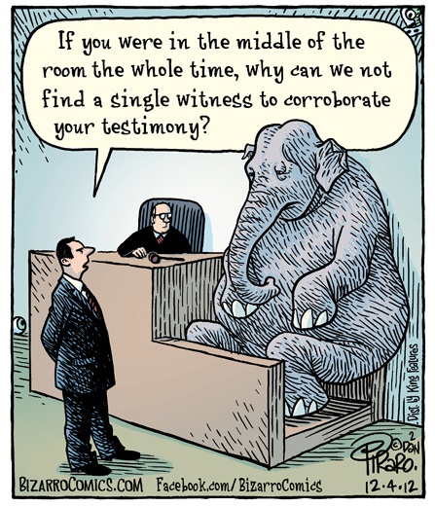
Questions?

Slide 13
References
Ernst, B, Orensanz, J.M., and Armstrong, D.A. 2005. Spatial dynamics of female snow crab (Chionoecetes opilio) in the eastern Bering Sea. Can. J. Fish. Aquat. Sci. 62: 250-268.
Fonseca, D.B., Sainte-Marie, B., and Hazel, F. 2008. Longevity and change in shell condition of adult male snow crab Chionoecetes opilio inferred from dactyl wear and mark-recapture data. Trans. Amer. Fish. Soc. 137: 1029-1043.
Zheng, J, Rumble, J.M., and Bishop G.H. 2006. Estimating southeast Alaska tanner crab abundance using pot survey and commercial catch data. Alsk. Fish. Res. Bull. 12: 196-211.

