Slide 1
GMACS Update
André E. Punt
School of Aquatic and Fishery Sciences
University of Washington

Slide 2



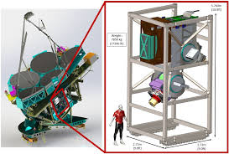

What is GMACS not!
The Giant Magellan Telescope Multi-object Astronomical and Cosmological Spectrograph

Slide 3
What is GMACS-I
ADMB software that implements a generalized stock assessment platform for size-structured assessment.
  Generalized in that it is (relatively) easy to add new features (e.g. types of selectivity patterns, assumptions about time-trends in M).
  Generalized in that all input is via three files (.DAT, .CTL and .PRJ) and no quantities are “hard-wired”.
  Generalized in that it is easy to conduct phasing and placing bounds on parameters.

Slide 4
What is GMACS-II
Fully open-source (on github – though the version is a bit out of date)
Routines to automatically produce diagnostics plots to evaluate fits and summarize model results (not currently fully functional)
Process to (easily) evaluate sensitivity to alternative assumptions.
(Ultimately) routines to generate pseudo data sets to test model performance.

Slide 5
Current Status of GMACS
GMACS has been used for the last two assessments for St Matthew Island blue king crab (single sex; three size-classes; limited fleets)
GMACS is being considered for application (in September 2019) to data for Bristol Bay red king crab (two sexes; 26 size-classes; multiple fleets; many data types)
Much of the basic coding is done (and tested), but a major extension is to allow for a terminal molt (required for snow and Tanner crab)
In principle, inclusion of a terminal molt should not impact (a) the input files much, and (b) the results of current assessments.

Slide 6
Core file structure
Input files
GMACS.DAT: Contains the names of three files: a data file (e.g. “x.DAT”), a control file (x.CTL), and a projection file (x.PRJ).
The data file contains the dimensions of the problem and all the data.
The control file contains the specifications of the model (e.g. which parameters to estimate, selectivity patterns to assume, bounds, phases, etc.)
The projection file lists the specifications for forecasts and OFL/ABC calculations.
Output files
Checkfile.rep: A file that repeats much of the input – if your read-in files fail, look at this file.
Gmacs_in.dat & gmacs_in.ctl: Your data and control rules reformatted (perhaps wrongly)
Gamsall.out: The output file – in generalized format – read it into R and search for the labels (no hard-coding as this file is continually under development).

Slide 8
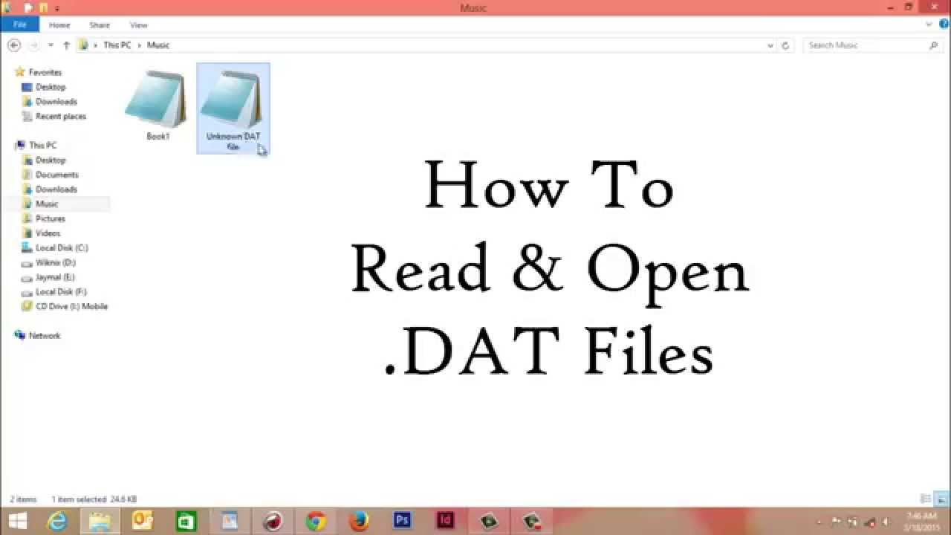
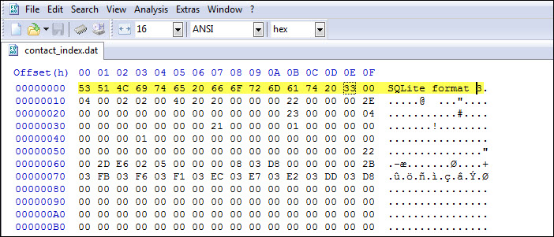

The DAT File

Slide 9
Broad structure
Dimensions
Length of each of the annual seasons
Catch data
Index data
Length-frequency data
Growth data
Custom specifications (need to move to the CTL file)
Note: The “type-1” weights are specified in the DAT file, “type 2” in the control file

Slide 10
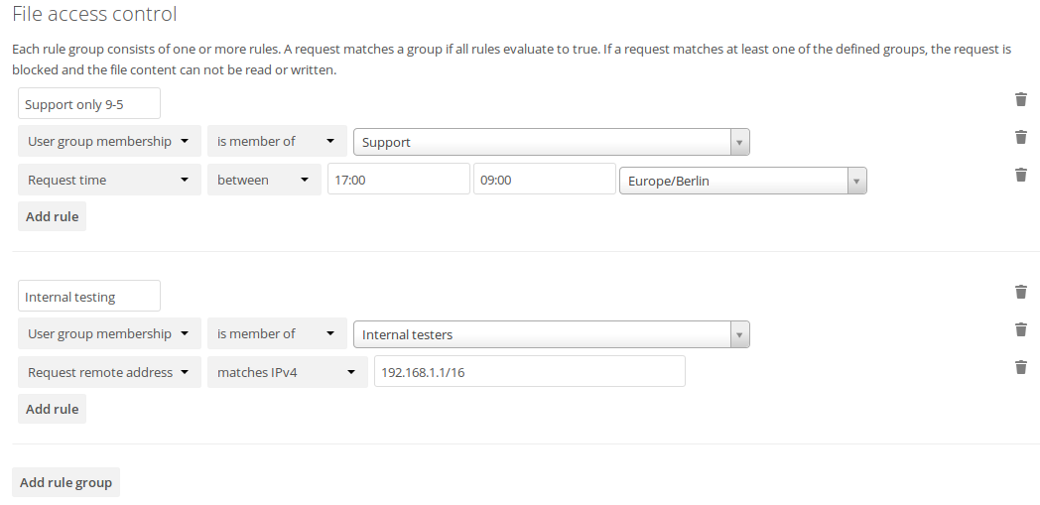
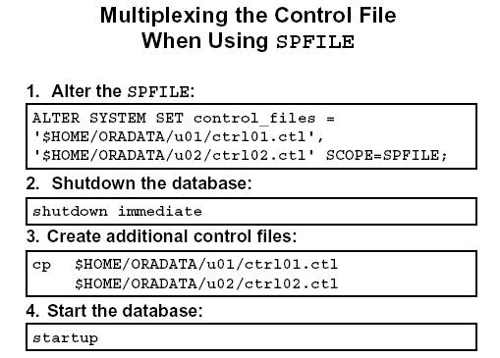
The CTL File

Slide 11
Broad structure
Core parameters
Length and weight specifications
Growth
  Transition matrix and molting probability (time-varying)
Selectivity and retention
Survey catchability and additional CVs
Fishing mortality priors
Size-composition specifications
Natural mortality
Weighting factors

Slide 12
Core (theta) parameters
The Core parameters provide the overall scaling of the population and also specify how recruitment is parameterized. The first input is the number of theta parameters
## ntetha
9
For each parameter you need to specify:
Initial value
Lower and upper bounds
Phase (negative means pre-specify)
Prior (0=uniform; 1=normal; 2=lognormal; 3=beta; 4=gamma)
Parameters of the prior

Slide 13
Core (theta) parameters
## ival lb ub phz prior p1 p2 # parameter ##
## ———————————————————————————————##
0.18 0.15 0.2 -4 2 0.18 0.04 # M
16.5 -10 18 -2 0 -10.0 20.0 # logR0
18.0 -10 25 3 0 10.0 20.0 # logRini, to estimate if NOT initialized at unfished (n68)
16.5 -10 25 1 0 10.0 20.0 # logRbar, to estimate if NOT initialized at unfished
72.5 55 100 -4 1 72.5 7.25 # recruitment expected value (males or combined)
0.726149 0.32 1.64 3 0 0.1 5.0 # recruitment scale (variance component) (males or combined)
0.00 -5 5 -4 0 0.0 20.00 # recruitment expected value offset (females)
0.00 -1.69 0.40 3 0 0.0 20.0 # recruitment scale offset (variance component) (females)

Slide 14
Growth parameters-I
Options for setting the growth and size-transition matrices
Option 1: Pre-specify the growth-transition matrix (uses the estimated molt probability)
Option 2: Pre-specify the size-transition matrix directly (molt probability is ignored)
Option 3: The growth-transition matrix is based on gamma-distributed increments (size-increment is gamma)
Option 4: The growth-transition matrix is based on gamma-distributed increments (size after increment is gamma)
Option 5: The growth-transition matrix is based on kappa varying among individuals
Option 6: The growth-transition matrix is based on L∞ varying among individuals
Option 7: The growth-transition matrix is based on kappa and L∞ varying among individuals
Option 8: The growth-transition matrix is based on normally-distributed increments (size after increment is normal)

Slide 15
Growth parameters-II
Options for setting the growth increment model
Option 0: No estimated parameters
Option 1: Three parameters for each growth-increment matrix
Option 2: One parameter per class (plus one for the scale parameter of the beta distribution)
Option 3: Same as Option 2! Except growth data do not appear in the likelihood
Option 4:
Option 5: L∞, Kappa, the variance of Kappa for each growth-increment matrix
Option 6: L∞, Kappa, the variance of L∞ for each growth-increment matrix
Option 7: L∞, Kappa, the variance of Kappa and L∞ for each growth-increment matrix

Slide 16
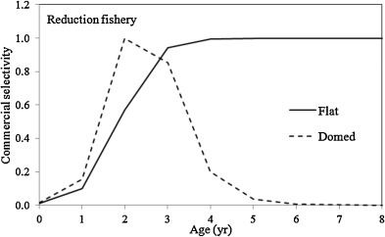
Selectivity and retention parameters-I
Specifying selectivity and retention has three stages:
Specify the type of selectivity pattern (all fisheries and surveys), along with whether they depend on sex / vary with time / etc
Specify how the parameters should be estimated (selectivity then retention)
Specify any asymptotic discard parameters

Slide 17
Selectivity and retention parameters-II
There are 11 rows of inputs (one column for each fishery / survey)
Selectivity-specific
Number of time blocks for selectivity (minimum 1)
Is selectivity sex-specific? (1=yes; 0=no)
Male selectivity pattern (parameters per block)
  0=“parametric” (nclass); 1=individual parameter for each class (nclass); 2=logistic type 1 (2); 3=logistic type 2 (2); 4=double normal (3); 5=uniform=1 (1); 6=uniform=0 (1)
Female selectivity pattern (as above)
Within another gear (point to a gear number within which the current gear is nested – used to model BSFRF surveys)

Slide 18
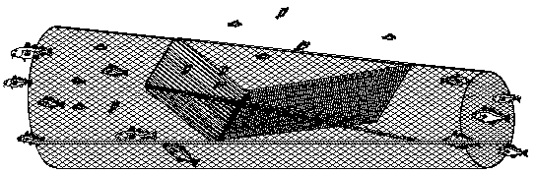
Selectivity and retention parameters-III
There are 11 rows of inputs (one column for each fishery / survey)
Retention-specific
Number of time blocks for retention (minimum 1)
Is retention sex-specific? (1=yes; 0=no)
Male retention pattern (as above)
Female retention pattern (as above)
Are males retained? (1=Yes; 0=No)
Are females retained? (1=Yes; 0=No)
www.fao.org

Slide 19
Time-varying natural mortality-I
The options for time-varying natural mortality are:
## 0 = constant natural mortality
## 1 = Random walk
## 2 = Cubic Spline
## 3 = Time blocks in M relative to the base M (see theta section); blocks are cumulative
## 4 = Time blocks in M (absolute values are estimated)
## 5 = Changes in M for specific years relative to the base M (see theta section)
## 6 = Time blocks in M relative to the base M (see theta section); blocks are not
cumulative

Slide 20
Time-varying natural mortality-II
## 0:
## 1:
## 2:
## 3:
## 4 :
## 5 :
## 6 :

Slide 21
Other Controls
1975 # First rec_dev
2017 # last rec_dev
2 # Estimated rec_dev phase
-3 # Estimated rec_ini phase
1 # VERBOSE FLAG (0 = off, 1 = on, 2 = objective func; 3 diagnostics)
3 # Initial conditions (0 = Unfished, 1 = Steady-state fished, 2 = Free parameters, 3 = Free parameters (revised))
1 # Lambda (proportion of mature male biomass for SPR reference points).
1 # Use empirical molt increment data (0=FALSE, 1=TRUE)
0 # Stock-Recruit-Relationship (0 = none, 1 = Beverton-Holt)
10 # Maximum phase (stop the estimation after this phase).
-1 # Maximum number of function calls

Slide 22
Emphasis factors
## EMPHASIS FACTORS (Catch)
#Ret_male Disc_male Disc_female Disc_trawl Disc_Tanner_male Disc_Tanner_female Disc_fixed
1 1 1 1 1 1 1
## ————————————————————————————————————————————————————
## EMPHASIS FACTORS (Priors)
# Log_fdevs meanF Mdevs Rec_devs Initial_devs Fst_dif_dev Mean_sex-Ratio
10000 0 1 2 0 0 10
Recommended

Slide 23
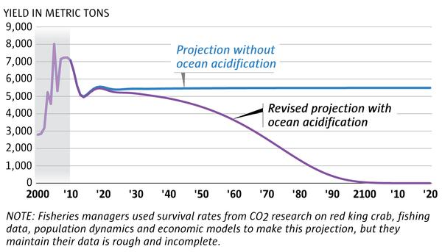
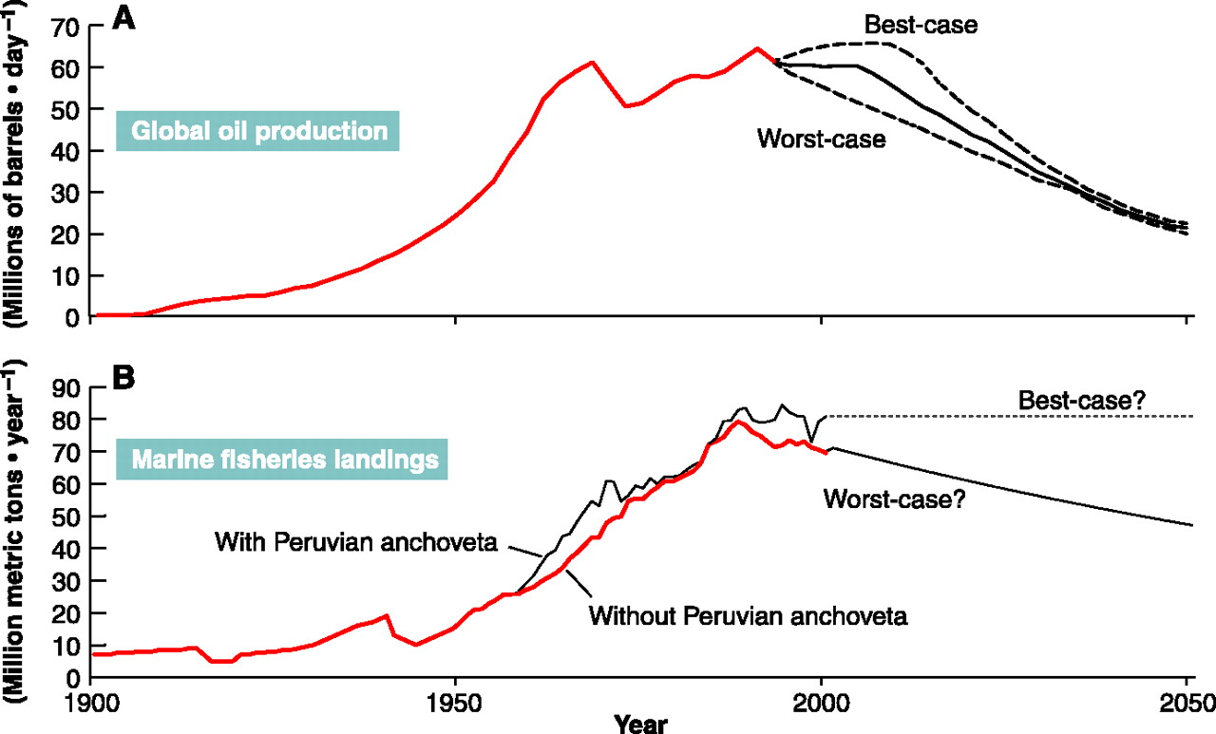
The PRJ File

Slide 24
Broad structure
Which fleets are managed.
OFL and ABC control rules (and yield curve).
What strategies to consider:
  range of target Fs;
  State Strategy usage; and
  use or ignore bycatch mortality
Assumptions about future recruitment

Slide 26
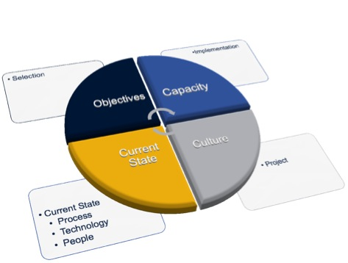
Current status

Slide 27
Current Status
Multiple changes since the September 2018 CPT meeting and the January 2019 workshop. Key highlights:
Instantaneous mortality is now correctly (I think) implemented
Additional options for selectivity, retention and growth added (all selected in the CTL file)
Input files modified so that only data appear in the DAT file and all parameter specification is via the CTL file.
An additional example has been created (for the January 2019 course)
All base models converge with low final maximum gradients and there is no evidence for differentiability issues.

Slide 28
Instantaneous vs continuous F
Discrete fishing mortality
Total mortality
Retained catch
Discarded catch (but may live)
Survival

Slide 29
Instantaneous vs continuous F
Continuous fishing mortality
Total mortality
Retained catch
Discarded catch (but may live)
Survival

Slide 31
Projections
Calculating Generation Time
Including a stock-recruitment relationship
Projections for St Matts blue king crab

Slide 32
Generation Time-I
Generation time is defined as a the average AGE of spawners in an unfished state, i.e.:”
Numbers-at-age
Fecundity-at-age

Slide 33
Generation Time-II
For crab we have some complexities (!), (a) growth is length-structured, (b) recruitment is not at age-0, and (c) spawning occurs on 15 February each year so generation time is:
Lets us assume that (a) recruitment is for one cohort (age at Y) and (b) all recruitment
is to size-class 1, i.e.:

Slide 34
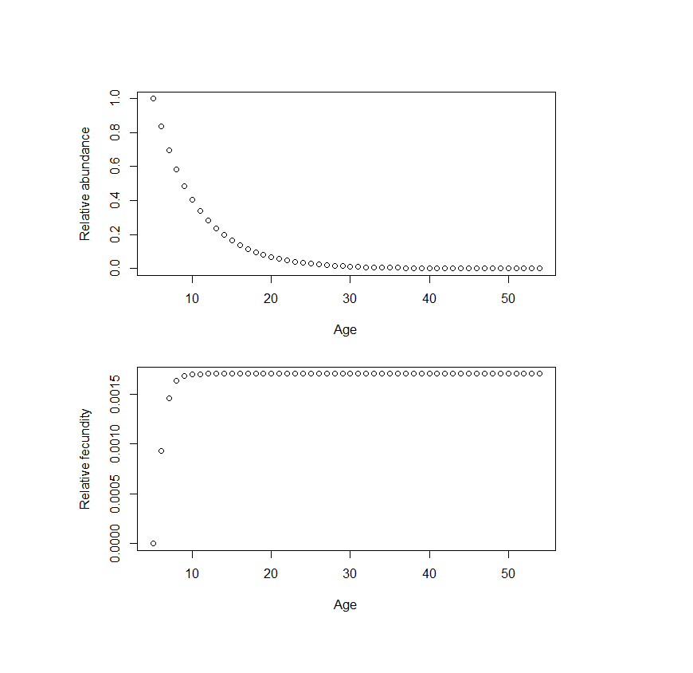
Generation Time-III
For St Matthews Blue king crab, the average generation time is 11.59 years assuming an age-at-recruitment if 5

Slide 35
Stock-recruitment relationship
This is parameterized so that F_{MSY} equals the F_{MSY} proxy and B_{MSY} equals the B_{MSY} proxy, i.e. first solving for “steepness” such as that:
Then finding equilibrium recruitment such that:

Slide 36
Decision points for projections (Status)
What range of years for computing average bycatch mortality in groundfish fisheries?
  5 most recent years (recommended approach) [Specified ]
  Long-term: 1991-present [This can be specified in the .PRJ file]
What range of years for computing selectivity in the directed fishery?
  Recommended approach: use 2017
How do we want to estimate recruitment?:
  Ricker/Hockey stick SR model? [See above]
  Randomly select from historical model estimates?
    What range of years? [The range of years can be specified in the PRJ file]
      Full time series
      Most recent “stanza”: 1995-2016
      Rebuilding period: 1999-2008
What range of F? 0.0 - 0.18
  F=0, then add groundfish bycatch, then add in state HS for directed fishery
  [The number of Fs and their range is given in the PRJ file; no state HS (or ABC) yet]
How many years for projections?
  10 yrs
  10 yrs + regeneration time (~8 yrs-ish)
  100 yrs
  [Project length (final project year) is specified in the PRJ file – now]

Slide 37
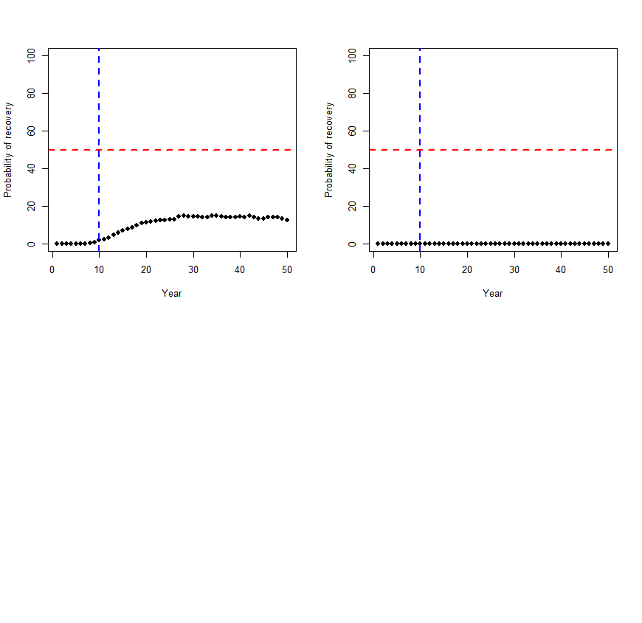


Recruitment 1999-2008; with future bycatch mortality; 2 year recovery
Recruitment 1999-2008; no future bycatch mortality; 1 year recovery
Recruitment 1999-2008; no future bycatch mortality; 2 year recovery

Slide 38
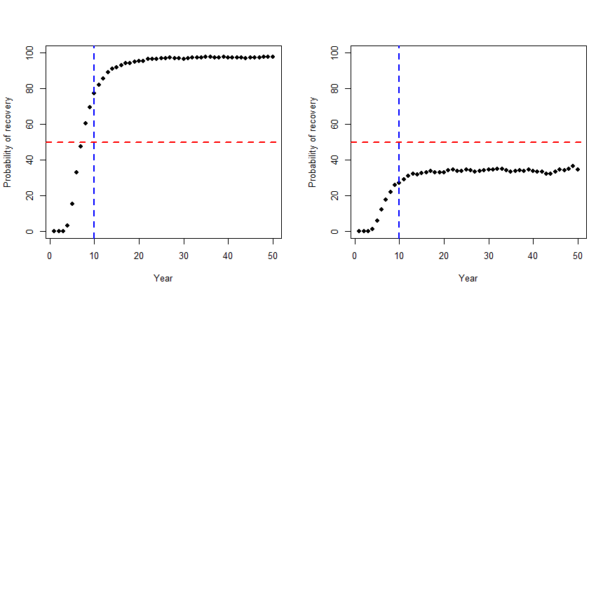
Conclusion – recruitment matters (a lot)
Recruitment 1978-2017; with future bycatch mortality; 2 year recovery

Slide 40
Key next steps (from the January CPT meeting)
High and very priority (all completed)
Implement MCMC sampler output dump (very high priority, St Matts rebuilder)
Give the entire program a careful final check (and see if changes impact the results of current examples
Finalize implementation of the calculation of reference points (Tier 3 and 4; F_{35%})
Finalize implementation calculation of OFLs
Create a forecast file (Tier, buffer, etc)

Slide 41
Key next steps
Medium priority
Completed
  Finalize implementation of labels in the code (e.g. MALES instead of 1)
  Sex – and length-class-specific basal M
  Implement a fished and unfished initial size-structure option
In progress
  Check graphical summaries still work (May 2019)
  Test Pribilof Island red king crab (May 2019)
  St Matts update assessment (May 2019; Zheng and Ianelli)
  BBRKC update assessment (May 2019; Zheng, Siddeek, etc)
  Technical Appendix for the model specifications (Sept 2019?)
  St Matts update assessment (Sept 2019; Zheng and Ianelli)
  BBRKC update assessment (Sept 2019; Zheng , Siddeek, etc)

Slide 42
Key next steps
Desirable priority
Implement Golden king crab (Sept 2019)
Implement terminal molt (Buck and Cody)
Implement Norton Sound red king crab

