Slide 1
GMACS-1
Andre E. Punt
School of Aquatic and Fishery Sciences
University of Washington

Slide 2



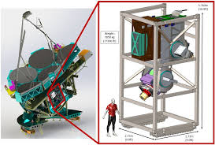
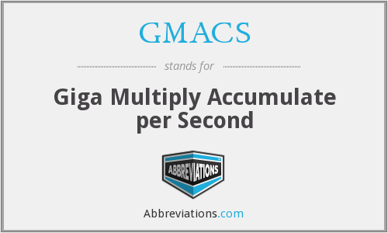
What is GMACS not!
Some of you may wish to leave about now
The Giant Magellan Telescope Multi-object Astronomical and Cosmological Spectrograph

Slide 3
What is GMACS-I
ADMB software that implements a generalized stock assessment platform for size-structured assessment.
  Generalized in that it is (relatively) easy to add new features (e.g. types of selectivity patterns, assumptions about time-trends in M).
  Generalized in that all input is via two files (.DAT and .CTL) and no quantities are “hard-wired”.
  Generalized in that it is easy to conduct phasing and place bounds on parameters.

Slide 4
What is GMACS-II
Fully open-source (on github – though the version is a bit out of date)
Routines to automatically produce diagnostics plots to evaluate fits and summarize model results (not currently fully functional)
Process to (easily) evaluate sensitivity to alternative assumptions.
(Ultimately) routines to generate pseudo data sets to test model performance.

Slide 5
Current Status of GMACS
GMACS has been used for the last two assessments for St Matthew Island blue king crab (single sex; three size-classes; limited fleets)
GMACS is being considered for application (in September 2019) to data for Bristol Bay red king crab (two sexes; 26 size-classes; multiple fleets; many data types)
Much of the basic coding is done (and tested), but a major extension is to allow for a terminal molt (required for snow and Tanner crab)
In principle, inclusion of a terminal molt should not impact (a) the input files much, and (b) the results of current assessments.

Slide 6
Core file structure
Input files
GMACS.DAT: Contains the names of two files: a data file (e.g. “x.DAT”) and a control file (x.CTL).
The data file contains the dimensions of the problem and all the data.
The control rule contains the specifications of the model (e.g. which parameters to estimate, selectivity patterns to assume, bounds, phases, etc.)
Output files
Checkfile.rep: A file that repeats much of the input – if your read-in files fail, look at this file.
Gmacs_in.dat & gmacs_in.ctl: Your data and control rules reformatted (perhaps wrongly)
Gamsall.out: The output file – in generalized format – read it into R and search for the labels (no hard-coding as this file is continually under development).

Slide 8
Current Status
Multiple changes since the September 2018 CPT meeting and even the January 2019 workshop. Key highlights:
Instantaneous mortality is now correctly (I think) implemented
Additional options for selectivity, retention and growth added (all selected in the CTL file)
Input files modified so that only data appear in the DAT file and all parameter specification is via the CTL file.
An additional example has been created (for the January 2019 course)
All base models converge with low final maximum gradients and there is no evidence for differentiability issues.

Slide 9
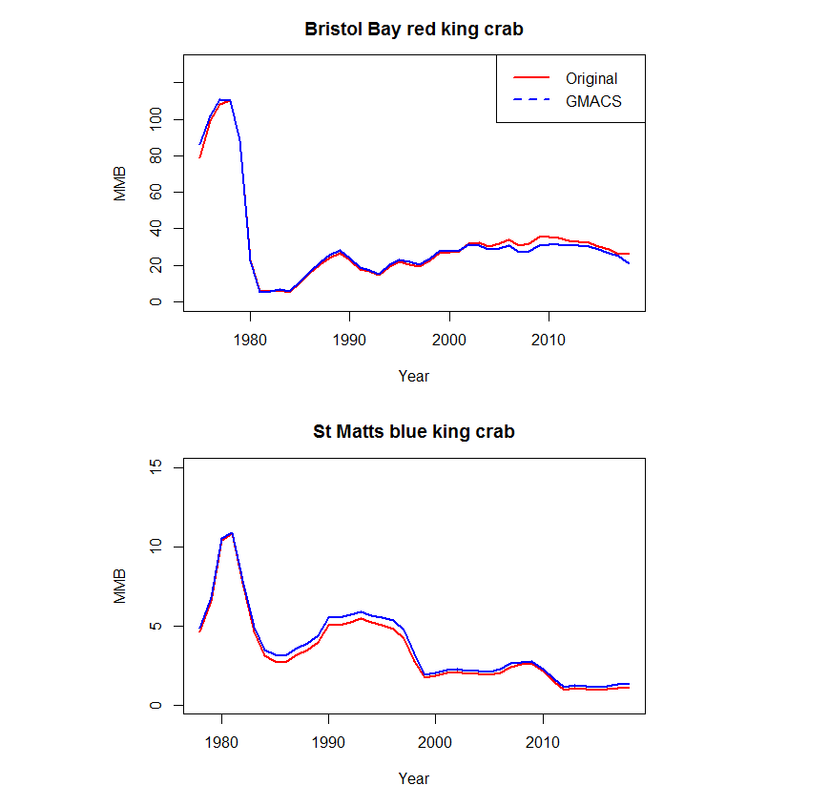
The Bottom Line
Bristol Bay red king crab (2018)
Original: 20,859t (instantaneous)
GMACS: 26,325t (continuous)
St Matt Blue King Crab (2018)
Original: 1,309t
GMACS: 1,105t
Note that the models are not identically specified (e.g. different penalties)

Slide 10
Instantaneous vs continuous F
Discrete fishing mortality
Total mortality
Retained catch
Discarded catch (but may live)
Survival

Slide 11
Instantaneous vs continuous F
Continuous fishing mortality
Total mortality
Retained catch
Discarded catch (but may live)
Survival

Slide 13
Key next steps
High and very priority
Implement MCMC sampler output dump (very high priority, St Matts rebuilder) [ Target Feb 17]
Give the entire program a careful final check (and see if changes impact the results of current examples [High priority, Target Feb 17]
Finalize implementation of the calculation of reference points (Tier 3 and 4; F_{35%}) [High priority, Target Feb 17]
Finalize implementation calculation of OFLs [High priority, Target Feb 17]
Create a forecast file (Tier, buffer, etc) [High priority, Target Feb 17]

Slide 14
Key next steps
Medium priority
Finalize implementation of labels in the code (e.g. MALES instead of 1) (May 2019)
Sex – and length-class-specific basal M (May 2019)
Implement a fished and unfished initial size-structure option (May 2019)
Check graphical summaries still work (May 2019)
Test Pribilof Island red king crab (May 2019)
St Matts update assessment (May 2019; Zheng and Ianelli)
BBRKC update assessment (May 2019; Zheng, Siddeek, etc)
Technical Appendix for the model specifications (Sept 2019?)
St Matts update assessment (Sept 2019; Zheng and Ianelli)
BBRKC update assessment (Sept 2019; Zheng , Siddeek, etc)

Slide 15
Key next steps
Desirable priority
Implement Golden king crab (Sept 2019)
Implement terminal molt (Buck and Cody)
Implement Norton Sound red king crab

