Slide 1
GMACS-2
(Thursday Morning)
Andre E. Punt
School of Aquatic and Fishery Sciences
University of Washington

Slide 2
Agenda Items
Calculating Generation Time
Including a stock-recruitment relationship
Projections for St Matts blue king crab

Slide 3
Generation Time-I
Generation time is defined as a the average AGE of spawners in an unfished state, i.e.:”
Numbers-at-age
Fecundity-at-age

Slide 4
Generation Time-II
For crab we have some complexities (!), (a) growth is length-structured, (b) recruitment is not at age-0, and (c) spawning occurs on 15 February each year so generation time is:
Lets us assume that (a) recruitment is for one cohort (age at Y) and (b) all recruitment
is to size-class 1, i.e.:

Slide 5
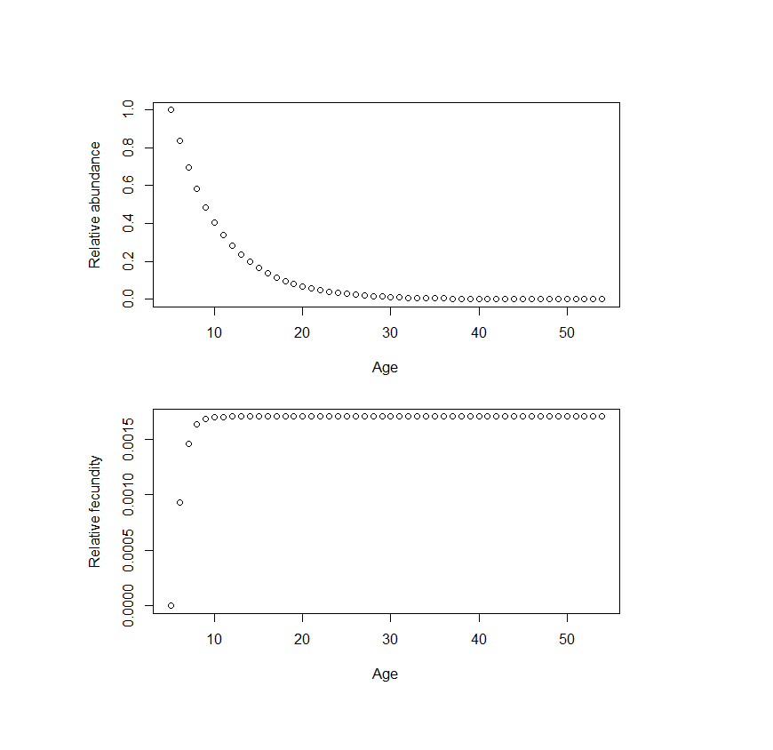
Generation Time-III
For St Matthews Blue king crab, the average generation time is 11.59 years assuming an age-at-recruitment if 5

Slide 6
Stock-recruitment relationship
If this is of interest (sigh), it could be parameterized so that F_{MSY} equals the F_{MSY} proxy and B_{MSY} equals the B_{MSY} proxy, i.e. first solving for “steepness” such as that:
Then finding equilibrium recruitment such that:
The per-recruit calculations already exist so it would be adding the numerical solution

Slide 7
Decision points for projections (Status)
What range of years for computing average bycatch mortality in groundfish fisheries?
  5 most recent years (recommended approach) [Specified ]
  Long-term: 1991-present [This can be specified in the .PRJ file]
What range of years for computing selectivity in the directed fishery?
  Recommended approach: use 2017
How do we want to estimate recruitment?:
  Ricker/Hockey stick SR model? [See above]
  Randomly select from historical model estimates?
    What range of years? [The range of years can be specified in the PRJ file]
      Full time series
      Most recent “stanza”: 1995-2016
      Rebuilding period: 1999-2008
What range of F? 0.0 - 0.18
  F=0, then add groundfish bycatch, then add in state HS for directed fishery
  [The number of Fs and their range is given in the PRJ file; no state HS (or ABC) yet]
How many years for projections?
  10 yrs
  10 yrs + regeneration time (~8 yrs-ish)
  100 yrs
  [Project length (final project year) is specified in the PRJ file – now]

Slide 8
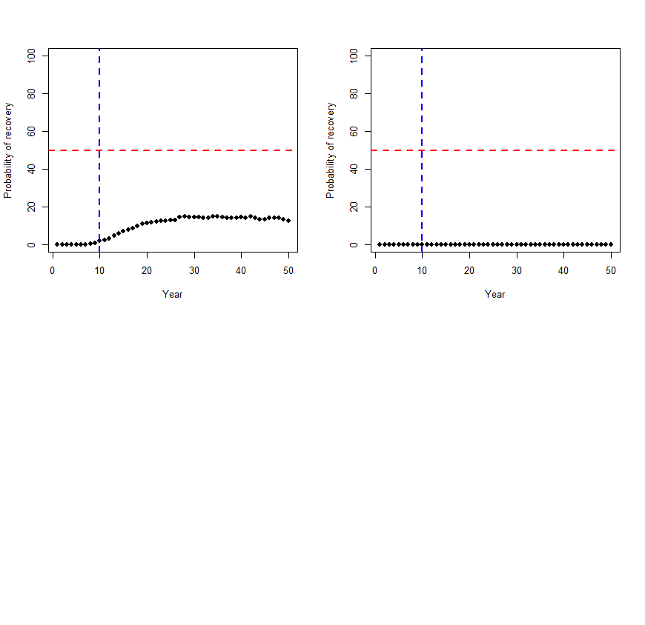


Recruitment 1999-2008; with future bycatch mortality; 2 year recovery
Recruitment 1999-2008; no future bycatch mortality; 1 year recovery
Recruitment 1999-2008; no future bycatch mortality; 2 year recovery

Slide 9
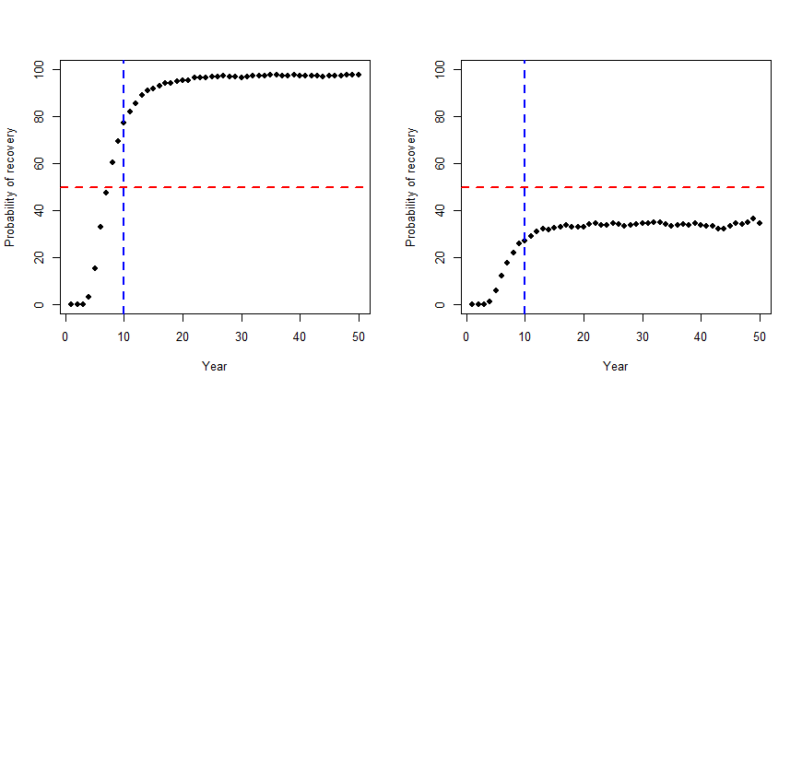
Conclusion – recruitment matters (a lot)
Recruitment 1978-2017; with future bycatch mortality; 2 year recovery

Slide 10
Decision points for projections
Bmsy estimate for each replicate or “best estimate”
  Both ways ultimately: do by replicate for now
  Recommended approach: by replicate
  [Whether you want a specified value or a simulation-specific set of values can be specified in the prj file]
How should we incorporate the state harvest strategy…..does this get converted into an F value? (yes) Does this F vary for each projection year? (yes)
  [No progress yet]
Define what “rebuilt” means……1 or 2 years above Bmsy?
  Recommended approach: we recommend 1 year above Bmsy, but let Council weigh in
  [This is done in the R code]
Need a list of desired outputs
  MMB, MMA, LMA, RETC (retained catch mortality), TOTC (total mortality), OFL, ABC, GFcatch, Bmsy
  [MMB and BMSY are output; working on RETC, TOTC and Gfcatch – Gfcatch dead?]
Need to double check catch input files
[Not me!]

