Slide 1
GMACS-1
Introduction to GMACS

Slide 2



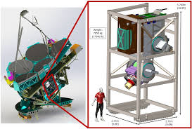
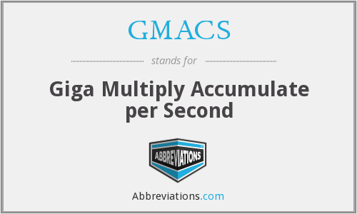
What is GMACS not!
Some of you may wish to leave about now
The Giant Magellan Telescope Multi-object Astronomical and Cosmological Spectrograph

Slide 3
What is GMACS-I
ADMB software that implements a generalized stock assessment platform for size-structured assessment.
  Generalized in that it is (relatively) easy to add new features (e.g. types of selectivity patterns, assumptions about time-trends in M).
  Generalized in that all input is via two files (.DAT and .CTL) and no quantities are “hard-wired”.
  Generalized in that it is easy to conduct phasing and place bounds on parameters.

Slide 4
What is GMACS-II
Fully open-source (on github – though the version is a bit out of date)
Routines to automatically produce diagnostics plots to evaluate fits and summarize model results (not currently fully functional)
Process to (easily) evaluate sensitivity to alternative assumptions.
(Ultimately) routines to generate pseudo data sets to test model performance.

Slide 5
Current Status of GMACS
GMACS has been used for the last two assessments for St Matthew Island blue king crab (single sex; three size-classes; limited fleets)
GMACS is being considered for application (in September 2019) to data for Bristol Bay red king crab (two sexes; 26 size-classes; multiple fleets; many data types)
Much of the basic coding is done (and tested), but a major extension is to allow for a terminal molt (required for snow and Tanner crab)
In principle, inclusion of a terminal molt should not impact (a) the input files much, and (b) the results of current assessments.

Slide 6
Core file structure
Input files
GMACS.DAT: Contains the names of two files: a data file (e.g. “x.DAT”) and a control file (x.CTL).
The data file contains the dimensions of the problem and all the data.
The control rule contains the specifications of the model (e.g. which parameters to estimate, selectivity patterns to assume, bounds, phases, etc.)
Output files
Checkfile.rep: A file that repeats much of the input – if your read-in files fail, look at this file.
Gmacs_in.dat & gmacs_in.ctl: Your data and control rules reformatted (perhaps wrongly)
Gamsall.out: The output file – in generalized format – read it into R and search for the labels (no hard-coding as this file is continually under development).

Slide 7
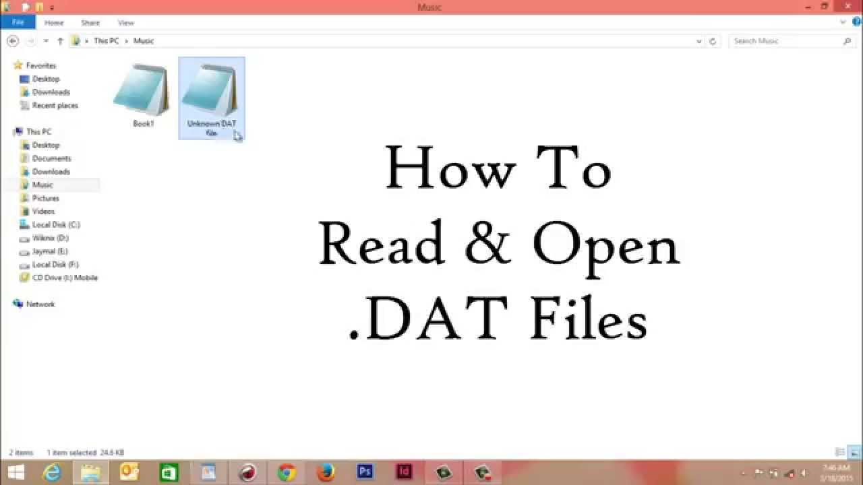
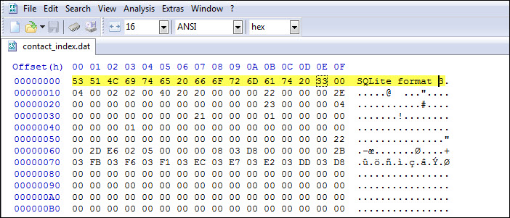

GMACS-2
The DAT File

Slide 8
Broad structure
Dimensions
Pre-specified biological parameters (need to move to the CTL file)
Length of each of the annual seasons
Catch data
Index data
Length-frequency data
Growth data
Custom specifications (need to move to the CTL file)
Note: The “type-1” weights are specified in the DAT file, “type 2” in the control file

Slide 9
The Dimensions
1975 # start year
2018 # end year
2019 # projection year
# number of seasons
6 # number of data groups
# number of sexes
# number of shell condition groups
# number of maturity types
# number of size-classes
# Season for recruitment
7 # Season for molting and growth
# Season to compute SSB
1 # Season for N output
Seasons allow for discrete events in GMACS
Combinations of fleets (including discards)
Old shell / new shell
Recruitment, growth can occur in different seasons

Slide 10
Biological parameters-I
Vector of LOWER LIMITS of the size-bins (Nclass+1 entries)
65 70 75 80 85 90 95
Length-weight relationship
(1 = allometry [w_l = a*l^b], 2 = vector by sex)
2
## a (male, female)
4.03E-07 4.08E-07
## b (male, female)
3.141334 3.127956
## Males
0.000224781 0.000281351 0.000346923 0.000422209
## Females
0.0002151 0.00026898 0.00033137 0.00040294

Slide 11
Biological parameters-II
# Male mature weight-at-length (weight * proportion mature)
0 0 0 0 0 0 0 0 0 0 0 1.46163 1.65736 1.87023 2.10101 2.35048 2.61942 2.90861 3.21882 3.9059
# Proportion mature by sex
0 0 0 0 0 0 ….
0 0 0 0 0 1 ..
# natural mortality type (1 = vector by season, 2 = matrix by season/year)
2
# Proportion of TOTAL natural mortality by season (seasonal – add to 1 please)
0.0000 0.2329 0.0000 0.2671 0.000 0.194 0.306 #1975
0.0000 0.2795 0.0000 0.2205 0.000 0.194 0.306 #1976

Slide 12
Catch data-I
Continuous means the length of the season is non-zero. An error occurs if you select “discrete” (0) and the season(a) with catches is not of zero duration. Try it!
# Fishing fleet names (delimited with: no spaces in names)
Pot_Fishery:Trawl_Bycatch:Bairdi_Fishery_Bycatch:Fixed_Gear
# Survey names (delimited with: no spaces in names)
NMFS_Trawl:BSFRF
# Are the fleets instantaneous (0) or continuous (1)
0 0 0 0 0 0
# Number of catch data frames
7
# Number of rows in each data frame
43 28 28 42 25 25 9
A catch data frame is a set of catches for one fleet. GMACS does not distinguish between fishery and survey fleets

Slide 13
Catch data-II
Year
Fleet
Catch
and CV
Unit
Effort
Season
Sex
Type
Mult
Discard
mortality
1975 3 1 1 23281.2 0.03 1 1 1 0 0.2
1976 3 1 1 28993.6 0.03 1 1 1 0 0.2
1977 3 1 1 31736.9 0.03 1 1 1 0 0.2
1978 3 1 1 39743 0.03 1 1 1 0 0.2
1990 3 1 1 11782.9 0.04 3 1 1 0 0.2
1991 3 1 1 9974 0.04 3 1 1 0 0.2
1992 3 1 1 6013.7 0.04 3 1 1 0 0.2
1981 5 2 0 274.229 0.04 2 1 1 0 0.8
1982 5 2 0 718.61 0.04 2 1 1 0 0.8
1983 5 2 0 525.554 0.04 2 1 1 0 0.8
1984 5 2 0 1367.55 0.04 2 1 1 0 0.8
1985 5 2 0 487.576 0.04 2 1 1 0 0.8

Slide 14
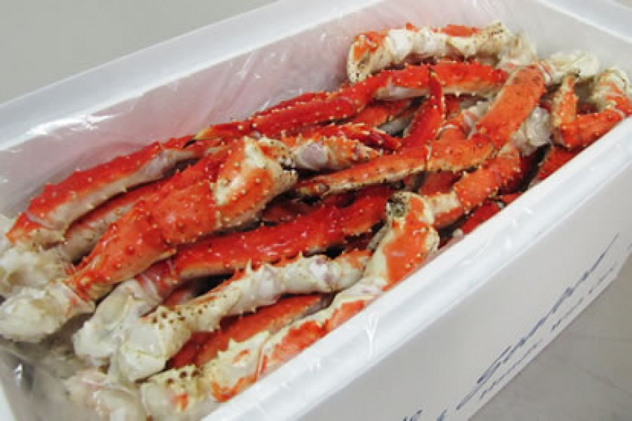
Catch data-III
Sex:
  1=Male; 2=Female; 0=Both
Type:
  1=Retained; 2=Discarded;3=Total
Unit:
  1=Mass; 2=numbers
Mult
  1=Use data are they are; 2 = multiply by this number (e.g. lbs to kg)

Slide 15
Relative abundance indices
Units:
1=mass; 2= numbers
CV:
Type I CV; it can be increased by an additional variance term (see specifications for the control file)
#Relative abundance
## Number of relative abundance indices
2
## Number of rows in each index
88 12
#Survey data
#Year Season Fleet Sex Abundance CV Units
1975 1 5 1 135463 0.193 1
1976 1 5 1 260149 0.206 1
1977 1 5 1 235411 0.144 1

Slide 16
Length-frequency data-I
## Number of length frequency matrices
4
## Number of rows in each matrix
40 26 26 41
## Number of bins in each matrix (columns of size data)
20 20 16 20
Prof tip: Always check you have the counts correct. This is a great way to get things mixed up.
Males
Females

Slide 17
Length-frequency data-II
#Retained males
#Year Season Fleet Sex Type Shell Maturity Nsamp DataVec
1975 3 1 1 1 0 0 100 0 0 0
1976 3 1 1 1 0 0 100 0 0 0
1977 3 1 1 1 0 0 100 0 0 0
1978 3 1 1 1 0 0 100 0 0 0
#Total males
1990 3 1 1 0 0 0 91.6 0 0 0.0004
1991 3 1 1 0 0 0 100 0.0009 0.0038 0.0075
1992 3 1 1 0 0 0 100 0 0.0006 0.0008
1993 3 1 1 0 0 0 100 0.0008 0.0024 0.0031
#Trawl bycatch male
1976 5 2 1 0 0 0 50 0 0 0
1977 5 2 1 0 0 0 50 0.0036 0.0009 0.0009
1978 5 2 1 0 0 0 50 0 0 0

Slide 18
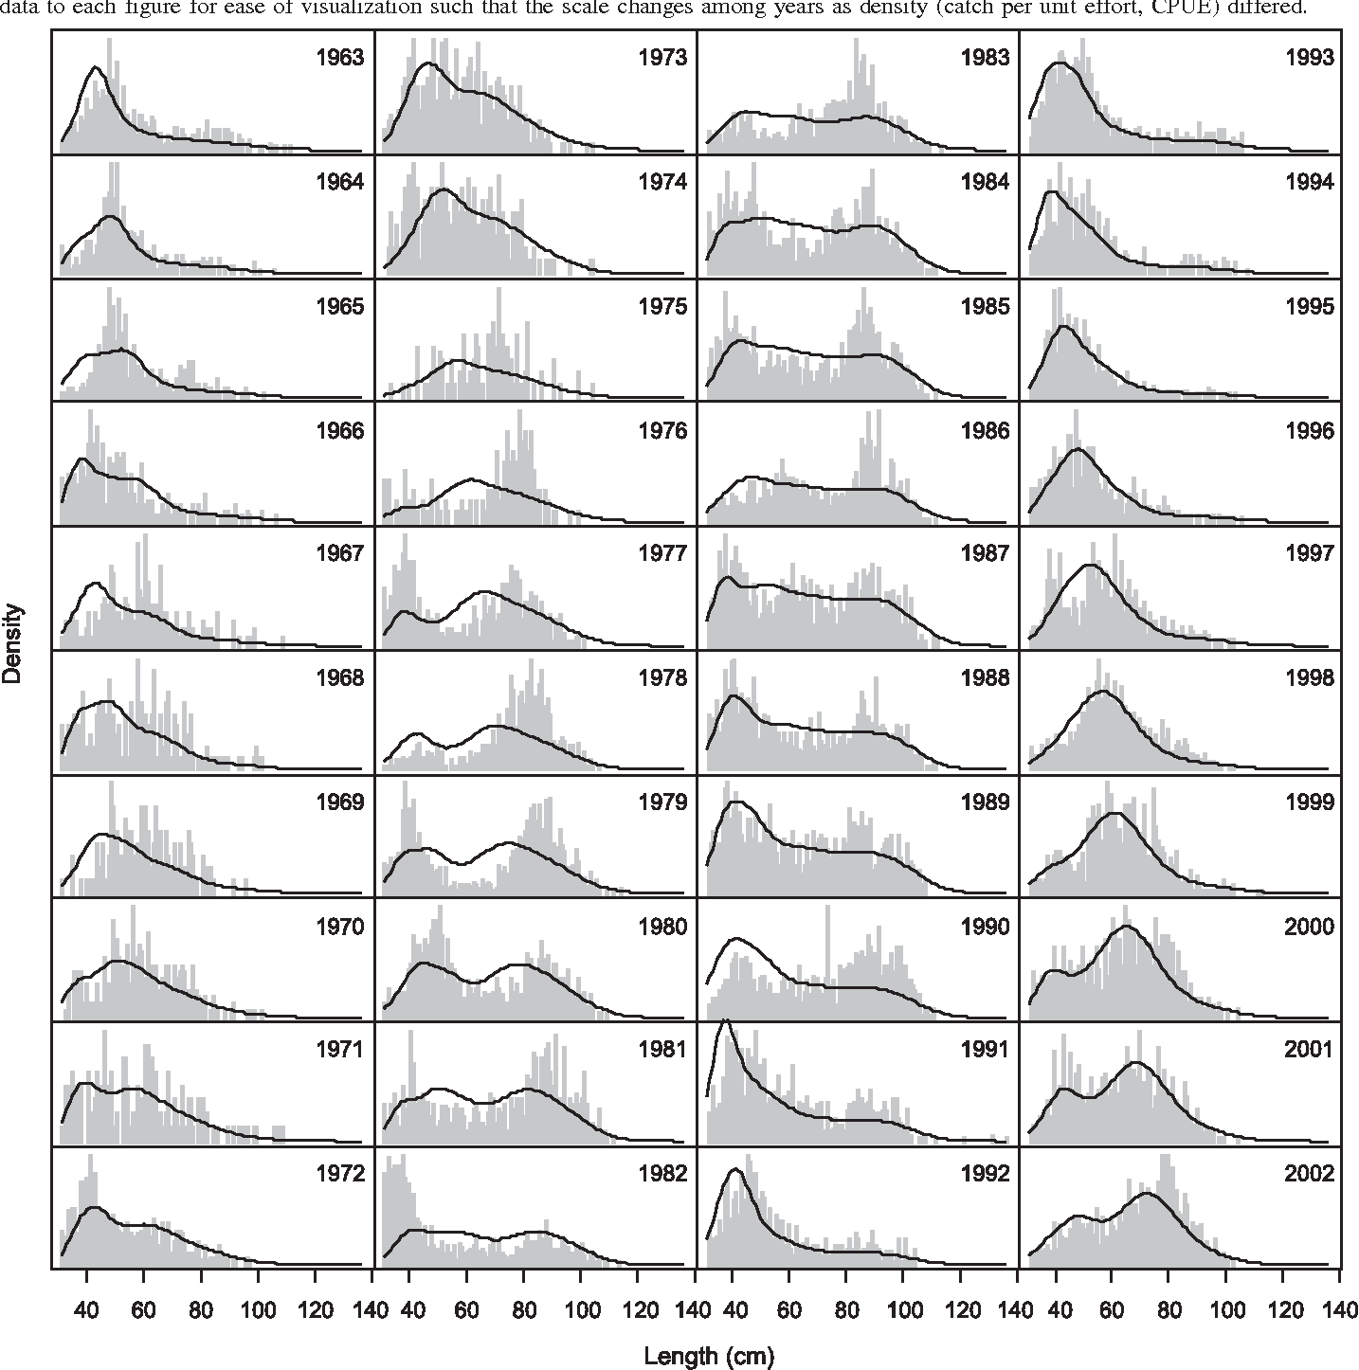
Length-frequency data-III
Sex:
  1=Male; 2=Female; 0=Both
Type:
  1=Retained; 2=Discarded;0=Total
Shell/Maturity
  Which type of length data (for now always select 0)
Nsamp
  Type I effective sample size.

Slide 19
Growth Data-I
There are two types of growth data: (a) increments and (b) transitions
# Growth increments
## Growth data
# Type of growth increment (1=growth increment with a CV;2=size-at-release; size-at-recapture)
1
# nobs_growth
1
# MidPoint Sex Increment CV
67.5 2 14.76 1000

Slide 20
Growth Data-II
There are two types of growth data: (a) increments and (b) transitions
# Transition matrix entries
## Growth data
# Type of growth increment (1=growth increment with a CV;2=size-at-release; size-at-recapture)
2
# nobs_growth
2
# Class-at-release; Sex; Class-at-recapture; Years-at-liberty; which transition matrix; sample size
2 1 4 1 1 2
2 1 5 1 1 1

Slide 21
Final steps
# Use custom natural mortality (0=no, 1=yes, by sex and year) 0 # #Custom natural mortality rates (by sex)
#1975 1976 1977 1978
0.18 0.27 0.27 0.27
## eof
9999
Custom natural mortality allows the user to pre-specify M by year (this should be in the CTL file). EOF is a check value.
If something is wrong, an EOF error will be generated and program will stop.

