Slide 1
Snow crab assessment going forward: GMACS and rebuilding plans
Cody Szuwalski
January 15, 2022

Slide 2
Outline
Re-accepting GMACS
Time-variation in M for terminal molt
Projection variations

Slide 3
GMACS + snow crab history
September 2020 | CPT accepted GMACS for snow crab
October 2020 | SSC rejected GMACS based on large estimates of recruitment
May 2021 | Models with time-varying q and M were presented, but not selected for use in September
August 2021 | Survey showed large declines in snow crab
September 2021 | CPT accepted the status quo model with time-varying M in 2018 and 2019
October 2021 | SSC accepted the status quo model with time-varying M in 2018 and 2019
October 2021 | Snow crab officially declared overfished
January 2022 | Another (simplified) model presented with time-varying M and q

Slide 4
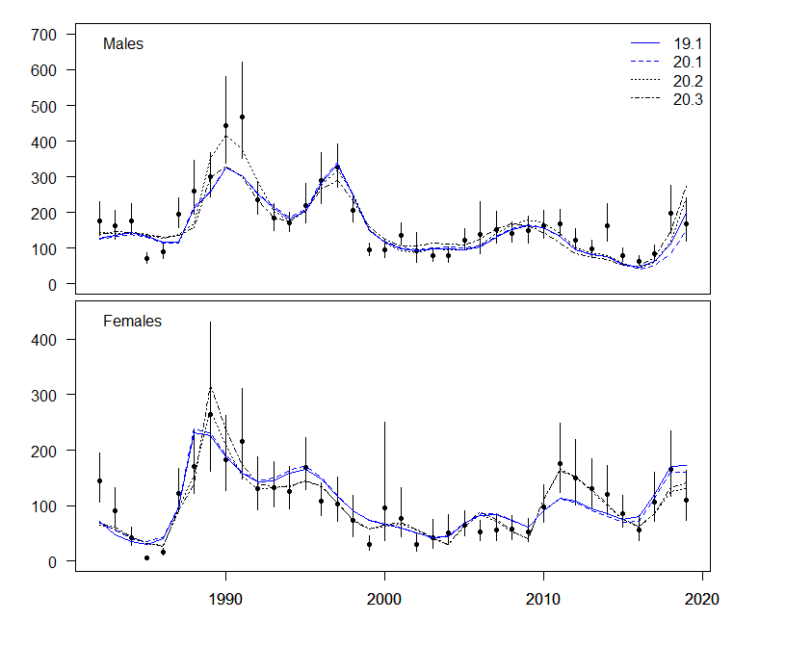
Sept. 2020: CPT accepted GMACS for snow crab
Better model fits
Improved structure and assumptions
Model stability
Common code base

Slide 5
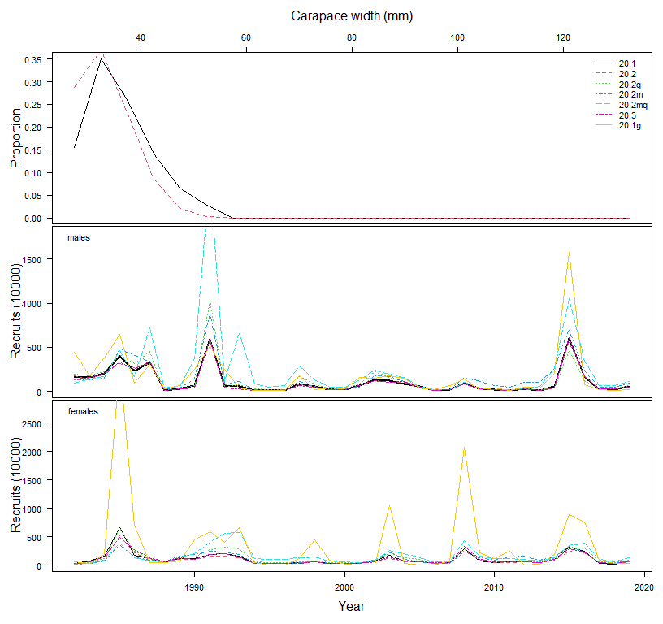
Oct. 2020: SSC rejected GMACS for snow crab
Primarily due to high estimates of recruitment in 2015

Slide 6
August 2021
Big surprise in the survey
Status quo model would not converge with new data
Status quo model with extra mortality in 2018 and 2019
Could not code time-varying natural mortality for terminally molting into GMACS in time for use in management

Slide 7
Tasks accomplished since September 2021
Time-variation in GMACS for terminally molting life history
Prepared a range of preliminary projections
Outstanding tasks
Projected natural mortality?
Projected recruitment?
Time-variation in the probability of having undergone terminal molt?
Non-parametric survey selectivity?
Functional maturity?

Slide 8
GMACS does not solve problems related to
Retrospective patterns
Identifying appropriate time-variation in population processes (though these can be considered in GMACS…and also can ‘treat’ retrospective patterns)
Uncertainty around appropriate currency of management (morphometric maturity vs. functional maturity)

Slide 9
Status quo vs GMACS
(both with time-varying M)

Slide 10
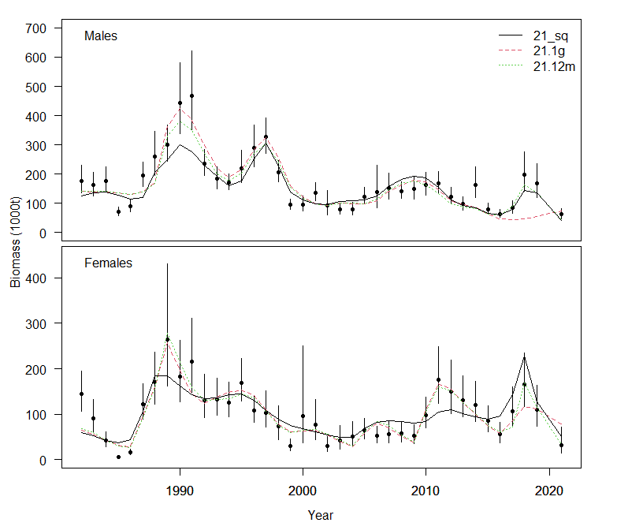

Slide 11
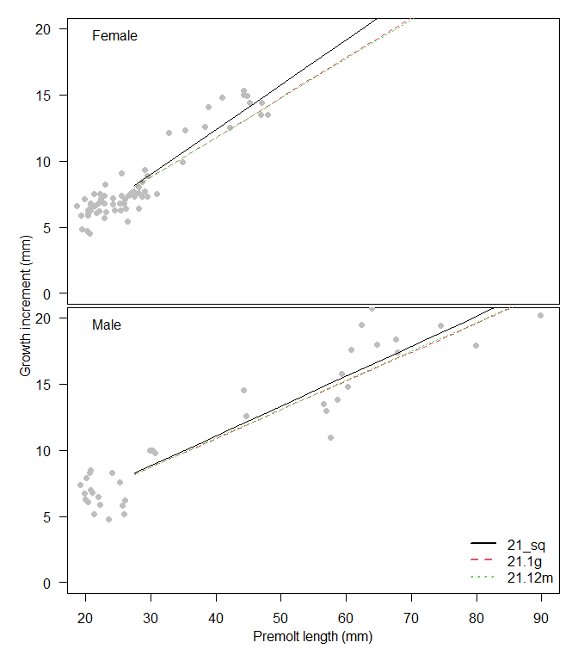

Slide 12
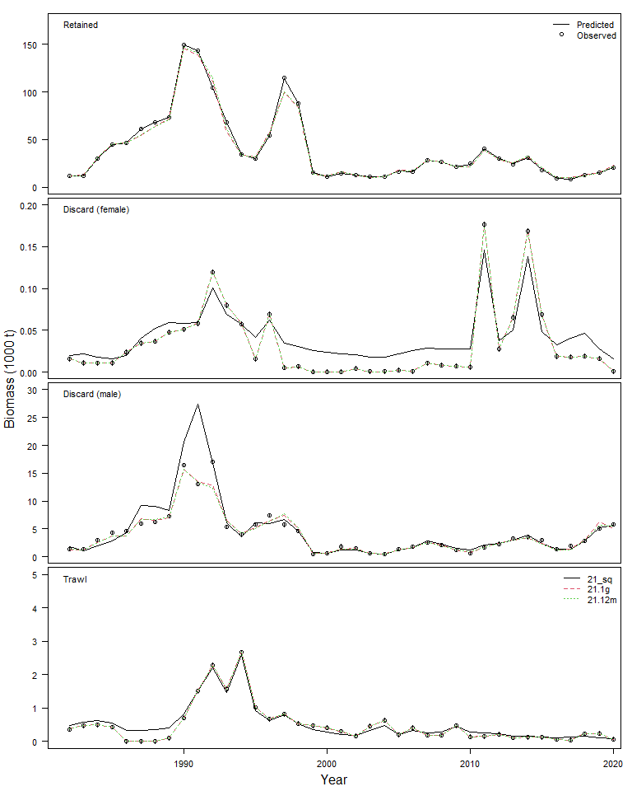

Slide 13
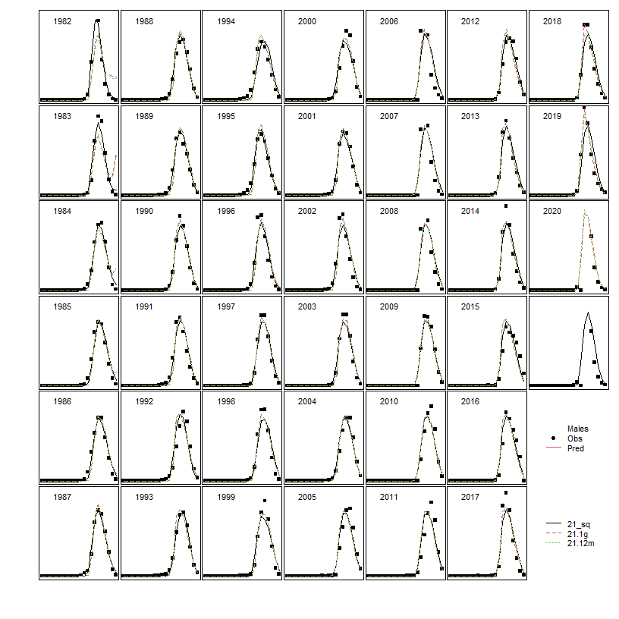
Retained catch

Slide 14
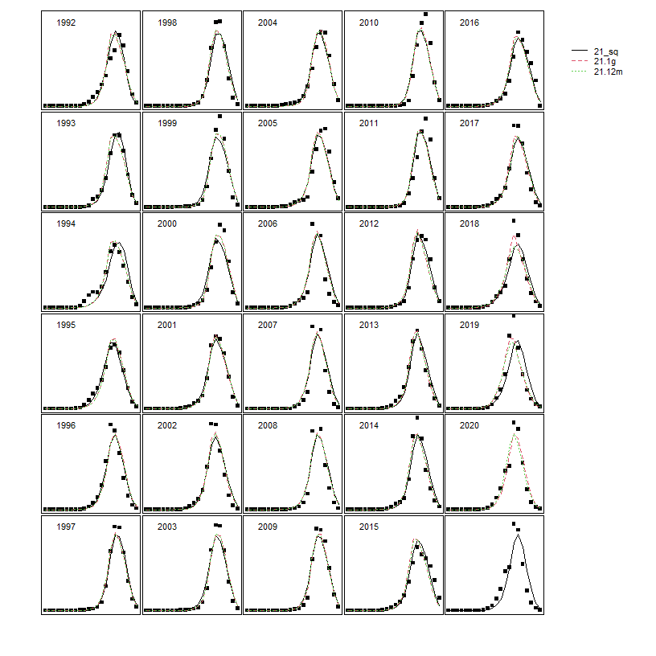
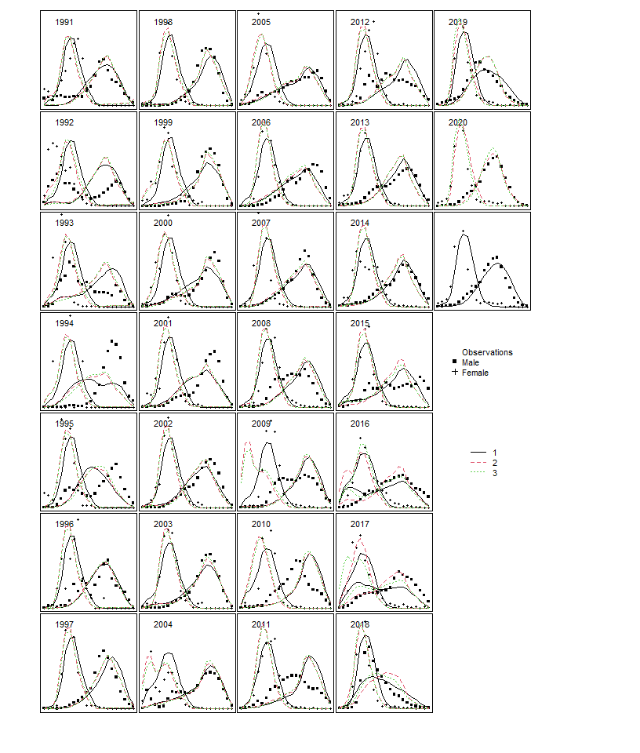
Total catch
Byatch

Slide 15
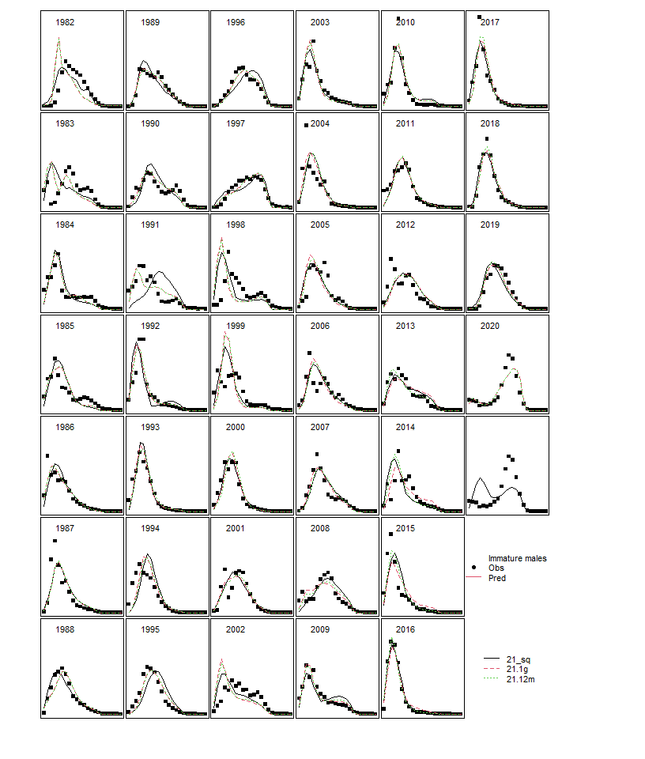
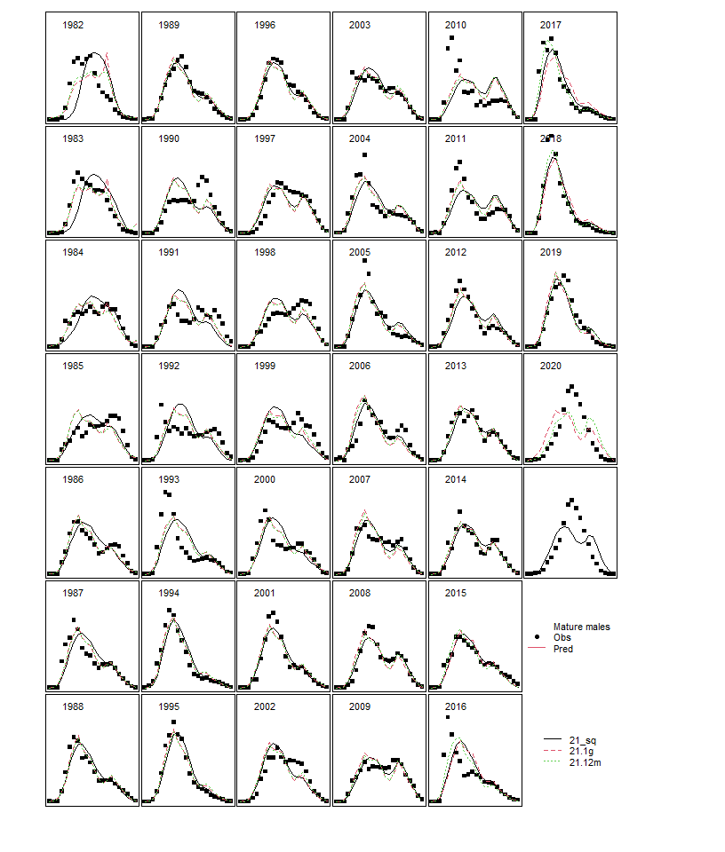
Survey (immature males)
Survey (mature males)

Slide 16
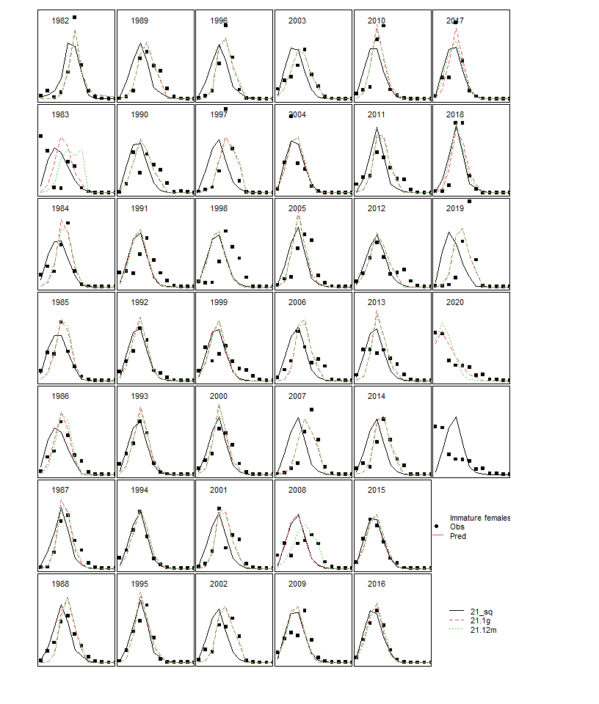
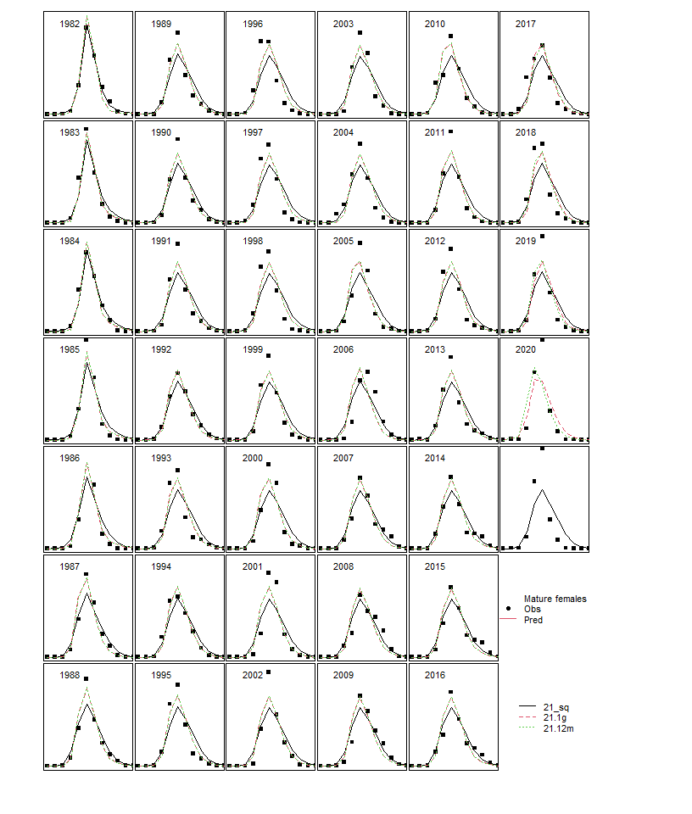
Survey (immature females)
Survey (mature females)

Slide 17
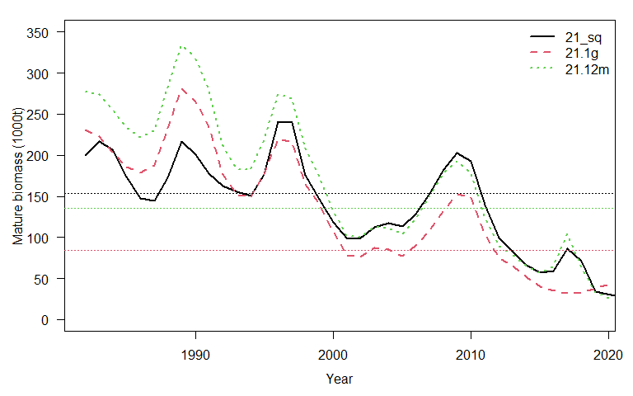

Slide 18
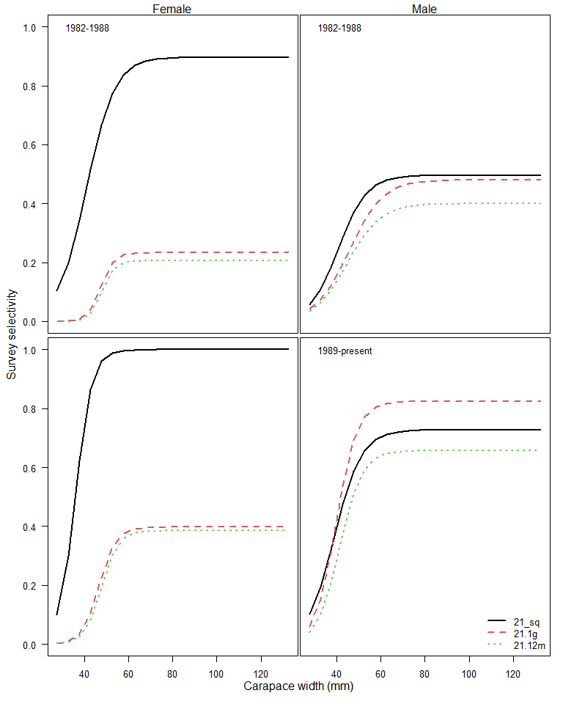
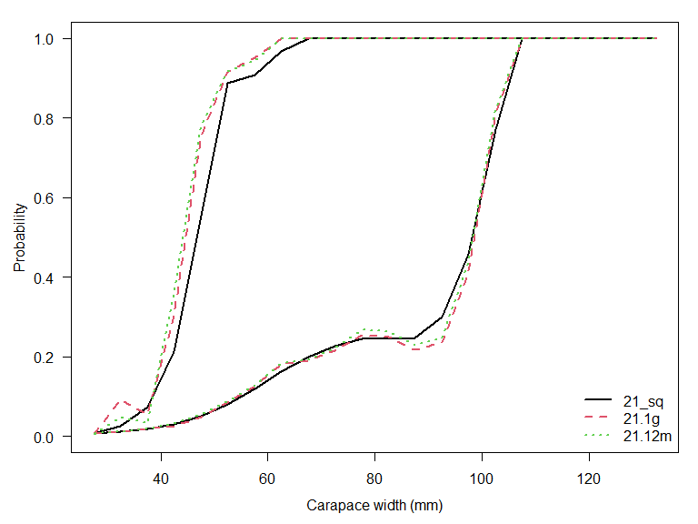
(these both would change if survey selectivity was allowed to vary more by size)

Slide 19
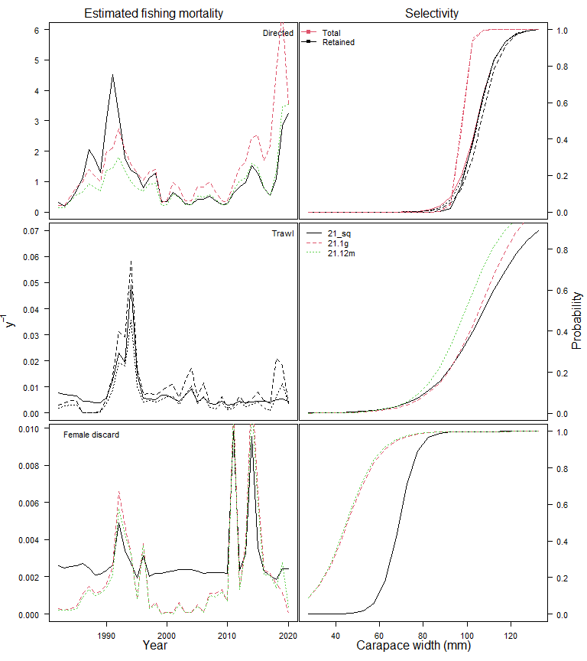
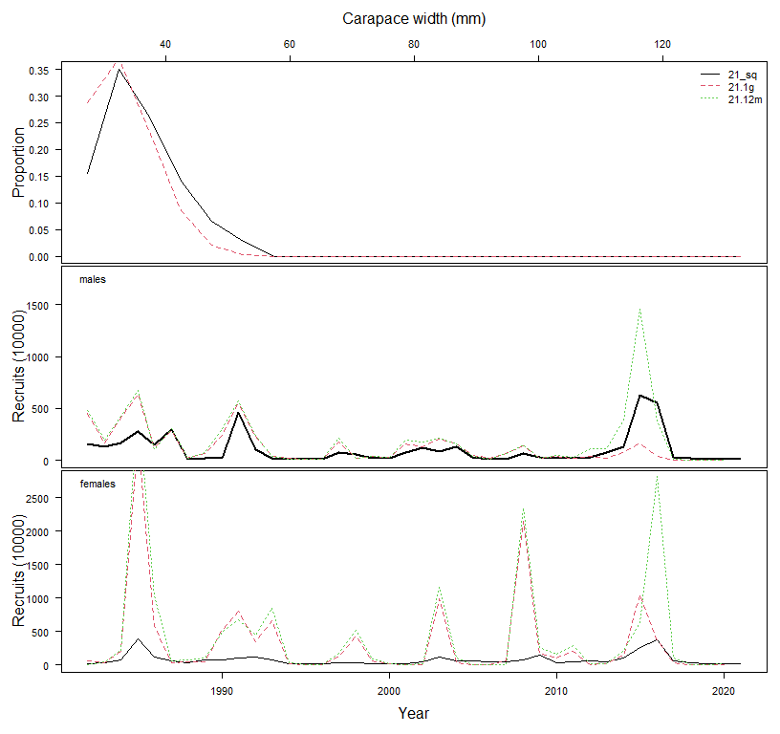

Slide 20
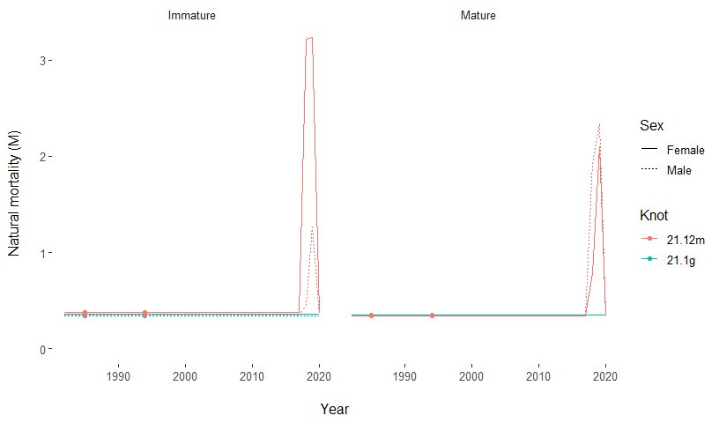

Slide 21
Model | MMB | B35 | F35 | FOFL | OFL | M | avg_rec
21_sq | 26.74 | 153.42 | 1.43 | 0.37 | 7.50 | 0.27 | 106.14
21.1g | 43.51 | 84.20 | 2.60 | 1.40 | 23.69 | 0.35 | 125.20
21.1g_m | 25.53 | 135.32 | 2.31 | 0.00 | 0.10 | 0.36 | 189.52

Slide 22
Projection assumption
Projected recruitment?
Projected natural mortality?
BMSY is based on:
  Recruitment 1982-2020
  Average natural mortality NOT including the 2018 & 2019 deviations

Slide 23
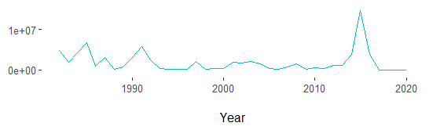
Projected recruitment
Exclude >2014
1989 climate shift (starting 1994)
Status quo

Slide 24
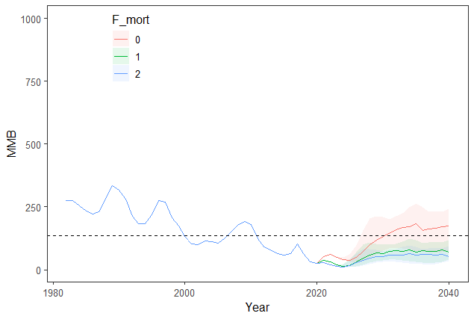
Exclude >2014

Slide 25
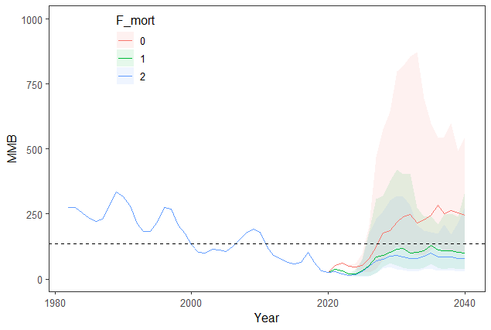
1989 climate shift (starting 1994)

Slide 26
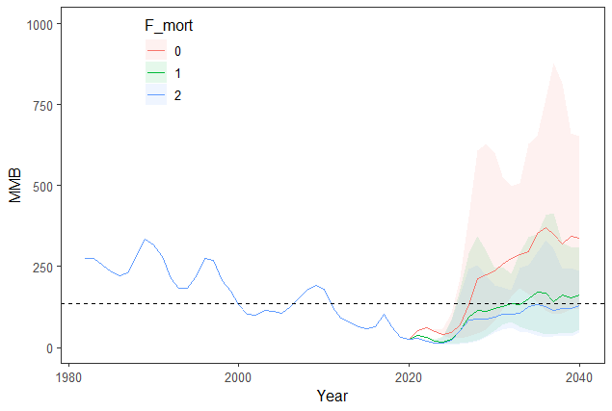
Status quo

Slide 27
Recruitment | Time to rebuild (F35%) | Time to rebuild (F=0)
Recent regime + exclude >2015 | >2040 | 2031
Recent regime | >2040 | 2028
Status quo | >2040 | 2028

