Slide 1
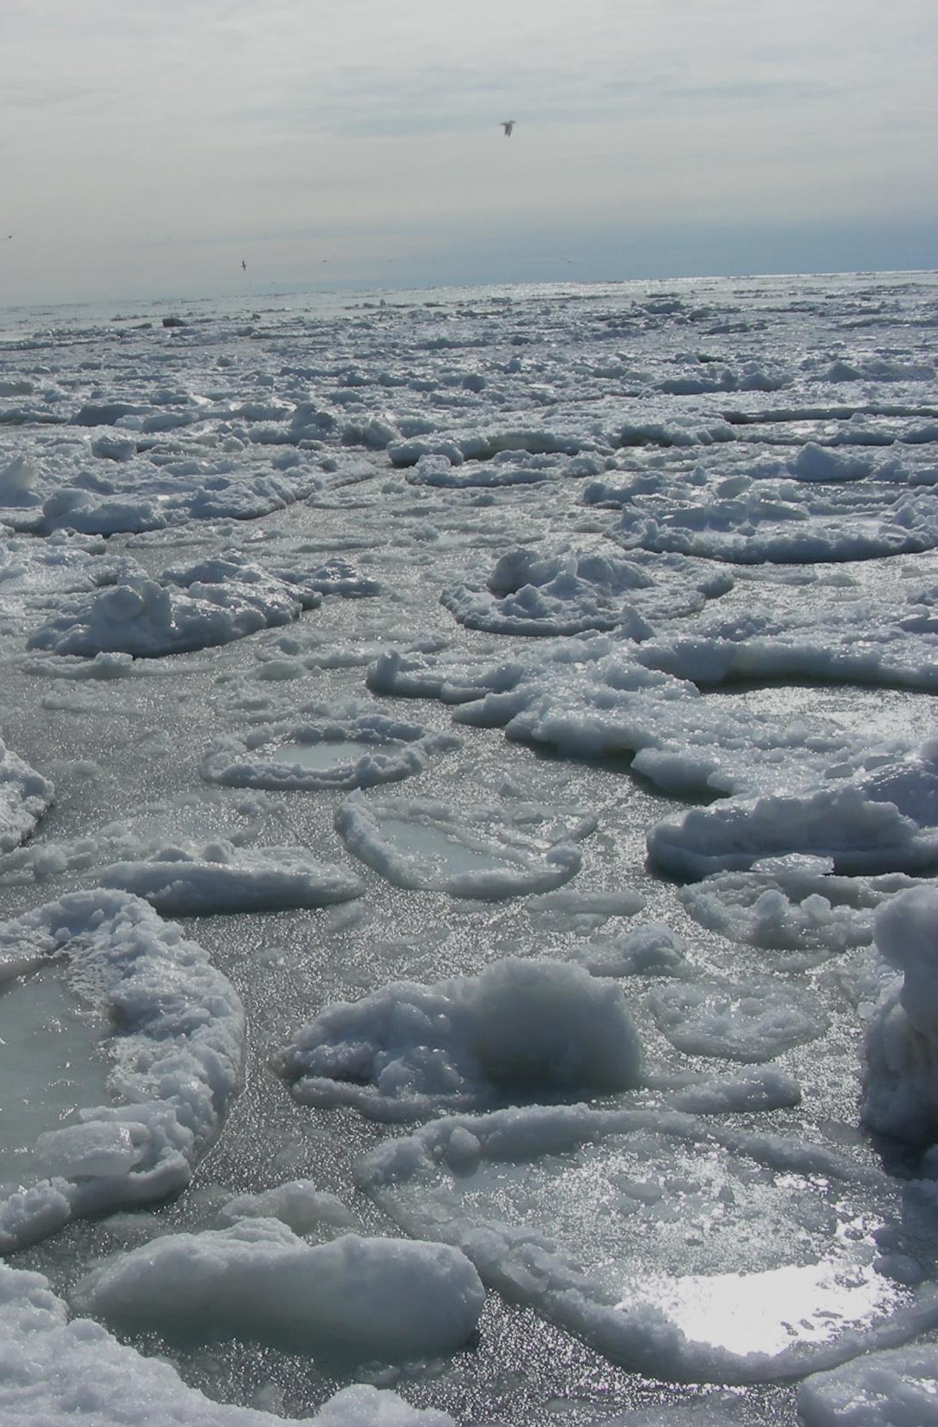

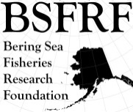


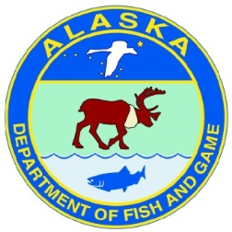




BSFRF Research Update
Scott Goodman – CPT JANUARY 2022
Post-Doc
Research/Support
Develop New
Co-op Partners
Pre-recruit
Surveys
Ocean Acifification
Research
Life History
Research
Trawl Selectivity
Research
Stock Assessment
Support
BSFRF Survey Data
FEBRUARY SHARE
Movement Research
Tagging & Monitoring
Crab Aging
Research
Climate-Ecosytem
Crab Research
Snow Crab Cooperative
Workshop (DEC 2021)
Discard - Handling
Mortality
Natural
Mortality
2021 Contingency Planning
Bycatch Research
BREP Projects
Harvesters - Processors
Cooperative Research Partners

Slide 2
For this update
Bycatch focus – BREP project update
Tagging-movement work status
Snow crab workshop summary
Next steps for BSFRF

Slide 3
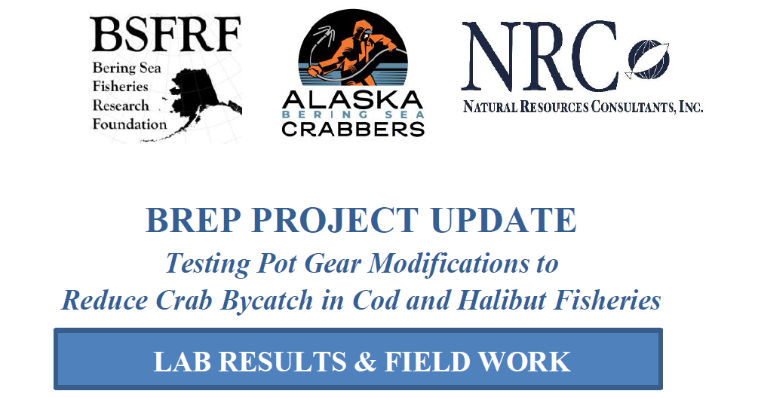
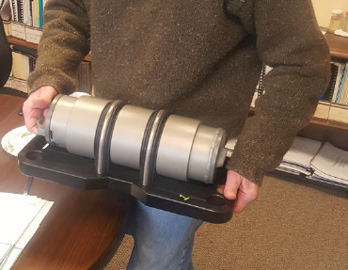
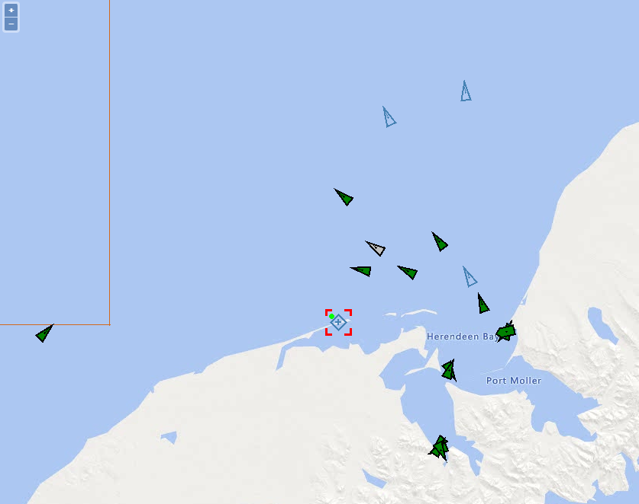
Current research updates

Slide 4
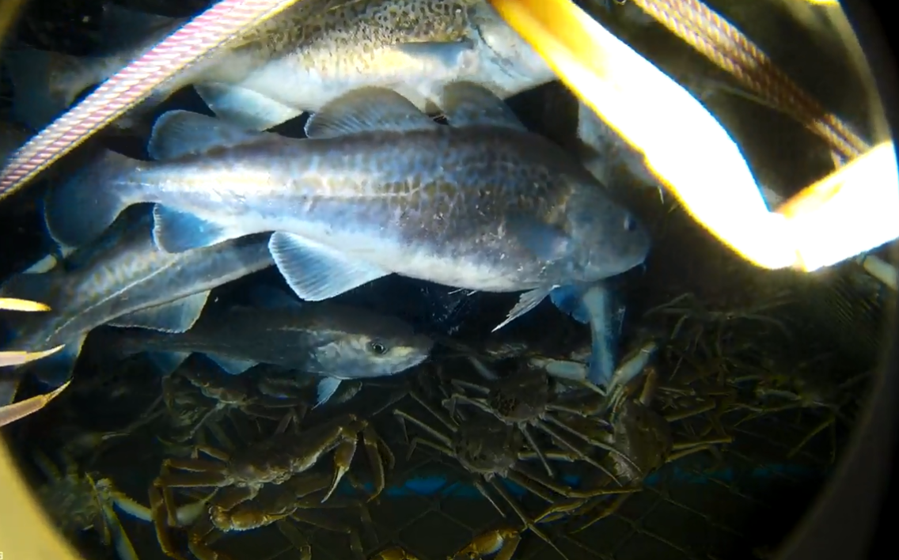
Current research updates
More video at next in-person meeting…

Slide 5
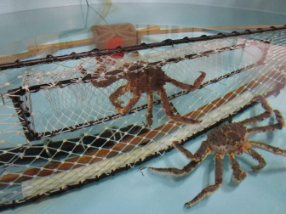
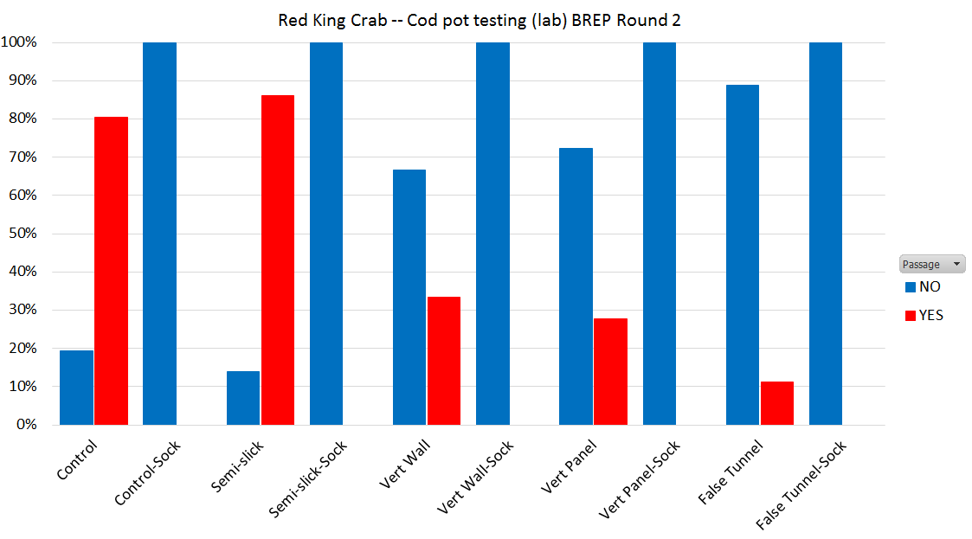
BREP Project Update - PRELIMS
2020-2021 Lab Work
Summary – Lab Results

Slide 6
BREP Project Update - PRELIMS
SEP 2021 Field Work

Slide 7

BREP Project Update - PRELIMS
SEP 2021 Field Work
Summary Across All Boats

Slide 8
BREP Project Update - PRELIMS
SEP 2021 Field Work
Summary By Boat-Gear

Slide 9
BREP Project Update – next steps
Update to NPFMC in February
Final snow crab samples in Kodiak March
Further field work for RKC in September
Project complete Sep-Oct

Slide 10
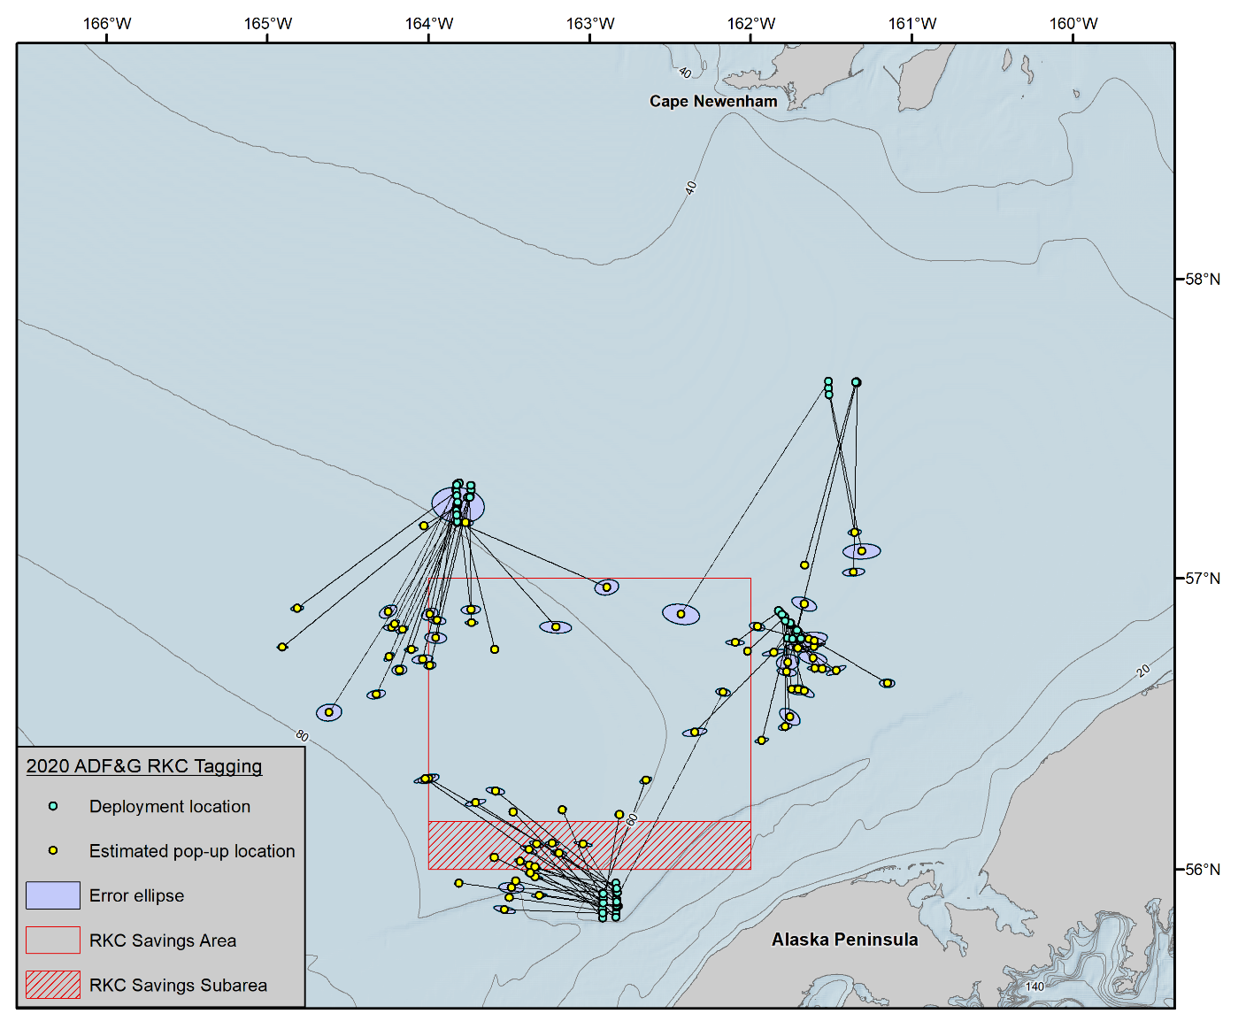
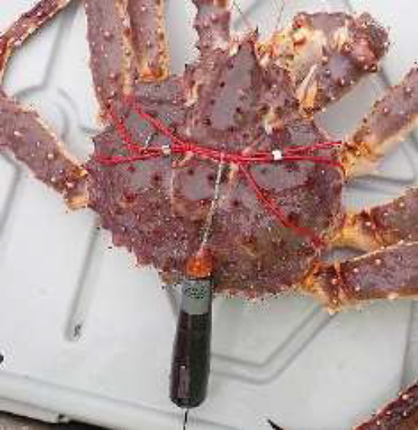
Current research updates
Movement/Tagging update – switching tag tech
Satellite Tag
2020
2021
2022
Figure 2: Movement vectors for legal male Bristol Bay red king crab between July and October, 2020. All crab were tagged with pop-up satellite tags (Wildlife Computers, MrPAT and MiniPAT), with crab end location likely occurring within the error ellipse.

Slide 11
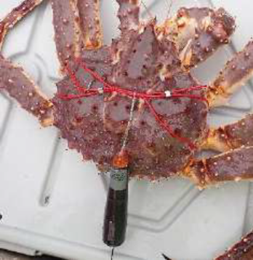
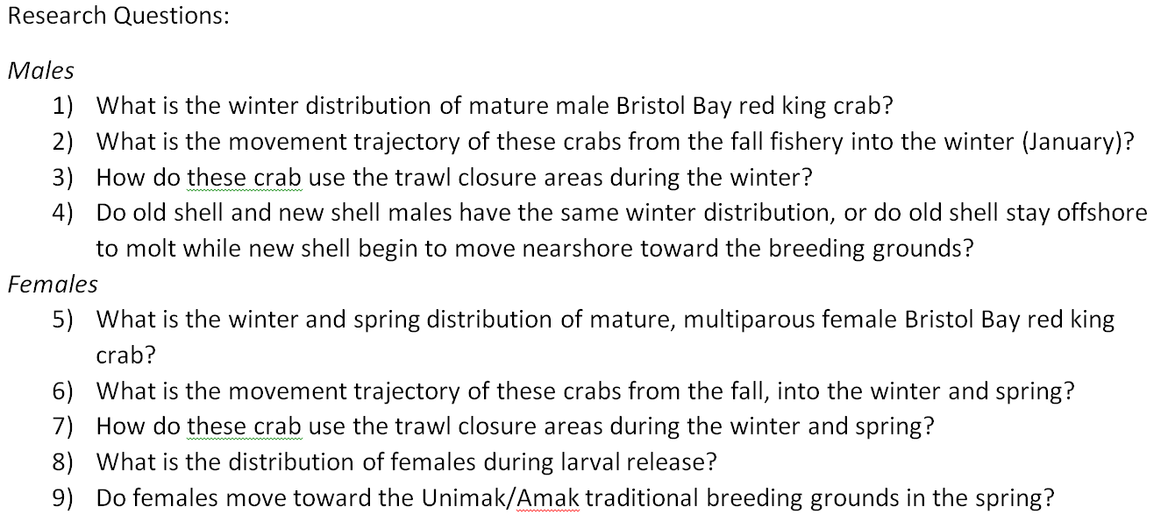
Current research updates
Movement/Tagging update – switching tag tech

Slide 12
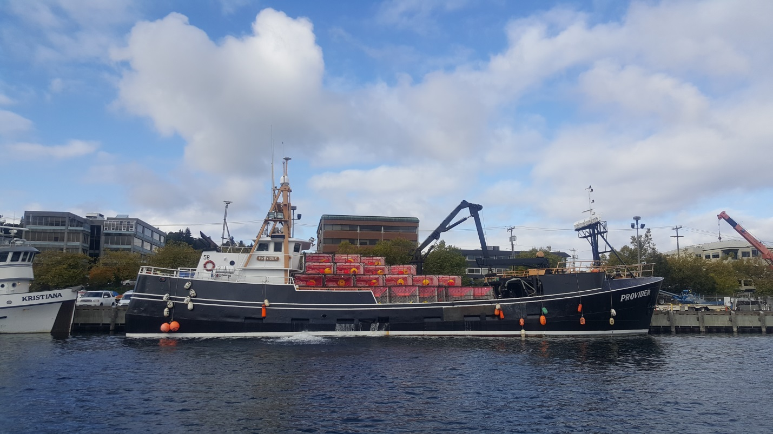
Current research updates
Movement/Tagging update – switching tag tech
Large Research Project Focus:
ADFG $ 191 k
NOAA $ 164 k + Charter/Sampling
BSFRF $ 234 k
Total $ 590 k
22 day charter OCT-NOV
Onboard FV Provider
Ben Daly-ADFG
Chris Long-NMFS
Jared Weems-ADFG
Vicki Vanek-ADFG
Charlie Heller-BSFRF
Preliminary pop-up tag returns are relatively strong!

Slide 13

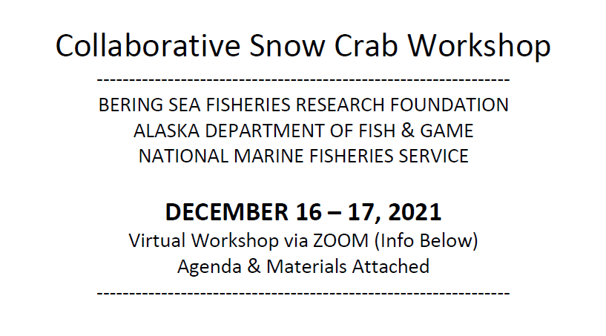

Welcome – Workshop will start soon…

Slide 14
What happened? What can we do about it?
be broadly informative about the scale of the changes in the stock and the current stock status
to help identify what research may be needed to reveal more about the status
to conduct the workshop as a collaboration with industry stakeholders that shares information and expectations about the stock

Slide 15
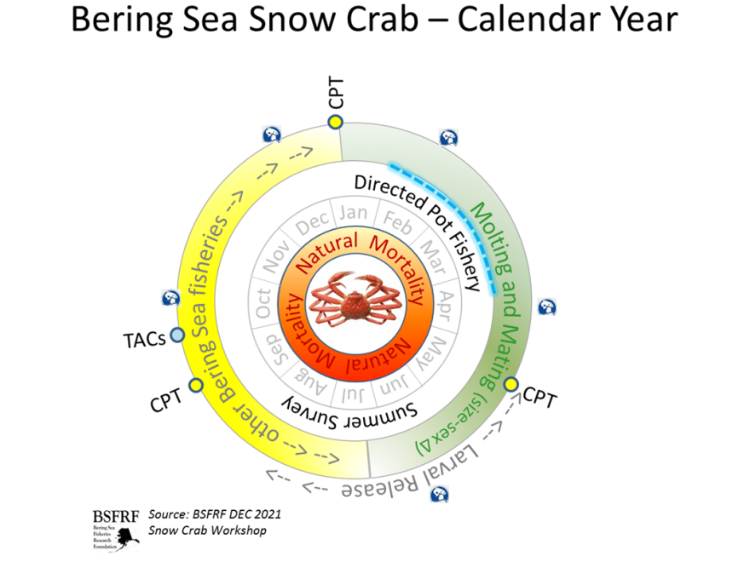
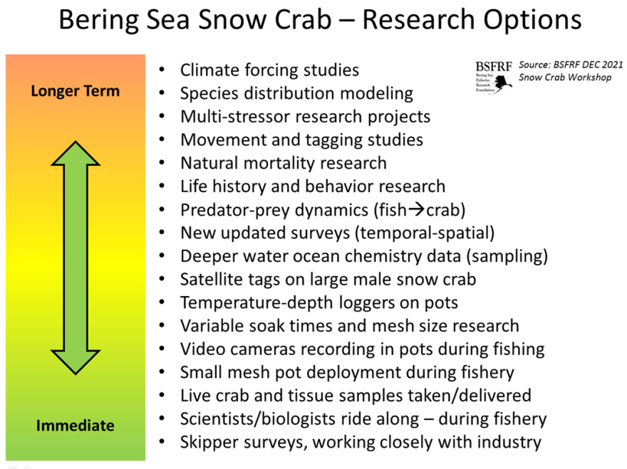
Day 1
Erin Fedewa – eco indicators
Cody Szuwalski – current work
Ben Daly – current management
Mark Stichert – season outlook
QA with stakeholders
Day 2
Discussion of research options
Couple of guiding slides
QA with stakeholders

Slide 16
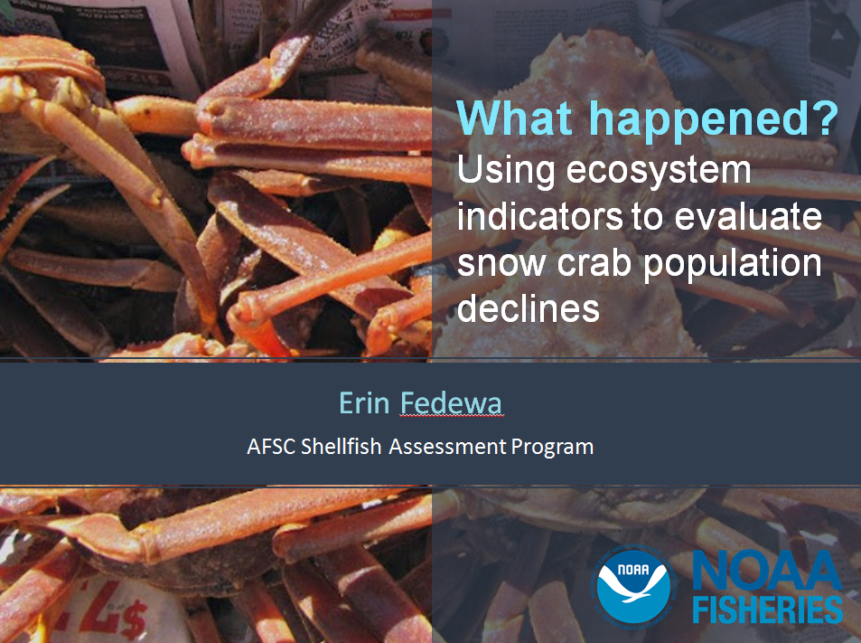
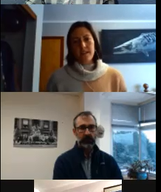

Slide 17
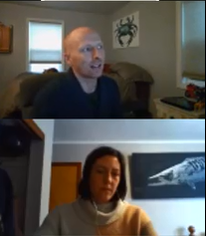
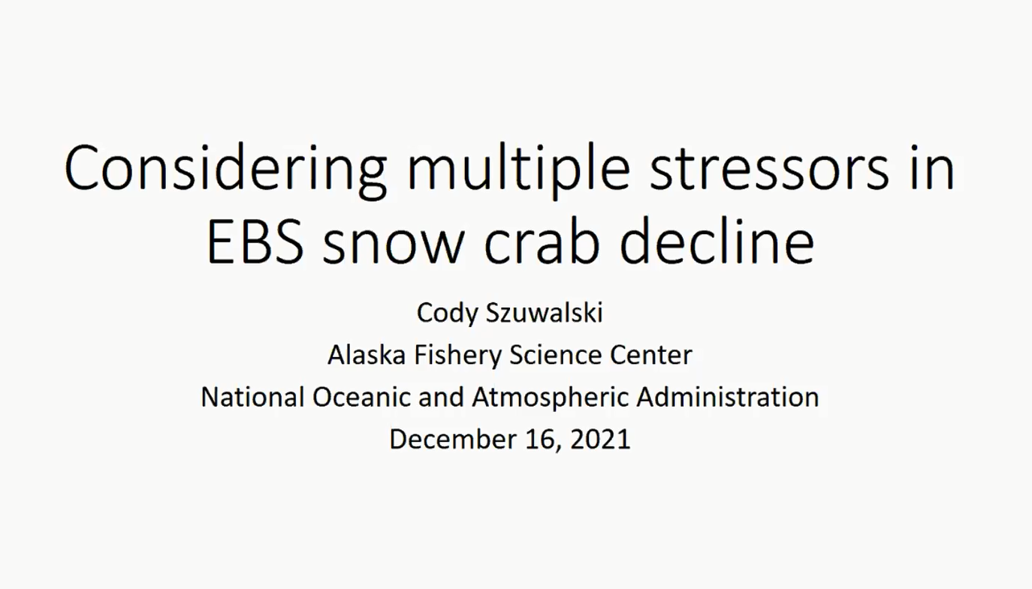

Slide 18
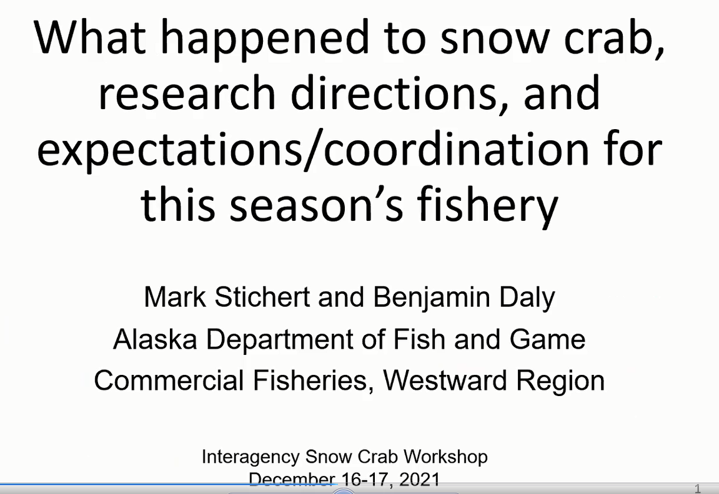
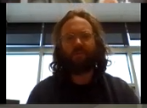
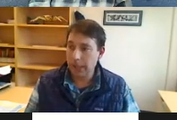

Slide 19

What’s next? Steering Committee Summaries
Working plans for higher level research
Crab-climate working group
NPRB-MOU
Other collaborations
Action plans for current research
Working with vessels during opilio fishing
Tagging opilio
Placing scientists/others on vessels
Instruments deployment
Collecting info from vessels
Assembling workshop summaries for sharing soon
Stay tuned for more updates

Slide 20
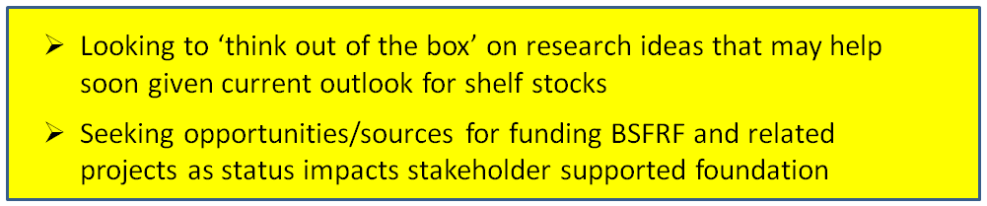
BSFRF Research Update
Scott Goodman – CPT JANUARY 2022
Post-Doc
Research/Support
Develop New
Co-op Partners
Pre-recruit
Surveys
Ocean Acifification
Research
Life History
Research
Trawl Selectivity
Research
Stock Assessment
Support
BSFRF Survey Data
FEBRUARY SHARE
Movement Research
Tagging & Monitoring
Crab Aging
Research
Climate-Ecosytem
Crab Research
Snow Crab Cooperative
Workshop (DEC 2021)
Discard - Handling
Mortality
Natural
Mortality
2021 Contingency Planning
Bycatch Research
BREP Projects

