Slide 1
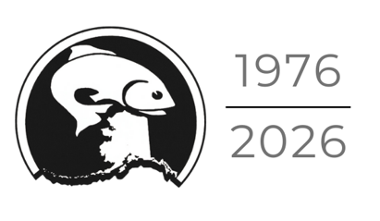
Joint Protocol Committee of the
North Pacific Fishery Management Council and the Alaska Board of Fisheries
Staff/expert presentations
October 16, 2026
Anchorage, AK

Slide 2
Outline of presentations for the JPC
Part 1: Fisheries Descriptions (Karla Bush, ADF&G and Sarah Marrinan, NPFMC staff)
Part 2: Management measures (Sarah Marrinan, NPFMC staff)
Part 3: Habitat
Essential Fish Habitat (Jodi Pirtle, Ph.D., NMFS)
Fishing Effects Model as an EFH input (Brad Harris, Ph.D., UAA/APU)
Part 4: State of the technology
Gear Innovation Initiative (Brad Harris, Ph.D., APU)
Bottom contact sensors/ modified footrope Exempted Fishing Permit (Noelle Yochum, Ph.D. and Shannon Carroll, Trident/EFP applicants)
Part 5: Ongoing NPFMC actions (Sarah Marrinan, NPFMC staff)

Slide 3
Terms and acronyms
ABC = Acceptable Biological Catch
AFA = American Fisheries Act; federal law that rationalized the BSAI pollock fishery
Amendment 80 = BSAI non-pelagic trawl catcher/processor rationalization program. Includes Atka mackerel, Aleutian Islands Pacific ocean perch, flathead sole, Pacific cod, rock sole, and yellowfin sole.
BoF = Board of Fisheries
BS / AI or BSAI = Bering Sea / Aleutian Islands
CDQ = Community Development Quota; federal fisheries program that allocates a percentage of all BSAI quotas for groundfish, prohibited species, halibut, and crab to eligible communities who have formed regional organizations
GHL = Guideline Harvest Level (State-waters catch limit)
GOA = Gulf of Alaska; Western, Central, and Eastern areas referred to as WGOA, CGOA, EGOA
EFH = Essential Fish Habitat; waters and substrate necessary to fish for spawning, breeding, feeding, or growth to maturity.
EFP = Exempted Fishing Permit; is an authorization issued by NOAA that allows for experimental fishing practices or gear design that would otherwise be prohibited under regulations (similar to a Commissioner’s permit)
EM = Electronic monitoring
FEM = Fishing Effects model; a decision-support tool to quantify and visualize commercial fishing activity and
resulting seafloor habitat disturbance.
FFP = Federal Fisheries Permit; permit is required for US vessels used to fish for groundfish in the GOA or BSAI. Recordkeeping, reporting, and monitoring requirements apply to all vessels with an FFP.
FMP = Federal fishery management plan; the North Pacific Fishery Management Council has six FMPs.
NMFS = National Marine Fisheries Service
NPFMC = North Pacific Fishery Management Council (i.e., Council)
TAC = Total Allowable Catch (Federal/parallel catch limit)
TLAS = Trawl Limited Access Sector; encompasses all non-Amendment 80 trawl fishery participants

Slide 4
Part 1: Fisheries Description
Scope: Pelagic trawl fishing in state waters and non-pelagic trawl fishing in state waters of the Aleutian Islands
Karla Bush (ADF&G) and Sarah Marrinan (NPFMC)

Slide 5
Three types of groundfish trawl gear fisheries occur off of Alaska
Federal fisheries
Federal waters (3–200 nmi) guided by the North Pacific Fishery Management Council (NPFMC) process. Harvest deducted from federal total allowable catch (TAC).
Parallel fisheries
State waters (0–3 nmi) concurrent with adjacent federal fishery and generally adopt federal regulations and management measures as guided by the Board of Fisheries (BOF) process. Harvest deducted from federal TAC.
State fisheries
State waters (0–3 nmi) guided by the BOF process. Harvest deducted from state guideline harvest level (GHL).
State of Alaska management authority applies to both the parallel fisheries
and state-managed fisheries

Slide 6
Fleet profile focus:
Gulf of Alaska pelagic trawl
  Parallel fisheries:
    GOA pollock fishery
  State fishery:
    Prince William Sound pollock fishery
Aleutian Islands non-pelagic trawl
  Parallel fisheries:
    Amendment 80 and Trawl Limited Access flatfish fishery
  State fishery:
    AI Subdistrict Pacific cod fishery

Slide 7
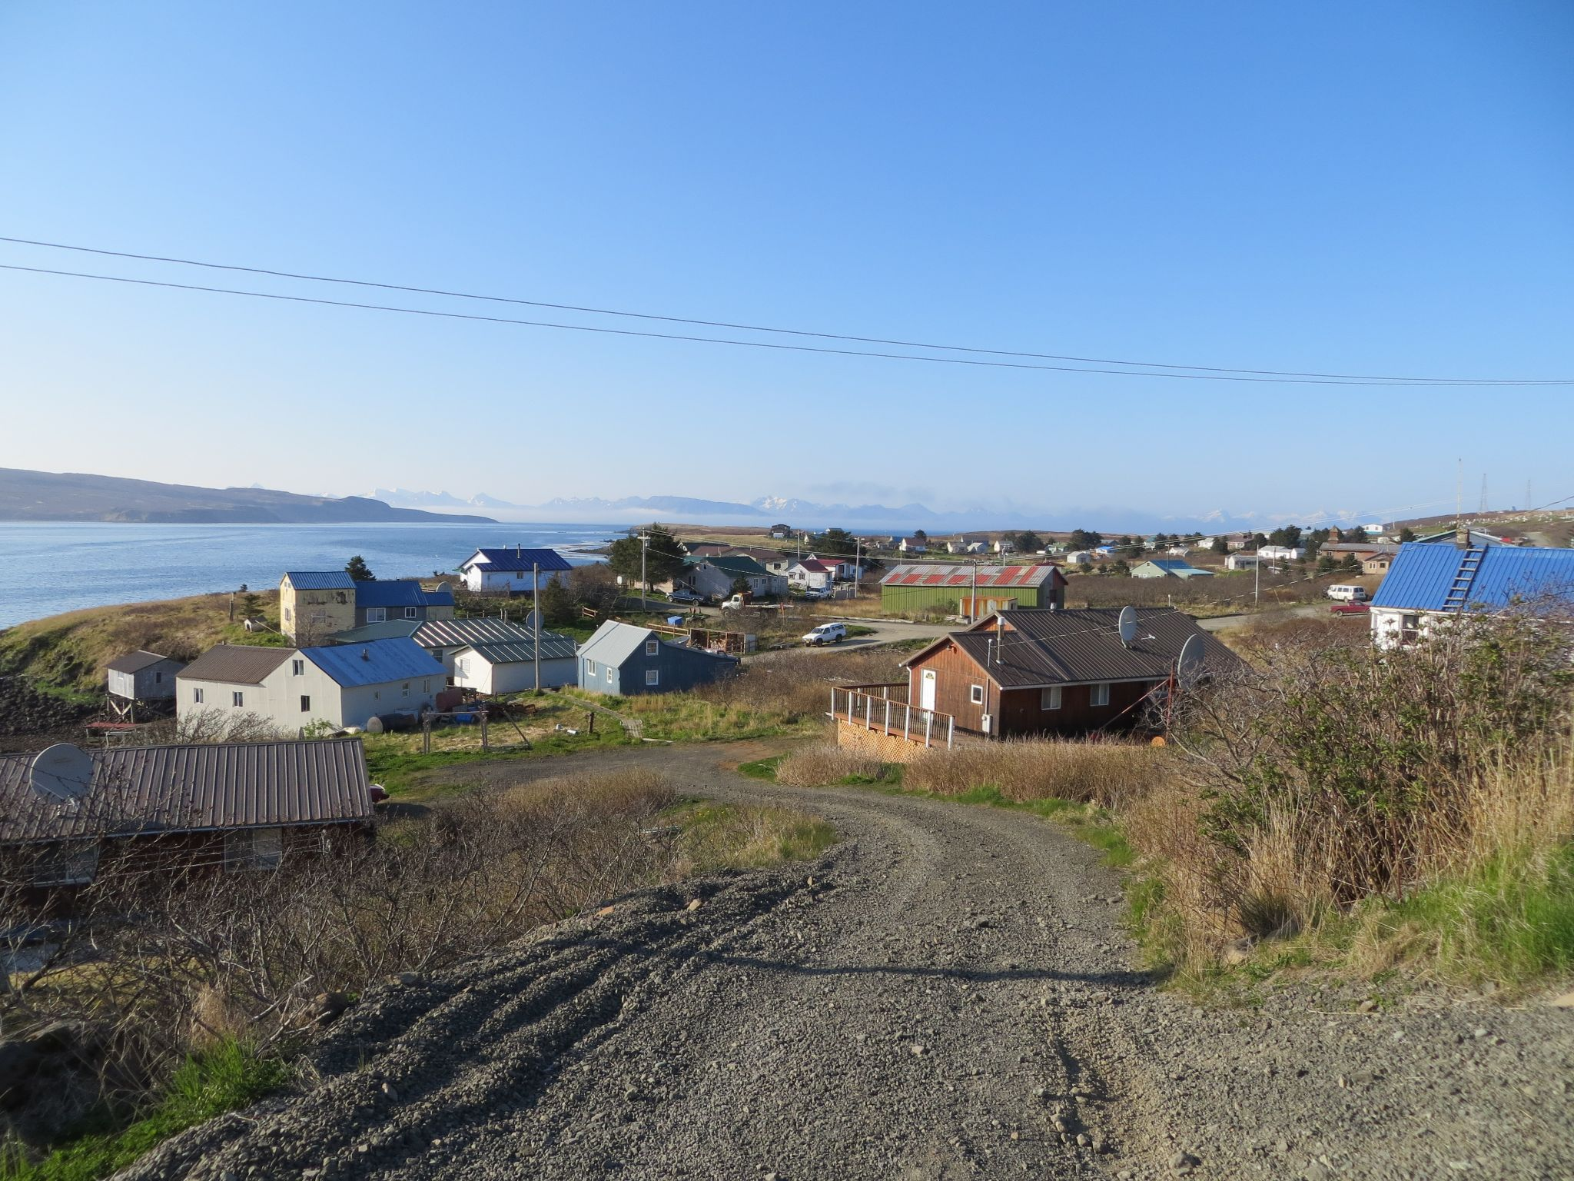
Fleet profile focus
Gulf of Alaska pelagic trawl
  Parallel fisheries:
    GOA pollock fishery
  State fishery:
    Prince William Sound pollock fishery

Slide 8
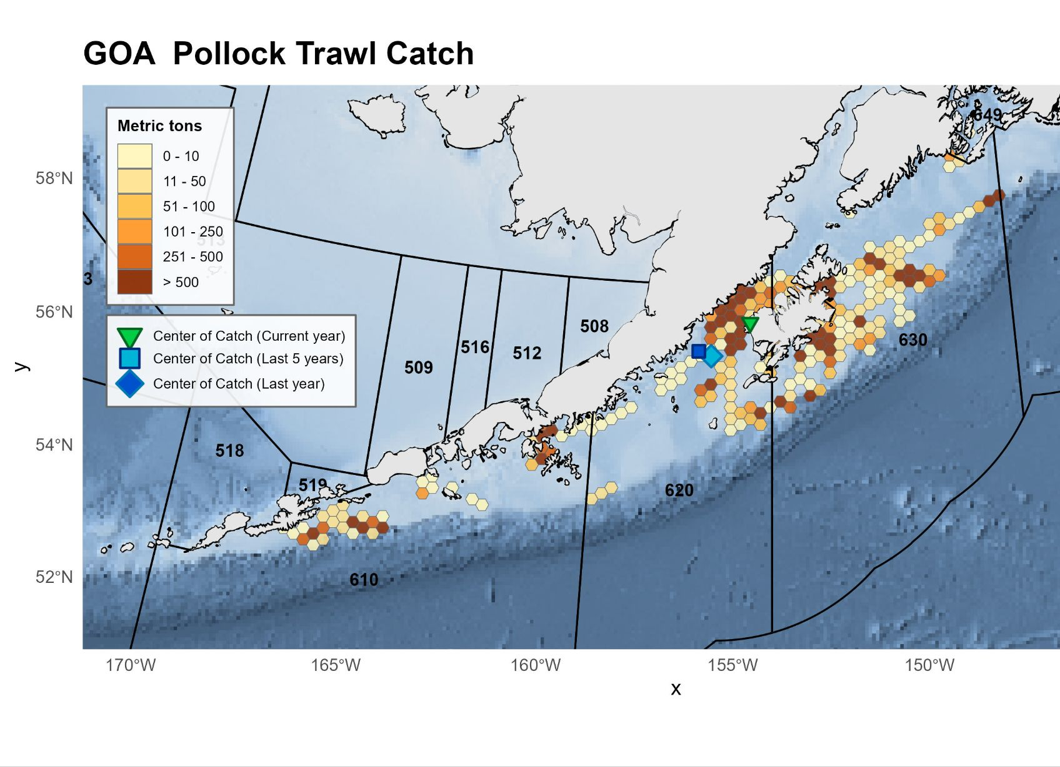
GOA Pollock trawl catch, 2025
All vessels fishing with pelagic trawl gear in State waters also participate in Federally managed trawl fisheries.
State waters that have had pelagic trawl harvest primarily includes:
the State PWS pollock fishery,
pollock fishing in areas of the Western GOA and
pollock fishing in some areas around Kodiak Island
Source: NMFS Inseason management

Slide 9
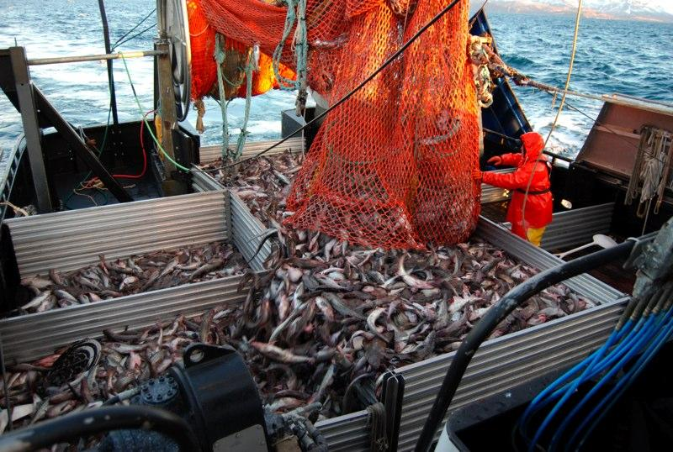
Monitoring requirements for GOA pollock fleet
Gulf of Alaska pollock fisheries: 100% Electronic Monitoring (EM) + 100% salmon accounting at processing plant (via human observers, who also take salmon genetic samples and biological samples on other fish). If a vessel does not opt into EM program, it must take human observer instead on selected trips.
Of the 45 Gulf catcher vessels, only one is not in EM program.
These vessels have the same monitoring requirements in state or federal waters during the federal/parallel Gulf fisheries.

Slide 10
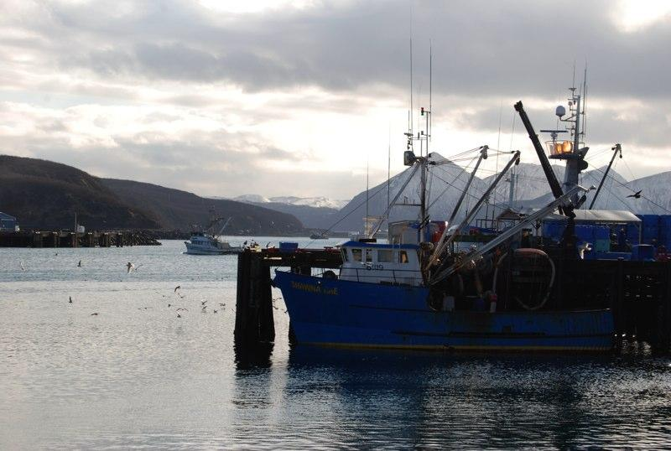
Overall Monitoring in the North Pacific federal fisheries
Percent of catch monitored by area and gear-type (all fisheries):
Trawl Fixed gear
BSAI 100% 89%
Gulf of Alaska 86% 14%

Slide 11
Fleet profiles GOA pelagic trawl
Parallel (State) waters: Vessels fishing for pollock in Central and Western GOA. These vessels are fishing off a federal TAC but go back and forth between Federal and State waters. The state retains jurisdiction over State waters but typically mirrors Federal rules.
In 2025, 33 catcher vessels fished in GOA parallel (State) waters at some point during the season; 5-yr avg is 41 vessels
Represents the majority of the GOA pollock vessels (73% in 2025)
Majority of vessel owners are from Kodiak and Sand Point (61% in 2025)
These vessels deliver into Alaska communities; primarily Kodiak, Sand Point, and Akutan
These vessels are diversified by size, target species, and by gear type:
  These vessels also fish Pacific cod, rockfish, flatfish species, and salmon, provide tendering in salmon season, some of the vessels fish in the Bering Sea
  Vessels range from 58 ft - 112 ft in length; 10 vessels = 58 ft; 32 vessels <100 ft.
  Considerable variation in reliance on state waters, but an average of 10% of the gross revenue from active vessels comes from state waters

Slide 12
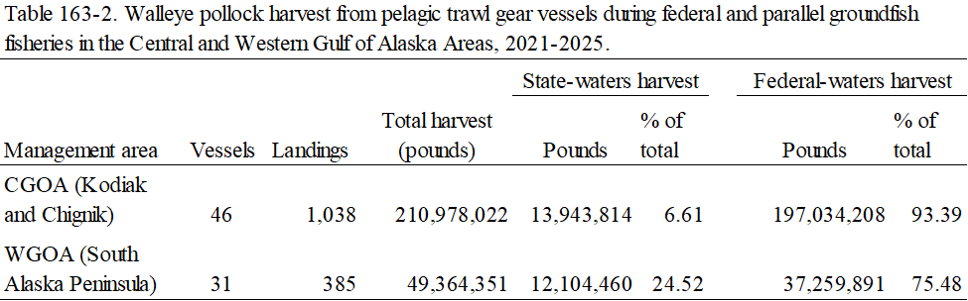
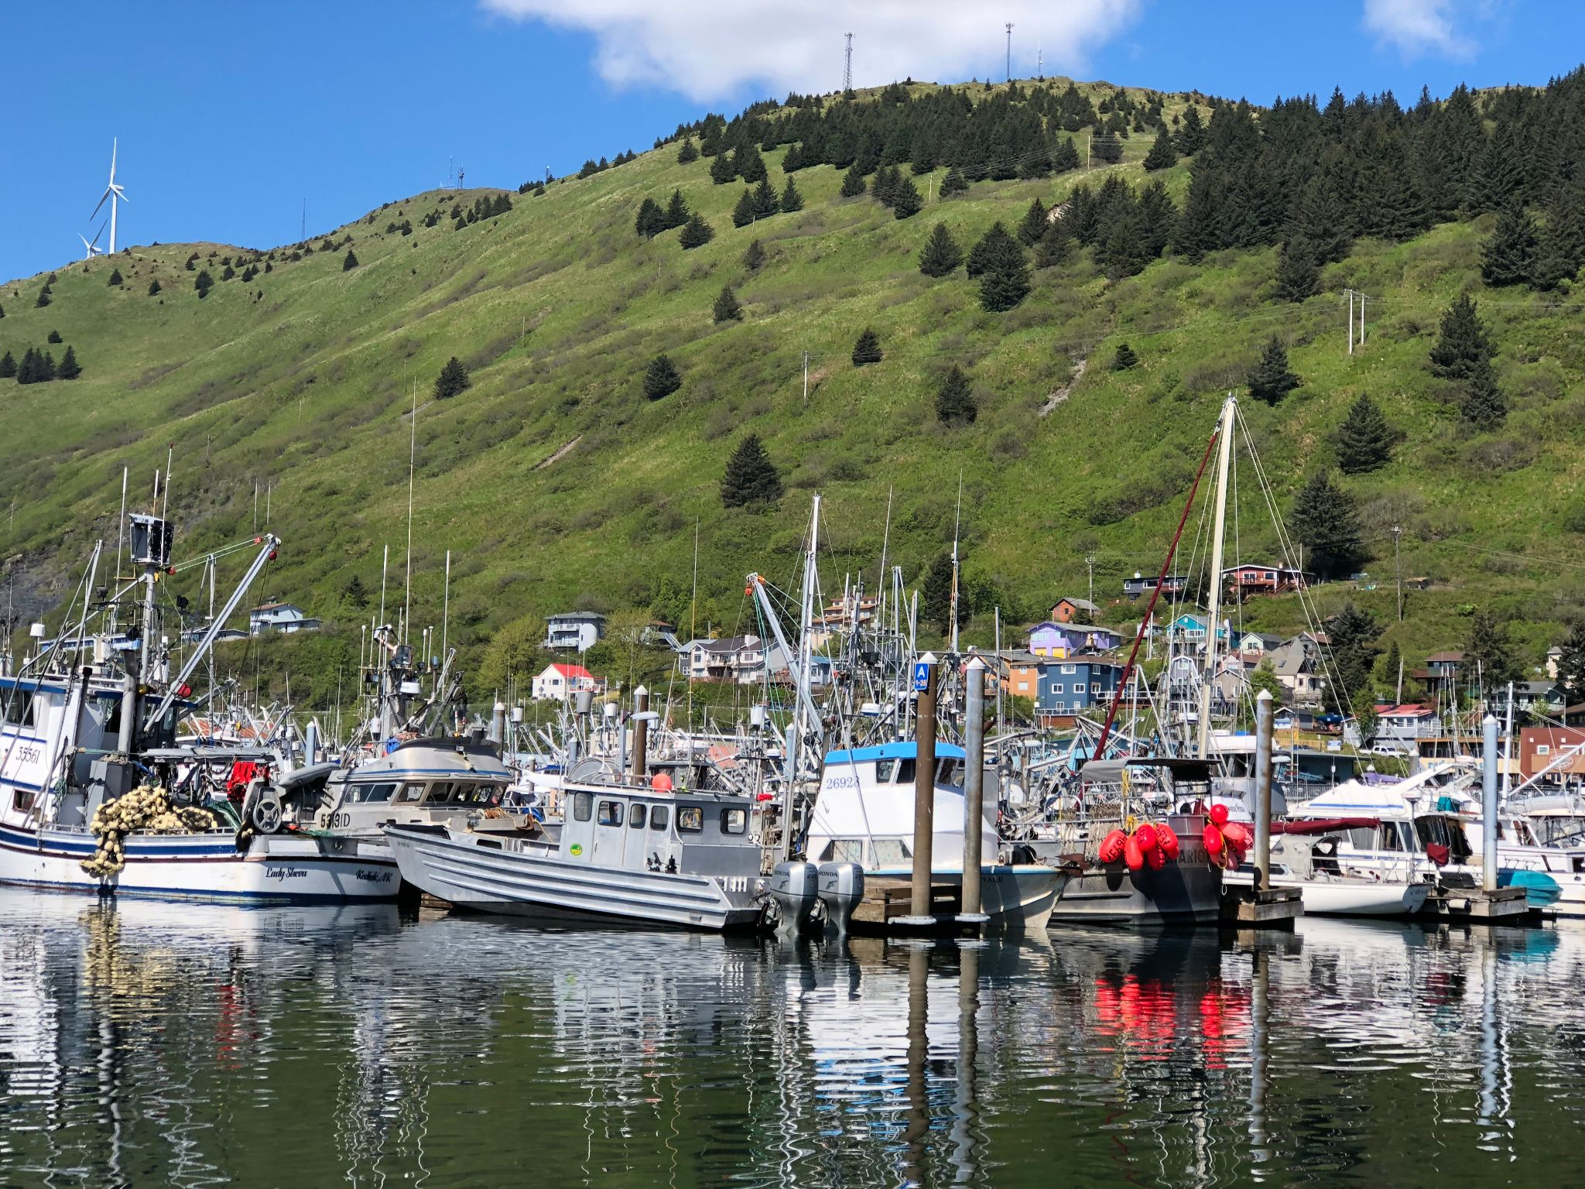
Source: Alaska Department of Fish and Game Staff Comments on the Commercial, Personal use, Sport and Subsistence regulatory proposals (March 17-21, 2026)

Slide 13
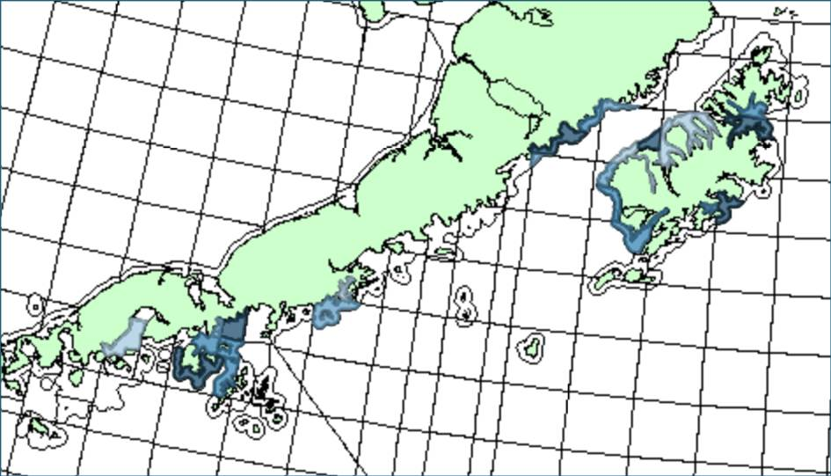
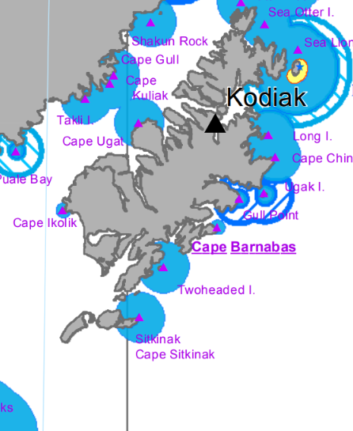
Fleet profiles GOA pelagic trawl
Central GOA pollock harvest in state waters (parallel fishery) 2021-2025
< 832,999 pounds
833,000 - 2,487,999 pounds
2,488,000 - 6,893,999 pounds
> 6,894,000 pounds

Slide 14
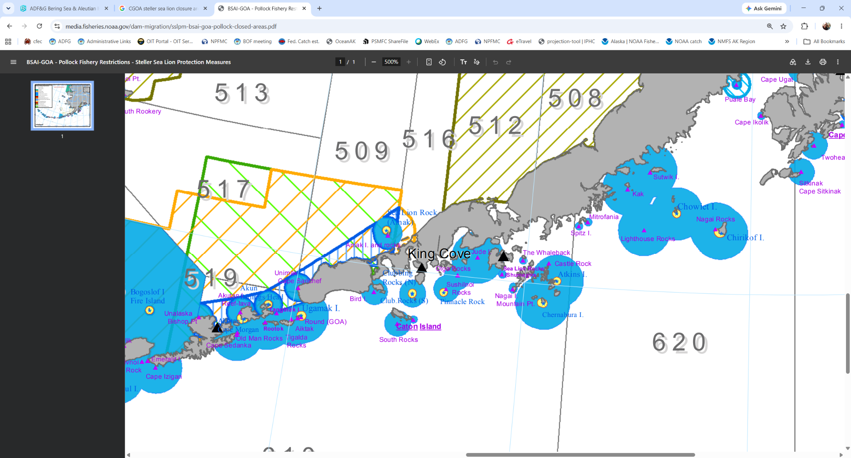
Fleet profiles GOA pelagic trawl
< 832,999 pounds
833,000 - 2,487,999 pounds
2,488,000 - 6,893,999 pounds
> 6,894,000 pounds
< 832,999 pounds
833,000 - 2,487,999 pounds
2,488,000 - 6,893,999 pounds
> 6,894,000 pounds
Western GOA pollock harvest in state waters (parallel fishery) 2021-2025

Slide 15
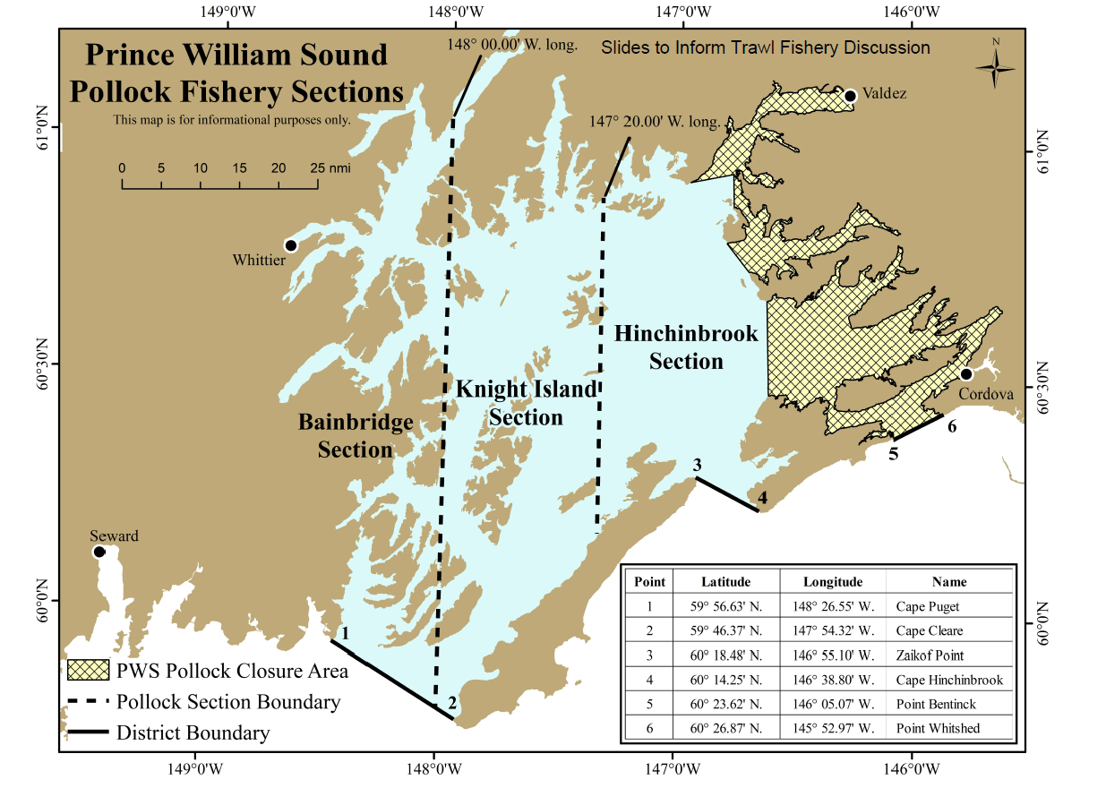
Fleet profiles GOA pelagic trawl
State waters fishery: Prince William Sound pollock fishery

Slide 16
Fleet profiles GOA pelagic trawl
State managed fishery: Prince William Sound pollock fishery
Total of 11 active catcher vessels in 2025; 5-yr average is 14 vessels. 29 unique vessels have participated since 2021.
All vessels also participate in federally managed trawl fisheries.
55% of vessels homeported in Kodiak in 2025; 5-yr average is 63%.
Vessel size ranges from 58’ to 121’ and averages 90’.
ADF&G staff coordinate with the fleet to limit the number of vessels actively fishing.
Majority of harvest delivered to Kodiak. Operational costs for the PWS fishery are generally higher due to fuel costs.
This fishery fills a seasonal gap for some vessels (pre-Feb).

Slide 17
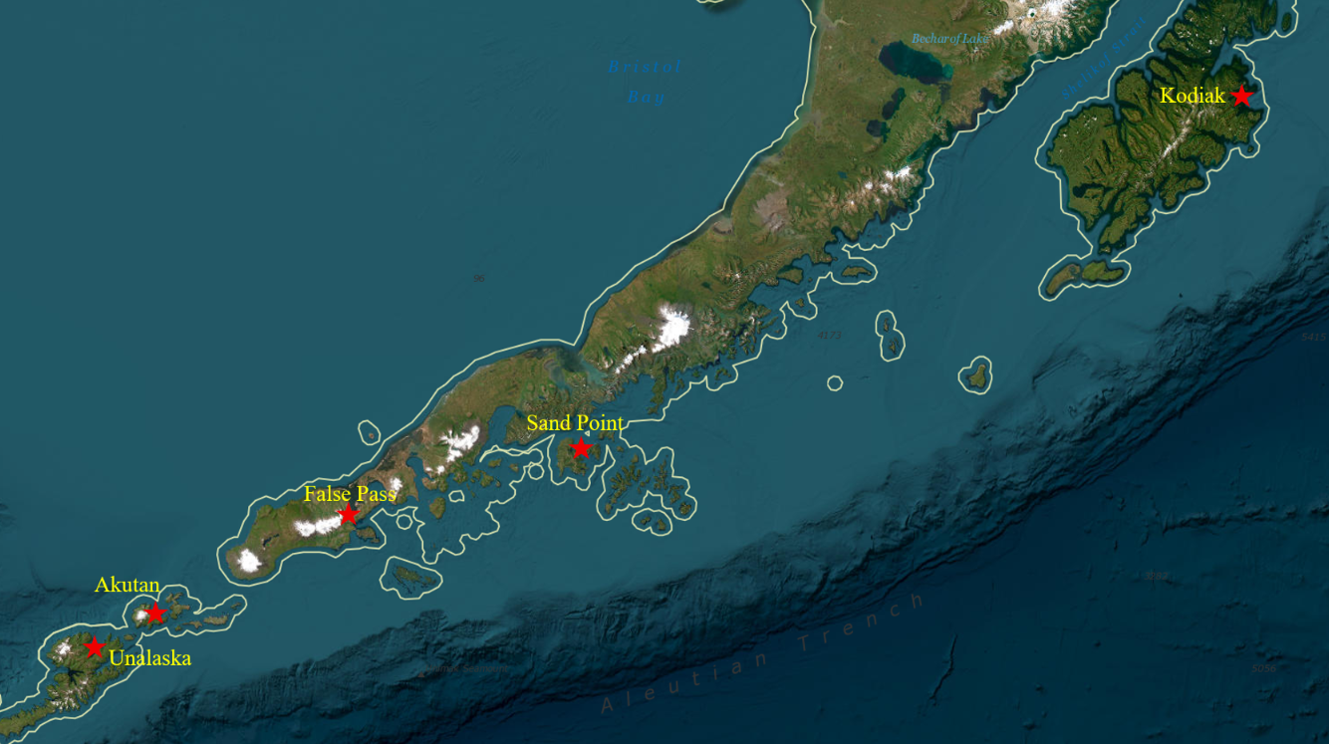
Shore-based processors
Western GOA pollock are primarily processed in Sand Point and Akutan with limited amounts processed in Unalaska and False Pass. Prior to 2023 deliveries also occurred in King Cove.
Central GOA and PWS pollock are processed primarily in Kodiak by four processing companies.

Slide 18
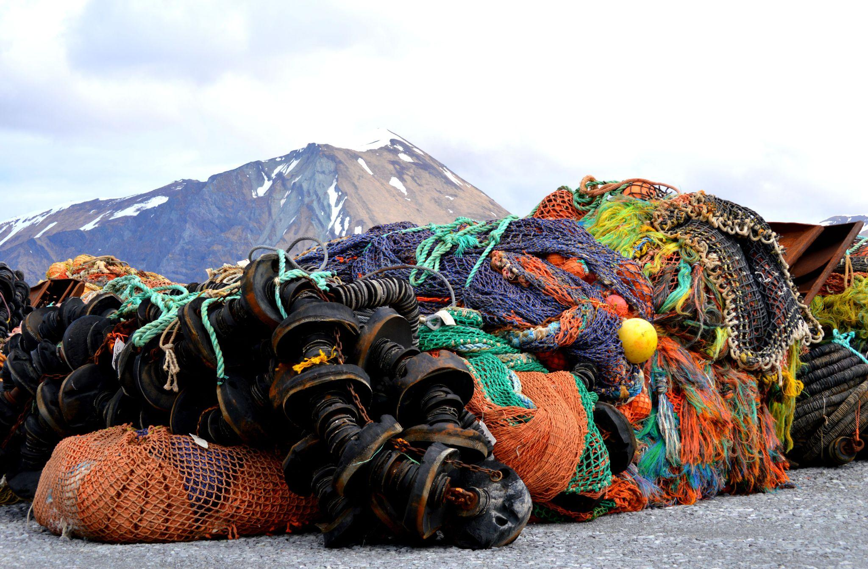
Fleet profile focus
Aleutian Islands non-pelagic trawl
  State fishery:
    AI Subdistrict Pacific cod fishery
  Parallel fisheries:
    Amendment 80 and Trawl Limited Access fishery

Slide 19
Fleet profiles Aleutian Islands non-pelagic trawl (W of 170° W long)
State managed fishery: Aleutian Island Subdistrict Pacific cod fishery
2 active trawl vessels in 2025; 14 unique trawl vessels in the past 10 years. Fishery also open to pot, longline, and jig vessels.
5 trawl vessels homeported in Alaska; 9 vessels homeported in Oregon/Washington
Trawl vessel size ranges from 58’ to 99’; 5 vessels are 58’ and 9 vessels are 85’ - 99’
Vessel size restrictions that vary throughout the season
  first open to vessels <60’,
  then vessels <100’ after March 15 at Commissioner’s discretion
All vessels also participate in federally managed pelagic and/or non-pelagic trawl fisheries
  These vessels are all diversified by target and by gear type: AFA pollock, GOA pollock, Amendment 80, CDQ, Pacific cod Trawl Cooperative, Rockfish Program, GOA pollock, tendering.

Slide 20
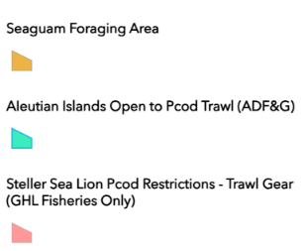
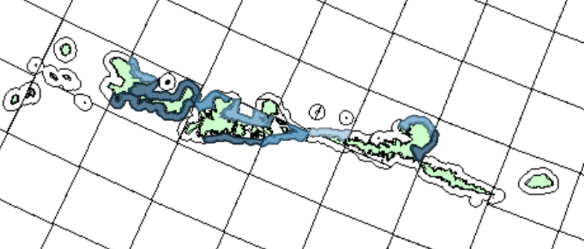
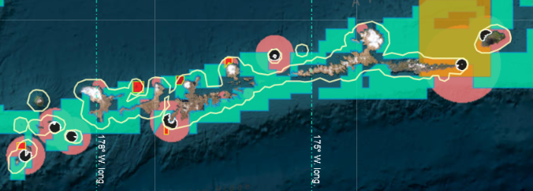
Fleet profiles Aleutian Islands non-pelagic trawl (W of 170° W long)
State managed fishery: Aleutian Island Subdistrict Pacific cod fishery
Pacific cod harvest by trawl vessels 2016-2025
< 347,999 pounds
348,000 - 526,999 pounds
527,000 - 1,500,999 pounds
> 1,501,000 pounds

Slide 21
Monitoring requirements Aleutian Islands parallel fisheries (mainly Atka mackerel & Pacific ocean perch):
Amendment 80 (catcher processors): 200% observer coverage (2 people) + cameras
Trawl Limited Access fisheries (catcher vessels): delivering unsorted catch to motherships with 100% observer coverage for sampling and accounting on mothership
These vessels have the same monitoring requirements in state or federal waters during the AI parallel fisheries.

Slide 22
Fleet profiles Aleutian Islands non-pelagic trawl (W of 170° W long)
Parallel (State) waters: Vessels fishing for rockfish and groundfish in the Aleutian Islands. These vessels are fishing off a federal TAC but go back and forth between Federal and State waters. The state retains jurisdiction over State waters but typically mirrors Federal rules.
Amendment 80 and Trawl Limited Access (TLAS) vessels primarily targeting Pacific Ocean Perch (POP) and Atka Mackerel
  In 2025, 14 vessels fished non-pelagic trawl in the Aleutian Islands, 5 of these vessels had some activity in parallel fisheries; 5-yr avg of 6 vessels.
  These are large catcher processor vessels and some large catcher vessels (98-300 ft in length), primarily processing at sea
  Vessel ownership connected to Seattle, WA and Rockland, ME
  Of the vessels that were active in state-waters, ~1.2% of gross revenue from state waters
  These areas are used for operational flexibility and bycatch avoidance.
Much of the Aleutian Islands is closed to fishing with non-pelagic trawl gear and specific closures related to fishing targeting prey species of Steller Sea Lions (pollock, Pacific cod, and Atka Mackerel), but some discrete area remain open.

Slide 23
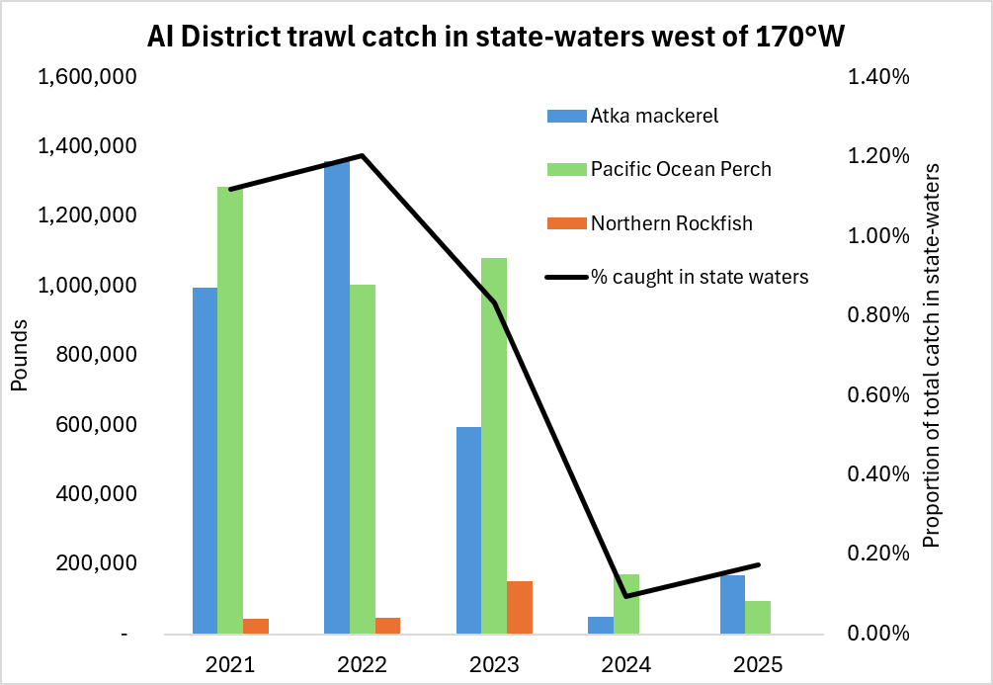
Figure based on data found in Table 11-3, in Alaska Department of Fish and Game Staff Comments on the Commercial, Personal use, Sport and Subsistence regulatory proposals (March 17-21, 2026) which demonstrates trends in pounds harvested in state and federal waters.

Slide 24
Part 2: Management Measures
Scope: Federal management measures to minimize adverse impacts from commercial fishing
Sarah Marrinan (NPFMC)

Slide 25
 | Type of management measures (examples)
 | Area closures | Bycatch limit | Gear requirements
Objective | Protect sensitive habitat Reduce bycatch and gear interactions in known areas of encounters | Incentivize avoidance of certain non-target species Ensure certain level of catch of non-target species is not exceeded | Bycatch reduction Reducing physical impact of gear Safety standards Effort control
Variations | Could be specific to: certain types of gear, certain sensitive times of the year for a species, or triggered based on inseason bycatch Dynamic area closures (rolling hotspot program) intended to reduce bycatch based on inseason catch and bycatch data | Hard cap that closes a fishery Cap that triggers an area and/ or time- based closure Performance standard that may lower the cap based on repeated overages Sometimes bycatch limits are indexed to abundance of a non-target species | Specification in regulation Frameworked in regulations
Examples | Aleutian Island Habitat Conservation Area Red King Crab Savings Area Ongoing consideration of a custom area on the East side of Kodiak Island | Chinook salmon hard cap and performance standard cap for Bering Sea pollock fishery (indexed to abundance) Halibut abundance-based cap for Amendment 80 fishery | Required use of raised sweeps for non-pelagic trawl gear Required use of biodegradable twine in pots Limits on vessel size
  Management tools are chosen to address specific objectives

Slide 26
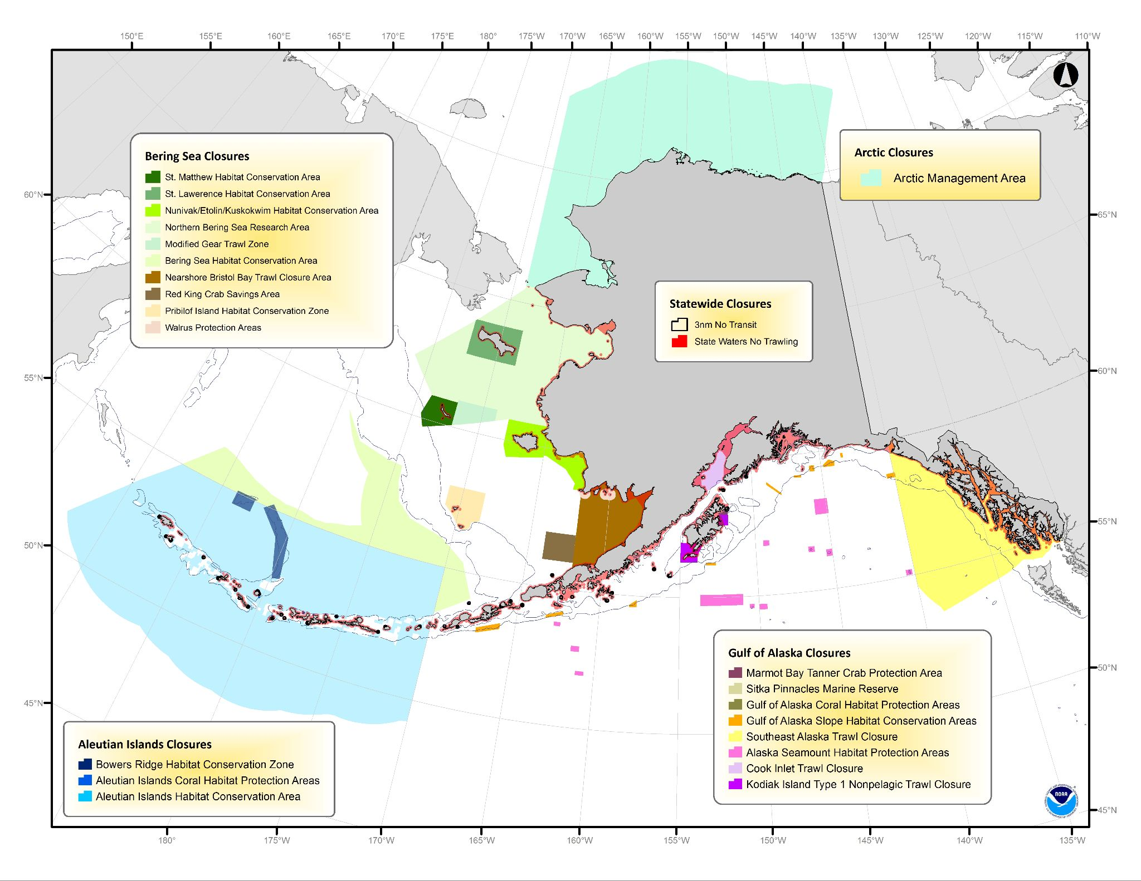

Slide 27
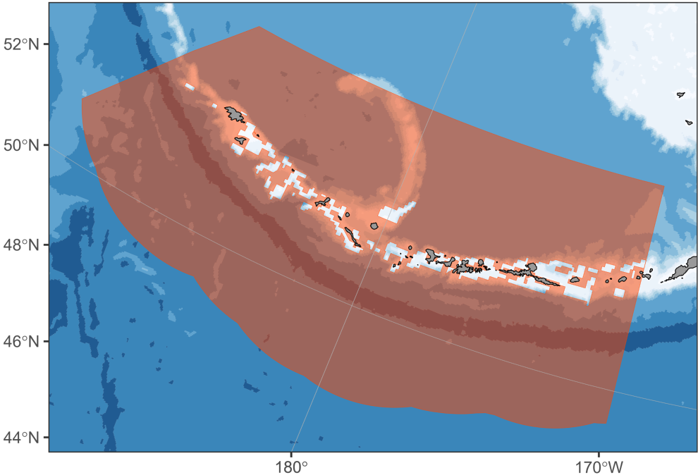
Area closures: Aleutian Island Habitat Conservation Area
The AIHCA encompasses the entire Aleutian Islands subarea except for specified areas
Implemented in 2006 to prevent the expansion of non-pelagic trawling into relatively undisturbed habitats while allowing most major fishing areas to remain open.
Areas with historically high catches were designated to remain open.
Includes habitat not designated as EFH; however, incomplete information suggested a more precautionary measure that may be important to managed species
Source: North Pacific Conservation and Spatial Management Areas in Alaska’s Exclusive Economic Zone; Areas Summaries
For more information: Amend 78 Proposed Rule, 71 FR 14470, March 22, 2006
And Amend 88 Proposed Rule, 72 FR 655539, Nov 21, 2007

Slide 28
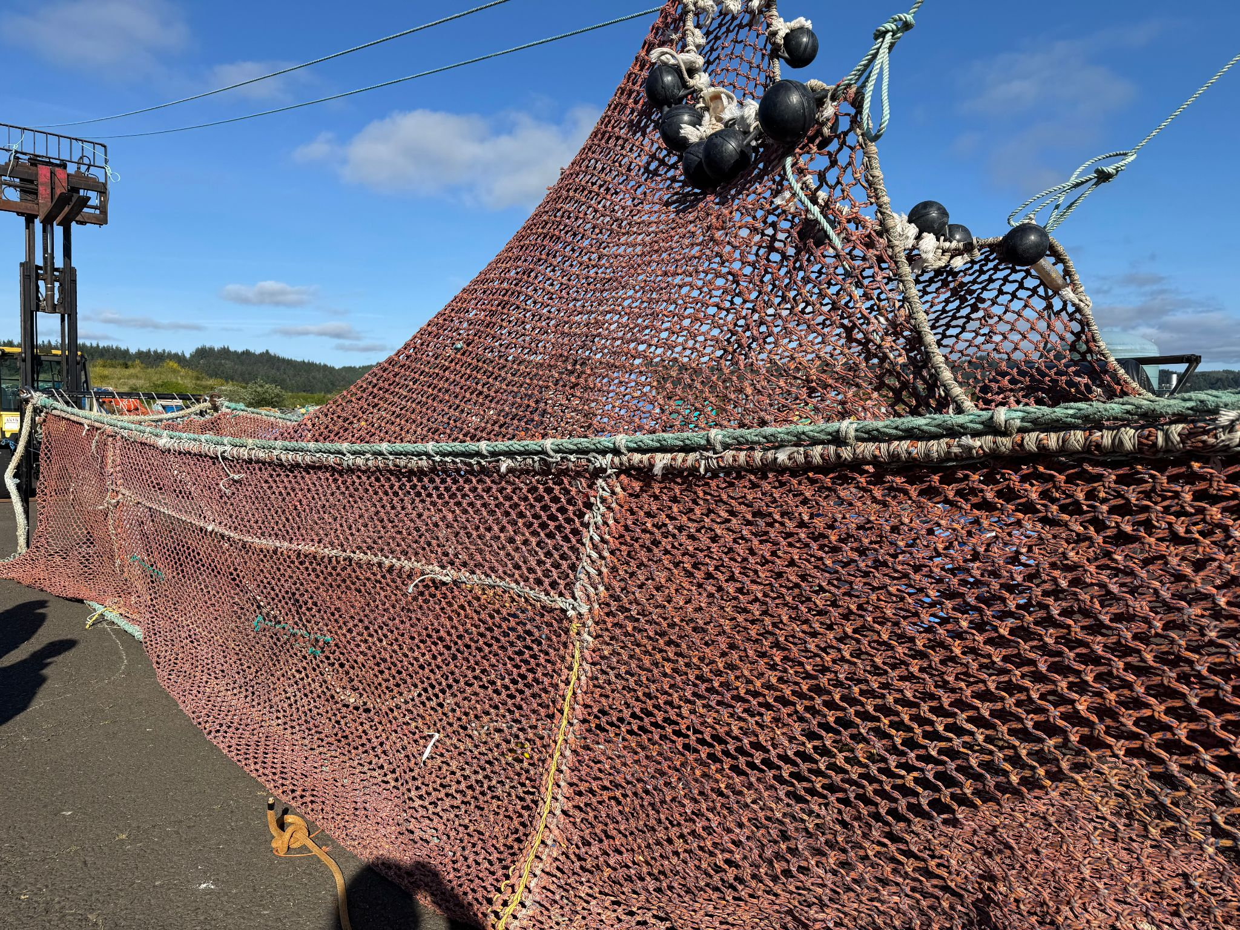
Salmon excluder use and requirements in Federal waters
Salmon excluders are a modification to a trawl net that allows salmon to escape, while retaining the target catch.
Bering Sea pelagic trawl fisheries: Required for the fleet throughout the year in contracts that are required in regulation and approved by NMFS. Annual reports are also must be submitted to the Council describing use, compliance, and highlighting any contingencies. Regulations do not dictate design or specifications.
GOA pelagic trawl fisheries: Widely adopted by most of the Central Gulf fleet delivering to Kodiak. Less overall use by the WGOA fleet. Largest hurdle cited by these operators was in identifying an effective design for smaller, low horsepower vessels. No Federal requirements or specifications for excluder use in the GOA.

Slide 29
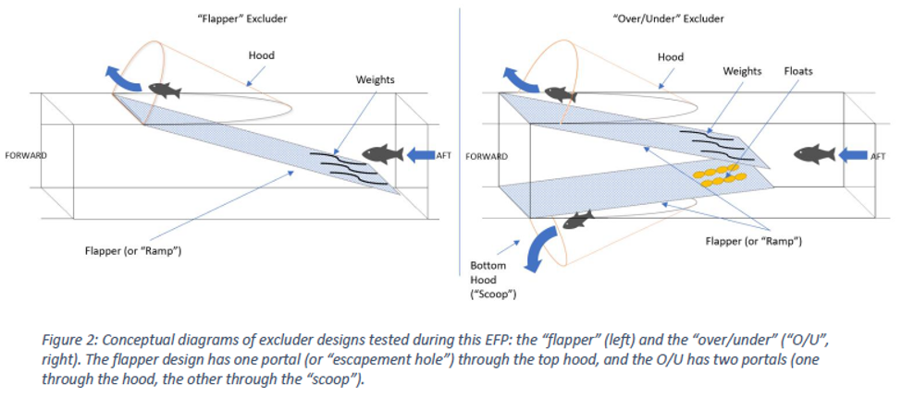
Salmon excluder design and innovation
Two common designs for salmon excluders: “flapper” design and the “over/under” (O/U) design
Both styles rely on the difference in swimming behavior between the target catch and bycatch species to encourage escapement from the bycaught species.
There are variations on these designs, as well as how they are installed (e.g. where in the net), and deployed. They are highly customizable.
Source: EFP 2018-03 Final Report

Slide 30
Salmon excluder design and innovation
Different designs work better for different vessels
Vessel horsepower and towing speed has shown to be a key factor in effectiveness
EFPs demonstrate they can be highly effective under the right conditions and when installed on the right vessel
Can have negative impacts on catch and bycatch when the wrong design or configuration is used for a vessel
Detailed specifications on gear design in regulations can inhibit opportunities for innovation
Salmon excluder designs have been tested and modified through Exempted Fishing Permits (EFP) and through on-the-water use since 2003.
There have been 6 EFPs since, testing and modifying design variables.
Currently one active EFP for a chum salmon excluder design which is a very different design (EFP report linked in the eAgenda)
There are likely to be future improvements in design and configuration

Slide 31
Part 3: Habitat
Scope: Statutory requirements for assessing the impacts of Council-managed groundfish fisheries on habitat, and tools the Council uses
Jodi Pirtle, Ph.D. (NMFS) - Essential Fish Habitat Overview
Brad Harris, Ph.D. (UAA/APU) - Fishing Effects Model as an input in EFH Review

Slide 32
Essential Fish Habitat (EFH) Resources Linked
2023 EFH Review Final Summary Report - Excellent Overall Reference
2022 EFH Fishing Effects Evaluation - Detailed Reference
Infographic EFH Fishing Effects Model - Handy Guide
Current EFH Review Workplan and Council Motion (D3 Dec 2025)
  Current EFH Review Descriptions and Maps Workplan (D2 Feb 2026)
  Current EFH Review Fishing Effects Workplan (D2 Feb 2026)
Joint Protocol Committee Meeting October 2026 eAgenda

Slide 33
EFH Introduction
The Magnuson-Stevens Fishery Conservation and Management Act (MSA) defines EFH as “those waters and substrate necessary to fish for spawning, breeding, feeding, or growth to maturity”.
The MSA (303(a)(7)) requires that fishery management plans describe and identify EFH, minimize to the extent practicable adverse effects on EFH caused by fishing, and identify other actions to encourage the conservation and enhancement of EFH.
We must identify EFH for species with a federal fishery management plan, evaluate whether federal fisheries are having more than minimal or temporary adverse effects on EFH, and act as warranted.
NMFS published guidelines to implement the MSA’s EFH provisions in Federal regulations at 50 CFR 600 Subpart J - Essential Fish Habitat and Subpart K - EFH Coordination, Consultations, and Recommendations.
2023 EFH Review Final Summary Report (chapter 1) and Current EFH 5-year Review Workplan (December 2025; chapter 1)

Slide 34
EFH Components of Fishery Management Plans
Description and identification of EFH
Fishing activities that may adversely affect EFH
Non-MSA fishing activities that may adversely affect EFH
Non-fishing activities that may adversely affect EFH
Cumulative impacts analysis
Conservation and enhancement
Prey species list and habitat locations
Identification of habitat areas of particular concern
Research and Information needs
Review and revision of EFH components of fishery management plans
Federal regulations require each federal fishery management plan contain the ten EFH components.
2023 EFH Review Final Summary Report (chapter 1) and Current EFH 5-year Review Workplan (December 2025; chapter 1)

Slide 35
EFH Components of Fishery Management Plans
Description and identification of EFH
Fishing activities that may adversely affect EFH
Non-MSA fishing activities that may adversely affect EFH
Non-fishing activities that may adversely affect EFH
Cumulative impacts analysis
Conservation and enhancement
Prey species list and habitat locations
Identification of habitat areas of particular concern
Research and Information needs
Review and revision of EFH components of fishery management plans
Decision-support system to meet the MSA requirements for assessing the impacts of Council-managed groundfish fisheries on EFH.

Slide 36
EFH 5-year Reviews
The EFH 5-year review is a mechanism to ensure that the Councils and NMFS incorporate the best science available for EFH into fishery management.
EFH Component 10: Federal regulations require Fishery Management Councils review and revise EFH components at least every five years, and amend EFH provisions in the FMPs, as warranted, based on available information (50 CFR 600.815(a)(10)).
EFH EIS (2005) and EFH reviews (2010, 2017, 2023, and current review in-progress).
The plan for the current EFH review is based on direction received from the Council during the 2023 EFH Review and reflects the priorities of the Council and NMFS.
2023 EFH Review Final Summary Report (chapter 1) and Current EFH 5-year Review Workplan (December 2025; Appendix A)

Slide 37
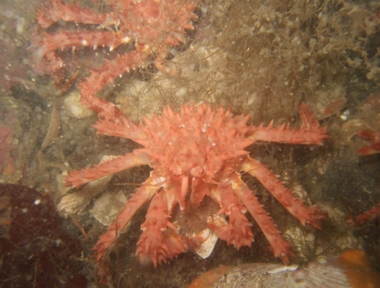
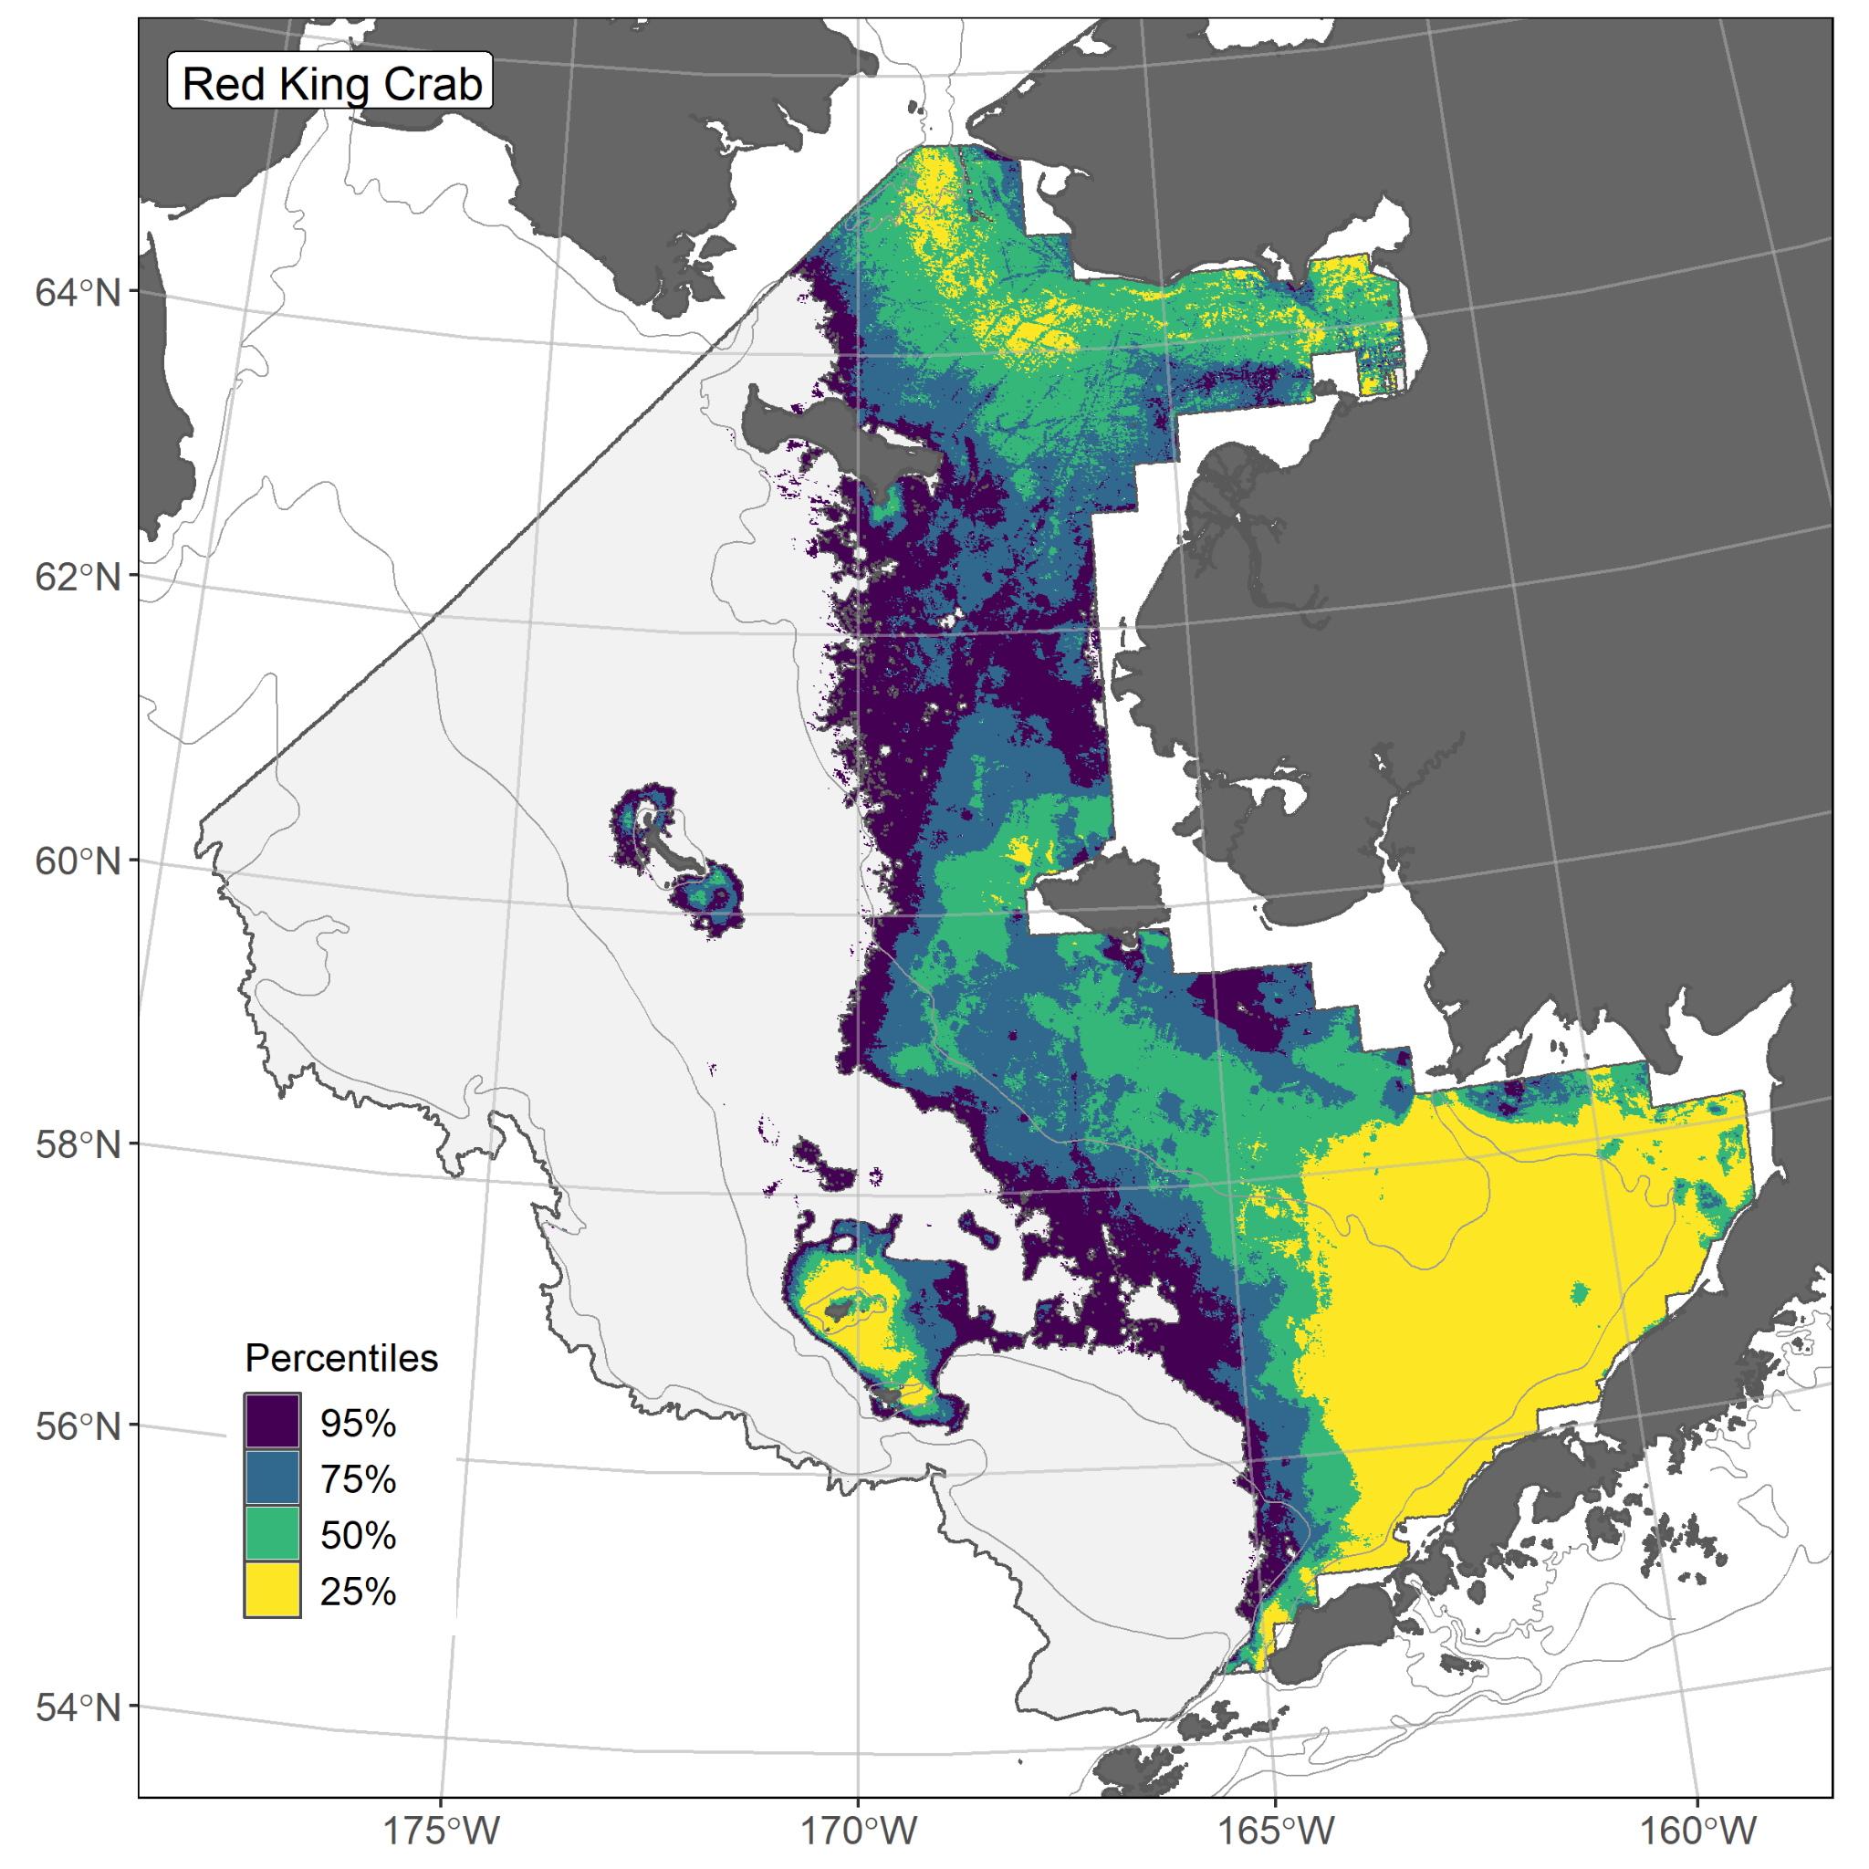
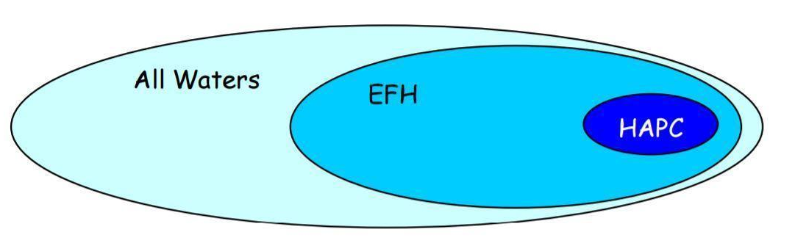
EFH Description and Identification
EFH Component 1 - Description and Identification. In the fishery management plans (FMPs) as text descriptions, tables, and maps.
Requires individual species maps for the fishery management unit of the FMP (50 CFR 600.805(b)), where some or all portions of the species’ geographic range is mapped (50 CFR 600.815(a)(1)).
Red King Crab EFH Map
2023 EFH Review Final Summary Report (chapter 2)

Slide 38
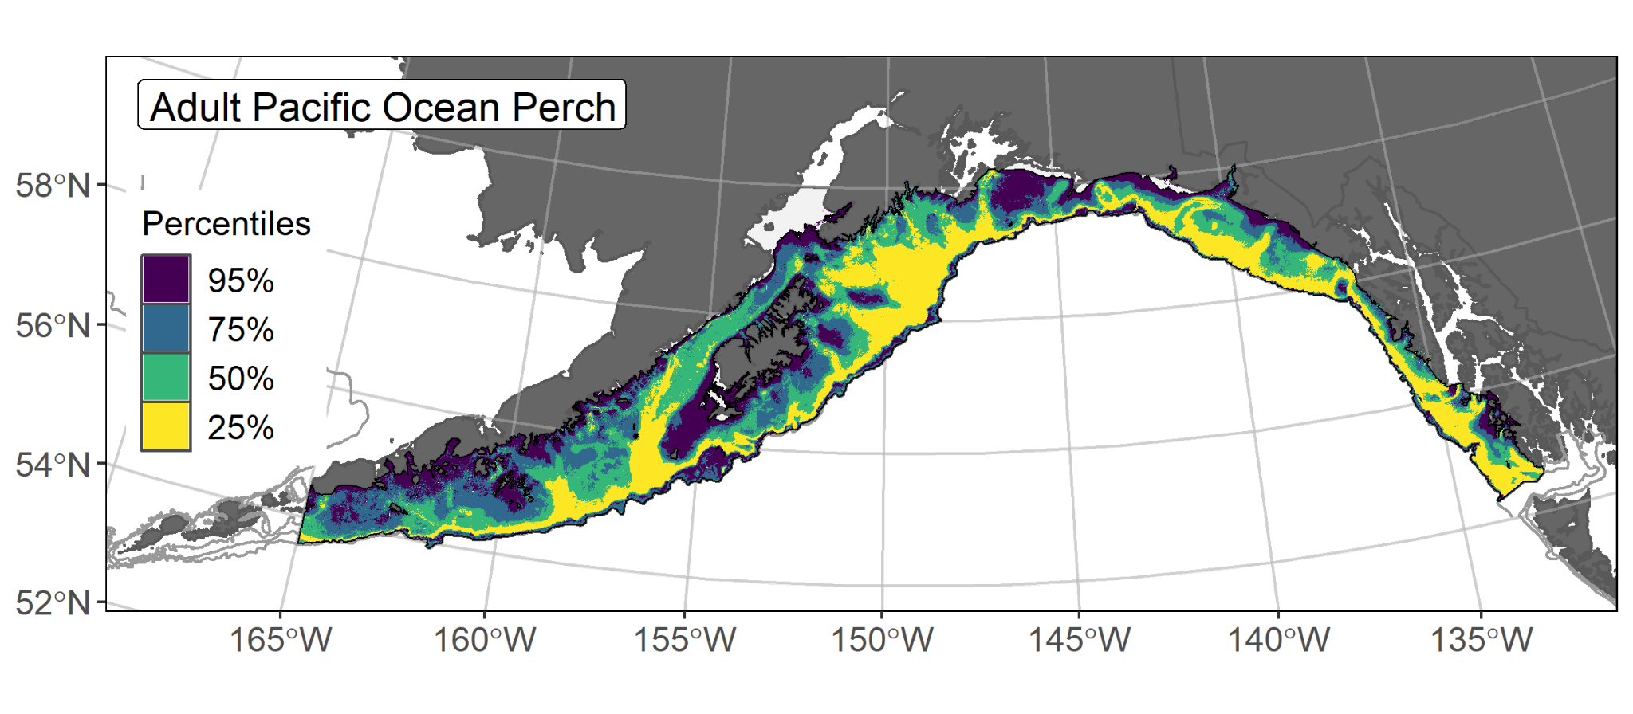
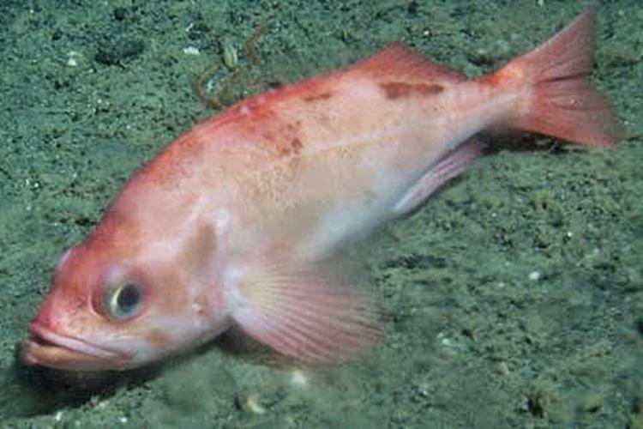
North Pacific EFH Maps
We map EFH in our region using Species Distribution Models (SDMs).
SDMs apply data to produce a map based on the relationship between species occurrences and environmental variables (e.g., temperature, depth, coral presence).
SDM EFH maps were introduced in the 2017 EFH Review and refined in each subsequent EFH review with updated methods and data to improve model skill.
EFH is the upper 95% of the spatial domain of occupied habitat.
Core EFH area is the upper 50% of the area of occupied habitat (yellow and green areas) and is an EFH fishing effects analysis input.
EFH Descriptions and Maps Workplan (February 2026) and 2023 EFH Review Final Summary Report (chapter 2)

Slide 39
EFH Descriptions and Maps Update
For the current EFH 5-year Review, we will apply the 2023 EFH Review SDM ensemble with new and revised species and environmental data to map EFH.
New EFH maps will be developed for the following:
  A subset of groundfish species by life history stage in the BSAI and GOA FMPs: sablefish, pollock, Pacific cod, Pacific ocean perch, and arrowtooth flounder.
  All five crab species in the Crab FMP, by sex and maturity stage, which was a research recommendation from the 2023 Review.
We will also develop new spatio-temporal SDMs to explore changes in EFH over time, as recommended by the SSC during the 2023 Review (e.g., Council’s Climate Workplan).
EFH Descriptions and Maps Workplan (February 2026)

Slide 40
EFH Fishing Effects
EFH Component 2 - Fishing activities that may adversely affect EFH
EFH regulations (50 CFR 600.815(a)(2)):
(i) Evaluation: Each FMP must contain an evaluation of the potential adverse effects of fishing on EFH designated under the FMP.
(ii) Minimizing adverse effects: Each FMP must minimize to the extent practicable adverse effects from fishing on EFH. Councils must act to prevent, mitigate, or minimize any adverse effects from fishing, to the extent practicable, if there is evidence that a fishing activity adversely affects EFH in a manner that is more than minimal and not temporary in nature, based on the evaluation.
The Council has taken several actions to minimize potential adverse impacts to EFH from fishing activities (EFH conservation measures, sections 7.1 and 9.3).
2023 EFH Review Final Summary Report (chapter 3, chapter 7 section 7.1, chapter 9 section 9.3) and North Pacific Conservation Area Summaries

Slide 41
EFH Fishing Effects Evaluation Workflow
Step 1: Review and update FE model inputs with new data and information
Step 2: Run the FE model
EFH Fishing Effects (FE) evaluation is a multi-step process:
Review and update inputs to FE model.
  WE ARE HERE
FAST Lab runs the FE model.
Overlay FE model results with the updated EFH maps.
Stock assessment authors conduct their evaluation process.
  Effects determinations by species.
Report findings and conclusions to Council bodies.
  Opportunity to recommend species for possible mitigation measures as related to FE evaluation results.
Step 3: Overlay FE model results with updated EFH Maps (SDM CEAs) and calculate estimates of habitat disturbance for each area
Step 4: Provide stock assessment authors with species results and launch their evaluation of adverse effects to EFH at the species population level
Step 5: Report FE model results and stock assessment author conclusions to the Council bodies
EFH Fishing Effects Workplan (February 2026) and 2022 EFH Fishing Effects Evaluation

Slide 42
Current EFH 5-year Review
The current EFH 5-year review was launched in December 2025.
The plan is based on direction received from the Council during the 2023 EFH Review (2023 EFH Review Final Summary Report) and reflects the priorities of the Council and NMFS.
The Council’s Scientific and Statistical Committee (SSC) reviewed proposed workplans for the EFH maps and EFH FE evaluation in February 2026.
The SSC is scheduled to receive a progress update on the EFH FE model in February 2027.
The Council will receive a Summary Report representing new information available from the current EFH Review. Appropriate analysis will follow at the Council’s recommendation.
Current EFH 5-year Review Workplan (December 2025; Appendix A) and Council Motion (December 2025)

