Slide 1
Part 5: Ongoing NPFMC Actions
Scope: Council actions underway related to habitat, trawl gear bottom contact, and gear innovation
Sarah Marrinan, NPFMC

Slide 2
Consideration of Pelagic Trawl Gear Performance Standard
This is identified as one of the Council’s explicit top priorities
In June 2026, the Council focused on regulatory mechanisms to reduce bottom contact of pelagic trawl gear in areas currently closed to non-pelagic trawl gear, while still meeting other legal requirements such as maintaining optimum yield for the fisheries and minimizing salmon bycatch.
The Council stated its focus is on unobserved crab mortality, not benthic habitat effects
  In light of depressed red king crab populations and significantly changing ecosystem conditions
  Because the EFH reviews have not identified significant benthic habitat impacts from any fishing sector gear type (conclusions are that adverse effects of fishing activity on EFH are no more than minimal and temporary)
The Council’s next step is to use the upcoming staff analysis to develop new management measures to reduce bottom contact by pelagic trawl gear.
The Council continues to endorse ongoing gear research on pelagic trawl gear innovation in support of future management actions.

Slide 3
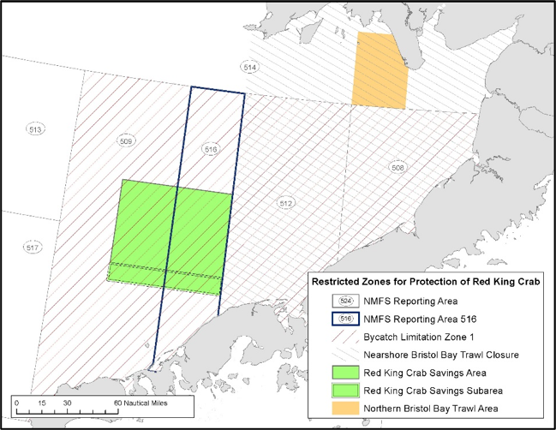
Voluntary Crab Closures
The Council also requested the pollock industry develop spatial closures during the A season in 2026 (and again in 2027), while articulating that salmon bycatch avoidance remains the highest priority.
In June 2026, the Council received presentations from pollock industry representatives on these dynamic spatial closures that were used for crab avoidance in the 2026 A season inside and outside the Red King Crab Savings Area (RKCSA).
This area already prohibits non-pelagic trawling as a crab protection measure.

Slide 4
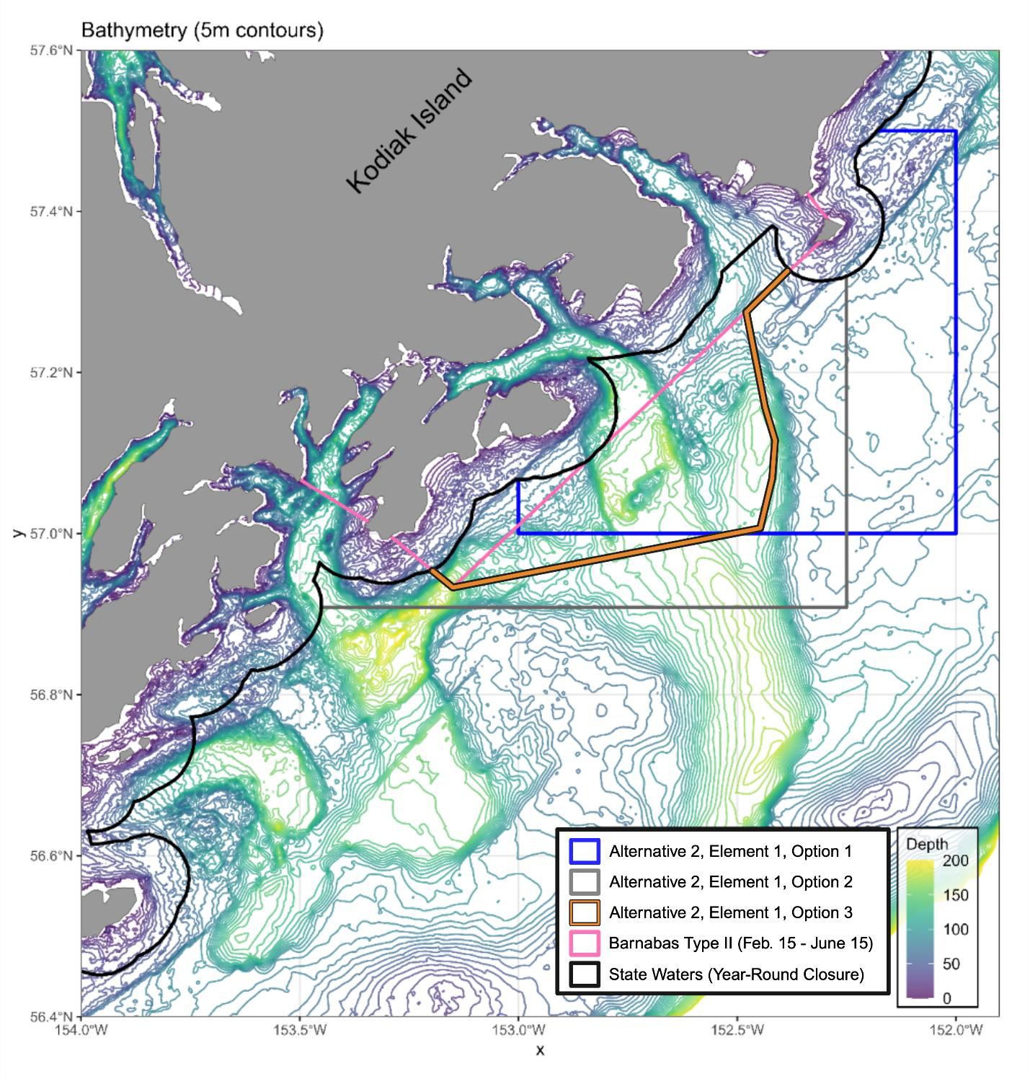
Consideration of Kodiak Tanner Crab Protection Measures
This is one of the Council’s explicit top priorities.
The Council is considering closing additional areas to bottom trawl, pelagic trawl and/or pot gear around Kodiak to protect Gulf of Alaska Tanner crab (a state managed fishery). The areas under consideration are where high densities of Tanner crab are known to occur during important life stages
The Council’s objective is to further conserve and protect Tanner crab around Kodiak Island, while minimizing negative impacts on groundfish fisheries, as both crab and groundfish fisheries are important to the harvesting, processing, and support sectors in Kodiak.
As with all actions, the Council must consider impacts to fishing and processing participants, communities, impacts to other bycatch species, impacts on safety, etc.
Figure: Alternative 2, Element 1, Options 1, 2, and 3; see motion for full consideration of proposed changes

Slide 5
Essential Fish Habitat 5-yr Review
The next EFH 5-year review is scheduled to occur in 2028.
This will include a process where components of the review are presented to the SSC and Council in steps.
The next step will be in Feb 2027, with the SSC review of EFH Fishing Effects (FE) progress update, including planned FE model updates in progress and FE model analysis draft methods, supporting the EFH FE evaluation.

Slide 6
Summary notes
Part 1: Fisheries Description
Pelagic trawl fishing in State waters primarily occurs in 1) areas of the WGOA, 2) areas around Kodiak Island, and 3) the Prince William Sound pollock fishery. Many of these vessels are from the WGOA and Kodiak and catch is delivered to Kodiak, Sand Point and Akutan, AK. Most vessels utilize state waters for a portion of their catch and some vessels are highly dependent on state waters.
Most of the AI is closed to non-pelagic trawl, but there are some distinct areas still open. Trawl fishing West of 170 W long primarily includes vessels <100’ participating in the State managed AI Subdistrict Pacific cod fishery and some activity from Amendment 80 and TLAS vessels.
All vessels that have been fishing with trawl gear in state waters have an FFP which means they must comply with federal monitoring and reporting requirements.
Part 2: Management Measures
There are many types of area closures in Federal waters designed around a specific intent (e.g., protections for sensitive habitat, bycatch reduction, etc.)
The AIHCA was designed to ‘freeze the footprint’ of non-pelagic trawl fishing the AIHCA and protect sensitive habitats, such as cold water corals and relatively undisturbed areas.
Salmon excluders have been fully adopted in the Bering Sea pollock fishery and widely adopted in the GOA to minimize salmon bycatch.
While some excluder designs have been used for years now, there is also ongoing innovation and customization in the design, as they are not a one-size-fits all tool.

Slide 7
Summary notes
Part 3: Essential Fish Habitat
Identification of EFH is a Federal requirement under the Magnuson-Stevens Act
Adverse fishing effects on EFH are required to be mitigated and evaluated for whether they meet a threshold of ‘more than minimal and not temporary’.
In the North Pacific, there is a specific 5-year review process that is peer-reviewed and is continually improving as information is available.
This review has shown that with the existing protection measures, fishing effects in the North Pacific do not meet the threshold of more than minimal and not temporary.
Part 4: State of the Technology
Ongoing work is being done to improve our understanding of fishing gear impacts. Specifically, work is being done to catalog how every pelagic trawl net in the Bering Sea and GOA impacts EFH (rather than general characterizations).
Work is also being done to continue to identify ways to minimize impacts of that gear on habitat and bycatch where possible. This research gear design and innovation often comes through EFPs initiated by the fishing industry.
The Trident modified footrope EFP is an example of efforts underway to reduce bottom contact through changes in design.
New technology aims to work towards goals of minimizing habitat and bycatch impacts without compromising efficiencies.
Once these changes have been proven they can be implemented into a management system (bottom trawl raised sweeps and trawl EM are examples of this that have been implemented in the past).

Slide 8
Summary notes
Part 5: Ongoing Council actions
The Council is actively reviewing better ways to consider the pelagic trawl gear performance standard, to measure bottom contact, and address concerns around unobserved crab mortality.
In the meantime, the Council has requested industry collaboration in using dynamic spatial closures for the protection of crab, in particular in and around the Red King Crab Savings Area, while also prioritizing avoidance of salmon bycatch.
The Council is reviewing fishing area closures options around Kodiak Island to protect Tanner crab.
Council and NMFS are continuously evaluating commercial fishing effects on habitat and identifying EFH through a 5-year review process. Although the review is every 5 years (next scheduled 2028), the work to support this review is continuous. The Council is currently engaging with the workplan and methodology for the next review.

