Slide 1
Economic Data Reporting (EDR)
Stakeholder Discussion
Webinar #1 Summary and Discussion
NPFMC Social Science Planning Team Meeting, 9/21/20
Katie Latanich, Facilitator

Slide 2

Workshop agenda and objectives
Virtual engagement strategies
Themes of discussion
Overview
Speaking - Katie Latanich

Slide 3
EDR Discussion Objectives
1. Discuss the Council’s existing EDR programs, including their objectives, the use of EDR information to support decision-making, and the relationship between the data elements collected, economic performance metrics, and the management questions they can inform.
2. Generate ideas for improving the usablity, efficiency, and consistency of existing EDR programs while minimizing their cost and burden to industry and the government.
Speaking - Katie Latanich

Slide 4
1. Introductions and purpose
2. Quick discussion: Economic data objectives
3. Presentation: EDR objectives and use
BREAK (10 min)
4. Discussion: Balancing utility, cost, and burden
Webinar Agenda
Speaking - Katie Latanich

Slide 5
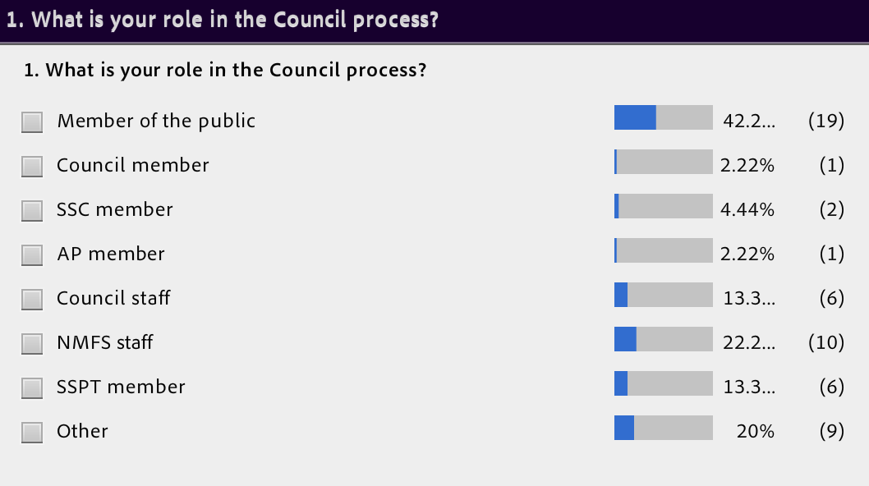
Virtual engagement
Given the large group size (60+) we used voluntary multiple-choice polls for participant introductions and to provide a quick snapshot of participation. (Caveats: not all participants opted to respond, and respondents varied between questions.)
Speaking - Katie Latanich

Slide 6
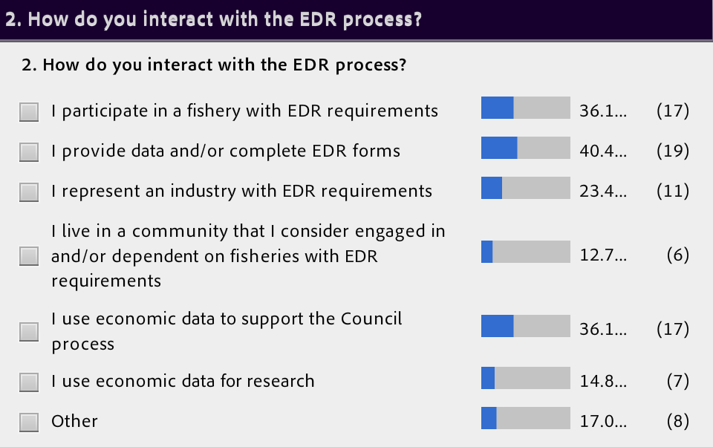
Speaking - Katie Latanich

Slide 7
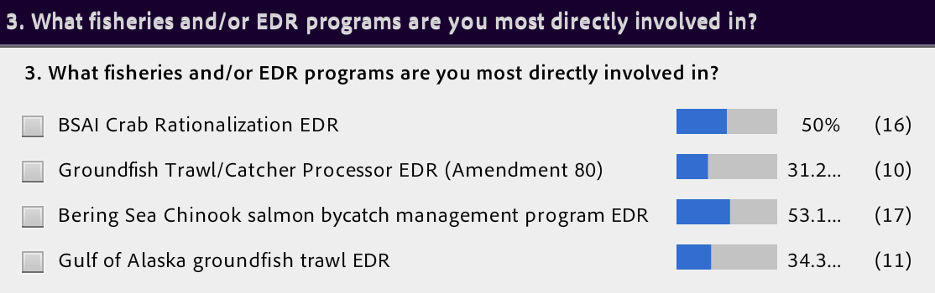
Speaking - Katie Latanich

Slide 8
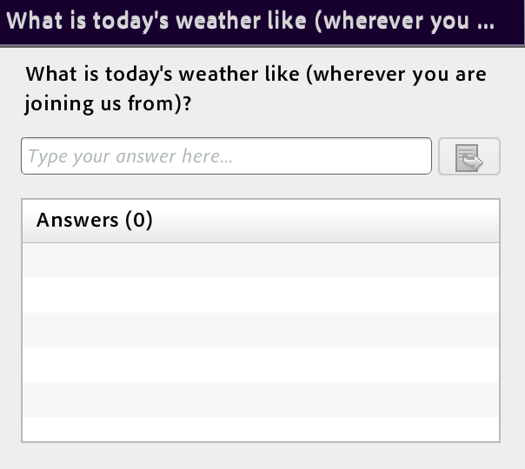
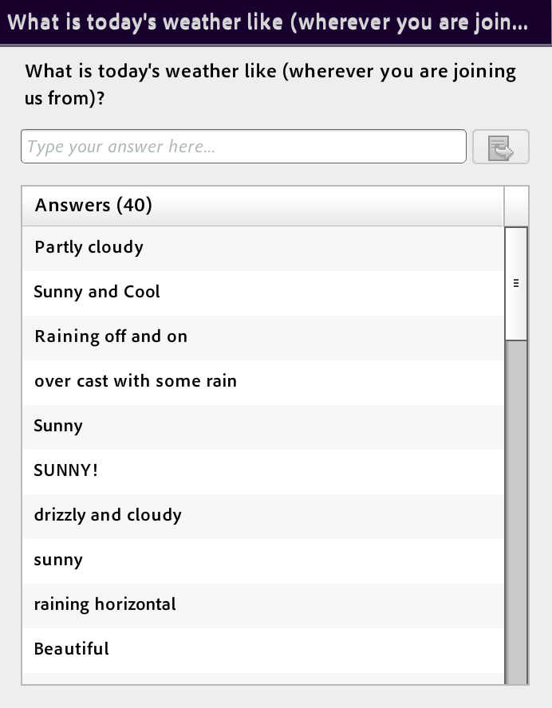
Test question
We used open-ended, short answer questions used as a virtual flip chart. We began with an example to familiarize participants with this format.
“Thinking time,” then display results
Speaking - Katie Latanich

Slide 9
1. Discuss the Council’s existing EDR programs, including their objectives, the use of EDR information to support decision-making, and the relationship between the data elements collected, economic performance metrics, and the management questions they can inform.
2. Generate ideas for improving the usablity, efficiency, and consistency of existing EDR programs while minimizing their cost and burden to industry and the government.
EDR Discussion Objectives
Speaking - Katie Latanich

Slide 10
Short answer polls: Use and caveats
Virtual flip chart and discussion tool, quick (2 min)
Most helpful for capturing the range of ideas, topics, and concerns
Responses vary in format (words, phrases, questions)
Not: how important are these concerns; how widely are they shared, etc.
Speaking - Katie Latanich

Slide 11
What economic dynamics and concerns are important to your business or community that you think the Council should understand in decision making?
Speaking - Katie Latanich

Slide 12
What do you feel are the biggest factors contributing to the time and burden of EDR data collection?
What do you think it means to use EDR data effectively?
What else? What other questions should we ask about the EDR program?
Speaking - Katie Latanich

Slide 13
Time and burden
What do you feel are the biggest factors contributing to the time and burden of EDR data collection?
Duplication
Frequency/time frame
Recordkeeping
Accuracy and representativeness
Other concerns
  Costs
  Audits
  Privacy/invasiveness
  Equity
Speaking - Katie Latanich

Slide 14
Utility
What do you think it means to use EDR data effectively?
3 bins...
Attributes of EDR data and collections
Metrics EDR data help inform
Management applications of EDR data
Speaking - Katie Latanich

Slide 15
Questions and discussion opportunities
What else? What other questions should we ask?
Topics
Timing
Relevance
Utility/use in Council process
Duplication
Consistency vs. specificity
Burden and equity
Speaking - Katie Latanich

Slide 16
Questions and Discussion
Speaking - Katie Latanich

