Slide 1
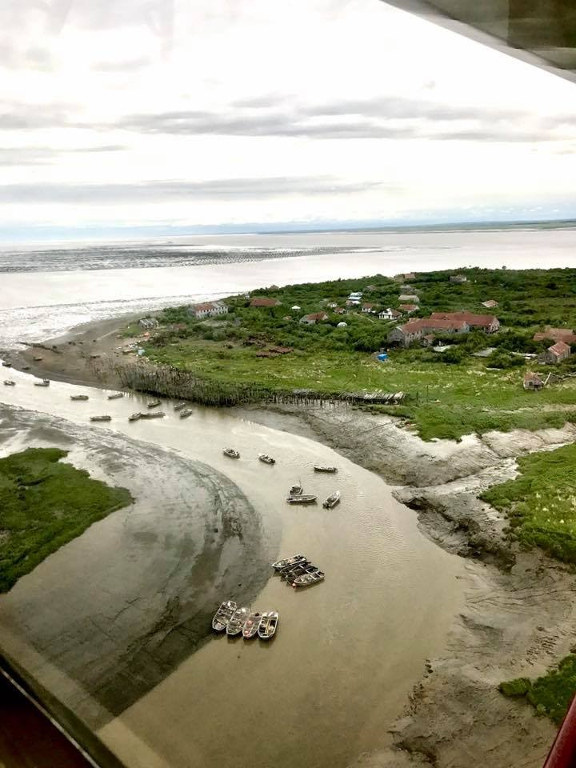
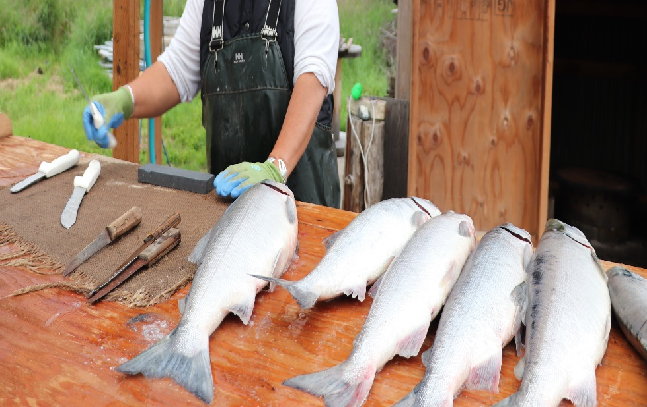
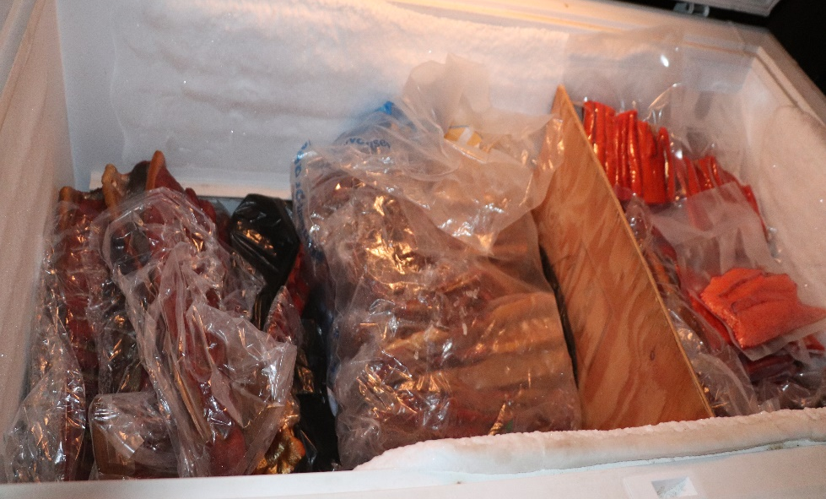
Local Knowledge, Traditional Knowledge, and Subsistence Taskforce
Fishcamp- Graveyard, AK
Task Force Meeting
April 27-28 2020
Co-chairs: Sarah Wise
sarah.wise@noaa.gov and
Kate Haapala
kate.haapala@noaa.gov
Photo: Judy Jo Matsun

Slide 2
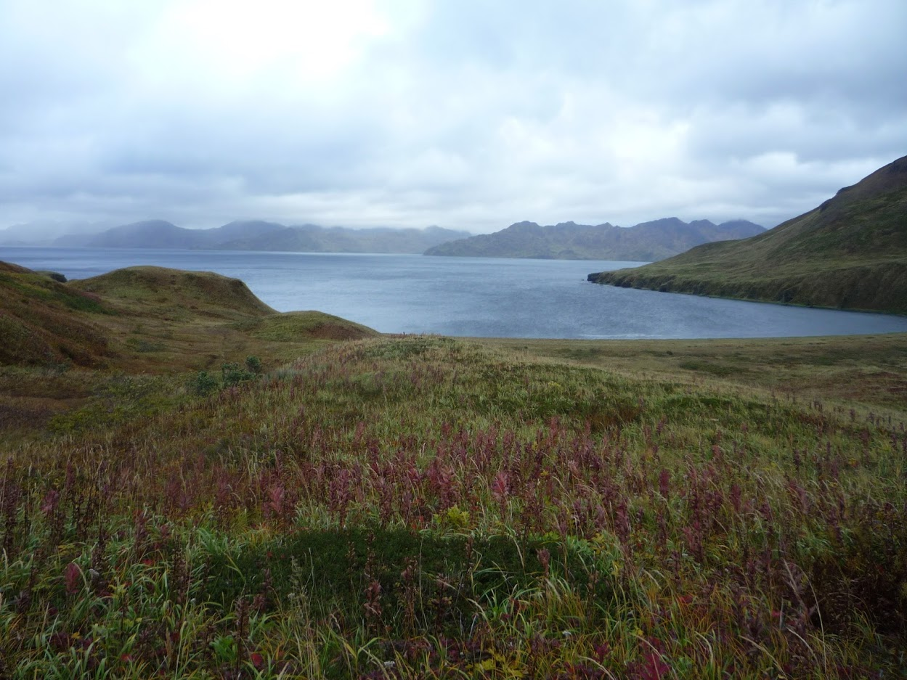
Welcome!
Welcome!
Introductions
Review agenda
Questions, comments, reflections

Slide 3
Meeting Objectives
Discuss and reach consensus on updated workplan
Discuss ongoing work and products; reach consensus on a pathway to move forward
Case study discussion - feasibility and utility
Work plan moving forward - next steps

Slide 4
Updates from the Climate Change Task Force

Slide 5
Opportunities for Collaboration
What opportunities does the Taskforce see for cross collaboration?
  Sociocultural or socioeconomic indicators - how best to address?
  Changes in abundance, species profile, and condition of subsistence catch
  Adaptations to changes
  Addressing the issue of scale
  What is most beneficial?
Notes:
3 meetings/year (2 in person; 1 virtual)
Public engagement is welcome and encouraged. Public testimony will be solicited by phone, written, or in person.
Outreach efforts are important and will be considered a priority.
Importance to document examples of how climate change is affecting knowledge and subsistence activities.

Slide 6
Updates from the January 2020 Council Meeting

Slide 7
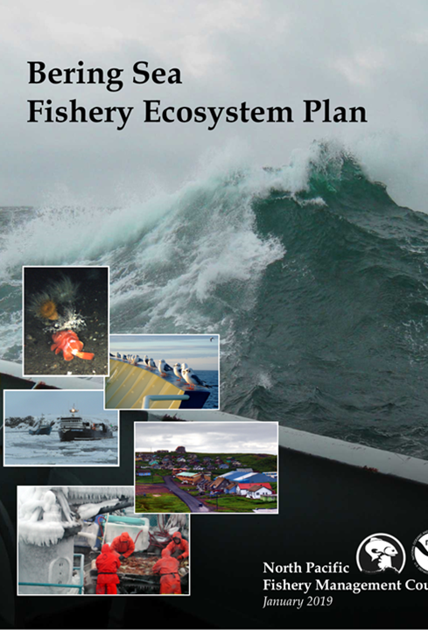
Review of Action Module Goal
Develop protocols for operationalizing Local Knowledge (LK), Traditional Knowledge (TK) in management and formulate methods for assessing the likelihood a given Council action may affect subsistence resources and users. (BS FEP 2019, pg. 9)

Slide 8
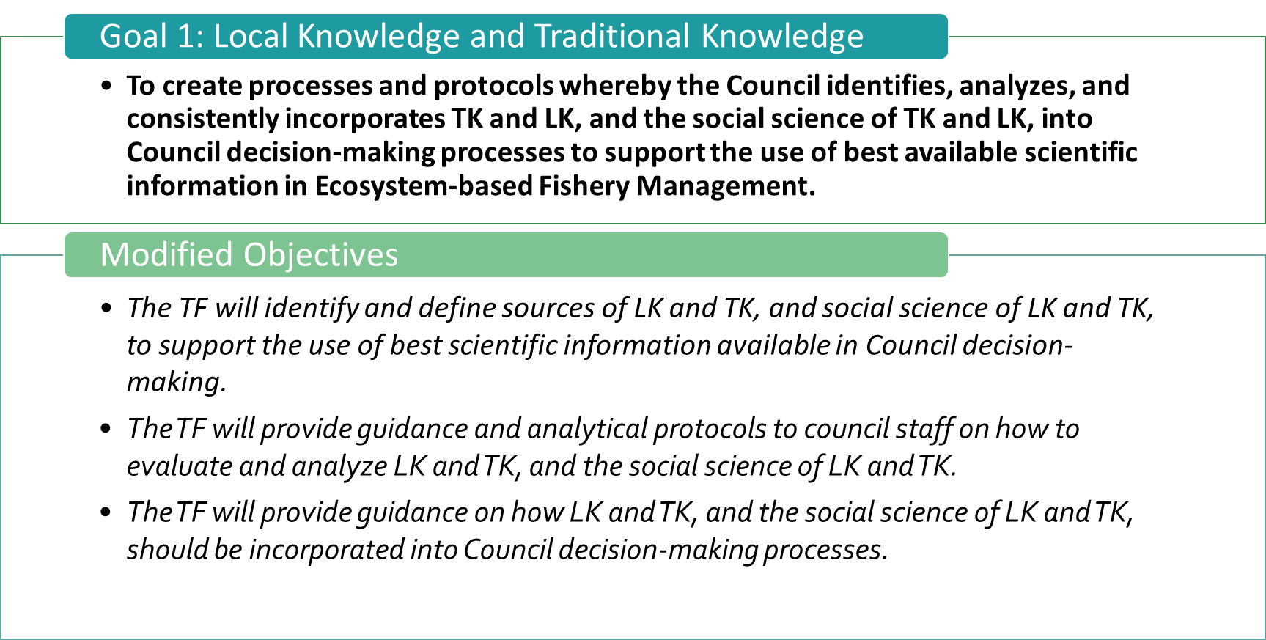
Taskforce Goals and Objectives – Meeting 1
Steps
Identify
Analyze
Incorporate

Slide 9
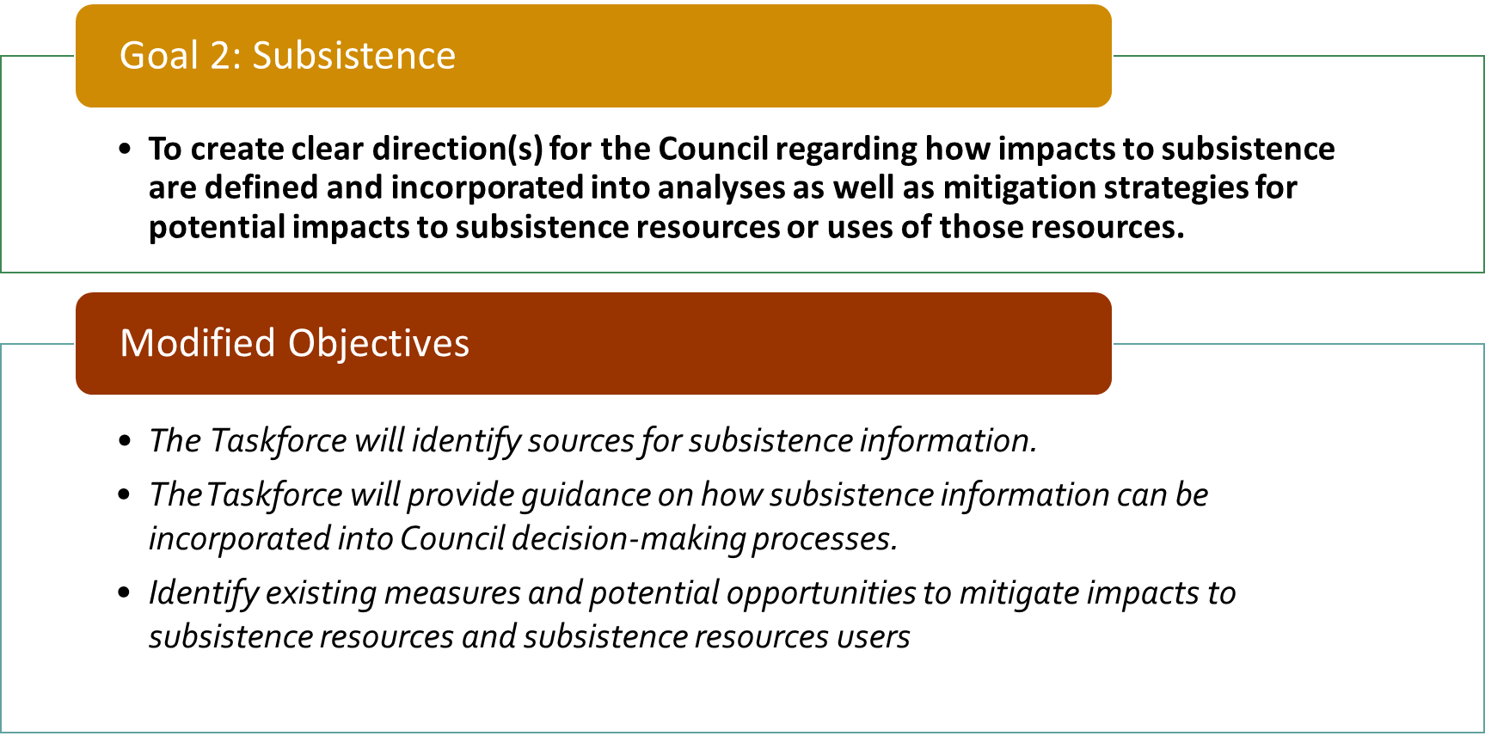
Taskforce Goals and Objectives – Meeting 1
Steps
Identify
Analyze
Incorporate

Slide 10
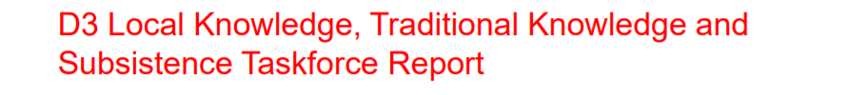
SSC Comments
Taskforce workplan is ambitious and will require an ongoing commitment of substantial Council and NMFS staff time.
The SSC recommends that the human subjects issues of informed consent, confidentiality, and risk to participants be central to the plans for the creation and maintenance of repositories.
Explore the creation of protocols that would provide guidance when information derived from different LK or TK sources is inconsistent or contradictory.
Supports plan to explore and synthesize a list of existing protocols and projects related to LK and TK and the social science of LK and TK as one of the first tasks to undertaken.
Recommends additional focus on LK for non-subsistence fisheries and recommends the taskforce consider adding a member with non-subsistence LK experience.
Recommends in-person meetings of the taskforce be supported to the extent feasible
Recommends case study analysis

Slide 11
Council motion
The Council adopts GOAL 1…
Goal 1:
To create processes and protocols through which the Council can identify, analyze, and consistently incorporate TK and LK, and the social science of TK and LK, into Council decision making processes to support the use of best available scientific information in Ecosystem-based Fishery Management (EBFM).

Slide 12
Council Motion Modified Goal 2 …
Original Goal 2: To create clear direction(s) for the Council regarding how impacts to subsistence are defined and incorporated into analyses as well as mitigation strategies for potential impacts to subsistence resources or uses of those resources
Amended and authorized Goal 2: To create a protocol and develop recommendations through which the Council can define and incorporate subsistence information into analyses and decision-making.
  Goal 2 no longer reflects the language of 'impacts' and 'mitigation.' This will influence the long-term work of the Taskforce.
  Council adopted Objective 1-5.
  Objective 6: Identify existing measures and potential opportunities to mitigate impacts to subsistence resources and subsistence resources users

Slide 13
Council motion
Work Products
Create a glossary of terms to be included in the Taskforce’s workplan.
Identify potential “onramps,” or points of entry, within the Council process (e.g., public testimony or analyses) for the Taskforce’s work.
Develop a protocol outlining the best practices for soliciting LK and TK, and a protocol for the Council to identify, analyze, and incorporate TK and LK into Council decision-making documents as appropriate.
Develop guidelines or protocols for Council staff for soliciting/identifying, analyzing, and using subsistence data and information in analyses
Prepare a final report for the Council

Slide 14
Morning Break

Slide 15
Lunch

Slide 16
Updates and Changes to the Workplan

Slide 17
Background
Develop protocols for incorporating and considering Local Knowledge (LK), Traditional Knowledge (TK), and subsistence (LKTKS) information in the Council’s decision-making process.
Outcomes are expected to inform where and how these types of knowledge and information could consistently enter the Council’s existing decision-making process.
Our purpose is to review major changes and reach consensus on...
    Benefits of incorporating LKTKS into the Council’s process
Definition and graphic for subsistence
Terms of reference
Reflections and ideas to move forward information sources and onramps

Slide 18
Benefits of Including LKTKS into Council Process (pg. 3)
“LK and TK are relevant to all fisheries sectors (i.e., commercial, recreational, and subsistence) and all aspects of fishery management in the Bering Sea Ecosystem. Finding pathways to incorporate LK, TK, and subsistence information into the Council's existing processes can provide an opportunity for the Council to be more responsive to ecosystem-based fishery management (EBFM) and climate change impacts throughout the Bering Sea region. People who are intimately familiar with a particular landscape have knowledge about the past and present conditions of commercial and non-commercial fish species and could be the first to notice changes in resource abundance, species presence, or habitat destruction (Gadamus and Raymond-Yakoubian 2015; Clark 2016). For example, as Johannes and Nies (2007, 42) note, communities’ or "fishers' knowledge may often be the only source of information on the history of changes in local ecosystems and on their contemporary state that is sufficiently fine scale to help us design ways to protect stock remnants and critical habitats." A practical example of LK with direct relevance to fishery management is that inshore cod fishermen communicated a decrease in the North Atlantic cod spawning stock on their fishing grounds prior to the biological collapse of the cod fishery (Johannes et al., 2000).
Incorporating LK and TK into the Council's existing processes could increase institutional effectiveness by improving local buy-in to specific management actions and the Council’s decision-making more broadly, which could mitigate resource and policy conflicts over the long-run. Providing the Council these types of information expand the suite of usable scientific knowledge, though it is recognized that this information is both additive and complementary to other forms of science and information currently utilized in the Council process.”

Slide 19
Benefits of Including LKTKS into Council Process (pg. 3)
“LK and TK are relevant to all fisheries sectors (i.e., commercial, recreational, and subsistence) and all aspects of fishery management in the Bering Sea Ecosystem. Finding pathways to incorporate LK, TK, and subsistence information into the Council's existing processes can provide an opportunity for the Council to be more responsive to ecosystem-based fishery management (EBFM) and climate change impacts throughout the Bering Sea region. People who are intimately familiar with a particular landscape have knowledge about the past and present conditions of commercial and non-commercial fish species and could be the first to notice changes in resource abundance, species presence, or habitat destruction (Gadamus and Raymond-Yakoubian 2015; Clark 2016). For example, as Johannes and Nies (2007, 42) note, communities’ or "fishers' knowledge may often be the only source of information on the history of changes in local ecosystems and on their contemporary state that is sufficiently fine scale to help us design ways to protect stock remnants and critical habitats." A practical example of LK with direct relevance to fishery management is that inshore cod fishermen communicated a decrease in the North Atlantic cod spawning stock on their fishing grounds prior to the biological collapse of the cod fishery (Johannes et al., 2000).
Incorporating LK and TK into the Council's existing processes could increase institutional effectiveness by improving local buy-in to specific management actions and the Council’s decision-making more broadly, which could mitigate resource and policy conflicts over the long-run. Providing the Council these types of information expand the suite of usable scientific knowledge, though it is recognized that this information is both additive and complementary to other forms of science and information currently utilized in the Council process.”
Provide opportunity for Council to be more responsive
Address gaps in data - provide valuable information
Sufficiently fine scale
Increase institutional effectiveness
Improve local “buy in” or relevancy
Help to mitigate resource and policy conflicts
Expand the suite of useable scientific knowledge

Slide 20
Subsistence Definition in Workplan (pg. 3)
“There are different ways of understanding of defining subsistence in Alaska, and those understandings influence how communities access resources and engage a subsistence way of life. For example, the State of Alaska has historically approached defining subsistence as traditional or customary use of resources, and the value of subsistence is communicated via commercialized indices that quantify resource consumption rates and utilizing comparative cost estimates. Federal policy, as designated under the Alaska National Interest Land Conservation Act of 1980, establishes a “rural preference” for subsistence rights for resource access and use on federal lands (Anderson 2016). Another understanding of subsistence, however, is from the "Indigenous perspective [that] encompasses hunting and gathering related activities which have a deep connection to history, culture, and tradition, and which are primarily understood to be separate from commercial activities" (Raymond-Yakoubian, Raymond-Yakoubian, Monicreff 2017). Yet it is also important to note that Alaska Native people across different regions of the state deliberately engage in commercial and market-oriented economies while maintaining subsistence practices (Langdon 1991), and that contemporary cash economies play a critical role in supporting subsistence lifestyles (Reedy-Maschner 2009). The importance of subsistence for Alaska Native communities, and the continuation of subsistence-related practices, is that it is a critical linkage to linguistic and cultural survival (Active 1999). As such, subsistence practices are meaningful beyond the harvest of nutritional and cultural goods as they create and reproduce linkages across multiple social and ecological domains.”

Slide 21
Subsistence Definition in Workplan (pg. 3)
What are we comfortable saying?
Definition of subsistence:
“There are different ways of understanding of defining subsistence in Alaska, and those understandings influence how communities access resources and engage a subsistence way of life. For example, the State of Alaska has historically approached defining subsistence as traditional or customary use of resources, and the value of subsistence is communicated via commercialized indices that quantify resource consumption rates and utilizing comparative cost estimates. Federal policy, as designated under the Alaska National Interest Land Conservation Act of 1980, establishes a “rural preference” for subsistence rights for resource access and use on federal lands (Anderson 2016). Another understanding of subsistence, however, is from the "Indigenous perspective [that] encompasses hunting and gathering related activities which have a deep connection to history, culture, and tradition, and which are primarily understood to be separate from commercial activities" (Raymond-Yakoubian, Raymond-Yakoubian, Monicreff 2017). Yet it is also important to note that Alaska Native people across different regions of the state deliberately engage in commercial and market-oriented economies while maintaining subsistence practices (Langdon 1991), and that contemporary cash economies play a critical role in supporting subsistence lifestyles (Reedy-Maschner 2009). The importance of subsistence for Alaska Native communities, and the continuation of subsistence-related practices, is that it is a critical linkage to linguistic and cultural survival (Active 1999). As such, subsistence practices are meaningful beyond the harvest of nutritional and cultural goods as they create and reproduce linkages across multiple social and ecological domains.”

Slide 22
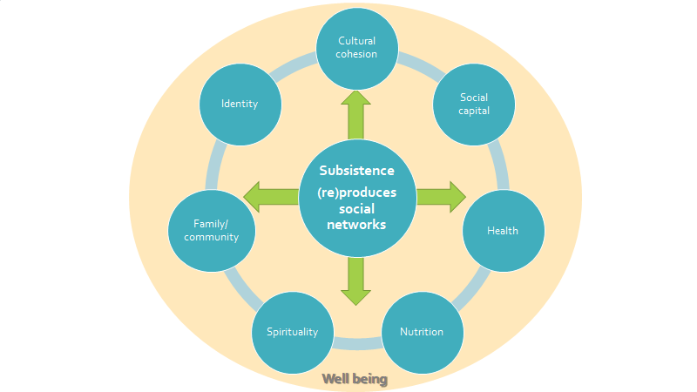
Domains of Subsistence Engagement
Subsistence practices are meaningful beyond the harvest of nutritional and cultural goods as they create and reproduce linkages across multiple social and ecological domains.
Figure 1. Domains of Subsistence Engagement (pg. 4)
Wise, lee, and Sparks, forthcoming

Slide 23
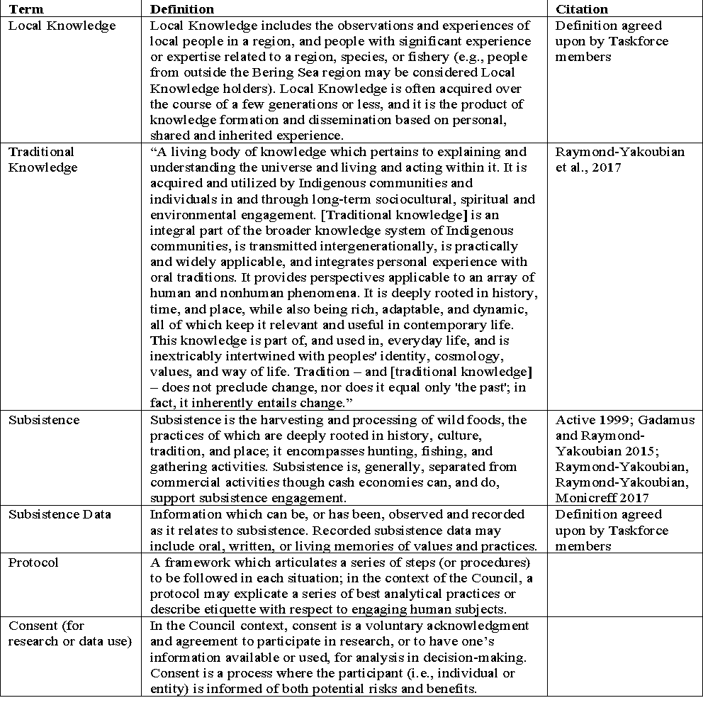
Appendix 1 Glossary of Terms

Slide 24
Council motion
Work Products
At the February 2020 Council meeting, the Council took action to task the Taskforce with creating the following work products:
Create a glossary of terms to be included in the Taskforce’s workplan.
Identify potential “onramps,” or points of entry, within the Council process (e.g., public testimony or analyses) for the Taskforce’s work.
Develop a protocol outlining the best practices for soliciting LK and TK, and a protocol for the Council to identify, analyze, and incorporate TK and LK into Council decision-making documents as appropriate.
Develop guidelines or protocols for Council staff for soliciting/identifying, analyzing, and using subsistence data and information in analyses
Prepare a final report for the Council

Slide 25
Sources of LKTKS
Identify sources of LKTKS to support the use of best scientific information available in Council decision-making.
  Draw insight and lessons learned for protocol development.
Types of work and ways of moving forward
Synthesis and summaries: Draw out best practices or ‘lessons learned’ from existing projects, research, and efforts to incorporate LKTKS into resource management.
Meta analysis and table development: Organize and catalogue existing sources of LKTKS in a useful way.

Slide 26
Onramps for LKTKS in Council Process
Review document
Gain consensus on different options and develop rationale
Discussion questions
What are the most appropriate onramps for LK, TK, or the social science of LK and TK?
What are the most useful onramps for LK, TK, or the social science of LK and TK (from multiple perspectives)?
Are there any types of documents or analyses that are best (or worst) suited for LK, TK, or the social science of LK and TK?
How to approach the indicator issue?

Slide 27
Afternoon Break

Slide 28
Local Knowledge, Traditional Knowledge, and Subsistence Taskforce
Fishcamp- Graveyard, AK
Task Force Meeting 2
April 28 2020
Co-chairs: Sarah Wise
sarah.wise@noaa.gov and
Kate Haapala
kate.haapala@noaa.gov
Photo: Judy Jo Matsun

Slide 29
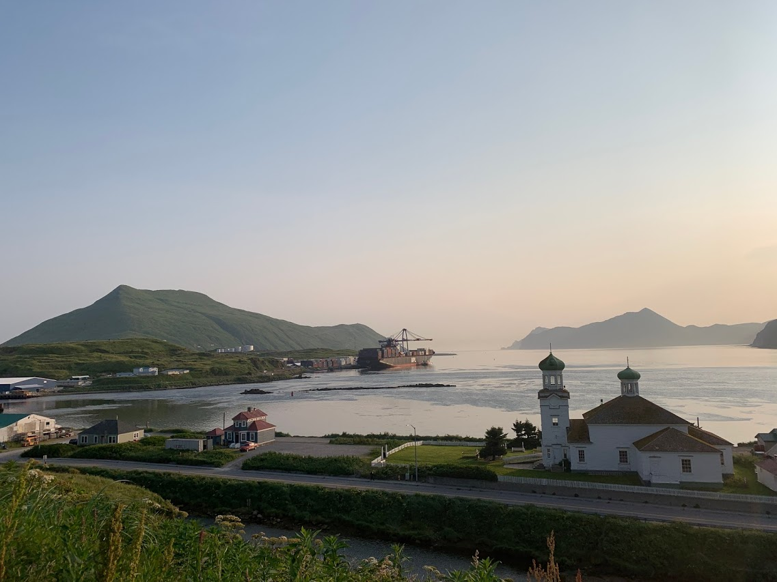
Welcome!
Introductions
Review agenda
Questions, comments, reflections

Slide 30
Taskforce Case Study

Slide 31
Council minutes February 2020
“The SSC suggests that joint efforts could be focused on a case study designed to address the primary goals of both the CCTF and LK/TK TF. One example may be a case study focused on Norton Sound red king crab. This case combines the need for long-term, strategic recommendations on how to adapt to climate change with a need to involve a variety of local stakeholders.”
Goal of case study:
To groundtruth proposed framework for using LKTK in council process
Related questions
How to identify LKTK?
What are the appropriate pathways for collaboration? with LK and TK holders?
What are the social and cultural connections to the fishery?
Mechanism to identify and communicate “Red Flags” in fishery/community?

Slide 32
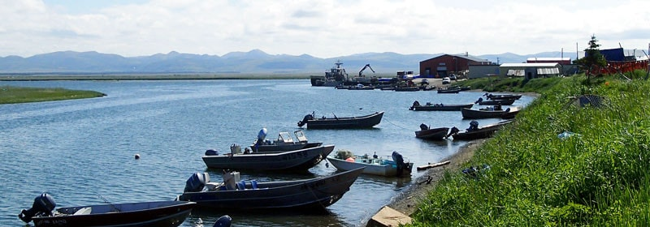
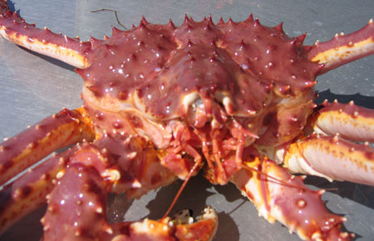
Ideas - Council suggested
Questions
What do we want to get out of the case study?
How will it support Goals 1&2?
What are some limits?
  Federal fishery
  Secondary data exists
  Budgetary constraints
  Time constraints
Will Norton Sound RKC do this?
Norton Sound Red King Crab
Important fishery across scale (time, region, type)
Small fishery
Both commercial and subsistence
Experiencing significant change
...

Slide 33
Updates on Mapping Tools

Slide 34
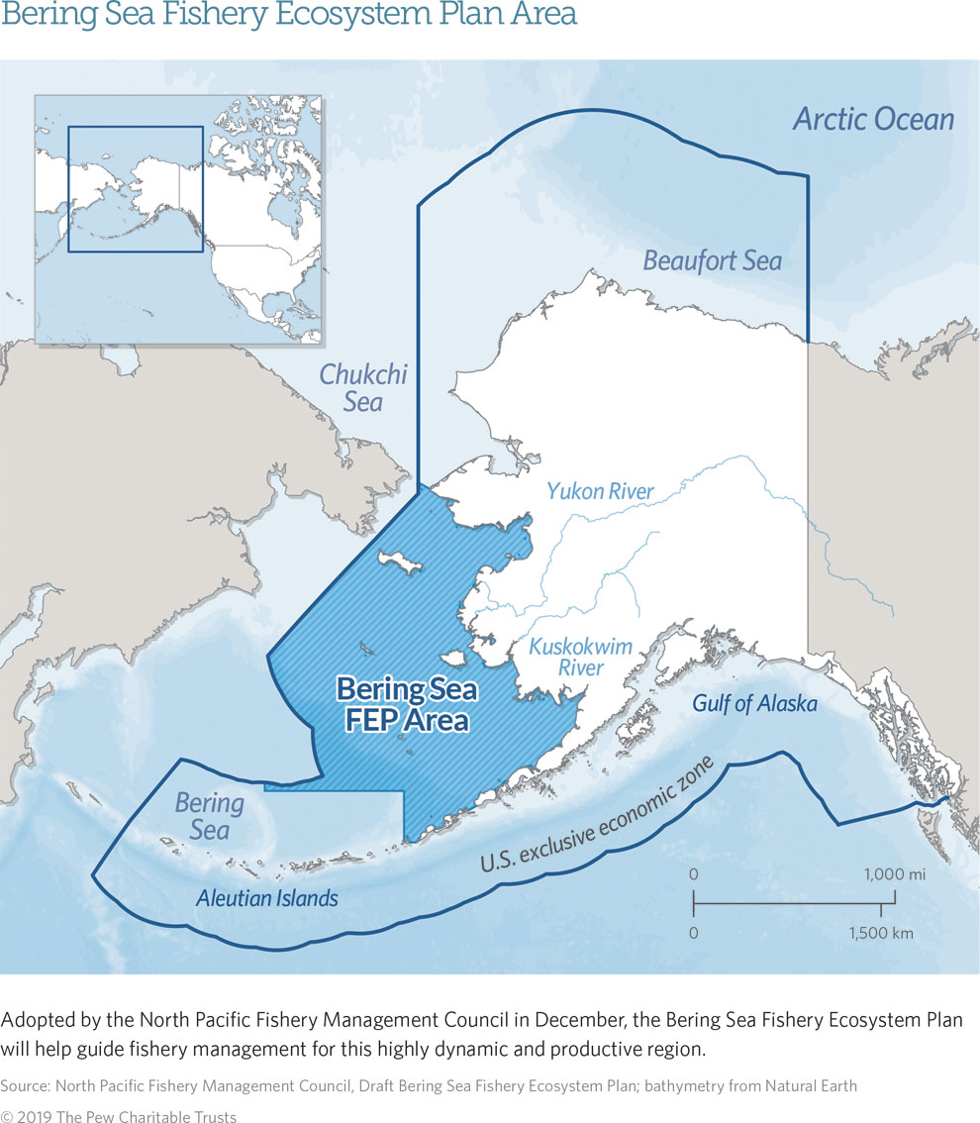
Web Products
Maps and Stories
BS FEP Dashboard
Community Profile Dashboard
Community centric Story Maps

Slide 35
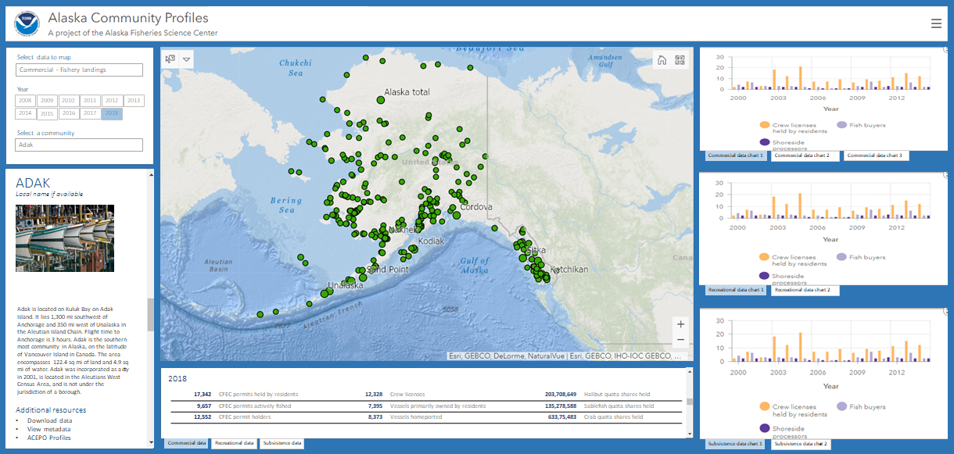
mapping slide here
EARLY DRAFT - do not share
How should we show subsistence?

Slide 36
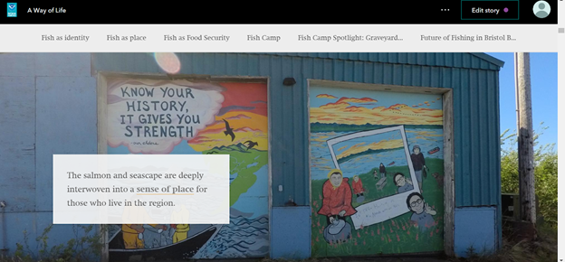
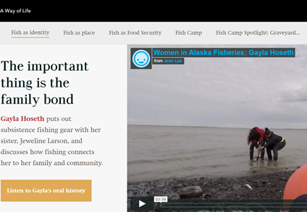
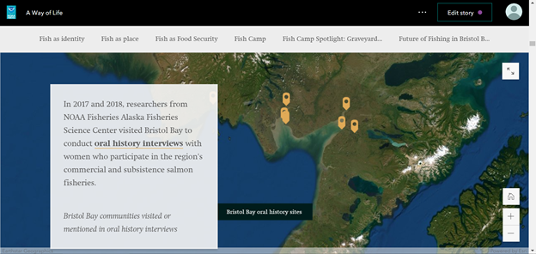
Maps and Stories

Slide 37
Other Items and Discussion

