Slide 1

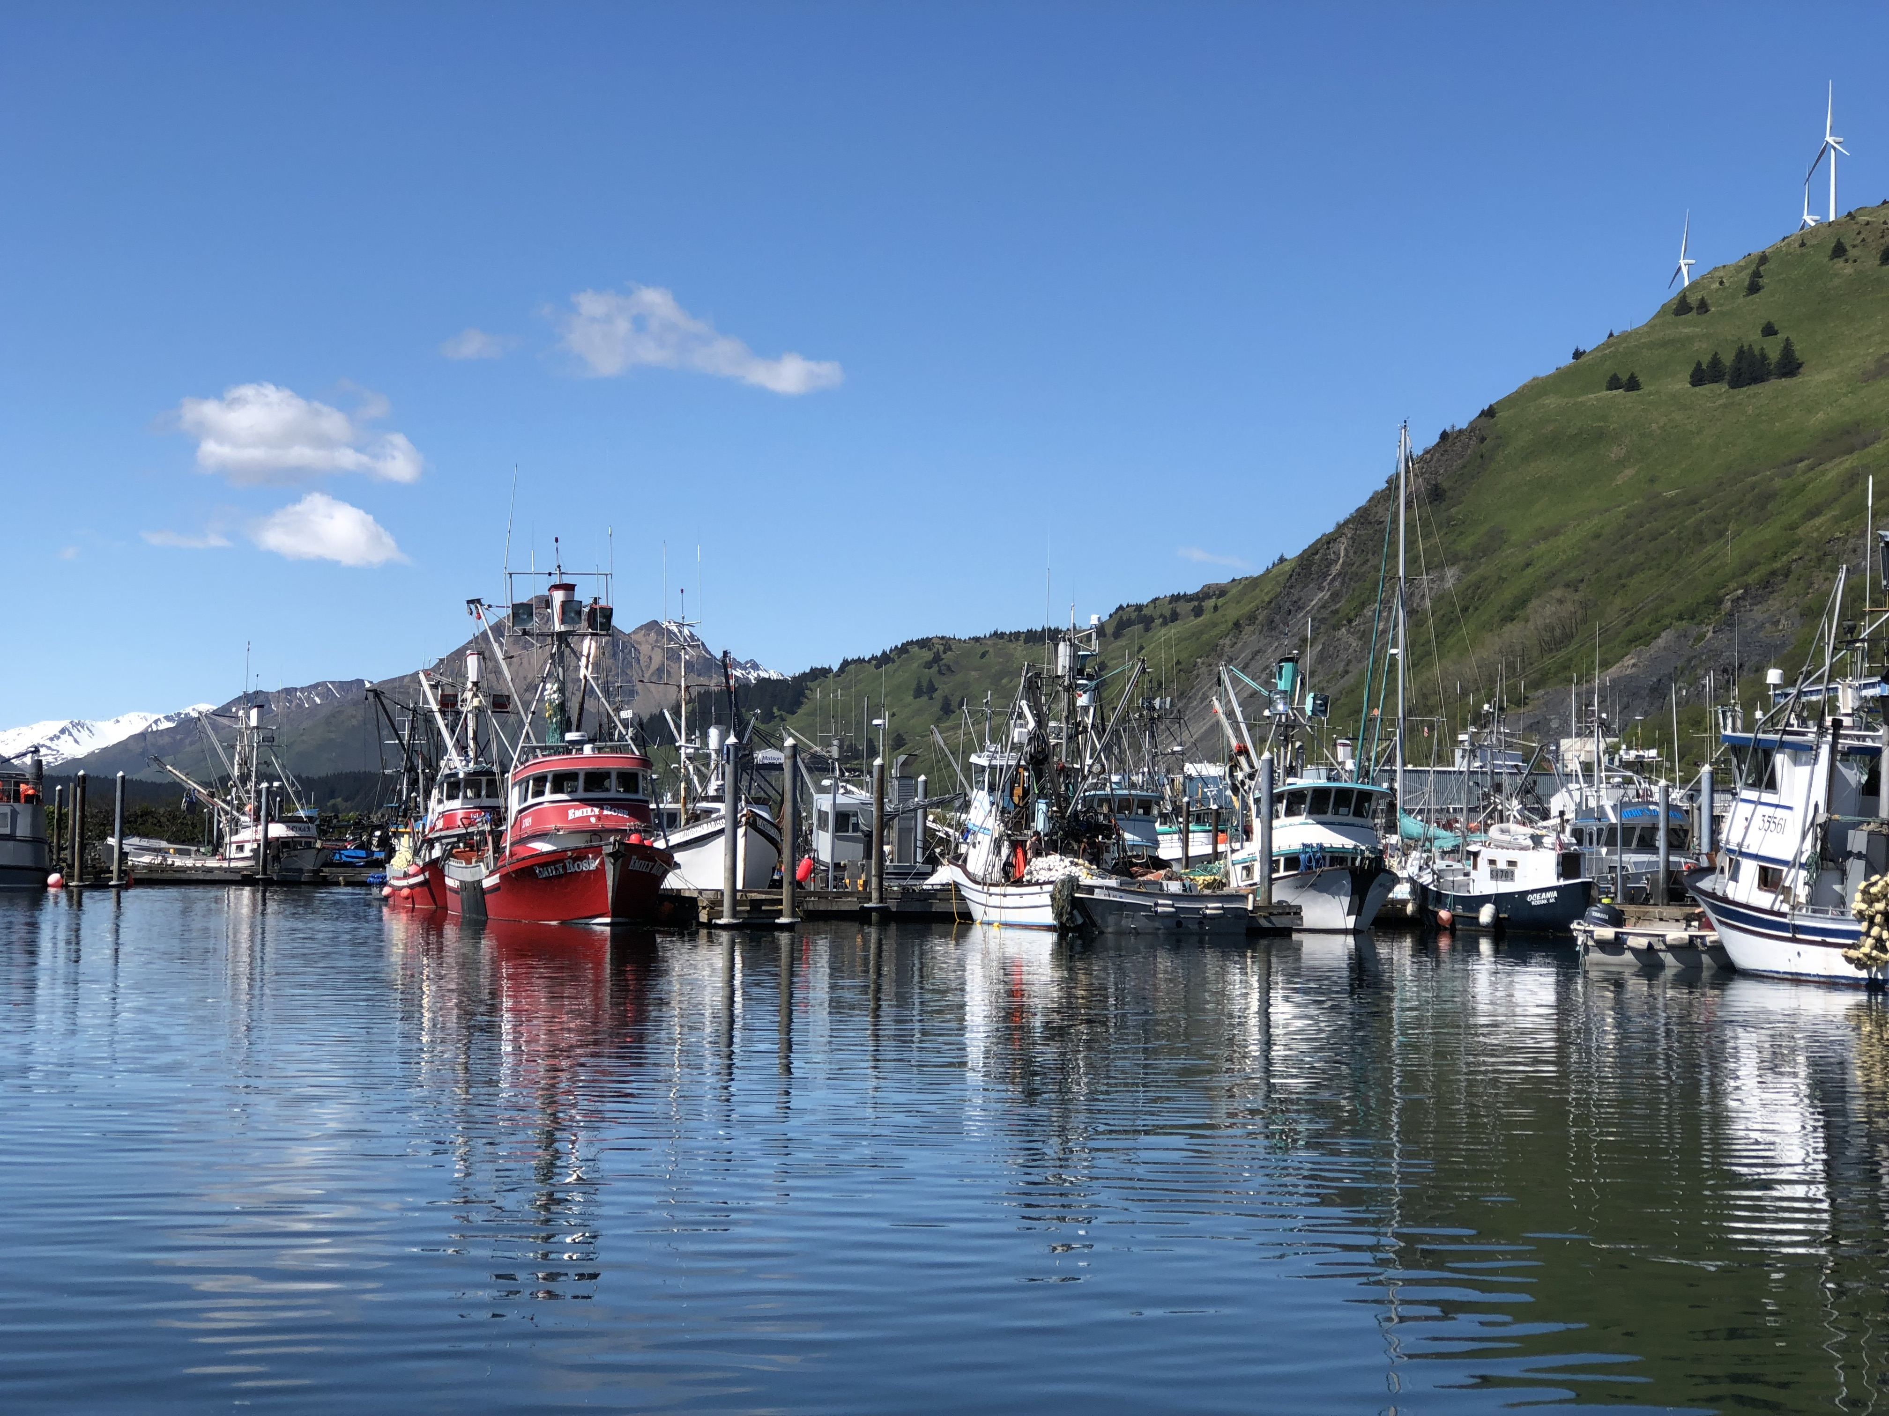


Welcome to the Social Science Planning Team
Online Meeting
September 21, 2020
Connecting to the meeting audio
SSPT members and those who wish to speak should connect their audio by phone.
To connect by phone:
  Mark the dial-out option and type in your phone number
  You should receive a phone call from a Colorado number
  Mute speakers on your phone and microphone on the computer.
Members of the public should connect in “Listen Only” mode unless you’re planning on providing comments.
Additional information
You’ll be able to see yourself in the “attendees” pod.
FYI, 00 indicates SSPT Chair
01 indicates SSPT member
If you’re having trouble with the connection, see if you can shut down competing draws on your internet bandwidth (vpn, streaming services, iphone backups, Bluetooth, etc.)
You can full-screen a window by clicking in the top right corner of the box
This meeting is being recorded.
For tech support use the “Technical Support” box.

Slide 2

Tips for quality audio
Please keep yourself on mute unless you need to talk and remember to mute yourself when you are finished talking
    It’s best to press the mute button on your phone than to mute yourself from the computer, though both work
    Admin staff can mute you if you forget; if this occurs you would have to unmute yourself on the computer to speak
Make sure you can only hear the meeting through your phone
    You want to see a sign by your speaker on the top left
    For extra security, mute your computer, too.

Slide 3
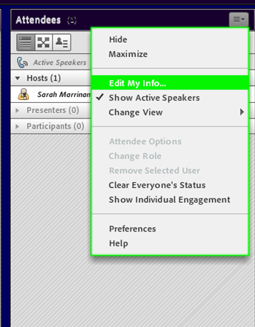
Changing your name
SSPT members please sign in with “01” followed by your full name
You can change your name by clicking on the top right-hand corner in the “Attendees” box and clicking “edit my info”

Slide 4

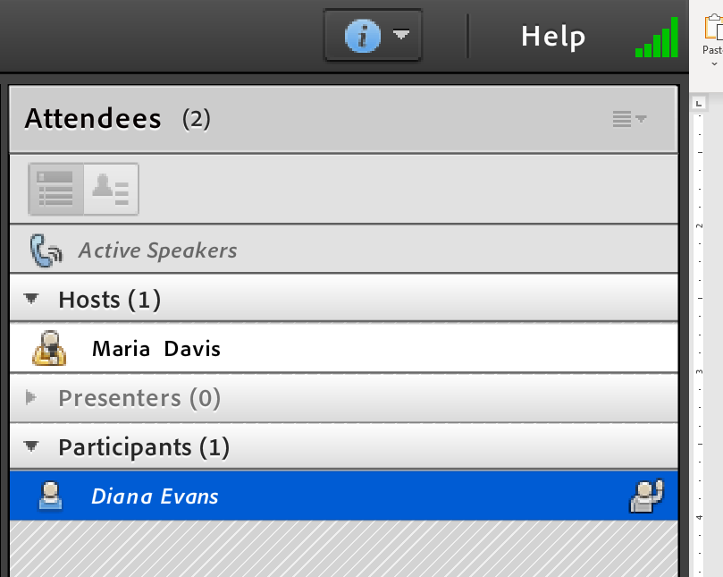
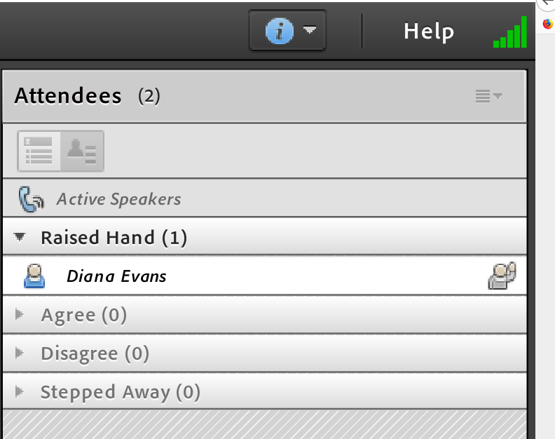
Raising your hand to be acknowledged
We are using the ‘raise hand’ feature in the app, and the Chair will call on people.
Click on the ‘raise hand’ icon to raise or lower your hand (or use the drop down menu)
You can see your hand is raised in the attendee pod:
Or toggle to ‘attendee status view’ and see only the raised hands (listed in order):

Slide 5
Introduction and Agenda
Objectives:
1. Discuss EDR Workshop and Report
2. Plan the next round of EDR Workshops to get whatever feedback necessary for SSPT to make recommendations on EDR revisions.
Time | Topic | Lead (rapporteur)
9:00 am | Intro and troubleshooting for Adobe Connect | Sarah and admin
9:10 am | Introductions, roll-call, and review of objectives | Steve (Sam)
9:15 am | Expected timeline for SSPT EDR Revisions | Sarah (Seth)
9:20 am | EDR Workshop Report and discussion | Katie (Mike F.)
10:15 am | Next round of EDR Workshops | Steve (Kate)
10:45 am | Break
11:00 am | Public Comment*
11:30 pm | Continued Next Round of EDR Workshop discussions | Steve (Kate)
12:45 pm | Other business | Steve (Sarah)
1:00 pm | Adjourn
*Public comments are scheduled for 11 am but we welcome comments throughout the discussions in the chat box in Adobe Connect.
*New assignments for minutes

Slide 6
Expected Timeline for SSPT’s Role in EDR Revisions
August: Webinar (8/26)
Task: Generate ideas for further discussion
September: SSPT meeting (TODAY)
Task: Identify topics for in-depth stakeholder discussions
October (anticipated): Focused stakeholder meetings
Task: Provide feedback on specific issues
November (anticipated) SSPT meeting
Task: Address purpose and need statements + develop range of alternatives
February 2021 meeting (T): Final report and Council discussion
Minutes: Seth

Slide 7
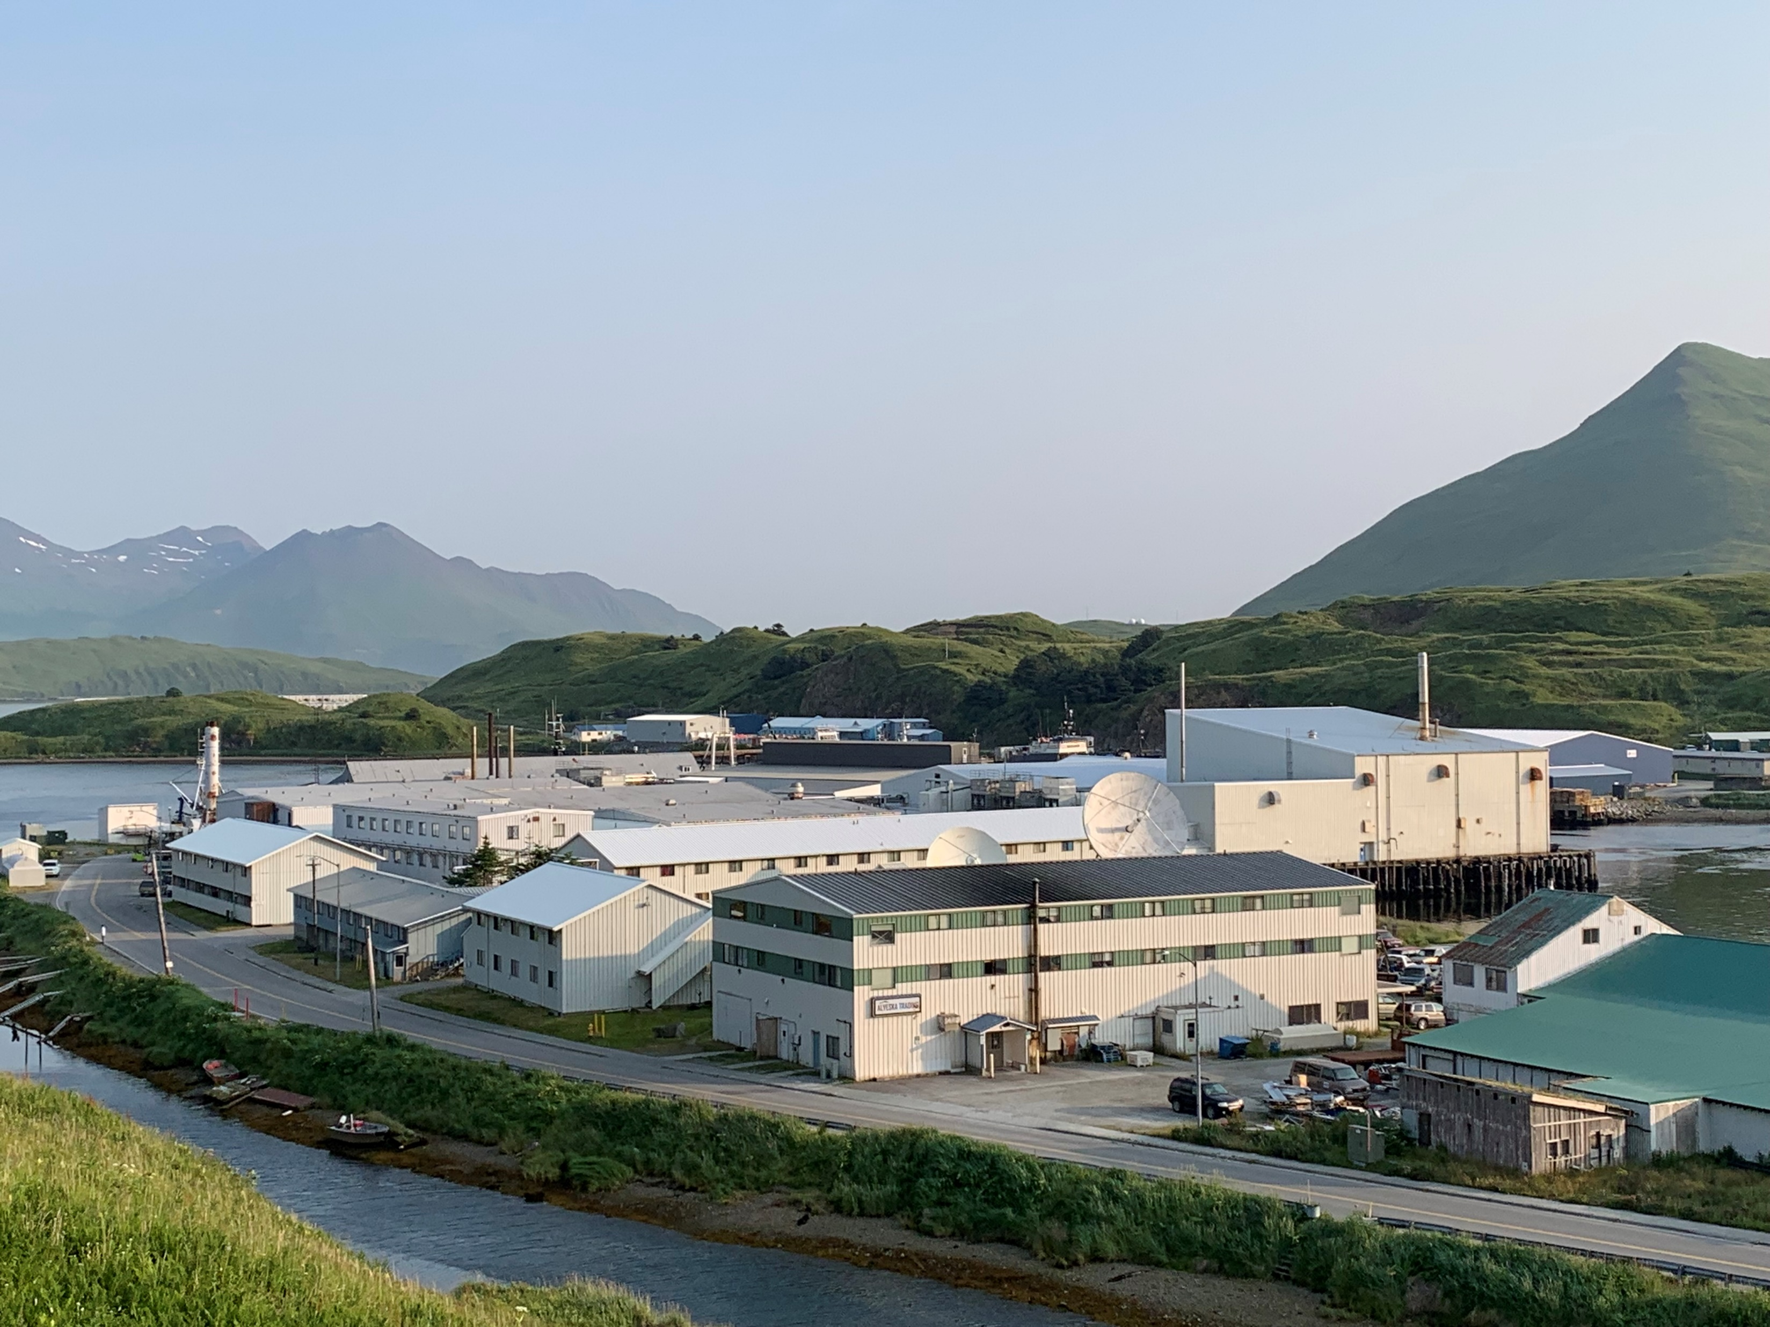
EDR Stakeholder Workshop Report
Minutes: Mike Fey

Slide 8
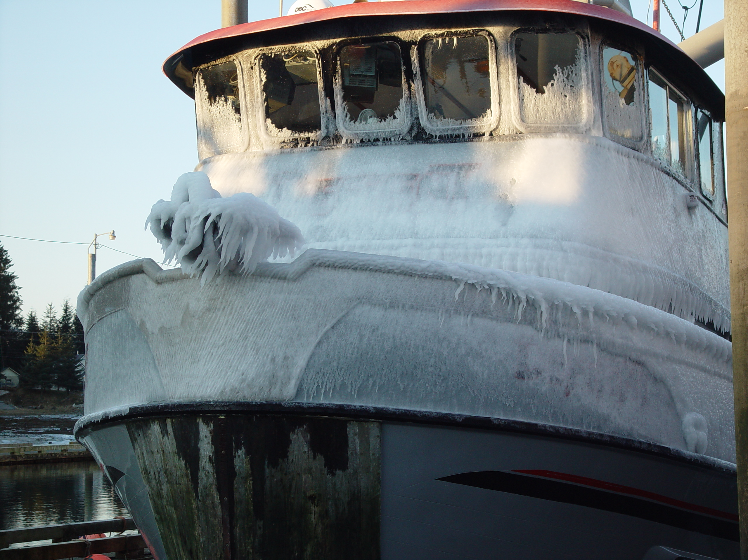
EDR Stakeholder Workshop Report
Role of economic information: What should economic information be used for in the Council process? (e.g. monitoring, explaining, predicting?) At what frequency?
Minutes: Mike Fey

Slide 9
EDR Stakeholder Workshop Report
Type of economic information: What are the most compelling pieces of economic information the council should have for decision making?
Minutes: Mike Fey

Slide 10
EDR Stakeholder Workshop Report
Main takeaways or surprising responses from the EDR Workshop?
Minutes: Mike Fey

Slide 11
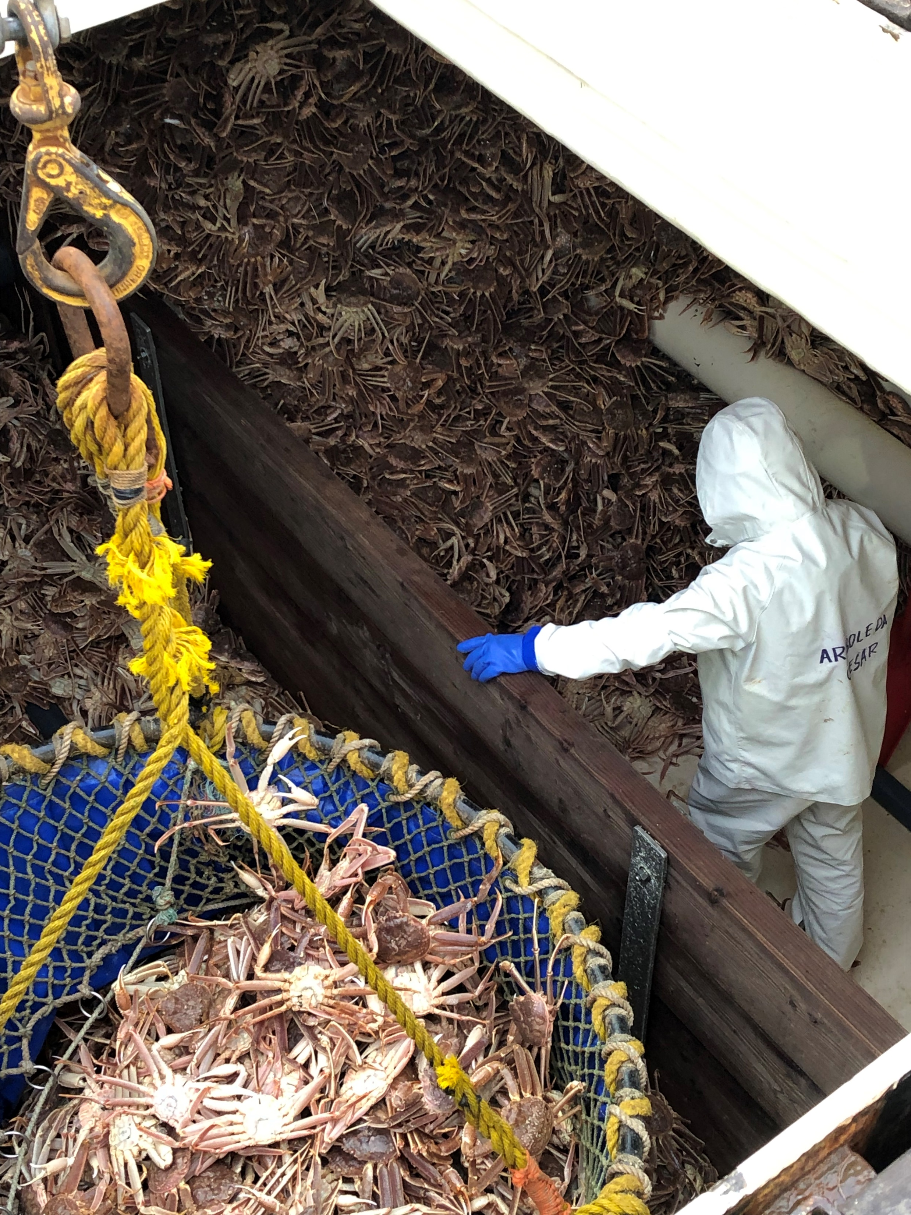
Next Round of EDR Stakeholder Meetings
How do you feel about organizing the alternative set as no changes, small changes, large changes, and eliminate programs?
Minutes: Kate

Slide 12

Next Round of EDR Stakeholder Meetings
Suggestions for changes (small or large)?
Minutes: Kate

Slide 13
Next Round of EDR Stakeholder Meetings
What information would be important to follow up with stakeholder about if doing small changes? Large changes?
Minutes: Kate

Slide 14
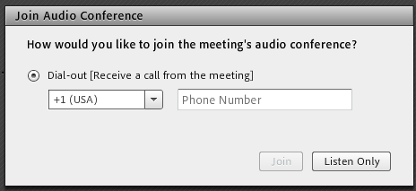
Reconnecting audio after a break
Go ahead and hang up your phone on the break, so you can use it for other things
When you are ready to reconnect, click on the phone icon at the top:
You will get the same “dial out” option as when you joined.
Be patient, and only press “Join” once!
It takes a little while for the meeting to call you, especially when everyone is calling at the same time.

Slide 15
Next Steps and Other Business
August: Webinar (8/26)
Task: Generate ideas for further discussion
September: SSPT meeting (TODAY)
Task: Identify topics for in-depth stakeholder discussions
October (anticipated): Focused stakeholder meetings
Task: Provide feedback on specific issues
November (anticipated) SSPT meeting
Task: Address purpose and need statements + develop range of alternatives
February 2021 meeting (T): Final report and Council discussion
Minutes: Sarah

