Slide 1
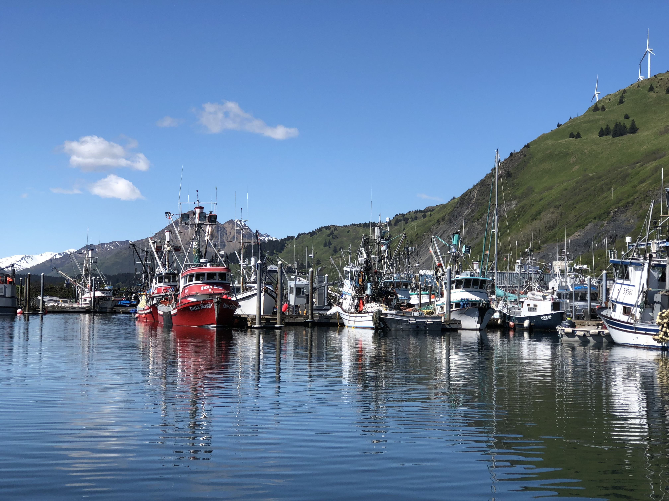


Welcome to the Partial Coverage Fishery Monitoring Advisory Committee
Online Meeting
Meeting Tips
For tech support email: npfmc.admin@noaa.gov
If connecting via phone, it can take up to a minute
If you’re connected via your phone, mute your speakers and mic on your computer
Please place your phone away from your computer
If you’re in “LISTEN ONLY” mode, you won’t be able to speak
You can full-screen a window by clicking in the top R corner of the box

Slide 2
Welcome to the Partial Coverage Fishery Monitoring Advisory Committee
Online Meeting
Meeting Tips
You’ll be able to see your status in the “attendees” pod (presenter or participants)
01 designates Committee member
Committee members, Council staff, and agency members giving presentations should turn on their video camera
  You must turn on the video and share your video for others to see you

Slide 3
Welcome to the Partial Coverage Fishery Monitoring Advisory Committee
Online Meeting
Meeting Tips
Committee discussion will be facilitated at the end of each agenda item using the ‘raise hand’ feature
Public comment will use the ‘raise hand feature’
  If you have a PowerPoint or document to share, please email it in advance to kate.haapala@noaa.gov
If you’re having trouble with the connection, check for competing internet bandwidth that you can adjust
(VPN, streaming services, iPhone backups, etc.)

