Slide 1
An Overview of the Assessment of Past and Existing Conditions Related to the Upper Cook Inlet Drift Gillnet Fishery
A presentation to The Cook Inlet Salmon Committee
by Marcus Hartley
February 25, 2020

Slide 2
Presentation Outline
Northern Economics, Inc. —Who we are
Organization of Environmental Assessment/Regulatory Impact Review
Review of Initial Findings of Interest

Slide 3
Northern Economics, Inc.
Social and Economic Consultants in Alaska Since 1982
Two Major Focus Areas
  Natural Resource Economics
    Fisheries
    Oil and Gas
    Mining
  Transportation and Infrastructure Economics
    Marine Transportation and Ferries
    Roads and Bridges
    Airports

Slide 4
Our Team
Marcus Hartley: Project Manager
Dr. Donald Schug: Primary Author
Brock Lane: Analyst
Emilie Franke: Analyst

Slide 5
Presentation Outline
Northern Economics, Inc. —Who we are
Organization of Environmental Assessment/Regulatory Impact Review

Slide 6
Level 1 Headings of the EA/RIR
1. Introduction
2. Description of Alternatives
3. Environmental Assessment
4. Regulatory Impact Review
5. Magnuson-Stevens Act and FMP Considerations
6. Preparers and Persons Consulted
7. References

Slide 7
Level 2 Headings of the RIR (Section 4)
4.1. Statutory Authority
4.2. Purpose and Need for Action
4.3. Alternatives
4.4. Methods Used for the Impact Analysis
4.5. Description of the Upper Cook Inlet Salmon Drift Gillnet Fishery
4.6. Description of Other Potentially Affected Salmon Fisheries
4.7. Analysis of Impacts: Alternative 1, No Action
4.8. Analysis of Impacts: Alternative 2
4.9. Analysis of Impacts: Alternative 3
4.10. Management and Enforcement Considerations
4.11. Affected Small Entities (Regulatory Flexibility Act Considerations)
4.12. Summation of the Alternatives with Respect to Net Benefit to the Nation

Slide 8
Level 2 Headings of the RIR (Section 4)
4.1. Statutory Authority
4.2. Purpose and Need for Action
4.3. Alternatives
4.4. Methods Used for the Impact Analysis
4.5. Description of the Upper Cook Inlet Salmon Drift Gillnet Fishery
4.6. Description of Other Potentially Affected Salmon Fisheries
4.7. Analysis of Impacts: Alternative 1, No Action
4.8. Analysis of Impacts: Alternative 2
4.9. Analysis of Impacts: Alternative 3
4.10. Management and Enforcement Considerations
4.11. Affected Small Entities (Regulatory Flexibility Act Considerations)
4.12. Summation of the Alternatives with Respect to Net Benefit to the Nation

Slide 9
Presentation Outline
Northern Economics, Inc. —Who we are
Organization of Environmental Assessment/Regulatory Impact Review
Review of Initial Findings of Interest

Slide 10
Annual Harvests in the UCI Drift Gillnet Fishery by Species, 1966–2019

Slide 11
UCI Drift Gillnet Sockeye Harvests by Quintile
Each quintile equals 20 percent of active permits sorted from low to high
Sum of quintiles equals total harvest

Slide 12
Estimating Harvest in Federal Water (EEZ)
ADF&G estimates percentage for each opening
Estimates based primarily stat-areas and management areas open for fishing
ADF&G assigns data for the intended harvest area as Locale-Code
Estimation of EEZ harvests combines of reported stat-area and Locale-Codes

Slide 13
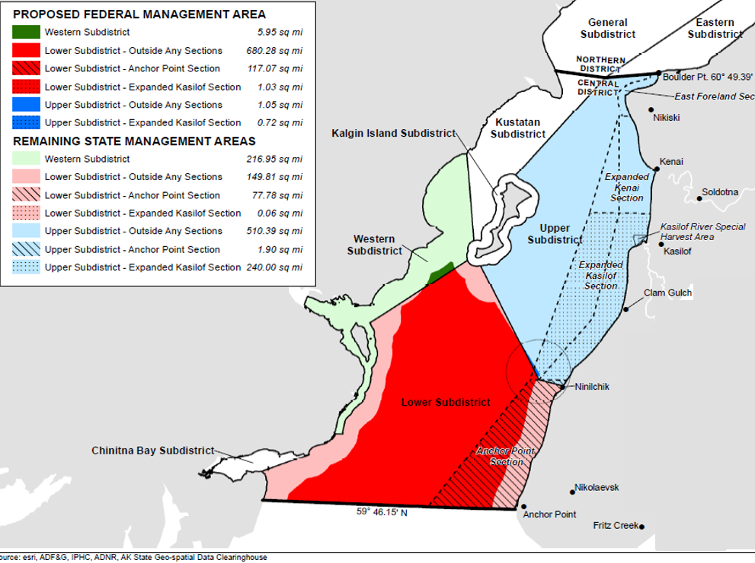
ADFG Management/Stat-Area and Federal Waters

Slide 14
Stat-Areas and Local Codes with Assigned Percentages for State and EEZ Harvests
Stat-Area | Name/Description | Local Code | State-Water % | EEZ %
24426 | Kasilof SHA | All | 100% | 0%
24450 | NW of Kalgin Island | All | 100% | 0%
24451 | Kenai Section | All | 100% | 0%
24455 | Full Regular Corridor | All | 100% | 0%
24456 | Exp. Full Corridor | 0 | 100% | 0%
24456 |  | 1 | 25% | 75%
24457 | Exp. Ken/Kas & AP | 0 | 94% | 6%
24457 |  | 1 | 25% | 75%
24460 | District Wide | 0 | 50% | 50%
24460 |  | 1 | 25% | 75%
24460 |  | 3 | 75% | 25%
24460 |  | 4 | 75% | 25%
24460 |  | 5 | 50% | 50%
24461 | Kasilof Section | All | 100% | 0%
24510 | Chitina Bay | All | 100% | 0%

Slide 15
Sockeye Salmon Harvests in Federal Waters (EEZ) as a Percent of Total UCI Drift Gillnet Harvest

Slide 16
USI Drift Gillnet Sockeye Harvests Relative to Sockeye Forecasts

Slide 17

Thank you!
Marcus Hartley is Northern Economics’ President and Principal Economist

