Slide 1



ADF&G eLogbook
Division of Sport fish
Guide registration and logbook programs
Ben Jevons
Ben.Jevons@alaska.gov
907-267-2299

Slide 2
Agenda:
Why 2025?
Benefits to you
eLogbook at a glance
Outreach
Questions
If time/interest:
Entering a trip
Reviewing your trip
Configuration
Questions

Slide 3
Why statewide in 2025?
Communication Plan for the Mandatory eLogbook Reporting of Saltwater Charter Activity in Alaska beginning in 2025
Thru: Tom Taube
From: Ben Jevons
The successful implementation of mandatory electronic reporting for the charter sector in Southeast Alaska has proven beneficial to both industry and the Department through demonstrated increase in logbook data collection efficiency, as well as timelier charter fishery data. Users of the electronic logbook have been active in providing feedback to improve the interface and the utility of data summaries available through the application. Recent restrictions to saltwater species throughout the state have highlighted the need for more accurate and timelier reporting in all regions. Considering the success in Southeast, the Department has decided to mandate electronic reporting for saltwater charter logbooks (eLogbook) statewide to promote timely and responsive fisheries management for marine species in all saltwater areas.
Too long don’t read:
The eLogbook has been wildly successful
Preliminary glances suggest equivalent level of data collection with good compliance
Effective industry-agency coordination
Timelier charter data in the hands of agency staff close to a year earlier
It’s more efficient for us and you

Slide 4
How does this benefit you?
All electronically-submitted trip history will be maintained for business owners’ use.
Keeps downloadable records of paper and electronic trips since 2016.
Search trips by year, guide, vessel, and date.
Generate trip summaries based on:
  Bottomfish effort
  Salmon effort
  Trips per day (useful for businesses with more than one vessel/guide operating)
MORE TIMELY DATA (eLogbook data is available almost in-season)
Our goal is to make logbook data collection beneficial to you and us.

Slide 5
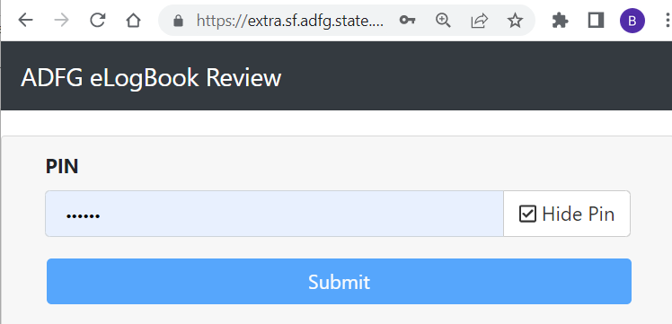
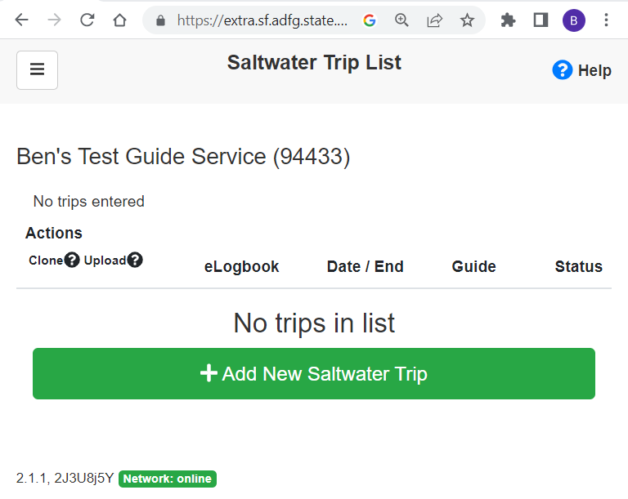
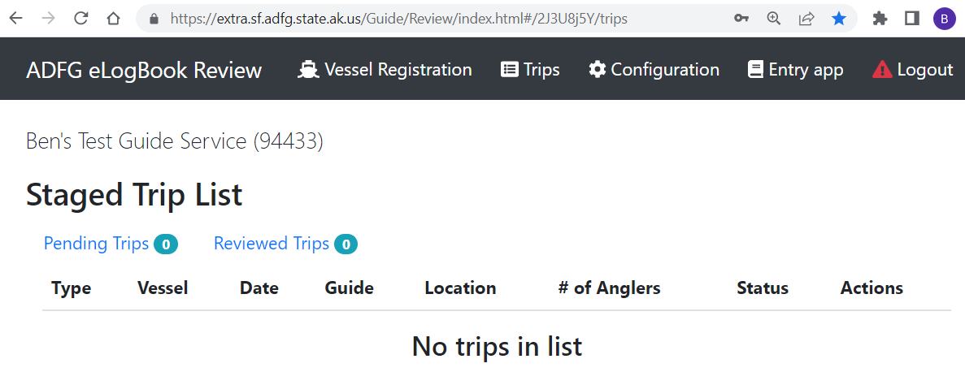
The two applications at a glance:
Logical flow and internet needs
“eLogBook” is composed of two web-based applications
  Review Application: designed for business owners
  Entry Application: designed for guides

Slide 6




The two applications at a glance:
Logical flow and internet needs
“eLogBook” is composed of two web-based applications
  Review Application: designed for business owners
  Entry Application: designed for guides
Links are emailed and are business-specific
Works on most browsers
Reminder: The ‘flow’ of the eLogBook
Do you need internet?
CONFIGURE
ENTER
REVIEW
???

Slide 7
The two applications at a glance:
Logical flow and internet needs
ENTRY APP:
TRIP ENTRY & SUBMISSION
Receive configurations
Enter trip data offline.
Data is locally stored ffline until you need to submit trips.
Submit trips to ADF&G online.
REVIEW APP:
CONFIGURATION
Configure settings that will be sent to your guide’s Entry app:
Anglers
Guides
Operating Areas
Locations
(Statistical Areas)
Vessels
Species
2
3
1
REVIEW APP:
TRIP REVIEW & SUMMARIES
Review submitted trips for 48hrs after submitting to ADF&G.
Optional: Generate data summaries for your own uses:
Bottomfish effort
Salmon effort
Guide
Daily trip activity
Pre-Season
In-Season and Post-Season

Slide 8

The two applications at a glance:
Logical flow and internet needs
ENTRY APP:
TRIP ENTRY & SUBMISSION
Receive configurations
Enter trip data offline.
Data is locally stored ffline until you need to submit trips.
Submit trips to ADF&G online.
REVIEW APP:
CONFIGURATION
Configure settings that will be sent to your guide’s Entry app:
Anglers
Guides
Operating Areas
Locations
(Statistical Areas)
Vessels
Species
2
3
1
REVIEW APP:
TRIP REVIEW & SUMMARIES
Review submitted trips for 48hrs after submitting to ADF&G.
Optional: Generate data summaries for your own uses:
Bottomfish effort
Salmon effort
Guide
Daily trip activity
CONFIGURE
RECEIVE
ENTER
SUBMIT
REVIEW

Slide 9
The two applications at a glance:
Logical flow and internet needs
ENTRY APP:
TRIP ENTRY & SUBMISSION
Receive configurations ONLINE
Enter trip data OFFLINEoffline.
Data is locally stored OFFLINEoffline until you need to submit trips.
Submit trips to ADF&G ONLINEonline.
REVIEW APP:
CONFIGURATION
Configure settings that will be sent to your guide’s Entry app:
Anglers
Guides
Operating Areas
Locations
(Statistical Areas)
Vessels
Species
2
3
1
REVIEW APP:
TRIP REVIEW & SUMMARIES
Review submitted trips for 48hrs after submitting to ADF&G.
Optional: Generate data summaries for your own uses:
Bottomfish effort
Salmon effort
Guide
Daily trip activity
CONFIGURE
RECEIVE
ENTER
SUBMIT
REVIEW

Slide 10
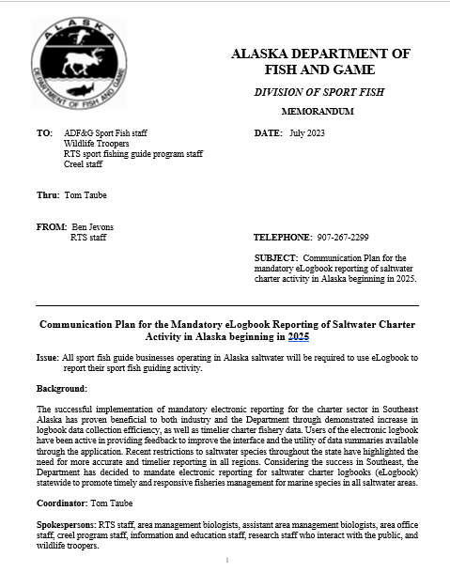
outreach for 2025
We will be conducting significant outreach between 2023-2025
  Communication plan established and in action
  Updated web page
  Updated videos
  Annual letter to industry
  Webinars
  Travel to critical ports
  Enforcement meetings (AWT, NOAA OLE, USCG)
  Ongoing technical support
  Creel/port sampler/front office/tech training

Slide 11
Questions?
Let’s enter and review a trip

Slide 12




Why the transition?
Timelier data for management
A user-friendly, electronic interface (paper-free)
Efficient data collection (no papers to lose, less error messages, and no runs to the drop-box/post office)
Cost-effective
Gives back to the industry:
All electronically-submitted trip history will be maintained for business owners’ use.

Slide 13
https://extra.sf.adfg.state.ak.us/Guide/Entry/index.html#/2J3U8j5Y/saltwater/trips https://extra.sf.adfg.state.ak.us/Guide/Review/index.html#/2J3U8j5Y/login

